Slide 1
Model compression and acceleration technology based on attention extraction mechanism
Zikun Guo
2021225559
Artificial Brain Research Lab
Department of Artificial Intelligence
Kyungpook university
Notes:
大家好，我是子坤，今天我向大家介绍的我的研究。Model compression and acceleration technology based on attention extraction mechanism

Slide 2
Contents
Introduction
Experimental method
Result
Future work

Slide 3
Introduction
In recent years, deep learning models have continuously refreshed the performance of traditional models in various fields such as computer vision, natural language processing, and search recommendation advertising, and have been widely used. With the continuous improvement of the computing power of mobile devices, the implementation of mobile AI has also become possible.
Model compression and acceleration can not only improve the performance of mobile models, but also greatly speed up inference response on the server.
The following are commonly used compression methods
Algorithm layer compression acceleration.
Framework layer acceleration
Hardware layer acceleration.
We focus on model-independent compression methods that enable low-parameter models to approach the performance of high-parameter models: Use the pre-training model to extract information for the input, and the extraction method is specially optimized for prediction, so as to get rid of the useless information that interferes with the model prediction
Notes:
近年来深度学习模型在计算机视觉、自然语言处理、搜索推荐广告等各种领域，不断刷新传统模型性能，并得到了广泛应用。随着移动端设备计算能力的不断提升，移动端AI落地也成为了可能。
模型压缩和加速不仅仅可以提升移动端模型性能，在服务端也可以大大加快推理响应速度
算法层压缩加速。这个维度主要在算法应用层，也是大多数算法工程师的工作范畴。主要包括结构优化（如矩阵分解、分组卷积、小卷积核等）、量化与定点化、模型剪枝、模型蒸馏等。
框架层加速。这个维度主要在算法框架层，比如tf-lite、NCNN、MNN等。主要包括编译优化、缓存优化、稀疏存储和计算、NEON指令应用、算子优化等
硬件层加速。这个维度主要在AI硬件芯片层，目前有GPU、FPGA、ASIC等多种方案，各种TPU、NPU就是ASIC这种方案，通过专门为深度学习进行芯片定制，大大加速模型运行速度。

Slide 4
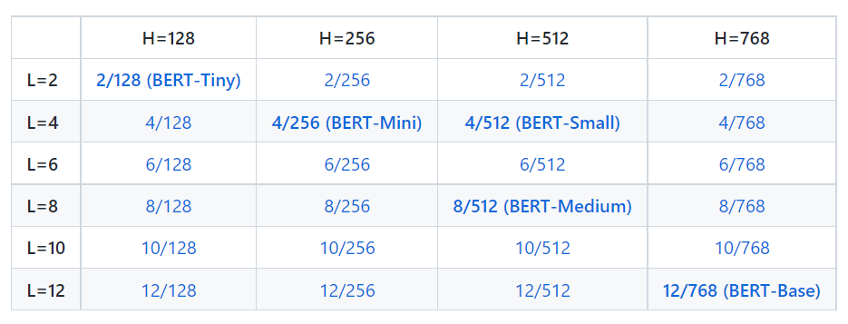
Introduction
Disadvantages
The pre-trained model Bert can handle a maximum sequence length of 512.
When dealing with long text (document level), the text truncation or sliding window method is usually used to make the sequence length of the input model conform to the preset value, but this processing method will causes the loss of task-related global information.
Schematic diagram
Notes:
除了 BERT-Base 和 BERT-Large 之外，标准 BERT 配方（包括模型架构和训练目标）对各种模型大小都有效。 较小的 BERT 模型适用于计算资源受限的环境。 它们可以以与原始 BERT 模型相同的方式进行微调。 然而，它们在知识提炼的背景下最为有效，其中微调标签由更大、更准确的教师生成。但是有如下缺点：（念ppt）
the standard BERT recipe (including model architecture and training objective) is effective on a wide range of model sizes, beyond BERT-Base and BERT-Large. The smaller BERT models are intended for environments with restricted computational resources. They can be fine-tuned in the same manner as the original BERT models. However, they are most effective in the context of knowledge distillation, where the fine-tuning labels are produced by a larger and more accurate teacher. But there are the following disadvantages（念ppt）：
The pre-trained model Bert can handle a maximum sequence length of 512.
When dealing with long text (document level), the text truncation or sliding window method is usually used to make the sequence length of the input model conform to the preset value, but this processing method will causes the loss of task-related global information.

Slide 5
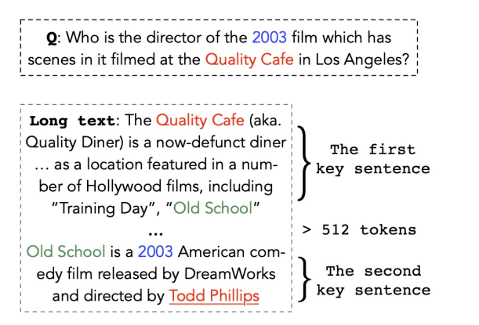
Contribution value principle division
Transformation strategies (reserving [CLS] and [SEP]):
(1) head-only: the first 510 tokens
(2) tail-only: after 510 tokens;
(3) head+tail: select the first 128 and 382 tokens based on experience
(4) Segmentation: First, the input text (length L) is divided into k = L/510 small paragraphs, and they are sequentially input into BERT to obtain the representation of k text paragraphs. The representation of each paragraph is the hidden state of the last layer [CLS], and the representations of all paragraphs are merged using mean pooling, max pooling and self-attention
Notes:
举个例子，当我们有一个问题和文本，我们需要提取问题的答案位置，如果答案转换成tokens的话，长度小于512，很简单，我们只需要简单的输入到模型然后查看模型的预测。但是当长度大于512的时候，我们需要截断句子，但是一般的方法都是
由于bert文本长度最大为512，因此当文本超过512时，需要改进bert。本文就此改进进行阐述。针对长度超过512的文本，可以应用如下转换策略（预留[CLS]和[SEP]）：（1）head-only：前512tokens（2）tail-only：后510tokens；（3）head+tail：根据经验选择前128和382tokens（4）分段：首先将输入文本（长度为L）分成k = L/510个小段落，将它们依次输入BERT得到k个文本段落的表示。每个段落的representation是最后一层[CLS]的hidden state，并分别使用mean pooling, max pooling and self-attention来合并所有段落的representation。
For example, when we have a question and text, we need to extract the answer position of the question. If the answer is converted into tokens, the length is less than 512. It is very simple, we just need to simply input it into the model and see the prediction of the model. But when the length is greater than 512, we need to truncate the sentence, but the general method is
Since the maximum text length of bert is 512, when the text exceeds 512, bert needs to be improved.
For text longer than 512, the following transformation strategies can be applied (reserving [CLS] and [SEP]):
(1) head-only: the first 510 tokens
(2) tail-only: after 510 tokens;
(3) head+tail: select the first 128 and 382 tokens based on experience
(4) Segmentation: First, the input text (length L) is divided into k = L/510 small paragraphs, and they are sequentially input into BERT to obtain the representation of k text paragraphs. The representation of each paragraph is the hidden state of the last layer [CLS], and the representations of all paragraphs are merged using mean pooling, max pooling and self-attention respectively.

Slide 6
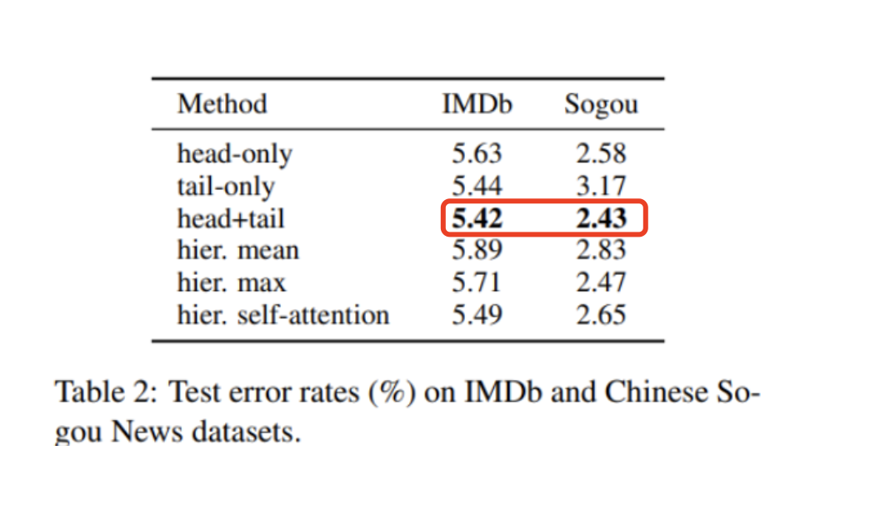
Contribution value principle division
Notes:
上表中可以看出，第三种模式准确率较高，可能重要信息恰巧集中在头和尾部。
As can be seen from the above table, the third mode has a higher accuracy rate, and it is possible that important information happens to be concentrated in the head and tail.

Slide 7
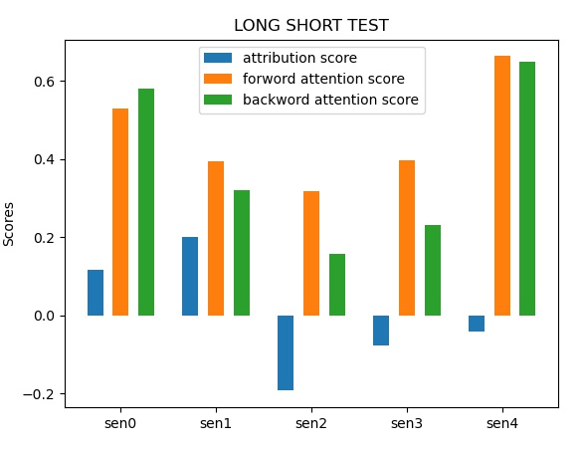
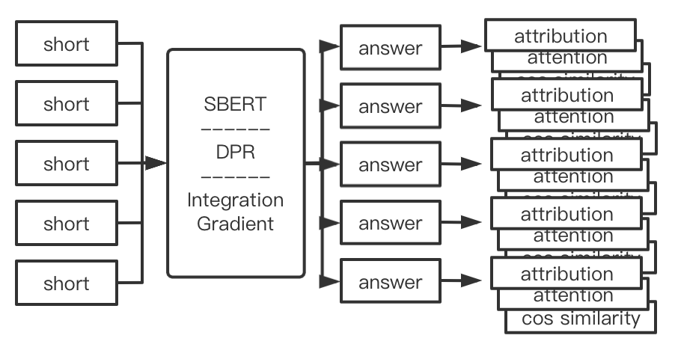
Experiment
Sentence splitting:
In the text, only one paragraph contains the answer
Use the tokenizer to tokenize sentences.
The attention and interpretation results of the model are different after the clauses with and without the answer are entered into the model
Notes:
这是我们的方法，我们通过使用可解释ai来计算每个句子的贡献值，由于tranformer模型包含语义信息，所以我们还可以使用sbert进行句子划分，我会在后边的进行介绍，我们通过梯度积分算法得到句子对答案的贡献值，forward attention score和 backword attention score，这两个score很好获取，不需要计算，只需要再模型最后的softmax层读取即可。Ok，我们创建了一个外部选择模型，不同的是，我们不使用squad数据集进行训练，而是使用每个句子的贡献值和前后注意力值进行训练，旨在让模型能够识别那个句子中包含答案的概率最大。

Slide 8
Dataset(SQUAD)
Crashed Dataset
This data set is obtained by processing the Squad dataset. By splitting sentences and comparing with the questions, if the answer is included, the label is the position of the answer, and if the answer is not included, the label is empty(0)
Through the test records of the model, we can obtain a large number of test records, including: changes in probability and changes in f1. Among them, the label of the data we manually add the highest f1 value index
There is basically no difference in size, but there are more labels for each sentence: whether it contains the ground truth
Notes:
为了训练这个模型，我们使用自己分割后的数据集，这个数据集我们称为Crashed Dataset,
so is this datasets:
This data set is obtained by processing the Squad dataset. By splitting sentences and comparing with the questions, if the answer is included, the label is the position of the answer, and if the answer is not included, the label is empty(0)
Through the test records of the model, we can obtain a large number of test records, including: changes in probability and changes in f1. Among them, the label of the data we manually add the highest f1 value index
There is basically no difference in size, but there are more labels for each sentence: whether it contains the ground truth

Slide 9
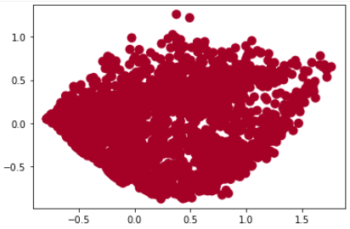
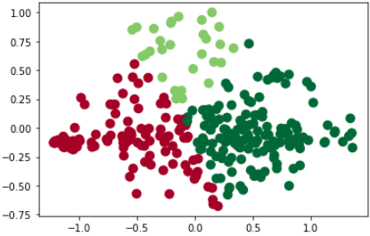
Dataset(SQUAD)
Data balance
On average, each text will be divided into 3-8 clauses
Only the clause containing the answer will mark the position of the answer
So let the model learn directly, resulting in the model learning a lot of irrelevant information
Remove a lot of empty label data to make the data label balanced
Notes:
在处理数据集的时候，由于数据的不平衡性，第一次训练出来的模型是有问题的，因为在分割数据的时候，标签只存在一个，而句子往往有多个，这样算下来，训练中针对无标签训练或不包含答案的数据占比大概70%到80%，而模型在训练的时候如果准确率提高到70%-80%的话，模型只需要做一个简单的预测：不包含，如图1所示，这里分类的结果都是单一的，因此在平衡数据后，训练后的数据达到了平衡的分布。总结起来就是四点：（念ppt）
When processing the data set, due to the imbalance of the data, the model trained for the first time is problematic, because when dividing the data, there is only one label, and there are often multiple sentences. The proportion of data for unlabeled training or not containing answers is about 70% to 80%, and if the accuracy of the model increases to 70%-80% during training, the model only needs to make a simple prediction: not included, As shown in Figure 1, the results of classification here are all single, so after balancing the data, the training data reaches a balanced distribution. In summary, four points:
On average, each text will be divided into 3-8 clauses
Only the clause containing the answer will mark the position of the answer
So let the model learn directly, resulting in the model learning a lot of irrelevant information
Remove a lot of empty label data to make the data label balanced

Slide 10
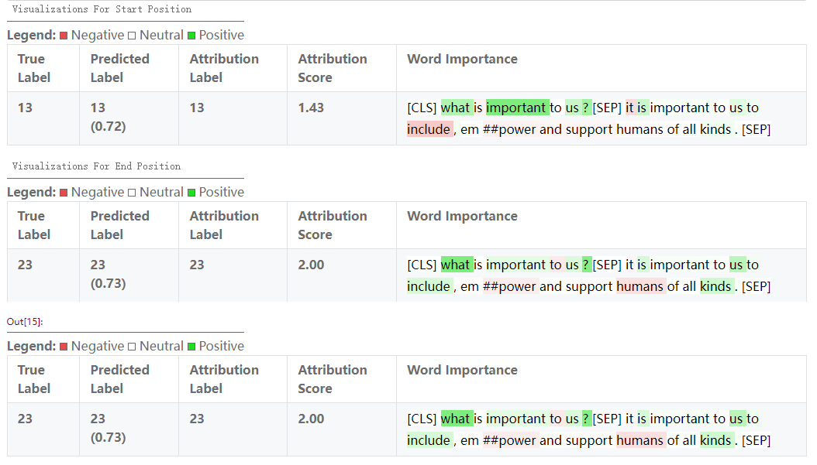
Information Retrieval（XAI, SBERT, DPR）
Integral Gradient
Integral gradient method expects the contribution of non-zero gradients in the unsaturated region to decision importance by integrating the gradients along different paths.
Notes:
Ok，第一点，梯度积分算法，是我们在可解释ai中最重要的应用，所以，什么是梯度积分，首先，这是一种可解释ai技术，相比较于最开始使用的baseline技术。Baseline是衡量（measure）一个特征如何对模型输出。但是由于不同的特征对结果的影响是有一个极限（limit）的，譬如说一个大象的鼻子的长度，是衡量大象的重要特征（characteristic），但是并不代表，The longer the noses, the more we think it‘s an elephant.所以大家可以看到，任何一个特征都会存在一个极限，这就是baseline的含义，同样如果我们把x作为特征的程度衡量(measure)，y作为对结果的影响程度，那么这样的函数我们称之为baseline。但是在实际应用中（practical application），我们为了忽略特征增长到一定程度（grow to a certain extent）就不变化这一现象（Phenomenon），于是我们引用（quote）了梯度积分这一算法，通过这种算法，我们可以连续(continuously )的观察特征对结果的影响（We can continuously observe the effect of features on the results）。
Ok, the first point, the gradient integration algorithm is our most important application in interpretable AI, so what is IG, first of all, this is an interpretable AI technology, compared to the baseline witch was used at the beginning xai. Baseline is a measure of how a feature outputs to the model. However, there is a limit to the impact of different features on the results. For example, the length of an elephant's nose is an important characteristic for measuring elephants, but it does not mean that The longer the noses, the more we think it's an elephant. So you can see that any feature will have a limit, which is the meaning of baseline. Similarly, if we measure x as the degree of the feature and y as the degree of influence on the result, then The function we call baseline. But in practical application, in order to ignore the phenomenon that the feature does not change when it grows to a certain extent, we quote the gradient integration algorithm, through this With this algorithm, we can continuously observe the effect of features on the results.

Slide 11
Information Retrieval
SBERT/DPR:
The entire sentence is input into the pre-training model, and the sentence vector of the sentence is obtained, which is then represented as the sentence vector of the sentence.
For two similar sentences, the resulting sentence vectors may be very different.(huge expenses)
Use Siamese and triplet network structures to obtain semantically meaningful sentence embeddings, so as to obtain fixed-length sentence embeddings, and use cosine similarity or Manhattan/Euclidean distance to compare to find semantically similar sentences.
Basic idea
input the question into BERT to get a d-dimensional vector Q
input the paragraph into another BERT to get a d-dimensional vector P
Calculate the cosine similarity between Q and P to get the distance between the two vectors.
The BERT parameters used by the question and paragraph are not shared.
Notes:
除了使用可解释ai，梯度积分算法计算句子和答案的贡献值，我们还考虑使用sbert和dpr模型，计算文本和答案的语义相似度。
首先我来简单的介绍bert模型（念ppt）
u, v : two input sentence
|u-v| : absolute value
u, v, |u-v| : splicing three vectors in the -1 dimension

Slide 12
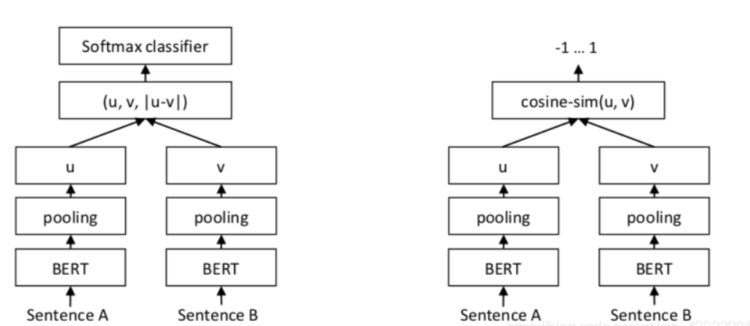
Information Retrieval
Notes:
除了使用可解释ai，梯度积分算法计算句子和答案的贡献值，我们还考虑使用sbert和dpr模型，计算文本和答案的语义相似度。
首先我来简单的介绍bert模型（念ppt）
u, v : two input sentence
|u-v| : absolute value
u, v, |u-v| : splicing three vectors in the -1 dimension

Slide 13
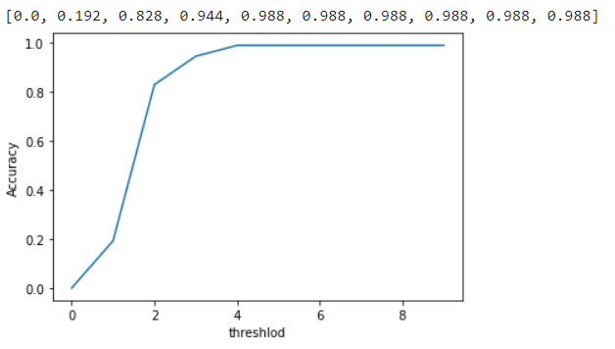
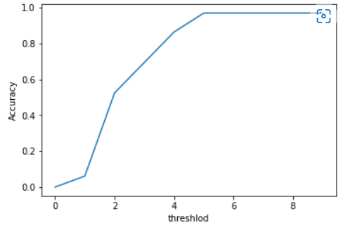
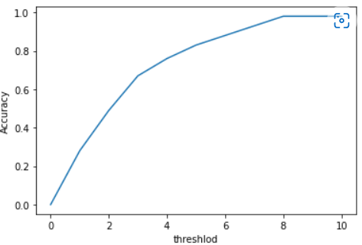
Information Retrieval
Dense Channel Retrieval (DPR)
a set of tools and models for state-of-the-art open-domain question answering research.
Basic idea of DPR method
input the question into BERT to get a d-dimensional vector Q
input the paragraph into another BERT to get a d-dimensional vector P
Calculate the cosine similarity between Q and P to get the distance between the two vectors.
The BERT parameters used by the question and paragraph are not shared.
X -The accuracy of how many answers has contain Y- degree of data splitting
DPR
SBERT
XAI
Notes:
这是使用dpr模型进行的information retrival的结果，dpr是（念ppt）
我们可以看到两幅图中，sbert的提取效果比dpr稍差，当阈值等于40%的时候，dpr模型在整个数据集中就做到提取后的文本全部包含答案的信息，而sbert的处理速度快于dpr，但是前提是当阈值达到50%的时候才能保证提取后的文本包含答案，但是速度要慢于sbert，我们使用sbert和dpr提取后的数据集进行后期测试，
This is the result of an information retrival using the dpr model, dpr is
We can see that the extraction effect of sbert is slightly worse than that of dpr in the two figures. When the threshold is equal to 40%, the dpr model can achieve that the extracted text contains all the answer information in the entire data set, and the processing speed of sbert Faster than dpr, but the premise is that when the threshold reaches 50%, the extracted text can be guaranteed to contain the answer, but the speed is slower than sbert. We use the data set extracted by sbert and dpr for post-testing,

Slide 14
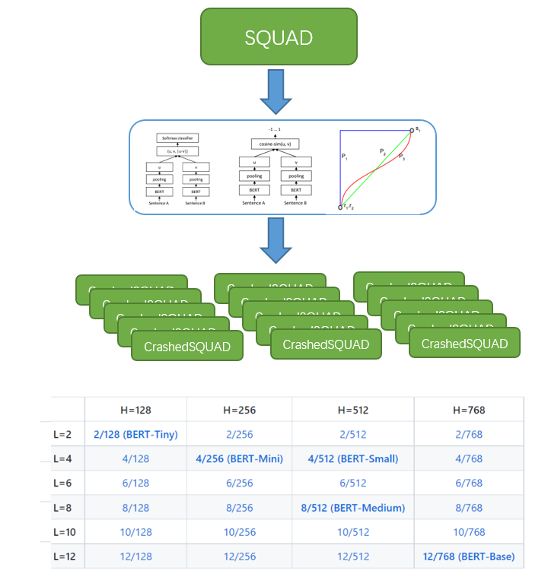
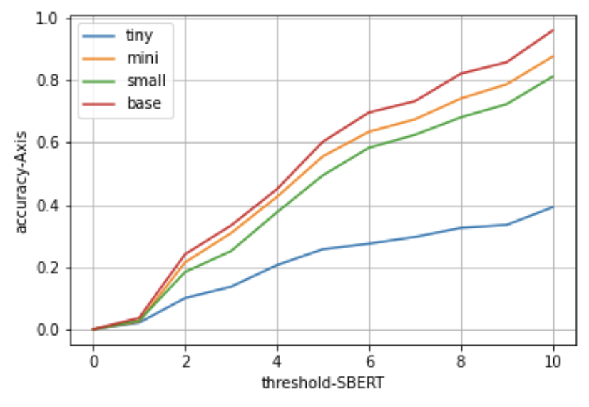
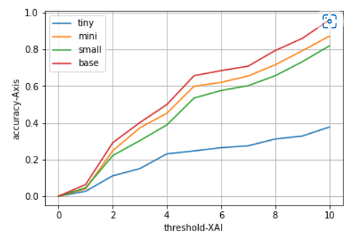
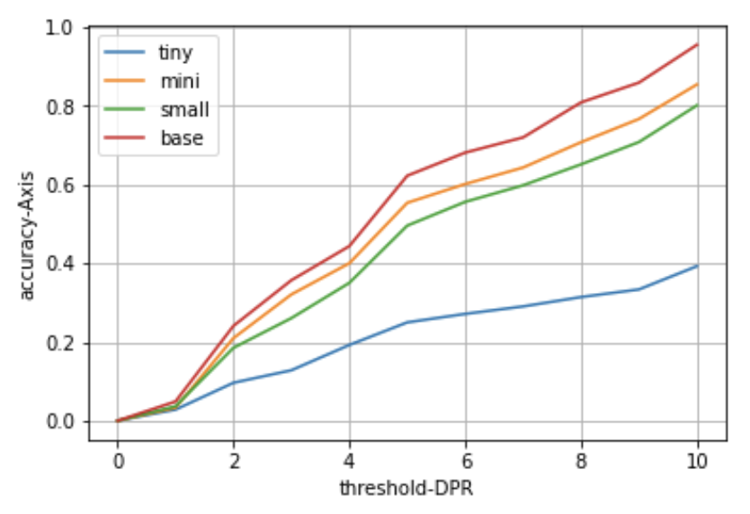
Result
original tiny f1 : 0.40884628753599345
original small f1 : 0.8975059767717662
original mini f1 : 0.7990479908979908
original base f1 : 0.9494428150968399
Notes:
这是根据不同分割方式得数据集在bert tiny，mini，small， base上得性能表现，我们根据前页得ppt可以看到模型的性能表现基本上和答案得包含程度呈正相关
This is the performance of the data set in bert tiny, mini, small and base according to different segmentation methods. According to the previous slid, we can see that the performance of the model is basically positively related to the degree of inclusion of the answer.

Slide 15
Conclusion
We propose to use IR to filter useless information in question answering systems for small models to obtain the performance of large models. The intuition is that making filters not only eliminates the need for retraining.
It can meet the ability to handle far beyond its own limitations. The problem of incomplete information caused by other algorithms such as sliding windows is prevented.

Slide 16
Thanks

