Slide 1
A Universal model improvement method for Self-verification through interpretation
Zikun Guo
2021225559
Artificial Brain Research Lab
Department of Artificial Intelligence
Kyungpook university
Notes:
大家好，我是子坤，今天我向大家介绍的我的研究。A Universal model improvement method for Self-verification through interpretation

Slide 2
Contents
Introduction
Experimental method
Result
Future work

Slide 3
Introduction
Recently some interpretable methods have been proposed, one of the interpretation method for question answering systems is Integrated Gradients. We propose a novel method to improve the performance of the model based on the characteristics of the Integrated Gradients applied in the question answering system: Cascading Explaining. This method is to extract information from the interpretation of the model output, and then let the model predict again. Under this condition, the model showed better performance than before .We have used some experiments to prove that this method has successfully passed the sanity check, and has greatly improved the accuracy and probability of model predictions. At the same time, This method is also applicable to emotion recognition, two-classification, and multi-classification fields.

Slide 4
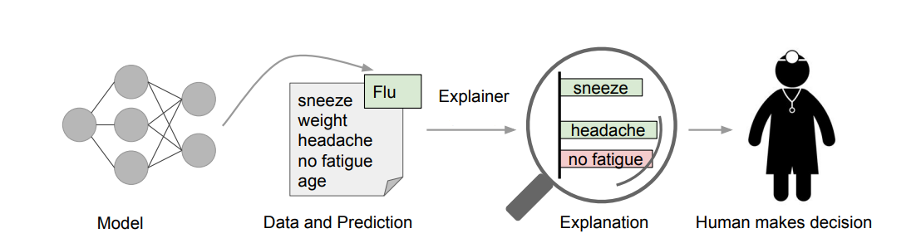
Introduction
What is xai
Notes:
首先我在介绍论文之前我先向大家介绍什么是hi可解释ai，可解释的人工智能 (XAI) 是一套流程（process）和方法，可使人类用户能够理解和信任机器学习算法所产生的结果和输出。 可解释的 AI 用于描述 AI 模型、其预期影响(Influence)和潜在偏见(potential bias)。 它有助于描述 AI 支持的决策中的模型准确性、公平性、透明度(transparency)和结果。 在将 AI 模型投入生产(rpoduction)时，可解释的 AI 对于组织建立信任和信心(confidence)至关重要。 AI 可解释性也有助于组织采用负责任(Adopt a responsible approach)的方法进行 AI 开发。

Slide 5
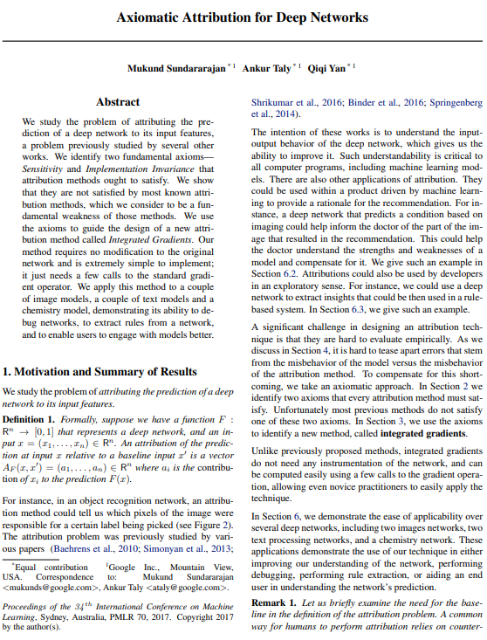
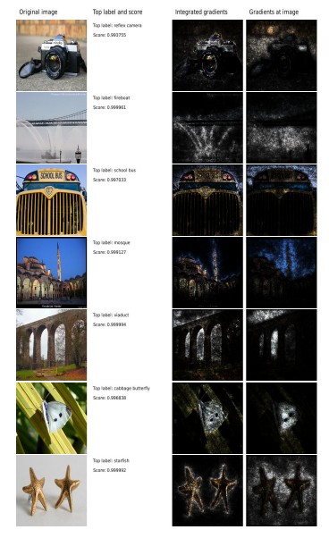
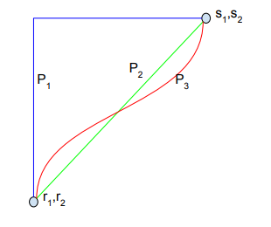
Integrated Gradients
Notes:
Ok，第一点，梯度积分算法，是我们在可解释ai中最重要的应用，所以，什么是梯度积分，首先，这是一种可解释ai技术，相比较于最开始使用的baseline技术。Baseline是衡量（measure）一个特征如何对模型输出。但是由于不同的特征对结果的影响是有一个极限（limit）的，譬如说一个大象的鼻子的长度，是衡量大象的重要特征（characteristic），但是并不代表，The longer the noses, the more we think it‘s an elephant.所以大家可以看到，任何一个特征都会存在一个极限，这就是baseline的含义，同样如果我们把x作为特征的程度衡量，y作为对结果的影响程度，那么这样的函数我们称之为baseline。但是在实际应用中（practical application），我们为了忽略特征增长到一定程度（grow to a certain extent）就不变化这一现象（Phenomenon），于是我们引用（quote）了梯度积分这一算法，通过这种算法，我们可以连续的观察特征对结果的影响（We can continuously observe the effect of features on the results）。

Slide 6


Integrated Gradients
Function F : R n → [0, 1] that represents a deep network. Specifically, let x ∈ R n be the input at hand, and x 0 ∈ R n be the baseline input.
Notes:
这个是具体的数学原理：
This is the specific mathematical principle:
Approximately equal to
For networks( text or image model), the baseline could be the black image, while for text models it could be the zero embedding vector.

Slide 7
Integrated Gradients
Function F : R n → [0, 1] that represents a deep network. Specifically, let x ∈ R n be the input at hand, and x 0 ∈ R n be the baseline input.
Straightline path (in R^{n}) from the baseline X₀ to the input x, and compute the gradients at all points along the path. Integrated gradients are obtained by cumulating these gradients. integrated gradients are defined as the path intergral of the gradients along the straightline path from the baseline X₀ to the input x.
Notes:
这个是具体的数学原理：
This is the specific mathematical principle:
Approximately equal to

Slide 8
Integrated Gradients
Function F : R n → [0, 1] that represents a deep network. Specifically, let x ∈ R n be the input at hand, and x 0 ∈ R n be the baseline input.
Straightline path (in R^{n}) from the baseline X₀ to the input x, and compute the gradients at all points along the path. Integrated gradients are obtained by cumulating these gradients. integrated gradients are defined as the path intergral of the gradients along the straightline path from the baseline X₀ to the input x.
For most deep networks, it is possible to choose a baseline such that the prediction at the baseline is near zero (F(x) ≈ 0). (For image models, the black image baseline indeed satisfies this property.) In such cases, there is an intepretation of the resulting attributions that ignores the baseline and amounts to distributing the output to the individual input features.
Notes:
这个是具体的数学原理：
This is the specific mathematical principle:
Approximately equal to
For networks( text or image model), the baseline could be the black image, while for text models it could be the zero embedding vector.

Slide 9
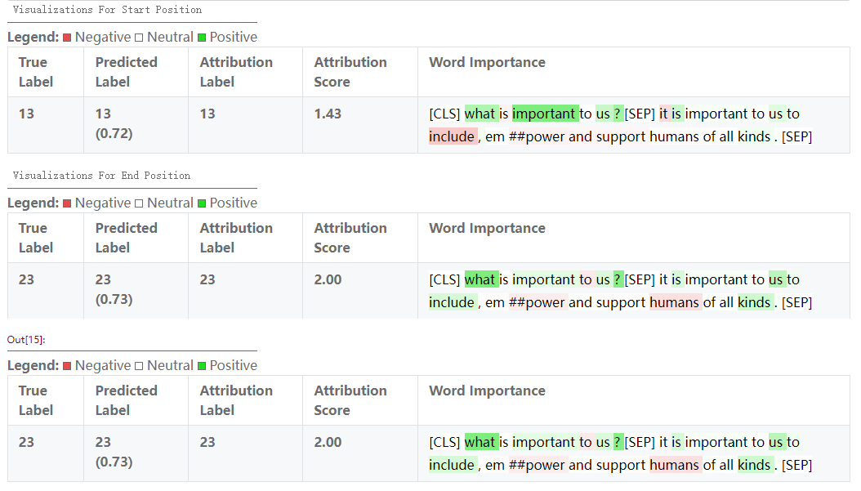
Integrated Gradients- Q&A Example
brief context
Notes:
这是使用ig算法的具体例子。这是通过ig算法对bert模型进行的解释说明。其中绿色的部分是代表（represent）对结果起到积极作用的token，红色代表消极作用的tokens。我们通过比较不同句子中的tokens，来计算整段句子对结果的贡献。

Slide 10
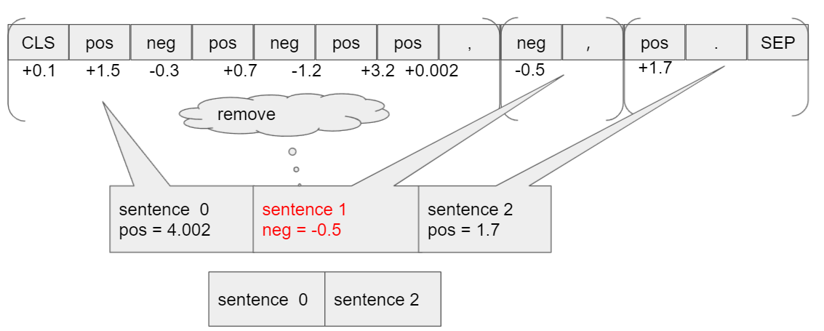
Self-verification through explanation
Extract word for preditction
Notes:
这就是具体计算方法，我们通过计算不同的tokens的平均值，来计算整个句子的贡献，通过删除掉低贡献的句子，我们可以蒸馏（Distill out ）出结果。Whitch means，我们在充满了无意义的句子中，进行一种滤波，滤掉（filtered out）了大部分对结果不重要的句子。于是，模型不需要再对那些拉乱无章的部分添加注意力，仅需要（only required）对结果起到积极作用的要点部分进行处理。

Slide 11
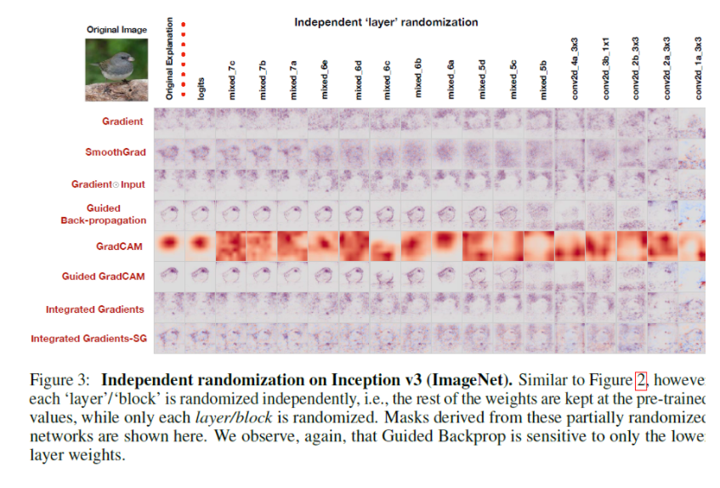
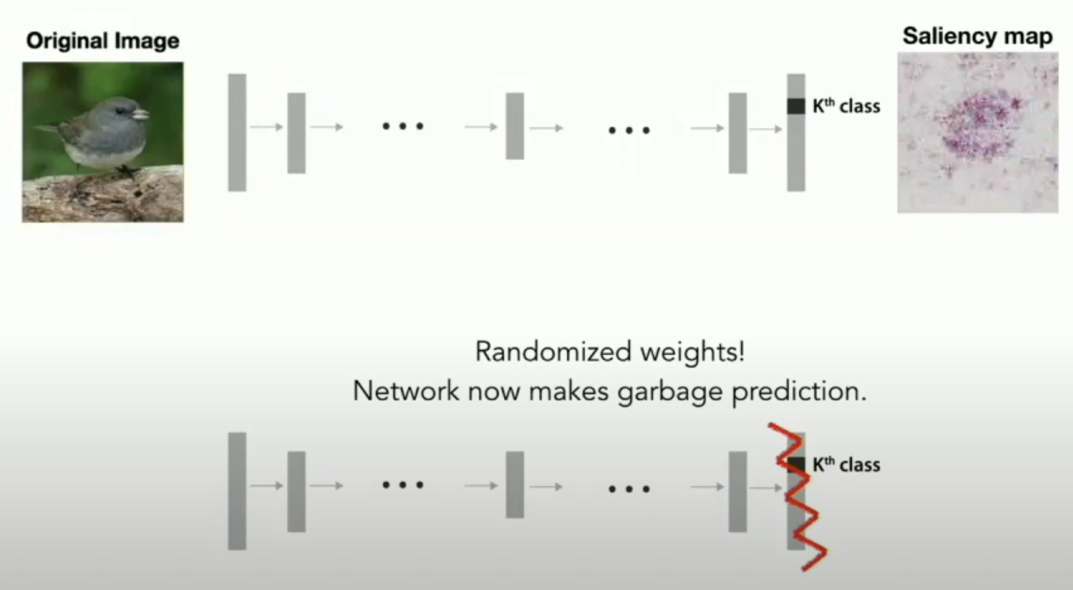
Sanity check for Saliency Maps
Sometimes, in the CNN network, the interpretation is independent of the model ：
Notes:
为了让解释有意义，我们应用了谷歌研究员 kim been的研究方法：sanity check 旨在cnn网络中，随机化一层模型的权重，因此输出的答案是没有意义的答案。但是采用解释方法以后，我们依然发现解释却是不变的，因此人们开始质疑xai的作用，所以为了证明解释是有意义的，该论文推荐使用可以通过sanity check的方法进行研究。

Slide 12
Sanity check for Saliency Maps
Cascading Randomization:
randomize the weights of a model starting from the top layer, successively, all the way to the bottom layer.
Independent Randomization:
Conduct an independent layer-by-layer randomization with the goal of isolating the dependence of the explanations by layer. This approach allows us to exhaustively assess the dependence of saliency masks on lower versus higher layer weights. More concretely, for each layer, we fix the weights of other layers to their original values, and randomize one layer at a time.

Slide 13
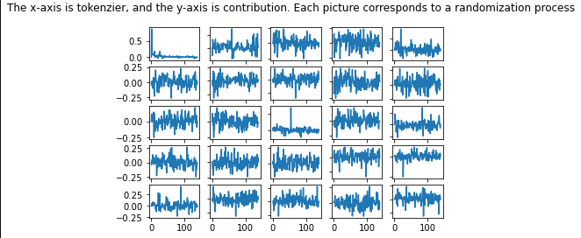
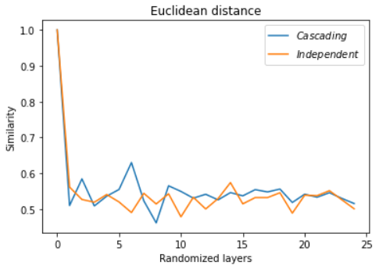
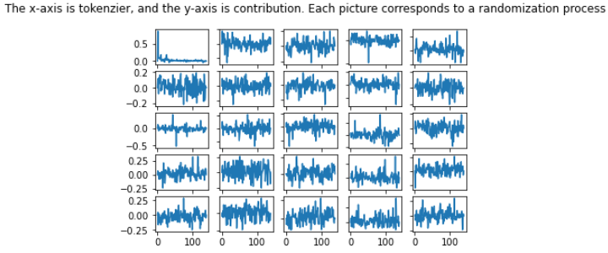
Self-verification through explanation
Euclidean distance
Cascading
Independent
Notes:
根据之前介绍的方法，我对transformer模型进行了sanity check，结果如图所示，我们可以发现，sanity check针对trnasformer模型的应先基本没有，原因在于：我们可以看图1（cascading方法）：左上角的tokens贡献是原有的的解释，我们观察到对结果贡献最高的地方集中在，句子的头部，曲线最高的地方。因此在我们随机化一层网络之后，我们发现cnn的情并没有发生，而是解释的结果随着随机化操作而变化，于是根据这个结论，我们可以证明，transformer模型结构并不适用于sanity check。也就是说，发生在cnn的解释问题，并不会发生在bert模型上。我们可以放心的去做解释和优化工作。

Slide 14
Self-verification through explanation
Explain and remove negative part
Explain and remove negative part
Explain and remove negative part
Explain and remove negative part
Explain and remove negative part
Explain and remove negative part
Each interpretation gets a new set of contribution values, and each time unimportant contributions are eliminated, resulting in a distilled answer proof.

Slide 15
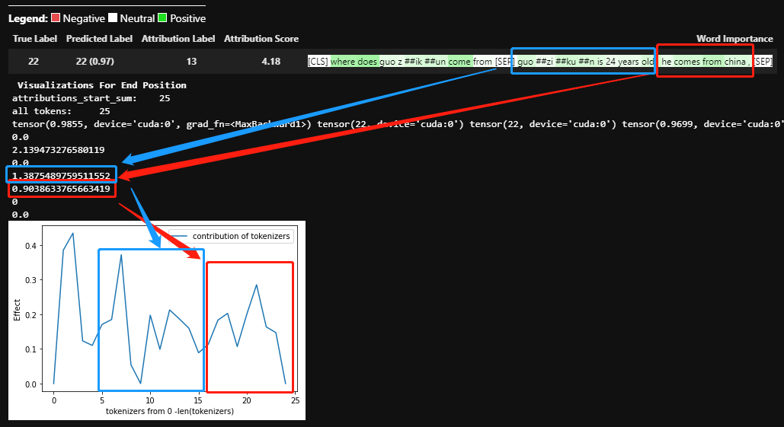
Self-verification through explanation

Slide 16
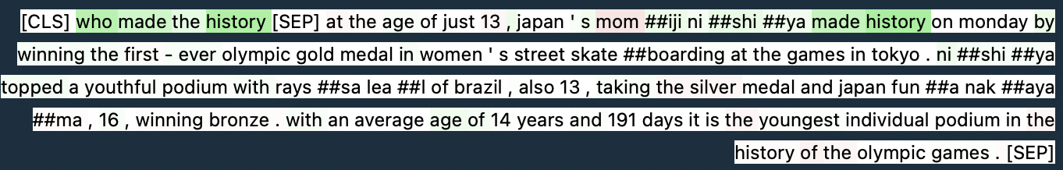
Self-verification through explanation
Extract word for preditction
Original Test Explanation
Interpret the results after 20 times

Slide 17
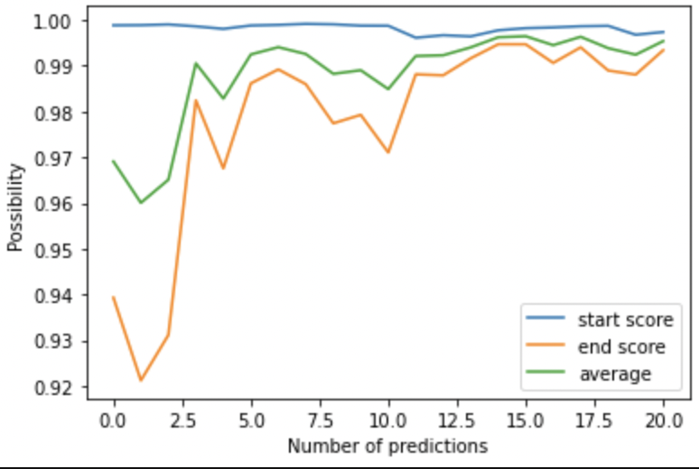
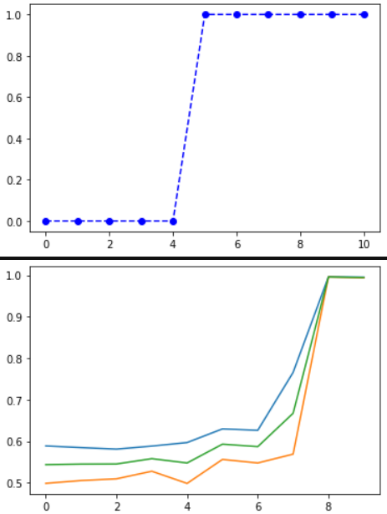
Self-verification through explanation
Situation 1: The answer has not changed, but the probability has been increasing
Situation 2: The answer was wrong for the first time, and the answer was corrected with constant checking. At the same time the probability increases

Slide 18
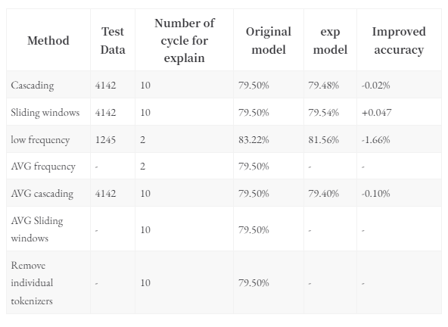
Self-verification through explanation

Slide 19
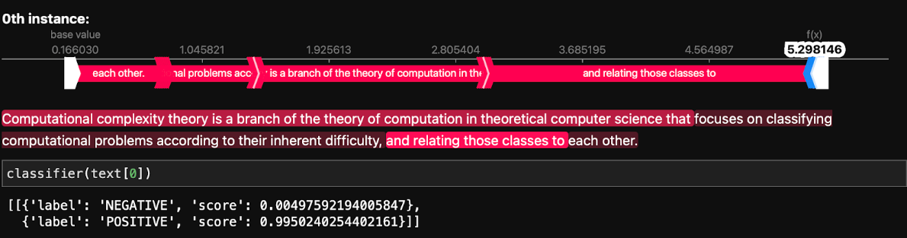
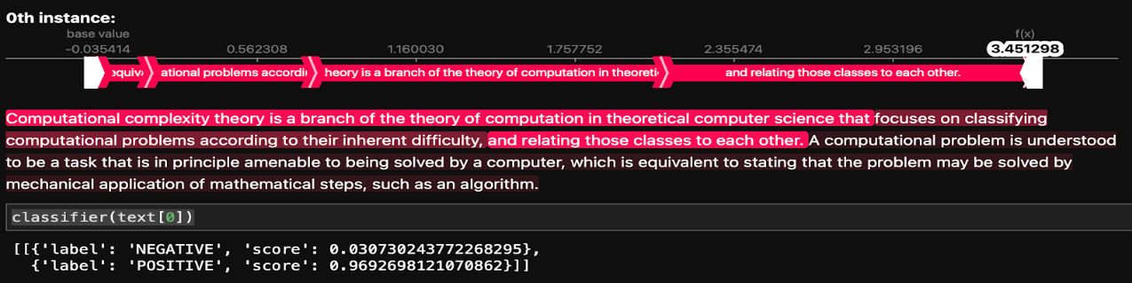
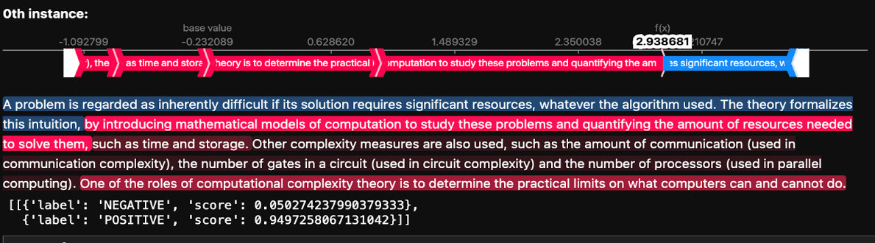
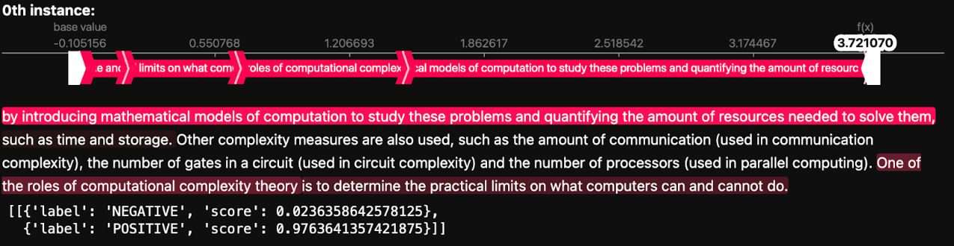
Self-verification through explanation
96.9% -> 99.5%
94.9% -> 97.6%

Slide 20
Future work
Using xai technology to reduce the model, reduce the dataset, so that the large model can be embedded in the mobile device through the method of xai technology. without losing accuracy
Create a new interpretable method to solve a series of problems such as sanity check under CNN

Slide 21
Thanks

