Slide 1
Model compression and acceleration technology based on attention extraction mechanism
Zikun Guo
2021225559
Artificial Brain Research Lab
Department of Artificial Intelligence
Kyungpook university
Notes:
大家好，我是子坤，今天我向大家介绍的我的研究。Model compression and acceleration technology based on attention extraction mechanism

Slide 2
Contents
Introduction
Experimental method
Result
Future work

Slide 3
Introduction
In recent years, deep learning models have continuously refreshed the performance of traditional models in various fields such as computer vision, natural language processing, and search recommendation advertising, and have been widely used. With the continuous improvement of the computing power of mobile devices, the implementation of mobile AI has also become possible.
Model compression and acceleration can not only improve the performance of mobile models, but also greatly speed up inference response on the server.
The following are commonly used compression methods
Algorithm layer compression acceleration.
Framework layer acceleration
Hardware layer acceleration.
We focus on model-independent compression methods that enable low-parameter models to approach the performance of high-parameter models: Use the pre-training model to extract information for the input, and the extraction method is specially optimized for prediction, so as to get rid of the useless information that interferes with the model prediction
Notes:
近年来深度学习模型在计算机视觉、自然语言处理、搜索推荐广告等各种领域，不断刷新传统模型性能，并得到了广泛应用。随着移动端设备计算能力的不断提升，移动端AI落地也成为了可能。
模型压缩和加速不仅仅可以提升移动端模型性能，在服务端也可以大大加快推理响应速度
算法层压缩加速。这个维度主要在算法应用层，也是大多数算法工程师的工作范畴。主要包括结构优化（如矩阵分解、分组卷积、小卷积核等）、量化与定点化、模型剪枝、模型蒸馏等。
框架层加速。这个维度主要在算法框架层，比如tf-lite、NCNN、MNN等。主要包括编译优化、缓存优化、稀疏存储和计算、NEON指令应用、算子优化等
硬件层加速。这个维度主要在AI硬件芯片层，目前有GPU、FPGA、ASIC等多种方案，各种TPU、NPU就是ASIC这种方案，通过专门为深度学习进行芯片定制，大大加速模型运行速度。

Slide 4
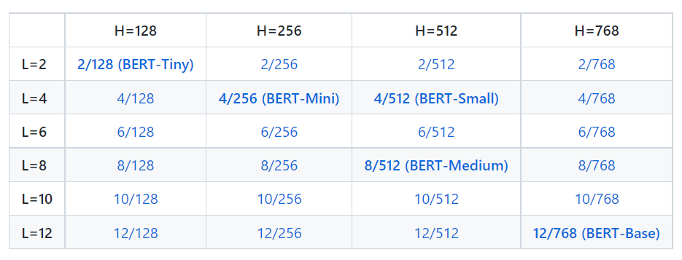
Introduction
Disadvantages
The pre-trained model Bert can handle a maximum sequence length of 512.
When dealing with long text (document level), the text truncation or sliding window method is usually used to make the sequence length of the input model conform to the preset value, but this processing method will causes the loss of task-related global information.
Schematic diagram

Slide 5
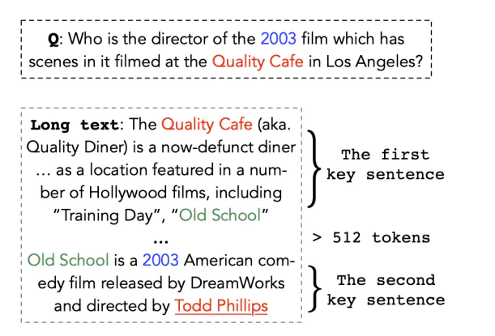
Contribution value principle division
Transformation strategies (reserving [CLS] and [SEP]):
(1) head-only: the first 510 tokens
(2) tail-only: after 510 tokens;
(3) head+tail: select the first 128 and 382 tokens based on experience
(4) Segmentation: First, the input text (length L) is divided into k = L/510 small paragraphs, and they are sequentially input into BERT to obtain the representation of k text paragraphs. The representation of each paragraph is the hidden state of the last layer [CLS], and the representations of all paragraphs are merged using mean pooling, max pooling and self-attention
Notes:
举个例子，当我们有一个问题和文本，我们需要提取问题的答案位置，如果答案转换成tokens的话，长度小于512，很简单，我们只需要简单的输入到模型然后查看模型的预测。但是当长度大于512的时候，我们需要截断句子，但是一般的方法都是
由于bert文本长度最大为512，因此当文本超过512时，需要改进bert。本文就此改进进行阐述。针对长度超过512的文本，可以应用如下转换策略（预留[CLS]和[SEP]）：（1）head-only：前512tokens（2）tail-only：后510tokens；（3）head+tail：根据经验选择前128和382tokens（4）分段：首先将输入文本（长度为L）分成k = L/510个小段落，将它们依次输入BERT得到k个文本段落的表示。每个段落的representation是最后一层[CLS]的hidden state，并分别使用mean pooling, max pooling and self-attention来合并所有段落的representation。
Since the maximum text length of bert is 512, when the text exceeds 512, bert needs to be improved.
For text longer than 512, the following transformation strategies can be applied (reserving [CLS] and [SEP]):
(1) head-only: the first 510 tokens
(2) tail-only: after 510 tokens;
(3) head+tail: select the first 128 and 382 tokens based on experience
(4) Segmentation: First, the input text (length L) is divided into k = L/510 small paragraphs, and they are sequentially input into BERT to obtain the representation of k text paragraphs. The representation of each paragraph is the hidden state of the last layer [CLS], and the representations of all paragraphs are merged using mean pooling, max pooling and self-attention respectively.

Slide 6
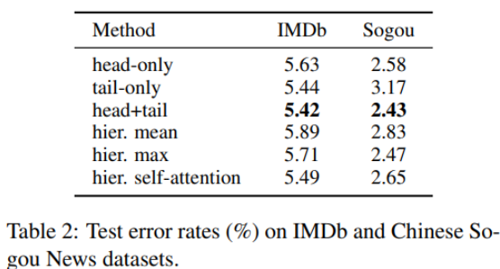
Contribution value principle division
Notes:
上表中可以看出，第三种模式准确率较高，可能重要信息恰巧集中在头和尾部。
As can be seen from the above table, the third mode has a higher accuracy rate, and it is possible that important information happens to be concentrated in the head and tail.

Slide 7
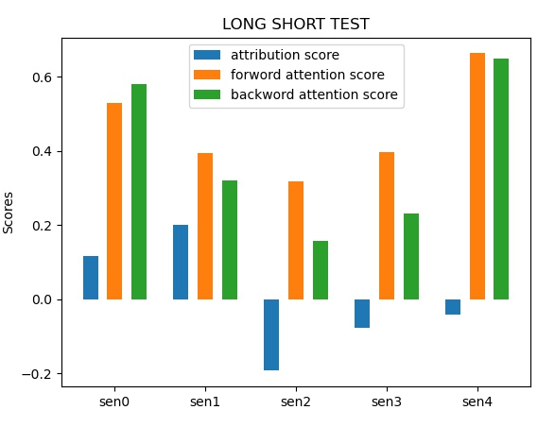
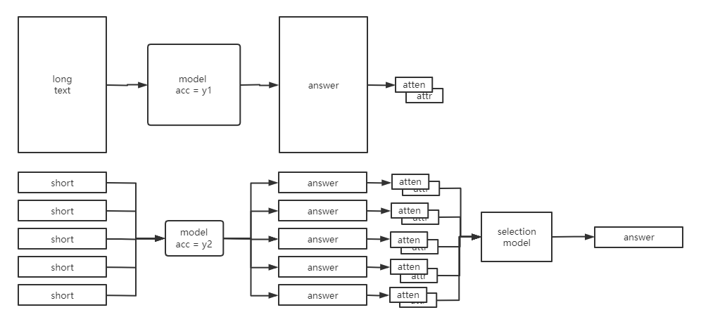
Experiment
Sentence splitting:
In the text, only one paragraph contains the answer
Use the tokenizer to tokenize sentences.
The attention and interpretation results of the model are different after the clauses with and without the answer are entered into the model
Notes:
这是我们的方法，我们通过使用可解释ai来计算每个句子的贡献值，由于tranformer模型包含语义信息，所以我们还可以使用sbert进行句子划分，我会在后边的进行介绍，我们通过梯度积分算法得到句子对答案的贡献值，forward attention score和 backword attention score，这两个score很好获取，不需要计算，只需要再模型最后的softmax层读取即可。Ok，我们创建了一个外部选择模型，不同的是，我们不使用squad数据集进行训练，而是使用每个句子的贡献值和前后注意力值进行训练，旨在让模型能够识别那个句子中包含答案的概率最大。

Slide 8
Dataset(SQUAD)
Crashed Dataset
This data set is obtained by processing the Squad dataset. By splitting sentences and comparing with the questions, if the answer is included, the label is the position of the answer, and if the answer is not included, the label is empty(0)
Through the test records of the model, we can obtain a large number of test records, including: changes in probability and changes in f1. Among them, the label of the data we manually add the highest f1 value index
There is basically no difference in size, but there are more labels for each sentence: whether it contains the ground turth
Notes:
为了训练这个模型，我们使用自己分割后的数据集，这个数据集我们称为Crashed Dataset,

Slide 9
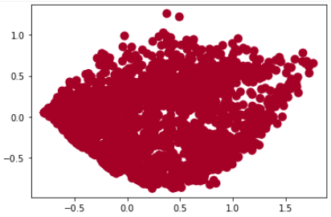
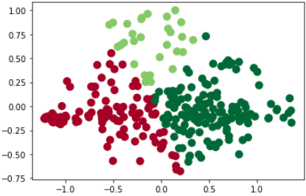
Dataset(SQUAD)
Data balance
On average, each text will be divided into 3-8 clauses
Only the clause containing the answer will mark the position of the answer
So let the model learn directly, resulting in the model learning a lot of irrelevant information
Remove a lot of empty label data to make the data label balanced

Slide 10
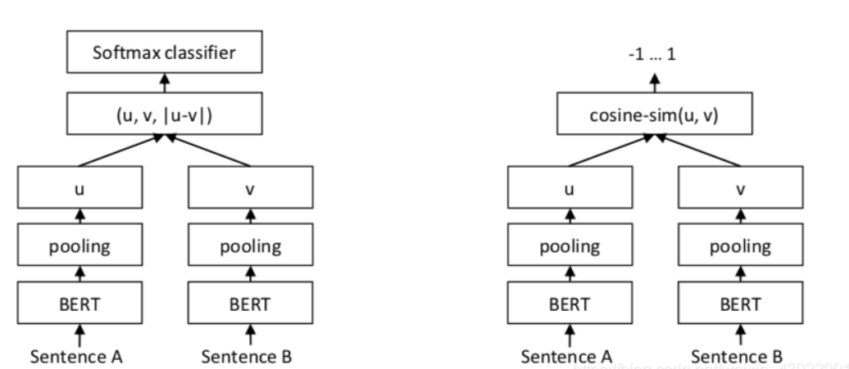
Information Retrieval
SBERT:
The entire sentence is input into the pre-training model, and the sentence vector of the sentence is obtained, which is then represented as the sentence vector of the sentence.
For two similar sentences, the resulting sentence vectors may be very different.(huge expenses)
Use Siamese and triplet network structures to obtain semantically meaningful sentence embeddings, so as to obtain fixed-length sentence embeddings, and use cosine similarity or Manhattan/Euclidean distance to compare to find semantically similar sentences.
Notes:
u, v : two input sentence
|u-v| : absolute value
u, v, |u-v| : splicing three vectors in the -1 dimension

Slide 11
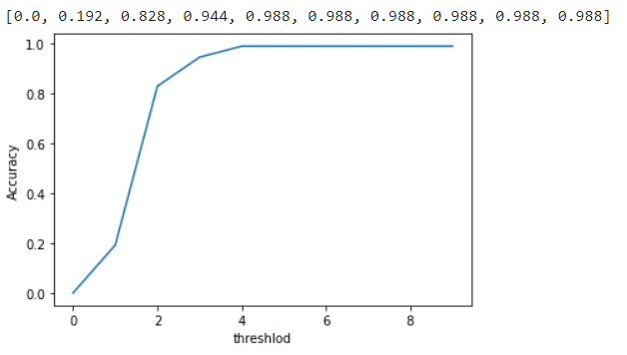
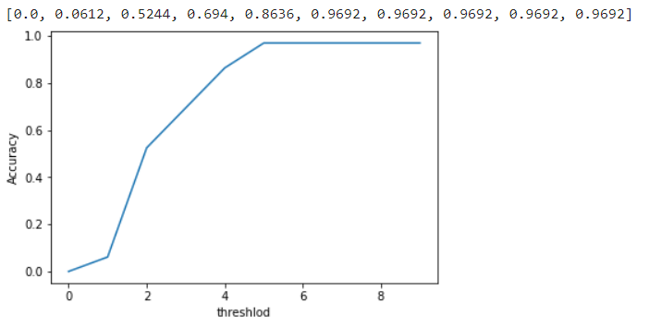
Information Retrieval
The sentence with the shortest distance in dpr is the one that contains the answer：
DPR : 707/1000 —>70.7%
8 min
SBERT : 605/1000 —> 60.5%
1.67 min
Dense channel retrieval
Dense Channel Retrieval (DPR) - is a set of tools and models for state-of-the-art open-domain question answering research. It is based on the following papers:
Notes:
u, v : two input sentence
|u-v| : absolute value
u, v, |u-v| : splicing three vectors in the -1 dimension

Slide 12
Conclusion
We propose to use IR to filter useless information in question answering systems for small models to obtain the performance of large models. The intuition is that making filters not only eliminates the need for retraining.
At the same time, it can meet the ability to handle far beyond its own limitations. The problem of incomplete information caused by other algorithms such as sliding windows is prevented.
Notes:
u, v : two input sentence
|u-v| : absolute value
u, v, |u-v| : splicing three vectors in the -1 dimension

Slide 13
Thanks

