Slide 1
CHAPTER 1:
Computers and Systems
The Architecture of Computer Hardware, Systems Software & Networking:
An Information Technology Approach
Lecturer: Maryam Cheraghy
Notes:
In this course you will learn how to Properly use hardware and software terms to describe computing systems.
How to Describe the interaction of hardware and software components of computing and explain the underlying principles.
You will Understand and demonstrate the role of the operating system and networks in computing,
And you will find how to interact with the operating system to execute software with simple scripting.

Slide 2
Assessment:
The final grade will be based on: Exams, Quizzes, Assignments, and Attendance.
Grades:
50% Exams (3)
20% Assignment,
10% Quizzes
10% Papers & Presentation
10% Participation/Attendance

Slide 3
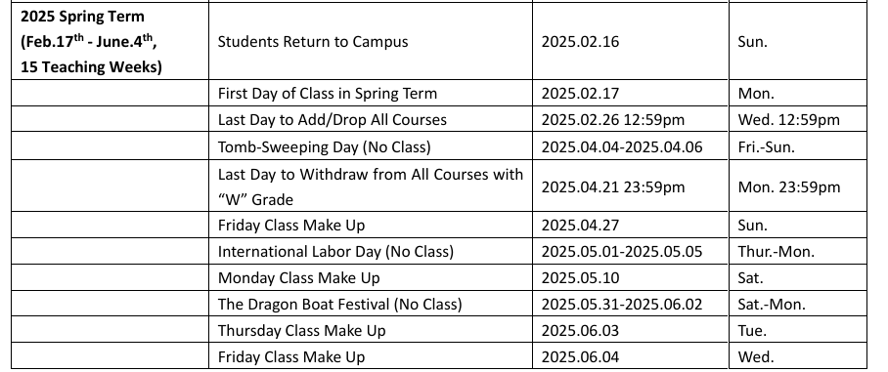
WENZHOU-KEAN UNIVERSITY ACADEMIC CALENDAR 2024-2025
1-<number>

Slide 4
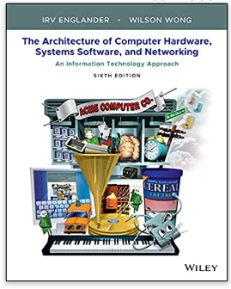
Textbook Title:
The Architecture of Computer Hardware, Systems Software, & Networking, 9781119495208, Englander and Wong, Wiley 2021, 6th.
Your Campus bookstore offers a Price Match guarantee. If you find our class texts or access codes cheaper at Book smart, Barnes & Noble, or Amazon the campus bookstore will match the price at the time of purchase, or for up to 7 days after purchase. Search your course materials by the ISBN provided in this syllabus to assure that your price match is acceptable.
1-<number>

Slide 5
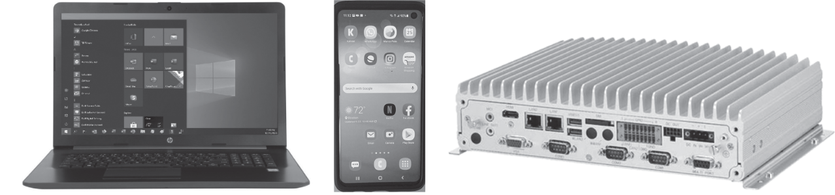
Computing Devices – Old and New
Copyright 2021 John Wiley & Sons, Inc.
1-<number>
Notes:
Welcome to the wonderful modern world of computers. Where the technology changes daily. It’s true that the computer of today looks nothing like the computer of even five or ten years ago. It is nearly impossible today to escape the immediate and ubiquitous reach of computers and computer-based systems and devices. There is probably a smartphone in your pocket or on your desk. For many of you, your laptop or tablet is sitting nearby .Furthermore, your smartphone probably has more computing power than most of the computers on the market ten years ago. It fits easily in your pocket or purse. It weighs less than 1/100 of that old desktop computer and has at least ten times as much memory!
And that’s not all. Your car has several embedded computers controlling various automotive functions, and perhaps a touch screen for hands-free telephone, navigation, the radio, Internet access, and more. Even your microwave oven and the washing machine depend on computers to function. most of these machines can talk to each other, using the Internet, Bluetooth or some other networking technology for example iot. “.
the focus of this book is on IT systems, our discussion of computer hardware, software, and networking .In this figure, we have three very different looking pieces of equipment working on different types of applications.
The picture shows typical of a recent laptop, a 2020 smartphone, and a current embedded computer that controls many functions in your car.
. And these three systems share a lot in common. They are all computer based. All contain at least one central processing unit (CPU, some contain more) and memory. All provide a facility for interacting with long-term storage and other devices and with users. the programs that they run are also essentially similar but the systems may have different amounts of memory, different types of displays, different I/O devices, and different operating systems, as well as running different types of applications and serving different purposes.

Slide 6
Modern Computing
Computing is ubiquitous
  It is everywhere and anywhere
  No longer limited to a traditional ‘computer’
  Greater variety of computing platforms exist now
Computing is pervasive
  Embedded in many other types of devices such as appliances and automobiles
  Users no longer have to understand the details of how they work to operate the device
Copyright 2021 John Wiley & Sons, Inc.
1-<number>
Notes:
There is obviously no need to understand the inner workings of most modern computer-based systems to operate them adequately. Indeed, in many cases, the presence of the computer is hidden from us, or embedded, and its operation is invisible to us as users. We don’t need to know how a computer works to read an E-book. Even as experienced users, we can run standard software packages on a personal computer or apps on a smartphone without understanding exactly how they work; we can program a computer in a high-level or a scripting language without understanding the details of how the machine executes the individual instructions; we can design and implement Web pages without understanding how the Web browser gets its pages from a Web server or how the Web server creates those pages; we can purchase a tablet or a laptop computer from a salesperson without understanding the specifications of the system.

Slide 7
Why Study Computer System Architecture?
User
  Understand system capabilities, strengths, and limitations
  Make better informed decisions
  Improve communications with information technology professionals
Programmer
  Create efficient application software for specific processing needs
Systems Architect or Systems Analyst
  Specify computer systems and architecture to meet application requirements
  Make intelligent decisions about system strategy
Copyright 2021 John Wiley & Sons, Inc.
1-<number>
Notes:
As a user, you will be more aware of the capabilities, strengths, and limitations of a computer system. You will have a better understanding of the commands that you use. You will understand what is taking place during the operation of the program applications that you use. You can make better decisions about your computer equipment and application programs. You will understand more clearly what an operating system is, and how to use it effectively and to your advantage. You will know when it is preferable to do a job manually, and when the computer should be used. You will understand the most efficient way to “go online”, and what benefits might be gained from your home network. You will improve your ability to communicate with system analysts,
As a programmer, it will allow you to write better programs. You will be able to use the characteristics of the machine to make your programs operate more effectively. For example, choosing the appropriate data type for a variable you can see faster performance.
As a systems architect or system analyst, you will be responsible for the design and implementation of systems that meet an organization’s information technology (IT) needs, recognizing that the differences in the cost and capabilities of the components that you select may have significant impact on the organization. You will be in a better position to determine and justify the set of computer system components and the system architecture that are appropriate for a particular job and to determine the trade-offs with other possible system architectures. You’ll be able to assist management in making intelligent decisions about system strategy: should the company adopt a large mainframe/virtual machine system approach for its Web servers, or would a system consisting of a network of off-the-shelf blade servers provide better performance at lower cost?

Slide 8
Why Study Computer System Architecture?
Networking Professional
  Design, maintain, support, and manage networks
  Optimize equipment and network resources
Web Services Designer
  Optimize customer accessibility to Web services
  Optimize web system configurations
  Select appropriate data formats, page designs and scripting languages
  Design efficient Web pages
Copyright 2021 John Wiley & Sons, Inc.
1-<number>
Notes:
As a networking professional, you are responsible for the design, maintenance, support, and management of the networks that connect your computer systems together and provide the required interfaces to the outside world. You must be able to specify network layouts that optimize your equipment and network resources.
Web Services Designer, you must be able to make intelligent decisions to optimize your Web system configurations, page designs, data formatting and scripting language choices, and operating systems to optimize customer accessibility to your Web services.

Slide 9
Why Study Computer System Architecture?
System Administrator / Manager
  Install, configure, maintain, and upgrade computer systems
  Maximize system availability and efficiency
  Optimize system performance
  Select cloud services
  Ensure system security
Copyright 2021 John Wiley & Sons, Inc.
1-<number>
Notes:
As a system administrator or manager, your job is to maximize the availability and efficiency of your systems. You will need to understand the reports generated by your systems and be able to use the information in those reports to make changes to the systems that will optimize system performance.
You will need to know when additional resources are required, and be able to specify appropriate choices.
You will need to specify and configure operating system parameters, set up file systems, select cloud services, manage system and user PC upgrades in a fast-changing environment, reconfigure networks, provide and ensure the robustness of system security, and perform many other system management tasks

Slide 10
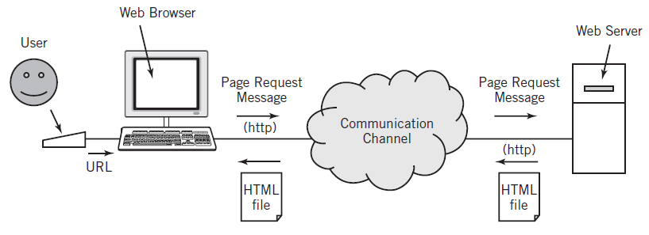
Web Browser Application Use
Copyright 2021 John Wiley & Sons, Inc.
1-<number>
Notes:
Your task in this example is to access a Web page on the Internet. Again, your input to the computer is via keyboard and pointer control device. When you type the Web page URL, however, your computer sends a message to another computer that contains Web server software. That computer, in turn, sends a Web page file that is interpreted by the browser on your computer and presented on your screen. We know that HyperText Transfer Protocol (HTTP) is used as a standard for Web message exchanges
Your command inputs tell a Web browser software application on your computer what processing is to take place; in this case, your desire to access a Web page.
The output from your computer is a message to a Web server on the remote computer requesting the data that represents the Web page. Your computer receives the data as input from the network; the Web browser processes the data and presents the Web page output on the screen.
An HTML file consists of text, that is, the words that you want to appear in your document and embedded instructions called HTML tags

Slide 11
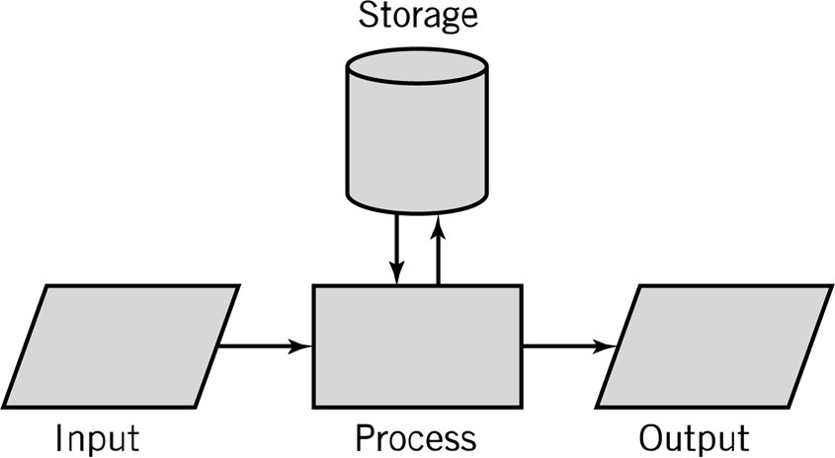
Input-Process-Output Model (IPO)
Input: keyboard, mouse, scanner
Processing: CPU executes the computer program
Output: monitor, printer, fax machine
Storage: hard drive, optical media, diskettes, magnetic tape
Copyright 2021 John Wiley & Sons, Inc.
1-<number>
Notes:
The work performed by an individual computer system within the IT system can be characterized by input, processing, and output. This characterization is often represented by the Input-Process-Output (IPO) model. The IPO model provides an important basic tool for system analysis and design practices.
1.Storage is also represented within this model. Alternatively, storage can be interpreted as output to be saved for use as future input. Storage is also used to hold the software programs that determine the processing operations to be performed. The ability to store programs and data on a temporary, short-term, or long-term basis is fundamental to the system.
In Chapter 2, we will show that all IT systems can ultimately be characterized by the same basic IPO model at all levels, from a single computer to a complex aggregation of computers, although the complexity of large systems may obscure the model and make it more difficult to determine the actual inputs, outputs, and processing operations.

Slide 12
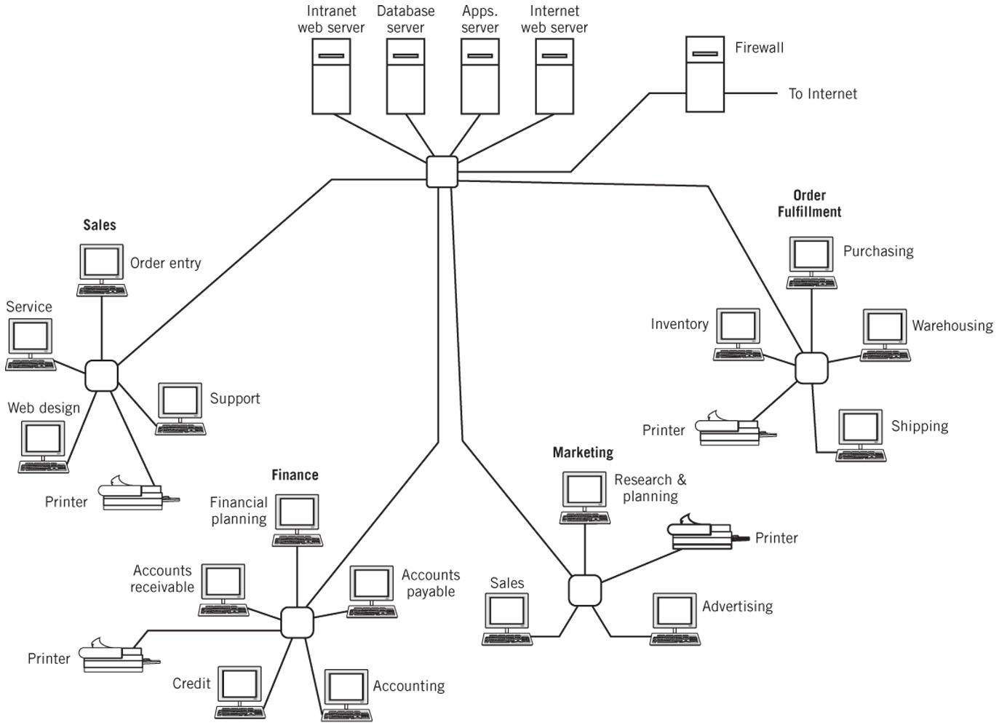
Simplified IT Computer System Layout
Copyright 2021 John Wiley & Sons, Inc.
1-<number>
Notes:
This fig is a simple illustration of computer systems embedded in a larger IT system. The components of an individual computer system consist of processing hardware, input devices, output devices, storage devices, application software, and operating system software. The task of the operating system software is to provide overall control of the individual system, including management of input, output, and file storage functions. The medium of exchange, both with users and between computers within a larger system, is data.

Slide 13
Computer System Components
Hardware
  Processes data by executing instructions
  Provides input and output
  Control input, output, and storage components
Software
  Applications and system software
  Instructions tell hardware exactly what tasks to perform and in what order
Data
  Fundamental representation of facts and observations
Communications
  Sharing data and processing among different systems
Copyright 2021 John Wiley & Sons, Inc.
1-<number>
Notes:
1. The computer hardware, which provides the physical mechanisms to input and output data, to manipulate and process data, and to electronically control the various input, output, and storage components.
2. The software, both application and system, which provides instructions that tell the hardware exactly what tasks are to be performed and in what order.
3. The data that is being manipulated and processed. This data may be numeric, it may be alphanumeric, it may be graphic, or it may take some other form, but in all cases it must be representable in a form that the computer can manipulate.
In modern systems, input entry, output display, and storage of the data and software used for processing often take place at a location different from the computer where the actual processing occurs. In many installations, actual processing is distributed among computer systems, with particular results passed to the individual systems that require them. Therefore, we must also consider a fourth component:
4. The communication component, which consists of hardware and software that transport programs and data between interconnected computer systems. The hardware and system software components make up the architecture of the computer system. The communication component connects individual computer systems together.
The data component and also the application software, while fundamental to the operation of the computer system, are supplied to the computer system by the user or vendor, rather than being a part of the architecture of the computer system itself.

Slide 14
Hardware Component
Input/Output devices
Storage Devices
CPU – Central Processing Unit
  ALU: arithmetic/logic unit
  CU: control unit
  Interface unit
Memory
  Short-term storage for CPU calculations
Copyright 2021 John Wiley & Sons, Inc.
1-<number>
Notes:
The most visible part of the computer system is obviously the hardware that makes up the system. . The hardware forms the tangible part of the system. It is physical—you can touch it
.Consider the computer system upon which you write and execute your programs. You use a keyboard or touch screen and a pointing device to provide input of your program text and data, as well as for commands to the computer. A display screen is commonly used to observe output. A printer is frequently available as an alternative output to the screen. These are all physical components.
Calculations and other operations in your program are performed by one or more central processing units (CPUs), or “cores” inside the computer.
A storage device is a piece of hardware that is primarily used for storing data. Other input and output devices, such as a disk and SD plug-in cards, are used to provide long-term storage of your program and data files.
Memory is provided to hold your programs and data while processing is taking place.
Data and programs are transferred between the various input/output (I/O) devices and memory for the CPUs to use.

Slide 15
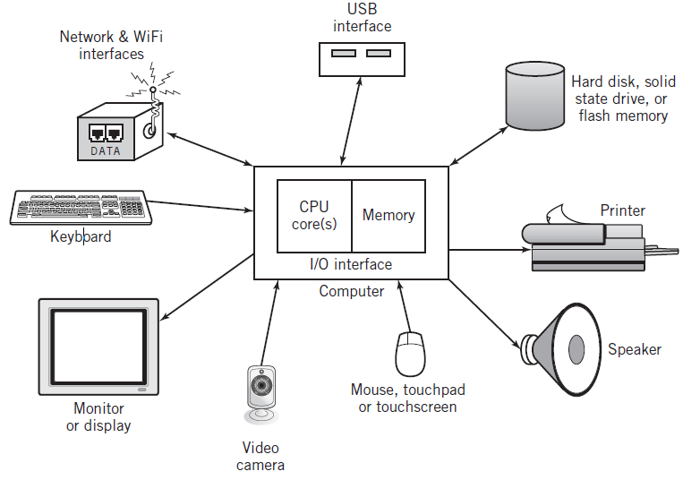
Typical Personal Computer System
Copyright 2021 John Wiley & Sons, Inc.
1-<number>
Notes:
The CPUs, memory, and all the input, output, and storage devices form the hardware part of a computer system. The hardware forms the tangible part of the system. It is physical—you can touch it, which is what the word “tangible” means. A typical hardware block diagram for a computer is seen in this Figure. This diagram of this figure can apply equally well in large mainframe computers, small personal computers and tablets, and even devices with computers embedded in them, such as automobiles, smart doorbells, voice recognition devices. Large and small computers differ primarily in the number of cores, the amount of memory, speed, capacity, and the selection of input and output devices provided. The basic hardware components and design are very similar.

Slide 16
CPU: Central Processing Unit
ALU: arithmetic/logic unit
  Performs arithmetic and Boolean logical calculations
CU: control unit
  Controls processing of instructions
  Controls movement of data within the CPU
Interface unit
  Moves instructions and data between the CPU and other hardware components
  Bus: bundle of wires that carry signals and power between different components
Copyright 2021 John Wiley & Sons, Inc.
1-<number>
Notes:
Calculations and other operations in your program are performed by one or more central processing units (CPUs), or “cores” inside the computer.
The arithmetic/logic unit (ALU) where arithmetic and Boolean logical calculations are performed. 2. The control unit (CU), which controls the processing of instructions and the movement of internal CPU data from one part of the CPU to another. 3. The interface unit, which moves program instructions and data between the CPU and other hardware components.
The interface unit interconnects the CPU with memory and also with the various I/O modules. It can also be used to connect multiple CPU cores together. In many computer systems, a bus interconnects the CPU, memory, and all of the I/O components. A bus is simply a bundle of wires that carry signals and power between different components

Slide 17
Memory
Also known as primary storage, working storage, and RAM (random access memory)
Consists of bits, each of which hold a value of either 0 or 1 (8 bits = 1 byte)
Holds both instructions and data of a computer program (stored program concept)
The amount of primary storage determines the maximum number of instructions and data words that can be loaded into memory
Copyright 2021 John Wiley & Sons, Inc.
1-<number>
Notes:
The main memory, often known as primary storage, working storage, or RAM (for random access memory), holds programs and data for access by the CPU.
Primary storage is made up of a large number of cells, each numbered and individually addressable. Each cell holds a single binary number representing part of a data value or part of an instruction. The smallest addressable size of the cell in most current computers is 8 bits, known as a byte of memory. Eight bits of memory can only hold 256 different patterns, so neighboring cells in memory are nearly always combined to form groupings with a larger number of bits.
In many systems, for example, 4 bytes of memory combine to form a 32-bit word. Modern computers address memory at least 4 bytes (a “32-bit” computer) or 8 bytes (a “64-bit” computer) at a time to take advantage of larger instruction and data groupings.
The amount of primary storage determines the maximum number of instructions and data words that can be loaded into memory from a peripheral device at one time.
For example, a computer with "8 gigabytes (GB), actually 8,589,934,592 bytes, of memory would not be able to execute a program that requires 9.7 GB for its instructions and data unless some means is provided within the computer to load the program in sections as each section of the program is needed."

Slide 18
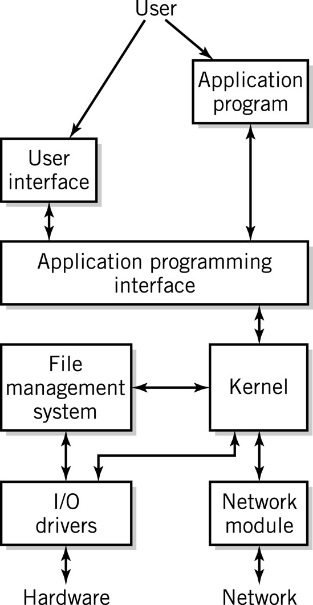
Software Component
Applications
Operating System
  API: application program interface
  File management
  I/O
  Kernel
    Memory management
    Resource scheduling
    Program communication
    Security
  Network Module
Copyright 2021 John Wiley & Sons, Inc.
1-<number>
Notes:
In addition to the hardware requirement, your computer system also requires software. Software consists of the programs that tell the computer what to do. To do useful work, your system must execute instructions from some program. There are two major categories of software: system software and application software. the application programs, such as Microsoft Word, or Firefox, or the programs that you write, that you normally run to get your work done.
System software helps you to manage your files, to load and execute programs, and to accept your commands. The system software programs that manage the computer are collectively known as an operating system, Windows, Linux, MAC OS X, iOS, and Android are the best known examples of an operating system. Others include Unix, Oracle Solaris, and IBM z/OS. The operating system is an essential part of the computer system. Like the hardware, it is made up of many components. A simplified representation of an operating system is shown in Figure.
The most obvious element is the user interface that allows you to execute programs, enter commands, and manipulate files. The user interface accepts input from a keyboard and, in most modern systems, a mouse, touch screen, or other pointing device. The user interface also does output presentation on the display.
The operating system’s application programming interface (API), acts as an interface for application programs and utilities to access the internal services provided by the operating system. These include file services, I/O services, data communication services, user interface services, program execution services, and more.2
Many of the internal services are provided by the kernel module, which contains the most important operating system processing functions. The remaining services are provided by other modules that are controlled by the kernel. The kernel manages memory by locating and allocating space to programs that need it, schedules time for each application to execute, provides communication between programs that are being executed, manages and arranges services and resources that are provided by other modules, and provides security.
The file management system allocates and manages secondary storage space and translates file requests from their name-based form into specific I/O requests.
The actual storage and retrieval of the files is performed by the I/O drivers that comprise the I/O component of the operating system. Each I/O driver controls one or more hardware devices of similar type.
The network module controls interactions between the computer system and the network(s) to which it is attached.

Slide 19
Communication Component
Hardware
  Communication channels
    Physical connections between computer systems
    Examples: wire cable, phone lines, fiber optic cable, wireless technology, infrared light, radio based technology (Wi-Fi or Bluetooth)
  Interface hardware
    Handles communication between the computer and the communication channel
    Modem or network interface card (NIC)
Software
  Establish connections
  Control flow of data
  Directs data to the proper applications for use
Copyright 2021 John Wiley & Sons, Inc.
1-<number>
Notes:
Very few modern computers can operate independently. Instead, they are tied to other computers directly, by modem, or through a network connection. The computers may be located physically close to each other, or they may be separated, even by thousands of miles. To work together, computers must have means to communicate with each other. The communication component requires both hardware and software to achieve this goal.
Additional hardware components physically connect computers together into multiprocessing systems, or clusters, or networks, or, via telephone, satellite, microwave, or other network technology, to computers at other remote locations.
A communication channel provides the connection between computers. The channel may be a wire cable, a fiber-optic cable, a telephone line, or a wireless technology, such as infrared light, cellular phone, or radio-based technology such as Wi-Fi or Bluetooth.
Special I/O hardware, consisting of a device such as a modem or network interface card (NIC) within the computer, serves as an interface between the computer and the communication channel.
may be there are additional hardware within the channel itself. The communication component also requires additional software within the operating system of each computer to understand what the other computers that they are connected with are saying. This software establishes the connections, controls the flow of data, and directs the data to the proper applications for use

Slide 20
Computer Systems
All computer systems, no matter how complex, consists of the following:
At least one CPU
Memory to hold programs and data
I/O devices
Long-term storage
Copyright 2021 John Wiley & Sons, Inc.
1-<number>
Notes:
1.every computer system consists of at least one CPU, where all the processing takes place; . Most modern computer systems provide more than one CPU (or “core”) within the computer system. A single CPU can process only one instruction at a time; multiple CPUs helps to increase processing speed by allowing instructions to be executed in parallel and they don’t have effect on each other.
2.memory to hold the programs and data while they are being processed;
and some form of I/O, usually one or more keyboards, touch screens, pointer devices, and flat‐screen display devices.
2.Computer systems also include one or more forms of long‐term storage, usually hard disks or solid‐state storage, but also possibly network (“cloud”) storage, optical disks, and USB or SD plug‐in memory.
Memory is what your computer uses to store data temporarily, while storage is where you save files permanently.

Slide 21
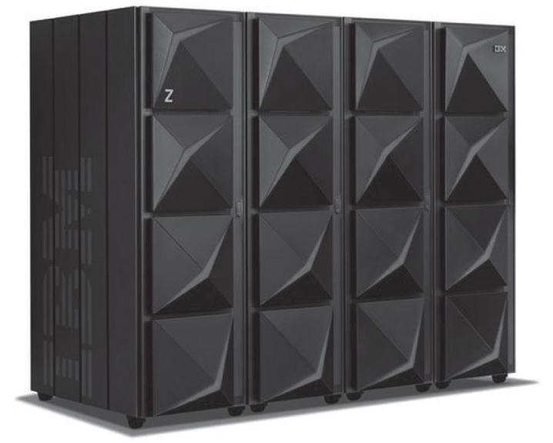
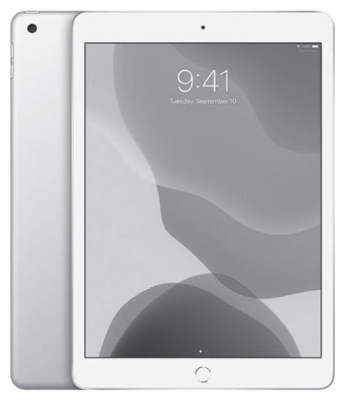
Computer Systems Examples
IBM System z15 T01 EC Mainframe
Copyright 2021 John Wiley & Sons, Inc.
1-<number>
Notes:
"As a specific example, the large z15 T01 IBM mainframe computer shown in this Figure can provide complex Web services to thousands of users at a time.
Mainframe: 512 GB up to 40 TB primary storage. can have 190 CPUs working together
Apple Ipad: 3GB RAM storage.
Z15 T01 is capable of executing instructions at rates of up to hundreds of billions of instructions per second!
The powerful z/OS operating system can keep track of hundreds or thousands of simultaneous users and divides the time among them to satisfy their differing requirements.
In addition to the CPU, there are many large I/O devices—including tape drives and high‐speed printers—and disks and solid‐state devices that store essentially unlimited amounts of data. The biggest version of this computer alone weighs over 6000 pounds/2800 kilograms!
In contrast, the Apple iPad tablet is designed for personal use. Everything is self‐contained in one hand‐held package. This system only has 3 GB of primary RAM storage and operates at a small fraction of the speed of the z15. Long‐term storage is 128 GB of solid‐state memory. The entire system, complete with display screen, built‐in webcams, multiple network connections, including an optional cellular connection, and battery, weighs about 1.1 pounds (0.49 kilograms, if you prefer).
They are different but not in the concept and different is about the applications. The fundamental system architecture is same. The actual processing of cpu is also same. The large system operates much faster, can support much more memory, and handles more input and output much faster. It has operating system software that allows many users to share this larger resource.

Slide 22
Virtualization
Virtual (American Heritage Dictionary
  Existing or result in essence or effect though not in actual fact, form or name
  Created, simulated, or carried on by means of a computer or computer network
Computer systems examples
  Virtual memory
  Virtual networks
  Java Virtual Machine
Copyright 2021 John Wiley & Sons, Inc.
1-<number>
Notes:
The word “virtual” appears frequently throughout the computer literature in many different contexts.
The American Heritage Dictionary offers two applicable definitions of virtual that together describe the usage of the word in modern computing:
existing or resulting in essence or effect though not in actual fact, form, or name;
2. created, simulated, or carried on by means of a computer or computer network.
Wikipedia defines virtualization as “a broad term that refers to the abstraction of computer resources”.
We can name a few applications same as virtual computers, a Java Virtual Machine (JVM), virtual memory, and virtual networks.
-Sometimes, a synonymous word, logical, is used instead: in networking we have logical connections.
-Virtual storage consists of a relationship between logical memory and physical memory.
In essence, virtual and logical are used to refer to something that appears as though it is something different.
Thus, the Java Virtual Machine uses software to simulate a real computer that works well with the Java programming language, even though the actual computer executes a different set of instructions than the JVM.
A logical connection in networking offers the appearance of a direct communication link for passing data between two computers, even though the actual connection might involve a complex series of interconnections involving many computers and other devices and a variety of software to make it all look simple

Slide 23
Standards
Created to ensure universal compatibility of data formats and protocols
May be created by committee or may become a de facto standard through popular use
Examples:
  Computer languages: Java, SQL, C, JavaScript
  Display standards: Postscript, MPEG-2, JPEG, PNG
  Character set standards: ASCII, Unicode, EBCDIC
  Multimedia standards: MPEG-2, MPEG-4, MP3, DVD-ROM
Copyright 2021 John Wiley & Sons, Inc.
1-<number>
Notes:
Standards are agreements among interested parties, often manufacturers, to assure that various system components will work together interchangeably. Standards make it possible to build a computer with components from different suppliers,
Standards apply to every aspect of computing: hardware, software, data, and communications; the voltage of a power supply; the physical spacing of pins on a connector; the format of a file; and the pulses generated by a mouse.
Standards can arise in many different ways. Many standards occur naturally: a proprietary data format, belonging to a single vendor, becomes a de facto standard due to the popularity of the product. The PDF print description language is an example. Other standards are created because of the requirements in that area where no standard exists.
a committee can investigate the requirements and create the standard. The MPEG-2 and MPEG-4 standards. The JPEG photographic standard and MP3 and MP4 sound standards are other examples of standards that were developed formally.
- Computer language standards, such as Java and SQL, allow programs written on one type of computer to execute properly and consistently on another, and also make it possible for programmers to work together to create and maintain programs.
data format and data presentation standards, such as the PNG and JPEG image format standards,
the Unicode text format standard, and
the HTML and XML Web presentation standards, allow different systems to manipulate and display data in a consistent manner.

Slide 24
Protocols
Common ground rules of communication between computers, I/O devices, and many software programs
Examples
  HTTP: between Web servers and Web browsers
  TCP/IP: between computers on the Internet and local area networks
  SATA: between storage devices and computers
  XML,RSS, SIP: new protocols developed to meet new demands
Copyright 2021 John Wiley & Sons, Inc.
1-<number>
Notes:
Protocols define the specific agreed-upon sets of ground rules that make it possible for a communication to take place.
Protocols exist for communications between computers, for the communications between various I/O devices and a computer, and for communications between many software programs.
A protocol specification defines such communication features as data representation, signaling characteristics, message format, meanings of messages, identification and authentication, and error detection.
Protocols in a client–server system assure that requests are understood and fulfilled and that responses are interpreted correctly.
Although not always the case, protocols that are not standardized tend to die out from lack of use. In fact, international standards are often created to ensure that the protocols are universally compatible.
As an example, HTTP, HyperText Transfer Protocol, guides communication between Web servers and Web browsers on the Internet.
TCP IP:The movement of data through the Internet is controlled by a suite of protocols called TCP/IP (Transmission Control Protocol/Internet Protocol).
SATA:Storage devices communicate with a computer using a protocol called SATA. There are thousands of such protocols.
Serial ATA (Serial Advanced Technology Attachment or SATA) is a command and transport protocol that defines how data is transferred between a computer's motherboard and mass storage devices, such as hard disk drives (HDDs), optical drives and solid-state drives (SSDs).
XML, RSS, and SIP are all examples of protocols developed recently to meet new and changing demands.
Satellite telecasting, near-universal telephone communication, wireless communications, and the Internet all demonstrate powerful and useful technologies made possible by protocols and standards.

Slide 25
Early History
1642: Blaise Pascal invents a calculating machine
1801: Joseph Marie Jacquard invents a loom that uses punch cards (first application)
1800’s:
  Charles Babbage attempts to build an analytical engine (mechanical computer)
  Augusta Ada Byron develops many of the fundamental concepts of programming
  George Boole invents Boolean logic
Copyright 2021 John Wiley & Sons, Inc.
1-<number>
Notes:
1.In the late 1500s, though, European inventors again started to put their minds to the problem of automatic calculation. Blaise Pascal, a noted French mathematician of the 1600s, invented a calculating machine in 1642 at the age of nineteen, although he was never able to construct the machine.
2.In 1801, Joseph Marie Jacquard invented a loom that used punched cards to control the patterns woven into cloth. The program provided by the punched cards controlled rods that raised and lowered different threads in the correct sequence to print a particular pattern. This is the first documented application of the use of some form of storage to hold a program for the use of a semi automated, programmable machine.
3.Charles Babbage, an English mathematician spent much of his own personal money to build a mechanical calculating machine that he called an “analytical engine”. The analytical engine resembles the modern computer in many conceptual ways.
4.Augusta Ada Byron, Countess of Lovelace and the daughter of the poet Lord Byron, worked closely with Babbage and developed many of the fundamental ideas of programming and program design, including the concepts of branches and loops.
,5.George Boole, developed the binary theory of logic that bears his name, Boolean logic. He also recognized the relationship between binary arithmetic and Boolean logic

Slide 26
Modern Computer Development
1937: Mark I is built (Aiken, Harvard University, IBM).
  First electronic computer using relays
1939: Atanasoff-Berry Computer (ABC) is built
  First fully electronic digital computer; used vacuum tubes
1943-46: ENIAC (Mauchly, Eckert, University of Pennsylvania).
  First general purpose digital computer
1945: Von Neumann architecture proposed
  Still the standard for present day computers
1947: Creation of the transistor
  (Bardeen, Shockley, Brattain, Bell Labs)
1951-2: EDVAC and IAS
Copyright 2021 John Wiley & Sons, Inc.
1-<number>
Notes:
. The Mark I, built in 1937 by Howard H. Aiken and associates at Harvard University with help and funding from IBM, used thousands of mechanical relays; relays are binary switches controlled by electrical currents to perform Boolean logic.
The first totally electronic digital computer was apparently devised by John V. Atanasoff, a physicist at Iowa State College, in 1937. The machine was built in 1939 by Atanasoff and a graduate student, Clifford Berry, using electronic vacuum tubes as the switching components. The machine was known as ABC, for Atanasoff-Berry Computer.
The ENIAC is generally considered to be the first all-electronic digital computer. It was designed and built between 1943 and 1946 by John W. Mauchly and J. Presper Eckert at the University of Pennsylvania, using the concepts that Mauchly had seen in Atanasoff’s machine, although this was not publicly known at the time. ENIAC had very limited storage capability,
In 1945, John von Neumann, a consultant on the ENIAC project, proposed a computer that included a number of significant improvements over the ENIAC design. The most important of these were 1. A memory that would hold both programs and data, the so-called stored program concept. 2. Binary processing of data. This simplified the design of the computer and allowed the use of binary memory for both instructions and data.The CPU was to include ALU, memory, and CU components. The control unit read instructions from memory and executed them. A method of handling I/O through the control unit was also established. Modern computer architecture is still referred to as von Neumann architecture.
All of these early electronic computers relied on the electronic vacuum tube for their operation. Vacuum tubes were bulky, made of glass, fragile, short-lived, and required large amounts of power to operate. Vacuum tubes require an internal electric heater to function, and the heaters tend to fail quickly.
6- Due to political intrigue two different versions of von Neumann’s architecture were designed and built, EDVAC at the University of Pennsylvania and IAS at the Princeton University Institute for Advanced Studies). Both machines were completed in 1951–1952. The success of EDVAC and IAS led to the development of several commercial computers, including the first IBM computers.

Slide 27
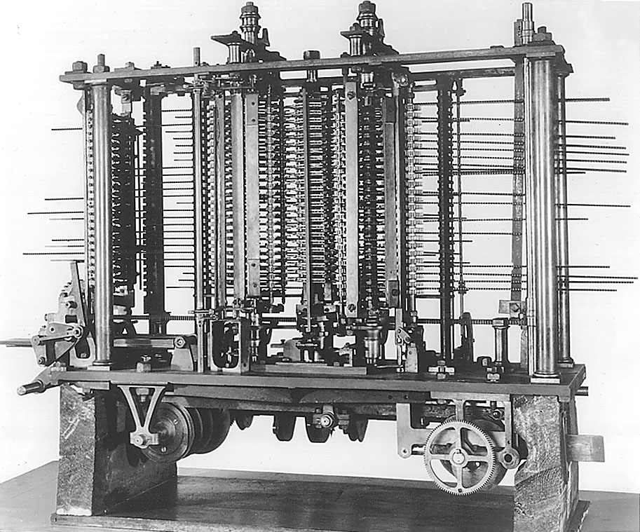
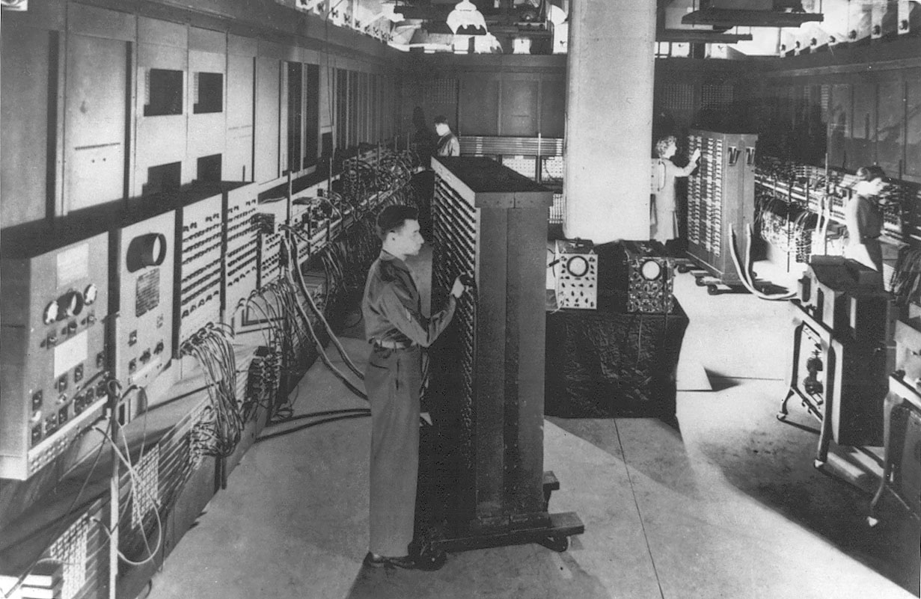
Early Computers
Babbage’s Analytical Engine
ENIAC
Copyright 2021 John Wiley & Sons, Inc.
1-<number>
Notes:
1.ENIAC contained eighteen thousand vacuum tubes, occupied a floor space of more than fifteen thousand square feet, and weighed more than thirty tons. A photograph of ENIAC, taken from The New York Times of February 15, 1946. EVEN in its day, ENIAC was recognized as an important achievement.
2.Charles Babbage, an English mathematician who lived in the early 1800s, spent much of his own personal fortune attempting to build a mechanical calculating machine that he called ananalytical engine”. The analytical engine resembles the modern computer in many conceptual ways.

Slide 28
System Software History
Early computers had no operating systems and were single user systems
  Programs were entered using switches for each bit or by plugging wires into a panel
1953-54: First operating system was built by General Motors Research Laboratories for their IBM 701 computer
Other early systems
  FORTRAN Monitor System (FMS)
  IBSYS
  Share Operating System (SOS)
Copyright 2021 John Wiley & Sons, Inc.
1-<number>
Notes:
Given how easy it is to communicate with computers today, it is hard to picture a time when the user had to do everything by hand, one step at a time.
Early computers had no operating systems. The user, who was also the programmer, entered a program by setting it, one word at a time.
In fact, as late as the mid-1970s, there were still vendors producing computer systems with no operating system and computer hardware that was still bootstrapped by entering the bootstrap program,
Many important development in operating system design occurred in the early 1960s

Slide 29
Operating System Development
1963: Master Control Program (MCP) by Burroughs
  Included many modern OS features
1964: OS/360 by IBM
  Included batch processing of programs
1962: MIT Project MAC created a time-sharing OS called CTSS
  Shortly afterwards, MIT, Bell Labs, and GE developed Multics (Multiplexed Information and Computing Services)
Copyright 2021 John Wiley & Sons, Inc.
1-<number>
Notes:
In 1963, Burroughs released its Master Control Program (MCP). MCP contained many of the features of modern systems, including high-level language facilities and support for multiprocessing (with two identical CPUs)
IBM introduced OS/360 as the operating system for its new System/360 in 1964. OS/360 provided a powerful language to expedite batch processing, JCL, or Job Control Language, and a simple form of multiprogramming that made it possible to load several jobs into memory, so that other jobs could use the CPU when one job was busy with I/O. By this time, disks were also becoming available, JCL is still used for batch processing.
In 1962, a group at MIT known as Project MAC introduced the concept of time-sharing with an experimental operating system called CTSS. Project MAC was one of the seminal centers for the development of computer science.
Shortly thereafter, MIT, Bell Labs, and GE formed a partnership to develop a major time-sharing system. The system was called MULTICS (Multiplexed Information and Computing Service), and although MULTICS couldn't be a major computer utility, many of the most important multitasking concepts and algorithms were developed by the MULTICS team. It was supplied for many years as the operating system for Honeywell computer systems.

Slide 30
UNIX
After Bell Labs withdrew from the Multics project, Ken Thompson developed a personal operating system called UNIX using assembly language
Dennis Ritchie developed the programming language C which was used to rewrite much of UNIX in a high-level language
UNIX introduced
  A hierarchical file system
  The shell concept
  Document production and formatting
  Tools for networked and distributed processing
Copyright 2021 John Wiley & Sons, Inc.
1-<number>
Notes:
1.When Bell Labs withdrew from the MULTICS project, Ken Thompson, a MULTICS researcher, turned to the development of a small personal operating system, which he called Unics, later UNIX, to contrast it from MULTICS.
2.He was later joined by Dennis Ritchie.
The original UNIX development was performed on a Digital PDP-7 minicomputer and later moved to a PDP-11 minicomputer, then to the Digital VAX computer. Originally, the system was written in assembly language, but Ritchie developed a new high-level language, which he called C, and the operating system was largely rewritten in C.
3. uNIX introduced many important OS concepts that are standard today, including
the hierarchical file system,
the shell concept, redirection, piping, and the use of simple commands that can be combined to perform powerful operations.
Thompson and Ritchie included facilities for document production and formatting, including such novelties as a spell checker and a grammar checker.
They created many inventive algorithms to improve operating system performance, developed techniques for interprocess communication,
and even provided tools for networked and distributed processing.
UNIX earned a reputation for power and flexibility. Because it was written in C, it was also easy to port it, that is, convert it for use, to other computers. As a result of these factors, UNIX became an important operating system for universities and was ultimately adopted, in many versions, by the commercial marketplace as well. UNIX and its direct derivatives, FreeBSD, Linux, and Android, continue to be of great importance, particularly due to UNIX’s flexibility in the area of networks and distributed systems.

Slide 31
Graphical User Interfaces
1960s: Doug Englebart (Stanford Research Institute)
  Invented windows and a mouse interface
1970s: Xerox PARC
  Creates a practical windowing system for the Dynabook project
1980s: Steve Jobs (Apple)
  Developed the Apple Lisa and Macintosh
Copyright 2021 John Wiley & Sons, Inc.
1-<number>
Notes:
1.Another important innovation, some would say the most important development in making the computer accessible to nontechnical users, was the development of the concept of graphical user interfaces. Most historians would credit the invention of the windows and mouse interface to Doug Englebart in the 1960s, at Stanford Research Institute.
2.A practical windowing system was built in the 1970s by Alan Kay and others at Xerox PARC (Palo Alto Research Center), as part of a visionary computer concept known as the Dynabook project. Conceptually, the Dynabook is the direct forerunner of today’s smartphones, tablets, and E-books. The original intention of Dynabook was to develop a book-sized personal computer with a high-resolution color display and wireless communication that would provide computer capabilities (particularly secretarial), games, e-mail, and a reference library.
It is believed that a visit to Xerox PARC by Steve Jobs, the founder of Apple, in 1979, inspired the development of the Apple Lisa and, subsequently, the Apple Macintosh.

Slide 32
IBM PC
1982: Stand-alone, single user computer
PC-DOS, MS-DOS (disk operating system)
Later versions of DOS added
  Hierarchical directory file storage
  File redirection
  Better memory management
Windowing systems
  Windows 2.0, Windows 3.1, Windows 95
  Windows NT, Windows XP, Windows Vista
  Windows 8 and 10
Copyright 2021 John Wiley & Sons, Inc.
1-<number>
Notes:
1.in 1982 The IBM PC was designed as a stand-alone, single-user computer for the mass market. The IBM PC was supplied with a reasonably easy-to-use operating system.
2.PC-DOS, which was developed and also later marketed by Microsoft as MS-DOS. PC-DOS was actually derived from an earlier personal computer operating system, CP/M (Control Program for Microcomputers),
3.With later versions, Microsoft made many improvements, including hierarchical directory file storage, file redirection, better memory management, and an improved and expanded command set.
4.Many of these improvements were derived from UNIX innovations. With the addition of Englebart and Kay’s user interface innovations, MS-DOS has gradually evolved into Windows NT and Windows XP, and most recently, Windows 10.

Slide 33
Communications
1960s and 1970s: users communicated on multiterminal computer systems using talk and email facilities
1971: Ray Tomlinson creates the standard username@hostname email standard
Modems permitted users to login to office systems, electronic bulletin board systems, Compuserve, AOL, and Prodigy
1969: ARPANET begun
1985: First TCP/IP wide area network
1991: Tim Berners Lee develops the concepts that become the World Wide Web
1993: Max Andreessen develops Mosaic, the first graphical browser
Copyright 2021 John Wiley & Sons, Inc.
1-<number>
Notes:
1.in 1971, Ray Tomlinson created the standard username@hostname format that is still in use today.
2. As modems became available for users to log into their office systems from home and computers became more affordable, software innovators developed bulletin board systems, newsgroups, and discussion boards, where users could dial in and leave and retrieve messages. Gradually, it became possible to support modems on multiple lines, and affordable real-time “chat rooms” became possible.
t. Much of the modern history of networking and communication can be traced back to two specific developments:
a research project, ARPANET, whose goal was to connect computers at various universities and research centers, funded starting in 1969 by the U.S. Defense Department and later by the National Science Foundation and other groups, and
(2) the development of the Ethernet by Robert Metcalfe, David Boggs, and others, which started at Xerox PARC in 1973. The ARPANET project was responsible for the design of TCP/IP, which was first tested in 1974, and issued as an international standard in 1981

