Slide 1





HealthCare-Provider-Fraud-Detection-Project Machine Learning Winter 2025
By:
Abdelhamid Elnaggar
Adham Barakat
Sherif Ahmed Halawa
Omar Bassem Talaat Mustafa

Slide 2
OUTLINE
DATA EXPLORATION AND FEATURE ENGINEERING
MODELING
EVALUATION

Slide 3
Data exploration and feature engineering.
Goal: Detect fraudulent Medicare providers using claim-leveldata
Data Sources: Beneficiary, Inpatient, Outpatient, and Labelsdatasets
Target Variable: PotentialFraud (Yes/No)

Slide 4
Data quality check (checking for missing values and duplicates
Beneficiary Data
Shape: (138,556, 25)
Missing: DOD (98.97%)
Duplicates: 0
Inpatient Data
Shape: (40,474, 30)
Missing: High in OtherPhysician, OperatingPhysician, and procedure/diagnosis codes
Duplicates: 0
Outpatient Data
Shape: (119,605, 27)
Missing: Extensive in diagnosis and procedure codes
Duplicates: 0

Slide 5
Preprocessing & Merging
Combined inpatient and outpatient claims → claims_df (160,079 rows)
Merged with beneficiary data on BeneID → full_df (160,079 rows, 55 columns)

Slide 6
Feature Engineering (Provider Level)
Aggregated by Provider to create:
Claim Volume: Total, Inpatient, Outpatient
Financials: Total/Avg Reimbursed, Deductibles
Network: Unique Beneficiaries, Attending Physicians
Patient Profile: Avg Age, Chronic Conditions
Geography: Most Common State
Final shape: provider_df → (4,956, 24)

Slide 7
Final dataset
Merged with fraud labels → final_df
Encoded PotentialFraud: Yes → 1, No → 0
Final shape: (4,956, 25)

Slide 8
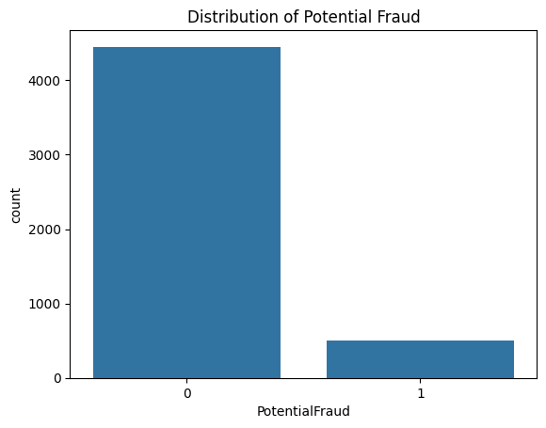
Class Imbalance
Fraudulent Providers(1): 10.2%
Non-Fraudulent Providers(0): 89.8%
Imbalance highlights need for careful model evaluation

Slide 9
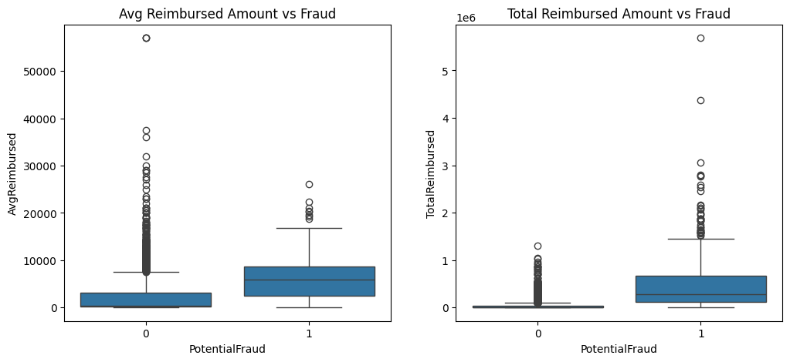
Financials vs Fraud
Avg Reimbursed Amount
Non-Fraudulent Providers (0): Lower median reimbursement, tighter distribution.
Fraudulent Providers (1):
Higher median average reimbursement.
Wider interquartile range → more variability.
Numerous outliers → some providers consistently claim unusually high amounts.
Insight: Fraudulent providers tend to submit claims with higher average reimbursement per claim, suggesting possible inflation or manipulation of individual claim values.
Total Reimbursed Amount
Non-Fraudulent Providers (0): Lower total reimbursement, fewer extreme values.
Fraudulent Providers (1):
Significantly higher total reimbursement.
Greater spread and more extreme outliers.
Insight: Fraudulent providers not only inflate individual claims but also accumulate much larger total reimbursements, possibly due to high claim volume or bundling strategies.

Slide 10
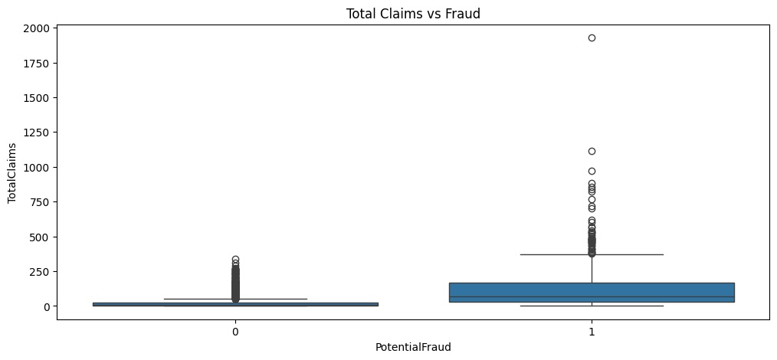
Claims Volume vs Fraud
Non-Fraudulent Providers (0):
Lower median number of claims.
Narrow interquartile range → consistent claim behavior.
Few outliers → most providers operate within expected bounds.
Fraudulent Providers (1):
Higher median claim count.
Wider interquartile range → more variability in claim volume.
Numerous extreme outliers → some providers submit up to ~2000 claims.

Slide 11
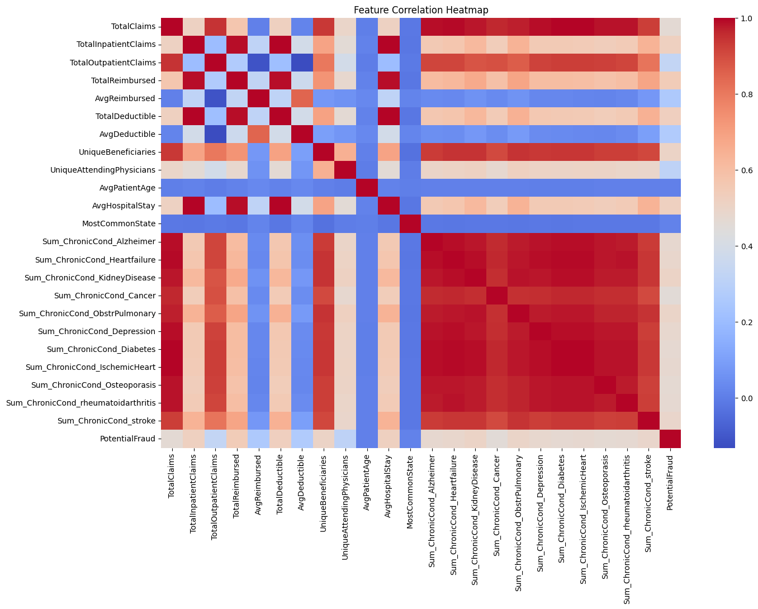
Correlation Heatmap
Strong Positive Correlation (Red):
Features move together — when one increases, the other tends to increase.
Example: TotalClaims ↔ TotalReimbursed
Weak or No Correlation (Blue/Neutral):
Features behave independently.
Example: MostCommonState ↔ AvgDeductible
Clusters of Red Blocks:
Indicate groups of features that are tightly linked — useful for dimensionality reduction or feature grouping.

Slide 12
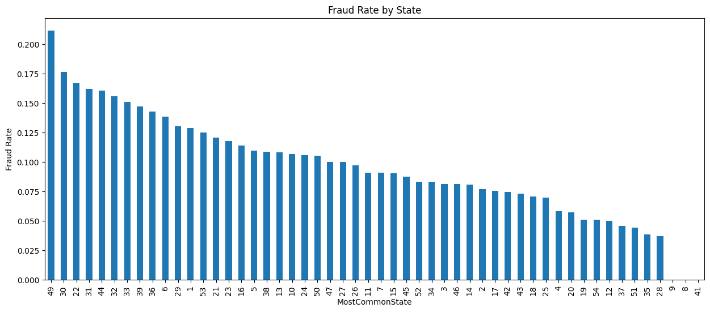
Geographic Fraud Patterns
State 49 has the highest fraud rate, exceeding 20%.
State 41 has the lowest fraud rate, below 4%.
There's a noticeable regional disparity in fraud prevalence.
Geographic variation may reflect:
Differences in regulatory oversight
Provider behavior or claim practices
Access to healthcare services or systemic vulnerabilities
This chart shows the fraud rate by state, based on the most common patient state per provider.
States are represented by numerical codes, sorted from highest to lowest fraud rate.

Slide 13
Modeling
We import all the libraries which will be used in the modeling.
Load the processed data in the .csv file which we got from the data exploration.
Split data into 80% for Training and 20% for testing.
Handling missing values , Standardizing the data
Numerical values = median
while we ignore the value of categorical

Slide 14
Model training
We tested three models :
1-logistic regression.
2-Random Forrest.
3-Gradient Boosting.
We used the SMOTE to handle class imbalance

Slide 15
Results
Training Logistic Regression...
Logistic Regression Results:
ROC AUC: 0.9554
PR AUC: 0.7570
Training Random Forest...
Random Forest Results:
ROC AUC: 0.9429
PR AUC: 0.6962
Gradient Boosting Results:
ROC AUC: 0.9410
PR AUC: 0.7290

Slide 16
Hyperparameter tuning (random forest)
param_dist = {
'classifier__n_estimators': [100, 200, 300],
'classifier__max_depth': [None, 10, 20, 30],
'classifier__min_samples_split': [2, 5, 10],
'classifier__min_samples_leaf': [1, 2, 4]
}
Best Params: number of estimators : 300,
Minimum samples split : 5,
Minimum samples leaf : 2,
Maximum depth : 30

Slide 17
Best Model
The best model which was chosen was the
tuned Random Forest model.
saves it to (test_predictions.csv )for analysis in the evaluation notebook.

Slide 18
Model Evaluation Overview
Evaluate model predictions
Interpret metrics
Analyze mistakes
Estimate financial impact

Slide 19
Key Performance Metrics
Precision: 0.52
→ When we predict fraud, we are correct 52% of the time.
Recall: 0.7723
→ We catch 77% of actual fraud cases.
→ This is strong and very important — missing fraud is costly.
F1 Score: 0.6215
→ Balanced measure of precision and recall.
ROC-AUC: 0.9464
→ Excellent separation between fraud vs non-fraud.
PR-AUC: 0.7370
→ Most important metric for imbalanced data.
→ Shows strong ability to detect rare fraud cases.
Even though precision is moderate, recall is high, which is what matters most in fraud detection

Slide 20
Confusion Matrix
TP (78): Correctly caught fraud
TN (909): Correctly cleared legitimate providers
FP (72): Investigated providers that were actually clean
FN (23): Fraud we missed — the worst outcome
False negatives (23) are the biggest risk because they represent real fraud that continues unnoticed

Slide 21
Cost Analysis
Assigned costs:
False Negative = $10,000
False Positive = $1,000
Calculated cost:
FN cost = 23 × 10,000 = $230,000
FP cost = 72 × 1,000 = $72,000
Total model cost = $302,000
“Even though false positives are more frequent, false negatives are much more expensive.
One missed fraud case costs the same as ten false alarms

Slide 22
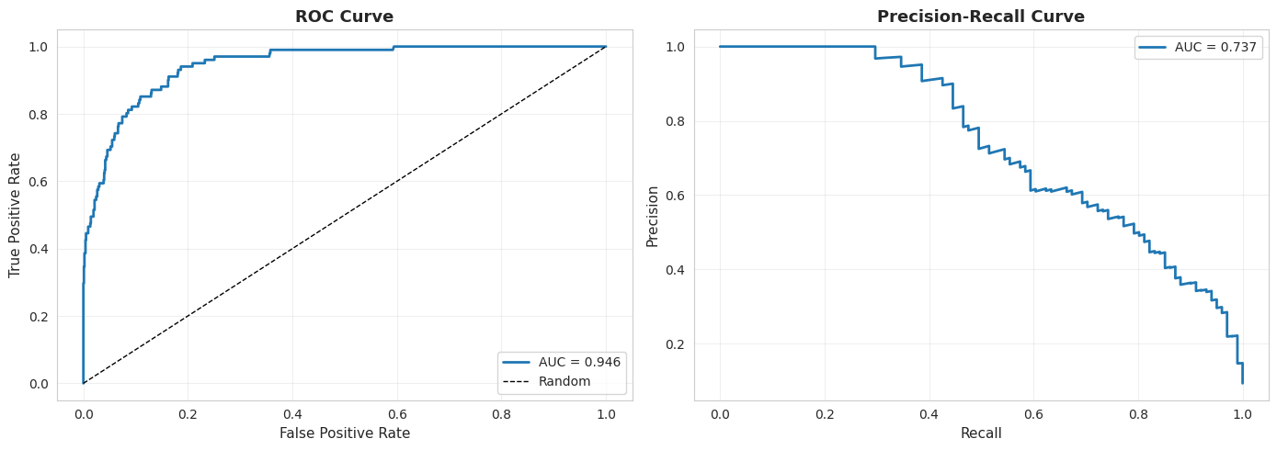
A. ROC Curve Explanation
→The ROC curve plots True Positive Rate (Recall) vs False Positive Rate.
→our ROC-AUC = 0.946 → Very high.
This indicates:
The model is excellent at ranking fraud cases above non-fraud cases.
→The curve rises steeply toward the top-left corner → Strong discrimination performance.
B. Precision-Recall Curve Explanation
→PR curve is preferred when dealing with imbalanced data like fraud detection.
→PR-AUC = 0.737, which is very strong given ~10% fraud prevalence.
→High precision at low recall early in the curve →
When the model predicts fraud, it is usually correct.
→Recall gradually increases →
Model can catch a large portion of fraud cases before precision collapses.
→This shows that:
The model performs very well even under class imbalance.
High precision + good recall = effective real-world fraud detection.

Slide 23
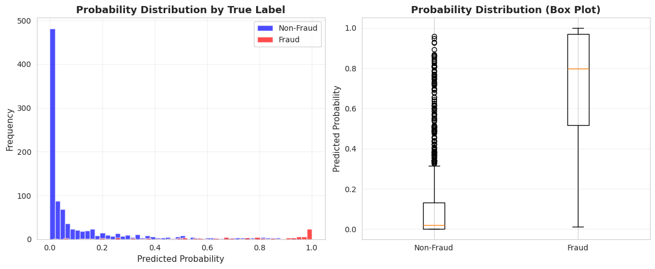
A. Histogram – "Probability Distribution by True Label"
→The blue bars (Non-Fraud providers) are heavily concentrated near 0.0–0.05, meaning
the model assigns very low fraud probabilities to most legitimate providers.
→The red bars (Fraud providers) are mostly placed around 0.7–1.0, indicating
fraudulent providers tend to get high predicted probabilities.
→There is a clear separation between the two groups, which means:
Overall:
This is a strong sign that our underlying model and features are truly capturing fraudulent behavior patterns.
B. Boxplot – "Probability Distribution (Box Plot)"
The Non-Fraud box is extremely compressed near 0.0 with some right-tail outliers.
→ This means almost all legitimate providers receive very low predictions.
The Fraud box has a high median (~0.75) and spans a higher probability range.
→ This indicates fraud predictions are consistently high for true fraud cases.
Overall:
Fraud and non-fraud providers have clearly different probability distributions.
The model provides well-separated scores — ideal for threshold tuning.

Slide 24
Final Insights & Takeaways
Model achieves high recall and strong PR-AUC, meaning it performs well where it matters most.
23 false negatives create the majority of the financial cost.
Precision is moderate (0.52), meaning some legitimate providers are flagged — but that’s acceptable in fraud detection.
Top false positives had very high fraud probabilities → model found them suspicious but they weren’t actually fraud.
Top false negatives had very low predicted probabilities → these are the tricky, subtle fraud cases.
Our evaluation shows the model works well overall, but future improvements should focus on reducing false negatives to lower the total cost

Slide 25

THE END

