Slide 1
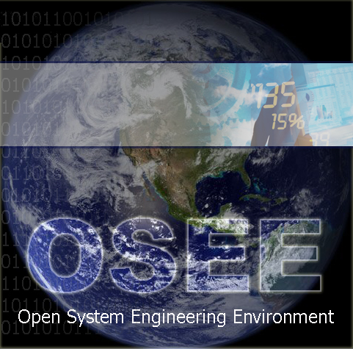
The Cure for Your Disconnected Toolset Headache
http://www.eclipse.org/osee/
2012-03-21
Ryan Brooks
Don Dunne

Slide 2
Disconnected Toolset Headache
Typically a large program that develops complex systems assembles a wide array of software products to provide piecemeal capabilities necessary for completing different stages of the engineering lifecycle.
Once installed, the daunting task of configuring and gluing them together begins. The resulting tools are disconnected, sporadically maintained, and use an overwhelming array of disjointed user interfaces to access partially redundant data.
Traditional approach to integration: point-to-point tool integration
OSEE approach: data-centric integration

Slide 3
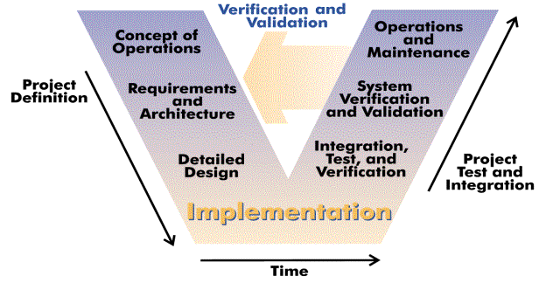
V-Model / Systems Engineering
The Open System Engineering Environment is a tightly integrated environment supporting the application of lean principles across a product's full life-cycle in the context of an overall systems engineering approach. It is integrated around a simple, user-definable data model providing end-to-end bidirectional traceability.
Notes:
Systems engineering is defined as "a branch of engineering whose responsibility is creating and executing an interdisciplinary process to ensure that customer and stakeholder's needs are satisfied in a high quality, trustworthy, cost efficient and schedule compliant manner throughout a system's entire life cycle, from development to operation to disposal.” INCOSE
Although OSEE was born out of Engineering Flight Software for Boeing Apache Attack Helicopter, it can be applied to any development effort that would benefit from systems engineering. OSEE is not just for Avionics Platforms.
No matter the size, it’s imperative to ensure that customer requirements are being met. For many projects, this is an after-thought or something to verify at delivery. This is due to complexity of tracking requirements all the way down to application code and unit tests.
With the ability to store and relate all the data at time of creation, it is possible to maintain and ensure that requirements are being decomposed and met and see live metrics throughout the project.
Open Source Extensible Platform
Open Eclipse Project w/ Collaboration
Tight Integration Around A Common Data Model
Full Lifecycle Engineering Environment

Slide 4








Eclipse Foundation
OSEE is an open source project hosted by the Eclipse Foundation
The OSEE project has 11 committers
All Eclipse projects:
1000+ committers
representing 60+ organizations
working on 200+ projects
180+ member organizations
Strategic Developers:
Notes:
Fully Extensible through Eclipse Extension Points

Slide 5
Applications / Extensible Framework
Third-Party Extensions and Legacy Software
Conflict Detection
Export / Import
Safety Analysis
Project Mgmt / Planning
Parallel Development
Change Reports
Workflow Config
Metrics
Rich Traceability
Process Mgmt
Document Mgmt
Requirement Mgmt
Visualization
Blam Operations
Rules Framework
Publishing
Variant Management
Messaging
Results Analyzer
Real Time Testing
Unit Testing
Reporting
Access Control
Task Scheduling
Database Analyzer
Training Services
Exemplary Applications Extensible Framework
Structural
Coverage
Configuration
Management
Systems
Engineering
Requirements
Management
Testing
Environment
OSEE Application Framework
Jetty
Xtext
Plugin Dev Utilities
Extensible Rendering
Remote Event Service
Indexing & Tagging
Dynamic Searching API
Dynamic Artifact Model
Multi-Level Transactions
Multi-Level Branching
Data Store Adapter
Access Control
Version Control
User Mgmt & Authentication
Object-Oriented Persistence
Web Tools Platform
BIRT
Nebula
CDT
JDT
Other
Eclipse Platform
Java Virtual Machine
Relational DB (Oracle, PostGreSQL, H2)
Operating System (Windows, Linux, OSX, Solaris)
Notes:
OSEE’s Architecture extends the Eclilpse Platform and provides it’s own extensions for use by the Applications that are built on top.
OSEE Application Framework provides the services necessary for the applications to share the common data model
Custom, Non-Engineering Environment Applications can be built on OSEE Application Framework and delivered to customers
OR Additional Applications can be plugged in to enhance OSEE’s already existing applications

Slide 6
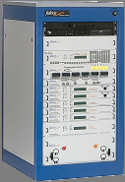
OSEE Architecture
HTTP
OSEE Application Servers
Web Clients
Arbitration Server
with Load Balancing
http://osee.organization.com
HTTP
RESTful API (JAX-RS)
Web UI (Vaadin)
Application Business Logic
HTTP
HTTP
Core Services (search,
authentication, admin, etc.)
Active MQ
Message Broker
Artifact Data Model
Eclipse IDE
Clients
JMS
Xtext-defined Type Model
Transactional Persistence
and Branching Service
UDP
UDP
JMS
JMS
NFS
JDBC
Test Station
With Physical I/O
Versioned
Object
Datastore
Soft Real-time
OSEE
Test
Environment
Server
Relational DB
Simulated OSEE
Test Environment
Server
Attribute
Value
Store

Slide 7
Systems Engineering Data Model
Functional Analysis
Requirements
Product Decomposition
Tier 1:
System
System
Function
System
Requirement
System
Design
System
Design
Design
Allocation
Dependency
Requirement Trace
Hierarchical
Subsystem
Function
Tier 2:
Subsystem
Design
Subsystem
Requirement
Subsystem
Subsystem
Subsystem
Design
Design
Allocation
Hierarchical
Hierarchical
Requirement Trace
Tier 3:
Component
Software
Design
Software
Requirement
Software
Component
Hardware
Component
Software
Component
Design
Verification
Verification
Allocation
Hierarchical
Test
Procedure
Hardware
Requirement
Automated
Test
Software
Unit

Slide 8
Manage Variants / Product Lines
Edit Artifacts / Change Report
Merge
Create Branch
Flag Ship Program Build 1
Commit
Working Branches
Transactions
Flag Ship Program – Build 2
Flag Ship Program – Build 3
Baseline Branches
Introduce
International Program X – Build 1
International Program X – Build 2
Common Branch ( User Artifacts, Action Data, etc…)
Time →

Slide 9
Simple, User-definable Data Model
Artifact
Software Requirement
Name: Display Versions
Design Assurance Level: E
Paragraph number: 1.1
Test Unit
Name: VersionTester
Source: <source code>
Attribute
Verification
Relation

Slide 10
Transaction-Based Revision Control
Transaction based version control with fine grained change identification
Transaction: 1000021
Timestamp: Mar 4, 2008
Author: Terry Bahill
My Requirement
My Code unit
Time
Transaction: 1000020
Timestamp: Mar 3, 2008
Author: Alan Turing
My Requirement
My Code unit
My Test unit
Transaction: 1000019
Timestamp: Mar 2, 2008
Author: Terry Bahill
My Requirement

Slide 11
Safety and Mission Critical Systems
Structural Coverage Analysis
Test Environment coordinates with mission software to capture raw coverage data
Raw coverage data is imported and merged into OSEE Database
ATS used to disposition coverage methods
ATS provides tracking of code, test, and requirements changes needed to resolve missing coverage
Auto generation of coverage reports for delivery to customer
Safety Critical Analysis
Traceability thread from System and Subsystem functions through all levels of requirements down to code units
Safety Criticality and Development Assurance Level

Slide 12
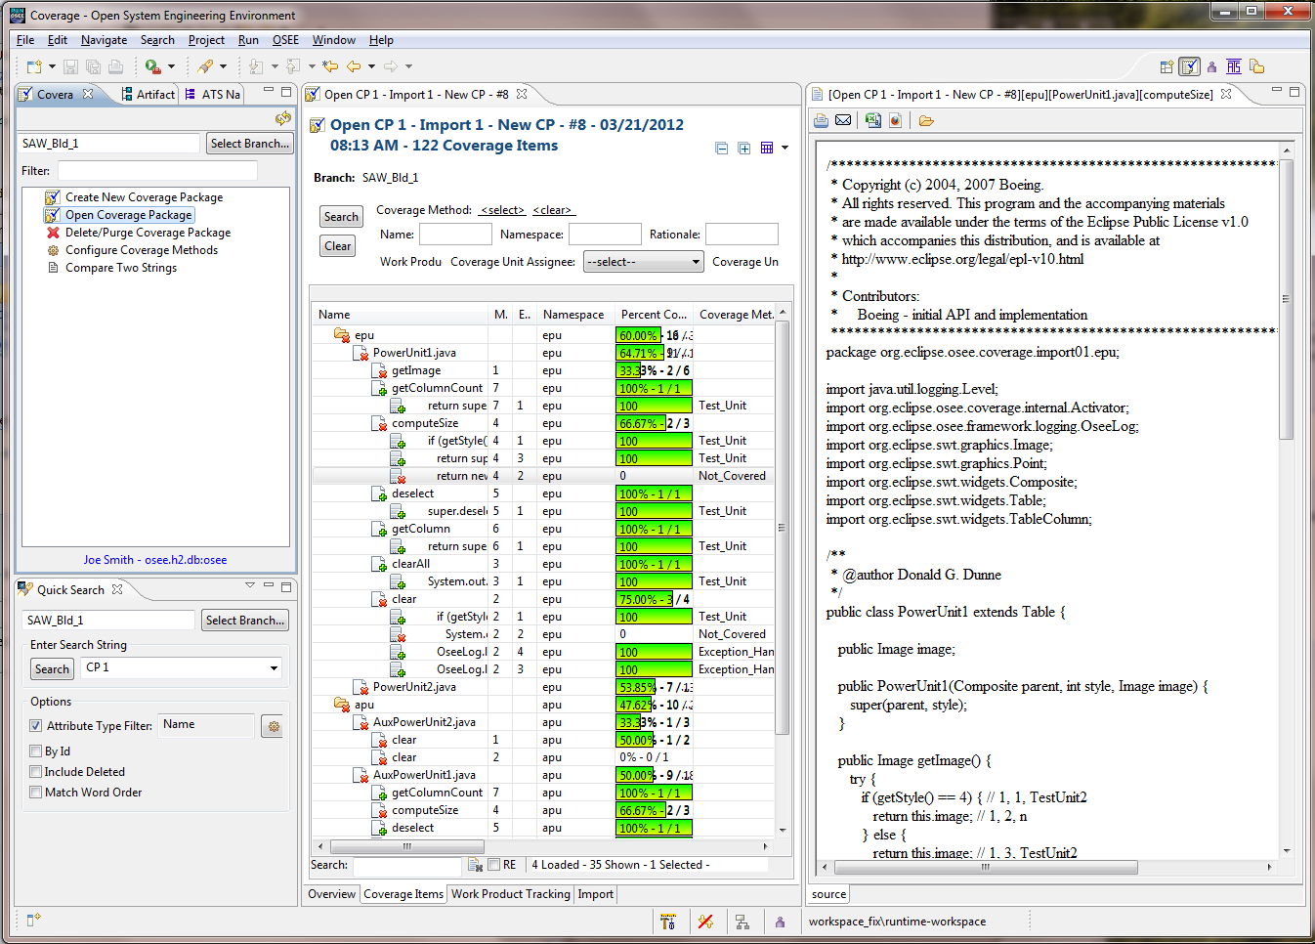

Slide 13
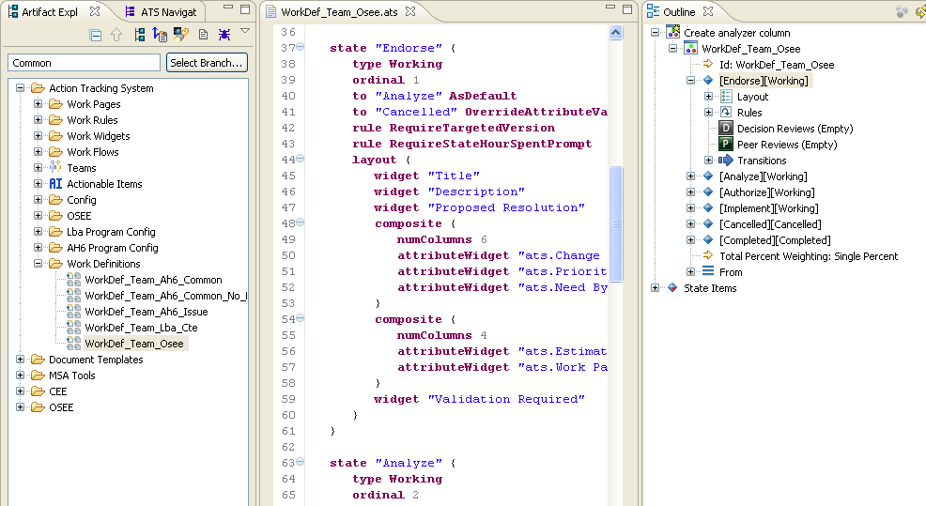
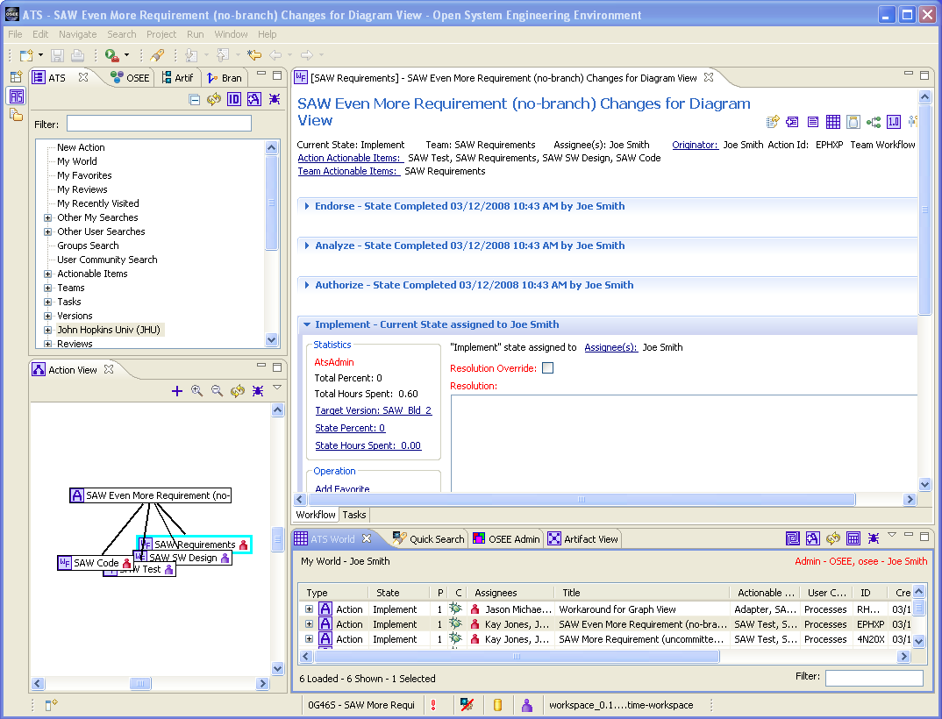
Integrated Process and Workflow
Integrated processes and workflows in OSEE allow engineers to focus more on engineering and less on process training and manual metrics reporting.
Work Definitions model the team's workflow and actively guide them through the work to be completed.
Work Definitions are created and stored in OSEE and consist of state machines with their own widgets, rules, and routing.
Each state can be assigned, statused, and transitioned.

Slide 14
Integrated Metrics and Project Planning
Integrated Metrics and Project planning
task generation - metircs Task status rolls up to Action and project status,
product management including build memo
Release reports - org.eclipse.osee.ats.navigate.report.PublishFullVersionReportItem
ATS - A powerful and tightly integrated change tracking system within OSEE that manages changes throughout the different aspects of a program’s lifecycle while ensuring integrated and automated workflow, processes and traceability.
Xviewer - Reports can be emailed, printed and exported to Excel for external use; Customizable column order, visibility, title stored globally or locally

Slide 15
ATS
Integrated customizable reviews that can be configured to be generated for any state and control state transition
Email notifications of state transitions and Users can subscribe to notifications of Action activity
Built-in configuration to automatically routing actions to appropriate leads / team members.
"My World" shows all work assigned to the user
Powerful Action querying, filtering and sorting

Slide 16
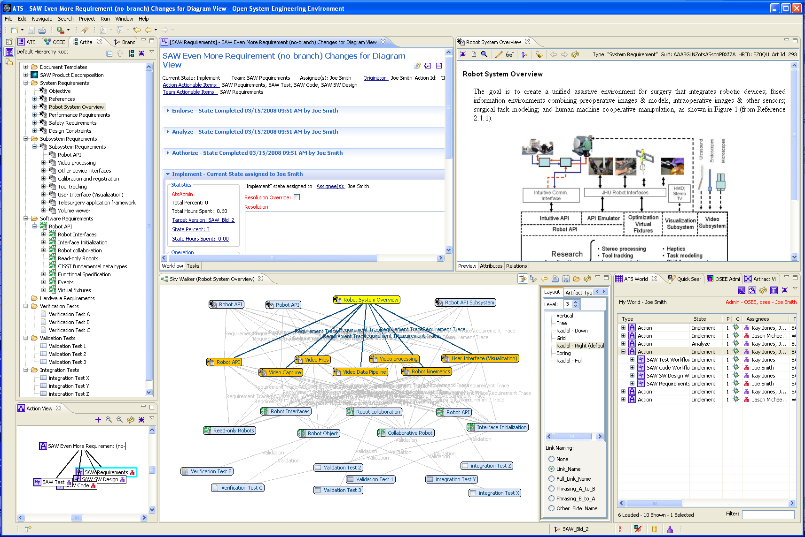
Traceability Demo

Slide 17
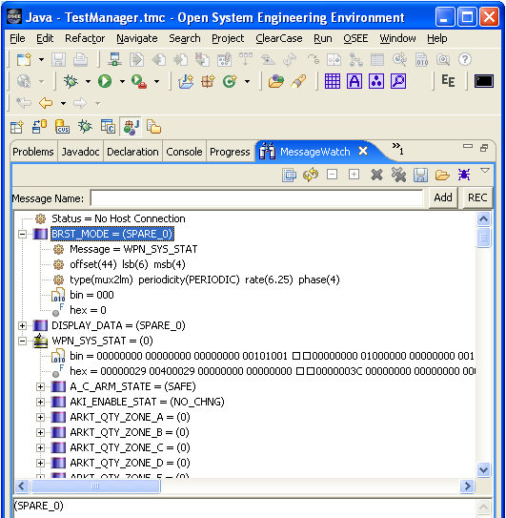
OSEE Test Environment
Real-time messaging:
Monitor
Manipulate
Simulate
Record
Playback

Slide 18
OSEE Application Framework
Requirements
Management
Modeling
Design
Implementation
(JDT,CDT,ADT…)
Validation
Integration
Verification
OSEE Application Framework
Access
Control
Extensible
Rendering
Remote Event
Service
Multi Level
Transaction
Multi Level
Branching
Advanced
Searching

Slide 19
Developing in a More Integrated Way
“The historical way of developing products just doesn't work when you're as ambitious as we are. When the challenges are that complex, you have to develop a product in a more collaborative, integrated way.”¹
--
Jonathan Ive, head of design – Apple
Engineering a product in a more collaborative, integrated way requires an environment that is itself tightly integrated.
¹ Grossman, Lev. "How Apple Does It" Time 24 Oct 2005. <http://www.time.com/time/archive/preview/0,10987,1118384,00.html>.

Slide 20
Key Project Activities and Timeline
Nov 2004 – OSEE Test Environment first used for requirements verification in simulated environment
EclipseCon 2007 – Explored idea for Eclipse project
Jul 10, 2007 – Project proposal approved
Aug 10, 2007 – Incubation Phase (conforming)
Nov 8, 2007 – Delivered OSEE w/database to US Army
Dec 8, 2007 – Initial source commit (140K LOC)
Jun 27, 2008 – First flight of next generation Apache Helicopter represents major maturity milestone for OSEE
Jun 17, 2009 – Initial source commit (45K LOC) of OSEE Test Environment for soft real-time and simulated testing
Nov 2010 – OSEE deployed on AH-6 program
Oct 2011 – Initial deployment of OSEE Web for US Army
Mar 2012 – BOSCH-RBEI extends OSEE for Automotive industry
Apr 2012 – BOSCH-RBEI contributes LDAP integration for OSEE

Slide 21
Why OSEE?
Overall systems engineering approach across the full life-cycle
Tight Integration Around a Common Data Model
Highly extensible and tightly integrated version control and change management
Open Source Extensible Platform leveraging Eclipse
Benefits of Collaboration through an Eclipse Project
Consistent user interface across engineering areas
Processes integrated into toolset including change management of processes

