Slide 1
What is Logistic Regression?
• Supervised learning algorithm
• Used for binary classification
• Predicts probability (0 to 1)
• Uses sigmoid function

Slide 2
Why Logistic Regression?
• Linear regression fails for classification
• Handles non-linearity
• Interpretable model

Slide 3
Problem Type
• Binary Classification
• Examples:
- Titanic Survival
- Spam Detection
- Disease Prediction

Slide 4
Model Equation
z = b0 + b1x1 + b2x2 + ... + bnxn

Slide 5
Sigmoid Function
σ(z) = 1 / (1 + e^(-z))
• Converts z to probability
• Output range (0,1)

Slide 6
Decision Rule
• Threshold = 0.5
• P ≥ 0.5 → Class 1
• P < 0.5 → Class 0

Slide 7
Odds & Log-Odds
Odds = P / (1 − P)
Logit = log(P / (1 − P))

Slide 8
Loss Function
Binary Cross Entropy:
Loss = −[y log(p) + (1 − y) log(1 − p)]

Slide 9
Optimization
• Gradient Descent
• Learning Rate α
• Iterative updates

Slide 10
Parameter Update
b = b − α (∂Loss / ∂b)

Slide 11
Titanic Dataset
Features:
• Age
• Fare
Target:
• Survived

Slide 12
Example Values
b0 = −3
b1 = −0.04 (Age)
b2 = 0.03 (Fare)
Age = 25, Fare = 60

Slide 13
Step 1: Compute z
z = −3 − (0.04 × 25) + (0.03 × 60)
z = −2.2

Slide 14
Step 2: Sigmoid Output
P = 1 / (1 + e^(2.2))
P ≈ 0.10

Slide 15
Prediction
• Probability = 10%
• Predicted: Did NOT survive

Slide 16
Evaluation Metrics
• Accuracy
• Precision
• Recall
• F1-score
• ROC-AUC

Slide 17
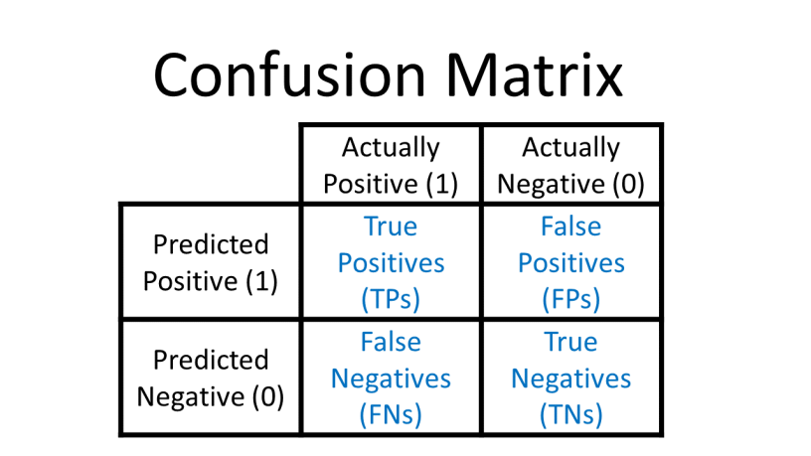
Confusion Matrix
TP | FP
FN | TN

Slide 18
Regularization
• L1 (Lasso)
Adds the sum of the absolute values of the coefficients as a penalty term to the loss function. It can drive some coefficients to exactly zero, effectively performing feature selection.
• L2 (Ridge)
Adds the squared magnitude of coefficients as a penalty term to the loss function. It reduces the complexity of the model by making the coefficients smaller but rarely sets them to zero.
• Prevents overfitting

Slide 19
Advantages
• Simple
• Probabilistic output
• Efficient

Slide 20
Disadvantages
• Linear decision boundary
• Limited for complex data

Slide 21
Applications
• Medical diagnosis
• Credit scoring
• Fraud detection

Slide 22
Summary
• Logistic regression is non-linear
• Uses sigmoid
• Widely used in ML

