Slide 1

Studying and developing
non-blocking distributed
MPSC queues
Vietnam National University Ho Chi Minh City
Ho Chi Minh University of Technology
Faculty of Computer Science and Engineering
Student: | Đỗ Nguyễn An Huy - 2110193
Thesis committee: | 6 - Đồ án chuyên ngành
Supervisors: | Dr. Diệp Thanh Đăng
 | Assoc. Prof. Dr. Thoại Nam
 | May, 2025 - Semester 242

Slide 2
Introduction
Vietnam National University Ho Chi Minh City
Ho Chi Minh University of Technology
Faculty of Computer Science and Engineering
- Motivation: Potential use cases for distributed MPSC queues.
- Research question.

Slide 3
Introduction - Patterns with MPSC queues
Vietnam National University Ho Chi Minh City
Ho Chi Minh University of Technology
Faculty of Computer Science and Engineering
Actor - Consumer
Task
Mailbox
MPSC queue behavior
Sub-task 1
Sub-task 2
Sub-task 3
Message
Message
Worker - Producer
Result
queue
MPSC queue behavior
Actor - Producer
Actor - Producer
Worker - Consumer
Actor model [1]
Fan-out/Fan-in pattern [2]
[1] Hewitt, C., Bishop, P., and Steiger, R. "A Universal Modular Actor Formalism for Artificial Intelligence," 1973, In Proceedings of the 3rd International Joint Conference on Artificial Intelligence.
[2] Dean, J. and Ghemawat, S. "MapReduce: simplified data processing on large clusters," 2008, Association for Computing Machinery. doi: 10.1145/1327452.1327492
Notes:
Add reference

Slide 4
Introduction - Supporting distributed MPSC queues
Vietnam National University Ho Chi Minh City
Ho Chi Minh University of Technology
Faculty of Computer Science and Engineering
One-sided communication interfaces bare resemblance to shared-memory programming.
A
A
Store()
Put()
B
B
Put()
Store()
X
X
Load()
Get()
Store()
Put()
C
C
Shared-memory programming
One-sided communication
Notes:
....

Slide 5
Introduction - Research question
Vietnam National University Ho Chi Minh City
Ho Chi Minh University of Technology
Faculty of Computer Science and Engineering
How to utilize shared-memory programming principles to model and design distributed MPSC queue algorithms in a correct, fault-tolerant and performant manner?

Slide 6
Introduction - Supporting distributed MPSC queues
Vietnam National University Ho Chi Minh City
Ho Chi Minh University of Technology
Faculty of Computer Science and Engineering
One-sided communication interfaces
Communication
Synchronization
Locks
Atomic operations

Slide 7
Introduction - Progress guarantee & Fault tolerance
Vietnam National University Ho Chi Minh City
Ho Chi Minh University of Technology
Faculty of Computer Science and Engineering
Process A
Process B
Process A
Process B
Acquire lock
Suspended
Suspended
Blocked trying to acquire lock
Completion
Lock-based algorithms are blocking
Algorithms that synchronize using atomic operations can be non-blocking

Slide 8




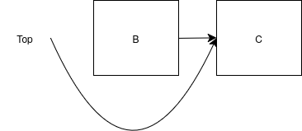
Introduction - Issues when designing non-blocking algorithms
Vietnam National University Ho Chi Minh City
Ho Chi Minh University of Technology
Faculty of Computer Science and Engineering
ABA problem: Associated with Compare-and-swap - A process fails to notice changes happening due to indistinguishable observed values
Safe memory reclamation problem: A process frees memory that another is trying to access

Slide 9
Related works
Vietnam National University Ho Chi Minh City
Ho Chi Minh University of Technology
Faculty of Computer Science and Engineering

Slide 10
Related works - Non-blocking MPSC queue algorithms
Vietnam National University Ho Chi Minh City
Ho Chi Minh University of Technology
Faculty of Computer Science and Engineering
MPSC queues | LTQueue (Jayanti & Petrovic, 2005) | DQueue (Wang et al., 2019) | WRLQueue (Yang et al., 2022) | Jiffy (Adas & Friedman, 2022)
ABA solution | Load-linked/Store-conditional | Incorrect custom scheme | Custom scheme | Custom scheme
Safe memory reclamation | Custom scheme | Incorrect custom scheme | Custom scheme | Custom scheme
Progress guarantee of dequeue | Wait-free | Wait-free | Blocking | Wait-free
Progress guarantee of enqueue | Wait-free | Wait-free | Wait-free | Wait-free
Number of elements | Unbounded | Unbounded | Bounded | Unbounded
Notes:
...

Slide 11
Distributed MPSC queue algorithms
Vietnam National University Ho Chi Minh City
Ho Chi Minh University of Technology
Faculty of Computer Science and Engineering

Slide 12
Distributed MPSC queue algorithms
Vietnam National University Ho Chi Minh City
Ho Chi Minh University of Technology
Faculty of Computer Science and Engineering
dLTQueueV1
Distributed
LTQueue
Distributed
Jiffy
dJiffy
dLTQueueV2
Slotqueue

Slide 13
Distributed MPSC queue algorithms
Vietnam National University Ho Chi Minh City
Ho Chi Minh University of Technology
Faculty of Computer Science and Engineering
dLTQueueV1
Distributed
LTQueue
Distributed
Jiffy
dJiffy
(straightforwad port)
dLTQueueV2
Slotqueue

Slide 14
Distributed MPSC queue algorithms - dJiffy
Vietnam National University Ho Chi Minh City
Ho Chi Minh University of Technology
Faculty of Computer Science and Engineering
 | dJiffy
ABA solution | Custom scheme
Safe memory reclamation | Custom scheme

Slide 15
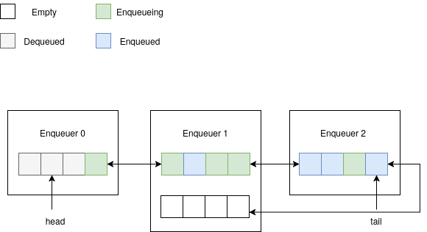
Distributed MPSC queue algorithms - dJiffy
Vietnam National University Ho Chi Minh City
Ho Chi Minh University of Technology
Faculty of Computer Science and Engineering

Slide 16
Distributed MPSC queue algorithms - dJiffy's summary
Vietnam National University Ho Chi Minh City
Ho Chi Minh University of Technology
Faculty of Computer Science and Engineering
 | dJiffy | dLTQueueV1 | dLTQueueV2 | Slotqueue
Progress guarantee of dequeue | Wait-free
Progress guarantee of enqueue | Wait-free
Time complexity of dequeue | n R
Time complexity of enqueue | 6 R
R: Number of remote operations
L: Number of local operations
n: Number of enqueuers
Notes:
Explain O(log n) remote operations

Slide 17
Distributed MPSC queue algorithms
Vietnam National University Ho Chi Minh City
Ho Chi Minh University of Technology
Faculty of Computer Science and Engineering
dLTQueueV1 (straightforward port)
Distributed
LTQueue
Distributed
Jiffy
dJiffy
(straightforward port)
dLTQueueV2
Slotqueue

Slide 18
Distributed MPSC queue algorithms - dLTQueueV1
Vietnam National University Ho Chi Minh City
Ho Chi Minh University of Technology
Faculty of Computer Science and Engineering
 | dLTQueueV1
ABA solution | CAS + Unique timestamp
Safe memory reclamation | Custom scheme

Slide 19
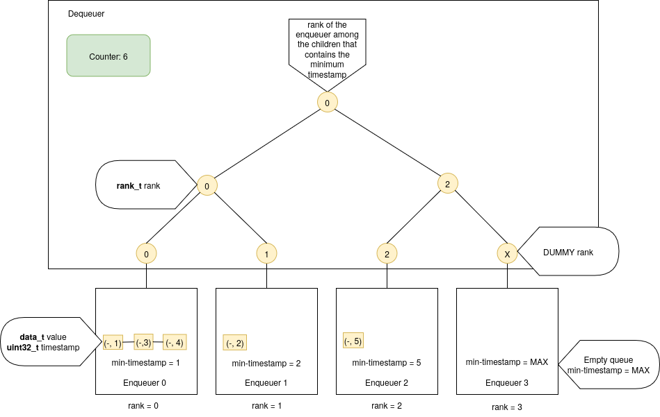
Distributed MPSC queue algorithms - dLTQueueV1
Vietnam National University Ho Chi Minh City
Ho Chi Minh University of Technology
Faculty of Computer Science and Engineering
Notes:
Explain O(log n) remote operations

Slide 20
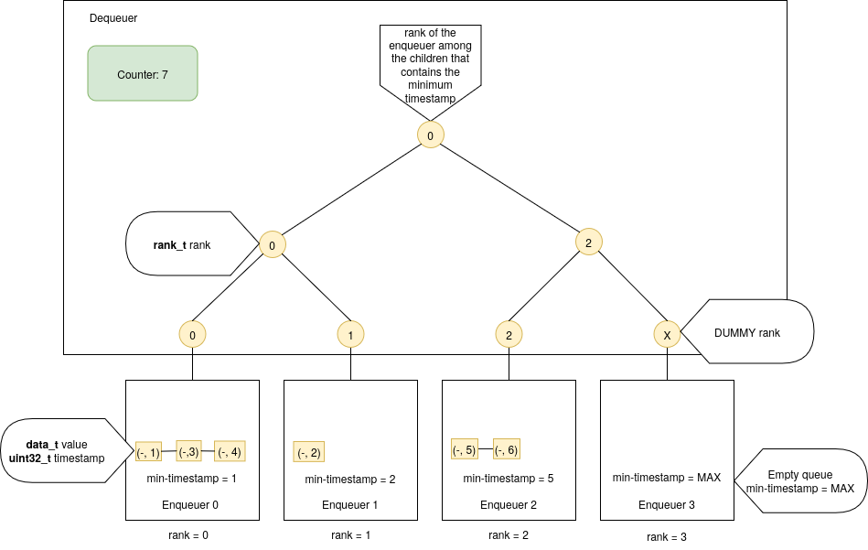

Distributed MPSC queue algorithms - dLTQueueV1's enqueue
Vietnam National University Ho Chi Minh City
Ho Chi Minh University of Technology
Faculty of Computer Science and Engineering
Notes:
Explain O(log n) remote operations

Slide 21
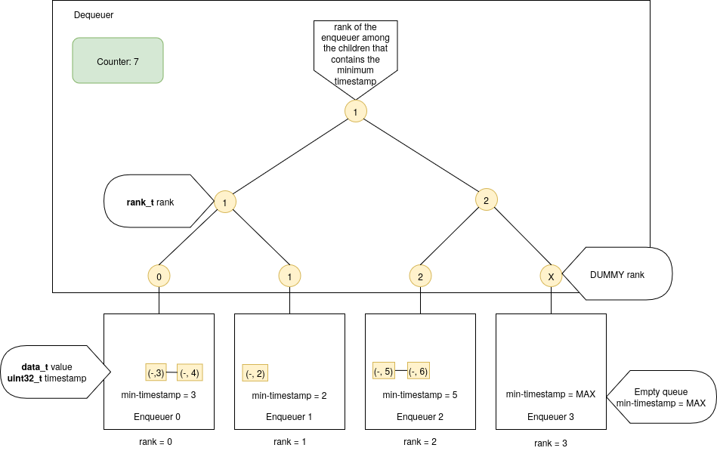

Distributed MPSC queue algorithms - dLTQueueV1's dequeue
Vietnam National University Ho Chi Minh City
Ho Chi Minh University of Technology
Faculty of Computer Science and Engineering

Slide 22
Distributed MPSC queue algorithms - dLTQueueV1's summary
Vietnam National University Ho Chi Minh City
Ho Chi Minh University of Technology
Faculty of Computer Science and Engineering
 | dJiffy | dLTQueueV1 | dLTQueueV2 | Slotqueue
Progress guarantee of dequeue | Wait-free | Wait-free
Progress guarantee of enqueue | Wait-free | Wait-free
Time complexity of dequeue | n R | 4 log(n) R + 6 log(n) L
Time complexity of enqueue | 6 R | 6 log(n) R + 4 log(n) L
R: Number of remote operations
L: Number of local operations
n: Number of enqueuers
Notes:
Explain O(log n) remote operations

Slide 23
Distributed MPSC queue algorithms - dLTQueueV2
Vietnam National University Ho Chi Minh City
Ho Chi Minh University of Technology
Faculty of Computer Science and Engineering
Notes:
Explain O(log n) remote operations

Slide 24
Distributed MPSC queue algorithms
Vietnam National University Ho Chi Minh City
Ho Chi Minh University of Technology
Faculty of Computer Science and Engineering
dLTQueueV1
(straightforward port)
Distributed
LTQueue
Distributed
Jiffy
dJiffy
(straightforward port)
dLTQueueV2
(avoid unnecessary propagation)
Slotqueue

Slide 25
Distributed MPSC queue algorithms - dLTQueueV2's summary
Vietnam National University Ho Chi Minh City
Ho Chi Minh University of Technology
Faculty of Computer Science and Engineering
 | dJiffy | dLTQueueV1 | dLTQueueV2 | Slotqueue
Progress guarantee of dequeue | Wait-free | Wait-free | Wait-free
Progress guarantee of enqueue | Wait-free | Wait-free | Wait-free
Time complexity of dequeue | n R | 4 log(n) R + 6 log(n) L | 4 log(n) R + 6 log(n) L
Time complexity of enqueue | 6 R | 6 log(n) R + 4 log(n) L | 4 R + 4 L
R: Number of remote operations
L: Number of local operations
n: Number of enqueuers
Notes:
Explain O(log n) remote operations

Slide 26
Distributed MPSC queue algorithms - dLTQueueV2
Vietnam National University Ho Chi Minh City
Ho Chi Minh University of Technology
Faculty of Computer Science and Engineering
Notes:
Explain O(log n) remote operations

Slide 27
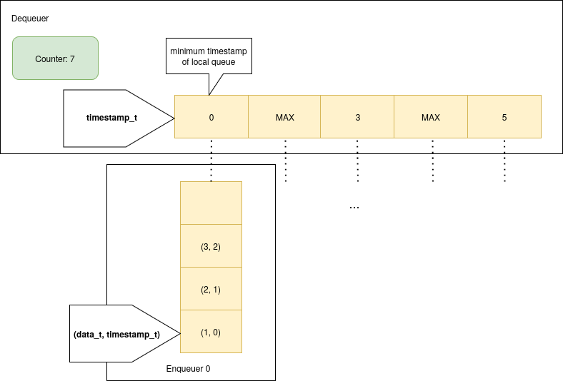
Distributed MPSC queue algorithms - Slotqueue
Vietnam National University Ho Chi Minh City
Ho Chi Minh University of Technology
Faculty of Computer Science and Engineering

Slide 28
Distributed MPSC queue algorithms
Vietnam National University Ho Chi Minh City
Ho Chi Minh University of Technology
Faculty of Computer Science and Engineering
dLTQueueV1
(straightforward port)
Distributed
LTQueue
Distributed
Jiffy
dJiffy
(straightforward port)
dLTQueueV2
(avoid unnecessary propagation)
Slotqueue
(optimize the tree structure)

Slide 29
Distributed MPSC queue algorithms - Slotqueue
Vietnam National University Ho Chi Minh City
Ho Chi Minh University of Technology
Faculty of Computer Science and Engineering
 | Slotqueue
ABA solution | No hazardous ABA problem
Safe memory reclamation | Custom scheme

Slide 30
Distributed MPSC queue algorithms - Slotqueue's summary
Vietnam National University Ho Chi Minh City
Ho Chi Minh University of Technology
Faculty of Computer Science and Engineering
 | dJiffy | dLTQueueV1 | dLTQueueV2 | Slotqueue
Progress guarantee of dequeue | Wait-free | Wait-free | Wait-free | Wait-free
Progress guarantee of enqueue | Wait-free | Wait-free | Wait-free | Wait-free
Time complexity of dequeue | n R | 4 log(n) R + 6 log(n) L | 4 log(n) R + 6 log(n) L | 3 R + 2n L
Time complexity of enqueue | 6 R | 6 log(n) R + 4 log(n) L | 4 R + 4 L | 4 R + 3 L
R: Number of remote operations
L: Number of local operations
n: Number of enqueuers
Notes:
Explain O(log n) remote operations

Slide 31
Preliminary results
Vietnam National University Ho Chi Minh City
Ho Chi Minh University of Technology
Faculty of Computer Science and Engineering
- Microbenchmarks.
- Benchmark metrics: latency.
- Benchmark baseline.
- Benchmark environment.

Slide 32
Empirical results - Baselines
Vietnam National University Ho Chi Minh City
Ho Chi Minh University of Technology
Faculty of Computer Science and Engineering
dJiffy
dLTQueueV2
Slotqueue
Active message queue [3]: A blocking MPSC queue.
[3] J. Schuchart, A. Bouteiller and G. Bosilca, "Using MPI-3 RMA for Active Messages," 2019 IEEE/ACM Workshop on Exascale MPI (ExaMPI), Denver, CO, USA, 2019, pp. 47-56, doi: 10.1109/ExaMPI49596.2019.00011.

Slide 33
Empirical results - Benchmark environment
Vietnam National University Ho Chi Minh City
Ho Chi Minh University of Technology
Faculty of Computer Science and Engineering
4 nodes (x8 cores)
Ethernet interconnect
Ubuntu 22.04.5 LTS
MPICH version 4.0, C++ 17

Slide 34
Empirical results - Microbenchmark
Vietnam National University Ho Chi Minh City
Ho Chi Minh University of Technology
Faculty of Computer Science and Engineering
A single MPSC queue shared by all processes, one of which is a dequeuer and all others are enqueuers.
All enqueuers enqueue a total of 10^4 items into the MPSC.
The dequeuer dequeues all the 10^4 items.
The MPSC is warmed up before the dequeuer starts.
We measure the throughput of dequeue and enqueue operations.

Slide 35
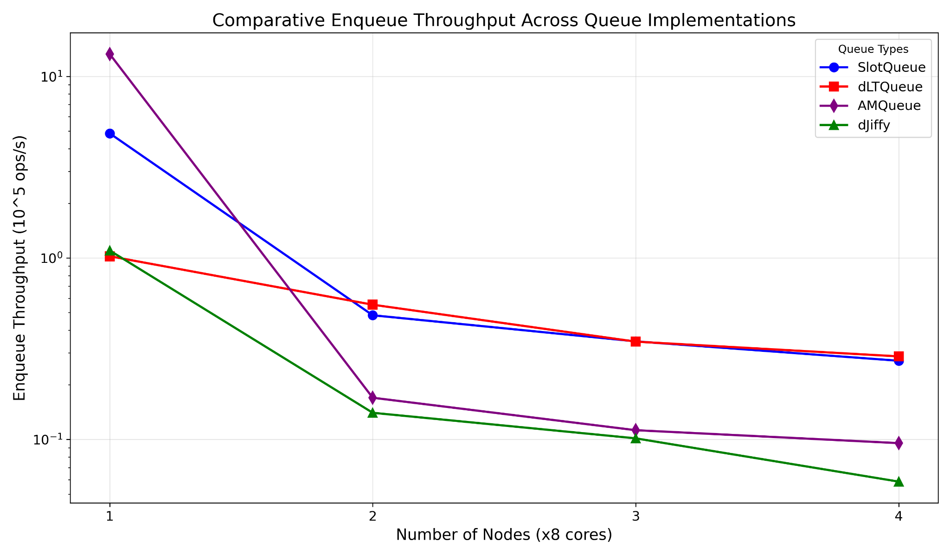
Empirical results - Enqueue throughput
Vietnam National University Ho Chi Minh City
Ho Chi Minh University of Technology
Faculty of Computer Science and Engineering

Slide 36
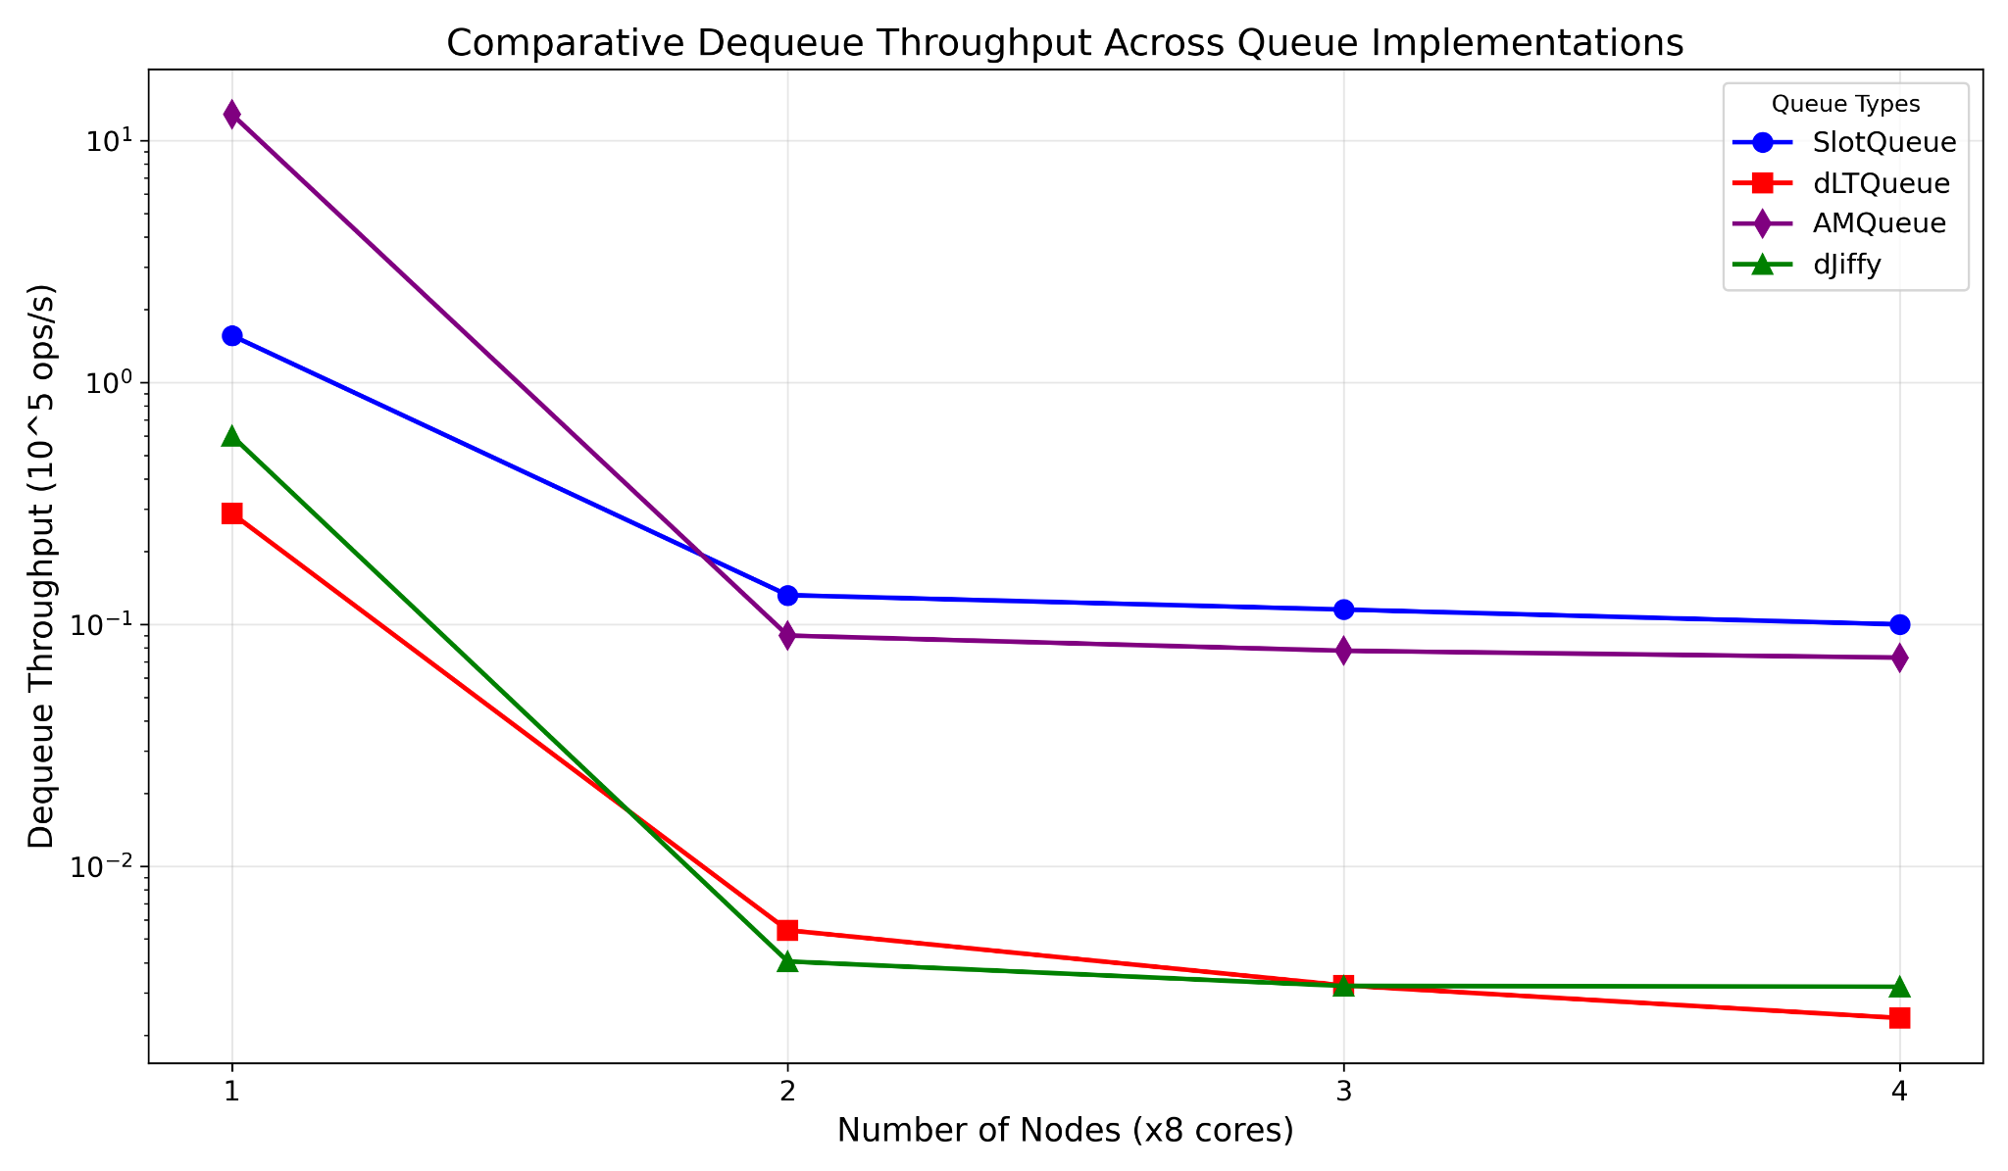
Empirical results - Dequeue throughput
Vietnam National University Ho Chi Minh City
Ho Chi Minh University of Technology
Faculty of Computer Science and Engineering

Slide 37
Empirical results - Next steps
Vietnam National University Ho Chi Minh City
Ho Chi Minh University of Technology
Faculty of Computer Science and Engineering
 | Tasks
Week 1-4 | Discover optimization opportunities with dJiffy, dLTQueue, Slotqueue. Potentially incorporate MPI-3′s new support for shared-memory windows and C++11 atomic operations to optimize intra-node communication.
Week 5-6 | Remove boundedness constraint on dLTQueue and Slotqueue.
Week 7-8 | Discover more potential algorithms for adapting to distributed environments. Discover more distributed MPSC for use as baselines.
Week 9-12 | Perform benchmarks on RDMA cluster. Investigate the performance degradation problem.
Week 13-15 | Finalize our results and provide insights from our research.

Slide 38
The end
Vietnam National University Ho Chi Minh City
Ho Chi Minh University of Technology
Faculty of Computer Science and Engineering

Slide 39
Appendix
Vietnam National University Ho Chi Minh City
Ho Chi Minh University of Technology
Faculty of Computer Science and Engineering

Slide 40
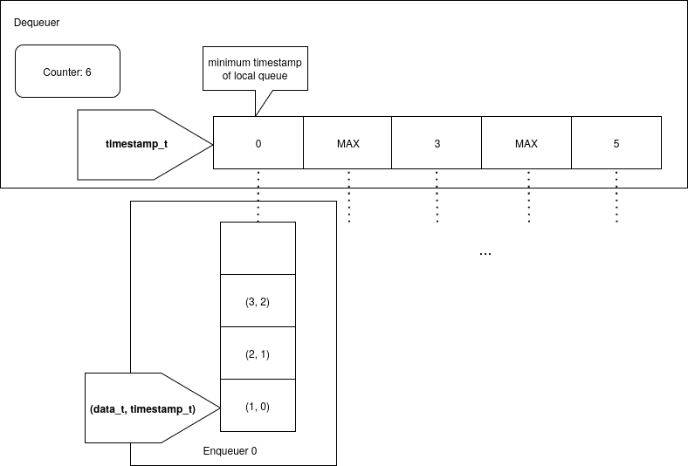
Distributed MPSC queue algorithms - Slotqueue enqueue
Vietnam National University Ho Chi Minh City
Ho Chi Minh University of Technology
Faculty of Computer Science and Engineering

Slide 41
Distributed MPSC queue algorithms - Slotqueue dequeue
Vietnam National University Ho Chi Minh City
Ho Chi Minh University of Technology
Faculty of Computer Science and Engineering

Slide 42
Introduction - Supporting distributed MPSC queues
Vietnam National University Ho Chi Minh City
Ho Chi Minh University of Technology
Faculty of Computer Science and Engineering
Distributed MPSC queue
Irregular application
Who will need to contact with me?
When will someone contact me?
One-sided communication interfaces

Slide 43
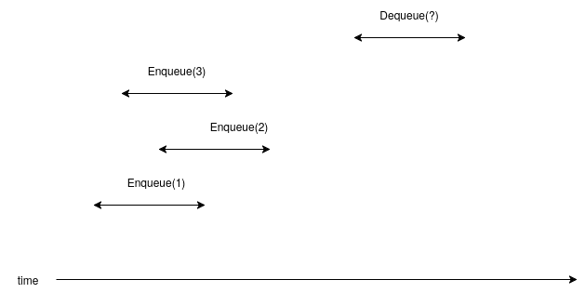
Appendix - Correctness
Vietnam National University Ho Chi Minh City
Ho Chi Minh University of Technology
Faculty of Computer Science and Engineering

Slide 44
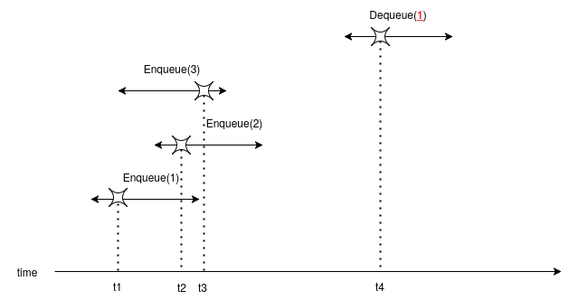
Appendix - Linearizability
Vietnam National University Ho Chi Minh City
Ho Chi Minh University of Technology
Faculty of Computer Science and Engineering
Linearizability: Each method call takes effect at some point during its execution.

Slide 45
Introduction - Lock-free & Wait-free
Vietnam National University Ho Chi Minh City
Ho Chi Minh University of Technology
Faculty of Computer Science and Engineering
Process A
Other processes
Process A
Process B
Process ...
Suspended
Suspended
Completion
Completion
Completion
Lock-freedom
Wait-freedom

Slide 46
Appendix - Safe memory reclamation scheme of LTQueue
Vietnam National University Ho Chi Minh City
Ho Chi Minh University of Technology
Faculty of Computer Science and Engineering
LTQueue pushes safe memory reclamation responsibility to the underlying SPSC, it doesn't perform any memory allocation and deallocation by itself.
First
Last

Slide 47
Appendix - Safe memory reclamation scheme of dLTQueue
Vietnam National University Ho Chi Minh City
Ho Chi Minh University of Technology
Faculty of Computer Science and Engineering
dLTQueue pushes safe memory reclamation responsibility to the underlying SPSC, it doesn't perform any memory allocation and deallocation by itself.
X
X
X
First
Last

Slide 48
Appendix - ABA safety
Vietnam National University Ho Chi Minh City
Ho Chi Minh University of Technology
Faculty of Computer Science and Engineering
ABA sequence
read a shared variable x
CAS x to a new value
No write to shared variables

Slide 49
Appendix - ABA safety
Vietnam National University Ho Chi Minh City
Ho Chi Minh University of Technology
Faculty of Computer Science and Engineering
successful
read x
CAS(x)
successful
ABA problem!
read x
CAS(x)

Slide 50
Appendix - ABA safety
Vietnam National University Ho Chi Minh City
Ho Chi Minh University of Technology
Faculty of Computer Science and Engineering
First process
read x
CAS(x)
read x
CAS(x)
Suppose the system states during these 2 time spans are indistinguishable from the first process's POV.

Slide 51
Appendix - ABA safety
Vietnam National University Ho Chi Minh City
Ho Chi Minh University of Technology
Faculty of Computer Science and Engineering
read x
CAS(x)
read x
CAS(x)
Then the effect is as if these two CAS sequences do not overlap. => ABA-safe

Slide 52
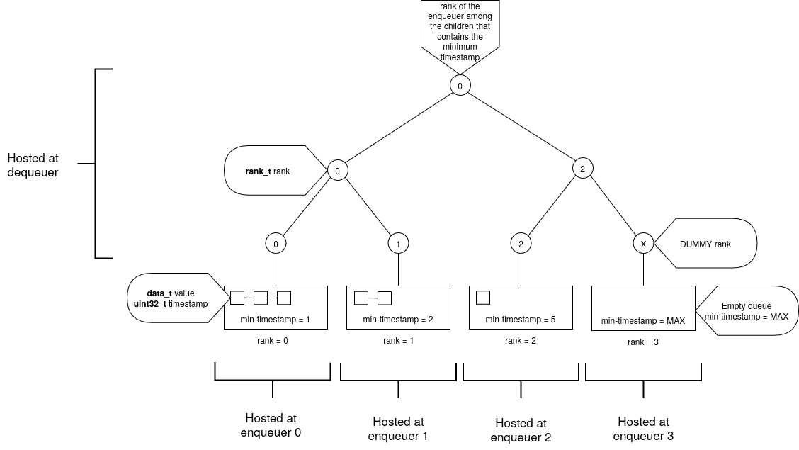
Appendix - dLTQueue
Vietnam National University Ho Chi Minh City
Ho Chi Minh University of Technology
Faculty of Computer Science and Engineering

Slide 53
Appendix - dLTQueue
Vietnam National University Ho Chi Minh City
Ho Chi Minh University of Technology
Faculty of Computer Science and Engineering
Enqueuer node

Slide 54
Appendix - dLTQueue
Vietnam National University Ho Chi Minh City
Ho Chi Minh University of Technology
Faculty of Computer Science and Engineering
Tree node

Slide 55
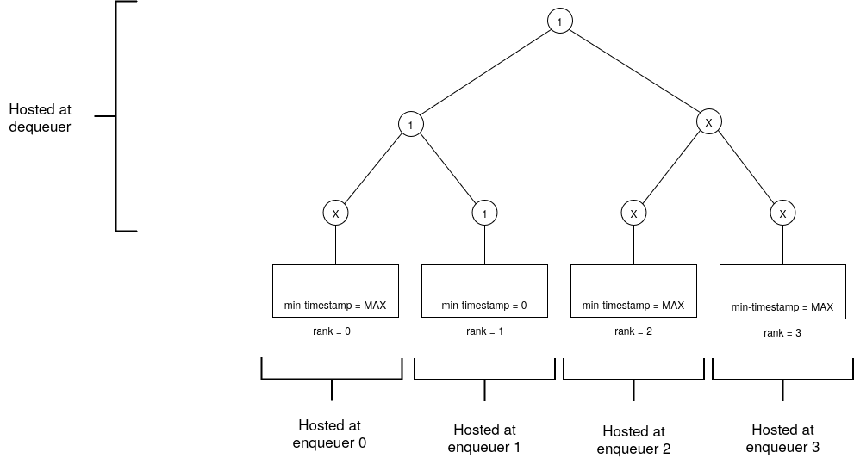
Appendix - dLTQueue's enqueue
Vietnam National University Ho Chi Minh City
Ho Chi Minh University of Technology
Faculty of Computer Science and Engineering
Counter = 1
Initial state

Slide 56
Appendix - dLTQueue's enqueue
Vietnam National University Ho Chi Minh City
Ho Chi Minh University of Technology
Faculty of Computer Science and Engineering
Counter = 1
Enqueuer 2 wants to enqueue a value

Slide 57
Appendix - dLTQueue's enqueue
Vietnam National University Ho Chi Minh City
Ho Chi Minh University of Technology
Faculty of Computer Science and Engineering
Counter = 2
Enqueuer 2 obtains
timestamp = 1

Slide 58

Appendix - dLTQueue's enqueue
Vietnam National University Ho Chi Minh City
Ho Chi Minh University of Technology
Faculty of Computer Science and Engineering
Counter = 2
Enqueuer 2 enqueues (-, 1) to its SPSC

Slide 59

Appendix - dLTQueue's enqueue
Vietnam National University Ho Chi Minh City
Ho Chi Minh University of Technology
Faculty of Computer Science and Engineering
Counter = 2
Enqueuer 2 refreshes its node's min-timestamp to 1

Slide 60
Appendix - dLTQueue's enqueue
Vietnam National University Ho Chi Minh City
Ho Chi Minh University of Technology
Faculty of Computer Science and Engineering
Counter = 2
Nodes that needs refreshing

Slide 61

Appendix - dLTQueue's enqueue
Vietnam National University Ho Chi Minh City
Ho Chi Minh University of Technology
Faculty of Computer Science and Engineering
Counter = 2
Final state

Slide 62
Appendix - dLTQueue's dequeue
Vietnam National University Ho Chi Minh City
Ho Chi Minh University of Technology
Faculty of Computer Science and Engineering
Counter = 2
Initial state

Slide 63
Appendix - dLTQueue's dequeue
Vietnam National University Ho Chi Minh City
Ho Chi Minh University of Technology
Faculty of Computer Science and Engineering
Counter = 2
Dequeuer sees rank 1.

Slide 64

Appendix - dLTQueue's dequeue
Vietnam National University Ho Chi Minh City
Ho Chi Minh University of Technology
Faculty of Computer Science and Engineering
Counter = 2
Dequeuer dequeues from the local SPSC of rank 1.

Slide 65

Appendix - dLTQueue's dequeue
Vietnam National University Ho Chi Minh City
Ho Chi Minh University of Technology
Faculty of Computer Science and Engineering
Counter = 2
Final state

Slide 66
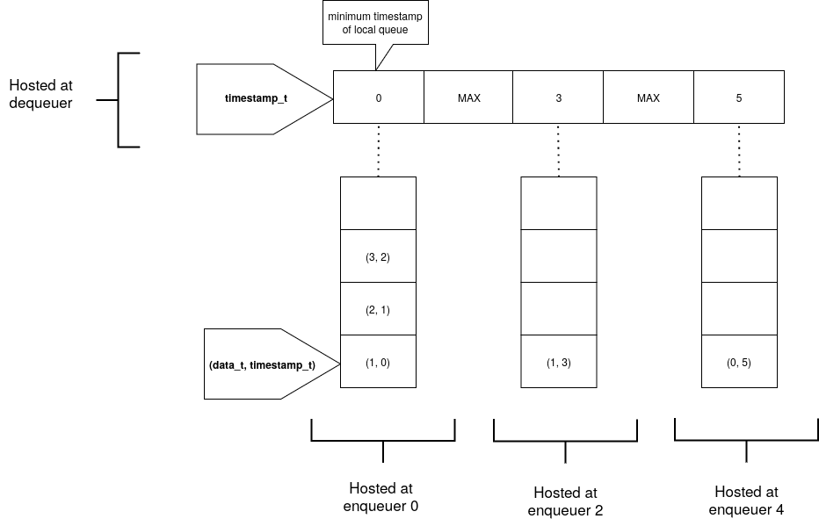
Appendix - Slotqueue
Vietnam National University Ho Chi Minh City
Ho Chi Minh University of Technology
Faculty of Computer Science and Engineering
Notes:
Explain the flattened idea

Slide 67
Appendix - Slotqueue
Vietnam National University Ho Chi Minh City
Ho Chi Minh University of Technology
Faculty of Computer Science and Engineering
Each enqueuer process hosts a distributed SPSC.

Slide 68
Appendix - Slotqueue
Vietnam National University Ho Chi Minh City
Ho Chi Minh University of Technology
Faculty of Computer Science and Engineering
A Slot storing the minimum timestamp of the corresponding SPSC.

Slide 69
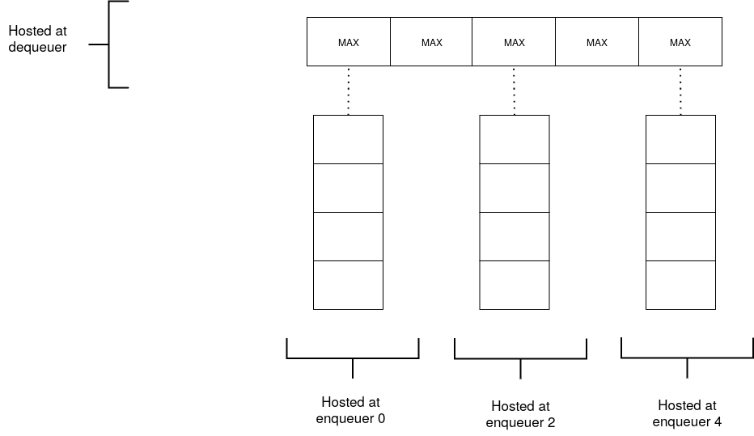
Appendix - Slotqueue’s enqueue
Vietnam National University Ho Chi Minh City
Ho Chi Minh University of Technology
Faculty of Computer Science and Engineering
Counter: 0
Initial state

Slide 70
Appendix - Slotqueue’s enqueue
Vietnam National University Ho Chi Minh City
Ho Chi Minh University of Technology
Faculty of Computer Science and Engineering
Counter: 0
Enqueuer 0 wants to enqueue a value.

Slide 71
Appendix - Slotqueue’s enqueue
Vietnam National University Ho Chi Minh City
Ho Chi Minh University of Technology
Faculty of Computer Science and Engineering
Counter: 1
Enqueuer 0 obtains the timestamp value = 0.

Slide 72

Appendix - Slotqueue’s enqueue
Vietnam National University Ho Chi Minh City
Ho Chi Minh University of Technology
Faculty of Computer Science and Engineering
Counter: 1
Enqueuer 0 enqueues the value and timestamp to its local SPSC.

Slide 73

Appendix - Slotqueue’s enqueue
Vietnam National University Ho Chi Minh City
Ho Chi Minh University of Technology
Faculty of Computer Science and Engineering
Counter: 1
Enqueuer 0 refreshes its slot with the minimum timestamp in the local SPSC.

Slide 74
Appendix - Slotqueue’s enqueue
Vietnam National University Ho Chi Minh City
Ho Chi Minh University of Technology
Faculty of Computer Science and Engineering
Counter: 1
Final state

Slide 75

Appendix - Slotqueue’s dequeue
Vietnam National University Ho Chi Minh City
Ho Chi Minh University of Technology
Faculty of Computer Science and Engineering
Counter: 3
Initial state

Slide 76
Appendix - Slotqueue’s dequeue
Vietnam National University Ho Chi Minh City
Ho Chi Minh University of Technology
Faculty of Computer Science and Engineering
Counter: 3
Dequeuer scans the slots for the minimum timestamp. It finds 0.

Slide 77
Appendix - Slotqueue’s dequeue
Vietnam National University Ho Chi Minh City
Ho Chi Minh University of Technology
Faculty of Computer Science and Engineering
Counter: 3
The dequeuer has to perform a rescan a second time to ensure linearizability. It still finds 0.

Slide 78

Appendix - Slotqueue’s dequeue
Vietnam National University Ho Chi Minh City
Ho Chi Minh University of Technology
Faculty of Computer Science and Engineering
Counter: 3
The dequeuer then dequeues from the SPSC of rank 0.

Slide 79

Appendix - Slotqueue’s dequeue
Vietnam National University Ho Chi Minh City
Ho Chi Minh University of Technology
Faculty of Computer Science and Engineering
Counter: 3
The dequeuer refreshes the slot of rank 0.

Slide 80
Appendix - Slotqueue’s dequeue
Vietnam National University Ho Chi Minh City
Ho Chi Minh University of Technology
Faculty of Computer Science and Engineering
Counter: 3
Final state

Slide 81

Appendix - Refresh in details (dLTqueue)
Vietnam National University Ho Chi Minh City
Ho Chi Minh University of Technology
Faculty of Computer Science and Engineering

Slide 82
Appendix - Refresh in details (dLTqueue)
Vietnam National University Ho Chi Minh City
Ho Chi Minh University of Technology
Faculty of Computer Science and Engineering
Read old_rank = X

Slide 83
Appendix - Refresh in details (dLTqueue)
Vietnam National University Ho Chi Minh City
Ho Chi Minh University of Technology
Faculty of Computer Science and Engineering
new_rank = rank with minimum min-timestamp = 2

Slide 84
Appendix - Refresh in details (dLTqueue)
Vietnam National University Ho Chi Minh City
Ho Chi Minh University of Technology
Faculty of Computer Science and Engineering
CAS(&node, old_rank, new_rank)
If fail, try one more time!

Slide 85
Appendix - Refresh in details (Slotqueue)
Vietnam National University Ho Chi Minh City
Ho Chi Minh University of Technology
Faculty of Computer Science and Engineering

Slide 86
Appendix - Refresh in details (Slotqueue)
Vietnam National University Ho Chi Minh City
Ho Chi Minh University of Technology
Faculty of Computer Science and Engineering
Read old_slot = MAX

Slide 87
Appendix - Refresh in details (Slotqueue)
Vietnam National University Ho Chi Minh City
Ho Chi Minh University of Technology
Faculty of Computer Science and Engineering
new_slot = spsc.readFront() = 0

Slide 88
Appendix - Refresh in details (Slotqueue)
Vietnam National University Ho Chi Minh City
Ho Chi Minh University of Technology
Faculty of Computer Science and Engineering
CAS(&slot, old_slot, new_slot)
If fail, try one more time!

Slide 89
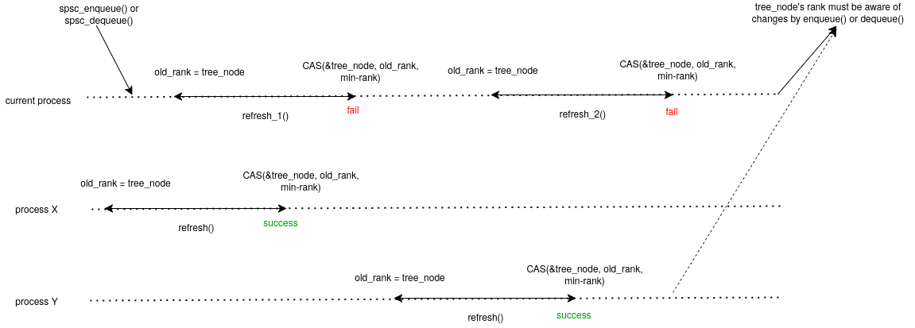
Appendix - Why only retry 2 times?
Vietnam National University Ho Chi Minh City
Ho Chi Minh University of Technology
Faculty of Computer Science and Engineering

Slide 90
Appendix - Why do we need 2 scans?
Vietnam National University Ho Chi Minh City
Ho Chi Minh University of Technology
Faculty of Computer Science and Engineering

Slide 91

Appendix - Why do we need 2 scans?
Vietnam National University Ho Chi Minh City
Ho Chi Minh University of Technology
Faculty of Computer Science and Engineering

Slide 92
Appendix - Why do we need 2 scans?
Vietnam National University Ho Chi Minh City
Ho Chi Minh University of Technology
Faculty of Computer Science and Engineering
Dequeuer check slot 0, nothing.

Slide 93
Appendix - Why do we need 2 scans?
Vietnam National University Ho Chi Minh City
Ho Chi Minh University of Technology
Faculty of Computer Science and Engineering
Dequeuer check slot 1, nothing. Then it suspends.

Slide 94

Appendix - Why do we need 2 scans?
Vietnam National University Ho Chi Minh City
Ho Chi Minh University of Technology
Faculty of Computer Science and Engineering
Enqueuer 0 obtains timestamp 0 and finishes enqueueing.

Slide 95

Appendix - Why do we need 2 scans?
Vietnam National University Ho Chi Minh City
Ho Chi Minh University of Technology
Faculty of Computer Science and Engineering
Enqueuer 2 obtains timestamp 1 and finishes enqueueing.

Slide 96
Appendix - Why do we need 2 scans?
Vietnam National University Ho Chi Minh City
Ho Chi Minh University of Technology
Faculty of Computer Science and Engineering
Dequeuer continues scanning and find 1 at slot 2. However, it's not linearizable to dequeue from this slot.

Slide 97
Appendix - Why do we need 2 scans?
Vietnam National University Ho Chi Minh City
Ho Chi Minh University of Technology
Faculty of Computer Science and Engineering
Dequeuer performs the scan a second time and finds 0.

Slide 98

Appendix - Why only 2 scans?
Vietnam National University Ho Chi Minh City
Ho Chi Minh University of Technology
Faculty of Computer Science and Engineering

Slide 99
Appendix - Why only 2 scans?
Vietnam National University Ho Chi Minh City
Ho Chi Minh University of Technology
Faculty of Computer Science and Engineering
Dequeuer finds this in the first scan
Dequeuer finds this in the second scan

Slide 100
Appendix - Why only 2 scans?
Vietnam National University Ho Chi Minh City
Ho Chi Minh University of Technology
Faculty of Computer Science and Engineering
t0 < t2
t0
t2

Slide 101
Appendix - Why only 2 scans?
Vietnam National University Ho Chi Minh City
Ho Chi Minh University of Technology
Faculty of Computer Science and Engineering
t0 < t2 < t3
t0
t2
If one of these is non-MAX during the second scan at t3...

Slide 102
Appendix - Why only 2 scans?
Vietnam National University Ho Chi Minh City
Ho Chi Minh University of Technology
Faculty of Computer Science and Engineering
t0 < t2 < t3
t0
t2
If one of these is MAX during the second scan at t3...

Slide 103
Appendix - Why only 2 scans?
Vietnam National University Ho Chi Minh City
Ho Chi Minh University of Technology
Faculty of Computer Science and Engineering
t0 < t1 < t2
t0
t2
If one of these is non-MAX during the second scan at t1...

Slide 104
Appendix - Why only 2 scans?
Vietnam National University Ho Chi Minh City
Ho Chi Minh University of Technology
Faculty of Computer Science and Engineering
t0 < t1 < t2
t0
t2
If one of these is MAX during the second scan at t1...

