Slide 1

Slotqueue: A constant-time wait-free distributed MPSC queue
Vietnam National University Ho Chi Minh City
Ho Chi Minh University of Technology
Faculty of Computer Science and Engineering
Student: | Đỗ Nguyễn An Huy
Supervisors: | Dr. Diệp Thanh Đăng
 | Assoc. Prof. Dr. Thoại Nam
 | May, 2025

Slide 2
Introduction
Vietnam National University Ho Chi Minh City
Ho Chi Minh University of Technology
Faculty of Computer Science and Engineering
- Motivation: Potential use cases for distributed MPSC queues.
- Research question.

Slide 3
Introduction - Patterns with MPSC
Vietnam National University Ho Chi Minh City
Ho Chi Minh University of Technology
Faculty of Computer Science and Engineering
Actor - Consumer
Task
Mailbox
MPSC queue behavior
Sub-task 1
Sub-task 2
Sub-task 3
Message
Message
Worker - Producer
Result
queue
MPSC queue behavior
Actor - Producer
Actor - Producer
Worker - Consumer
Actor model [1]
Fan-out/Fan-in pattern [2]
[1] Hewitt, C., Bishop, P., and Steiger, R. "A Universal Modular Actor Formalism for Artificial Intelligence," 1973, In Proceedings of the 3rd International Joint Conference on Artificial Intelligence.
[2] Dean, J. and Ghemawat, S. "MapReduce: simplified data processing on large clusters," 2008, Association for Computing Machinery. doi: 10.1145/1327452.1327492
Notes:
Add reference

Slide 4
Introduction - Supporting MPSC queue programming patterns in distributed environments
Vietnam National University Ho Chi Minh City
Ho Chi Minh University of Technology
Faculty of Computer Science and Engineering
Distributed actor model
Distributed Fan-out/Fan-in pattern
Distributed MPSC queue
Performant
Fault-tolerant

Slide 5
Introduction - Supporting distributed MPSC queues
Vietnam National University Ho Chi Minh City
Ho Chi Minh University of Technology
Faculty of Computer Science and Engineering
Distributed MPSC queue
Irregular application
Who will need to contact with me?
When will someone contact me?
One-sided communication interfaces

Slide 6
Introduction - Supporting distributed MPSC queues
Vietnam National University Ho Chi Minh City
Ho Chi Minh University of Technology
Faculty of Computer Science and Engineering
One-sided communication interfaces bare resemblance to shared-memory programming.
A
A
Store()
Put()
B
B
Put()
Store()
X
X
Load()
Get()
Store()
Put()
C
C
Shared-memory programming
One-sided communication
Notes:
....

Slide 7
Introduction - Supporting distributed MPSC queues
Vietnam National University Ho Chi Minh City
Ho Chi Minh University of Technology
Faculty of Computer Science and Engineering
One-sided communication interfaces
Communication
Synchronization
Locks
Atomic operations

Slide 8
Introduction - Progress guarantee & Fault tolerance
Vietnam National University Ho Chi Minh City
Ho Chi Minh University of Technology
Faculty of Computer Science and Engineering
Process A
Process B
Process A
Process B
Acquire lock
Suspended
Suspended
Blocked trying to acquire lock
Completion
Lock-based algorithms are blocking
Algorithms that synchronize using atomic operations can be non-blocking

Slide 9




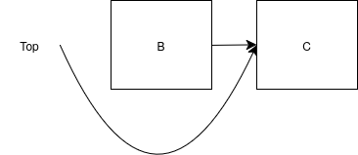
Introduction - Issues when designing non-blocking algorithms
Vietnam National University Ho Chi Minh City
Ho Chi Minh University of Technology
Faculty of Computer Science and Engineering
ABA problem: Associated with Compare-and-swap - A process fails to notice changes happening due to indistinguishable observed values
Safe memory reclamation problem: A process frees memory that another is trying to access

Slide 10
Introduction - Research question
Vietnam National University Ho Chi Minh City
Ho Chi Minh University of Technology
Faculty of Computer Science and Engineering
How to utilize shared-memory programming principles to model and design distributed MPSC queue algorithms in a correct, fault-tolerant and performant manner?

Slide 11
Related works
Vietnam National University Ho Chi Minh City
Ho Chi Minh University of Technology
Faculty of Computer Science and Engineering

Slide 12
Related works - Non-blocking MPSC queue algorithms
Vietnam National University Ho Chi Minh City
Ho Chi Minh University of Technology
Faculty of Computer Science and Engineering
MPSC queues | LTQueue (Jayanti & Petrovic, 2005) | DQueue (Wang et al., 2019) | WRLQueue (Yang et al., 2022) | Jiffy (Adas & Friedman, 2022)
ABA solution | Load-linked/Store-conditional | Incorrect custom scheme | Custom scheme | Custom scheme
Safe memory reclamation | Custom scheme | Incorrect custom scheme | Custom scheme | Custom scheme
Progress guarantee of dequeue | Wait-free | Wait-free | Blocking | Wait-free
Progress guarantee of enqueue | Wait-free | Wait-free | Wait-free | Wait-free
Number of elements | Unbounded | Unbounded | Bounded | Unbounded
Notes:
...

Slide 13
Distributed MPSC queue algorithms
Vietnam National University Ho Chi Minh City
Ho Chi Minh University of Technology
Faculty of Computer Science and Engineering

Slide 14
Distributed MPSC queue algorithms - MPSC queue algorithms
Vietnam National University Ho Chi Minh City
Ho Chi Minh University of Technology
Faculty of Computer Science and Engineering
Naive dLTQueue
(dLTQueueV1)
Distributed LTQueue
dLTQueueV2
dLTQueueV3
Slotqueue

Slide 15
Distributed MPSC queue algorithms - MPSC queue algorithms
Vietnam National University Ho Chi Minh City
Ho Chi Minh University of Technology
Faculty of Computer Science and Engineering
Naive dLTQueue
(dLTQueueV1)
Distributed LTQueue
dLTQueueV2
dLTQueueV3
Slotqueue

Slide 16
Distributed MPSC queue algorithms - Naive dLTQueue (dLTQueueV1)
Vietnam National University Ho Chi Minh City
Ho Chi Minh University of Technology
Faculty of Computer Science and Engineering
 | dLTQueueV1
ABA solution | CAS + Unique timestamp
Safe memory reclamation | Custom scheme

Slide 17
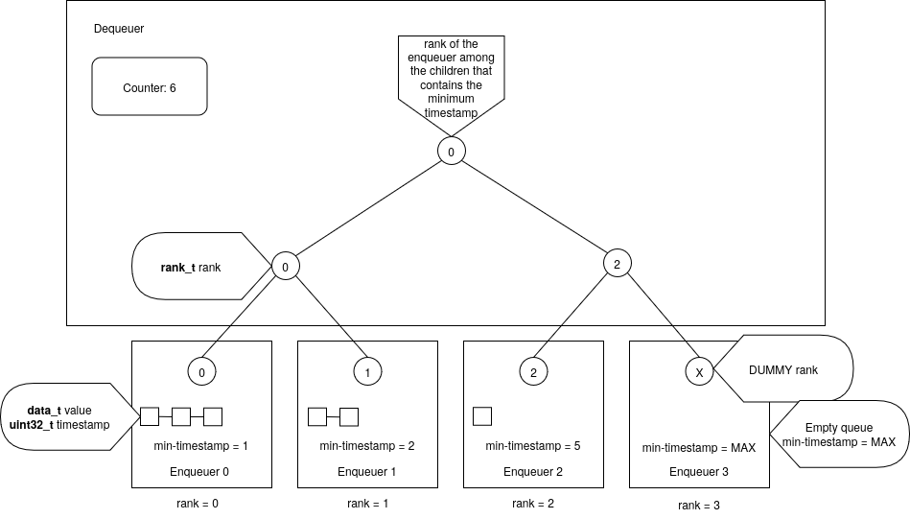
Distributed MPSC queue algorithms - Naive dLTQueue (dLTQueueV1)
Vietnam National University Ho Chi Minh City
Ho Chi Minh University of Technology
Faculty of Computer Science and Engineering
Notes:
Explain O(log n) remote operations

Slide 18
Distributed MPSC queue algorithms - Naive dLTQueue (dLTQueueV1)
Vietnam National University Ho Chi Minh City
Ho Chi Minh University of Technology
Faculty of Computer Science and Engineering
Notes:
Explain O(log n) remote operations

Slide 19
Distributed MPSC queue algorithms - Naive dLTQueue (dLTQueueV1)
Vietnam National University Ho Chi Minh City
Ho Chi Minh University of Technology
Faculty of Computer Science and Engineering

Slide 20
Distributed MPSC queue algorithms - dLTQueue's summary
Vietnam National University Ho Chi Minh City
Ho Chi Minh University of Technology
Faculty of Computer Science and Engineering
 | dLTQueueV1 | dLTQueueV2 | dLTQueueV3 | Slotqueue
Progress guarantee of dequeue | Wait-free
Progress guarantee of enqueue | Wait-free
Time complexity of dequeue | 4 log(n) R + 6 log(n) L
Time complexity of enqueue | 6 log(n) R + 4 log(n) L
R: Number of remote operations
L: Number of local operations
n: Number of enqueuers
C: Some constant number of operations
Notes:
Explain O(log n) remote operations

Slide 21
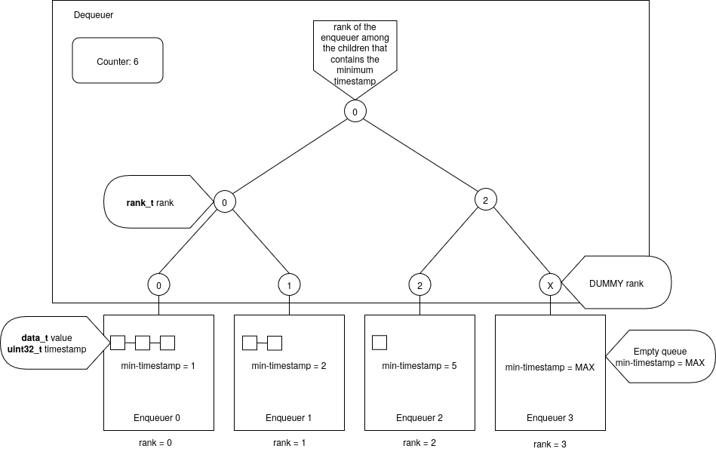
Distributed MPSC queue algorithms - dLTQueueV2
Vietnam National University Ho Chi Minh City
Ho Chi Minh University of Technology
Faculty of Computer Science and Engineering
Notes:
Explain O(log n) remote operations

Slide 22
Distributed MPSC queue algorithms - MPSC queue algorithms
Vietnam National University Ho Chi Minh City
Ho Chi Minh University of Technology
Faculty of Computer Science and Engineering
Naive dLTQueue
(dLTQueueV1)
dLTQueueV2 (optimize tree node placement)
Distributed LTQueue
dLTQueueV3
Slotqueue

Slide 23
Distributed MPSC queue algorithms - dLTQueue's summary
Vietnam National University Ho Chi Minh City
Ho Chi Minh University of Technology
Faculty of Computer Science and Engineering
 | dLTQueueV1 | dLTQueueV2 | dLTQueueV3 | Slotqueue
Progress guarantee of dequeue | Wait-free | Wait-free
Progress guarantee of enqueue | Wait-free | Wait-free
Time complexity of dequeue | 4 log(n) R + 6 log(n) L | 4 log(n) R + 6 log(n) L - C
Time complexity of enqueue | 6 log(n) R + 4 log(n) L | 6 log(n) R + 4 log(n) L + C
R: Number of remote operations
L: Number of local operations
n: Number of enqueuers
C: Some constant number of operations
Notes:
Explain O(log n) remote operations

Slide 24
Distributed MPSC queue algorithms - dLTQueueV3
Vietnam National University Ho Chi Minh City
Ho Chi Minh University of Technology
Faculty of Computer Science and Engineering
Notes:
Explain O(log n) remote operations

Slide 25
Distributed MPSC queue algorithms - MPSC queue algorithms
Vietnam National University Ho Chi Minh City
Ho Chi Minh University of Technology
Faculty of Computer Science and Engineering
Naive dLTQueue
(dLTQueueV1)
dLTQueueV2
(optimize tree node placement)
Distributed LTQueue
dLTQueueV3
(avoid unnecessary propagation)
Slotqueue

Slide 26
Distributed MPSC queue algorithms - dLTQueue's summary
Vietnam National University Ho Chi Minh City
Ho Chi Minh University of Technology
Faculty of Computer Science and Engineering
 | dLTQueueV1 | dLTQueueV2 | dLTQueueV3 | Slotqueue
Progress guarantee of dequeue | Wait-free | Wait-free | Wait-free
Progress guarantee of enqueue | Wait-free | Wait-free | Wait-free
Time complexity of dequeue | 4 log(n) R + 6 log(n) L | 4 log(n) R + 6 log(n) L - C | 4 log(n) R + 6 log(n) L - C
Time complexity of enqueue | 6 log(n) R + 4 log(n) L | 6 log(n) R + 4 log(n) L + C | 5R + 3L
R: Number of remote operations
L: Number of local operations
n: Number of enqueuers
C: Some constant number of operations
Notes:
Explain O(log n) remote operations

Slide 27
Distributed MPSC queue algorithms - dLTQueueV3
Vietnam National University Ho Chi Minh City
Ho Chi Minh University of Technology
Faculty of Computer Science and Engineering
Notes:
Explain O(log n) remote operations

Slide 28
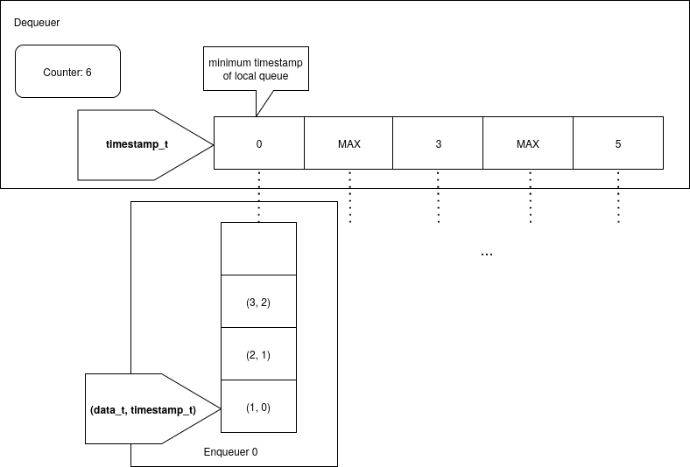
Distributed MPSC queue algorithms - Slotqueue
Vietnam National University Ho Chi Minh City
Ho Chi Minh University of Technology
Faculty of Computer Science and Engineering

Slide 29
Distributed MPSC queue algorithms - MPSC queue algorithms
Vietnam National University Ho Chi Minh City
Ho Chi Minh University of Technology
Faculty of Computer Science and Engineering
Naive dLTQueue
(dLTQueueV1)
dLTQueueV2
(optimize tree node placement)
Distributed LTQueue
dLTQueueV3
(avoid unnecessary propagation)
Slotqueue
(optimize data structure)

Slide 30
Distributed MPSC queue algorithms - Slotqueue
Vietnam National University Ho Chi Minh City
Ho Chi Minh University of Technology
Faculty of Computer Science and Engineering
 | Slotqueue
ABA solution | No hazardous ABA problem
Safe memory reclamation | Custom scheme

Slide 31
Distributed MPSC queue algorithms - Slotqueue
Vietnam National University Ho Chi Minh City
Ho Chi Minh University of Technology
Faculty of Computer Science and Engineering

Slide 32
Distributed MPSC queue algorithms - Slotqueue
Vietnam National University Ho Chi Minh City
Ho Chi Minh University of Technology
Faculty of Computer Science and Engineering

Slide 33
Distributed MPSC queue algorithms - Slotqueue
Vietnam National University Ho Chi Minh City
Ho Chi Minh University of Technology
Faculty of Computer Science and Engineering

Slide 34
Distributed MPSC queue algorithms - dLTQueue's summary
Vietnam National University Ho Chi Minh City
Ho Chi Minh University of Technology
Faculty of Computer Science and Engineering
 | dLTQueueV1 | dLTQueueV2 | dLTQueueV3 | Slotqueue
Progress guarantee of dequeue | Wait-free | Wait-free | Wait-free | Wait-free
Progress guarantee of enqueue | Wait-free | Wait-free | Wait-free | Wait-free
Time complexity of dequeue | 4 log(n) R + 6 log(n) L | 4 log(n) R + 6 log(n) L - C | 4 log(n) R + 6 log(n) L - C | 3R + 2n L
Time complexity of enqueue | 6 log(n) R + 4 log(n) L | 6 log(n) R + 4 log(n) L + C | 5R + 3L | 4R + 3L
R: Number of remote operations
L: Number of local operations
n: Number of enqueuers
Notes:
Explain O(log n) remote operations

Slide 35
Preliminary results
Vietnam National University Ho Chi Minh City
Ho Chi Minh University of Technology
Faculty of Computer Science and Engineering
- Microbenchmarks.
- Benchmark metrics: latency.
- Benchmark baseline.
- Benchmark environment.

Slide 36
Empirical results - Baselines
Vietnam National University Ho Chi Minh City
Ho Chi Minh University of Technology
Faculty of Computer Science and Engineering
dLTQueueV3
Slotqueue
Active message queue [3]: A hosted blocking MPSC queue.
[3] J. Schuchart, A. Bouteiller and G. Bosilca, "Using MPI-3 RMA for Active Messages," 2019 IEEE/ACM Workshop on Exascale MPI (ExaMPI), Denver, CO, USA, 2019, pp. 47-56, doi: 10.1109/ExaMPI49596.2019.00011.

Slide 37
Empirical results - Microbenchmark
Vietnam National University Ho Chi Minh City
Ho Chi Minh University of Technology
Faculty of Computer Science and Engineering
A single MPSC queue shared by all processes, one of which is a dequeuer and all others are enqueuers.
All enqueuers enqueue a total of 10^4 items into the MPSC.
The dequeuer dequeues all the 10^4 items.
The MPSC is warmed up before the dequeuer starts.
We measure the latency and throughput of dequeue and enqueue operations.

Slide 38
Empirical results - Benchmark environment
Vietnam National University Ho Chi Minh City
Ho Chi Minh University of Technology
Faculty of Computer Science and Engineering
4 nodes (x8 cores)
Ethernet interconnect
Ubuntu 22.04.5 LTS
MPICH version 4.0, C++ 17

Slide 39
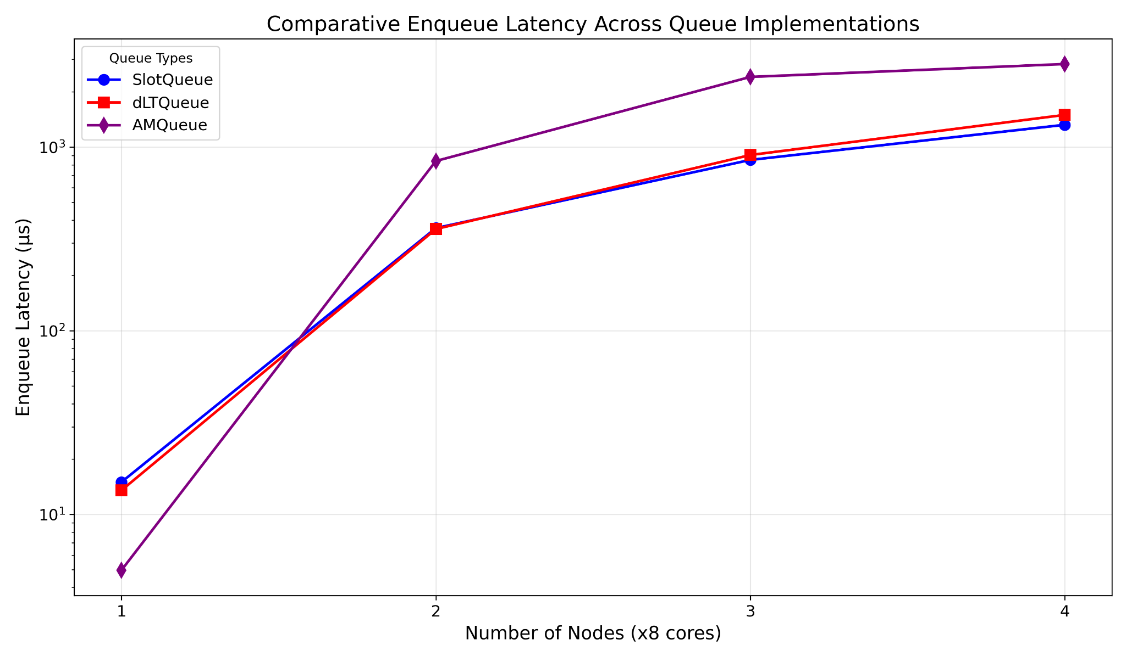
Empirical results - Enqueue latency
Vietnam National University Ho Chi Minh City
Ho Chi Minh University of Technology
Faculty of Computer Science and Engineering

Slide 40
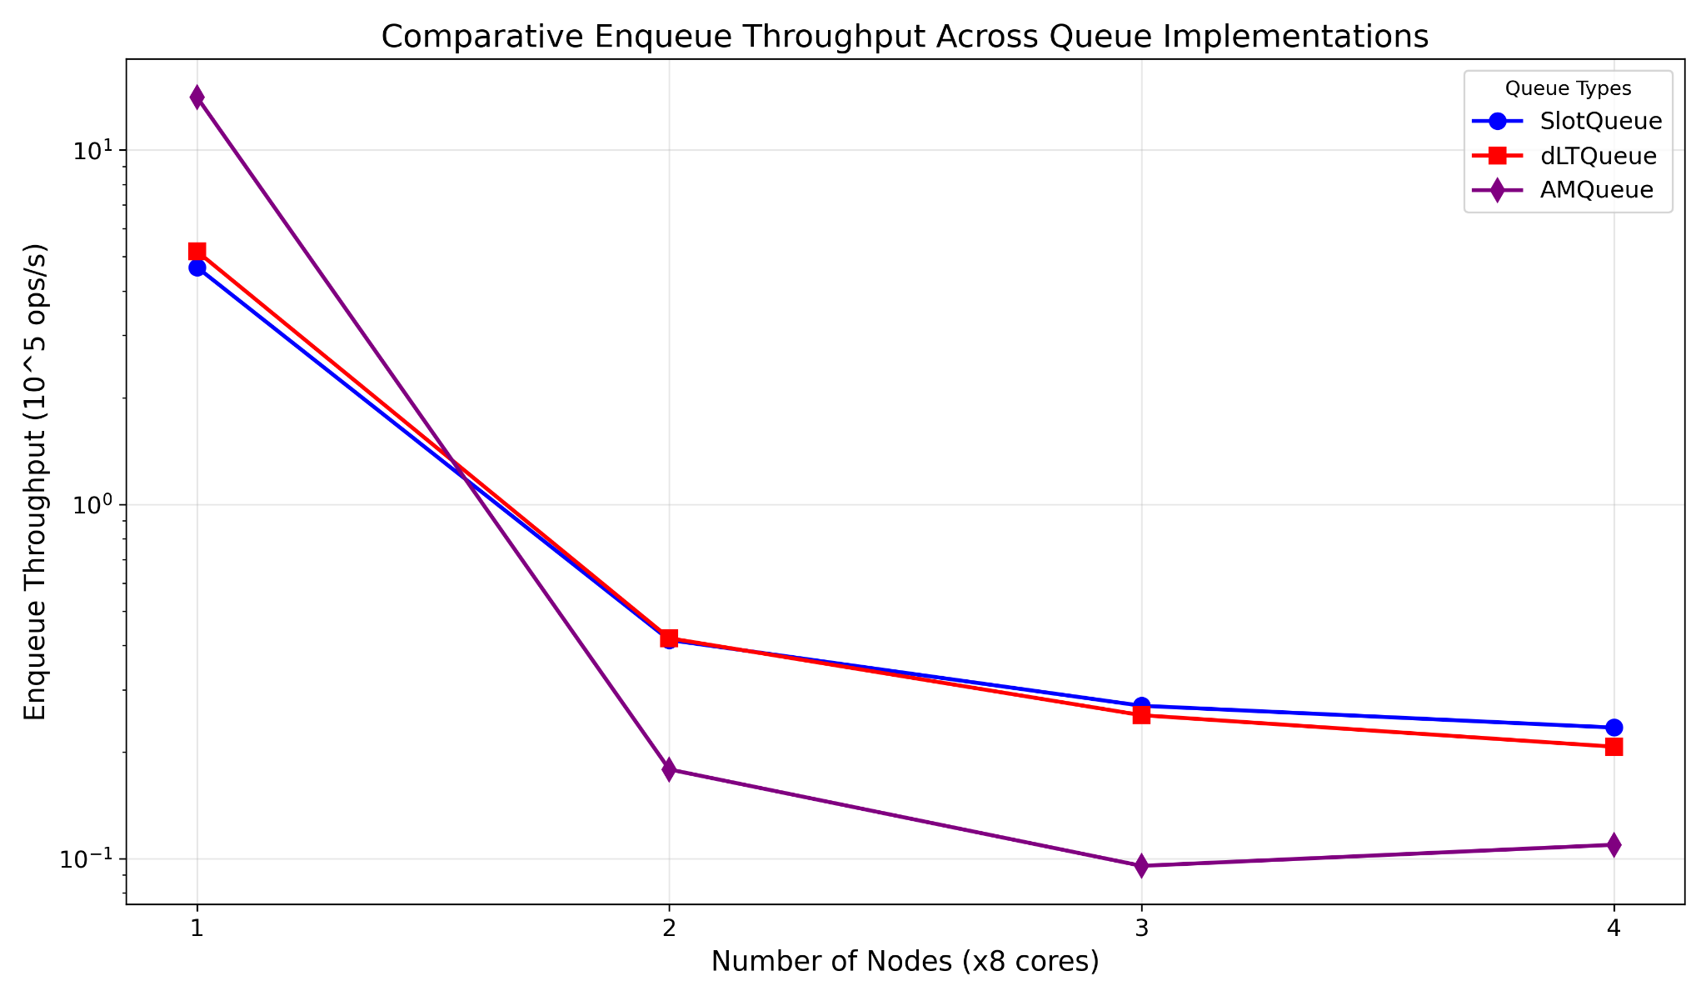
Empirical results - Enqueue throughput
Vietnam National University Ho Chi Minh City
Ho Chi Minh University of Technology
Faculty of Computer Science and Engineering

Slide 41
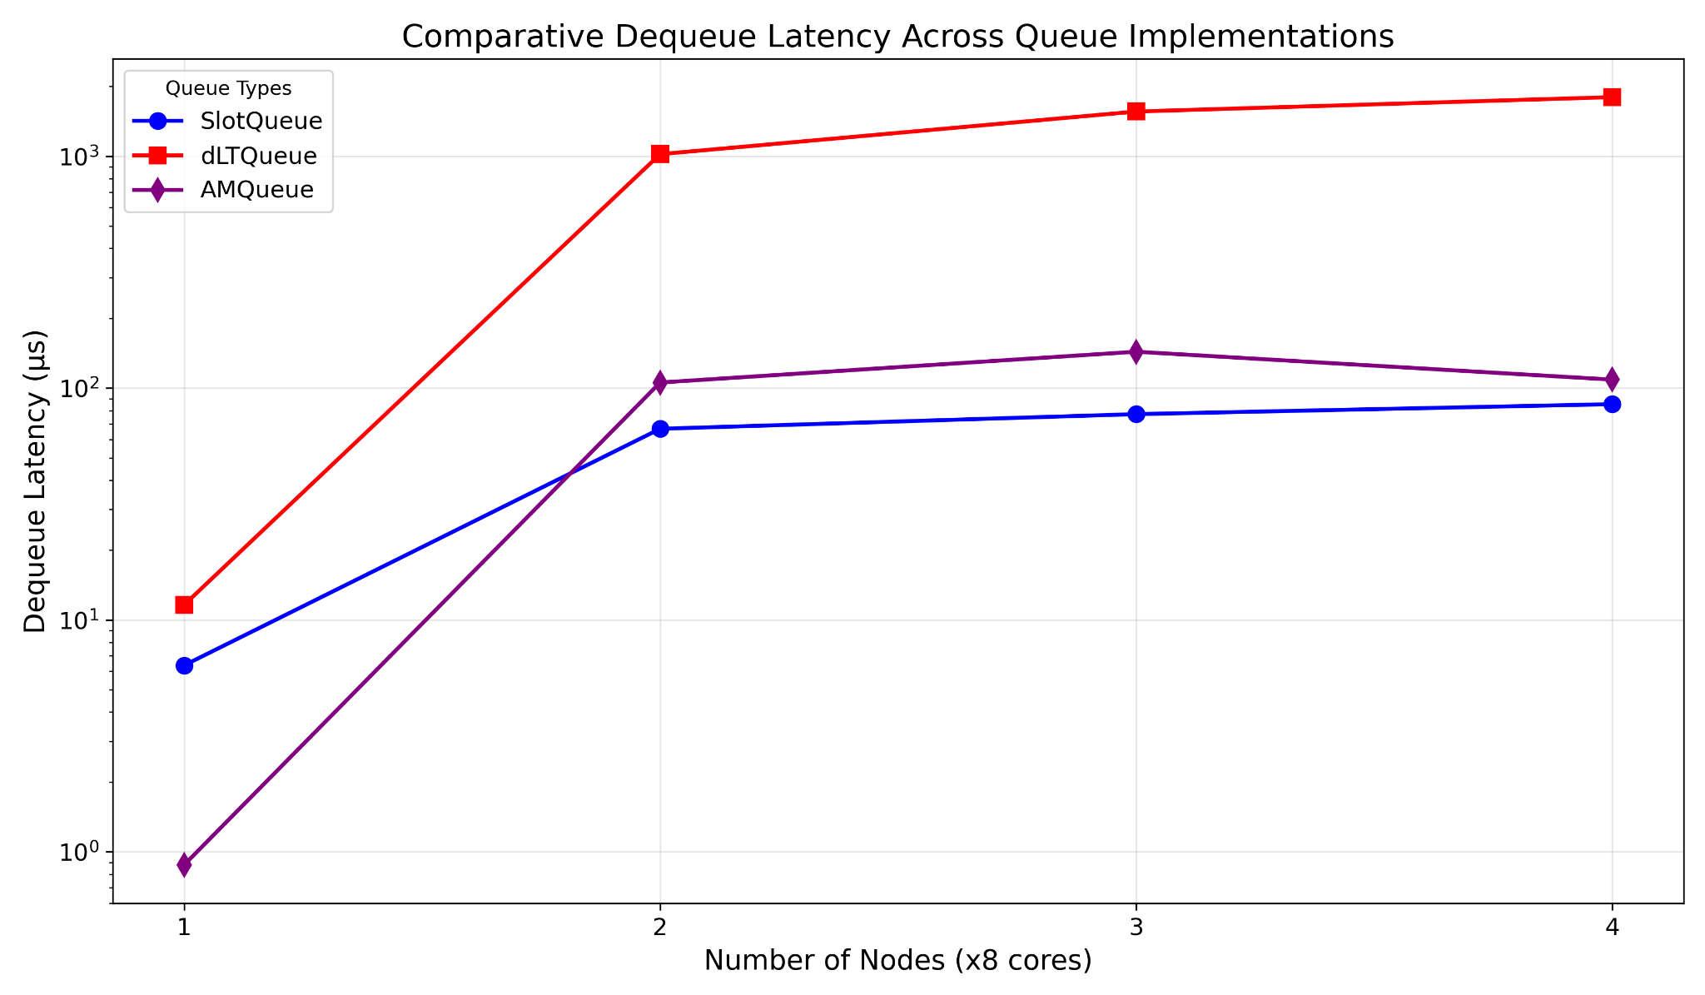
Empirical results - Dequeue latency
Vietnam National University Ho Chi Minh City
Ho Chi Minh University of Technology
Faculty of Computer Science and Engineering

Slide 42
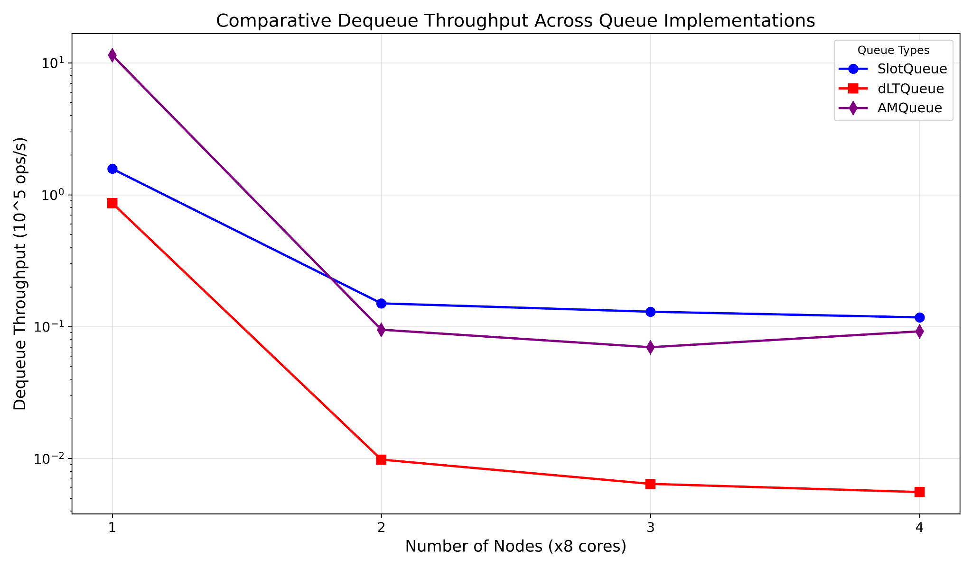
Empirical results - Dequeue throughput
Vietnam National University Ho Chi Minh City
Ho Chi Minh University of Technology
Faculty of Computer Science and Engineering

Slide 43
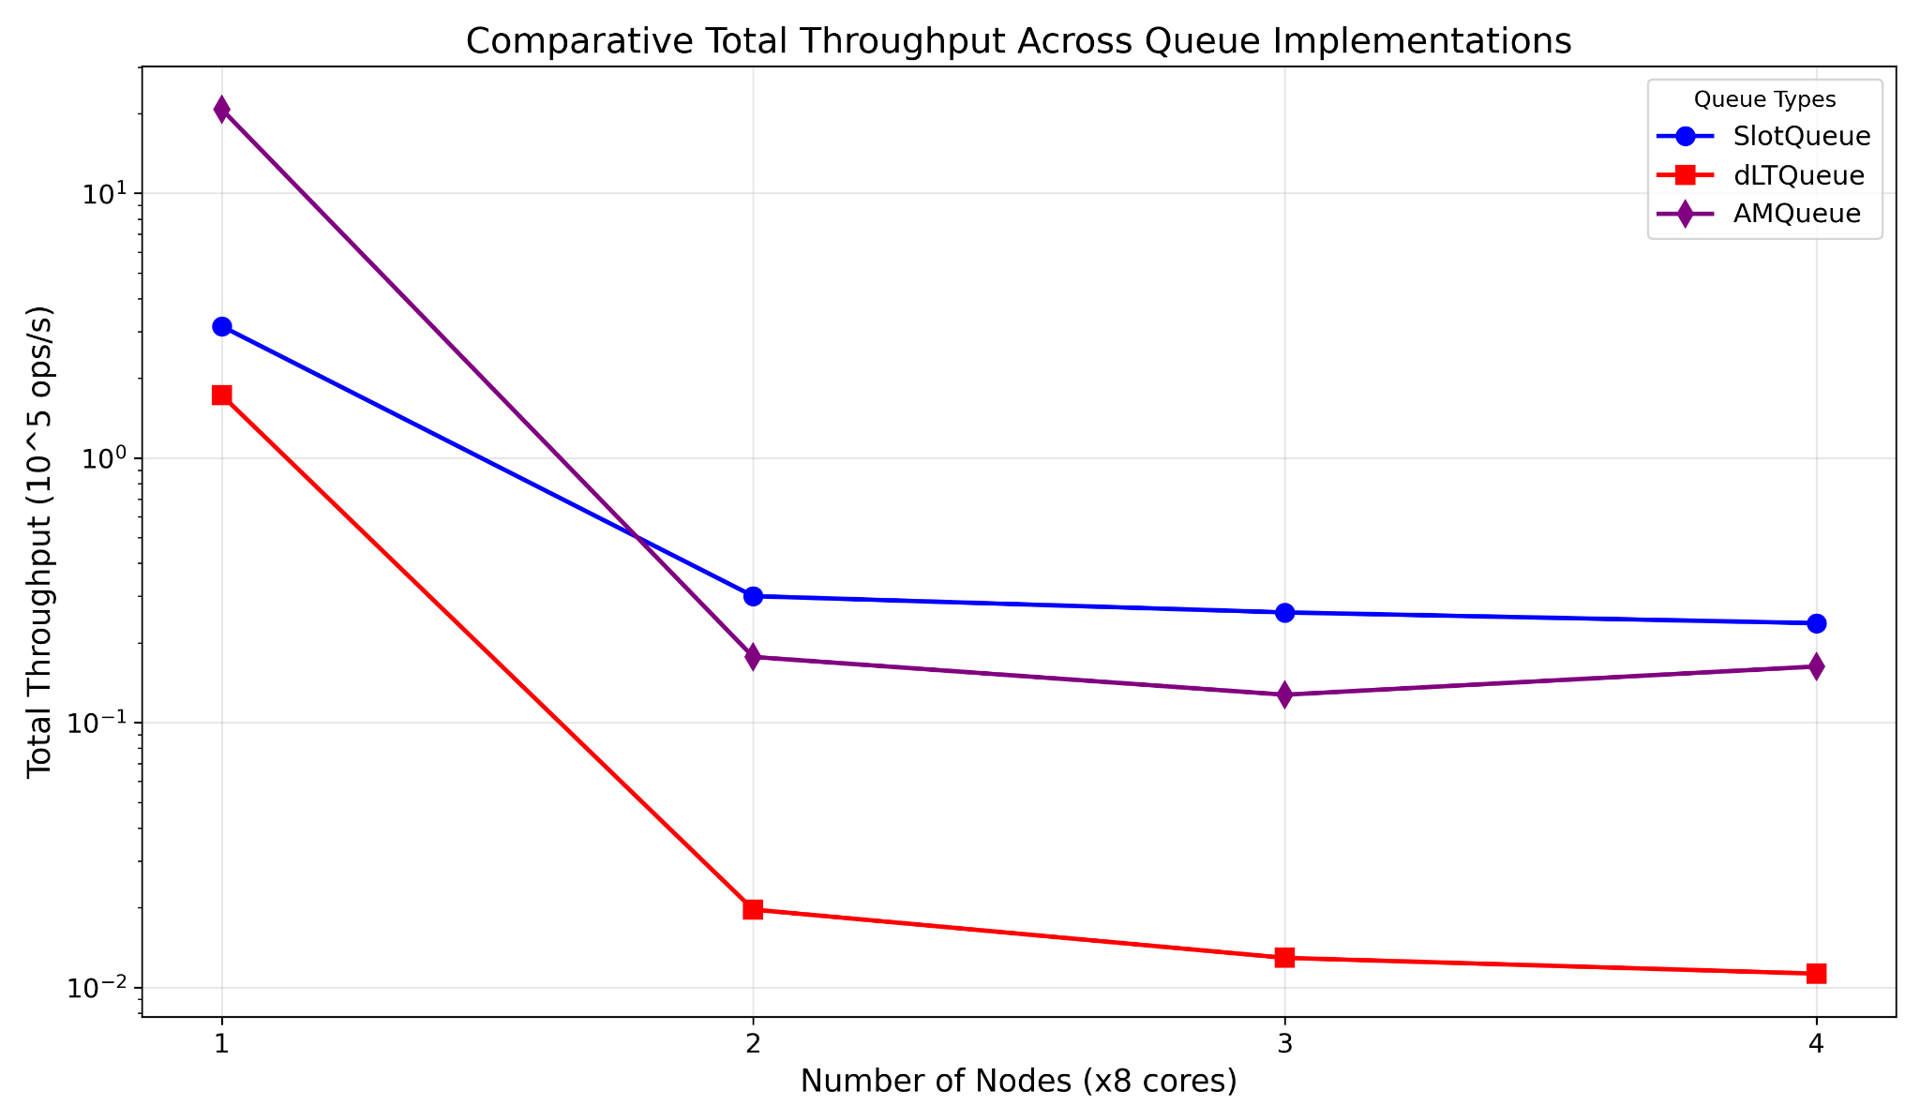
Empirical results - Total throughput
Vietnam National University Ho Chi Minh City
Ho Chi Minh University of Technology
Faculty of Computer Science and Engineering

Slide 44
Empirical results - Next steps
Vietnam National University Ho Chi Minh City
Ho Chi Minh University of Technology
Faculty of Computer Science and Engineering
Investigate Slotqueue's scalability problem.
Adapt Jiffy to distributed environment.
Discover more optimization opportunities for dLTQueue and Slotqueue.

Slide 45
The end
Vietnam National University Ho Chi Minh City
Ho Chi Minh University of Technology
Faculty of Computer Science and Engineering

Slide 46
Appendix
Vietnam National University Ho Chi Minh City
Ho Chi Minh University of Technology
Faculty of Computer Science and Engineering

Slide 47
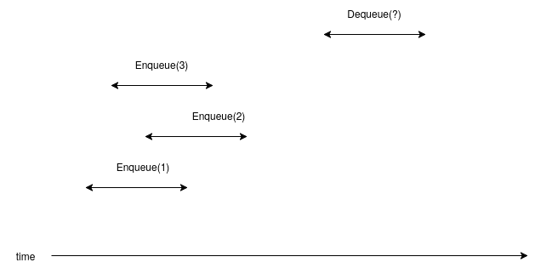
Appendix - Correctness
Vietnam National University Ho Chi Minh City
Ho Chi Minh University of Technology
Faculty of Computer Science and Engineering

Slide 48
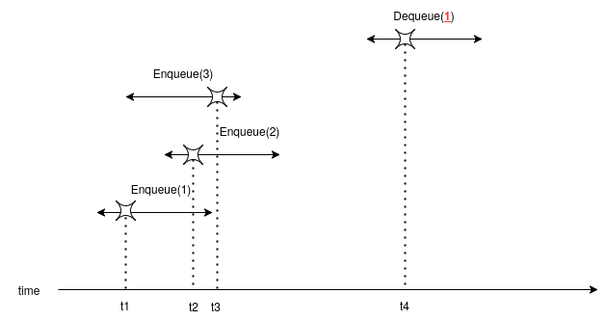
Appendix - Linearizability
Vietnam National University Ho Chi Minh City
Ho Chi Minh University of Technology
Faculty of Computer Science and Engineering
Linearizability: Each method call takes effect at some point during its execution.

Slide 49
Appendix - Safe memory reclamation scheme of LTQueue
Vietnam National University Ho Chi Minh City
Ho Chi Minh University of Technology
Faculty of Computer Science and Engineering
LTQueue pushes safe memory reclamation responsibility to the underlying SPSC, it doesn't perform any memory allocation and deallocation by itself.
First
Last

Slide 50
Appendix - Safe memory reclamation scheme of LTQueue
Vietnam National University Ho Chi Minh City
Ho Chi Minh University of Technology
Faculty of Computer Science and Engineering
Announce
First
Last

Slide 51
Appendix - Safe memory reclamation scheme of LTQueue
Vietnam National University Ho Chi Minh City
Ho Chi Minh University of Technology
Faculty of Computer Science and Engineering
Saved-later
First
Last

Slide 52
Appendix - Safe memory reclamation scheme of dLTQueue
Vietnam National University Ho Chi Minh City
Ho Chi Minh University of Technology
Faculty of Computer Science and Engineering
dLTQueue pushes safe memory reclamation responsibility to the underlying SPSC, it doesn't perform any memory allocation and deallocation by itself.
X
X
X
First
Last

Slide 53
Appendix - Safe memory reclamation scheme of dLTQueue
Vietnam National University Ho Chi Minh City
Ho Chi Minh University of Technology
Faculty of Computer Science and Engineering
dLTQueue pushes safe memory reclamation responsibility to the underlying SPSC, it doesn't perform any memory allocation and deallocation by itself.
X
X
X
First
Last

Slide 54
Appendix - ABA safety
Vietnam National University Ho Chi Minh City
Ho Chi Minh University of Technology
Faculty of Computer Science and Engineering
ABA sequence
read a shared variable x
CAS x to a new value
No write to shared variables

Slide 55
Appendix - ABA safety
Vietnam National University Ho Chi Minh City
Ho Chi Minh University of Technology
Faculty of Computer Science and Engineering
successful
read x
CAS(x)
successful
ABA problem!
read x
CAS(x)

Slide 56
Appendix - ABA safety
Vietnam National University Ho Chi Minh City
Ho Chi Minh University of Technology
Faculty of Computer Science and Engineering
First process
read x
CAS(x)
read x
CAS(x)
Suppose the system states during these 2 time spans are indistinguishable from the first process's POV.

Slide 57
Appendix - ABA safety
Vietnam National University Ho Chi Minh City
Ho Chi Minh University of Technology
Faculty of Computer Science and Engineering
read x
CAS(x)
read x
CAS(x)
Then the effect is as if these two CAS sequences do not overlap. => ABA-safe

Slide 58
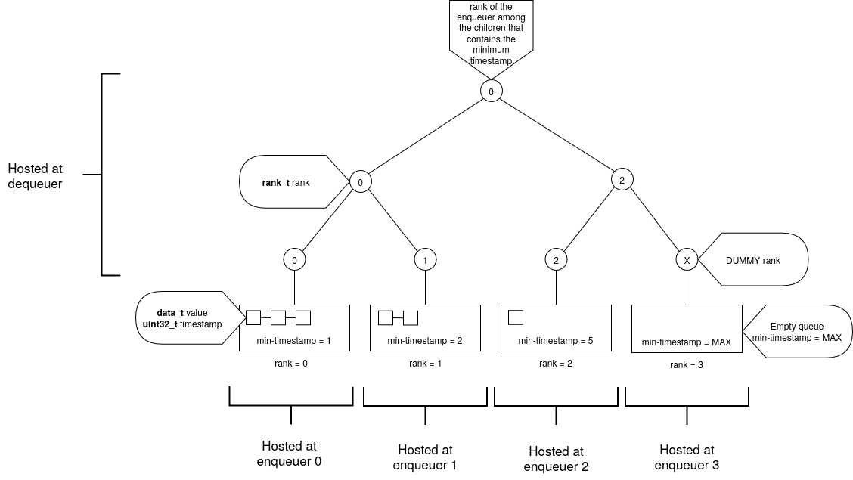
Appendix - dLTQueue
Vietnam National University Ho Chi Minh City
Ho Chi Minh University of Technology
Faculty of Computer Science and Engineering

Slide 59
Appendix - dLTQueue
Vietnam National University Ho Chi Minh City
Ho Chi Minh University of Technology
Faculty of Computer Science and Engineering
Enqueuer node

Slide 60
Appendix - dLTQueue
Vietnam National University Ho Chi Minh City
Ho Chi Minh University of Technology
Faculty of Computer Science and Engineering
Tree node

Slide 61
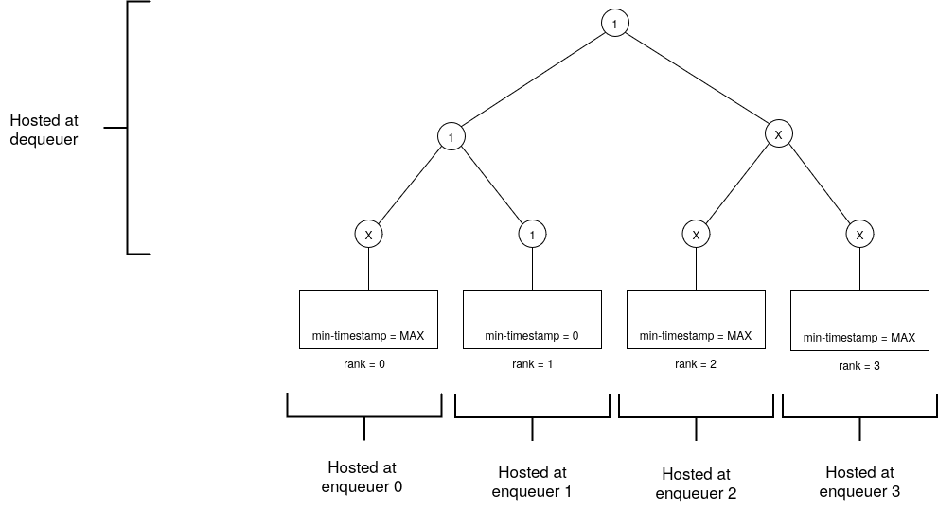
Appendix - dLTQueue's enqueue
Vietnam National University Ho Chi Minh City
Ho Chi Minh University of Technology
Faculty of Computer Science and Engineering
Counter = 1
Initial state

Slide 62
Appendix - dLTQueue's enqueue
Vietnam National University Ho Chi Minh City
Ho Chi Minh University of Technology
Faculty of Computer Science and Engineering
Counter = 1
Enqueuer 2 wants to enqueue a value

Slide 63
Appendix - dLTQueue's enqueue
Vietnam National University Ho Chi Minh City
Ho Chi Minh University of Technology
Faculty of Computer Science and Engineering
Counter = 2
Enqueuer 2 obtains
timestamp = 1

Slide 64

Appendix - dLTQueue's enqueue
Vietnam National University Ho Chi Minh City
Ho Chi Minh University of Technology
Faculty of Computer Science and Engineering
Counter = 2
Enqueuer 2 enqueues (-, 1) to its SPSC

Slide 65

Appendix - dLTQueue's enqueue
Vietnam National University Ho Chi Minh City
Ho Chi Minh University of Technology
Faculty of Computer Science and Engineering
Counter = 2
Enqueuer 2 refreshes its node's min-timestamp to 1

Slide 66
Appendix - dLTQueue's enqueue
Vietnam National University Ho Chi Minh City
Ho Chi Minh University of Technology
Faculty of Computer Science and Engineering
Counter = 2
Nodes that needs refreshing

Slide 67

Appendix - dLTQueue's enqueue
Vietnam National University Ho Chi Minh City
Ho Chi Minh University of Technology
Faculty of Computer Science and Engineering
Counter = 2
Final state

Slide 68
Appendix - dLTQueue's dequeue
Vietnam National University Ho Chi Minh City
Ho Chi Minh University of Technology
Faculty of Computer Science and Engineering
Counter = 2
Initial state

Slide 69
Appendix - dLTQueue's dequeue
Vietnam National University Ho Chi Minh City
Ho Chi Minh University of Technology
Faculty of Computer Science and Engineering
Counter = 2
Dequeuer sees rank 1.

Slide 70

Appendix - dLTQueue's dequeue
Vietnam National University Ho Chi Minh City
Ho Chi Minh University of Technology
Faculty of Computer Science and Engineering
Counter = 2
Dequeuer dequeues from the local SPSC of rank 1.

Slide 71

Appendix - dLTQueue's dequeue
Vietnam National University Ho Chi Minh City
Ho Chi Minh University of Technology
Faculty of Computer Science and Engineering
Counter = 2
Final state

Slide 72
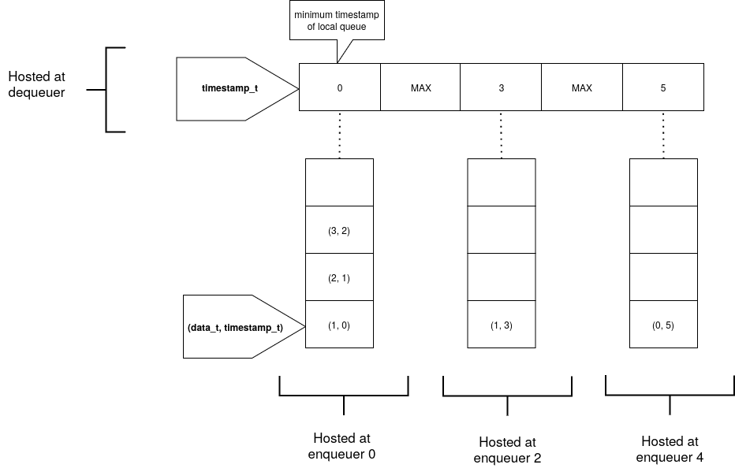
Appendix - Slotqueue
Vietnam National University Ho Chi Minh City
Ho Chi Minh University of Technology
Faculty of Computer Science and Engineering
Notes:
Explain the flattened idea

Slide 73
Appendix - Slotqueue
Vietnam National University Ho Chi Minh City
Ho Chi Minh University of Technology
Faculty of Computer Science and Engineering
Each enqueuer process hosts a distributed SPSC.

Slide 74
Appendix - Slotqueue
Vietnam National University Ho Chi Minh City
Ho Chi Minh University of Technology
Faculty of Computer Science and Engineering
A Slot storing the minimum timestamp of the corresponding SPSC.

Slide 75
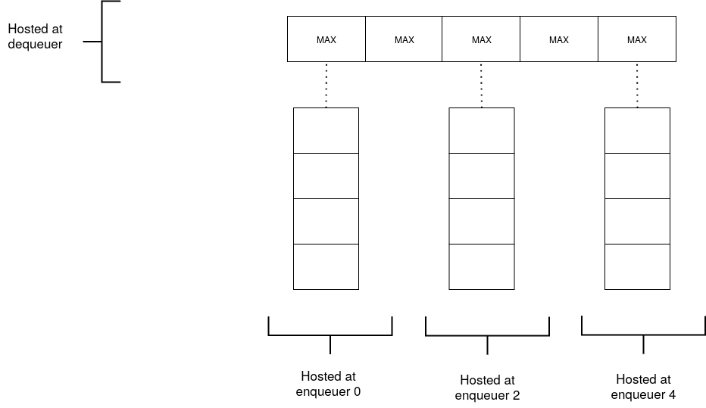
Appendix - Slotqueue’s enqueue
Vietnam National University Ho Chi Minh City
Ho Chi Minh University of Technology
Faculty of Computer Science and Engineering
Counter: 0
Initial state

Slide 76
Appendix - Slotqueue’s enqueue
Vietnam National University Ho Chi Minh City
Ho Chi Minh University of Technology
Faculty of Computer Science and Engineering
Counter: 0
Enqueuer 0 wants to enqueue a value.

Slide 77
Appendix - Slotqueue’s enqueue
Vietnam National University Ho Chi Minh City
Ho Chi Minh University of Technology
Faculty of Computer Science and Engineering
Counter: 1
Enqueuer 0 obtains the timestamp value = 0.

Slide 78

Appendix - Slotqueue’s enqueue
Vietnam National University Ho Chi Minh City
Ho Chi Minh University of Technology
Faculty of Computer Science and Engineering
Counter: 1
Enqueuer 0 enqueues the value and timestamp to its local SPSC.

Slide 79

Appendix - Slotqueue’s enqueue
Vietnam National University Ho Chi Minh City
Ho Chi Minh University of Technology
Faculty of Computer Science and Engineering
Counter: 1
Enqueuer 0 refreshes its slot with the minimum timestamp in the local SPSC.

Slide 80
Appendix - Slotqueue’s enqueue
Vietnam National University Ho Chi Minh City
Ho Chi Minh University of Technology
Faculty of Computer Science and Engineering
Counter: 1
Final state

Slide 81

Appendix - Slotqueue’s dequeue
Vietnam National University Ho Chi Minh City
Ho Chi Minh University of Technology
Faculty of Computer Science and Engineering
Counter: 3
Initial state

Slide 82
Appendix - Slotqueue’s dequeue
Vietnam National University Ho Chi Minh City
Ho Chi Minh University of Technology
Faculty of Computer Science and Engineering
Counter: 3
Dequeuer scans the slots for the minimum timestamp. It finds 0.

Slide 83
Appendix - Slotqueue’s dequeue
Vietnam National University Ho Chi Minh City
Ho Chi Minh University of Technology
Faculty of Computer Science and Engineering
Counter: 3
The dequeuer has to perform a rescan a second time to ensure linearizability. It still finds 0.

Slide 84

Appendix - Slotqueue’s dequeue
Vietnam National University Ho Chi Minh City
Ho Chi Minh University of Technology
Faculty of Computer Science and Engineering
Counter: 3
The dequeuer then dequeues from the SPSC of rank 0.

Slide 85

Appendix - Slotqueue’s dequeue
Vietnam National University Ho Chi Minh City
Ho Chi Minh University of Technology
Faculty of Computer Science and Engineering
Counter: 3
The dequeuer refreshes the slot of rank 0.

Slide 86
Appendix - Slotqueue’s dequeue
Vietnam National University Ho Chi Minh City
Ho Chi Minh University of Technology
Faculty of Computer Science and Engineering
Counter: 3
Final state

Slide 87

Appendix - Refresh in details (dLTqueue)
Vietnam National University Ho Chi Minh City
Ho Chi Minh University of Technology
Faculty of Computer Science and Engineering

Slide 88
Appendix - Refresh in details (dLTqueue)
Vietnam National University Ho Chi Minh City
Ho Chi Minh University of Technology
Faculty of Computer Science and Engineering
Read old_rank = X

Slide 89
Appendix - Refresh in details (dLTqueue)
Vietnam National University Ho Chi Minh City
Ho Chi Minh University of Technology
Faculty of Computer Science and Engineering
new_rank = rank with minimum min-timestamp = 2

Slide 90
Appendix - Refresh in details (dLTqueue)
Vietnam National University Ho Chi Minh City
Ho Chi Minh University of Technology
Faculty of Computer Science and Engineering
CAS(&node, old_rank, new_rank)
If fail, try one more time!

Slide 91
Appendix - Refresh in details (Slotqueue)
Vietnam National University Ho Chi Minh City
Ho Chi Minh University of Technology
Faculty of Computer Science and Engineering

Slide 92
Appendix - Refresh in details (Slotqueue)
Vietnam National University Ho Chi Minh City
Ho Chi Minh University of Technology
Faculty of Computer Science and Engineering
Read old_slot = MAX

Slide 93
Appendix - Refresh in details (Slotqueue)
Vietnam National University Ho Chi Minh City
Ho Chi Minh University of Technology
Faculty of Computer Science and Engineering
new_slot = spsc.readFront() = 0

Slide 94
Appendix - Refresh in details (Slotqueue)
Vietnam National University Ho Chi Minh City
Ho Chi Minh University of Technology
Faculty of Computer Science and Engineering
CAS(&slot, old_slot, new_slot)
If fail, try one more time!

Slide 95
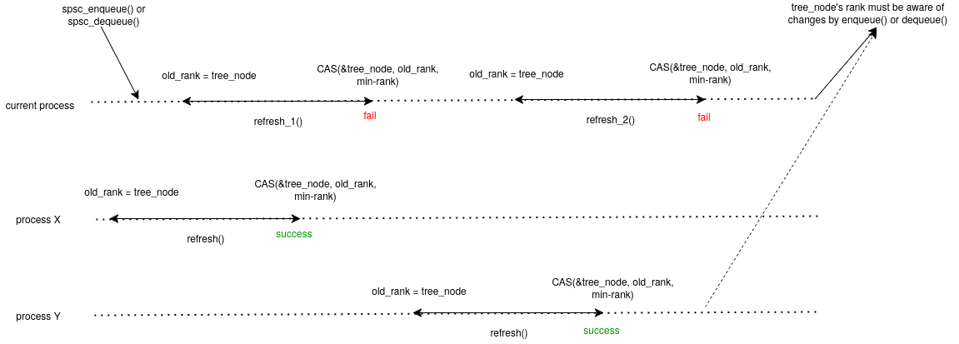
Appendix - Why only retry 2 times?
Vietnam National University Ho Chi Minh City
Ho Chi Minh University of Technology
Faculty of Computer Science and Engineering

Slide 96
Appendix - Why do we need 2 scans?
Vietnam National University Ho Chi Minh City
Ho Chi Minh University of Technology
Faculty of Computer Science and Engineering

Slide 97

Appendix - Why do we need 2 scans?
Vietnam National University Ho Chi Minh City
Ho Chi Minh University of Technology
Faculty of Computer Science and Engineering

Slide 98
Appendix - Why do we need 2 scans?
Vietnam National University Ho Chi Minh City
Ho Chi Minh University of Technology
Faculty of Computer Science and Engineering
Dequeuer check slot 0, nothing.

Slide 99
Appendix - Why do we need 2 scans?
Vietnam National University Ho Chi Minh City
Ho Chi Minh University of Technology
Faculty of Computer Science and Engineering
Dequeuer check slot 1, nothing. Then it suspends.

Slide 100

Appendix - Why do we need 2 scans?
Vietnam National University Ho Chi Minh City
Ho Chi Minh University of Technology
Faculty of Computer Science and Engineering
Enqueuer 0 obtains timestamp 0 and finishes enqueueing.

Slide 101

Appendix - Why do we need 2 scans?
Vietnam National University Ho Chi Minh City
Ho Chi Minh University of Technology
Faculty of Computer Science and Engineering
Enqueuer 2 obtains timestamp 1 and finishes enqueueing.

Slide 102
Appendix - Why do we need 2 scans?
Vietnam National University Ho Chi Minh City
Ho Chi Minh University of Technology
Faculty of Computer Science and Engineering
Dequeuer continues scanning and find 1 at slot 2. However, it's not linearizable to dequeue from this slot.

Slide 103
Appendix - Why do we need 2 scans?
Vietnam National University Ho Chi Minh City
Ho Chi Minh University of Technology
Faculty of Computer Science and Engineering
Dequeuer performs the scan a second time and finds 0.

Slide 104

Appendix - Why only 2 scans?
Vietnam National University Ho Chi Minh City
Ho Chi Minh University of Technology
Faculty of Computer Science and Engineering

Slide 105
Appendix - Why only 2 scans?
Vietnam National University Ho Chi Minh City
Ho Chi Minh University of Technology
Faculty of Computer Science and Engineering
Dequeuer finds this in the first scan
Dequeuer finds this in the second scan

Slide 106
Appendix - Why only 2 scans?
Vietnam National University Ho Chi Minh City
Ho Chi Minh University of Technology
Faculty of Computer Science and Engineering
t0 < t2
t0
t2

Slide 107
Appendix - Why only 2 scans?
Vietnam National University Ho Chi Minh City
Ho Chi Minh University of Technology
Faculty of Computer Science and Engineering
t0 < t2 < t3
t0
t2
If one of these is non-MAX during the second scan at t3...

Slide 108
Appendix - Why only 2 scans?
Vietnam National University Ho Chi Minh City
Ho Chi Minh University of Technology
Faculty of Computer Science and Engineering
t0 < t2 < t3
t0
t2
If one of these is MAX during the second scan at t3...

Slide 109
Appendix - Why only 2 scans?
Vietnam National University Ho Chi Minh City
Ho Chi Minh University of Technology
Faculty of Computer Science and Engineering
t0 < t1 < t2
t0
t2
If one of these is non-MAX during the second scan at t1...

Slide 110
Appendix - Why only 2 scans?
Vietnam National University Ho Chi Minh City
Ho Chi Minh University of Technology
Faculty of Computer Science and Engineering
t0 < t1 < t2
t0
t2
If one of these is MAX during the second scan at t1...

