Slide 1

REVERSABLE COMPUTATION
GROUP 20

Slide 2
MARWAN
OVERVIEW OF PURPOSE

Slide 3
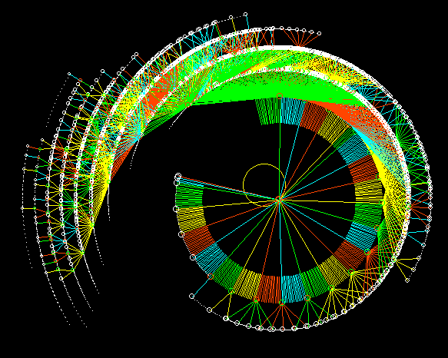
WHAT IS REVERSABLE COMPUTATION?
reversible computation allows the computer program to maintain a complete record of all the input and output values, making it possible to undo previous computations and recover the original inputs.

Slide 4
REVERSABLE COMPUTATION USES
Cryptography, by reducing the amount of data that needs to be stored and processed
situations where the computer program needs to maintain a record of all the input and output values for auditing or debugging purposes
Quantum computers use reversible computation as their underlying computing paradigm, making it possible to perform complex computations that are not feasible using classical computers.
computer hardware, such as reversible logic gates, which can reduce energy consumption and improve the efficiency of computing systems.

Slide 5

SPREADING AWARENESS
relatively new and specialized field, and it has not yet been widely adopted in mainstream computing systems
Complex making it more difficult for developers to write and debug reversible computing programs.
Reversible computation requires more memory making it expensive to run.
There is a lack of software tools and libraries for reversible computation.
We therefore must spread awareness on the subject due to how useful it can be so we can overcome the obstacles holding it back.

Slide 6
HARRY
KEY FEATURES

Slide 7
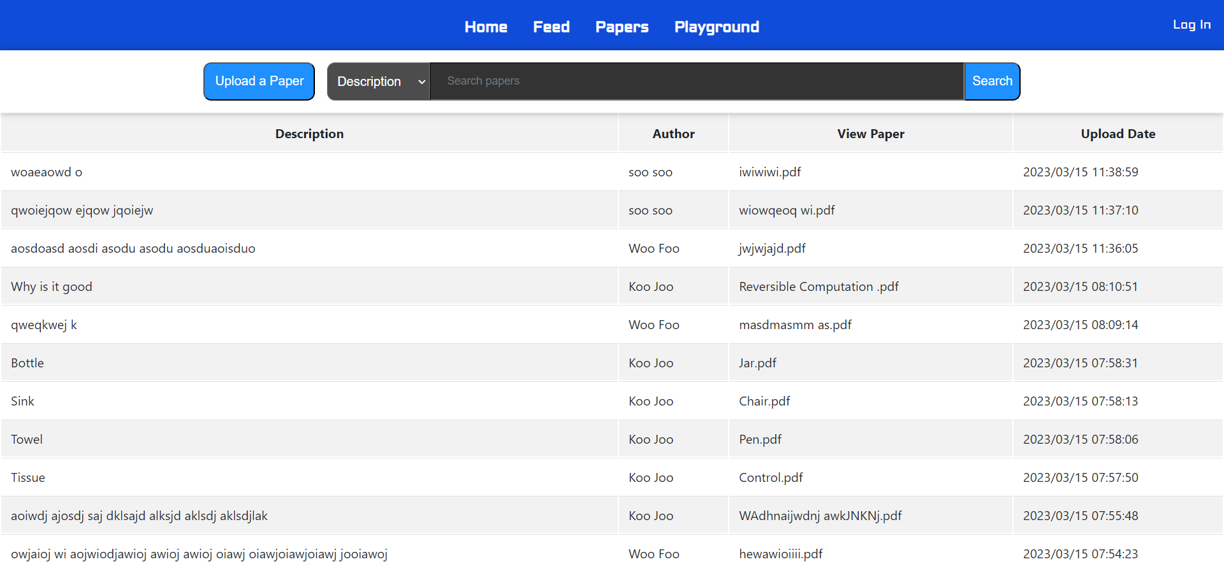
Papers
Allows users to upload pdf files
Viewable by other users
Facilitates the exchange of research

Slide 8
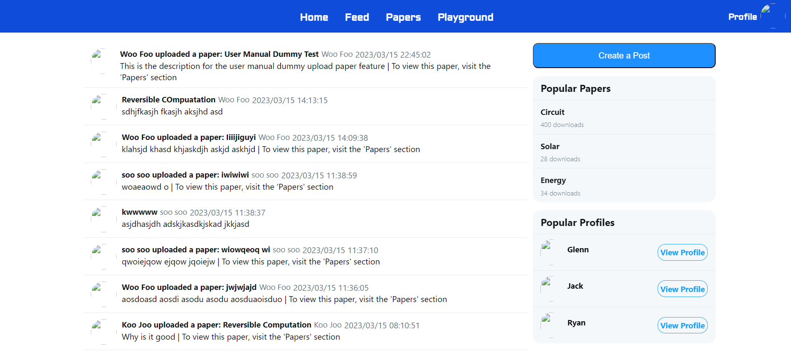
Feed
Allows users to communicate
Users can organise

Slide 9
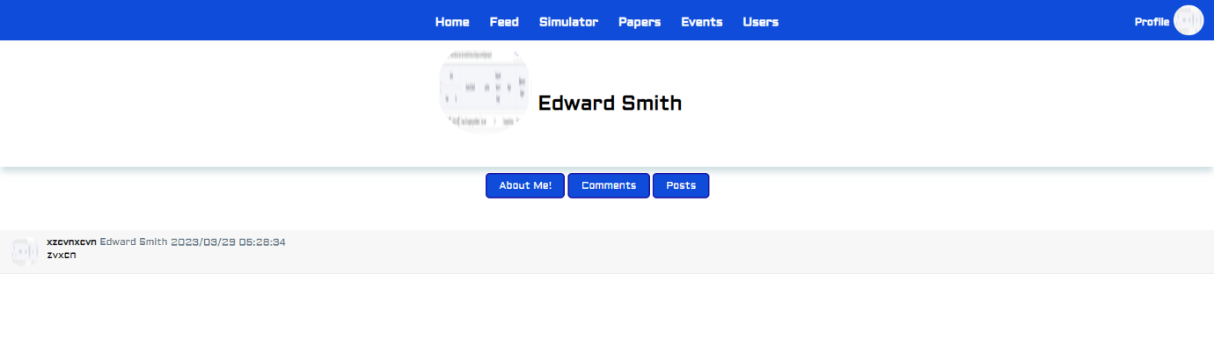
Profile
Users can see posts that someone has made
Can look into individuals of interest

Slide 10
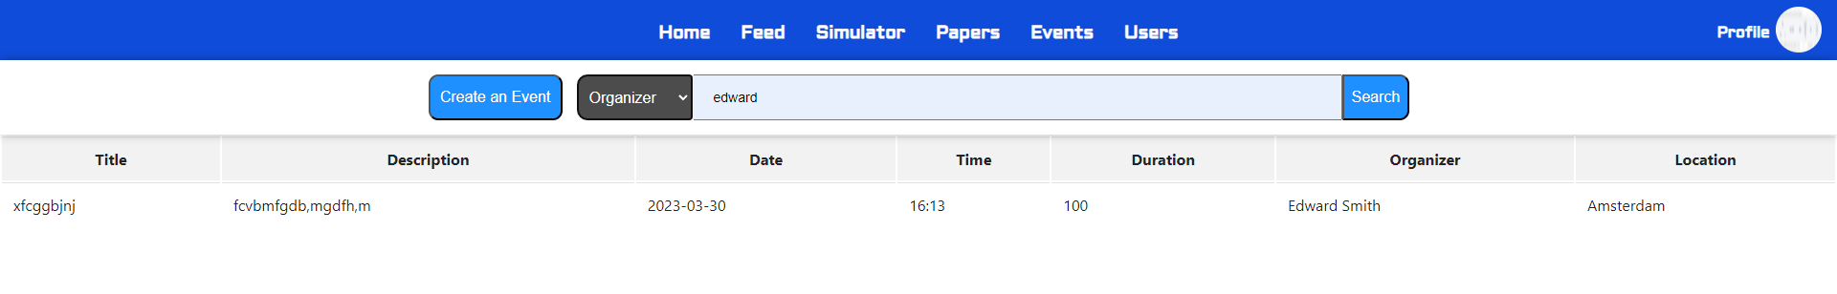
Events
Allows users to schedule events

Slide 11
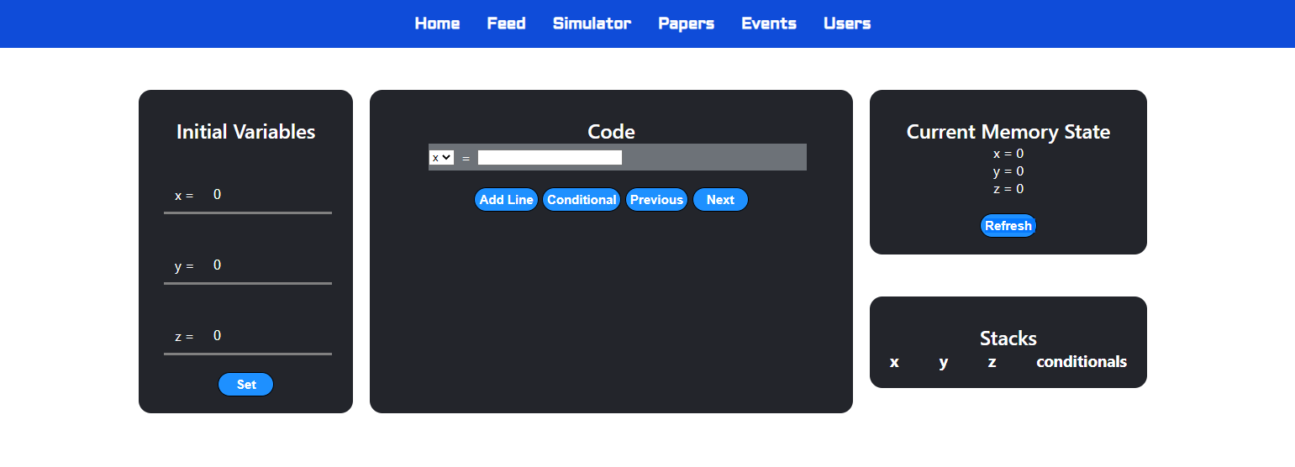
Simulator
Allows users not familiar with Reversible Computation to learn and engage with the subject matter

Slide 12
MANDEEP
SOFTWARE ARCHITECTURE

Slide 13
What is Soft Arc Components used
Is the blueprint for a system
Architecture describes
Major components
Structure of components
How components interact
Spring Boot
Java
HTML + CSS
MySQL
Hibernate
JavaScript

Slide 14
Architecture of the Software
Dispatcher Servlet
Step 2
Match URL to Controller
HTTP Client
HandlerMapping (Matches requests to Controller)
View Resolver
(Locates html page)
@Controller
Contains code to execute
Step 3
Get data from Model/DB
Step 1 Send Request
Model/Database
Stores data
Step 4
Send data and HTML page
Step 5
Load View
View
Step 6
Send view to Client

Slide 15
Example Request
Dispatcher Servlet
1st Step: Send a Request
http://localhost:8080/feed
Feed Page
HTTP Client
HandlerMapping (Matches requests to Controller)
View Resolver
(Locates html page)
Step 1 Send Request

Slide 16

Example Request
Dispatcher Servlet
2nd Step: Match Requested URL to correct Controller
Step 2
Match URL to Controller
HandlerMapping (Matches requests to Controller)
View Resolver
(Locates html page)
@Controller
Contains code to execute

Slide 17


Example Request
3rd Step: Controller executes code and gets required data from Model/Database
^Getting data using repository
^Returns ‘feed.html’ in from feed directory
@Controller
Contains code to execute
Step 3
Get data from Model/DB
Model/Database
Stores data

Slide 18
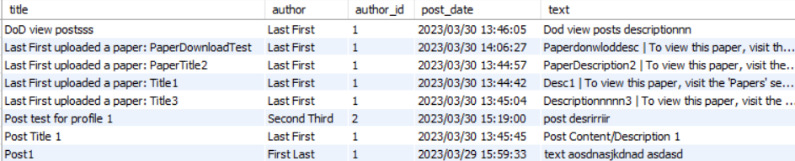
Example Request
Dispatcher Servlet
HandlerMapping (Matches requests to Controller)
View Resolver
(Locates html page)
4th Step: Controller sends acquired data (posts) and name of HTML page (feed.html) to View Resolver
Acquired data from DB:
@Controller
Contains code to execute
Step 4
Send data and HTML page

Slide 19
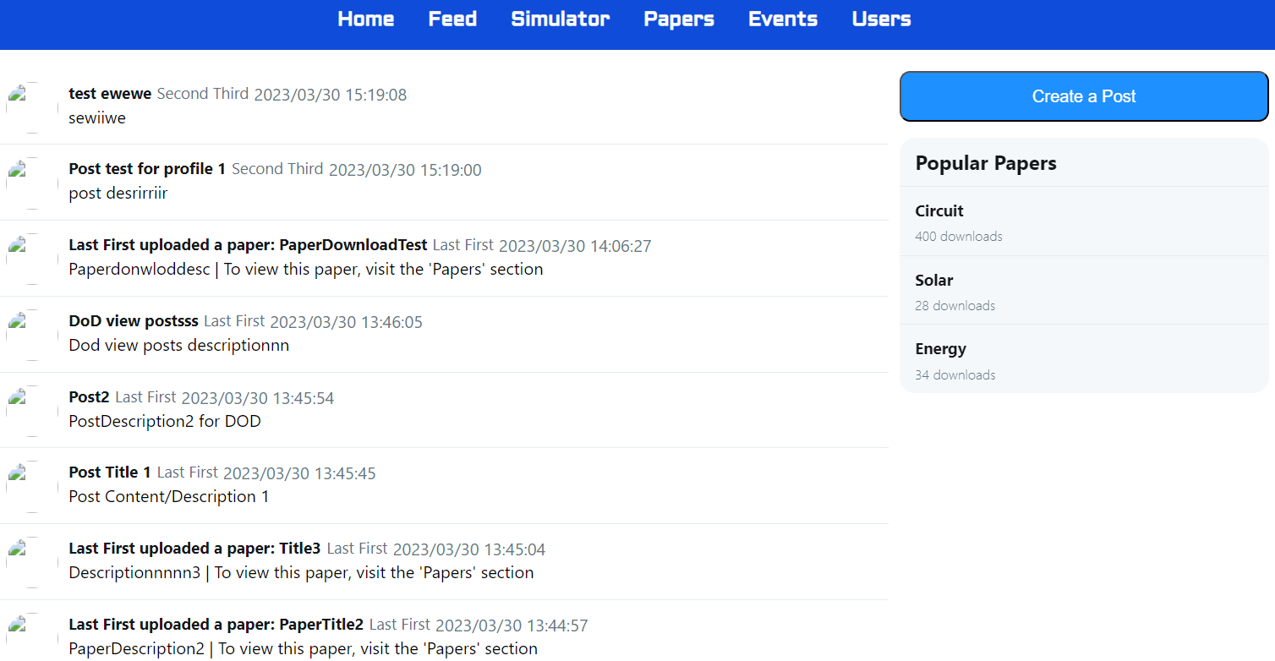
Example Request
HandlerMapping (Matches requests to Controller)
View Resolver
(Locates html page)
5th Step: View Resolver loads the View (page) using the data and HTML file
Loaded View →
Step 5
Load View
View

Slide 20
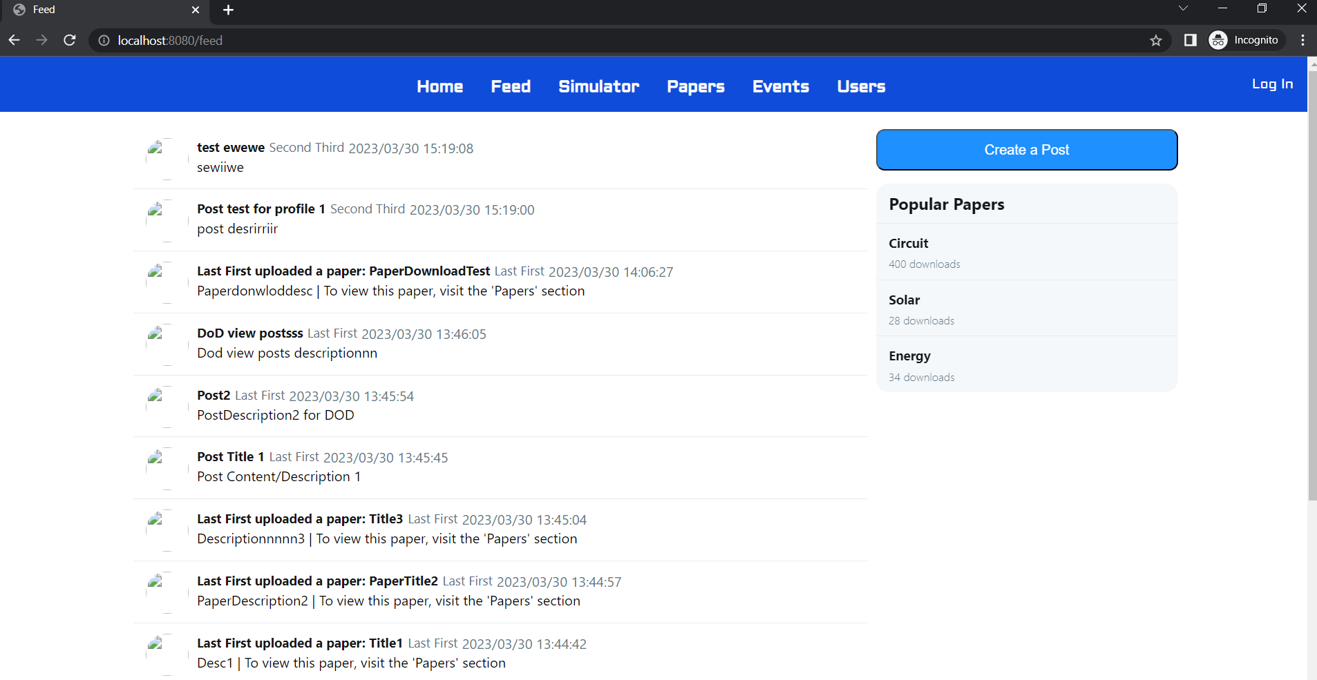
Example Request
HTTP Client
Step 6: Loaded View is sent to Client
View in Client’s browser:
View
Step 6
Send view to Client

Slide 21
Questions

Slide 22
LILIAN
IMPACT ON THE COMMUNITY

Slide 23
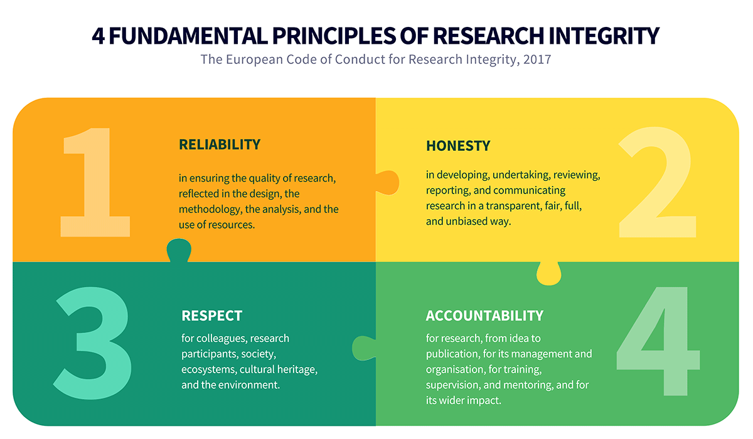
POSITIVE AND NEGATIVE IMPACTS TO SOCIETY
POSITIVE IMPACTS
Advancement of research
Openness and Transparency

Slide 24
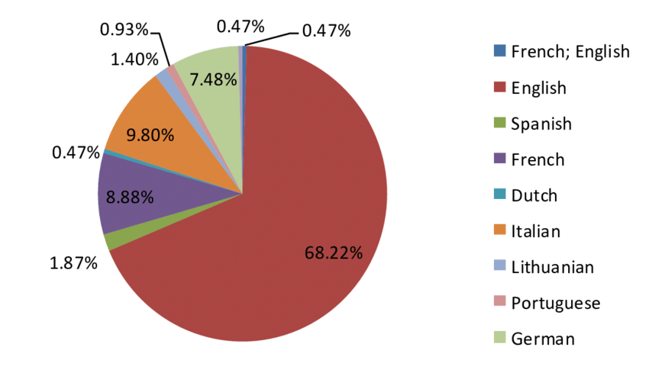
POSITIVE AND NEGATIVE IMPACTS TO SOCIETY
NEGATIVE IMPACTS
Lack of accessibility
Misuse of Information

Slide 25
POSITIVE AND NEGATIVE IMPACTS TO SOCIETY
SOLUTIONS
Ensure the website is designed with accessibility in mind
Develop clear policies and guidelines for the use of information shared on the website

Slide 26
LUKAS
• Realistic plans to take this project onwards

Slide 27
USER EXPERIENCE
Customisation
Provide the option for extra profile customisation, e.g. place of work
Implement website themes, e.g. dark and light
Language Support
Provide support for multiple languages
Allows us to build a larger and more diverse community
Gives more people access to materials they might have been missing, e.g. research papers

Slide 28
NEW FEATURES
Adding new features is important to keep the look fresh and appealing.
Ideas
Improve the simulator to function with complicated programs
Save favourite papers
Create groups for working and/or socialising
Forums for general or focused discussion of topics

Slide 29
MONETISATION
Server and database costs can be high, addition of advertisements may be necessary to keep the website running.
Ideas
Buy me a coffee/Patreon button
Non-invasive advertisements
Subscription service for instant access to the simulator (even when demand is high)

Slide 30
VICTOR
Something Non-Technical That I Learned During The Project

Slide 31
Non – Technical Things I Learned
ADAPTABILITY
I learned to be adaptable as unpredictable events can happen such as:
Sprint 3
Missing or late members at meetings.
PATIENCE
I learned to be patient with my group. For example:
Waiting for partner
PLANNING
Assigning tasks at the beginning of each sprint and planning meeting times.
RECEIVEING FEEDBACK/CRITCISM
The ability to trust others feedback and to compromise for the group
TIME MANAGEMENT
Prioritising certain tasks before others

Slide 32
THANKS FOR WATCHING
WE HOPE YOU ENJOYED

