Slide 1
Implementation irrigation system using Support Vector Machine
Electronics Research Institute
Presented to Dr. Heba Draz, ECIP Internship Program Committee
Presented by: Hazem & Ali
https://eri.sci.eg
Notes:
Hello everyone today I am going to talk about the first paper which is Implementation irrigation system using Support Vector Machine SVM

Slide 2
Agenda
01
Problem Statement
A Problem Statement is a clear, concise description of an issue that needs to be solved. It explains what the problem is, who it affects, and why it matters, without giving the solution yet.
02
About the Authors
A short section that gives brief background information about the people who wrote the paper.
03
Proposed Solution
The Proposed Solution explains how to solve the problem described in the problem statement.
04
Support Vector Machine
SVM is a machine learning method that learns from examples, finds patterns and classifies new data into groups.
05
Communication Protocol
What is the best for real-time IoT communication?
Notes:
So here is our agenda for the first presentation we will start with the problem statement, its just a concise description of an issue that needs to be solved also I will talk about the authors, proposed solutions and ofc the new technical topics which are the svm and the communication protocol used in this situation

Slide 3
Problem Statement
Why is it important to fix?
Notes:
Again why it is important to fix

Slide 4

Problem Statement – Inefficient Irrigation in Farming
04
02
01
The authors want a system that:
decides how much water plants need
opens the water pump valve by the correct amount.
This causes two big problems:
Too much water → waste of water
Too little water → plants do not grow well
As engineers we need to solve this problem
Because of climate change
farmers not using technology
Farmers usually water plants manually or with simple timers
05
03
Notes:
The authors believe that farmers usually water plants manually or with just simple timers. This may cause 2 problems. The first one is too much water which leads to waste of water while the 2nd problem is too little water and this leads to plants do not grow well However here is the thing farmers don’t even use technology WHY IS this? Because of climate change! So, our role here as engineers is to solve this huge problem and the authors claims that they have a system which decides how much water plants need and it opens the pump valve by the correct amount of water using trendy tech

Slide 5

About the Authors
Paper Title:
Implementation of an Irrigation System Using Support Vector Machine for Precision Agriculture Based on IoT
Authors: A Sumarudin, E Ismantohadi, A Puspaningrum, S Maulana and M Nadi
Affiliations: Informatics Department, Politeknik Negeri Indramayu, Jl. Lohbener Lama no 08, Indonesia
Published under licence by IOP Publishing Ltd
Paper link: https://iopscience.iop.org/article/10.1088/1757-899X/1098/3/032098
DOI:10.1088/1757-899X/1098/3/032098
Notes:
Thoso all the autors of the paper and by the way they all from Indonesia
Interesting right?

Slide 6
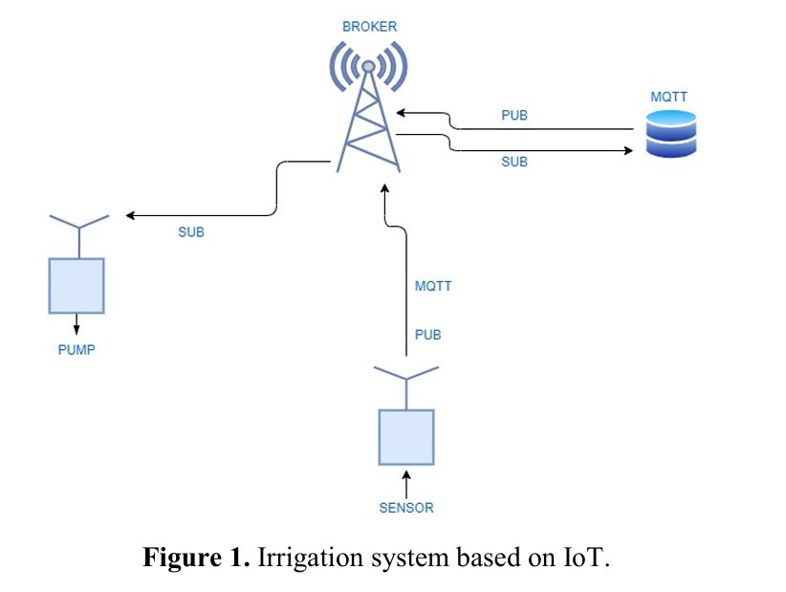
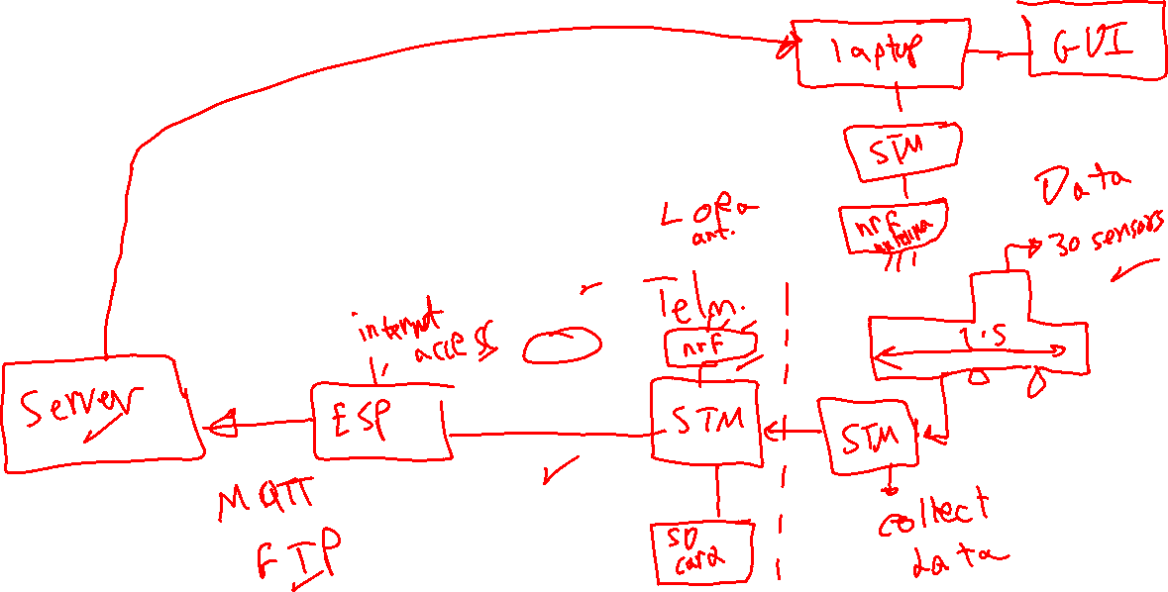
Proposed Solution - How does the system work?
Notes:
Here is the system and I love this system, I will tell u why in the next slide
In general this system consists of multiple technology and I will go through them one by one

Slide 7
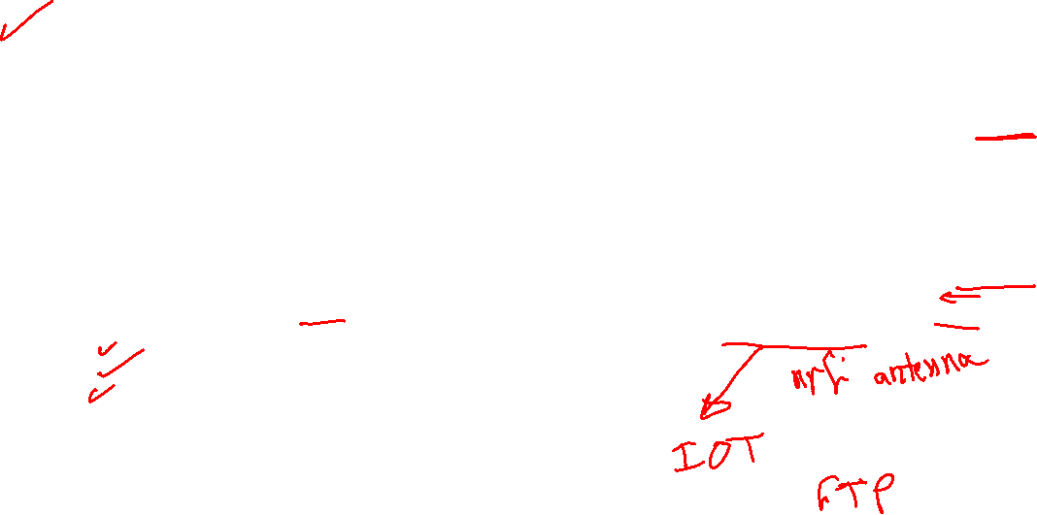
Proposed Solution - How does the system work?
Actuator node opens pump valve
So watering becomes automatic and smart.
Send Data
Prediction result is sent back using MQTT.
Support Vector Machine
Server uses Support Vector Machine to predict how much water is needed.
Collecting Data
Sensor nodes collect data.
Data is sent wirelessly using LoRa radio.
Data arrives at a gateway.
Gateway sends data to the server using MQTT protocol.
Sensors are placed near plants.
They measure:
Soil Moisture (how wet the soil is)
Air Temperature
Air Humidity

Slide 8
What is Support Vector Machine (SVM)?

Slide 9
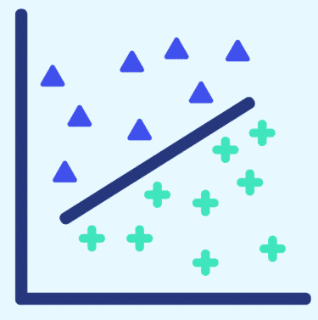
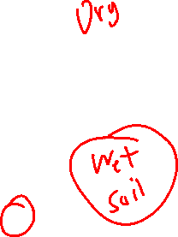
Support Vector Machine
SVM
is a machine learning method that learns from examples, finds patterns and classifies new data into groups.
Another Definition: Support Vector Machine is a method that finds the best boundary to separate data into different groups with the maximum margin between them.
How it works?
Imagine you have two types of soil data:
Dry soil data
Wet soil data
SVM draws a line (or curve) that separates them as clearly as possible, keeping the largest possible distance from both groups.
That line is called the hyperplane.
The closest points to that line are called support vectors and they decide the position of the boundary.

Slide 10
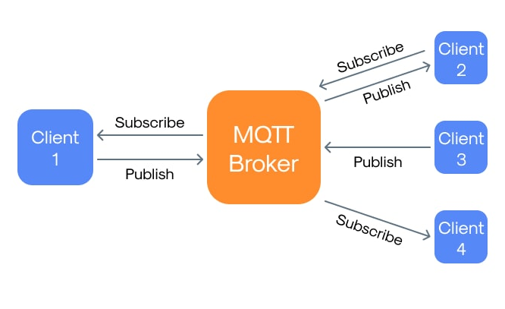
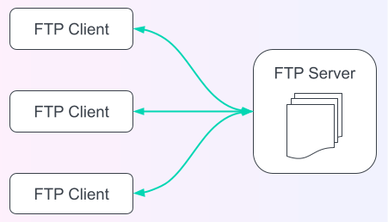

Communication Protocols
VS
MQTT
FTP

Slide 11
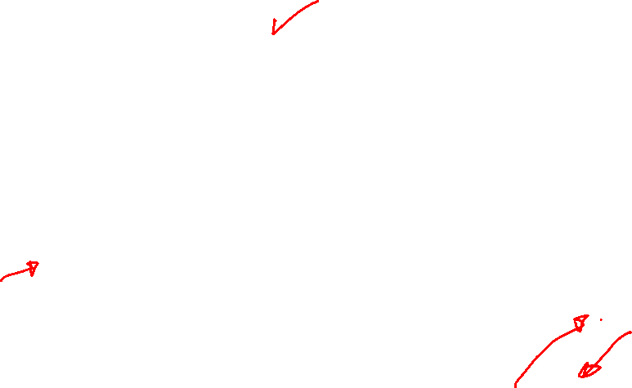
Communication Protocol
01
MQTT Communication Protocol
02
FTP Communication Protocol
Message Queuing Telemetry Transport
File Transfer Protocol
Key Features:
Publish/Subscribe model
Low power and low data usage
Fast and reliable message delivery
Ideal for sensors and embedded devices
How does MQTT work?
Publisher: Sensor nodes send data (soil moisture, temperature)
Broker: Central server that manages messages
Subscriber: Actuators or applications receive data and act on it
Key Features
Client–server based communication
Used for uploading and downloading files
Reliable file transfer using TCP
Requires stable network connection
Not optimized for low-power or real-time systems
How Does FTP Work?
Client: Requests to upload or download files
Server: Stores and manages files
Limitations for IoT:
High bandwidth and power consumption
No real-time data streaming

Slide 12
Water optimization technique for precision irrigation system using IoT and machine learning
Electronics Research Institute
Presented to Dr. Heba Draz, ECIP Internship Program Committee
Presented by: Hazem & Ali
https://eri.sci.eg
Notes:
This is the 2nd paper and it focuses on water optimization for irrigation using iot and machine learning

Slide 13
Agenda
01
Problem Statement
A Problem Statement is a clear, concise description of an issue that needs to be solved. It explains what the problem is, who it affects, and why it matters, without giving the solution yet.
02
About the Authors
A short section that gives brief background information about the people who wrote the paper.
03
Why Banana Crop?
Banana requires large, continuous water supply
04
Overall System Architecture
The system has 3 layers
05
Role of Each Algorithm & Conclusion
K-Nearest Neighbors (KNN), Gradient Boosted Tree (GBT) and LSTM (Long Short-Term Memory)
Notes:
So here is our agenda for the 2nd presentation we will start with the problem statement, all the way to the role of each algorithm

Slide 14
Problem Statement
Why is it important to fix?
Notes:
Again why it is important to fix

Slide 15
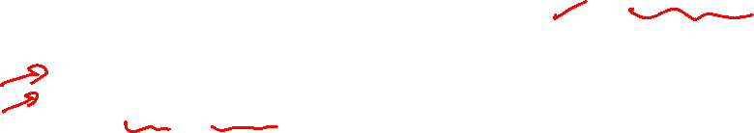
Problem Statement
01
Core Problem
02
Goal of the Paper
Agriculture consumes ~70% of global freshwater and huge electricity
Optimize water usage and reduce energy consumption in irrigation using IoT + Machine Learning
Traditional irrigation:
Over-waters crops
Wastes energy (pumps, motors)
Is often manual or rule-based
Specifically:
Use real-time sensor data
Apply machine learning forecasting
Make data-driven irrigation decisions
Test the system on banana cultivation
Notes:
The core problem is inefficient irrigation caused by static rules and lack of real-time intelligence.
And Agriculture consumes ~70% of global freshwater and huge electricity
So the goal is to optimize water usage and reduce energy consumption

Slide 16

About the Authors
Paper Title:
Water optimization technique for precision irrigation system using IoT and machine learning.
Affiliations: Department of Computer Science and Engineering, Jain University, Bangalore, India School of Computer Science, Galgotias University, Greater Noida, India School of Information Technology and Engineering, Vellore Institute of Technology, Vellore, India
Published under licence by: Elsevier Ltd
Paper link: https://doi.org/10.1016/j.seta.2022.102307
DOI: 10.1016/j.seta.2022.102307
Notes:
Thoso are some of the autors of the paper and by the way they are from different countries there is Italy and India

Slide 17
Why Banana Crop?
Notes:
The paper applied the science to only one crop which is banana but why banana?

Slide 18

Why Banana Crop?
Banana requires large, continuous water supply
Sensitive to:
Soil moisture
Root depth
Rainfall
Humidity
Any optimization here = significant water & energy savings
Key result:
31.4% water saved in 2020
~50% water saved in 2021 (due to rainfall-aware prediction)

Slide 19
Overall System Architecture

Slide 20
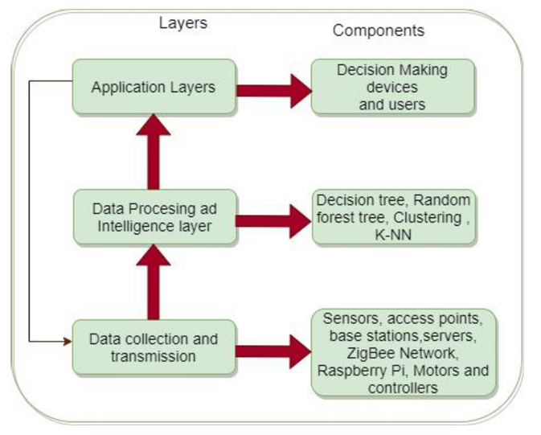
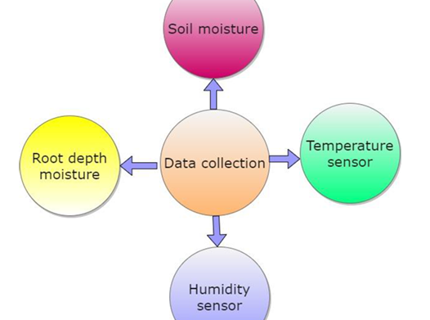
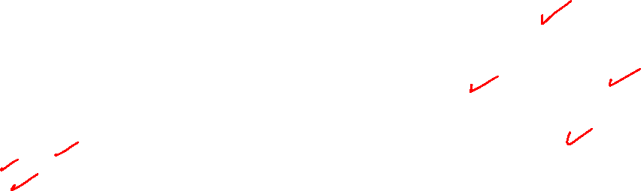
Overall System Architecture
The system has 3 layers:
i. Data gathering/collection and transmission
ii. Data processing and intelligence layer
iii. Application Layers
Why a Hybrid Machine Learning Model?
Problem with Existing Systems
Most use only one ML algorithm
Fail to capture:
Non-linear relationships
Time-series patterns
Solution in This Paper
Combine strengths of multiple models and select the best prediction dynamically
Technologies used
Sensors collect
Wireless Sensor Networks (WSN)
ZigBee
Cloud storage
Soil moisture
Root depth moisture
Temperature

Slide 21
Role of Each Algorithm

Slide 22
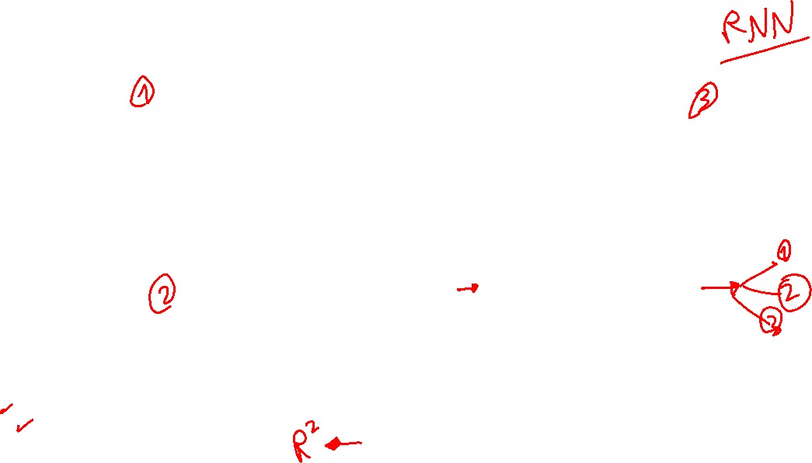
Role of Each Algorithm
K-Nearest Neighbors (KNN)
LSTM (Long Short-Term Memory)
Purpose:
Finds nearest sensor readings
Uses data from nearby plants / zones
Why KNN?
No assumptions about data distribution
Good for local similarity
Example: If nearby banana plants need water, this plant likely needs it too
Purpose:
Time-series forecasting
Predicts future water needs
Why LSTM?
Remembers past conditions
Example: If moisture has been dropping for 3 days, LSTM predicts higher irrigation need
Machine Leaning
Gradient Boosted Tree (GBT)
Spearman’s Rank Correlation (SRC)
Purpose:
Predicts real water requirement
Handles non-linear relationships
Why GBT?
High accuracy
Strong regression performance
Combines weak decision trees into a strong model
Used for:
Moisture
Temperature
Purpose:
Compares predicted values vs actual values
Ranks KNN, GBT, and LSTM predictions
Why Spearman?
Chooses the best model at each time interval
Final Output: A consolidated hybrid prediction

Slide 23
How the Hybrid Model Is Selected?
How can the system choose the best model if real output is unknown in real life?
During Training & Testing (Offline)
Real irrigation / water requirement data is available
GBT and LSTM predictions are compared with real values
Metrics used:
R²
RMSE
Spearman’s Rank Correlation
This analysis shows patterns:
GBT performs better for short-term predictions
LSTM performs better for long-term (time-series) predictions
So Model comparison and “best model” selection happen only here

Slide 24
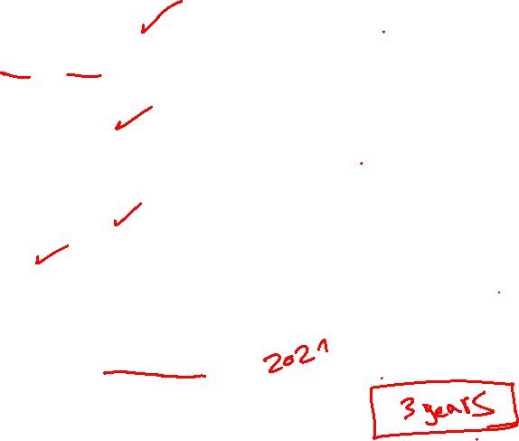
Full automation of irrigation
Conclusion
STRENGTHS
Real-world deployment
Multi-sensor data
Hybrid ML (not single algorithm)
Time-series forecasting
Significant water & energy savings
S
WEAKNESS
Not fully automated irrigation
Tested only on banana crop
Noise in sensor signals can affect accuracy
S
W
Future Work
Full automation of irrigation
Noise-resilient models
Apply to Carrot
F
This paper proposes an IoT-based hybrid machine learning system that combines KNN, GBT, LSTM, and Spearman correlation to optimize irrigation water usage, achieving up to 50% water savings in banana cultivation while indirectly reducing energy consumption.
Summary

Slide 25
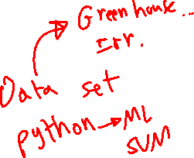
Thank you
Any Questions?

Slide 26
Role of Each Algorithm
K-Nearest Neighbors (KNN)
LSTM (Long Short-Term Memory)
Purpose:
Finds nearest sensor readings
Uses data from nearby plants / zones
Why KNN?
No assumptions about data distribution
Good for local similarity
Example: If nearby banana plants need water, this plant likely needs it too
Purpose:
Time-series forecasting
Predicts future water needs
Why LSTM?
Remembers past conditions
Example: If moisture has been dropping for 3 days, LSTM predicts higher irrigation need
Machine Leaning
Gradient Boosted Tree (GBT)
Spearman’s Rank Correlation (SRC)
Purpose:
Predicts real water requirement
Handles non-linear relationships
Why GBT?
High accuracy
Strong regression performance
Combines weak decision trees into a strong model
Used for:
Moisture
Temperature
Purpose:
Compares predicted values vs actual values
Ranks KNN, GBT, and LSTM predictions
Why Spearman?
Chooses the best model at each time interval
Final Output: A consolidated hybrid prediction

Slide 27
How the Hybrid Model Is Selected?
How can the system choose the best model if real output is unknown in real life?
During Training & Testing (Offline)
Real irrigation / water requirement data is available
GBT and LSTM predictions are compared with real values
Metrics used:
R²
RMSE
Spearman’s Rank Correlation
This analysis shows patterns:
GBT performs better for short-term predictions
LSTM performs better for long-term (time-series) predictions
So Model comparison and “best model” selection happen only here

