Slide 1
Crop Yield Prediction Using Decision Tree and Random Forest
Electronics Research Institute
Presented to Dr. Heba Draz, ECIP Internship Program Committee
hdraz@aucegypt.edu
Course: Hardware/Software Co-Design Presented by: Ali Adel | ali.adel@email.com
https://eri.sci.eg

Slide 2
01
Problem Statement & Objective
Agenda
02
About the Authors
03
Dataset Overview
04
Set up ML environment
05
Machine Learning Algorithms

Slide 3
Agenda
06
Model Evaluation Metrics
07
Results & Comparison
08
Conclusion

Slide 4
Problem Statement& Objective
Why is it important to fix?
Notes:
Again why it is important to fix

Slide 5

Problem Statement & Objective
Crop
yield depends on many interacting factors
For example: soil moisture, temperature and sunlight hours.
Farmers usually predict crop yield using a mix of experience and observation.
What about using magic?
Benefits:
Faster and more precise than traditional guesswork.
Helps in planning harvests, marketing, and resource allocation.
Can adapt to climate change scenarios.
Machine learning is the modern “magic” that turns data on weather, soil, and crops into accurate yield predictions.
Notes:
So a beginner farmer needs to spend valuable time with experienced farmers in order to get the prediction of the yield right
What if the beginner farmer used magic? He will has some benefits right?

Slide 6
About the Authors
Dataset Title:
Smart Farming Sensor Data for Yield Prediction
Dataset: Author (Atharva Soundankar) https://www.kaggle.com/datasets/atharvasoundankar/smart-farming-sensor-data-for-yield-prediction/data
Source Code: Author (ADITYA VERMA)
https://www.kaggle.com/code/adityaver/unit-5

Slide 7

Dataset Overview
sowing_date
Soil moisture
Date when the crop was sown.
High indicates wetter soil, low indicates dry soil.
soil_pH
harvest_date
High indicates alkaline, low indicates acidic.
Date when the crop was harvested.
yield_kg_per_hectare
Crop yield per hectare (target variable)
Notes:
The dataset contains so many features and here are some of them , and ofc we removed some of the features like farm id and sensor id

Slide 8
Set up ML environment
Model Evaluation Metrics
Mean Squared Error (MSE)
R² Score
Random Forest Regressor
Ensemble of multiple decision trees
Reduces overfitting
More robust to noise
Better generalization
Decision Tree Regressor
Tree-based model using if–else rules
Easy to interpret
Can overfit the data
Feature Engineering & Scaling
Created new feature: Growing Days
Calculated as harvest date minus sowing date.
Feature scaling using StandardScaler.
We need to scale features in ML because many algorithms are sensitive to the range and distribution of input values.
Xscaled =X−mean(X) / std(X)
Data Preprocessing
Handling missing values using median
Date conversion to datetime format
Train-test split (80% training, 20% testing)
Notes:
Ok we got the dataset and we understand it well the next step is to clean the data before using it

Slide 9
Machine Learning Algorithms

Slide 10
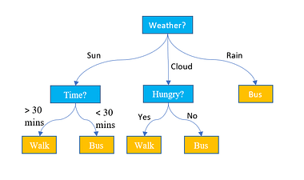
Decision Tree
DT
A supervised machine learning algorithm used for classification and regression.
How it works?
Start at the root node with all data.
Split data using the feature that best separates classes (or minimizes error).
Repeat recursively to form branches until stopping criteria (max depth, min samples) are met.
Leaf nodes give the final prediction.
Key Features:
Simple to understand and interpret.
Can handle numerical and categorical data.
Prone to overfitting if the tree is too deep.
Notes:
Weather is a root Walk,Bus are leaves

Slide 11
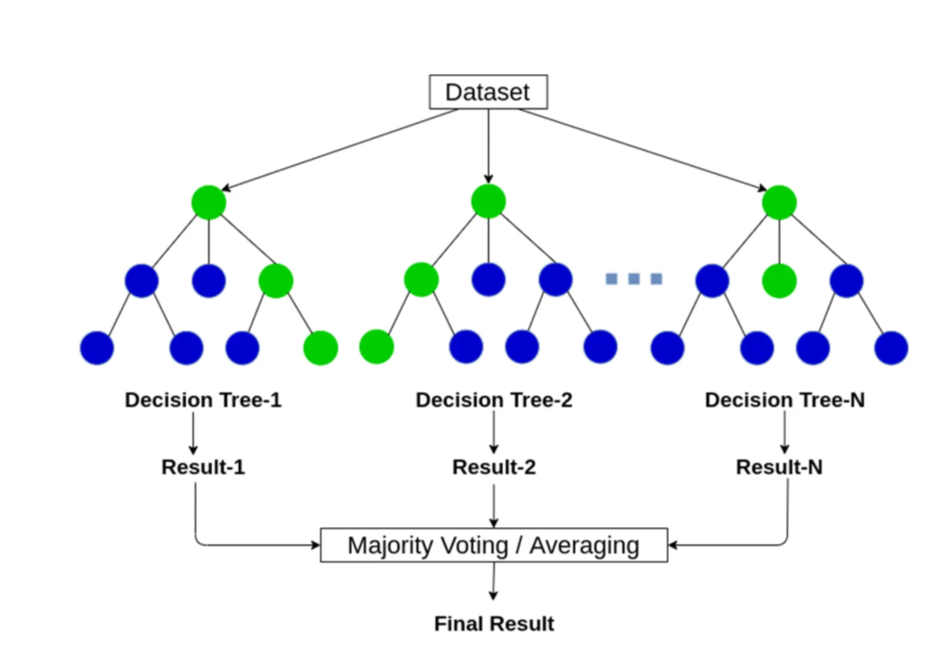
Random Forest
RF
An ensemble machine learning method that combines many decision trees.
How it works?
Randomly sample data
Grow multiple decision trees using random feature subsets.
Aggregate predictions:
Majority vote for classification
Average for regression
Key Features:
Reduces overfitting compared to a single decision tree.
Handles both classification and regression tasks.
Robust to noise and missing values.

Slide 12
Model Evaluation Metrics

Slide 13
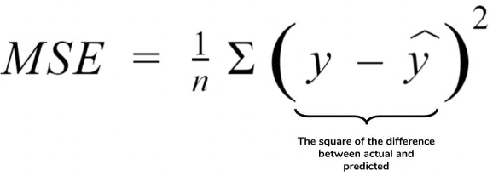
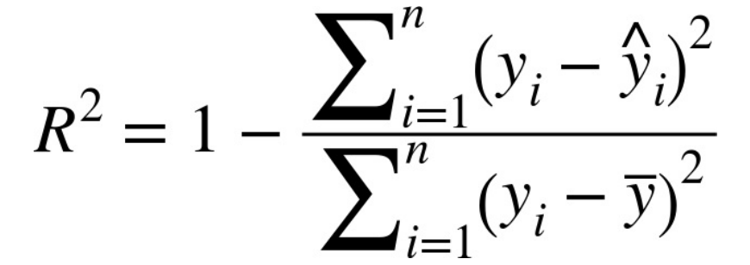
Model Evaluation Metrics
1
Mean Squared Error (MSE)
MSE is a regression metric that measures the average of the squared differences between the actual values and predicted values.
Key feature:
?
2
R²
Measures how well your model explains the variance in the target variable.
Values range from 0 to 1 (sometimes negative if the model is worse than predicting the mean).
Key feature:
?
Notes:
1 - Highlights large errors.
2- Higher values → model fits data better.

Slide 14
Results & Comparison

Slide 15
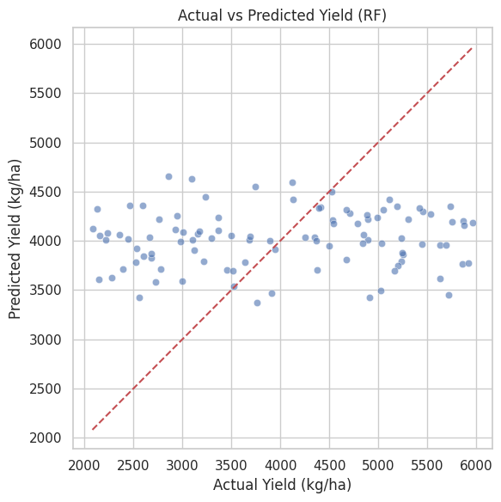
Results & Comparison
Notes:
To make the points fits to the linear line, we have to improve the data quality

Slide 16
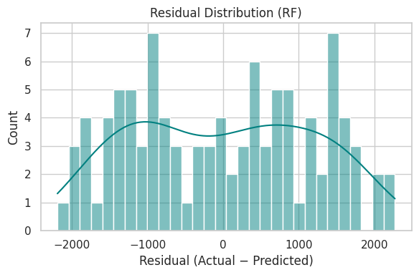
Results & Comparison
Notes:
The model could get only 4 values with a 100% accuracy
And got 7 values with a difference equal to -1000

Slide 17
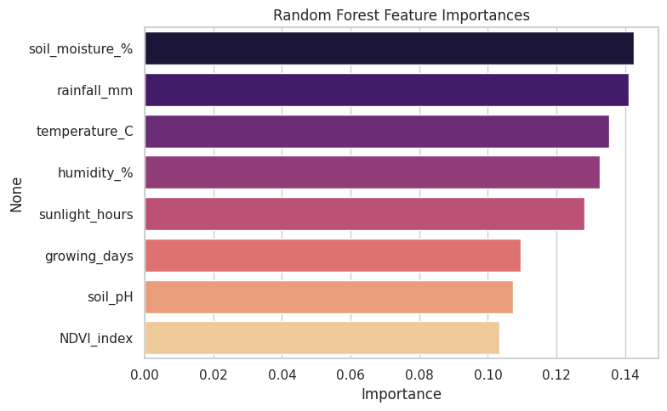
Results & Comparison
Notes:
The most dominating feature is the soil moisture followed by the rainfall and the last one is NDVI_index (Normalized Difference Vegetation Index) measures the crop health and it ranges from 0.3 to 0.9

Slide 18

Results & Comparison
1
Random Forest achieved higher R² and Lower MSE
2
Random Forest generalized better
DT Cross-Validation (CV) R²: -0.154 ± 0.084
RF Cross-Validation (CV) R²: -0.065 ± 0.070
Decision Tree Test MSE: 1682896.19, R²: -0.219
Random Forest Test MSE: 1414056.92, R²: -0.024

Slide 19
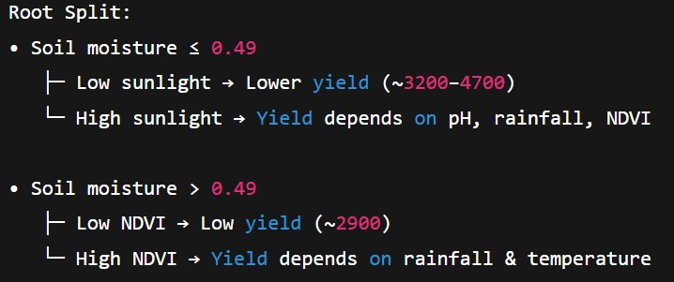

Results & Comparison

Slide 20
Full automation of irrigation
Conclusion
STRENGTHS
Well-organized and structured dataset
Suitable for FPGA-based implementation
S
WEAKNESS
Model performance depends strongly on data quality
S
W
Future Work
Finalize ML environment
Prepare and implement model on FPGA
F
Summary
Built and evaluated Decision Tree and Random Forest models for crop yield prediction

Slide 21
01
https://medium.com/@abhishekjainindore24/everything-about-random-forest-90c106d63989
References
https://mlkeww00jjj8.i.optimole.com/cb:_P4T.27e/w:380/h:422/q:mauto/f:best/https://www.displayr.com/wp-content/uploads/2018/07/what-is-a-decision-tree.png
02
03
Dataset:https://www.kaggle.com/datasets/atharvasoundankar/smart-farming-sensor-data-for-yield-prediction/data
04
Code:https://www.kaggle.com/code/adityaver/unit-5
05
https://en.wikipedia.org/wiki/Random_forest

Slide 22
Thank you
Any Questions?

