Slide 1
Register-Transfer Level
Electronics Research Institute
Presented to Dr. Heba Draz, ECIP Internship Program Committee
hdraz@aucegypt.edu
Course: Hardware/Software Co-Design Presented by: Ali Adel | ali.adel@email.com
https://eri.sci.eg

Slide 2
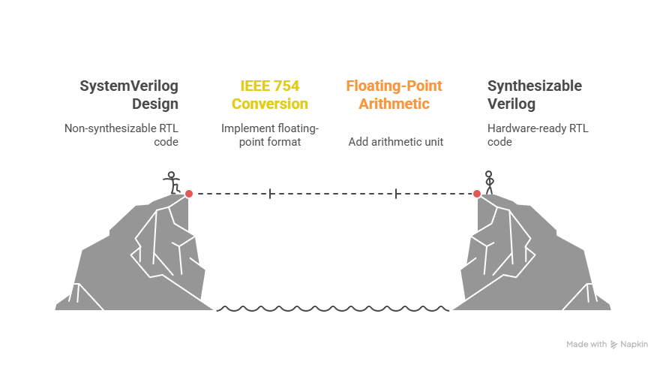
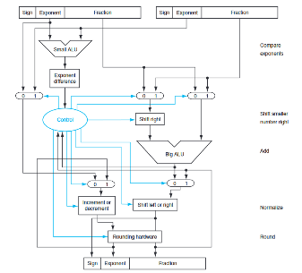

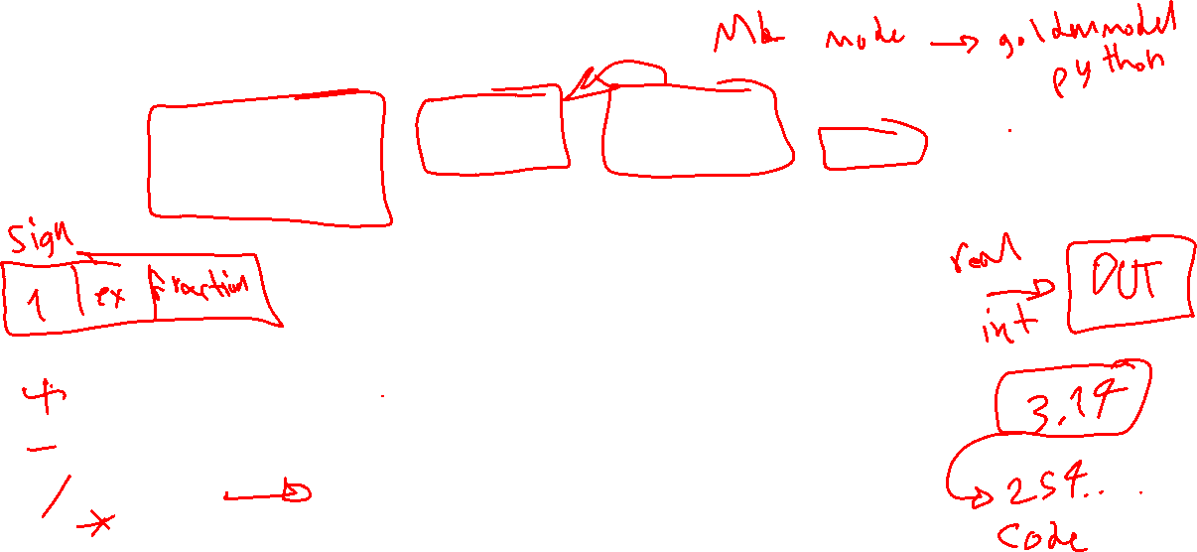
FPGA Flow: Register-Transfer Level
SystemVerilog to Synthesizable Verilog
+
https://github.com/dawsonjon/fpu/tree/master/float_to_int
https://github.com/akilm/FPU-IEEE-754/tree/main

Slide 3
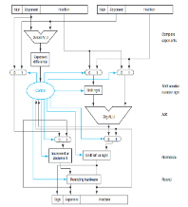
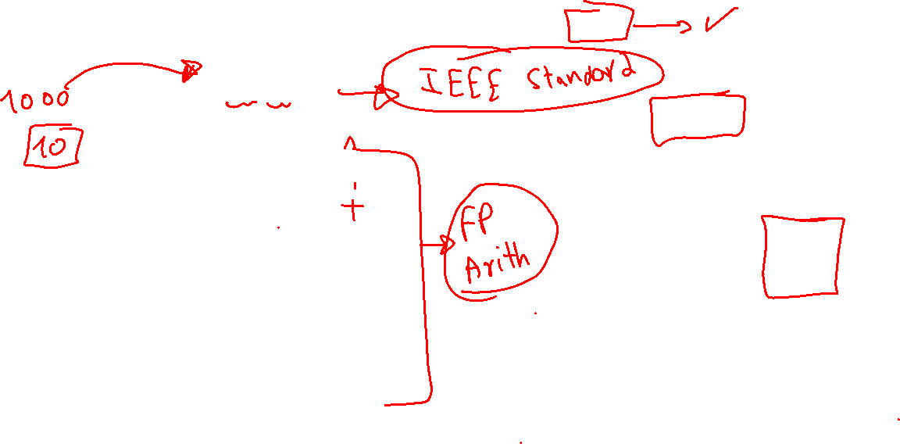
FPGA Flow: Register-Transfer Level
Design Modules
fpu.v: int_to_float, float_to_int.v
FloatingSqrt.v
FloatingAddition.v
Design
+
FloatingCompare.v
FloatingDivision.v
FloatingMultiplication.v

Slide 4
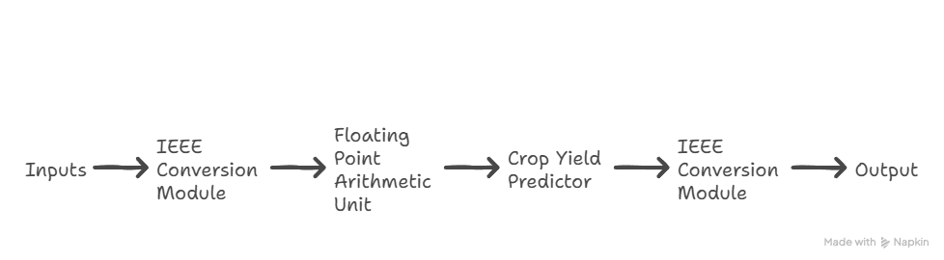
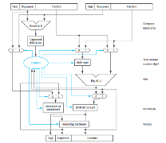
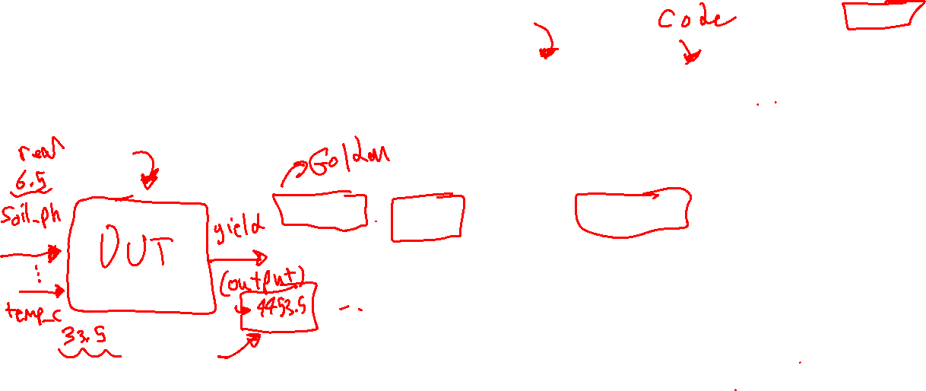
FPGA Flow: Register-Transfer Level
Design Flow
+

Slide 5
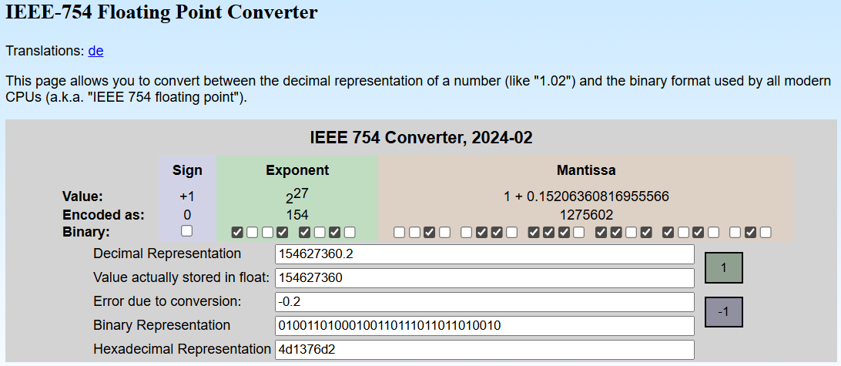
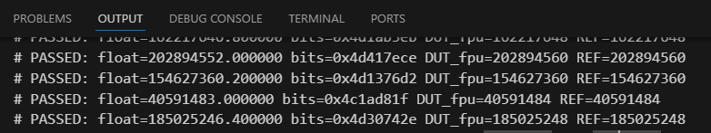






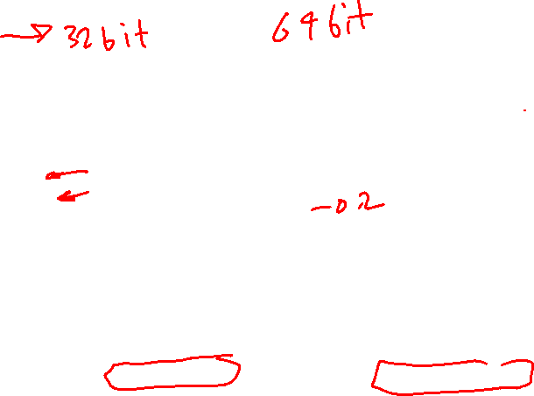
FPGA Flow: Tiny Testbench
fpu.v: int_to_float, float_to_int.v
Figure 1: IEEE 754 floating point converter ( website: https://www.h-schmidt.net/FloatConverter/IEEE754.html )
+
Figure 2: Tiny testbench output, DUT: fpu.v

Slide 6
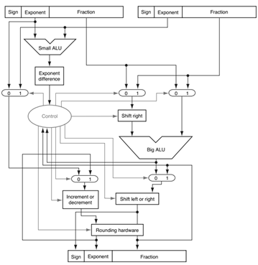
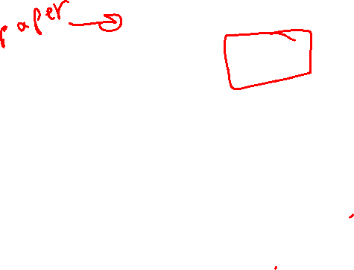
Questions
Block diagram of an arithmetic unit dedicated to floating-point addition

Slide 7
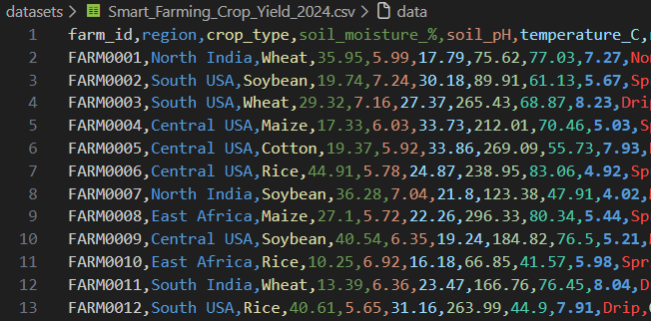
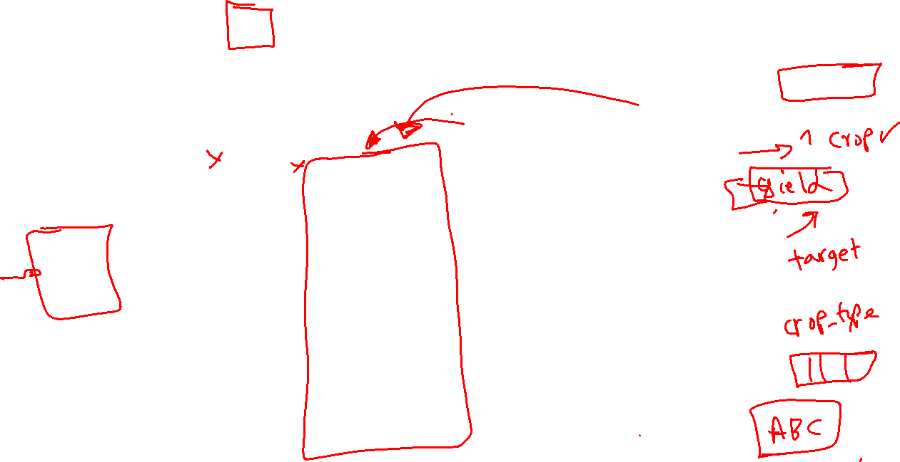
Questions
Kaggle Dataset

Slide 8
Thank you
Any Questions?

