Slide 1
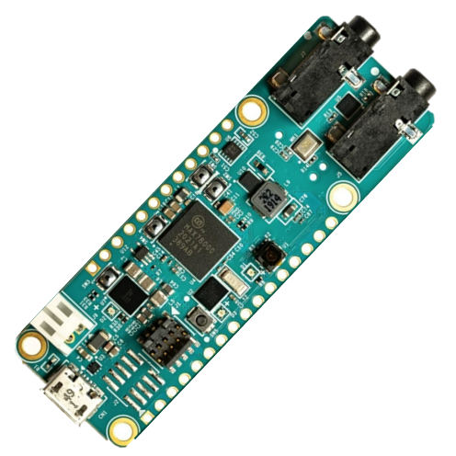
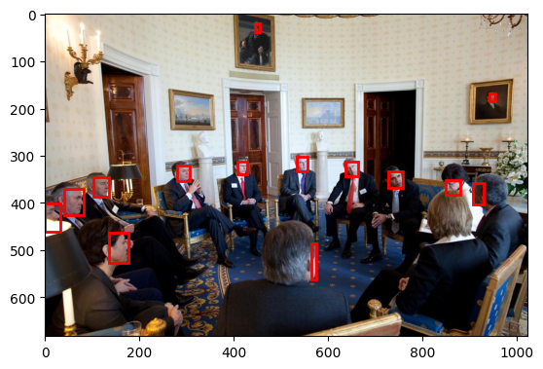
Face detection using MAX78000

Slide 2
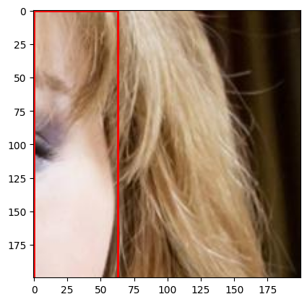

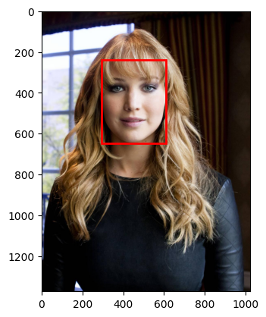
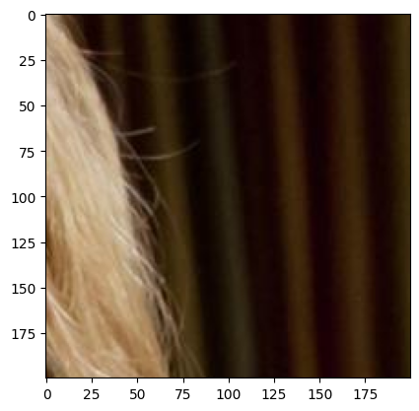
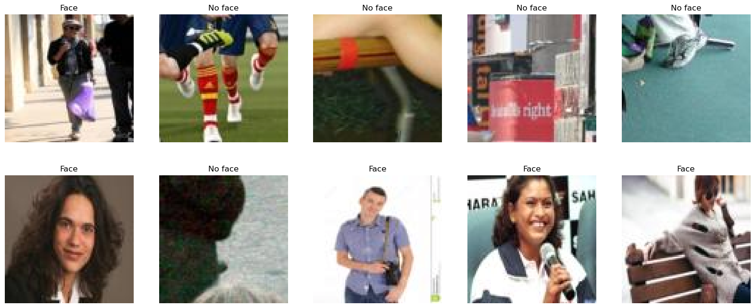
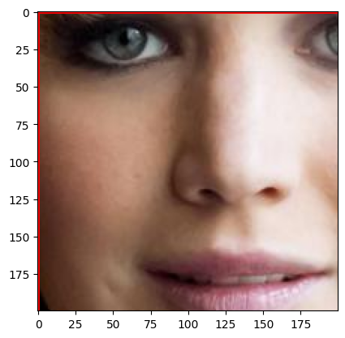


Dataset preprocessing
Random $200×200$ cropping
Removing ambiguous images
$88×88$ resize
WIDERface
Classification

Slide 3
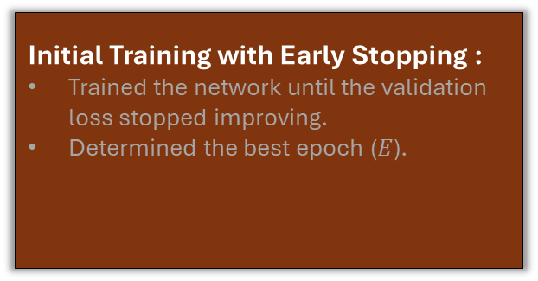
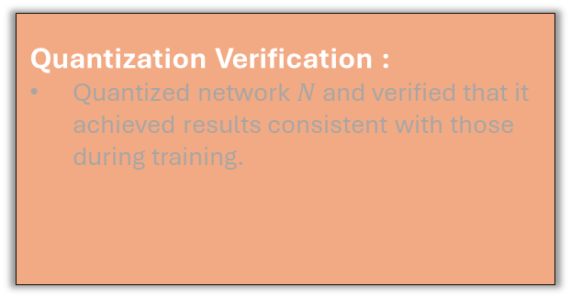
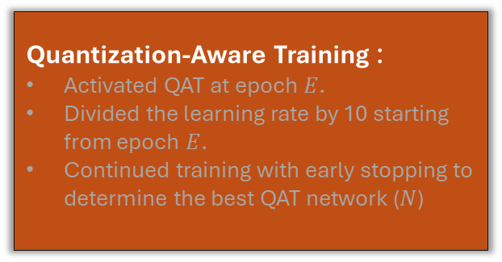
Training
Training with early stopping
QAT with reduced LR
Post-QAT consistency check
Initial Training with Early Stopping :
Trained the network until the validation loss stopped improving.
Determined the best epoch ($E$).
Quantization-Aware Training :
Activated QAT at epoch $E$.
Divided the learning rate by 10 starting from epoch $E$.
Continued training with early stopping to determine the best QAT network ($N$)
Quantization Verification :
Quantized network $N$ and verified that it achieved results consistent with those during training.
Optimizer | Adam
Learning rate | 0,001
Weight decay | 0,0001
Momentum | 0,9
Dampening | 0

Slide 4
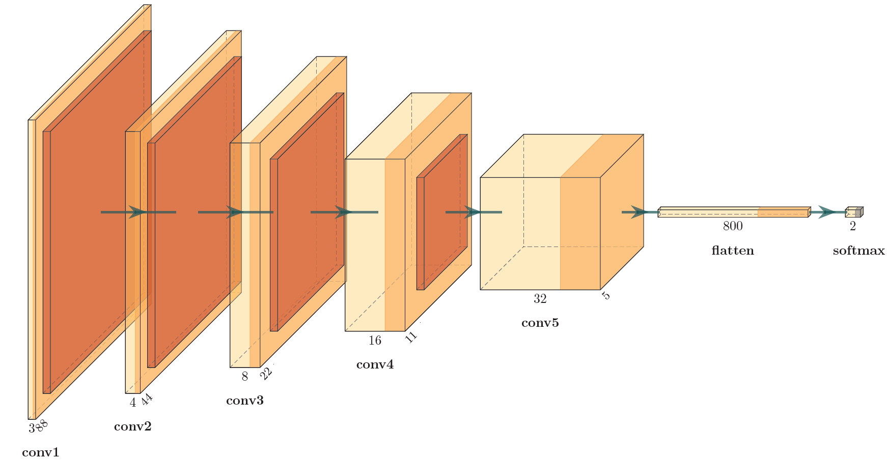
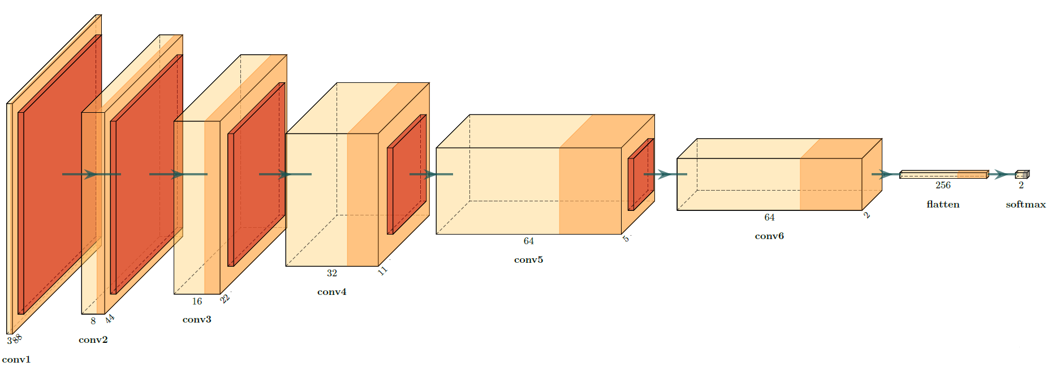
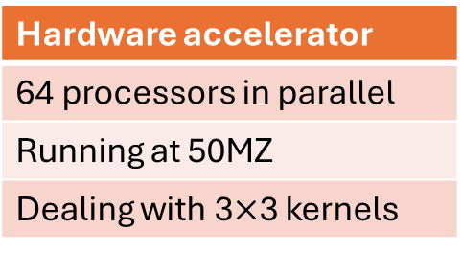
Predicting inference time
The MAX78000 has
a CNN hardware accelerator
SUMMARY OF OPS
Hardware: 2,857,344 ops (2,741,056 macc; 116,288 comp; 0 add; 0 mul; 0 bitwise)
Layer 0: 867,328 ops (836,352 macc; 30,976 comp; 0 add; 0 mul; 0 bitwise)
Layer 1: 604,032 ops (557,568 macc; 46,464 comp; 0 add; 0 mul; 0 bitwise)
Layer 2: 580,800 ops (557,568 macc; 23,232 comp; 0 add; 0 mul; 0 bitwise)
Layer 3: 569,184 ops (557,568 macc; 11,616 comp; 0 add; 0 mul; 0 bitwise)
Layer 4: 234,400 ops (230,400 macc; 4,000 comp; 0 add; 0 mul; 0 bitwise)
Layer 5: 1,600 ops (1,600 macc; 0 comp; 0 add; 0 mul; 0 bitwise)
RESOURCE USAGE
Weight memory: 16,972 bytes out of 442,368 bytes total (3.8%)
Bias memory: 2 bytes out of 2,048 bytes total (0.1%)
Hardware accelerator
64 processors in parallel
Running at 50MZ
Dealing with 3$×$3 kernels
Facenet v1, accuracy 85%
Facenet v2, accuracy 86%

Slide 5
Further quantization
SUMMARY OF OPS
Hardware: 9,666,944 ops (9,433,088 macc; 233,856 comp; 0 add; 0 mul; 0 bitwise)
Layer 0: 1,734,656 ops (1,672,704 macc; 61,952 comp; 0 add; 0 mul; 0 bitwise)
Layer 1: 2,323,200 ops (2,230,272 macc; 92,928 comp; 0 add; 0 mul; 0 bitwise)
Layer 2: 2,276,736 ops (2,230,272 macc; 46,464 comp; 0 add; 0 mul; 0 bitwise)
Layer 3: 2,253,504 ops (2,230,272 macc; 23,232 comp; 0 add; 0 mul; 0 bitwise)
Layer 4: 929,600 ops (921,600 macc; 8,000 comp; 0 add; 0 mul; 0 bitwise)
Layer 5: 148,736 ops (147,456 macc; 1,280 comp; 0 add; 0 mul; 0 bitwise)
Layer 6: 512 ops (512 macc; 0 comp; 0 add; 0 mul; 0 bitwise)
RESOURCE USAGE
Weight memory: 49,324 bytes out of 442,368 bytes total (11.1%)
Bias memory: 2 bytes out of 2,048 bytes total (0.1%)
Facenet v3
SUMMARY OF OPS
Hardware: 9,666,944 ops (9,433,088 macc; 233,856 comp; 0 add; 0 mul; 0 bitwise)
Layer 0: 1,734,656 ops (1,672,704 macc; 61,952 comp; 0 add; 0 mul; 0 bitwise)
Layer 1: 2,323,200 ops (2,230,272 macc; 92,928 comp; 0 add; 0 mul; 0 bitwise)
Layer 2: 2,276,736 ops (2,230,272 macc; 46,464 comp; 0 add; 0 mul; 0 bitwise)
Layer 3: 2,253,504 ops (2,230,272 macc; 23,232 comp; 0 add; 0 mul; 0 bitwise)
Layer 4: 929,600 ops (921,600 macc; 8,000 comp; 0 add; 0 mul; 0 bitwise)
Layer 5: 148,736 ops (147,456 macc; 1,280 comp; 0 add; 0 mul; 0 bitwise)
Layer 6: 512 ops (512 macc; 0 comp; 0 add; 0 mul; 0 bitwise)
RESOURCE USAGE
Weight memory: 98,648 bytes out of 442,368 bytes total (22.3%)
Bias memory: 2 bytes out of 2,048 bytes total (0.1%)
Facenet v2
Facenet v2 and v3 architecture

Slide 6
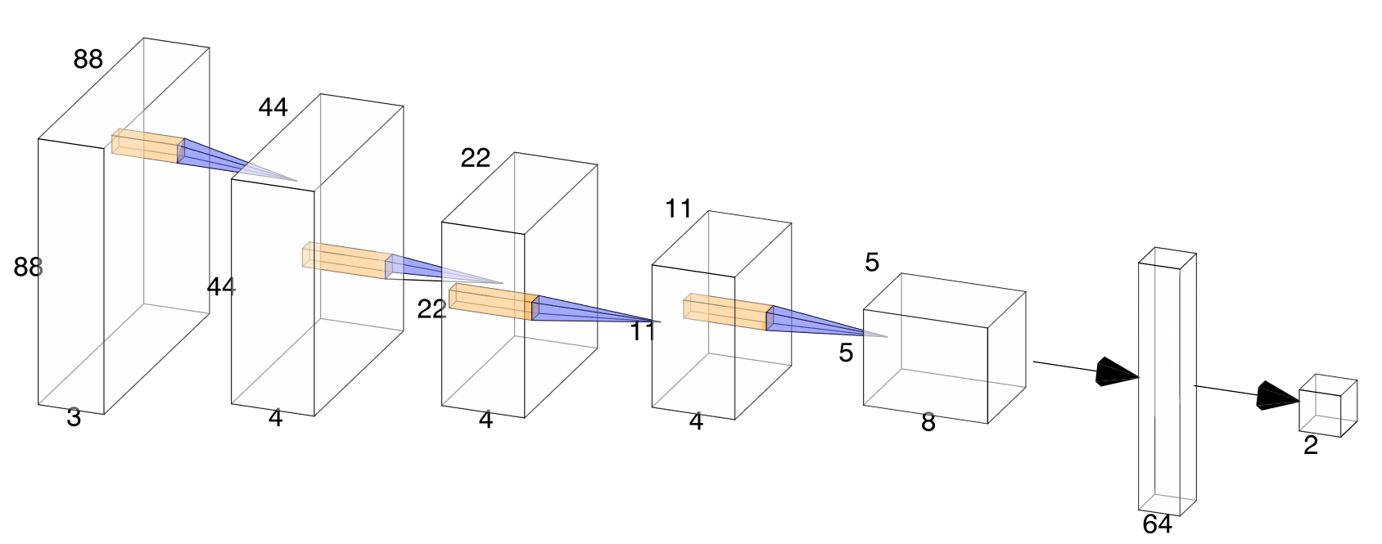
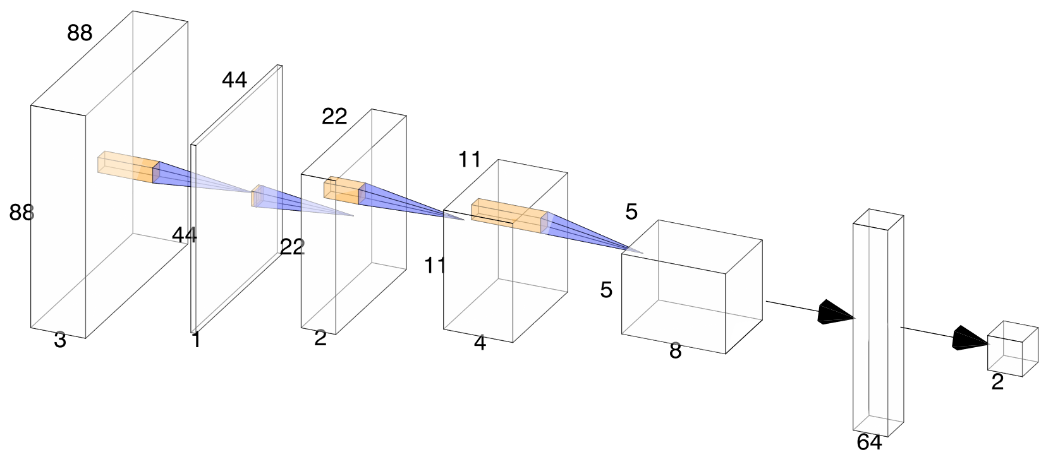
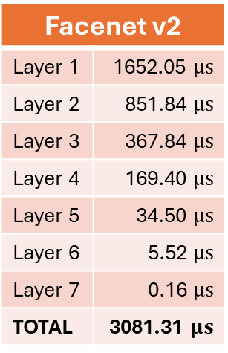
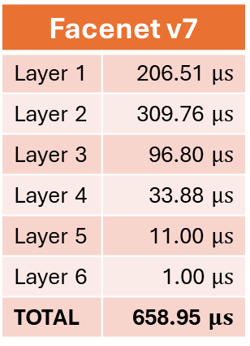
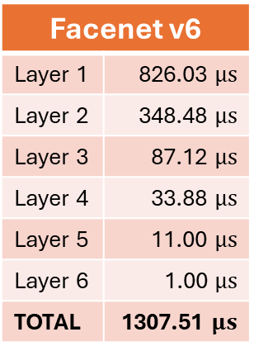
Optimizing inference time
Facenet v2
Layer 1 | 1652.05 $μs$
Layer 2 | 851.84 $μs$
Layer 3 | 367.84 $μs$
Layer 4 | 169.40 $μs$
Layer 5 | 34.50 $μs$
Layer 6 | 5.52 $μs$
Layer 7 | 0.16 $μs$
TOTAL | 3081.31 $μs$
Facenet v6
Layer 1 | 826.03 $μs$
Layer 2 | 348.48 $μs$
Layer 3 | 87.12 $μs$
Layer 4 | 33.88 $μs$
Layer 5 | 11.00 $μs$
Layer 6 | 1.00 $μs$
TOTAL | 1307.51 $μs$
Facenet v7
Layer 1 | 206.51 $μs$
Layer 2 | 309.76 $μs$
Layer 3 | 96.80 $μs$
Layer 4 | 33.88 $μs$
Layer 5 | 11.00 $μs$
Layer 6 | 1.00 $μs$
TOTAL | 658.95 $μs$
Expected inference time per layer
Facenet v6, accuracy 82%
Facenet v7, accuracy 82%

Slide 7
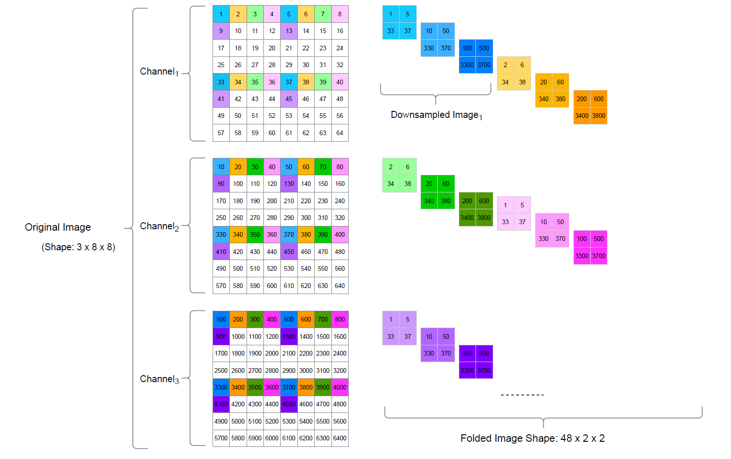
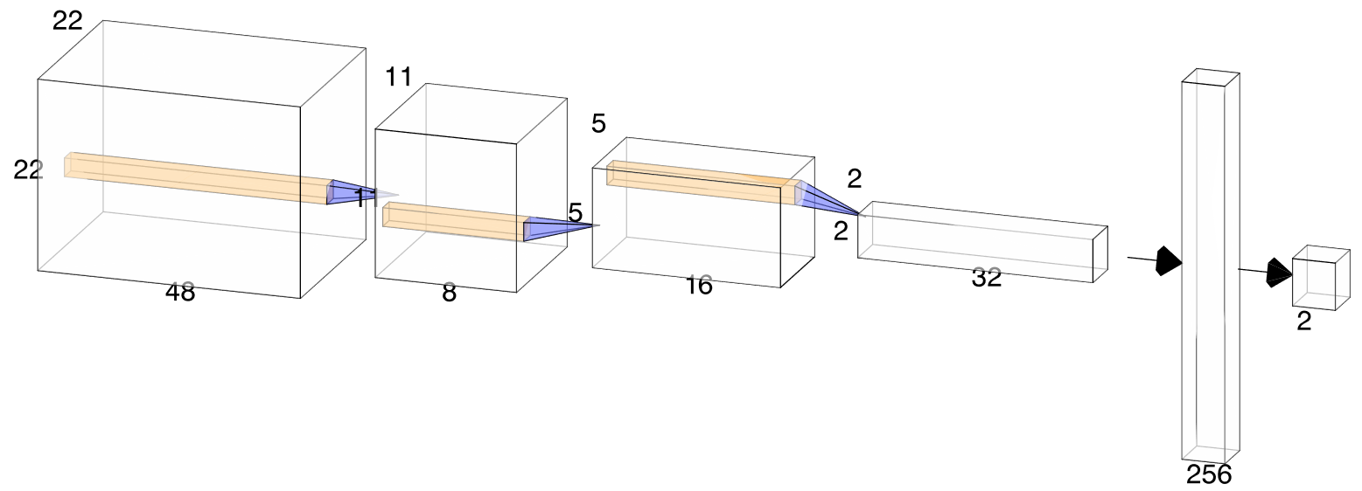
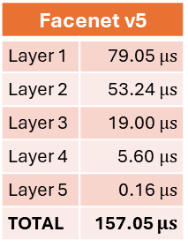
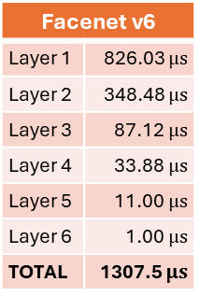
Data folding
Facenet v6
Layer 1 | 826.03 $μs$
Layer 2 | 348.48 $μs$
Layer 3 | 87.12 $μs$
Layer 4 | 33.88 $μs$
Layer 5 | 11.00 $μs$
Layer 6 | 1.00 $μs$
TOTAL | 1307.5 $μs$
Facenet v5
Layer 1 | 79.05 $μs$
Layer 2 | 53.24 $μs$
Layer 3 | 19.00 $μs$
Layer 4 | 5.60$μs$
Layer 5 | 0.16 $μs$
TOTAL | 157.05 $μs$
Data folding according to $L^{3}U$-net by Okman & al. [1]
Facenet v6 architecture
Facenet v5 architecture

Slide 8
References
Okman, Ulkar & Uyanik, 2022. L3U-net: Low-Latency Lightweight U-net Based Image Segmentation Model for Parallel CNN Processor, http://arxiv.org/abs/2203.16528 [1]

