Slide 1
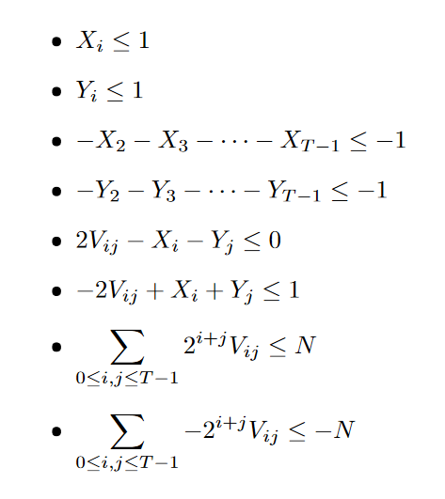
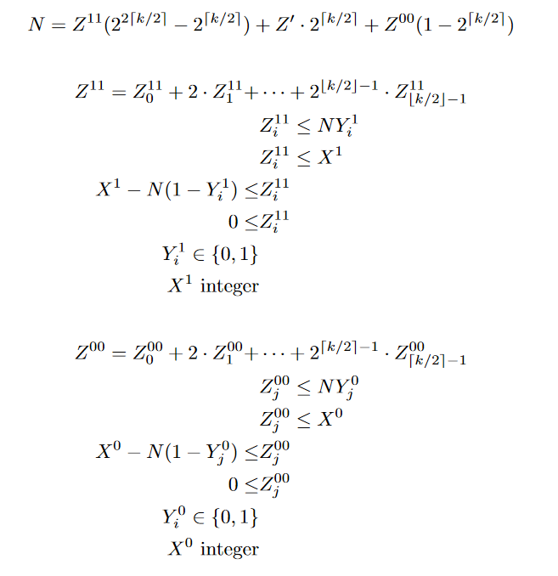
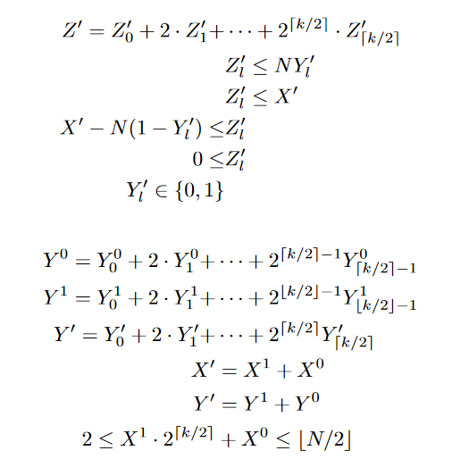
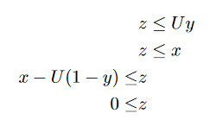

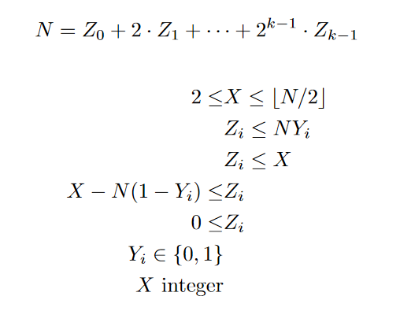
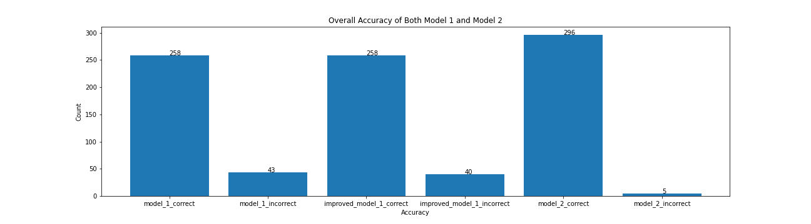
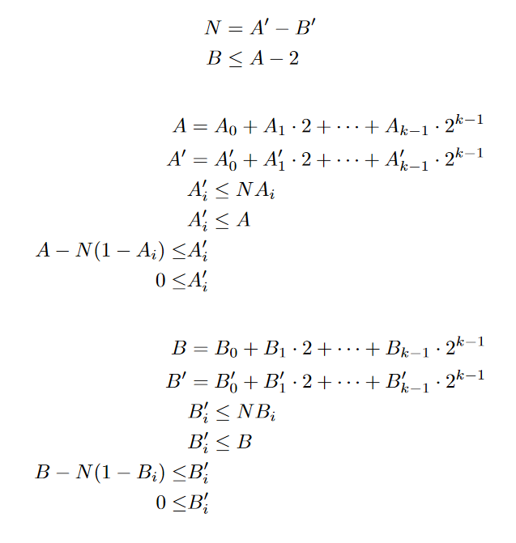
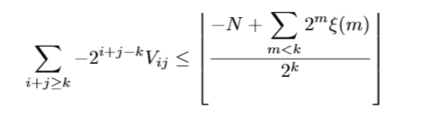
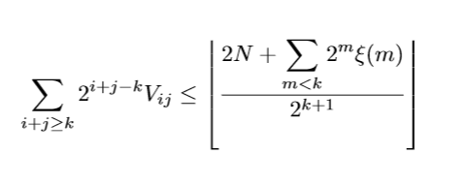
MIP for Factoring Integers
CO 255: Introduction to Optimization(Advanced Level)
Karatsuba
Problem of Interest
Formulating the Product of Variables
Binary Representation of Both Factors
We can express factorization of integers as a mixed-integer programming model
Can we create an efficient model for factorizing numbers?
Since we are working with linear problems, we cannot directly represent Z = XY. However, we can get around this with some linear inequalities
If we let Y be binary (0, or 1), we can represent Z = XY by the following (U is some constant):
Then for the special case of X, Y being both binary
Our Approach
We have created mixed-integer programming models for factorization as well as well-known number theory algorithms for multiplications/factorizations
Goal
A variety of methods have been developed in number theory, we wish to see what we can model, how these models behave and advantages and disadvantages of using such models
Given N = XY we wish to find a non-trivial positive integer solution (X, Y not equal to 1)
Binary Representation of One Factor
The first algorithm to multiply numbers faster than O(N^2)
We modelled it as a linear problem above
This gives T^2 + 2T variables as well as T^2 + 2T + 4 inequality constraints
In general the cutting should never depend on the value of N (except for its size), so we conjecture the existence of a “universal cut” that allows for a polynomial time factorization of N
We created a program to see howe well this model behaves in practice (model 2)
Here are some interesting “non-trivial” Chvátal cuts below (see the document for better cuts):
Fermat
This gives 2k + 1 variables, as well as 4k + 4 inequality constraints
We created a program to see how well this model behaves in practice (model 1)
Reference
Weimerskirch A. (2011) Karatsuba Algorithm. In: van Tilborg H.C.A., Jajodia S. (eds) Encyclopedia of Cryptography and Security. Springer, Boston, MA.
Somsuk, K. (2018). The improvement of initial value closer to the target for Fermat’s factorization algorithm. Journal of Discrete Mathematical Sciences and Cryptography, 21(7–8), 1573–1580.
Bertsimas, D., & Tsitsiklis, J. (1997). Introduction to linear optimization . Athena Scientific.
Factorization algorithm based on the difference of squares principle

