Slide 1
Predicting Litigation Outcomes of Challenges to Federal Regulations
Henry Hirsch

Slide 2
Problem (part 1)
Agencies regulate nearly every sector of the economy and most aspects of Americans’ daily lives. For example:
EPA: air, water, emissions
FDA: food, drugs, medical devices
DOL: workplace safety, wages
USDA: food safety, agriculture
HUD: housing, mortgages
DHS: immigration, security
DOE: energy, nuclear safety
DOJ: antitrust, civil rights
Agencies issue ~3,000-4,000 rules per year in the Federal Register, the daily journal of the U.S. govt.
Many rules are challenged in federal courts by regulated entities.
These challenges tend to occur in federal courts due to the Administrative Procedure Act, which grants U.S. federal courts oversight over all agency actions.
No systematic way to:
Predict which regulations will be overturned
Understand what makes a regulation legally vulnerable
Link regulations to their litigation outcomes

Slide 3
Problem (part 2)
Litigation is a time-consuming and expensive process for both agencies and the regulated entities challenging their rules in court.
Therefore, agencies attempt to assess litigation risk during rulemaking.
And regulated entities only challenge rules in court if they believe they are likely to win.

Slide 4
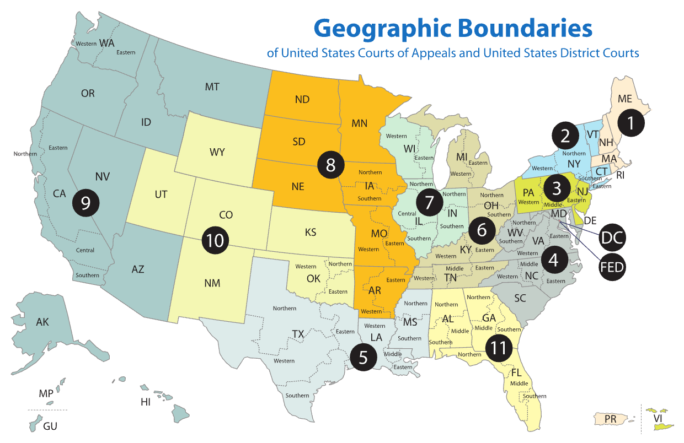
Goals
Predict whether a regulation will be overturned in court by analyzing the regulation’s text and characteristics
Determine which circuit court is most favorable for challenging the regulation
Rank the most similar regulations that were successfully challenged with the corresponding court opinion text

Slide 5
Data (source 1)
Federal Judicial Center Integrated Database (IDB)
44,462 regulatory cases from federal courts (1988-2025), can go back further to 1971
Case metadata: docket number, court circuit, judge, filing/termination dates, disposition
Filtered for: administrative review cases + regulatory NOS codes (890, 893, 899)
Disposition: Was regulation upheld or overturned? This is the target.

Slide 6
Data (source 2)
CourtListener (Free Law Project Bulk Legal Data) (CL)
Bulk data: ~10M+ court opinions (53GB compressed)
Also contains case docket numbers, so can link opinion text to the IDB filtered cases
Can extract Federal Register rule citations from the opinion text
For example: "Petitioners challenge EPA's rule promulgating emissions standards, 85 FR 64510, arguing it exceeds statutory authority."
Full opinion text for ~15,000-20,000 matched cases

Slide 7
Data (source 3)
Federal Register API
Take FR citations extracted from opinion texts and input into FR API to find the text of the corresponding rules (that those cases were challenging)
Also has metadata for cited rules: agency, CFR sections, rule type, date published (under which administration), etc.
Can use NLP techniques to extract prediction features from this text

