Slide 1
Single-Shot on-Chip Diffractive Speckle Spectrometer with High Spectral Channel Density
高光谱通道密度单次片上衍射散斑光谱仪
汇报人：
2025.4.3

Slide 2
CONTENTS
1
Introduction
4
Discussion
2
Methods
5
Summary
3
Result
Notes:
汇报分为5个部分

Slide 3
CONTENTS
1
Introduction
4
Discussion
1
2
Methods
5
Summary
3
Result

Slide 4
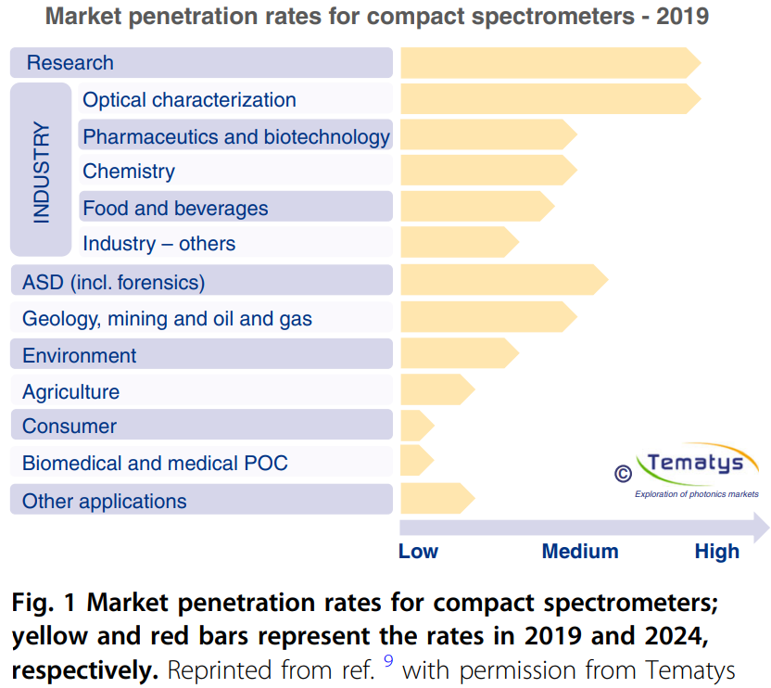
Introduction
Background
Limitations of Benchtop Spectrum Analyzers:
Large size, high power consumption, and lack of portability
Require precise alignment and stabilization systems
Need for Chip-Scale Spectrometers:
Application areas: healthcare, agriculture, consumer electronics, etc.
Chip-Scale Spectrometer Advantages:
Fabrication tolerance
Compact Packaging
Low-Cost Platform
Integration Potential
K. B. Bec ́, J. Grabska, C. W. Huck, Chem. - Eur. J. 2021, 27, 1514.
Notes:
传统的台式光谱仪，虽然有很好的性能，但是存在很多限制。需要精确的对准和复杂的稳定系统
市场渗透率 紧凑型光谱仪
芯片级片上光谱仪优点
工艺容忍度，小分装，低功耗，集成潜力

Slide 5
Introduction
Background
Key Goals of Spectral Sensing
High resolution and broad bandwidth
Primary Challenge
Achieving high resolution and wide bandwidth simultaneously
Limitations of Conventional Approaches
Sophisticated Tuning Mechanisms
Required Huge Chip Areas.
Consumes much Time and Power
Notes:
集成光谱仪的主要目标：获得高分辨率和大带宽
主要的挑战在于，如何在芯片级规模的大小空间上同时实现高分辨率和高带宽。
传统的方法的局限性：
复杂的调谐机制
需要巨大的芯片面积
需要较多的时间和能耗

Slide 6
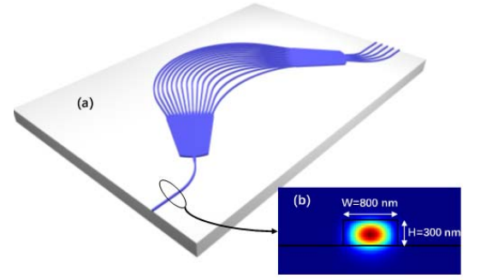
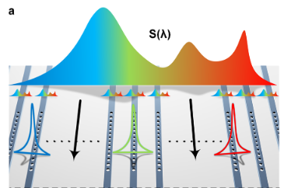
Introduction
Existing Approaches and Challenges
Dispersive Components
well-established by various waveguide structures
Require substantial chip areas to accumulate the path difference for high-resolution operation
Z. Zhang, Y. Wang, H. K. Tsang, ACS Photonics 2021, 8, 1251.
Narrowband Optical Filter Arrays
Can distinguish fine spectral lines
Need a vast number of filters with precise wavelength alignment for wide operation bandwidth
Single Tunable Filter Approach:
Widely adopted to retrieve spectral information with high resolution and wide bandwidth
The active tuning consumes too much time and power
Z. Cheng, Y. Zhao, J. Zhang, H. Zhou, D. Gao, J. Dong, X. Zhang, ACS Photonics 2022, 9, 74.
Notes:
现有的解决方案存在的问题
由各种波导结构组成分散元件的方法：需要很大的芯片面积来积累路径差
窄带滤波器方案：能够实现很高的分辨率 但是需要大量精确校准的滤波器，对高带宽的支持不好
单个可调滤波器：但是主动调整会消耗太多的时间和力量

Slide 7
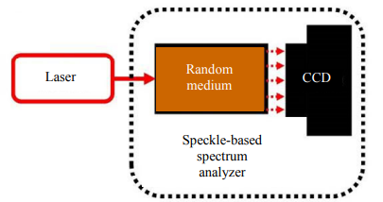
Introduction
Reconstructive Speckle Spectrometers
A spectrometer based on a wavelength-dependent speckle pattern,can satisfactorily resolve the trade-off between high resolution and wide bandwidth
On-chip speckle spectrometers have become popular in recent years.
Advantages of Speckle Spectrometers
Eliminate the need for carefully designed dispersive or narrowband filters.
No Spectral Redundancy
Robust to fabrication errors:
Wan, Y., Fan, X. & He, Z. Review on Speckle-Based Spectrum Analyzer. Photonic Sens 11, 187–202 (2021)
Notes:
重建型散斑光谱仪成为一个很有希望的实现高分辨和高带宽的解决方案
基于波长相关散斑图案
可以很好地解决高分辨率和宽带之间的权衡问题

Slide 8
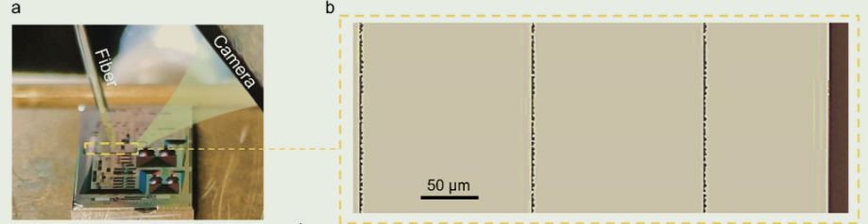
Introduction
Our Work
We proposed a single-shot spectrometer based on all passive on-chip diffractive metasurfaces with the following
Metasurface create the speckle pattern with richness of spectral information
Scaling the diffractive structure to three layers of metasurfaces to increase spectral channels
Converted 1D speckle patterns to 2D speckles via a wide grating coupler to increase spectral information
Zhang, Z., Xiao, S., Song, Q. et al. Scalable on-chip diffractive speckle spectrometer with high spectral channel density. Light Sci Appl 14, 130 (2025).
Notes:
我们提出了一种基于被动片上衍射超表面的单次光谱仪，具有以下特点
使用超表面制造带有丰富光谱信息的散斑
使用三层超表面散射结构，来提升光谱通道
通过 宽光栅耦合器 将1维散斑转换为2维，提高检测通道

Slide 9
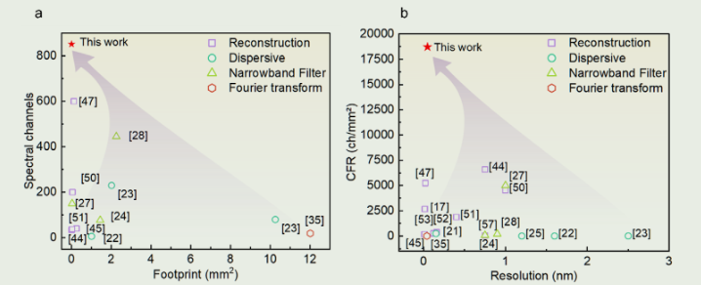
Introduction
Performance
Our work provides a possible means to develop single-shot and compact on-chip spectrometers beyond the resolution-bandwidth limit
High Resolution: Achieves 47 pm resolution across a 40 nm bandwidth.
High Channel Density: Provides 851 spectral channels within a 150 μm × 300 μm footprint, yielding a record-high spectral channel density of 18911 ch mm⁻².
Low Power Consumption: Operates with low power due to passive design.
Zhang, Z., Xiao, S., Song, Q. et al. Scalable on-chip diffractive speckle spectrometer with high spectral channel density. Light Sci Appl 14, 130 (2025).
Notes:
我们提出的光谱仪在非常小的封装面积下，实现了高分辨率和高带宽，创造了目前最高记录的光谱通道密度

Slide 10
CONTENTS
1
Introduction
4
Discussion
2
Methods
5
Summary
3
Result
Notes:
下面先介绍一下我们的设计和方法

Slide 11
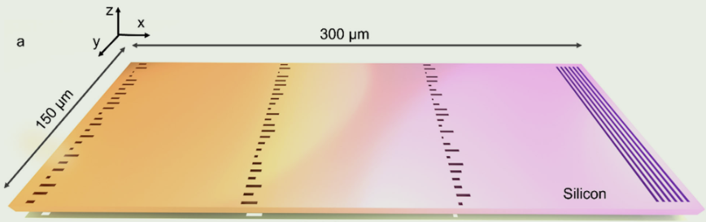
Methods
Design
The proposed spectrometer is designed on a silicon-on-insulator (SOI) platform with a 220 nm silicon cap layer and a 2 μm buried oxide layer.
Metasurfaces: constructed by 1D arrays of etched trenches, called transmit array
Zhang, Z., Xiao, S., Song, Q. et al. Scalable on-chip diffractive speckle spectrometer with high spectral channel density. Light Sci Appl 14, 130 (2025).
Notes:
光谱仪设计在绝缘体上硅（SOI）平台上，该平台具有220 nm的硅盖层和2μm的埋入氧化物层。
SOI平台上，我们制造了三条超表面，由1D蚀刻凹槽阵列组成

Slide 12
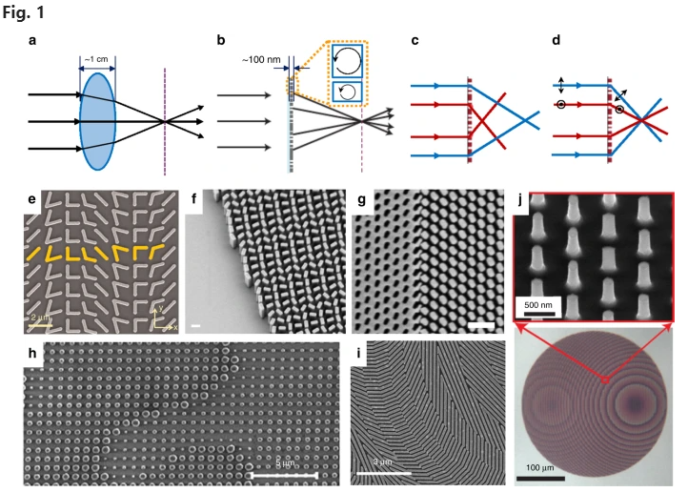
Methods
Metasurface
Metasurface refers to a kind of artificial sheet material with sub-wavelength features. Metasurfaces modulate the behaviors of electromagnetic waves through specific boundary conditions
Metasurface can modify the amplitude and impart an abrupt phase shift to the incident wave within the sub-wavelength scale through the light-matter interaction, and thus realize the wavefront modulation much more efficiently
Neshev, D., Aharonovich, I. Optical metasurfaces: new generation building blocks for multi-functional optics. Light Sci Appl 7, 58 (2018)
Notes:
超表面是指一种具有亚波长特征的人造片材 调节电磁波的行为
超表面可以通过光-物质相互作用改变振幅，并在亚波长尺度内对入射波施加突变相移，从而更有效地实现波阵面调制
传统透镜和超表面

Slide 13
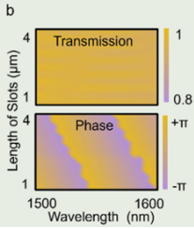
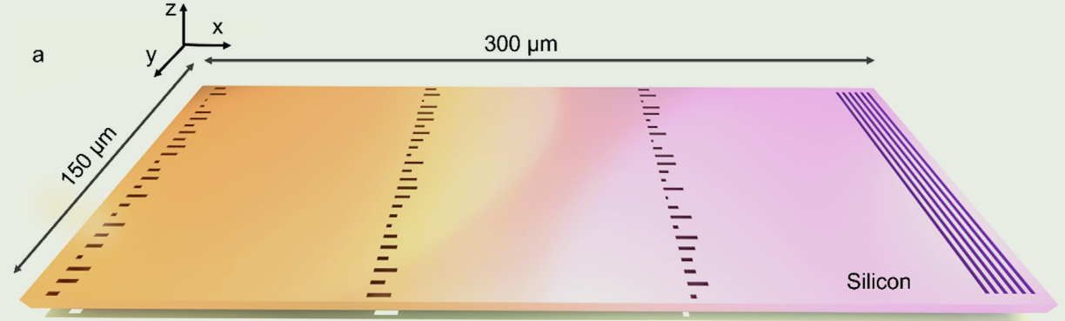
Methods
Design
Metasurfaces Design
The trenches widths are designed in subwavelength scale to minimize the optical losses
Achieves a high transmittance with an efficiency exceeding 90% across the 100 nm spectral range.
the phase change can cover a full range from –𝜋 to 𝜋.
The feature size of 180 nm is compatible with the fabrication process
Zhang, Z., Xiao, S., Song, Q. et al. Scalable on-chip diffractive speckle spectrometer with high spectral channel density. Light Sci Appl 14, 130 (2025).
Notes:
我们设计的超表面
subwavelength scale to minimize the optical losses
高透射率 100nm带宽上
相位调控
工艺兼容

Slide 14
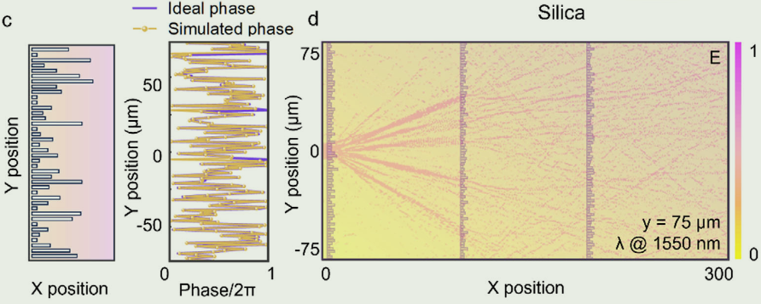
Methods
Disordered Phase Modulation
A metasurface with randomly varying slot length can create a disordered phase mask to scramble the spectrally dependent diffractions.
The optical field propagation through three layers of metasurfaces was numerically simulated via finite difference time domain (FDTD)
The results imply a deep diffractive behavior of the lightwaves, which eventually generates a speckle pattern at the output plane of the cascaded metasurfaces.
Zhang, Z., Xiao, S., Song, Q. et al. Scalable on-chip diffractive speckle spectrometer with high spectral channel density. Light Sci Appl 14, 130 (2025).
Notes:
随机相位调控
有随机变化的槽长的超表面可以创建无序的相位掩模，以扰乱光谱相关的衍射。
FDTD数值模拟
结果表明，光波具有深度衍射行为，最终在级联超表面的输出平面上产生散斑图案

Slide 15
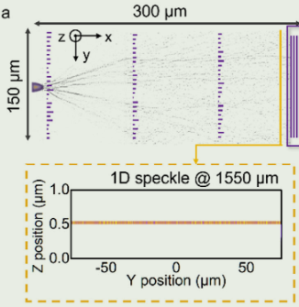
Methods
Principle
Huygens–Fresnel principle:the phase modulation from the metasurfaces can be converted to intensity speckles at the output plane via coherent interferences.
Phase-to-Intensity modulation conversion features random behaviors and eventually scrambles the spectral information in the speckle patterns.
Three layers of diffractive metasurfaces are cascaded to increase the spectral richness of the fingerprints
and the effective interference path lengths
Speckles patterns
carry spectral information
Zhang, Z., Xiao, S., Song, Q. et al. Scalable on-chip diffractive speckle spectrometer with high spectral channel density. Light Sci Appl 14, 130 (2025).
Notes:
来自超表面的相位调制可以通过相干干涉在输出平面转换为强度散斑。
相位到散斑强度调制转换具有随机行为，最终会扰乱散斑图案中的光谱信息
三层衍射超表面级联，以增加指纹的光谱丰富度以及有效干扰路径长度

Slide 16
Methods
Design
The proposed spectrometer is designed on a silicon-on-insulator (SOI) platform with a 220 nm silicon cap layer and a 2 μm buried oxide layer.
Multimode Grating Coupler : diffracted out and converted 1D speckle patterns to 2D speckles
grating coupler
Zhang, Z., Xiao, S., Song, Q. et al. Scalable on-chip diffractive speckle spectrometer with high spectral channel density. Light Sci Appl 14, 130 (2025).
Notes:
光栅耦合器 将1D散斑衍射，转化为2为散斑

Slide 17
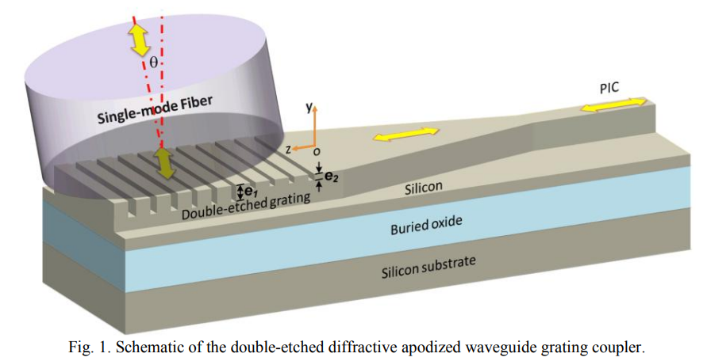
Methods
Grating Coupler
Grating Coupler is a micro-nano optical device used to couple light between optical fibers and chips.
In our work, the Grating Coupler is used to diffracted out the 1D speckle patterns at the output of metasurfaces to convert 1D speckle patterns to 2D speckle patterns
Biao Yang, Zhi-Yong Li, Xi Xiao, Jin-Zhong Yu, Yu-De Yu, "High-efficiency focusing grating coupler for large-scale silicon photonic integration", 2013 International Conference on Optoelectronics and Microelectronics (ICOM), pp.160-162, 2013.
Notes:
光栅耦合器，耦合光束

Slide 18
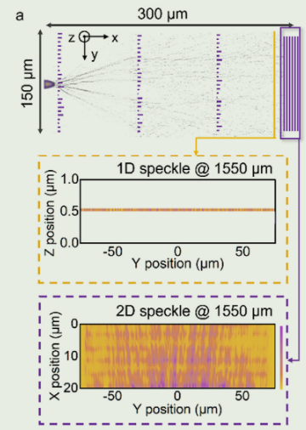
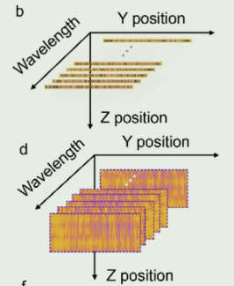
Methods
Sample
The output diffraction patterns from the wide grating coupler were captured by an InGaAs infrared camera (LUSTER-CB2000).
In contrast, the 2D speckles measured at different wavelengths have much more data channels for spectral reconstruction.
Zhang, Z., Xiao, S., Song, Q. et al. Scalable on-chip diffractive speckle spectrometer with high spectral channel density. Light Sci Appl 14, 130 (2025).
Notes:
对散斑进行采样
使用红外相机对散斑进行采样
相比于1D,2D散斑有更多的检测通道用于光谱重建

Slide 19
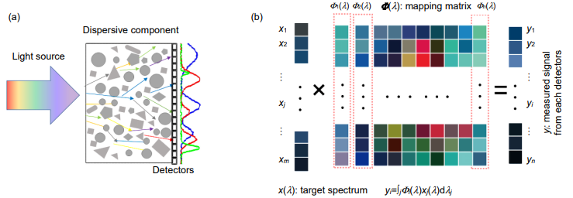
Methods
Principle of Speckle-Based Spectrometer
Calibration:
Input a series of monochromatic lights λ (i) for Calibration
Obtained the intensity signals Φ(i,j) on j detectors
Establishing a mapping relationship between wavelength and detector response(the transmission matrix Φ)
Spectral Detection :
Incident light X produces a series of response signals Y (j) on the detector
X can be obtained through t matrix inversion: X = Φ⁻¹ Y
Algorithm for Resolution Enhancemen
Wan, Y., Fan, X. & He, Z. Review on Speckle-Based Spectrum Analyzer. Photonic Sens 11, 187–202 (2021)
Zheng Q L, Wen L, Chen Q. Research progress of computational microspectrometer based on speckle inspection[J]. Opto-Electron Eng, 2021, 48(3)
Notes:
在介绍光谱重建之前，先讲一下基本原理
校准
光谱测量

Slide 20
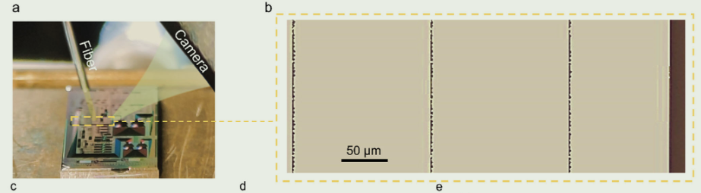
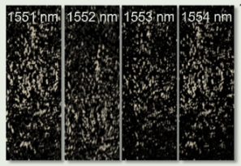
Methods
Calibration of the Spectrometer
Sweep laser (Santec TSL710)
The laser output was swept from 1530 nm to 1570 nm with 5 pm step size
The output diffraction patterns captured by an InGaAs infrared camera (LUSTER-CB2000)
Zhang, Z., Xiao, S., Song, Q. et al. Scalable on-chip diffractive speckle spectrometer with high spectral channel density. Light Sci Appl 14, 130 (2025).
Notes:
图片是不同nm下采样得到的图像

Slide 21
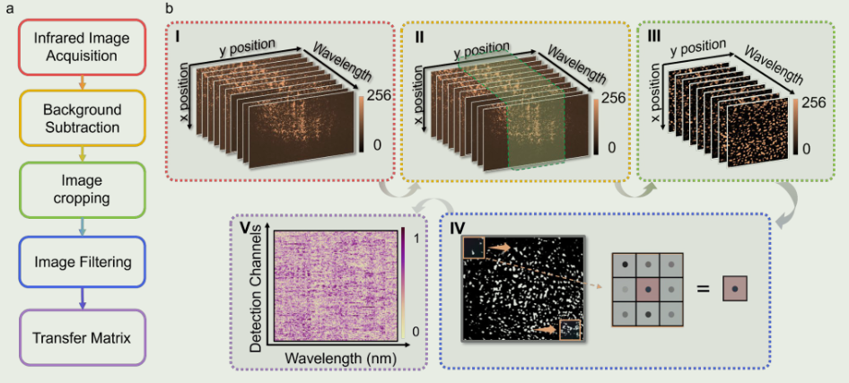
Methods
Image processing
Zhang, Z., Xiao, S., Song, Q. et al. Scalable on-chip diffractive speckle spectrometer with high spectral channel density. Light Sci Appl 14, 130 (2025).
Notes:
对采样的图像做一些图形处理
背景减法，量化，
图像分割以保留富含斑点的区域，有效地消除了无关紧要的背景噪声并提高了后续数据处理的效率和精度
图像过滤：图像中存在的噪声会损害重建精度，特别是对于具有宽带和窄带特征的光谱。为了减轻这种情况，应用中值过滤
13×13的卷积内核来优化传输矩阵的生成。
最后合成矩阵

Slide 22
Methods
Spectral Reconstruction
Compressed sensing approach based on the CVX (Convex) optimization
Input spectrum S(𝜆)
Measured speckles (fingerprints) I
The transmission matrix T(𝜆)
transfer matrix method is vulnerable to experimental noise
To improve the system robustness
𝛼1 and 𝛼2 represents the weight coefficient of 𝑙1and𝑙2 regularization respectively
a larger value of a1∕a2 is preferable for the reconstruction of continuous spectra
a smaller a1∕a2 is more suitable for reconstructing sparse spectra
Notes:
传输矩阵对环境噪声敏感，提高鲁棒性

Slide 23
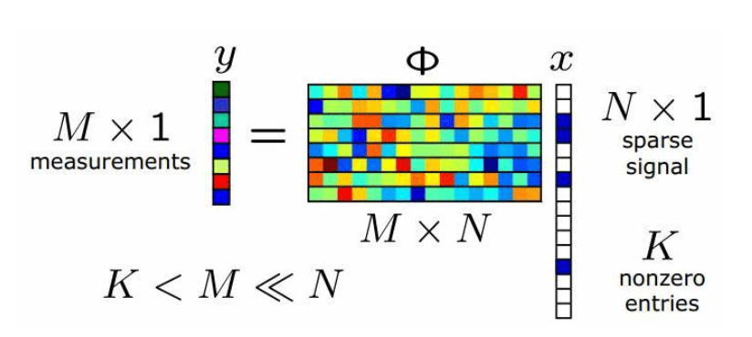
Methods
Compressed sensing
Definition:A method for reconstructing sparse signals from fewer measurements than the dimension of the signal space
Key Idea :
Sparsity: Signals can be represented with a few non-zero components in a suitable basis.
Random Sampling: Acquire fewer measurements using random projections
Optimization: Recover the original signal using optimization algorithms (e.g., l 1 ​ regularization).
Spectral
transmission matrix
2D speckles measured
Why It Works:
Reduces the number of measurements needed.
Robust to noise and efficient for sparse or compressible signals.
Notes:
压缩感知算法
一种从比信号空间维数更少的测量值重建稀疏信号的方法
Why it work
减少测量值的需要
较好的鲁棒性

Slide 24
Methods
Convex optimization
Norm: ∥TS−I∥ 2
Measures the difference between matrix TS and target matrix I.
Ensures TS is as close as possible to I
L2 Norm: ∥S∥2 2
Measures the size of S
Regularization to prevent overfitting and control the scale of S
for the reconstruction of continuous spectra
L1 Norm: ∥S∥1​
Measures the sparsity of matrix S.
Encourages sparsity in S
for the reconstruction of sparse spectra

Slide 25
CONTENTS
1
Introduction
4
Discussion
2
Methods
5
Summary
3
Result

Slide 26
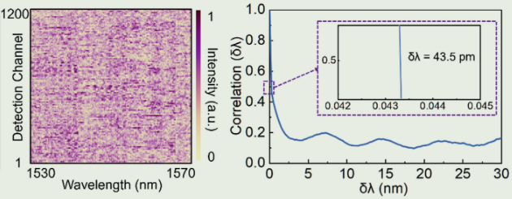

Result
Calibration of the Spectrometer
1200 physical detection channels:much higher density than the readout scheme via waveguide and detector array.
the minimum decorrelation wavelength 𝛿𝜆 = 43.5pm.
the spectral correlation function:
The half-width-half-maximum (HWHM) of C(Δ𝜆), implies the required minimum wavelength shift to reduce the spectral correlation by half
Zhang, Z., Xiao, S., Song, Q. et al. Scalable on-chip diffractive speckle spectrometer with high spectral channel density. Light Sci Appl 14, 130 (2025).
Notes:
spectral correlation function
半峰半宽 意味着将光谱相关性减半所需的最小波长偏移
我们的光谱仪理论𝛿𝜆 = 43.5pm分辨率

Slide 27
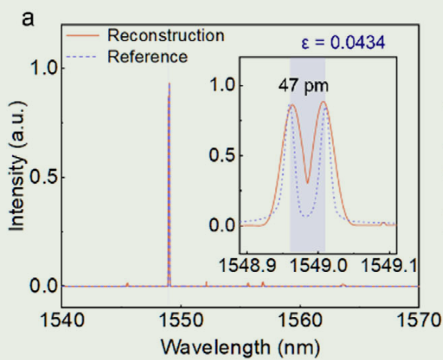
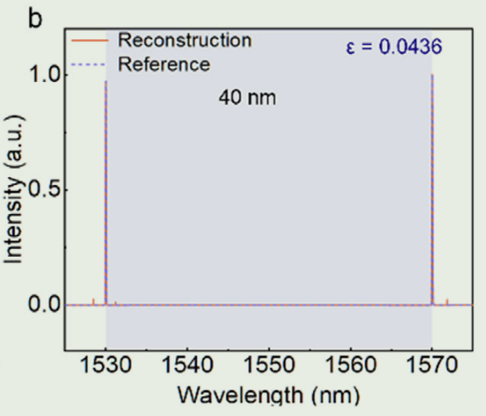
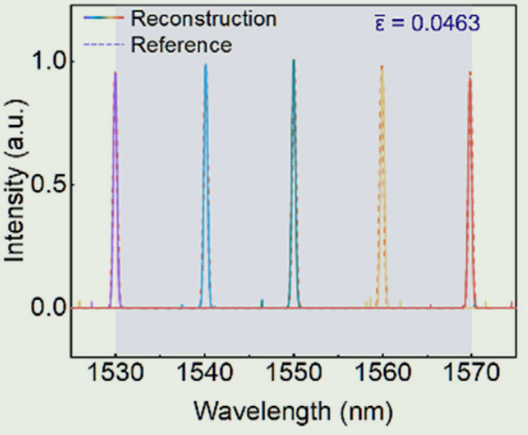
Result
Spectral Reconstruction Validation
The reconstruction outputs (solid line) were compared with the reference spectra obtained from a commercial optical spectrum analyzer (OSA, YOKOGAWA AQ6370C) (dashed lines)
Resolution:A dual-peak spectrum generated by two narrow-band lasers
Bandwidth:1530 nm to 1570 nm shifting spectral lines of tunable laser
Zhang, Z., Xiao, S., Song, Q. et al. Scalable on-chip diffractive speckle spectrometer with high spectral channel density. Light Sci Appl 14, 130 (2025).
Notes:
我们光谱仪重构的输出和商用高精度光谱仪的输出做一个对比
首先是分辨率，基本接近我们的理论分辨率
带宽验证 通过两个波峰和 可调激光器产生的转移光谱线

Slide 28
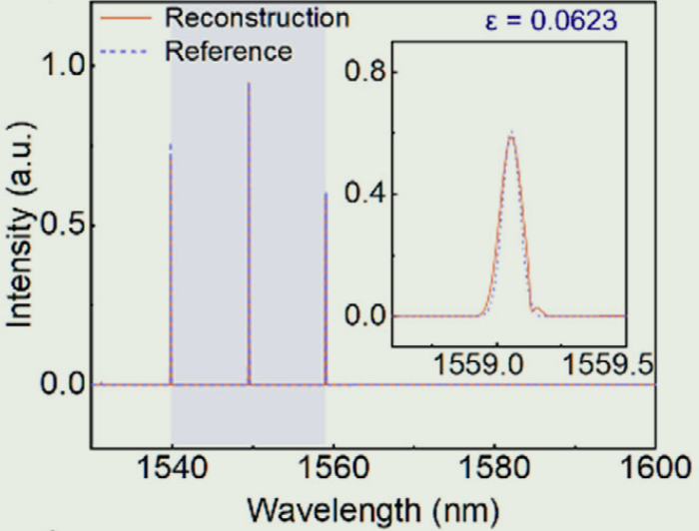
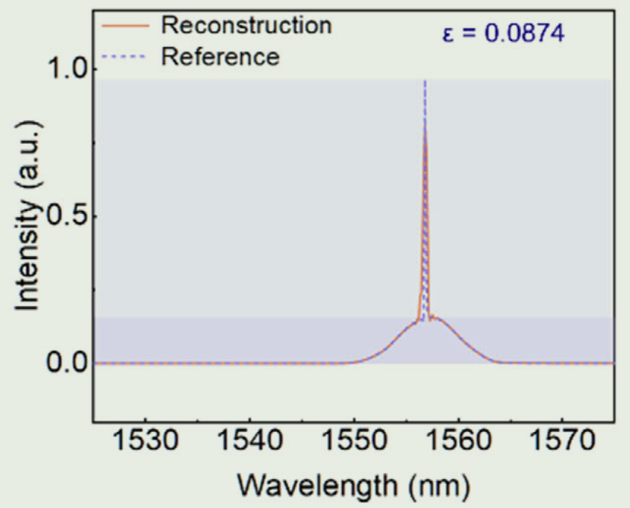
Result
Spectral Reconstruction Validation
The reconstruction outputs (solid line) were compared with the reference spectra obtained from a commercial optical spectrum analyzer (OSA, YOKOGAWA AQ6370C) (dashed lines)
multiple wavelength peaks
continuous broad spectrum
Zhang, Z., Xiao, S., Song, Q. et al. Scalable on-chip diffractive speckle spectrometer with high spectral channel density. Light Sci Appl 14, 130 (2025).
Notes:
对多峰光谱的验证
对连续谱的验证
结果显示：

Slide 29
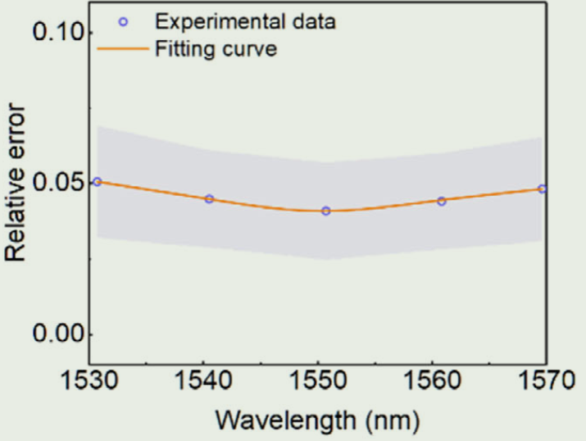
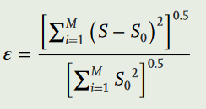
Result
Reconstruction Accuracy
Reconstruction accuracy was evaluated by calculation of relative errors between the results obtained from the speckle spectrometer and the commercial spectrum analyzer.
The relative reconstruction error can be calculated using the following equation:
where S and S0 denote the recovered and the original spectrum, respectively. M is the number of wavelength channels.
Zhang, Z., Xiao, S., Song, Q. et al. Scalable on-chip diffractive speckle spectrometer with high spectral channel density. Light Sci Appl 14, 130 (2025).
Notes:
重构精度
通过计算和参考光谱的相对误差来评判

Slide 30
Result
Resolution:47 pm
Bandwidth:40 nm
851 spectral channels
footprint of 150 μm × 300 μm
spectral channel density: 18911 ch mm−2
Image acquisition time: 7.5ms
Camera frame rate of 134 fps
Image processing time: 21 ms (CPU: Intel Xeon Platinum 8360Y).
Spectral reconstruction: 288 ms (CPU: Intel Xeon Platinum 8360Y).
Full operation time: 0.357 s.
Notes:
性能参数
高光谱通道密度
很好的时效性

Slide 31
CONTENTS
1
Introduction
4
Discussion
2
Methods
5
Summary
3
Result
Notes:
下面是对我们论文中方法的一些讨论

Slide 32
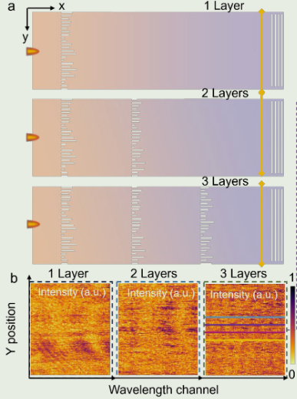
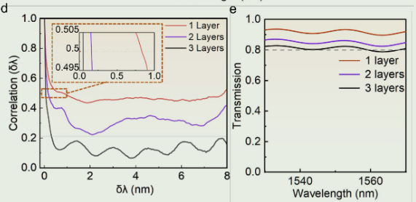
Discussion
Study of cascaded metasurfaces with multiple layers
richness of spectral information increases with the number of layers.
The half-width-half-maximum (HWHM)
transmission efficiency
Zhang, Z., Xiao, S., Song, Q. et al. Scalable on-chip diffractive speckle spectrometer with high spectral channel density. Light Sci Appl 14, 130 (2025).
Notes:
对多层级联的超表面做一个评估
可以看到级联的超表面可以显著提升HWHM

Slide 33
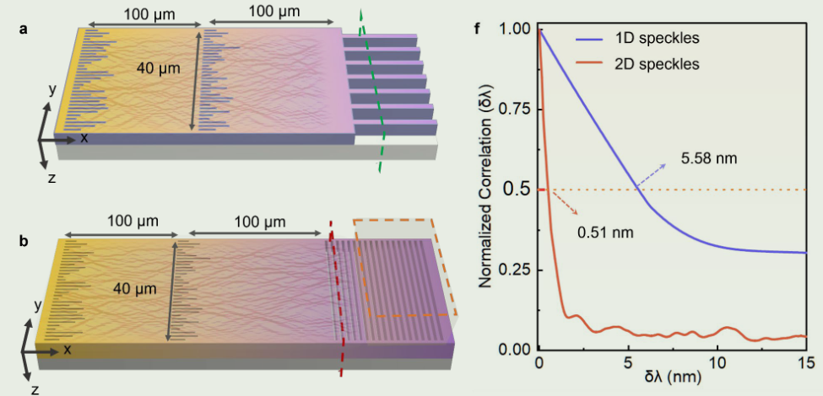
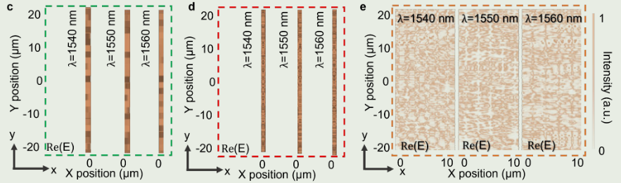
Discussion
Comparative analysis of the spectrometer via 1D and 2D speckles
1D speckles sampled by single-mode waveguide arrays
2D speckles sampled by multimode grating with imaging camera.
Resultion: 0.51 nm vs 5.58 nm much more sampling density
Zhang, Z., Xiao, S., Song, Q. et al. Scalable on-chip diffractive speckle spectrometer with high spectral channel density. Light Sci Appl 14, 130 (2025).
Notes:
对一维和二维散斑对比

Slide 34
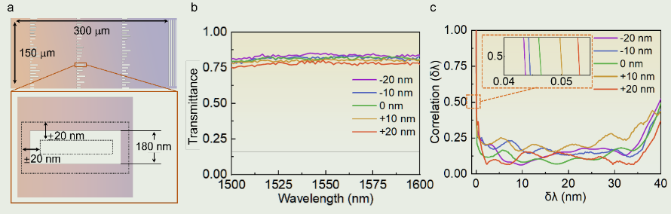
Discussion
Fabrication tolerance analysis
Trench dimension variations of ±20 nm for a three-layer metasurfaces
Optical Transmission
resolution performance
Zhang, Z., Xiao, S., Song, Q. et al. Scalable on-chip diffractive speckle spectrometer with high spectral channel density. Light Sci Appl 14, 130 (2025).
Notes:
对制造误差的分析

Slide 35
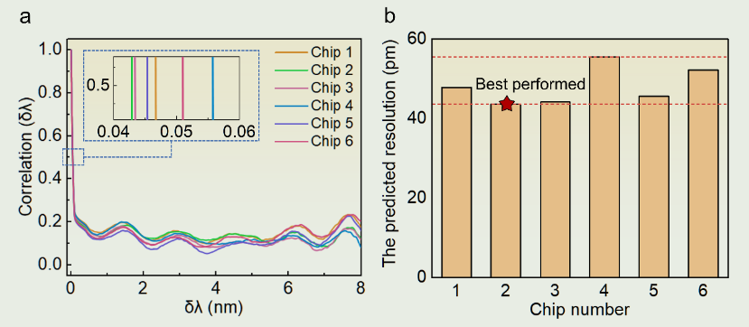
Discussion
Fabrication tolerance analysis
the performance consistency of the same design on different chips
Zhang, Z., Xiao, S., Song, Q. et al. Scalable on-chip diffractive speckle spectrometer with high spectral channel density. Light Sci Appl 14, 130 (2025).
Notes:
对制造一致性的分析

Slide 36
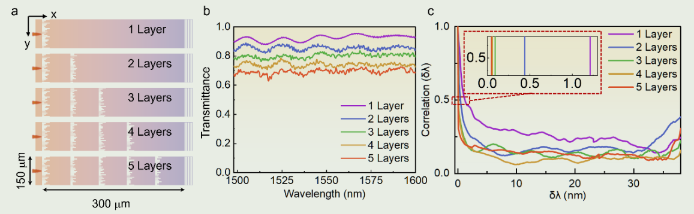
Discussion
The scalability Analysis of the layered metasurfaces device
Impact of increased number of layers
Optical Transmission
Resolution performance
Zhang, Z., Xiao, S., Song, Q. et al. Scalable on-chip diffractive speckle spectrometer with high spectral channel density. Light Sci Appl 14, 130 (2025).

Slide 37
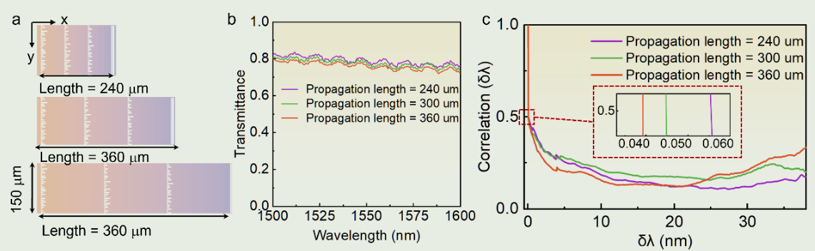
Discussion
The scalability Analysis of the layered metasurfaces device
Impact of inter-layer free propagation distance
Zhang, Z., Xiao, S., Song, Q. et al. Scalable on-chip diffractive speckle spectrometer with high spectral channel density. Light Sci Appl 14, 130 (2025).
Notes:
可扩展性分析

Slide 38
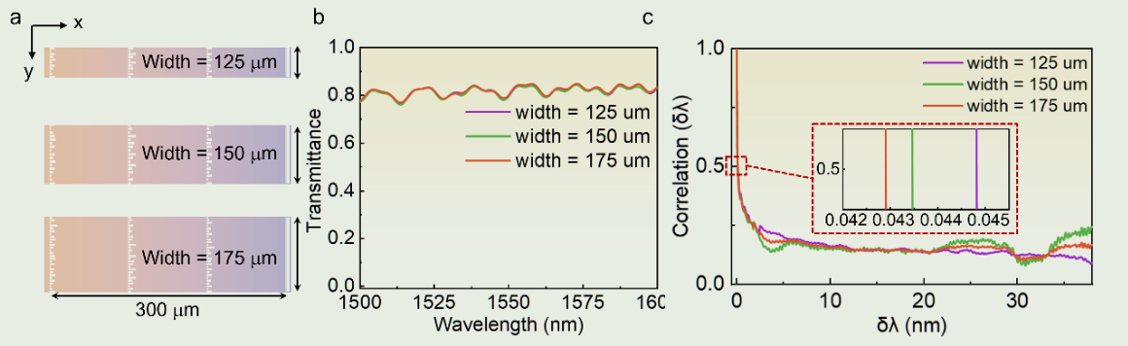
Discussion
The scalability Analysis of the layered metasurfaces device
Impact of metasurface and multimode waveguide width
Zhang, Z., Xiao, S., Song, Q. et al. Scalable on-chip diffractive speckle spectrometer with high spectral channel density. Light Sci Appl 14, 130 (2025).

Slide 39
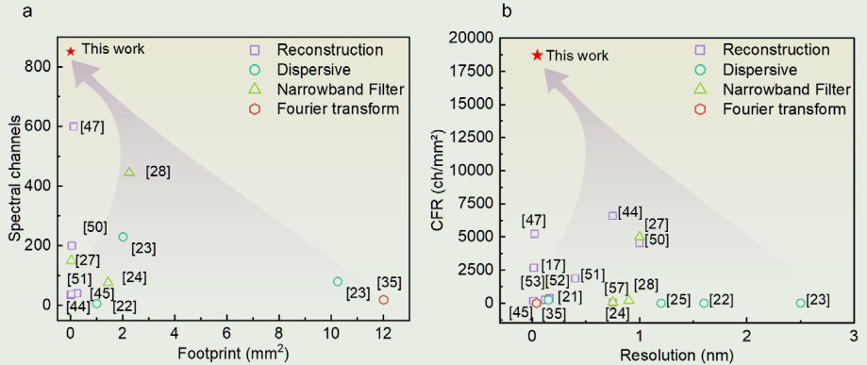
Discussion
Summary of recent advances of the single shot state-of-art spectrometers
Zhang, Z., Xiao, S., Song, Q. et al. Scalable on-chip diffractive speckle spectrometer with high spectral channel density. Light Sci Appl 14, 130 (2025).
Notes:
单次发射光谱仪最新进展总结

Slide 40
CONTENTS
1
Introduction
4
Discussion
2
Methods
5
Summary
3
Result

Slide 41
Summary
Growing demand for miniaturized and integrated spectral sensors
Primary challenges: trade-off between spectral resolution and bandwidth
All passive on-chip diffractive metasurfaces
Three layers of metasurfaces cascaded: increase the spectral richness of the fingerprints
Multimode Grating Coupler : diffracted out and converted 1D speckle patterns to 2D speckles
Calibration of the Spectrometer
Spectral Reconstruction: compressed sensing approach based on the CVX (Convex) optimization
Fabricated via a standard silicon photonic foundry with CMOS compatible processAchieves a record-high CFR of 18911 ch mm−2 with 47 pm resolution
Provide a possible means to develop single-shot and compact on-chip spectrometers beyond the resolution-bandwidth limit
Notes:
最后简单总结一下我们的工作
对小型化和集成光谱传感器的需求不断增长
主要挑战：光谱分辨率和带宽之间的权衡
所有无源片上衍射超表面
三层元表面级联：增加指纹的光谱丰富度
多模光栅耦合器：衍射出1D散斑图案并将其转换为2D散斑图案
光谱仪的校准
光谱重建：基于CVX（凸）优化的压缩感知方法
通过标准硅光子代工厂采用CMOS兼容工艺制造
实现了18911 ch mm−2的创纪录的CFR，分辨率为47 pm
提供一种可能的方法来开发超出分辨率带宽限制的单次拍摄和紧凑型片上光谱仪

Slide 42
Thank You
汇报人：
2025.4.3
Notes:
各位老师们好，我是主讲人黄贤敏，下午开始关于我们组srtp项目的答辩。

