Slide 1
A
B

Slide 2
A
B

Slide 3
A
θ
p

Slide 4
e₆
e₆
e₅
A
e₀
p
e₁
e₄
e₂
e₃

Slide 5
e₆
e₀
A
e₁
e₆
p
e₂
e₅
e₃
e₄

Slide 6
A
p
?
?

Slide 7
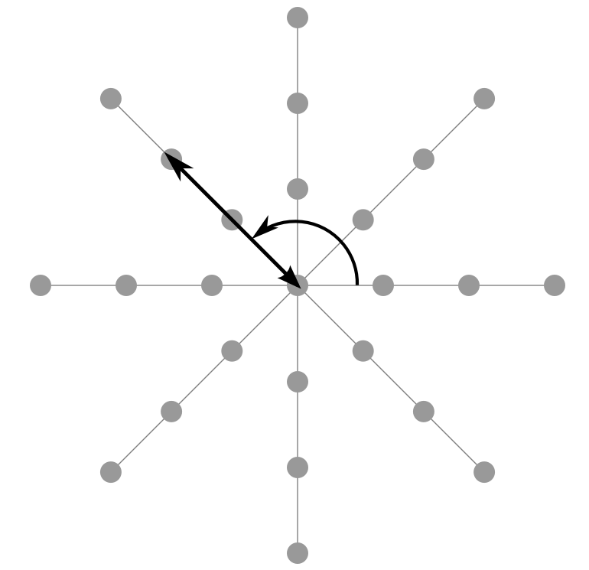
Cobweb
θ
Ψ
d
Ψ=[0, 45, 90, … 315]
d=[g, 2g, 3g]

Slide 8

Cobweb
θ

