Slide 1
MET581 02 - Explore R
15/10/2024
Matthew Bracher-Smith
smithmr5@Cardiff.ac.uk
Research Associate in Bioinformatics
Materials provided by Dr Georgina Menzies and Dr Nicos Angelopoulos

Slide 2
Aims and objectives
Todays Aims
Basics of Quarto
Using Quarto to create pdf’s
The R package tibble
The R package readr
Learning Objectives
Get familiar and comfortable with Quarto and creating pdf’s
Understand the differences between Rmarkdown and Quarto
Understand how to use tibble to make tables of data
Understand how to use readr to read in different formats of data

Slide 3
Homework
For those exercises you probably completed all tasks and copied all answers to a file like an R script
For all future homework we will learn how to make pdf’s or html files from R code, which look like the pdf file for the homework.

Slide 4
Question 1
> sqrt(6*2)
[1] 3.464102
> 4+3-2
[1] 5
> 1046*934
[1] 976964
A.
Question 2
B.
> nrow(women)
[1] 15
C.
> colnames(women)
[1] "height" "weight"

Slide 5
Question 2
women$ages < c(45,67,42,24,89,65,43,19,38,27,15,62,53,59,27)
women
## height weight ages
## 1 58 115 45
## 2 59 117 67
## 3 60 120 42
D.
> sum(women$height)
[1] 975
> sum(women$weight)
[1] 2051
> sum(women$ages)
[1] 675
> mean(women$height)
[1] 65
> mean(women$weight)
[1] 136.7333
> mean(women$ages)
[1] 45
E.

Slide 6
Question 3
females <- cohort[cohort$Gender=="F",]
B.
C.
write.csv(x=females, file="fig4-females.csv")
Question 4
A.
Factors and arrays
a
## [1] 1.0 2.0 5.3 6.0 -2.0 4.0
b
## [1] "one" "two" "three“
c
## [1] TRUE TRUE TRUE FALSE TRUE FALSE
c[c(1,3)]
## [1] TRUE TRUE
B.

Slide 7
Question 4
C.
C1 C2 C3 C4
R1 1 2 3 4
R2 5 6 7 8
R3 9 10 11 12
R4 13 14 15 16
“A dimnames attribute for the matrix: NULL or a list of length 2 giving the row and column names respectively. An empty list is treated as NULL, and a list of length one as row names. The list can be named, and the list names will be used as names for the dimensions.”
d <- c(1, 2, 3, 4)
e <- c("red", "white", "red", NA)
f <- c(TRUE, TRUE, TRUE, FALSE)
mydata <- data.frame(d, e, f)
names(mydata) <- c("ID", "Color", "Passed") # variable names
mydata
## ID Color Passed
## 1 1 red TRUE
## 2 2 white TRUE
## 3 3 red TRUE
## 4 4 <NA> FALSE
D.

Slide 8

Today we’re going to talk about Quarto, which we can use to make pdf and html files (and much more!) that integrate plain language, code and output (images etc.). This is excellent because it’s a dynamic document (and so more reproducible), and hugely flexible – various languages and engines, and outputs are supported.

Slide 9
But before Quarto, there was Rmarkdown…

Slide 10

Some background on Rmarkdown
Today we will be working on a .qmd (Quarto) file, but first, we need to talk about .rmd files.
This (an .rmd file) is an Rmarkdown file. You should remember a little about markdown from your Unix lectures. You will be completing your homework in this file, so let’s have a look at it now.
RMarkdown is a way to make documents which include R code. You can use this to write html documents, pdf’s and PowerPoints to show answers to coding problems, or the code themselves.
Can you think of any reasons for using this?

Slide 11

Some background on Quarto
Announced in 2022 and becoming more widely adopted only last year
Based on pandoc
Actually a separate software that we run within RStudio
The successor to Rmarkdown in many ways
Supports R, Python Julia and more
Can be used to make documents in Rstudio, or Jupyter notebooks or elsewhere (i.e. it’s both multi-language and multi-engine)
Creates .qmd files
Combines R Markdown, bookdown, distill, xaringian, and others “into a single consistent system”
Source: https://quarto.org/docs/faq/rmarkdown.html#is-r-markdown-going-away-will-my-r-markdown-documents-continue-to-work

Slide 12
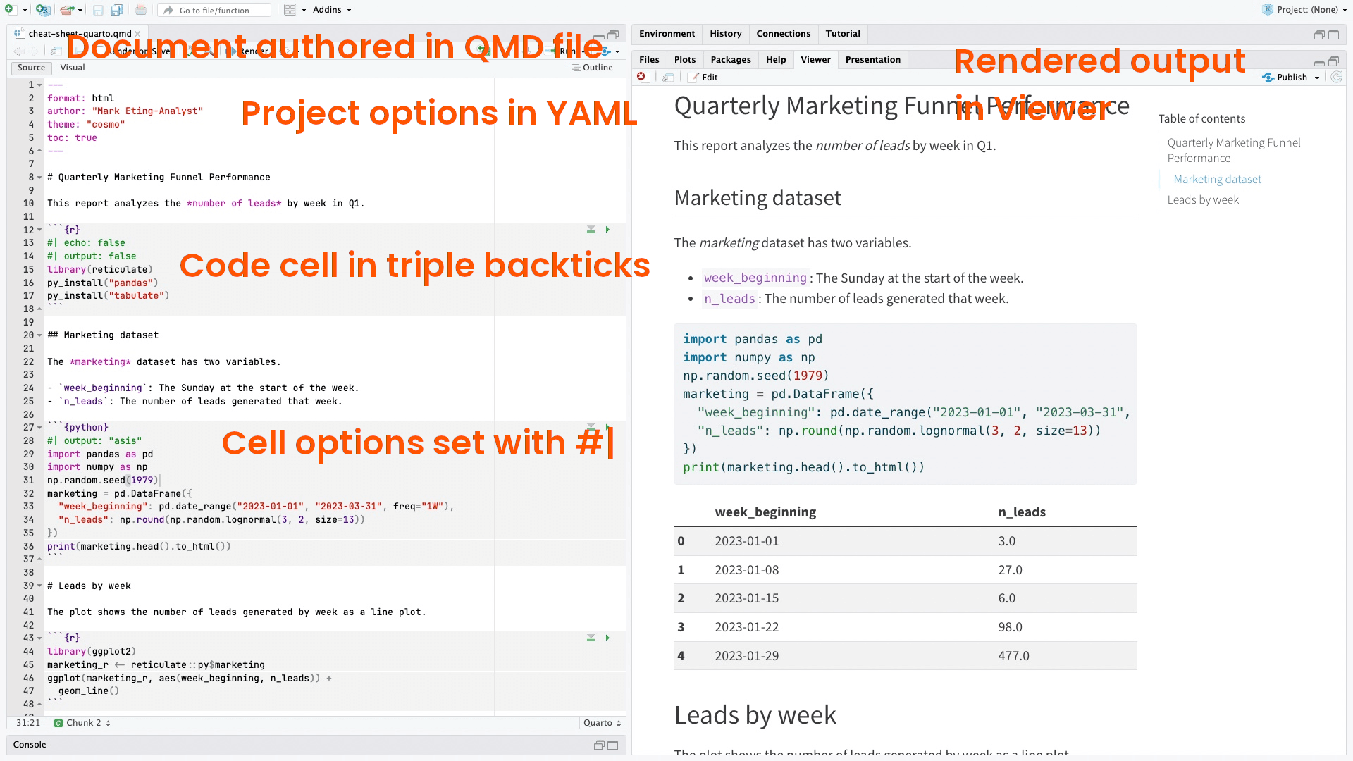
Some background on Quarto
Source: https://www.datacamp.com/cheat-sheet/quarto-cheat-sheet-previously-known-as-r-markdown

Slide 13
A note on Quarto
Fundamental usage for reports is the same as creating in Rmarkdown
It’s also what’s used to make many of the R books you may read online (including R for Data Science 2nd edition!)
Recommended that you use Quarto by default, because:
You will be easily be able to swap-in other languages besides R as/if you known them
You will more easily be able to use other Quarto features like those for making blogs and journal articles if you’re already familiar
It’s highly compatible - you can render most Rmarkdown or jupyter notebooks in Quarto easily. Meaning you can still make normal Rmarkdown documents with your knowledge if needed.
You’re up to date with the latest in reproducible research
Newest features will likely be added to Quarto over Rmarkdown

Slide 14
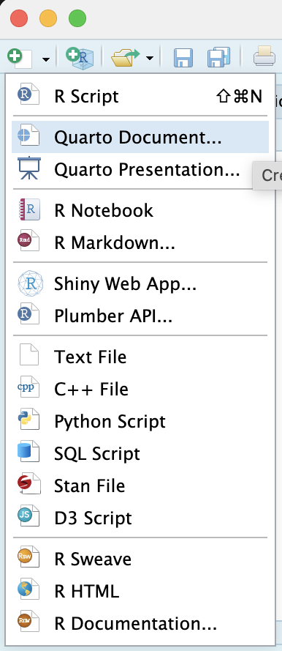
Making your first .qmd file
Use the menu bar to create a new Quarto document
We will focus on creating html documents today
Let’s start filling in the options
You will need to give it a name and fill in your name. This is a good practice, It will allow traceability of code. You will know when you open the file again that you authored it, and when you first created the file.
Notice that the file contains three types of content:
A YAML header surrounded by - - -
R code chunks surrounded by ```
Text mixed with simple markdown formatting
What do each of the bits of your new file do?
Let’s work through these now and create a knitted document!
Create your own with code/data you have, or download an example file from quarto from here

Slide 15
Elements of Quarto | The YAML header
Quarto documents start with a YAML header that sets metadata and configurations for the document.
YAML is a data serialisation language which aims to be useful for computers (often config files) and humans (it’s relatively easy to read)
Typical YAML options:
title: Title of the document
author: Author’s name
date: Document date
format: Specifies the output format (html, pdf, etc.)
theme: Defines a theme for visual style
Everything between the --- is part of the header
There are a lot of options we won’t cover today and they differ by document type!

Slide 16
Elements of Quarto | Code chunks
When you open the file in the RStudio IDE, it becomes a notebook interface for R. You can run each code chunk by clicking the green arrow icon. RStudio executes the code and display the results in line with your file.
There are three ways to insert R code into the file…
The keyboard shortcut Ctrl + Alt + I (OS X: Cmd + Option + I)
The +option in the menu bar
Or by typing the chunk delimiters ``` {r} ```

Slide 17
Elements of Quarto | Code chunks
In Quarto, chunk output can be customized with options prefixed by #| inside the chunk header. Here are some common options:
#| include: false
Excludes code and results from the rendered document but runs the code.
#| echo: false
Excludes code but displays results. Useful for embedding figures.
#| message: false
Suppresses messages generated by code.
#| warning: false
Suppresses warnings generated by code.
#| fig-cap: “This is a caption”
Adds a caption to figures.
In html documents, adding code-tools and using code-folding are usually preferred over include/echo

Slide 18
Elements of Quarto | Inline code
Code results can be inserted directly into the text of a .qmd file by enclosing the code with r.
Let’s try this now…recreate the results of the code below. This is a simple matrix using the commands we learned yesterday. Can you work out how to do this?
## [,1] [,2] [,3]
## [1,] 1 3 5
## [2,] 2 4 6

Slide 19
Elements of Quarto | Inline code
Code results can be inserted directly into the text of a .Rmd file by enclosing the code with r.
Let’s try this now…recreate the results of the code below. This is a simple matrix using the commands we learned yesterday. Can you work out how to do this?
Answer:
## [,1] [,2] [,3]
## [1,] 1 3 5
## [2,] 2 4 6
```{r}
#| echo: false
test <- c(1, 2, 3, 4, 5, 6)
testmatrix <- matrix(test, byrow = FALSE, nrow = 2, ncol = 3)
testmatrix
```

Slide 20
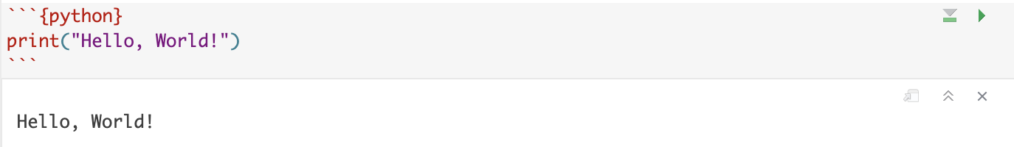
Elements of Quarto | Multiple languages
Quarto allows the use of multiple languages in code chunks. Specify the language using {} after the chunk delimiter, like python, julia, or r.
Example:

Slide 21
Elements of Quarto | Text Options
Some text formatting options, such as
Bold
Italics
Headers
Super^{script}
Sub_{script}
Strikethrough
And more….see the Quarto website which reviews some options for markdown formatting

Slide 22
Creating documents | Previewing and Rendering
In RStudio, you can preview and render Quarto documents easily
Render by clicking the 'Render' button
Preview by toggling the visual button
Quarto provides a command-line interface as well, which allows rendering with: quarto render myfile.qmd
You can specify output formats in the YAML header or when rendering

Slide 23
Creating documents | Quarto output formats
Quarto supports various output formats:
html: Web format with dynamic features
pdf: Portable document format for printing
docx: Microsoft Word format
revealjs: HTML presentations (for slides)
beamer: PDF presentations (for slides)
Specify these in the YAML or use them with the quarto render command.

Slide 24
- Here is a version of the document with other elements added - See if you can make an ordered list with sub items that contain at least one example of bold, italic, superscript and strikethrough text, as well as a 2x2 table with headers
Creating documents | Practice

Slide 25
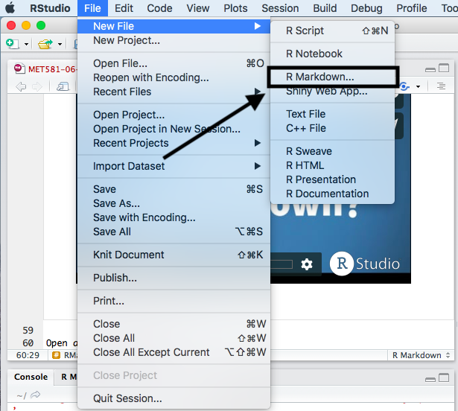
Now make an .rmd file
Compare it to a .rmd document
What do you notice that’s different?

Slide 26
Quarto (.qmd) and Rmarkdown (.rmd): Differences you need to know
Quarto:
Is language agnostic AND engine agnostic
Has a CLI option and is quite extensible
Can create a wider range of output formats
And allows for “project-based workflows” (for books, websites etc.)
Has easy two-column flexible layouts
Uses global chunk options using YAML
Can create chunks options with hashpipe (#|)
Has a surprisingly large and growing backing of users
Has robust cross-referencing options

Slide 27
Final links
Download the Quarto cheatsheet here
Quarto Cheatsheet Cheat sheets are helpful infographics that provide all the major things you need to get started
Authoring PDFs and more
You will need latex installed to create pdfs.
See your options here (the best bet is just TinyTex) for installing latex
See the pdf YAML reference here
You can output to multiple formats and use the quarto package directly
See the tutorial on authoring here

Slide 28
Break

Slide 29


Tibbles!
“Tibbles” are a new modern data frame. It keeps many important features of the original data frame. It removes many of the outdated features. They are another amazing feature added to R by Hadley Wickham. We will use them in the tidyverse to replace the older dataframe that we just learned about.

Slide 30
Tibbles!
Compared to Data Frames:
A tibble never changes the input type.
A tibble can have columns that are lists.
A tibble can have non-standard variable names.
can start with a number or contain spaces.
To use this refer to these in a backtick.
It only recycles vectors of length 1.
It never creates row names.
Enhanced print() behaviour

Slide 31
Tibbles!
library(tidyverse)
test<- tibble(x = 1:3, y = list(1:5, 1:10, 1:20))
test
## # A tibble: 3 × 2
## x y
## <int> <list>
## 1 1 <int [5]>
## 2 2 <int [10]>
## 3 3 <int [20]>
The syntax to make a tibble is nearly identical to data frames →
We can see that y is displayed as a list. If we try to do this with a traditional data frame we get:
test <- as.data.frame(c(x = 1:3, y = list(1:5, 1:10, 1:20)))
test

Slide 32
Tibbles!
You can coerce data frames to tibbles
Try to display the iris dataset in the console as a data.frame and then again as a tibble, what is the difference?
data(iris)
as_tibble(iris)

Slide 33
Tibbles!
You can coerce data frames to tibbles
Try to display the iris dataset in the console as a data.frame and then again as a tibble, what is the difference?
data(iris)
as_tibble(iris)
Tibbles only print the first 10 rows and all the columns that fit on a screen.
Each column displays its data type.
You will not accidentally print too much.

Slide 34
Tribble
Need to quickly make a small readable table?
tribble() allows you to make a tibble and fill it row wise (handy for data entry)
The ~ symbol is used to define column headers
tribble(~x, ~y, ~z,"a", 2, 3.6, "b", 1, 8.5)
# A tibble: 2 x 3
x y z
<chr> <dbl> <dbl>
1 a 2 3.6
2 b 1 8.5

Slide 35
Tibble exercises
How can you tell if an object is a tibble?
Compare and contrast the following operations on a data.frame and equivalent tibble. What is different?
df <- data.frame(abc = 1, xyz = “a”)
df$x
df[, “xyz”]
If you have the name of a column stored in an object, e.g. var <- “mpg”, how can you extract the column from a tibble?

Slide 36

Readr
There are many ways to import data into R, from inputting the data yourself to reading it in using the traditional R tools we used in lesson one.
The tidyverse way is to use a package called readr, there are several functions within this package you can use to read in different types of data.

Slide 37
Readr functions
read_csv() reads comma delimited files
read_csv2() reads semicolon separated files (common in countries where , is used as the decimal place)
read_tsv() reads tab delimited files
read_delim() reads in files with any delimiter.
read_fwf() reads fixed width files. You can specify fields either by their widths with fwf_widths() or their position with fwf_positions().
read_table() reads a common variation of fixed width files where columns are separated by white space.
read_log() reads Apache style log files.

Slide 38
Readr exercises
Use the base R function read.table() to import the pheno.txt file. Then repeat this with read_tsv() from Readr, what is the difference?
You may notice that read_csv automatically assumes your first row is your column headers, you may wish to alter this behaviour is your file comes with a header of information on the top row.
Open “Pheno.txt” in notepad or some form of text editor and add a header to the file.
What happens when you open this using read_csv?

Slide 39
Readr exercises continued
Let’s try this again, but skipping this header.
You can use skip = n to skip the first n lines; or use comment = “#” to drop all lines that start with (e.g.) #.
You may not have column names, in that case you can use col_names = FALSE to tell read_csv() not to treat the first row as headings, and instead label them sequentially from X1 to Xn

Slide 40
Readr vs. base R
Why use the readr functions?
They are typically much faster (~10x) than their base equivalents. Long running jobs have a progress bar, so you can see what’s happening. If you’re looking for raw speed, try fread() from the data.table package. It doesn’t fit quite so well into the tidyverse, but it can be quite a bit faster.
They produce tibbles, they don’t convert character vectors to factors, use row names, or munge the column names. These are common sources of frustration with the base R functions.
They are more reproducible. Base R functions inherit some behaviour from your operating system and environment variables, so code that works on your computer might not work on someone else’s.

Slide 41

R for Data Science Textbook (2nd Edition)
Extra reading
https://r4ds.hadley.nz/
Chapter 8: Data import
Chapter 29: Quarto
Chapter 30: Quarto formats
Advanced reading:
Chapters 21-25 (importing data)

