Slide 1
MET581 01 - Introduction to R
14/10/2024
Matthew Bracher-Smith
smithmr5@Cardiff.ac.uk
Research Associate in Bioinformatics
Materials provided by Dr Georgina Menzies and Dr Nicos Angelopoulos

Slide 2
Todays Aims
Basics of R
Importing and Exporting Data
Working with R packages
Basic data alterations
Learning Objectives
Get familiar and comfortable with RStudio
Understand the basic syntax of R
Learn how to calculate in R
Get to know the different data types and structures used by R
Basics of importing and exporting data in base R
Learn how to find extra help
Know how to find and install packages into R

Slide 3
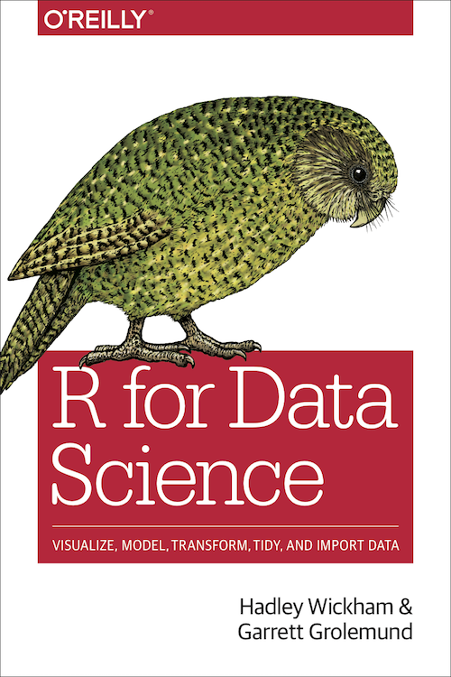
R for Data Science Textbook
This course will follow a similar structure to this free ebook

Slide 4
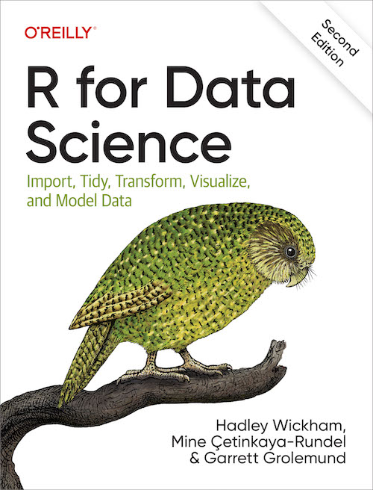
R for Data Science Textbook (2nd Edition)
https://r4ds.hadley.nz/
Major updates
Swap to Quarto from R markdown (which we’ll cover)
Minor changes in terminology over the years (which we’ll cover)
More on ggplot2, missing values and
No more modelling
For modelling, see “Tidy models in R”
https://www.tmwr.org/
For more ggplot2, see “ggplot2: Elegant Graphics for Data Analysis””
https://ggplot2-book.org/

Slide 5
Course Structure
Importing Data
Wrangling Data
Modelling
Visualisation
Communication
Finding Help
And all the associated packages used to do these!

Slide 6
Install R and RStudio
R is the language itself (current version 4.3.1 “Beagle Scouts”)
Windows
MacOS (use arm64 version for newer M1 based Macbooks)
Linux: sudo apt install r-base
RStudio is an interactive development environment (IDE) used to write code, interact with and analyse data, produce plots and graphics, write R markdown files and shiny apps…….It’s great!
Download
You are welcome to use Jupyter Notebooks/lab as well, but note that the course will assume Rstudio and it’s best to familiarise yourself with this first.

Slide 7
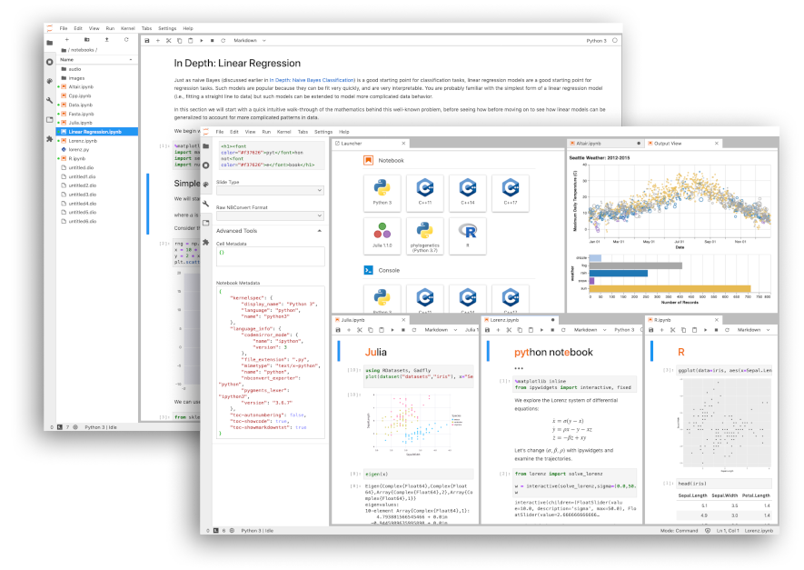
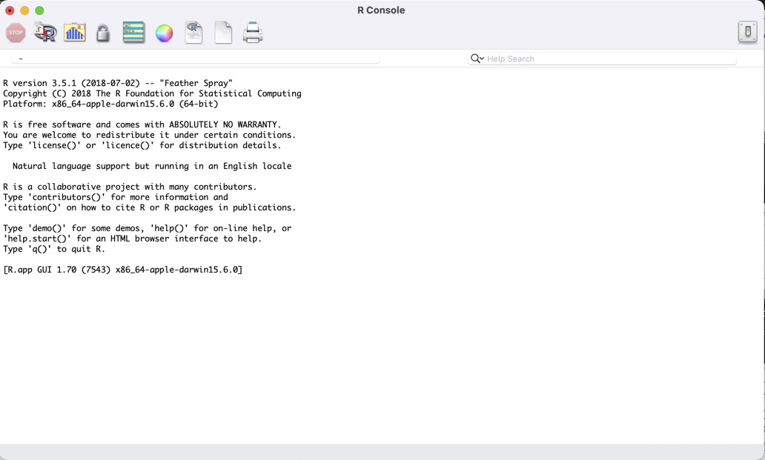
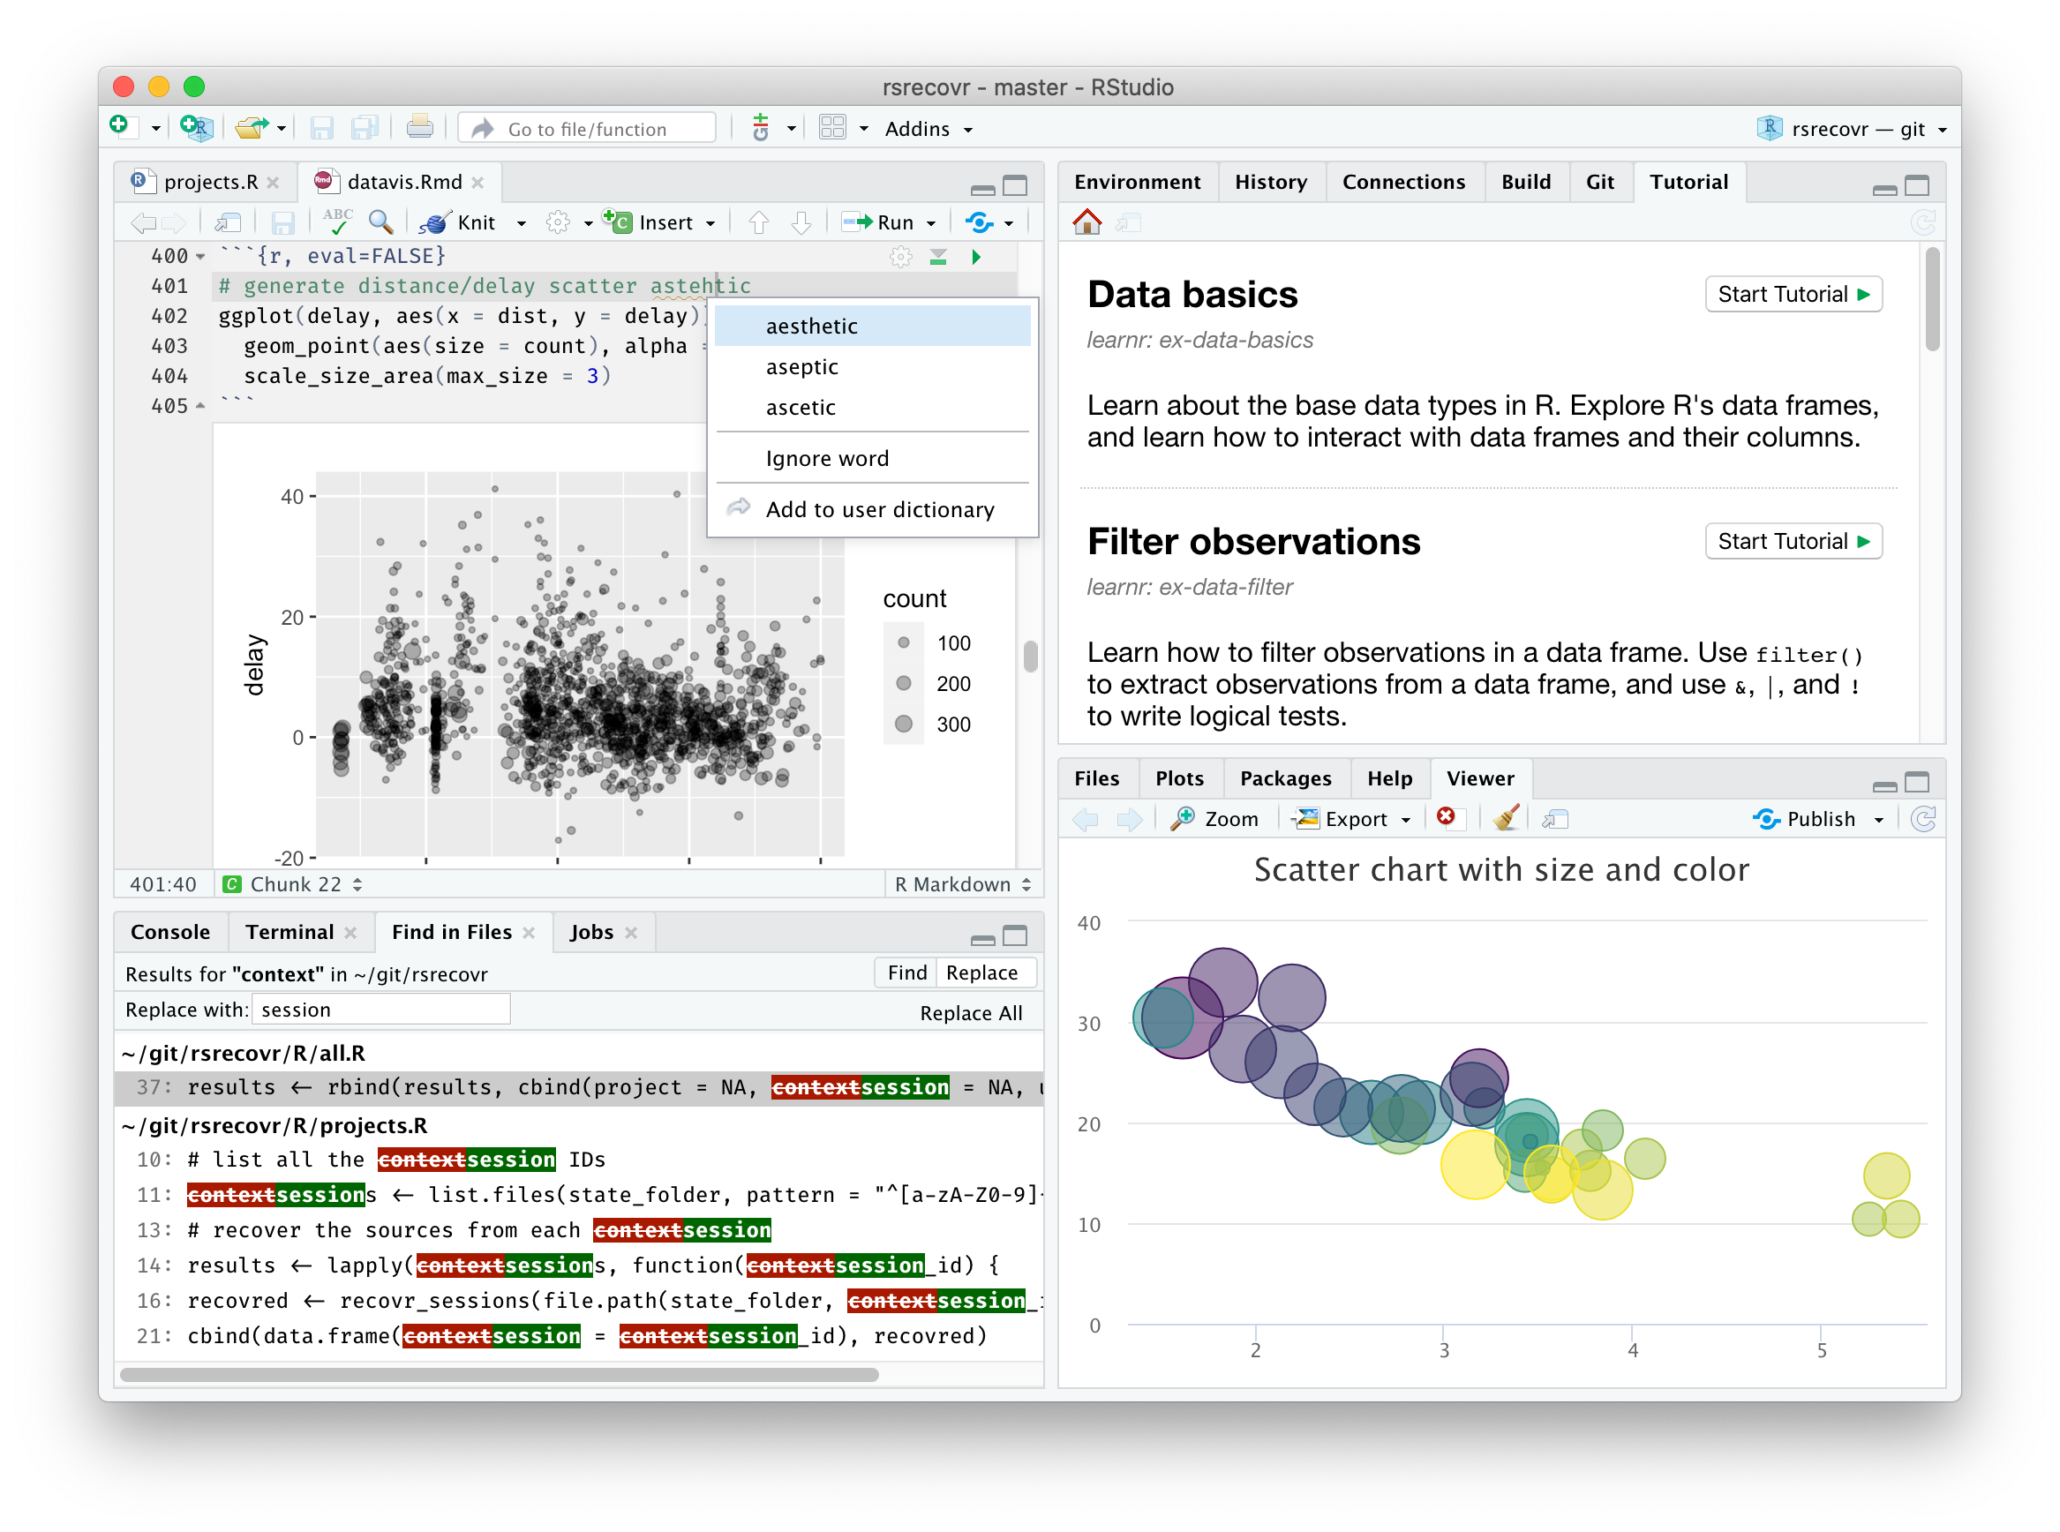
Jupyter vs Rstudio
R console
RStudio (by posit)
JupyterLab
Simplest way to interact with R
No additional features
Main IDE we will use
Includes console, scripts and much more
Can use any of Julia, Python or R
Happy for you to use/try but not the focus of this course

Slide 8
The Basics – Maths
2+2
5 - 3 + 2 * 4^2
11465 * 2358971436
options(scipen = 999)
11465 * 2358971436
What is the difference between these last two runs?
What do you think options(scipen = 999) is doing to the code?

Slide 9
options(Scipen)
‘scipen’: integer. A penalty to be applied when deciding to print numeric values in fixed or exponential notation. Positive values bias towards fixed and negative towards scientific notation: fixed notation will be preferred unless it is more than ‘scipen’ digits wider.

Slide 10
Some other examples of mathematics operations:
Follow this link for some more basic math functions in R.
Action | Symbol
Addition | +
Subtraction | -
Multiplication | *
Division | /
Exponentiation | ^
Modulo (remainder of the Euclidean division) | %%
Trig functions | sin(), cos(), tan(), acos(), asin(), atan()
Natural log | log(), log10(), log2()
Exponential | exp()
Absolute Value | abs()
Square Root | sqrt()
Rounding | ceiling(), floor(), round()

Slide 11
Maths
Carry these out in your R console:
What is 2 to the power of 16?
What is the square root of 92?
If I have 7 apples and 16 kids - how much of an apple do they each get?
2^16
sqrt(92)
7/16

Slide 12
The Prompt
The prompt is represented by this symbol >.
This means that R is waiting for your input.
This is how you know that nothing is currently running.
If your code isn’t correctly formatted, R will “hang”, and you will see this symbol instead +.
You will need to kill the line to try again, and you can do this using ESC.
If this prompt is missing you know that R is running your code, depending upon the complexity of the input code this might take some time.
Try running this code in R, what happens?
What do you think is wrong?
5 - 3 + 2 * 4 ^

Slide 13
Commenting your Code
R ignores everything after a #
You should be carefully and thoroughly commenting every bit of your code so that other people (including future you) understand what it does
Can also come after a command
>4 hashtags will also tell RStudio to allow code folding at that line, very handy for long scripts!
>"Hello_World" # a word/character
## [1] "Hello_World"

Slide 14
Getting help in R
R is great at offering extra help.
If you know the function name you can type ?function_name or help(function_name), if you aren’t quite sure of the function name try ??function_name!
Try this out and see what you get. We are going to test these out for the function mean.
?mean
??mean
help(mean)
Do you get the same response?
?mean
??mean
help(mean)

Slide 15
Google!
Your second port of call should be google! R is a free resource and a lot of people will have already asked a lot of the questions you might have
These are the results from googling
The internet is your friend
Cookbook for R
R-bloggers
Stackoverflow
CrossValidated
Google

Slide 16
Making a variable
We want to be able to save numbers, vectors, objects, data frames etc. so that we can call on them again later
Variable names cannot contain special characters, and they cannot start with a number.
<- is used to assign values to a variable
i.e. less than followed by a dash, I like to think of it as you are putting something into your variable name

Slide 17
variable <- 656
> variable
## [1] 656
Notice how you can display your variable by typing its name into the terminal and hitting enter. Print(variable) also works.
variable + 789
## [1] 657578

Slide 18
Good practice for coding
Good style practice : Space out your code!
# No spaces
x<--4+5/6*4
# With spaces
x <- -4 + 5 / 6 * 4

Slide 19
Style guides
Here are two R style guides which covers things like file names, variable names, assignments, spacing, syntax, etc.
One from Google
One from Hadley Wickham et al. (the Tidyverse Style Guide)
You can use = for assignment, but it is better to use the <- rather than =
However, there is a difference in their behaviour which is to do with scoping and environments in R.
It is better to use <- for assignment to avoid any potential future issues.

Slide 20
Naming conventions
Make them meaningful
Don’t make them too long
There are a variety of naming conventions which different people use:
this_is_called_snake_case
whileThisIsCamelCase
sometimes.there.are.periods
Or_thereAre.thoseThat_Annoy.everyone

Slide 21
Python compatibility
For best compatibility with other program (like Python), don’t use sometimes.there.are.periods as this can interfere with Pythons dot notation.
Remember R is case sensitive
i.e. TEST, test and Test are not the same thing.

Slide 22
Data types
There are many different types of data which you might be interested in loading into R.
R will treat these differently and making sure it knows the type of data it is dealing with can be important in certain functions and calculations.
The L after the number in the integer tells R that this is an integer. Integer is a subclass of numeric. Sometimes the double class is also used, which is also a subclass of numeric. Complex is for complex numbers with real and imaginary parts.
To determine what type of data something is you can use the class() or typeof() function. These give you slightly different information.
Types of data
Type | Example
Character | ‘words’
Numeric | 1, 23.25
Integer | 2L
Logical | TRUE, FALSE
Complex | 1+4i

Slide 23
x <- 3
typeof(x)
## [1] "double"
y <- ’cars’
class(y)
## [1] "character"

Slide 24
Tables, Data Frames, Lists, Vectors
The types of data that can be stored and used in R are collectively called objects

Slide 25
Vectors are multiple objects of the same class in one object. We use the ‘c’ function to join them all together. Make your own Vector like the one below.
Vectors
# Create a vector.
apple <- c('red','green',"yellow")
print(apple)
## [1] "red" "green" "yellow"
# Get the class of the vector.
print(class(apple))
## [1] "character"

Slide 26
Lets try these out
Make two vectors of equal length, containing only numbers, save them to new variables
Add the two vectors together using their variable names, what happened?
What happens if you type name_of_your_vector[2] ?

Slide 27
Indexing a vector
What do we do if we want to retrieve only the second element in our vector?
What about elements 2 to 5
What about 2 and 5?
vec <- c("a","b","c","d","e","f")
vec[2]
## [1] "b"
vec[2:5]
## [1] "b" "c" "d" "e"
vec[c(2,5)]
## [1] "b" "e"

Slide 28
Relational Operators
Logical Operators
Operator | Description
< | Less than
> | Greater than
<= | Less than or equal to
>= | Greater than or equal to
== | Equal to
!= | Not equal to
Operator | Description
! | Logical NOT
& | Element-wise logical AND
&& | Logical AND
| | Element-wise logical OR
|| | Logical OR

Slide 29
c(TRUE, TRUE, TRUE) & c(TRUE, TRUE, FALSE)
## [1] TRUE TRUE FALSE
c(TRUE, TRUE, TRUE) && c(TRUE, TRUE, FALSE)
## [1] TRUE
c(TRUE, TRUE, TRUE) | c(TRUE, TRUE, FALSE)
## [1] TRUE TRUE TRUE
c(TRUE, TRUE, TRUE) || c(TRUE, TRUE, FALSE)
## [1] TRUE

Slide 30
Lists
A list is an R-object which can contain many different types of elements inside it like vectors, functions and even another list inside it.
# Create a list.
list1 <- list(c(2,5,3),21.3,sin)
# Print the list.
print(list1)
## [[1]]
## [1] 2 5 3
##
## [[2]]
## [1] 21.3
##
## [[3]]
## function (x) .Primitive("sin")

Slide 31
Matrices
A matrix is a two-dimensional rectangular data set. It can be created using a vector input to the matrix function.
# Create a matrix.
M = matrix( c('a',’b',’c',’d',’e',’f'), nrow = 2, ncol = 3, byrow = TRUE)
print(M)
## [,1] [,2] [,3]
## [1,] "a" “b" “c"
## [2,] “d" “e" “f"
Repeat this code but set byrow to FALSE, what changed?
What if you don’t put byrow in at all?

Slide 32
Data Frames
Data Frames are where it starts to get a little more complex
Data frames are tabular data objects. Unlike a matrix in data frame each column can contain different modes of data. The first column can be numeric while the second column can be character and third column can be logical. It is a list of vectors of equal length.
Now you’ve learnt a little more about getting help in R. Can you find out how to make a data frame?

Slide 33
vector_1 <- c("a","b","c","d","e","f")
vector_2 <- c(1,2,3,4,5,6)
Data <- data.frame("letters" = vector_1, "numbers" = vector_2)
Data
letters numbers
1 a 1
2 b 2
3 c 3
4 d 4
5 e 5
6 f 6
Our data now has 2 dimensions (rows and columns)
To index something we need to specify both he row and column we want like this:
Data[3,1]
## [1] “c”
Can you tell me what you would need to type in to retrieve the number 5 ?

Slide 34
You can also reference a whole column using the $ operator followed by the column name
This can be useful for performing actions on a whole column
It can also be useful for adding and naming new columns
Data$numbers
## [1] 1 2 3 4 5 6
sum(Data$numbers)
## [1] 21
Data$symbols <- c("-", "_", "=", "+", "<", ".")
letters numbers symbols
1: a 1 -
2: b 2 _
3: c 3 =
4: d 4 +
5: e 5 <
6: f 6 .

Slide 35
Subsetting
By using indexing and the == operator we can request a subset from our data frame
Data$numbers == 5 evaluates the value in each row of the ‘numbers’ column and returns a vector of TRUE or FALSE for each.
Because we placed this in the row section inside the square brackets we have asked it to select all the rows which evaluated to true i.e the value was equal to 5.
subset <- Data[Data$numbers == 5, ]
print(subset)
letters numbers symbols
1: e 5 <
Data$numbers == 5
[1] FALSE FALSE FALSE FALSE TRUE FALSE

Slide 36
Break Time

Slide 37
R functions
You will learn how to properly write and use functions later
These are ways of saving time writing code you plan to use over and over again
R has many built-in functions but there are millions more other people have written as well.
# Example of a function to sum squares
sum.of.squares <- function(x,y) {
x^2 + y^2
}
# You would then run the code like this;
sum.of.squares(3,7)
## [1] 58

Slide 38
R packages
R is open source and easily expandable. Therefore a lot of people have contributed packages to R over the years. These are functions people have written to perform a wide variety of tasks.
You can find a very long list of packages here.
There is a biology specific set of packages for R called BioConductor, and a data science one called the tidyverse (and this we will be coming back to).
You can also write your own package and submit it to the R community. We will come back to looking at packages and the writing of packages later in the course, but if you are interested there is a book about it! You can find it online here.
Hilary Parker’s posts on personal R packages and how to create one

Slide 39
Installing packages
There are a couple of ways to install packages into R, but the easiest way is just to install them through the console and load them in like this:
Install the package. This downloads the required code from the web repository (by default this should be "https://cran.rstudio.com/" ). Packages may require other packages to work, therefore more than one package may downloaded.
install.packages(‘packagename’)
Load the package into R. Once the packages is downloaded, it then needs to be loaded into the R environment for use. Downloading the package does not make the commands available, it must be loaded into R first.
library(packagename)

Slide 40
Try installing the package “tidyverse” and loading it into the R environment You can also check to see which packages are installed using the function installed.packages()

Slide 41
Working directories
The data will be stored somewhere on your computer
We need to tell R where to look
This can be done in two ways:
Absolute paths
Relative paths
The absolute path includes the full directory listing form your root folder.
e.g. “C:/Users/matt/Dropbox/Teaching/Lesson 1 - An introduction to R/"

Slide 42
Setting the working directory
The often simpler method is to use paths relative to where R is looking i.e. the working directory
To see the current working directory use
You can change this
getwd()
## [1] “C:/”
setwd(“C:/Users/matt/Dropbox/Teaching/Lesson 1 - An introduction to R/”)
Change your working directory to somewhere useful now and then check it worked correctly

Slide 43
Loading data
Your data could be in many different formats
E.g. text tab delimited (.txt), comma separated file (.csv), SPSS format (.sav) etc.
The function we use to import the data will depend on the format it is in

Slide 44
Tab and space delimited (e.g. .tsv)
phenotype_data <- read.table(“pheno.tsv”, sep = “\t”) # tab delimited
phenotype_data <- read.table(“pheno.txt”, sep = “ ”) # Space delimited
Comma separated file (.csv)
phenotype_data <- read.csv(“pheno.txt”)
Excel spreadsheets (.xlsx)
install.packages("readxl")
library(readxl)
phenotype_data <- read_excel("pheno.xlsx", sheet = 1) # set sheet number

Slide 45
Stata format (.dta)
install.packages("haven")
library(haven)
phenotype_data <- read_dta("pheno.dta")
SPSS format (.sav)
install.packages("haven")
library(haven)
phenotype_data <- read_sav("pheno.sav")
There are other things to consider:
Does your data contain column headers
Are there any leading lines at the top that need to be skipped?
Is there a certain identifier for missing data? (NA, -9, - etc.)
What character is used as a decimal point?
There are arguments that can be added to each function to set these, how can we see these?

Slide 46
Exporting data
We want to save any data we have been working with
We will need to give it a name, location (absolute or relative path) and decide what format to save it in (.csv, .tsv etc. )
Different formats use different functions again
data(mtcars)
mydata <- mtcars
write.table(mydata, "mydata.txt", sep = "\t")
write.csv(mydata, “../mydata.csv")
# the ../ saves in the folder containing your working directory just like in UNIX
Useful options to usually set:
row.names = FALSE default is TRUE, but if you haven’t set row names they are useless
quote = FALSE default is TRUE which puts quotes around characters, which most people do not want

Slide 47
R for Data Science Textbook (2nd Edition)
Extra reading
https://r4ds.hadley.nz/
Chapter 1: Introduction
Chapter 3: Workflow - basics
Chapter 5: Workflow - code style
Chapter 9: Workflow - getting help

