Slide 1
ROOT-CAUSE DETECTION · BENCHMARK RESULTS
Causal discovery on the quadruple-tank process: raw data versus Gaussian-copula-transformed data
PC, PCMCI+, VAR-LiNGAM and LSTE on datasets P_minus and P_plus.
Results produced on 2 October 2026.
Runs: run-parcorr-tau20-s3, run-parcorr-tau20-full, run-copula-tau20-s3, run-copula-tau20-full, run-copula-lste-s3

Slide 2
THE SYSTEM
Two pumps, four tanks, one disturbance: eight directed links are the answer key for every result that follows
Physical rig (Johansson quadruple-tank process)
Same system as a causal graph: 7 nodes, 8 directed links
h3
d
h4
v1
d
v2
upper left
upper right
h3
h4
h1
h2
lower left
lower right
h1
h2
pump v1
pump v2
Variable | Meaning | Type
v1, v2 | pump voltages | binary PRBS inputs
d | disturbance flow into upper tanks | binary PRBS input
h1, h2 | lower-tank levels | continuous
h3, h4 | upper-tank levels | continuous
Each pump splits its flow between one lower tank and the diagonally opposite upper tank. Upper tanks drain into the tank below (burgundy). d feeds both upper tanks.
Source: datasets/QTank_Dynamics.m; Johansson, IEEE TCST 2000; datasets/generated/ground_truth_edges.json
2

Slide 3
DATA AND SETUP
Two operating points, two sampling rates, one window of 20 lags; every run is scored against the same 8 edges
Benchmark settings
cause → effect
Ground-truth edges
Item | Value
Datasets | P_minus (minimum phase), P_plus (non-minimum phase); same simulator and inputs
Variables | v1, v2, d (binary PRBS inputs); h1, h2, h3, h4 (tank levels)
Ground truth | 8 directed edges; no lag information recorded
Sampling, full | Ts = 5 s, 2880 rows (4 h)
Sampling, stride 3 | Ts = 15 s, 960 rows (same 4 h)
tau_max | 20 samples = 100 s (full) or 300 s (stride 3)
Standardisation | every column z-scored before each algorithm
Scoring | lags collapsed to unique directed edges; self-loops dropped; precision, recall, F1, SHD
# | Cause | Effect | Mechanism
1 | v1 | h1 | pump flow
2 | v1 | h4 | pump flow
3 | v2 | h2 | pump flow
4 | v2 | h3 | pump flow
5 | d | h3 | disturbance
6 | d | h4 | disturbance
7 | h3 | h1 | drainage
8 | h4 | h2 | drainage
Source: datasets/generated/ground_truth_edges.json; datasets/run_algorithms.py; docs/QTP_EXPECTATIONS.md
3

Slide 4
DATA AND SETUP · INPUT AND NOISE SIGNALS
Three binary excitations drive the plant and two small Gaussian noises perturb it; only the three excitations are recorded as inputs
amplitudes as generated, seed 0
The five signals
Design choices and why
Signal | Role | Type | Amplitude | Hold / rate | Recorded | Enters
v1 | pump 1 excitation | PRBS, ± | ±0.30 V around 3.00 V (P−) / 3.15 V (P+) | 30 s = 6 samples | yes, as v1 | h1 (gam1), h4 (1−gam1)
v2 | pump 2 excitation | PRBS, ± | ±0.30 V around 3.00 V (P−) / 3.15 V (P+) | 30 s = 6 samples | yes, as v2 | h2 (gam2), h3 (1−gam2)
d | disturbance flow | PRBS, ± | ±0.50 flow units, zero mean | 50 s = 10 samples | yes, as d | h3 (0.40), h4 (0.60)
pump noise | actuator error | Gaussian, white | sd 0.05 V (R_mat) | every 5 s sample | no | applied voltage, both pumps
meas. noise | sensor error | Gaussian, white | sd 0.05 cm (Q_mat) | every 5 s sample | inside h1–h4 | recorded levels only
– Why PRBS and not Gaussian excitation: the reference identification experiment used binary sequences, and VAR-LiNGAM needs non-Gaussian inputs to orient edges (PRBS excess kurtosis ≈ −2). For PC and PCMCI+ a held Gaussian of equal variance would work about as well.
– Why a 30 s hold: one third of the dominant time constant (about 90 s), so each switch is seen by the tanks while the run still contains about 480 switches.
– Why d holds for 50 s: different from the pumps so the three inputs never synchronise and their effects separate at every lag.
– Why ±0.30 V: keeps levels within a few cm of the operating point, where the square-root outflow is close to linear.
– Why the pump noise is unrecorded: the CSV stores the command, the plant sees command plus noise, so v1 and v2 stay exactly binary and the noise acts as process noise on the levels.
– Why sd 0.05 on both noises: the values of Q_mat and R_mat in the original Matlab model; six times smaller than the excitation.
– Steady states: P− levels (12.4, 12.7, 1.8, 1.4) cm, P+ levels (12.6, 13.0, 4.8, 4.9) cm. Burn-in of 600 s discarded before recording. 2880 rows kept.
– Consequence: the three input columns can never pass a normality test, before or after any marginal transform.
P_minus, Ts 5 s, zero-order hold
First 10 minutes of the recorded inputs
v1 [V]
v2 [V]
d [flow]
0 s 300 s 600 s
Source: datasets/generate_qtank_data.py (QTankParams, prbs, simulate); datasets/generated/*_meta.json; Johansson, IEEE TCST 2000 (Q_mat, R_mat)
4

Slide 5
ALGORITHMS
Four algorithms with identical settings on raw and transformed data; LSTE is restricted to 8 lags by cost
Configuration
Algorithm | Type | Independence test / estimator | Settings | Runs in this deck
PC (lagged, PC-stable) | constraint-based | ParCorr | pc_alpha 0.01, tau_max 20 | raw + copula, 960 and 2880 rows
PCMCI+ | constraint-based, autocorrelation-aware | ParCorr | pc_alpha 0.01, tau_max 20 | raw + copula, 960 and 2880 rows
VAR-LiNGAM | functional (non-Gaussian ICA) | none; VAR + ICA | lags 20, bootstrap 100, edge threshold 0.9 | raw + copula, 960 and 2880 rows
LSTE | information-theoretic | CMIknn, shuffle test | tau_max 8, 100 shuffles, alpha 0.05, FDR BH | copula, 960 rows, P_minus only
– ParCorr assumes linear dependence with Gaussian residuals; the copula transform targets the second assumption.
– LSTE at tau_max 20 was not run: 980 CMIknn tests per dataset at that window did not finish in earlier attempts. Cost at tau 20 is UNVERIFIED.
– The raw-data LSTE reference (run-lste-quick) returned 0 edges; its runtime was not recorded.
Source: datasets/run_algorithms.py (CONFIGS); run_summary.json of each run
5

Slide 6
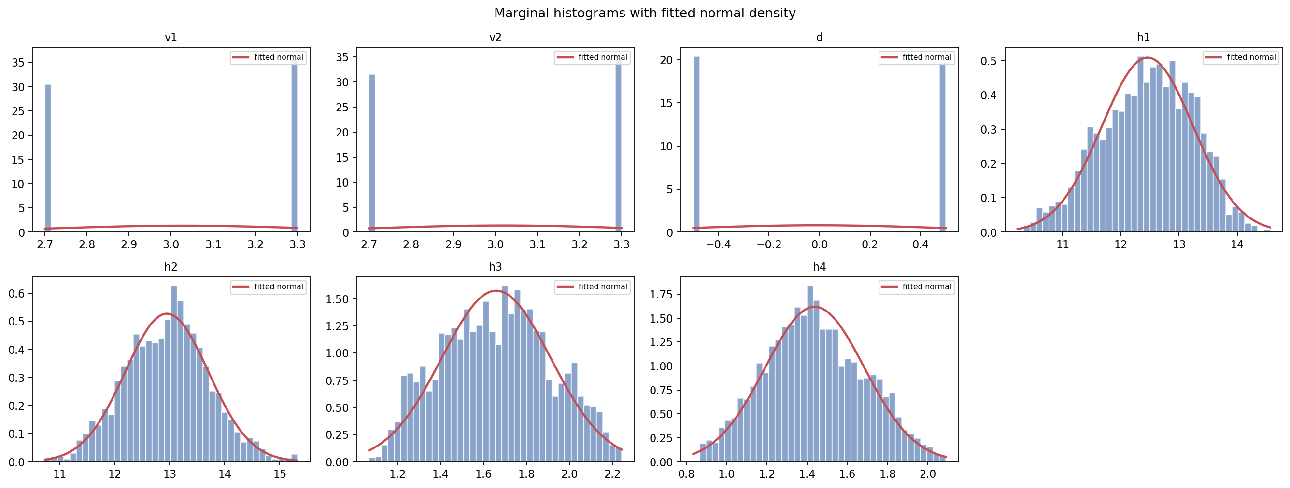
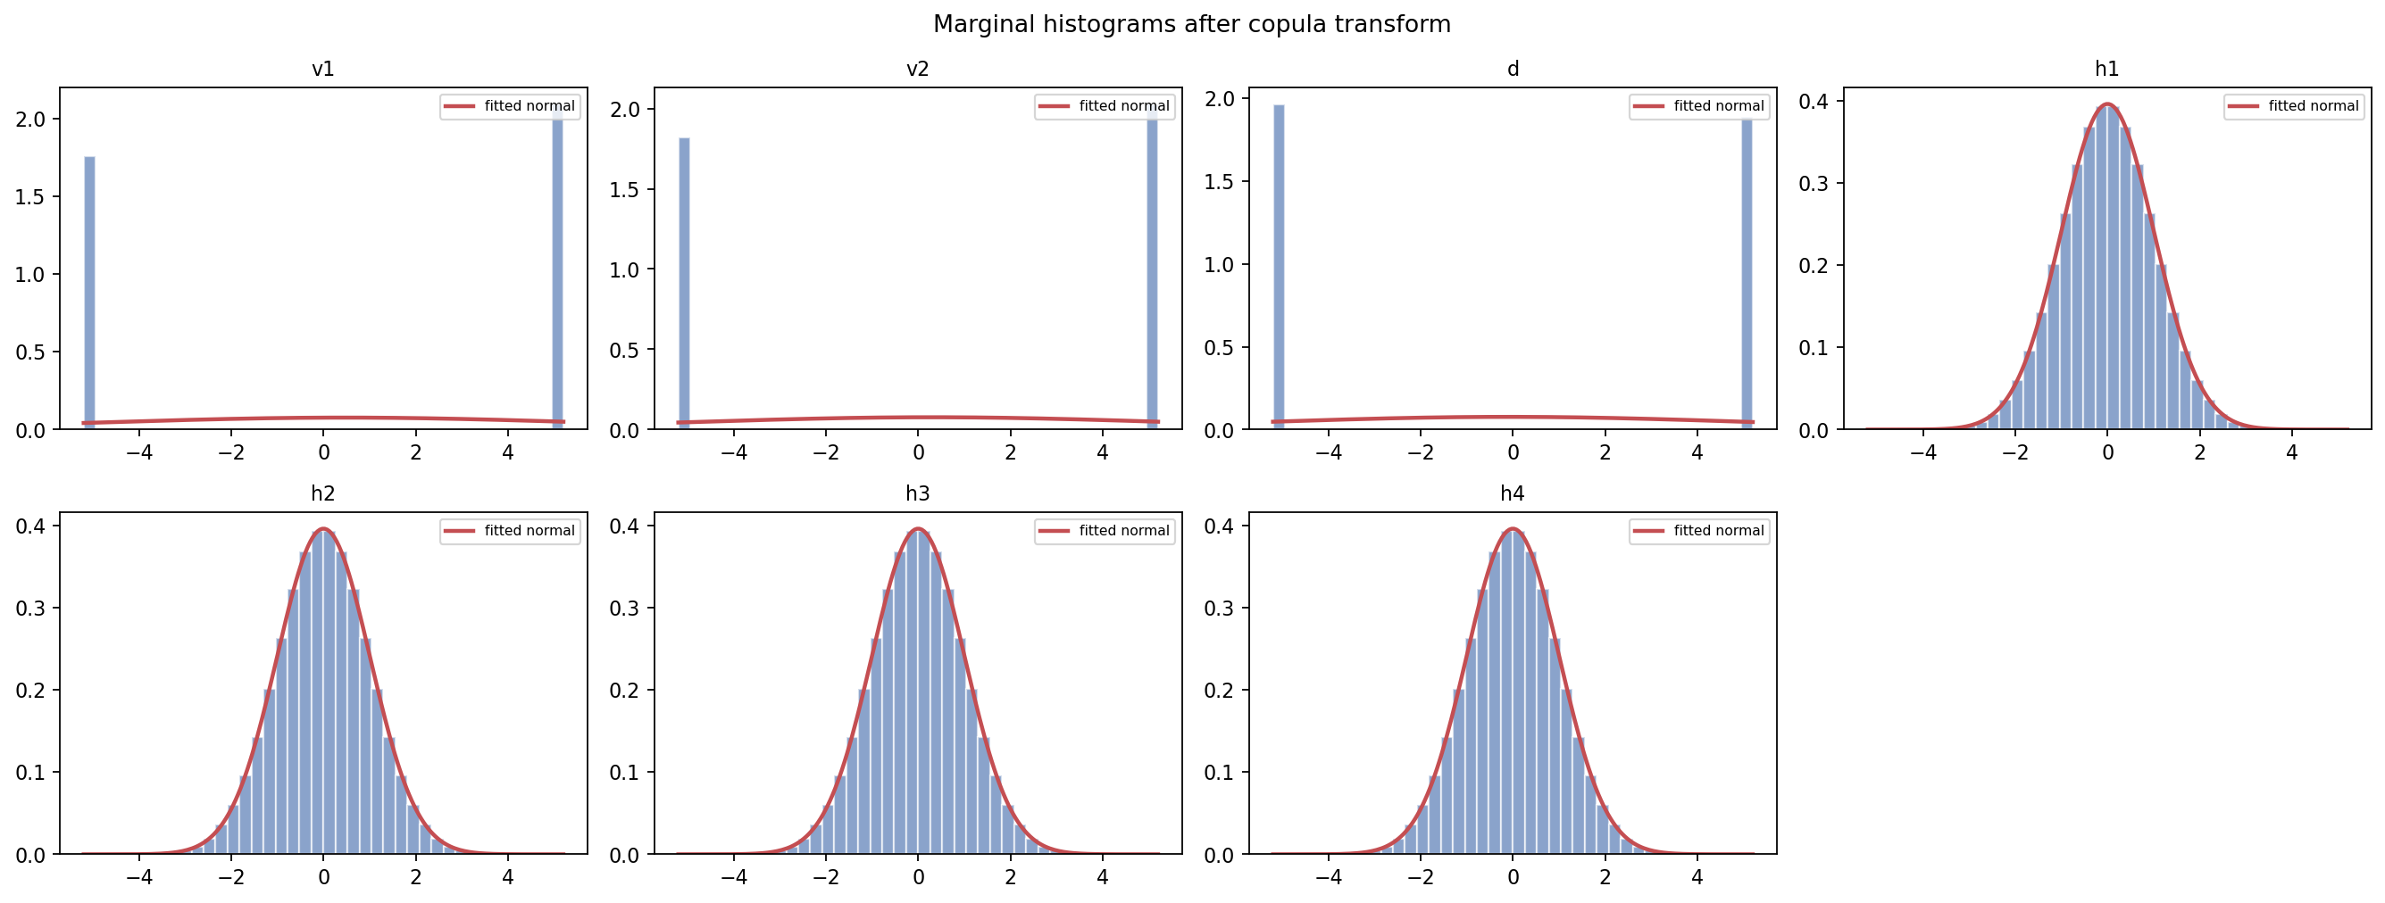
DATA PREPROCESSING · 1 OF 3
The copula transform maps each tank level to a near-Gaussian marginal; the three binary inputs stay two-valued
P_minus, 2880 rows
Before: raw marginals
same rows
After: per-column Gaussian copula
– Transform: QuantileTransformer(output_distribution="normal"), one transformer per column, n_quantiles = sample size. Dependence between columns is left unchanged.
– v1, v2, d are PRBS inputs with two values; they map to two normal quantiles and remain two-valued. No marginal transform makes a two-valued column continuous.
Source: src/causal_bench/eda/copula.py; results/eda-20261002-072603/figures (P_minus, 2880 rows)
6

Slide 7
DATA PREPROCESSING · 2 OF 3
Formal normality tests still reject on most columns after the transform; only Anderson-Darling rejections fall, from 7 to 3
P_minus, before vs after
Columns rejected by each normality test (of 7)
rejections of 7 columns
Both datasets
Test | P− before | P− after | P+ before | P+ after
Shapiro-Wilk | 7 | 7 | 7 | 7
D'Agostino K² | 6 | 7 | 7 | 7
Jarque-Bera | 6 | 7 | 6 | 7
Anderson-Darling | 7 | 3 | 7 | 3
Practically Gaussian* | 4 | 4 | 4 | 4
* |skew| < 0.5 and |excess kurtosis| < 1. Counts the four tank levels before and after.
– At n = 2880 the formal tests reject on departures too small to matter; the effect-size row is the operative one.
– The three binary inputs fail every test before and after, as expected.
Source: results/eda-20261002-072603/eda_summary.json (P_minus); results/eda-20261002-072543/eda_summary.json (P_plus); alpha 0.05
7

Slide 8
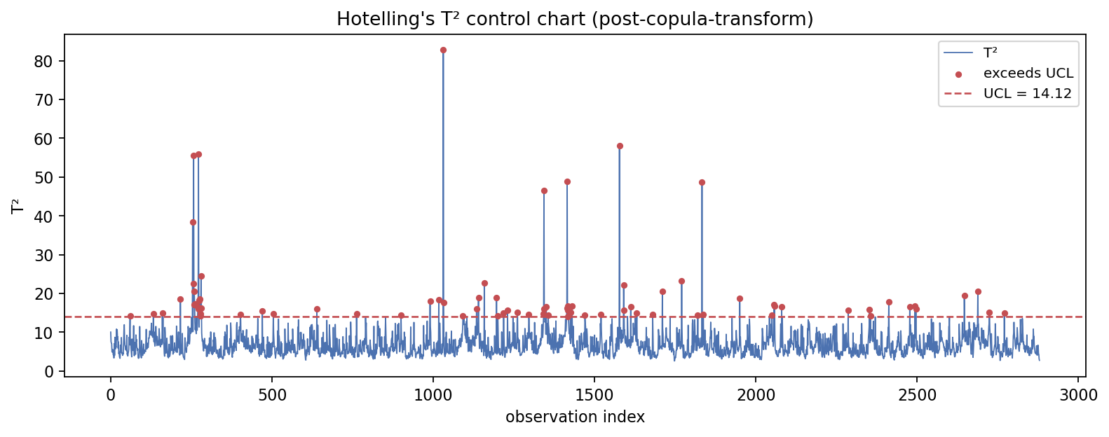
DATA PREPROCESSING · 3 OF 3
No MAD outliers in either dataset; after the transform 3 to 4 percent of rows exceed the Hotelling T² control limit, against 5 percent expected
P_minus; UCL at alpha 0.05
Hotelling T² per observation after the transform
Outliers and T² exceedance
Measure | P_minus | P_plus
MAD outliers (|z| > 3.5) | 0 | 0
IQR outliers (1.5 IQR) | 22 | 46
T² UCL | 14.12 | 14.12
Fraction above UCL | 0.028 | 0.042
Expected under null | 0.050 | 0.050
– Nothing is removed: outlier counts are diagnostic only, so the time index stays intact.
– The exceedance fraction below 0.05 is consistent with a successful marginal transform; it says nothing about causal structure.
Source: results/eda-20261002-072603/figures/step4_t2_control_chart.png; eda_summary.json of both EDA runs
8

Slide 9
RESULTS ON RAW DATA
PCMCI+ scores highest on both datasets at both row counts; stride 3 beats the full series for every algorithm
raw data
F1 against the 8 true edges
raw data
All scores
Rows | Dataset | Algorithm | Prec. | Recall | F1 | SHD
960 | P_minus | PC | 0.71 | 0.62 | 0.67 | 6
960 | P_minus | PCMCI+ | 0.88 | 0.88 | 0.88 | 2
960 | P_minus | VAR-LiNGAM | 0.60 | 0.75 | 0.67 | 5
960 | P_plus | PC | 1.00 | 0.62 | 0.77 | 3
960 | P_plus | PCMCI+ | 0.80 | 1.00 | 0.89 | 2
960 | P_plus | VAR-LiNGAM | 0.80 | 1.00 | 0.89 | 2
2880 | P_minus | PC | 0.67 | 0.50 | 0.57 | 6
2880 | P_minus | PCMCI+ | 0.78 | 0.88 | 0.82 | 3
2880 | P_minus | VAR-LiNGAM | 0.55 | 0.75 | 0.63 | 8
2880 | P_plus | PC | 1.00 | 0.38 | 0.55 | 5
2880 | P_plus | PCMCI+ | 0.78 | 0.88 | 0.82 | 2
2880 | P_plus | VAR-LiNGAM | 0.62 | 1.00 | 0.76 | 5
– PC has the lowest recall everywhere (0.38 to 0.62): it finds the pump links and misses the drainage links.
– The denser 5 s series lowers F1 for PC and VAR-LiNGAM; a 20-lag window then spans only 100 s against a 90 s time constant.
Source: results/qtank/run-parcorr-tau20-s3/scores.json; run-parcorr-tau20-full/scores.json
9

Slide 10
RESULTS AFTER THE COPULA TRANSFORM
The transform moves F1 by at most 0.10 in either direction and leaves the ranking unchanged
960 rows (left pair) and 2880 rows (right pair) per algorithm
F1, raw vs copula
Change raw → copula
Rows | Dataset | Algorithm | F1 raw | F1 cop. | ΔF1 | SHD raw | SHD cop.
960 | P_minus | PC | 0.67 | 0.71 | +0.05 | 6 | 5
960 | P_minus | PCMCI+ | 0.88 | 0.86 | -0.02 | 2 | 2
960 | P_minus | VAR-LiNGAM | 0.67 | 0.63 | -0.04 | 5 | 8
960 | P_plus | PC | 0.77 | 0.77 | +0.00 | 3 | 3
960 | P_plus | PCMCI+ | 0.89 | 0.82 | -0.07 | 2 | 2
960 | P_plus | VAR-LiNGAM | 0.89 | 0.80 | -0.09 | 2 | 5
2880 | P_minus | PC | 0.57 | 0.67 | +0.10 | 6 | 4
2880 | P_minus | PCMCI+ | 0.82 | 0.78 | -0.05 | 3 | 4
2880 | P_minus | VAR-LiNGAM | 0.63 | 0.71 | +0.07 | 8 | 5
2880 | P_plus | PC | 0.55 | 0.62 | +0.07 | 5 | 5
2880 | P_plus | PCMCI+ | 0.82 | 0.82 | +0.00 | 2 | 3
2880 | P_plus | VAR-LiNGAM | 0.76 | 0.74 | -0.03 | 5 | 6
960 | P_minus | LSTE | 0.00 | 0.00 | +0.00 | 8 | 8
– PC: F1 unchanged or higher in all four cases (+0.04, 0.00, +0.10, +0.07); false positives fall on P_minus.
– PCMCI+: within 0.07 of raw in every case; SHD unchanged or +1. VAR-LiNGAM: mixed, from −0.09 to +0.08.
– LSTE on copula P_minus: 0 edges in 1313 s. P_plus was not run.
Source: results/qtank/COPULA_RESULTS.md; run-copula-tau20-s3, run-copula-tau20-full, run-copula-lste-s3
10

Slide 11
RECOVERED GRAPHS · PC · P_MINUS (MINIMUM PHASE)
PC on P_minus: F1 rises from 0.67 to 0.71 after the transform
Found (true link recovered)
Invented (not in ground truth)
Reversed (true link, wrong direction)
Missed (true link not found)
8 links
Ground truth
F1 0.67 · SHD 6
PC, raw data
F1 0.71 · SHD 5
PC, copula-transformed
v1
d
v2
v1
d
v2
v1
d
v2
h3
h4
h3
h4
h3
h4
h1
h2
h1
h2
h1
h2
found 5 · invented 2 · reversed 1 · missed 3
found 5 · invented 1 · reversed 1 · missed 3
Change raw → copula. True links gained: none. True links lost: none. Wrong links added: none. Wrong links removed: h1→h2.
Source: directed_edges in results/qtank/run-parcorr-tau20-s3/graphs and run-copula-tau20-s3/graphs, lags collapsed; scores.json of both runs; 960 rows, tau_max 20
11

Slide 12
RECOVERED GRAPHS · PC · P_PLUS (NON-MINIMUM PHASE)
PC on P_plus: F1 unchanged at 0.77 after the transform
Found (true link recovered)
Invented (not in ground truth)
Reversed (true link, wrong direction)
Missed (true link not found)
8 links
Ground truth
F1 0.77 · SHD 3
PC, raw data
F1 0.77 · SHD 3
PC, copula-transformed
v1
d
v2
v1
d
v2
v1
d
v2
h3
h4
h3
h4
h3
h4
h1
h2
h1
h2
h1
h2
found 5 · invented 0 · reversed 0 · missed 3
found 5 · invented 0 · reversed 0 · missed 3
Change raw → copula. True links gained: none. True links lost: none. Wrong links added: none. Wrong links removed: none.
Source: directed_edges in results/qtank/run-parcorr-tau20-s3/graphs and run-copula-tau20-s3/graphs, lags collapsed; scores.json of both runs; 960 rows, tau_max 20
12

Slide 13
RECOVERED GRAPHS · PCMCI+ · P_MINUS (MINIMUM PHASE)
PCMCI+ on P_minus: F1 falls from 0.88 to 0.86 after the transform
Found (true link recovered)
Invented (not in ground truth)
Reversed (true link, wrong direction)
Missed (true link not found)
8 links
Ground truth
F1 0.88 · SHD 2
PCMCI+, raw data
F1 0.86 · SHD 2
PCMCI+, copula-transformed
v1
d
v2
v1
d
v2
v1
d
v2
h3
h4
h3
h4
h3
h4
h1
h2
h1
h2
h1
h2
found 7 · invented 0 · reversed 0 · missed 1
found 6 · invented 0 · reversed 0 · missed 2
Change raw → copula. True links gained: none. True links lost: h4→h2. Wrong links added: none. Wrong links removed: none.
Source: directed_edges in results/qtank/run-parcorr-tau20-s3/graphs and run-copula-tau20-s3/graphs, lags collapsed; scores.json of both runs; 960 rows, tau_max 20
13

Slide 14
RECOVERED GRAPHS · PCMCI+ · P_PLUS (NON-MINIMUM PHASE)
PCMCI+ on P_plus: F1 falls from 0.89 to 0.82 after the transform
Found (true link recovered)
Invented (not in ground truth)
Reversed (true link, wrong direction)
Missed (true link not found)
8 links
Ground truth
F1 0.89 · SHD 2
PCMCI+, raw data
F1 0.82 · SHD 2
PCMCI+, copula-transformed
v1
d
v2
v1
d
v2
v1
d
v2
h3
h4
h3
h4
h3
h4
h1
h2
h1
h2
h1
h2
found 8 · invented 2 · reversed 0 · missed 0
found 7 · invented 1 · reversed 1 · missed 1
Change raw → copula. True links gained: none. True links lost: h4→h2. Wrong links added: h2→h4. Wrong links removed: h4→h1.
Source: directed_edges in results/qtank/run-parcorr-tau20-s3/graphs and run-copula-tau20-s3/graphs, lags collapsed; scores.json of both runs; 960 rows, tau_max 20
14

Slide 15
RECOVERED GRAPHS · VAR-LINGAM · P_MINUS (MINIMUM PHASE)
VAR-LiNGAM on P_minus: F1 falls from 0.67 to 0.63 after the transform
Found (true link recovered)
Invented (not in ground truth)
Reversed (true link, wrong direction)
Missed (true link not found)
8 links
Ground truth
F1 0.67 · SHD 5
VAR-LiNGAM, raw data
F1 0.63 · SHD 8
VAR-LiNGAM, copula-transformed
v1
d
v2
v1
d
v2
v1
d
v2
h3
h4
h3
h4
h3
h4
h1
h2
h1
h2
h1
h2
found 6 · invented 3 · reversed 1 · missed 2
found 6 · invented 6 · reversed 0 · missed 2
Change raw → copula. True links gained: none. True links lost: none. Wrong links added: h1→h2, h4→h1, v2→h4. Wrong links removed: h1→h3.
Source: directed_edges in results/qtank/run-parcorr-tau20-s3/graphs and run-copula-tau20-s3/graphs, lags collapsed; scores.json of both runs; 960 rows, tau_max 20
15

Slide 16
RECOVERED GRAPHS · VAR-LINGAM · P_PLUS (NON-MINIMUM PHASE)
VAR-LiNGAM on P_plus: F1 falls from 0.89 to 0.80 after the transform
Found (true link recovered)
Invented (not in ground truth)
Reversed (true link, wrong direction)
Missed (true link not found)
8 links
Ground truth
F1 0.89 · SHD 2
VAR-LiNGAM, raw data
F1 0.80 · SHD 5
VAR-LiNGAM, copula-transformed
v1
d
v2
v1
d
v2
v1
d
v2
h3
h4
h3
h4
h3
h4
h1
h2
h1
h2
h1
h2
found 8 · invented 2 · reversed 0 · missed 0
found 8 · invented 5 · reversed 0 · missed 0
Change raw → copula. True links gained: none. True links lost: none. Wrong links added: h1→h2, h2→h1, h3→h2, h4→h1. Wrong links removed: v1→h2.
Source: directed_edges in results/qtank/run-parcorr-tau20-s3/graphs and run-copula-tau20-s3/graphs, lags collapsed; scores.json of both runs; 960 rows, tau_max 20
16

Slide 17
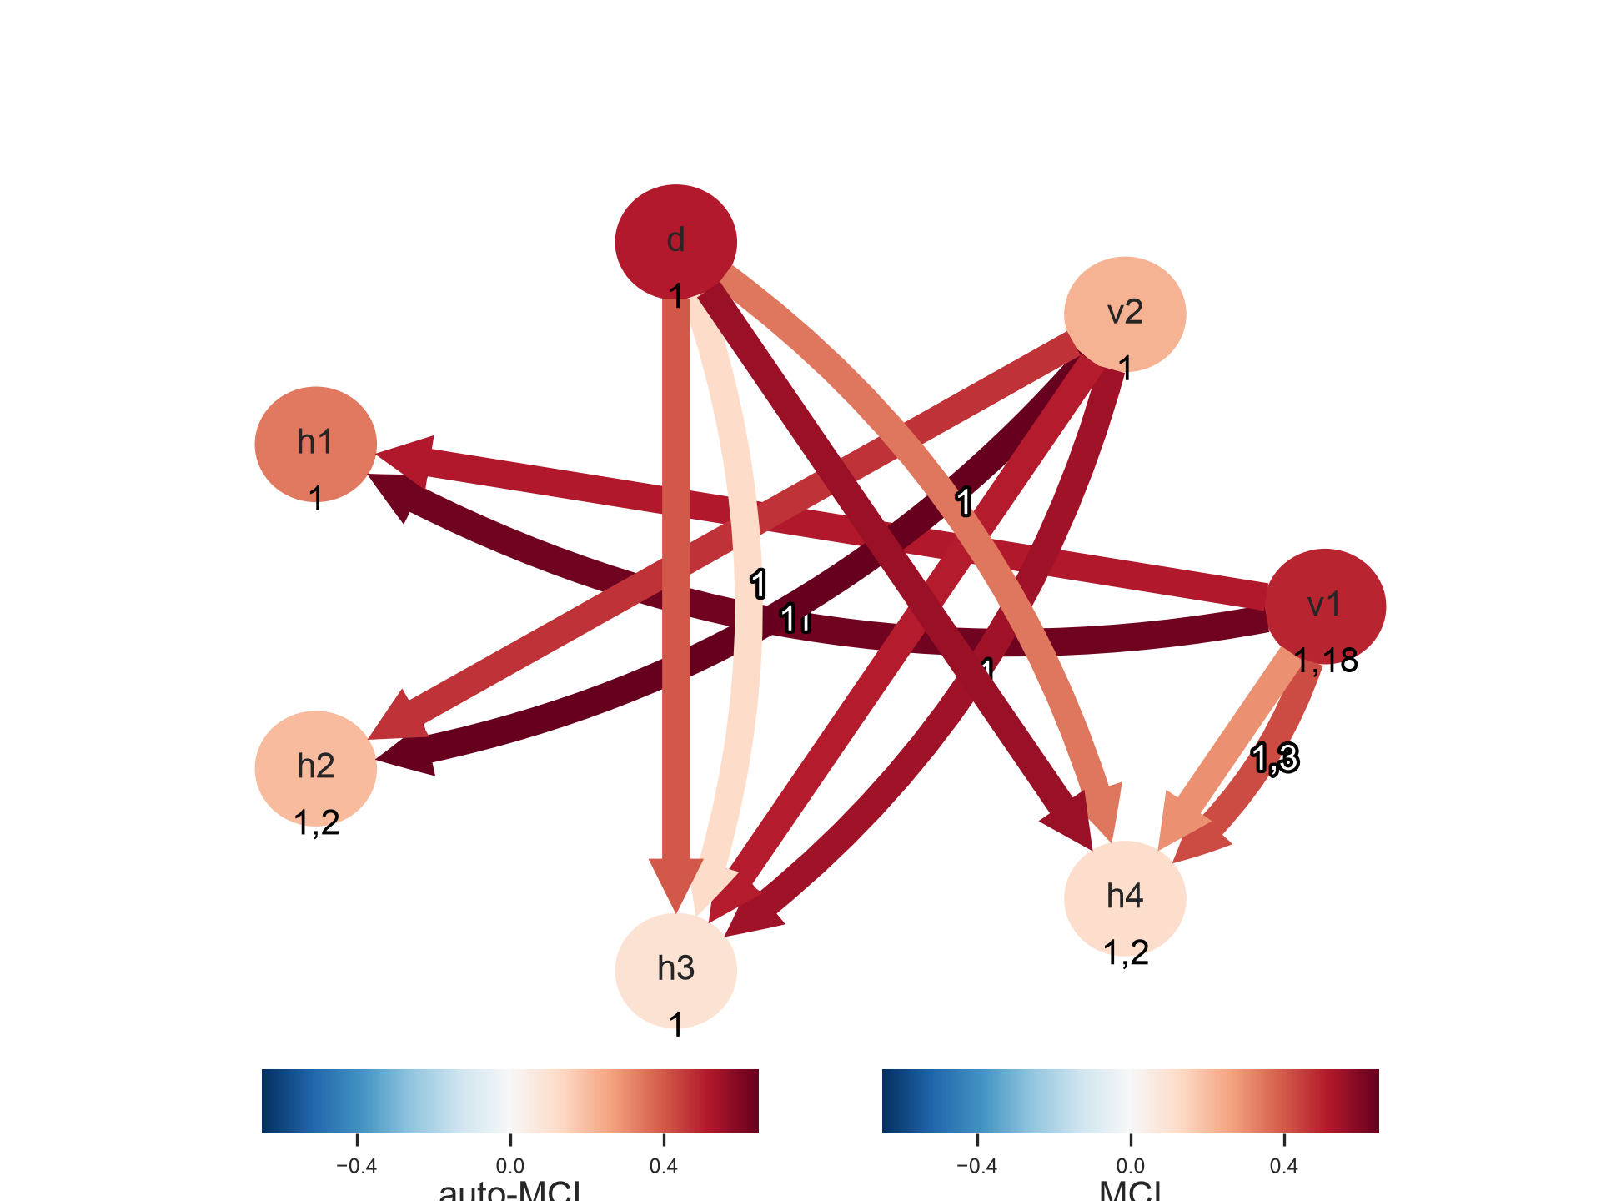
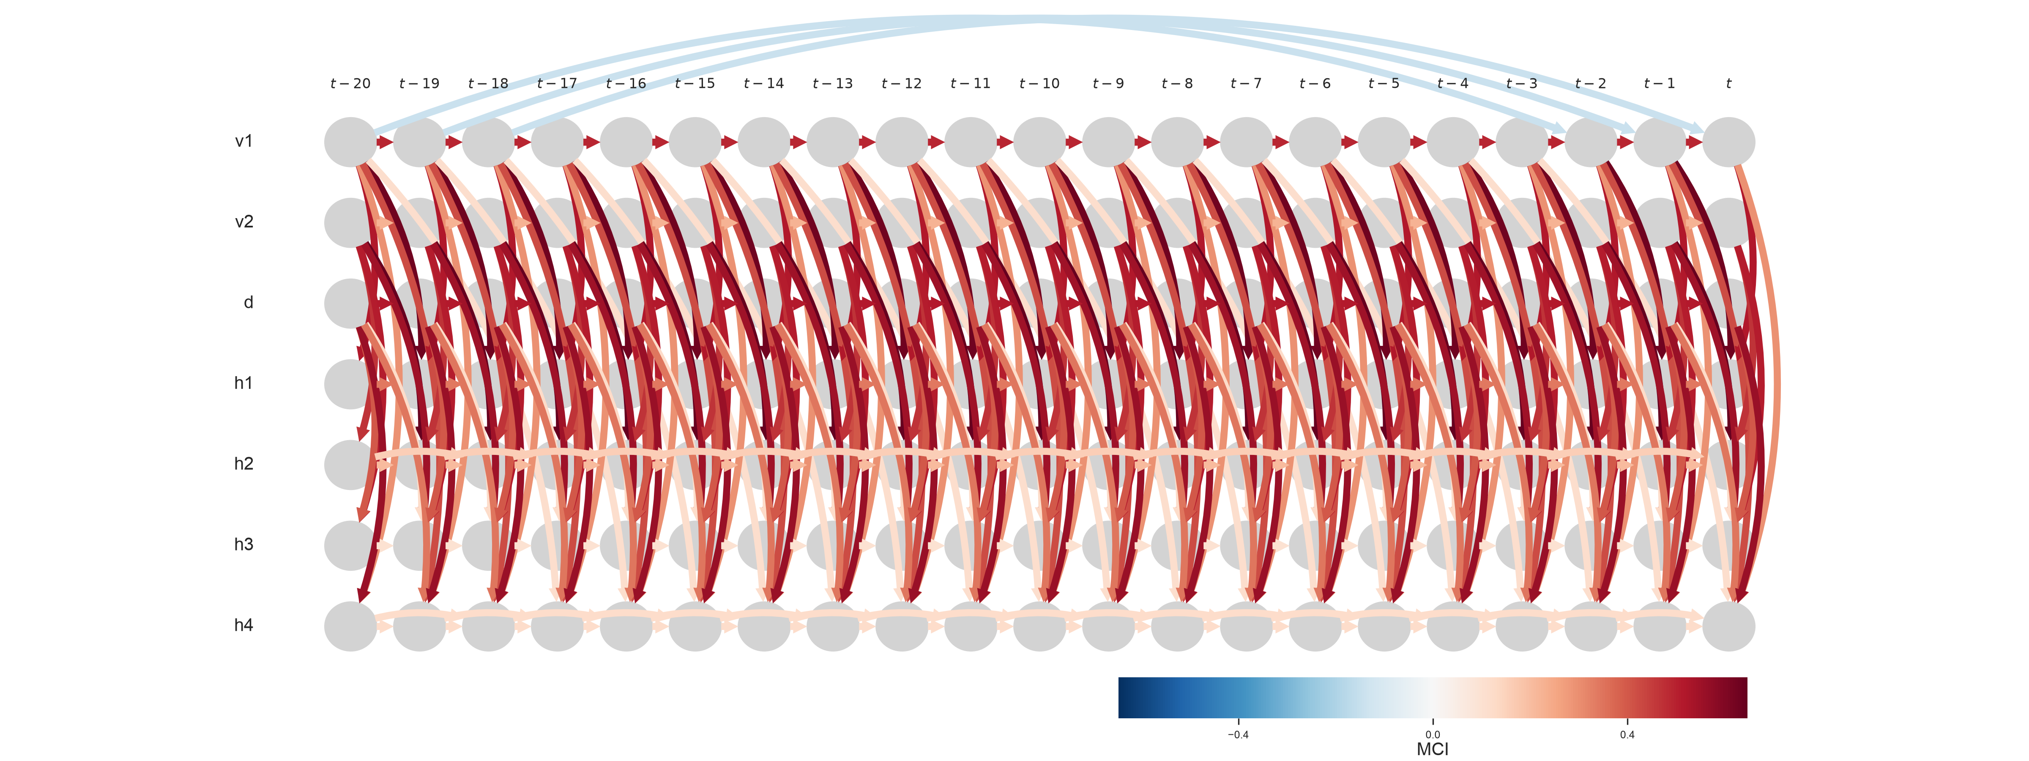
TIGRAMITE NATIVE PLOTTING
tigramite.plotting draws one graph adequately and does not cover comparison, scoring or long windows
PCMCI+, copula P_minus
plot_graph
same graph, 21 lag columns
plot_time_series_graph
10 functions, 58 files
What was tried and what broke
– All 10 plotting functions ran on the saved graphs after conversion to tigramite's (N, N, tau+1) string array.
– plot_time_series_graph and plot_tsg are unreadable at tau_max 20; usable only up to about 5 lags.
– Node colour in plot_graph is auto-MCI, which has no meaning for VAR-LiNGAM graphs.
– Mediation plots need a fitted LinearMediation model, drop contemporaneous links, and label the path np.int64(1) under NumPy 2.
– No multi-algorithm comparison, no ground-truth overlay, no precision/recall/SHD plots.
– plot_densityplots imports seaborn, which is not a declared dependency.
– Ground truth cannot be drawn at lag 0 without mirrored reverse links; it was drawn at lag 1.
21 lag columns × 7 variables; every repeated lag drawn.
Edge colour MCI, node colour auto-MCI, lag labels on edges.
– Verdict: use tigramite plots for a single PCMCI+ result at short windows; keep the comparison figures in this deck native or matplotlib.
Source: results/qtank/tigramite-plots-run-copula-tau20-s3/README.md and status.md; datasets/tigramite_plots.py
17

Slide 18
RUNTIME
The copula transform roughly doubles VAR-LiNGAM runtime; PC and PCMCI+ stay under one minute in every configuration
log scale
Wall-clock seconds per algorithm and dataset
Copula / raw ratio
Rows | Dataset | Algorithm | Raw (s) | Copula (s) | Ratio
960 | P_minus | PC | 4.4 | 3.4 | 0.8
960 | P_minus | PCMCI+ | 1.2 | 2.0 | 1.7
960 | P_minus | VAR-LiNGAM | 135.0 | 239.7 | 1.8
960 | P_plus | PC | 4.6 | 8.5 | 1.8
960 | P_plus | PCMCI+ | 1.4 | 5.3 | 3.8
960 | P_plus | VAR-LiNGAM | 134.3 | 249.3 | 1.9
2880 | P_minus | PC | 21.2 | 30.9 | 1.5
2880 | P_minus | PCMCI+ | 3.8 | 7.3 | 1.9
2880 | P_minus | VAR-LiNGAM | 300.1 | 516.4 | 1.7
2880 | P_plus | PC | 22.7 | 33.6 | 1.5
2880 | P_plus | PCMCI+ | 3.8 | 4.5 | 1.2
2880 | P_plus | VAR-LiNGAM | 288.7 | 468.7 | 1.6
960 | P_minus | LSTE | UNVERIFIED | 1313.1 | n/a
The copula runs shared the machine with the LSTE run; the share of the ratio due to contention is UNVERIFIED.
Source: run_summary.json of run-parcorr-tau20-s3, run-parcorr-tau20-full, run-copula-tau20-s3, run-copula-tau20-full, run-copula-lste-s3
18

Slide 19
OPEN ITEMS
Four measurements are missing from this benchmark
Not run, not completed, or not recorded
Item | Status | Reason | Cost to close
LSTE on P_plus (copula, tau 8, 100 shuffles) | Not run | Stopped after P_minus on request | about 22 min (P_minus took 1313 s)
LSTE at tau_max 20 | Not run | 980 CMIknn tests per dataset; earlier attempts did not finish | UNVERIFIED
CMIknn test for PC and PCMCI+ (Plan.md) | Not completed | Nonparametric test at 500 shuffles | about 2.7 h for both datasets, UNVERIFIED
LSTE raw-data runtime (run-lste-quick) | Not recorded | Run directory holds graphs only, no run_summary.json | re-run, same cost as above
Source: Plan.md (2026-09-27); results/qtank/run-lste-quick; results/qtank/run-copula-lste-s3/run_summary.json
19

