Slide 1
GLOF Early Warning System
Machine-learning risk scoring, dashboard and phone alerts for glacial lake outburst floods
Case study: South Lhonak Lake, Sikkim
Team: Harshyamsinh Jadeja and Saransh Mittal
Problem source: Ministry of Defence, DGRE (DRDO), 2024 | Disaster Management | Software
Submission: 15 November 2026
Notes:
Introduce the problem source and the case study. The four dots preview the four alert colours used throughout: green, yellow, orange, red.

Slide 2
When a glacial lake bursts
3-4 Oct 2023
1
Dam fails
The moraine or ice dam holding the lake gives way
South Lhonak Lake, Sikkim, outburst
The flood travelled down the Teesta valley and damaged the Chungthang (Teesta III) dam.
2
Flood surges
A huge volume of water is released suddenly
Climate change is increasing the number and size of glacial lakes, so the risk keeps growing.
3
Valley devastated
Settlements, roads, bridges and hydropower are hit
Notes:
A GLOF is a sudden release of water when the dam holding a glacial lake fails. South Lhonak Lake burst on the night of 3-4 October 2023. Verify the downstream damage details against your cited source.

Slide 3
Predict, explain, alert
1
2
What the system outputs
Sensors
Simulated hourly readings of 8 signals
Satellite
Published lake-area observations
Risk score from 0 to 1
Risk level: LOW to CRITICAL
3
4
Key drivers behind the level
ML model
Learns the precursor patterns of an outburst
Dashboard
Live view and phone alerts
Estimated lead time in hours
Notes:
We chose the predictive-model option of the problem statement. It is a software prototype, with no physical hardware.

Slide 4
System architecture
DATA LAYER
INTELLIGENCE LAYER
APPLICATION LAYER
Satellite
lake-area data
Dashboard
Streamlit
ML model + risk engine
score, level, drivers, lead time
Data layer
simulator + lake-area CSV
Authorities and villages
IoT sensors
simulated
Alerts
phone push + SQLite log
The layers meet at a fixed interface: predict_risk, simulate_episode and get_lake_area_series. The dashboard was built on stubs first, then connected to the real model with no code change.
Notes:
Three layers. Data and intelligence layers belong to Member A, the application layer to Member B. The frozen interface contract let both parts be built in parallel. You can replace this drawn diagram with docs/architecture.png if you prefer.

Slide 5
Data: simulated and published
Eight sensor signals, every hour
Simulated, on purpose
Real labelled GLOF sensor data is extremely scarce, so episodes are generated with precursors, noise and dropouts.
Water level
Seepage rate
Dam tilt
Inflow rate
Seismic activity
Rainfall
Published lake area
Approximate NRSC/ISRO and Planet Labs values, not Sentinel-2 NDWI computed by us.
Water temperature
Lake area
Notes:
Be upfront: sensor data is simulated. The lake-area values come from published sources and are approximate. The project did not compute Sentinel-2 NDWI itself.

Slide 6
The risk model
240 / 60
Features
8 sensor readings plus the 6-hour change of water level, seepage and tilt
1
training / test episodes
Risk score
Class probabilities weighted into one score from 0 to 1
2
11
input features
Key drivers
Feature importance times deviation from normal
3
Gradient Boosting
No leakage
Whole episodes go to train or test, never single rows
4
classifier with four risk levels
Notes:
Split by episode, never by row, so the test score is honest. The risk score is the probability-weighted level. Key drivers come from feature importance multiplied by how far each reading is from normal.

Slide 7
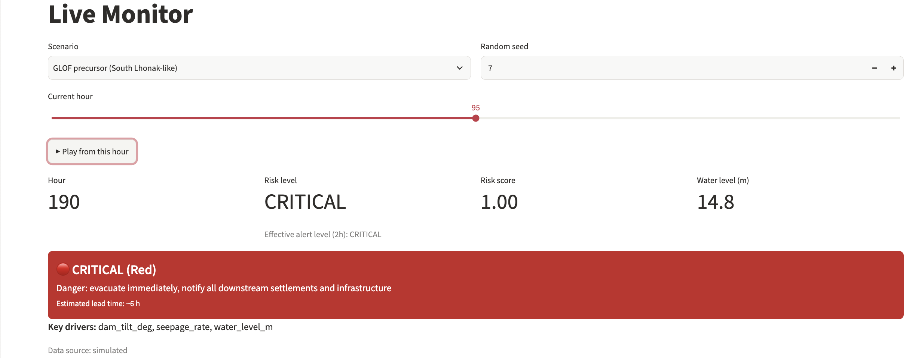
Dashboard for the control room
1
Overview
Map, level, risk score
2
Live Monitor
Play a scenario
3
Lake Growth
Lake-area data
4
Alerts Log
Every alert raised
Live Monitor: GLOF scenario, seed 7, level CRITICAL
Key drivers beside every level | Data source on every chart
5
Model Performance
Metrics and figures
Notes:
Live screenshot of the Live Monitor. Demo this live: choose the GLOF scenario, press Play and watch the level climb.

Slide 8
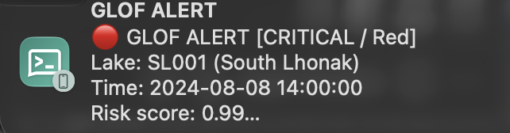
Four levels, one clear action
LOW
Green
Normal monitoring
MEDIUM
Yellow
Increase monitoring, notify control room
HIGH
Orange
Alert authorities, prepare evacuation
CRITICAL
Red
Evacuate now, notify all downstream
Smart repeats: alert when the level rises; repeat every 12 h at HIGH or CRITICAL
Reaches the phone: push notification through ntfy; Telegram and Discord supported
Fully logged: every alert is stored in SQLite and shown in the Alerts Log
Real notification received on a phone (ntfy)
Notes:
The anti-repeat rule avoids alert fatigue. The notification on the right is a real alert received during testing.

Slide 9
Case study: South Lhonak Lake
1
2
3
4
Lake grows
Glacier retreat enlarges the lake over decades
Precursors build
Water level, seepage, tilt and inflow climb
Model escalates
Risk level rises with key drivers and lead time
Outburst
Night of 3-4 October 2023, Teesta valley
Live Monitor replay of a South Lhonak-like scenario
LOW
→
MEDIUM
→
HIGH
→
CRITICAL
Each rise in level raises one phone alert, with the key drivers.
Notes:
This is a simulated scenario, not real sensor data from the lake. Replay it live in the Live Monitor and show the phone notification arriving.

Slide 10
Results on held-out episodes
0.86
macro F1
0.96
accuracy
0.29%
of normal rows flagged above LOW (21 of 7,200)
Synthetic data. Sources: metrics.json (60 test episodes), false_alarms.json (30 normal episodes)
Notes:
All numbers come from ml/results/metrics.json and are based on synthetic data, so they do not represent real-world performance. The 0.29% comes from false_alarms.json: 21 of 7,200 normal rows were predicted above LOW, so it counts MEDIUM as well as HIGH. Mention MEDIUM is the hardest level (recall 0.59). Add the lead-time figure from warning_timing.csv when you speak to this slide.

Slide 11
How early does it warn?
50 h
median warning before the outburst
21 h
shortest warning, all 30 test events warned
Seismic events are warned latest, as the signal arrives suddenly.
Simulated test episodes. Source: warning_timing.csv (30 events). Lead time = outburst hour minus first model warning.
Notes:
Computed from ml/results/warning_timing.csv: median 50 h, minimum 21 h, maximum 136 h across 30 simulated test events. Rain and seepage events were warned about 51-52 h ahead; seismic events about 33 h, because the seismic signal arrives suddenly (9 of 12 seismic events were warned after the true precursor window began). 10 of 30 warnings came after the start of the true warning window; 5 came more than 24 h before it, which could be very early detection or early false alerts. Confirm in ml/evaluate.py which risk level counts as the model warning before you state it aloud. All data is synthetic.

Slide 12
Limitations and future work
Limitations
Future work
Sensor data is simulated
Few real events to validate against
Thresholds and scenarios are assumptions
Sensor failures and other lakes untested
Train on real sensor data
Sentinel-1 SAR and Sentinel-2 NDWI lake tracking
DEM-based flood routing for arrival times
Edge AI and redundant alert channels
Notes:
Be honest about limits: judges value that. The biggest one is the use of simulated sensor data.

Slide 13
Early warning, with honest limits
1
2
3
Working prototype
ML risk model, dashboard and phone alerts, joined by a fixed interface.
Explainable
Every level comes with key drivers and an estimated lead time.
Honest about data
Sensors are simulated and lake-area values are published approximations.
Next: real sensors, Sentinel-1 SAR and DEM flood routing.
Notes:
Close with the three takeaways, then invite questions.

