Slide 1
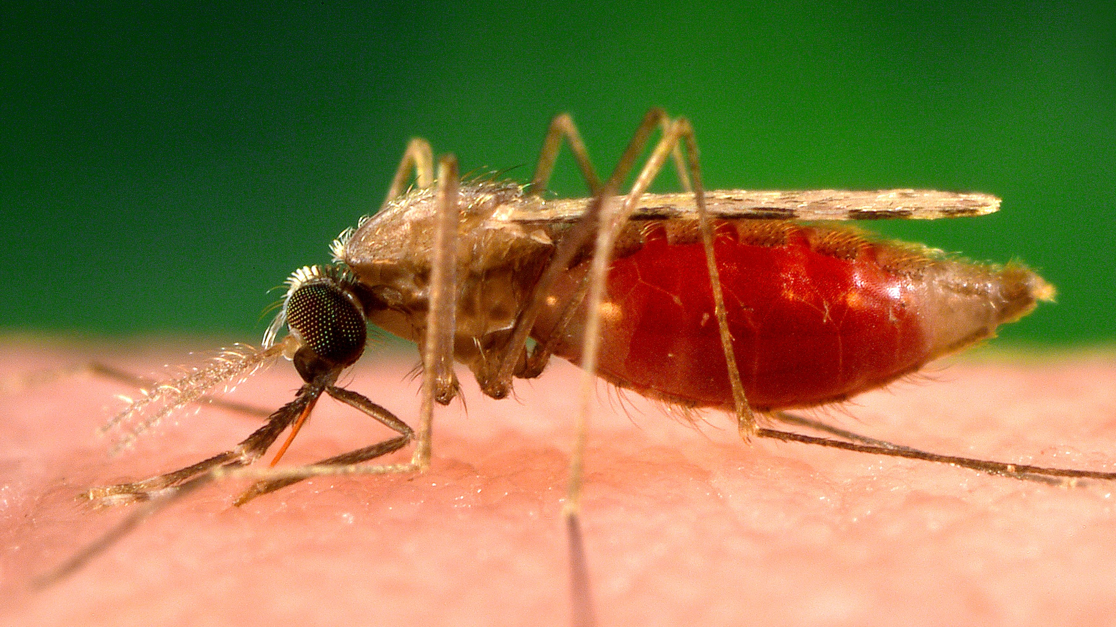
Malaria Predictive model
Group 2

Slide 2
Business understanding
Malaria remains a major public health challenge in Kenya, with 10 counties accounting for ~95% of the national burden—Turkana among the highest.
Kakuma Ward alone manages over 65,000 malaria cases annually, with increasingly unpredictable seasonal peaks due to climate variability.
Reactive responses in ASAL regions lead to stock-outs, Health Care Worker burnout, and excess morbidity , especially among pregnant women and children and mortality.
This capstone proposes a climate-informed malaria early warning and response platform, using weather data and historical trends to forecast outbreaks and guide timely interventions.

Slide 3
Data understanding
Data Acquisition: We used publicly available data from District Health Information System (DHIS 2) and Open-Meteo
Malaria Case Data The data was extracted from facility-level records in DHIS2, including case counts and malaria positivity rates for Kakuma Ward.
Weather Data Pulled from Open-Meteo APIs, covering key variables:
Rainfall
Temperature
Humidity
Wind speed
Soil moisture

Slide 4
Data preparation
Preprocessing Workflow Temporal alignment by week/location; impute rare gaps with flags; apply log1p transform;,, and residuals; engineer lags and rolling statistics.
Cleaning Challenges & Solutions Handle reporting backfills, outliers, heteroscedasticity, and multicollinearity, multiplicative and additive decomposition, regularization,
Minimum Dataset Size At least 300 weekly observations post-cleaning.
Visualization Techniques Rolling means, seasonal profiles (mean ± SD), anomaly heatmaps (z-scores), ACF/PACF plots, lagged correlations, and STL decomposition panels.

Slide 5
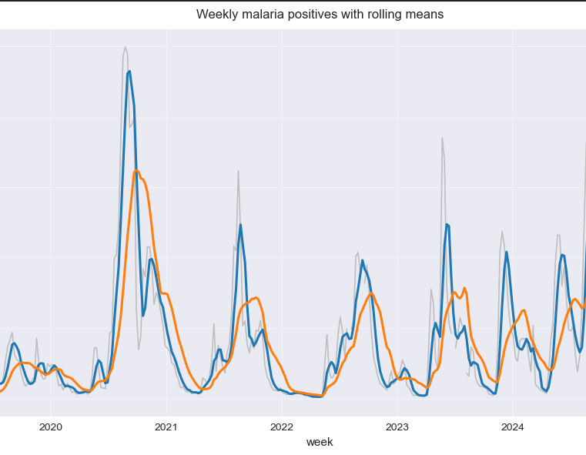
Malaria trends
Weekly malaria cases show seasonal peaks, with major spikes in 2020 and 2023.
Rolling averages (4-week & 12-week) reveal short-term fluctuations and a rising long-term trend.
Climate variability has made peak timing less predictable, complicating response planning.
Trend data supports seasonality-aware forecasting and early intervention strategies.

Slide 6
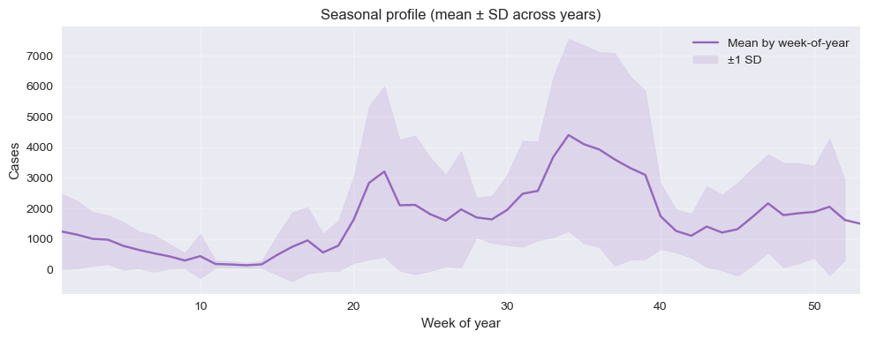
Seasonal profile graph
Two major peaks: around week 21 (May) and week 33 (August).
Shaded band shows variability—some years have much higher spikes than others.
Useful for timing interventions (e.g., Indoor Residual Spraying, Long Lasting Insecticide Nets distribution) and modeling seasonality features.

Slide 7
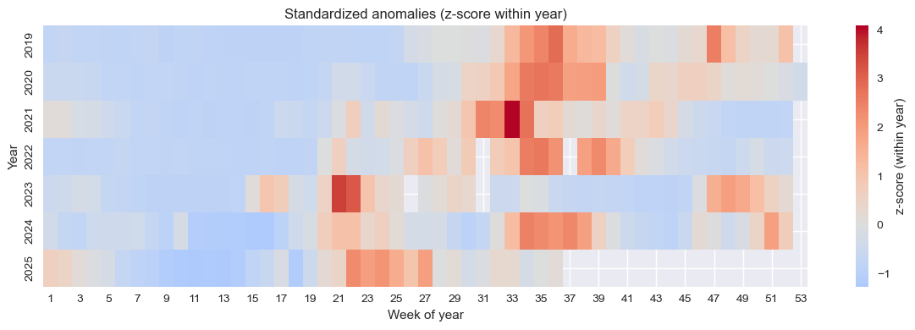
Anomaly heatmap
Red zones indicate weeks with significantly higher-than-normal cases (e.g., outbreaks).
Blue zones show lower-than-normal activity.
Consistent anomalies around weeks 21 and 33, confirming seasonal peaks.
Intense red clusters in 2020 and 2023 align with known outbreak years.

Slide 8
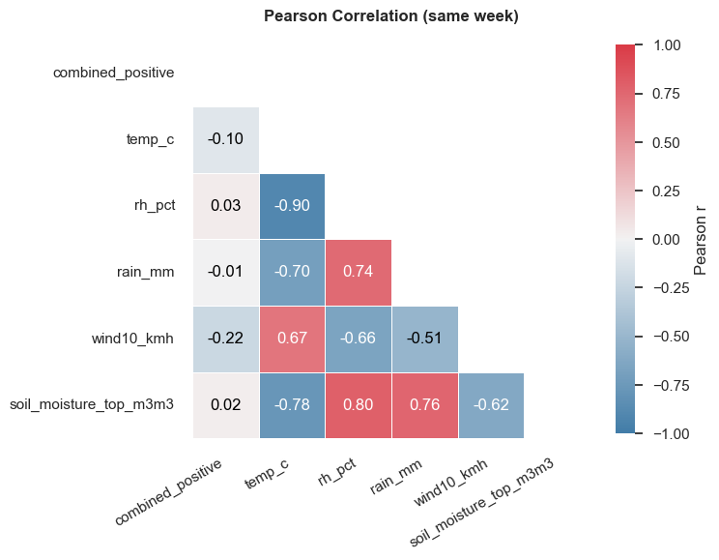
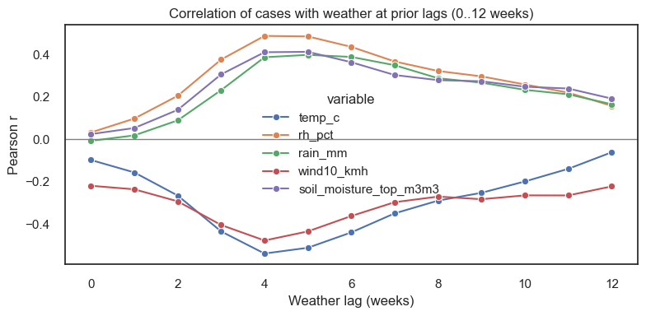
Correlation analysis
Lagged weather effects are key: Malaria cases correlate more strongly with weather conditions from 4–5 weeks earlier than with current conditions.
Rainfall, humidity, and soil moisture show positive correlations at 4–5 week lags, supporting their role in mosquito breeding and transmission risk.
Temperature and wind speed show negative correlations at similar lags, suggesting cooler, calmer conditions may favor malaria spread.

Slide 9
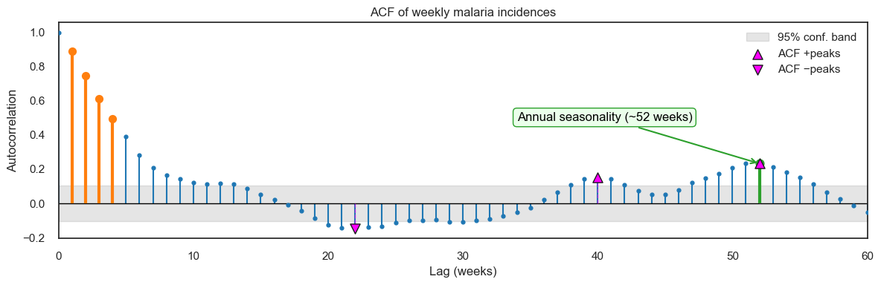
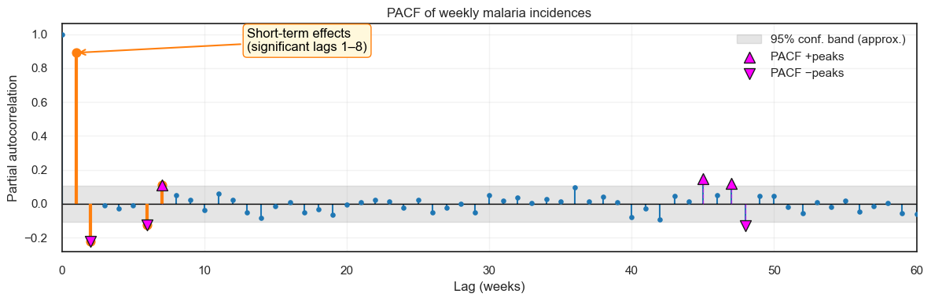
Autocorrelation
Strong short-term autoregression: Dominated by a large spike at lag 1 (≈0.89) and notable spikes at lags 2, 6, and 7.
No direct seasonal AR effect: Most coefficients beyond lag 8 fall within the 95% confidence band; weak signals near lags 45–47.
Model implication: Suggests a low-order autoregressive component, suitable for models like ARIMA with p ≈ 1–2.
Strong short-term dependence: Malaria cases show high autocorrelation at lags 1–4 weeks, especially at lag 1 (r ≈ 0.89), indicating persistence in weekly transmission.
Annual seasonality detected: A significant peak at lag 52 confirms yearly cycles, likely driven by seasonal weather patterns.
Mid-year dip pattern: Negative autocorrelations around lag 22 suggest a temporary decline in cases before seasonal peaks resume.

Slide 10
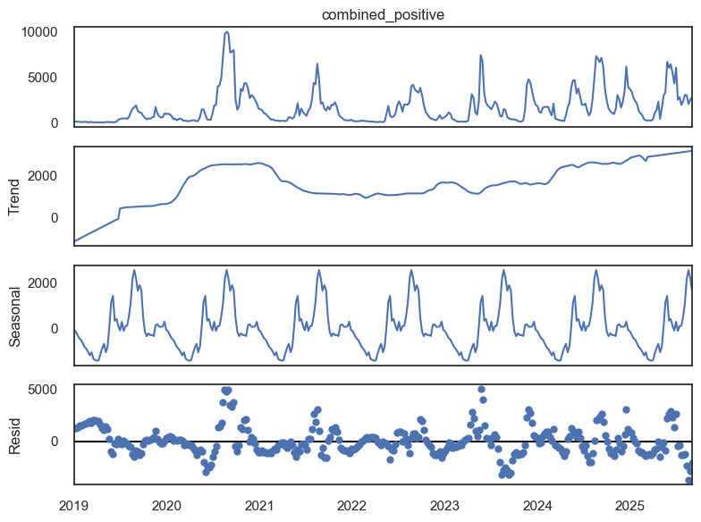
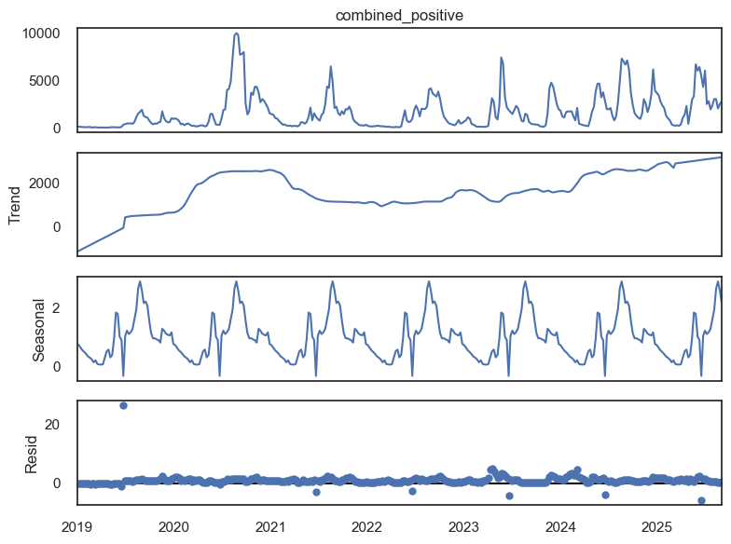
Seasonal decomposition
Additive
Clear trend and seasonality: Malaria cases show a rising long-term trend and a stable annual seasonal cycle.
Residuals reveal shocks: Large spikes in residuals around 2020–2021 and 2023 suggest episodic outbreaks.
Modeling implication: Most systematic variation is captured by trend and seasonality
Multiplicative
Seasonality scales with level: Malaria peaks are 2–3× higher than baseline during seasonal highs, indicating multiplicative seasonality.
Trend shows long-run increase: Rising baseline from 2020 to 2025 suggests growing transmission risk over time.
Residuals are minimal: Most variation is explained by trend and seasonality.

Slide 11
Feature engineering and tuning

Slide 12
Cases
Month
Weather
sin_month
cos_month
Feature engineering
Combined positive _positive_roll_mean_4
Train test split:
Train: Before July 1st 2024
Test: After July 1st 2024
Rain_mm_lag_4* Soil moisture
Ratio_lag
Hyperparameter Tuning using Gridsearch CV
Notes:
Seasonality Features
sin_month, cos_month: Capture annual cycles in malaria transmission.
Rolling Statistics
Combined_positive_roll_mean_4: 4-week moving average of cases.
Combined_positive_roll_std_4: 4-week variability.
Lagged Features
rain_mm_lag_4, humidity_lag_5: Reflect delayed impact of weather on mosquito breeding.
Interaction Terms
rain_mm × soil_moisture: Models joint effect on vector habitat suitability.
Ratio Features
ratio_lag_1: Next week’s cases ÷ this week’s cases.
Flags potential spikes (≥50% increase).
Model Tuning
Train/Test Split:
Train: Before July 1, 2024
Test: July 1, 2024 onward
Hyperparameter Optimization:
Used GridSearchCV to tune max_depth, n_estimators, etc.

Slide 13
MODELS
Model | R*2 | MASE | Precision | Recall | ROC-AUC
Light GBM
Validation | 0.76 | 1.63 | 0.50 | 0.50 | 0.67
Test | 0.71 | 0.93 | 0.33 | 0.50 | 0.55
HGB
Validation | 0.72 | 1.80 | 0.46 | 0.83 | 0.76
Test | 0.65 | 1.06 | 0.32 | 1.00 | 0.71
XGBoost
Validation | 0.76 | 1.61 | 0.41 | 0.75 | 0.71
Test | 0.60 | 1.10 | 0.29 | 0.67 | 0.67
Radom Forest
Validation | 0.74 | 1.73 | 0.43 | 0.50 | 0.70
Test | 0.75 | 0.90 | 0.43 | 0.50 | 0.83

Slide 14
Final Model performance
Radom Forest (Final) | R*2 | RMSE | MASE | F1 Score | Precision | Recall | ROC-AUC
Test (Regression) | 0.99 | 193 | 0.23 |  | 0.61 | 0.85 | 0.87
Test (Classification)

Slide 15
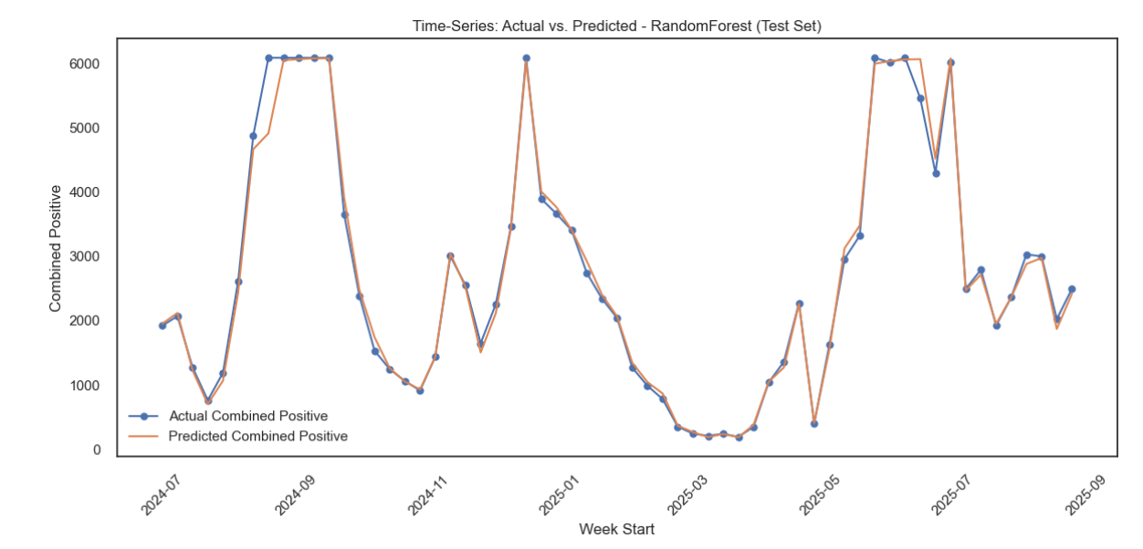
Time-Series: Actual vs. Predicted - RandomForest
High Accuracy Predicted values closely match actual data, indicating strong model performance.
Predictive Utility Reliable forecasts support planning for health interventions and resource allocation.

Slide 16
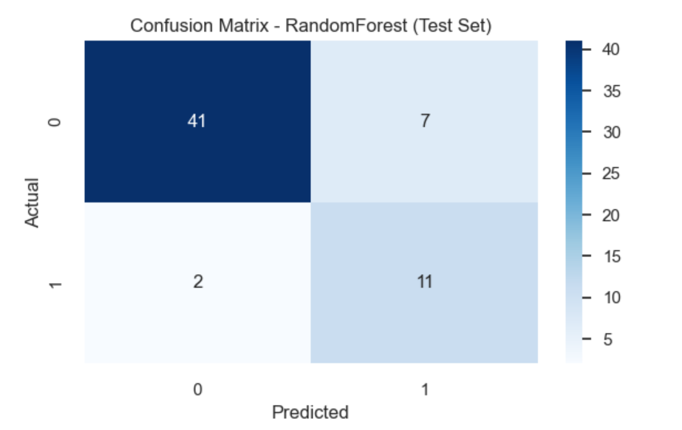
Confusion matrix
High True Negative Rate Majority of negative cases correctly identified (41 out of 50).
Low False Negative Count Only 2 actual positives missed, indicating good sensitivity.
Balanced Performance Model shows reasonable precision and recall, suitable for deployment with minor tuning

Slide 17
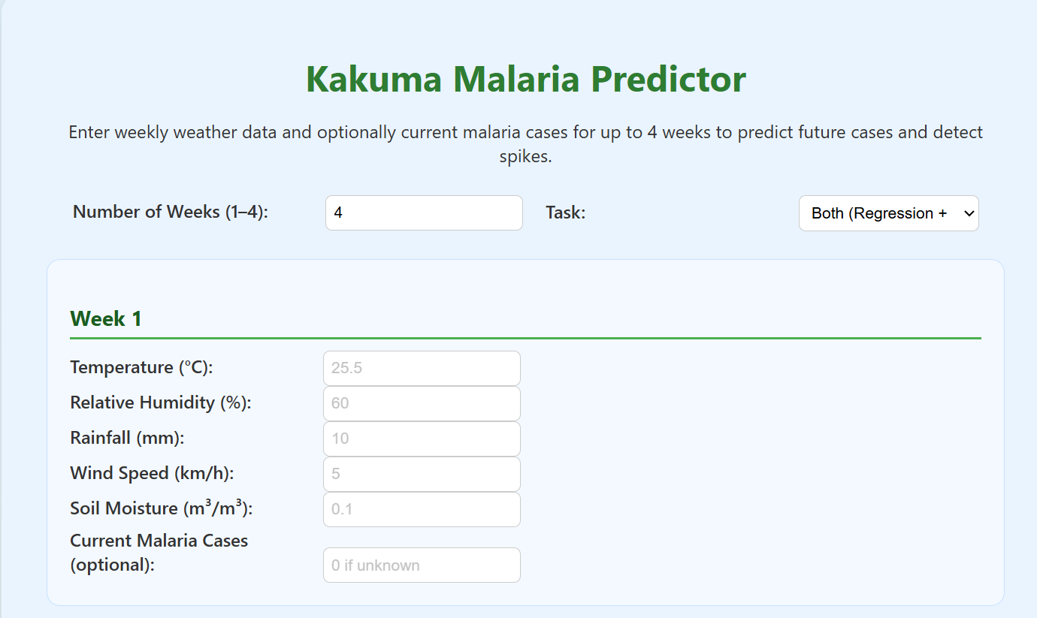
Business utility (for the health facility management):
Resource allocation. This include things like drugs, test kits and nets
Prepositioning of response supplies ahead of an outbreak or upsurge in cases
Timing of interventions such as insecticide spraying and net distribution.
Evaluate impact of interventions in averting high morbidity.
Operational logistics: Human resources, vehicles, fuel

Slide 18
Recommendations
1. Invest in Electronic Medical Records (EMRs)
Why: Real-time malaria case counts are essential for accurate forecasting and timely alerts.
Recommendation: Deploy EMRs in high-burden facilities starting with Kakuma, integrated with DHIS2 and the predictive model.
Impact: Enables automated data ingestion, reduces reporting delays, and improves model responsiveness.
2. Upgrade to Deep Learning Models
Why: Daily case counts allow for finer-grained predictions and anomaly detection.
Recommendation: Experiment with LSTM or Temporal Fusion Transformers for time-series forecasting.
Impact: Captures complex temporal patterns and improves early warning accuracy.

Slide 19
3. Strengthen Multiagency Collaboration
Why: Weather and environmental data are critical predictors.
Recommendation: Formalize data-sharing agreements with:
Kenya Meteorological Department (real-time weather)
Kenya Space Agency (satellite imagery, vegetation indices)
Impact: Enhances model inputs and supports geospatial risk mapping.
4. Add Geospatial Visualization
Why: Maps help localize outbreaks and guide targeted interventions.
Recommendation: Integrate GIS tools to display predicted hotspots by ward or village.
Impact: Improves decision-making for vector control and resource deployment.
5. Incorporate Satellite Imagery
Why: Vegetation indices (e.g., NDVI) correlate with mosquito habitats.
Recommendation: Use open satellite data (e.g., Sentinel, MODIS) to enrich environmental features.
Impact: Adds spatial depth to predictions and supports proactive planning.

Slide 20
6. Build an Alert System
Why: Timely alerts enable rapid response.
Recommendation: Develop an SMS/email alert system linked to model outputs.
Impact: Notifies health managers and CHWs of predicted spikes for early action.
7. Draft Operational SOPs
Why: Alerts must trigger structured responses.
Recommendation: Create SOPs for:
Resource prepositioning
CHW mobilization
Outbreak response protocols
Impact: Ensures consistency and accountability in response efforts.
8. Translate Insights for CHWs
Why: CHWs are frontline responders.
Recommendation: Simplify model outputs into actionable messages (e.g., “Expect spike in week 21—prepare for outreach”).
Impact: Empowers CHWs to act early and reduce morbidity.

Slide 21
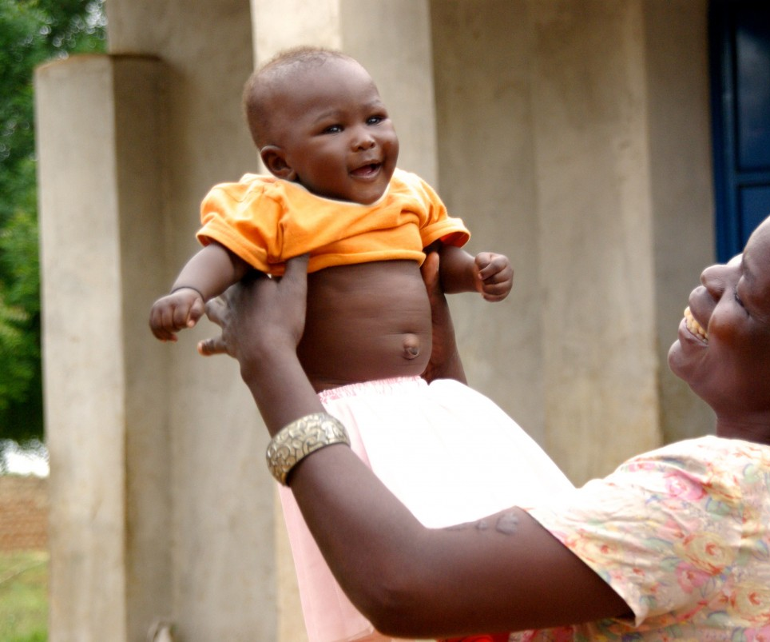
Thank you
Malaria does not have to be deadly. Timely interventions can reduce disease burden and mortality. Predictive disease models can help us intervene better.
Collaborators:
Hezron Rumenya
Joackim Kisienya
Eric Ongau
Lynn Kyalo
Newton Njeri
Joy Sila

