Slide 1
Tanzanian Water Wells
Presented by: Hezron Rumenya

Slide 2
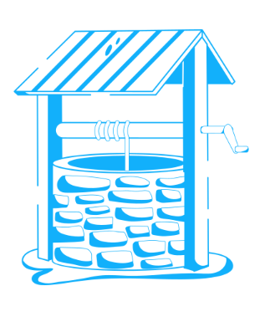

Overview
Tanzania is one of the countries located in East Africa and has a population of over 67 million.
Most people live in rural areas, and the population is largely young.
A critical concern is limited access to clean water, especially in rural areas where water sources are scarce or polluted.
This impacts health, agriculture, and education, particularly for women and children who collect water daily.
Tanzania Development Vision 2025 which aspires to achieve universal access to water supply in urban areas and ensuring 90% water supply coverage in rural areas by 2025.
In Tanzania, the current average water supply coverage in urban and rural areas is 78% and 59.76%, respectively.
The major water sources include Lake Victoria, Lake Tanganyika, rivers like the Rufiji, underground aquifers, and wells both shallow and deep.
However, access is challenged by seasonal variability, pollution, overuse, and inadequate infrastructure. In rural areas, many depend on wells, which often face issues like contamination, drying, and poor maintenance.

Slide 3
Problem statement
In Tanzania, a larger proportion of its citizenry relies of water wells as key source of water. Such sources are prone to contamination, drying, and poor maintenance. Therefore, it requires monitoring for water levels, quality and even maintenance.
The Tanzanian water wells dataset provides a comprehensive information for approximately over 59,000 water wells with necessary features providing information related to pump, installation, location and condition related.
As government in collaboration with sector stakeholders (NGOs, private actors) put measures to achieve universal access to water supply in urban areas and ensuring 90% water supply coverage in rural areas by 2025.
It is prudent to identify where to invest scarce resources and achieve optimal impact utilizing the available information. The task at hand involves finding a scientific approach that can provide information on which waterpoints (water wells) will likely fail and thus better plan accordingly for operational maintenance.

Slide 4
Stakeholders and objectives
Stakeholders
The Tanzanian government and its Agencies (Ministry of Water and Irrigation)
Non Governmental Organizations
Private Actors
Objectives
The overall objective is to build a predictive model that classifies the operational status of water wells based on attributes provided in the Tanzanian Water Wells dataset. To realize this, the following specific objectives are introduced.
To identify factors influencing the functionality of the wells
Develop models for predicting the functionality of the water wells
To evaluate the models and identify the significant features for determining wells functionality
Use the optimal model to predict test data

Slide 5
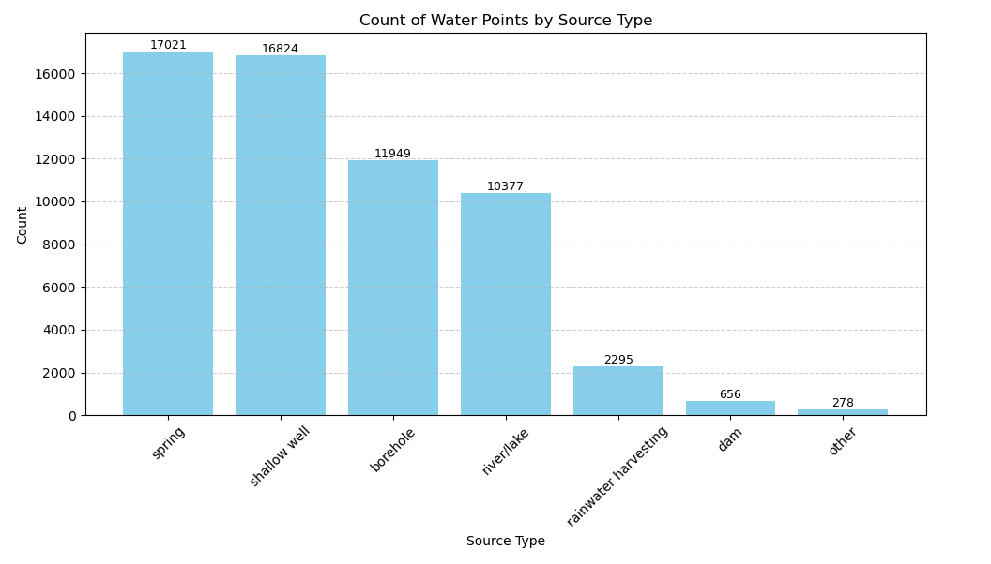
Tanzanian water points by source
The bar plot of water points by source type we observe that in Tanzania, Springs (17,021) are the main source of water followed by shallow wells (16,829) and boreholes (11,949), river/lakes, rainwater harvesting, dam and others in that order.
Wells are Man-made hole dug or drilled into the ground and require pumping or drawing manually to draw the water.

Slide 6
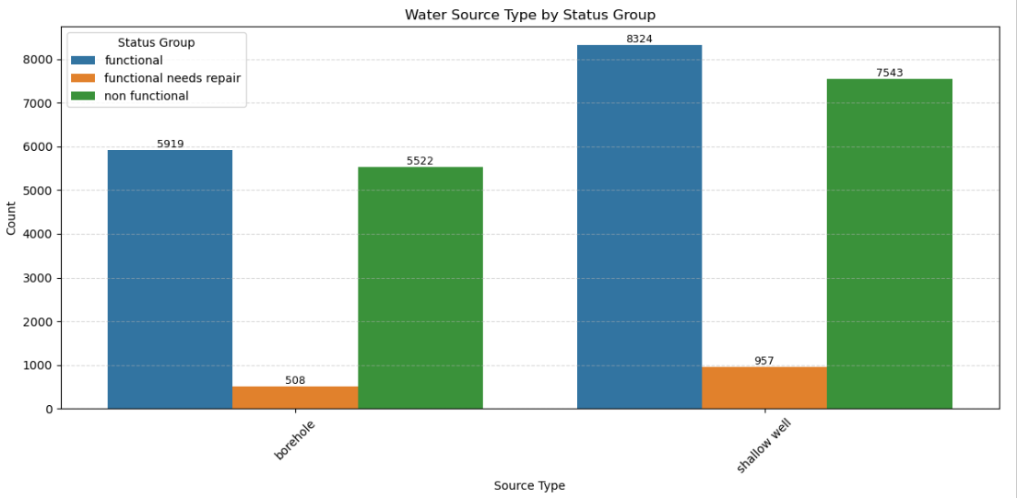
Water wells by functionality
From the bar plot, water wells data indicates three functionality status.
The functional and non-functional water wells are nearly equal,
However functional wells requiring repairs are significantly lower (under a thousand) for both categories.

Slide 7
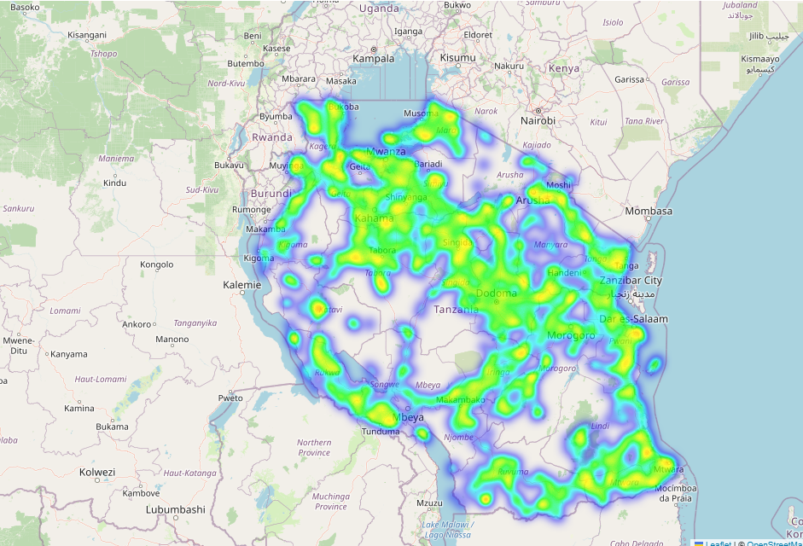
The heatmap above shows the distribution of water wells across the country, with much denser points indicating more wells than the less denser points. Relatively, the heatmap indicates coverage of relevant geographies in Tanzania.

Slide 8
Findings – data Exploration
Factors influencing the functionality of the wells
Using the distribution graphs, geographical information indicates water wells are distributed across the country (regions) – See the heatmap.
Eleven features (7 categorical and 4 numeric) were explored in modelling of the features
All numeric predictors showed statistically significant mean differences across the three status categories (ANOVA p < 10⁻⁶)
For categorical variables, each contributes some signal, but none alone would cleanly split the classes

Slide 9
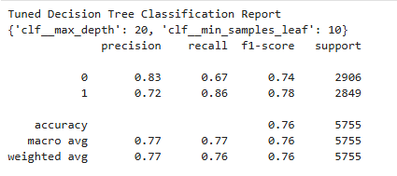
Binary classification models (functional and non-functional wells)
Models for predicting the functionality of the water wells
The tuned Decision Tree Model outperforms the Logistic model owing to the following factors
Accuracy rises from 0.74 to 0.76 and macro‑F1 from 0.74 to 0.76, thus mainly captures more non‑functional wells (recall 0.67 vs 0.59) while keeping high precision (0.83).
Functional well recall dips slightly (0.86 vs 0.90) but gains precision (0.72 vs 0.68), producing a better class balance.
Logistic regression still offers smoother probability ranking (ROC‑AUC 0.802) and simpler interpretation, but the tree’s richer splits deliver superior overall field usefulness in practice.

Slide 10
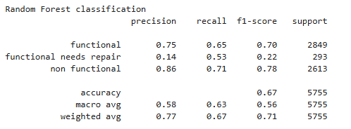
Multi-Class models (functional, functional need repair and non-functional wells)
Models for predicting the functionality of the water wells
The Model 5 – Random Forest performs the best overall.
It achieved the highest accuracy (0.67), macro average F1-score (0.63), and weighted average F1-score (0.71). It balances precision and recall well across all classes, especially handling the minority class "functional needs repair" better than others.
Compared to logistic regression and decision trees, Random Forest shows improved generalization and classification performance, making it the most reliable model here.

Slide 11
Features
Significant features for determining wells functionality
The most influential features in the Random Forest model are primarily numeric, with gps_height, construction_year, and population standing out as the top three.
gps_height contributes the most, suggesting that elevation plays a key role in determining pump functionality of a water well, perhaps due to its influence on water pressure or accessibility.
Construction_year highlights the relevance of infrastructure age, implying older pumps are more likely to need repair.
The population emphasizes usage demand, with higher population may lead to faster wear or increased strain on the system.
Also, categorical features play a significant role, particularly in representing the condition, type, and usage of the water point.
Features like quantity_group_dry, extraction_type_class_other, and waterpoint_type_group_other indicate that specific categories of water availability and extraction methods are strong signals of functionality of a water well.
Additionally, payment-related features such as payment_type_never pay and payment_type_unknown suggest that financial commitment and maintenance responsibility might influence whether a pump remains in working order.

Slide 12
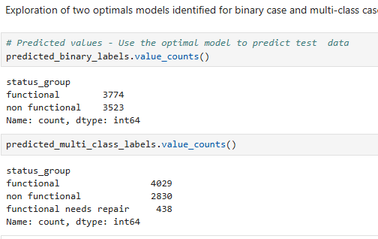
Prediction – using optimal models
Use the optimal model to predict test data
NB
Predicted datasets are saved in dataset for review

Slide 13
Conclusions and Recommendations
To determine Water Well (Shallow well and boreholes) by functionality and non-functionality, explore use of tuned Decision tree model.
To determine water well (Shallow well and boreholes) by all the three status groups, explore use of random forest.
The most important features in determining effective predictive model were elevation, construction year, population using the source, water availability and extraction methods, financial commitments and maintenance responsibility.
To further improve of predictive models, take next steps to explore fine tuning approaches of the optimal model - Random Forest.

Slide 14
Questions?

