Slide 1
How to work with RZSM products: From download to visualization
EUMETSAT Event week
5th November 2019
David Fairbairn, Patricia de Rosnay, Phil Browne, Lars Isaksen and Clement Albergel

Slide 2
Contents
Introduction;
Requirements for running metview-python and other libraries
Downloading and visualizing H14 and H27 data record product
Downloading the grib files from the ftp
Reading the grib data using metview-python
Plotting the grib data directly using metview-python
Converting to regular grid and plotting using cartopy
Plotting a time series of the H27 data record
Converting to netCDF with regional data
Plotting regional netCDF data with cartopy
Summary

Slide 3
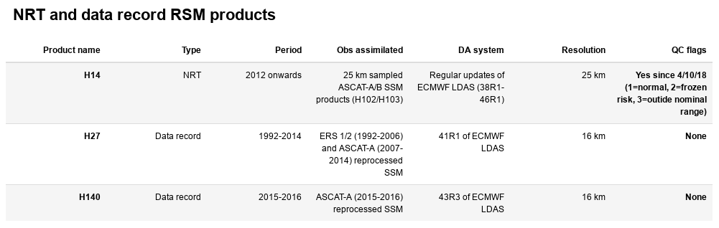
Table of current products

Slide 4
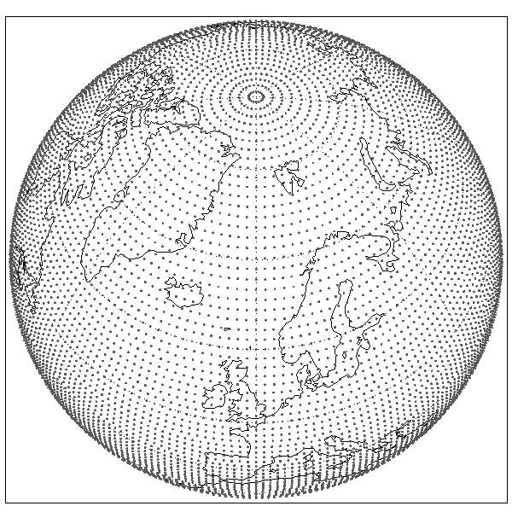
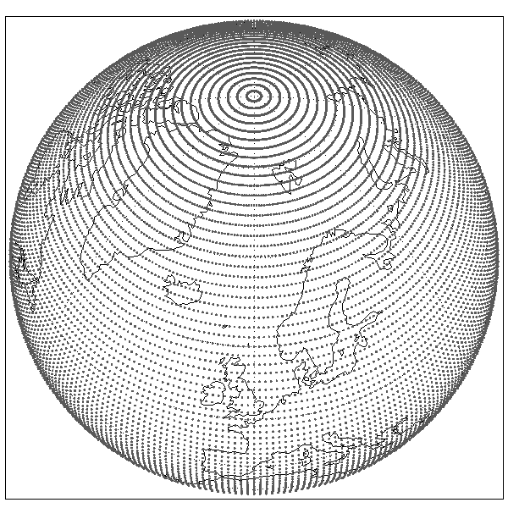
Format
H14 is available in grib format on a linear reduced Gaussian grid (T799~25 km resolution);
H27/H140 are available in grib format at (T1279~16 km resolution).
The reduced Gaussian grid maintains approximately equidistant grid-point distances between the poles and the equator (unlike regular lat/lon grid):
Reduced Gaussian grid:
Regular lat/lon grid:
For more info, see https://confluence.ecmwf.int/display/FCST/Gaussian+grids

Slide 5
Requirements for examples
python version 3.6
The following libraries: metview, pandas, pylab, matplotlib, numpy, cartopy
A miniconda script for linux/mac will be provided on github, which sets up a local environment and downloads the relevant libraries for all the soil moisture examples:
https://github.com/H-SAF/eumetrain_sm_week_2019
The following examples can be run in jupyter notebook (Exercise_2 from github above)
More information about metview-python: https://github.com/ecmwf/metview-python

Slide 6
Documentation
The documentation can be found via http://hsaf.meteoam.it/user-documents.php:
Product user manual
Algorithm theoretical baseline document
Product validation report
If you have any queries, please contact the H SAF helpdesk: us_hsaf@meteoam.it

Slide 7
Downloading the data from ftp
H14, H27 and H140 daily grib files can be downloaded via the H-SAF ftp: ftp://ftphsaf.meteoam.it/products
First register with H SAF: http://hsaf.meteoam.it/user-registration.php to obtain username and password
Easy to download data from ftp using software such as filezilla https://filezilla-project.org/ .
Alternatively, to download example file (H14 for 30/05/2018) from the terminal type:
ftp user@ftphsaf.meteoam.it
password: (type your password)
cd /products/h14/h14_cur_mon_grib
get h14_20190530_0000.grib.bz2
exit
bzip2 -d h14_20190530_0000.grib.bz2

Slide 8
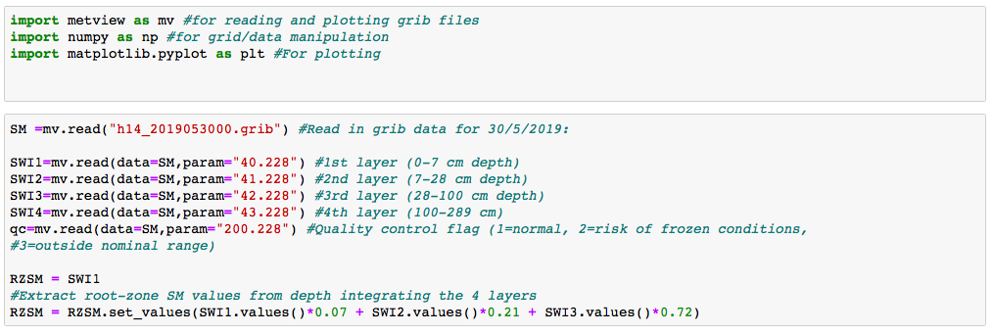
Reading grib data in metview-python

Slide 9
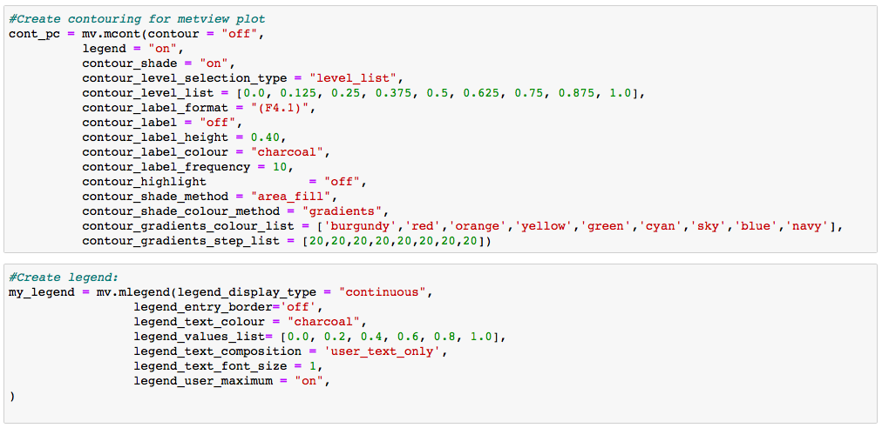
Plotting grib data in metview-python

Slide 10
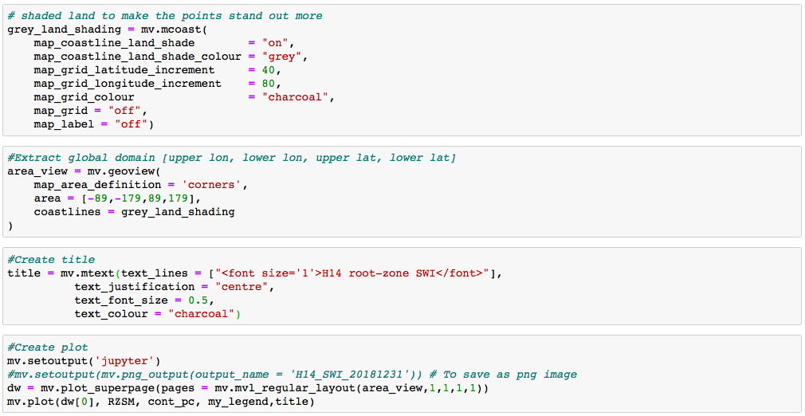
Plotting grib data in metview-python

Slide 11
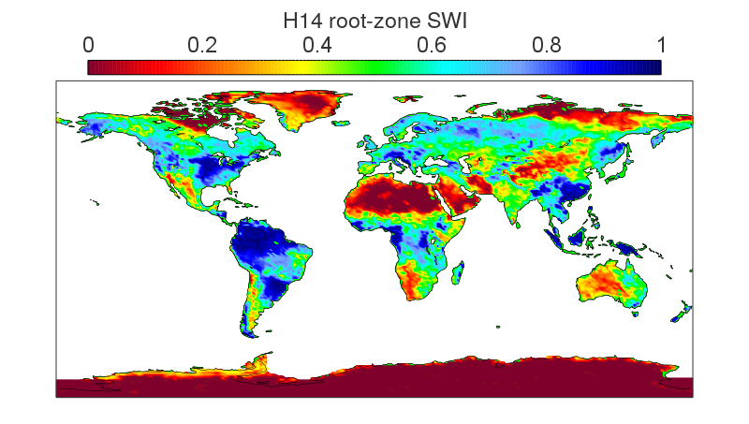
Plotting grib data in metview-python

Slide 12
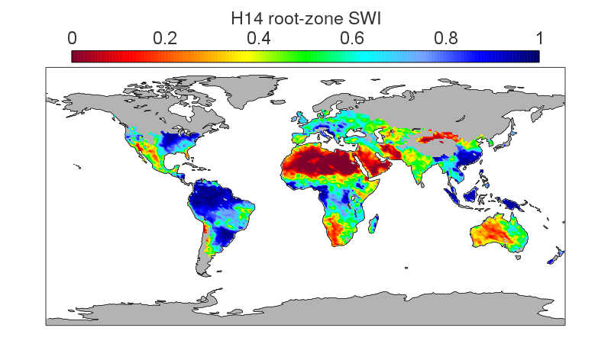
Masking suspect data

Slide 13
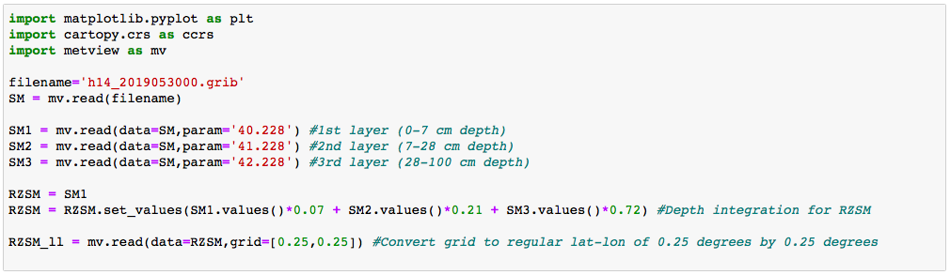
Conversion to regular grid

Slide 14
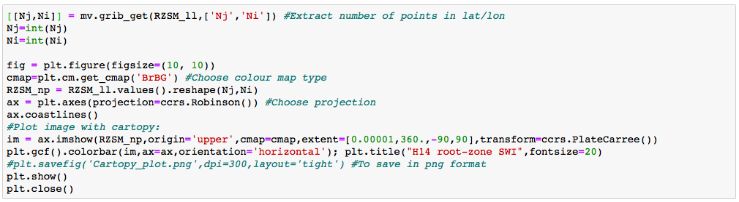
Plot with cartopy

Slide 15
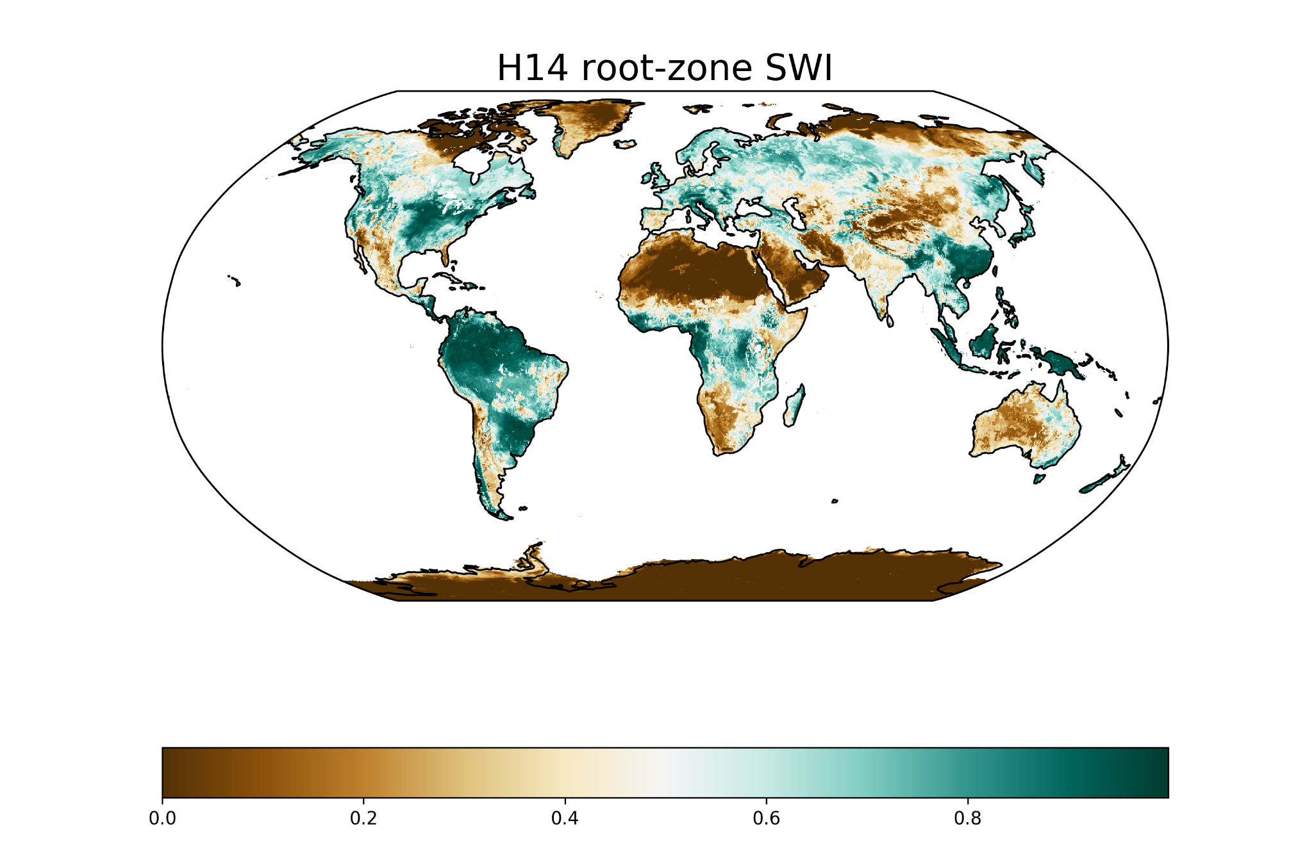
Plot with cartopy

Slide 16
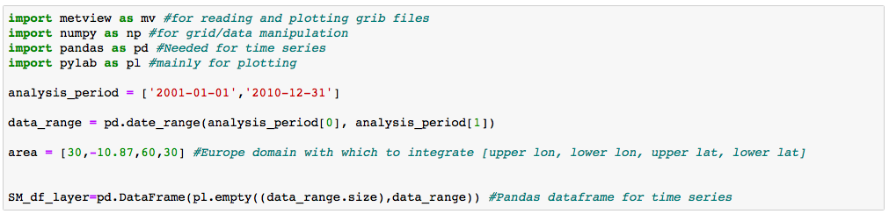
Plot time series over Europe

Slide 17
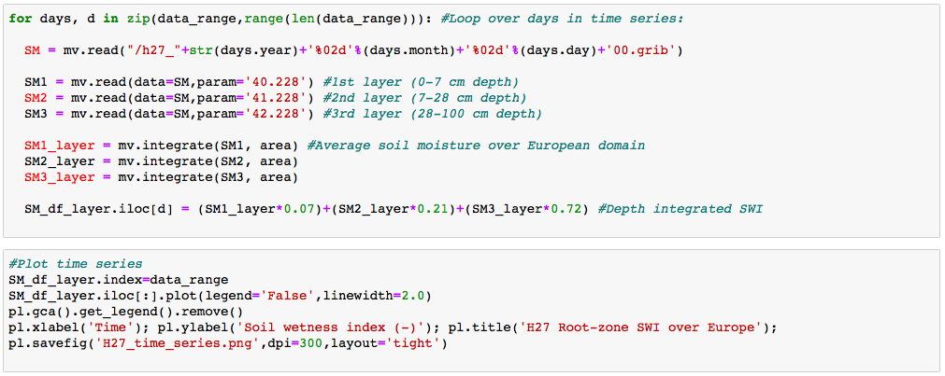
Plot time series over Europe

Slide 18
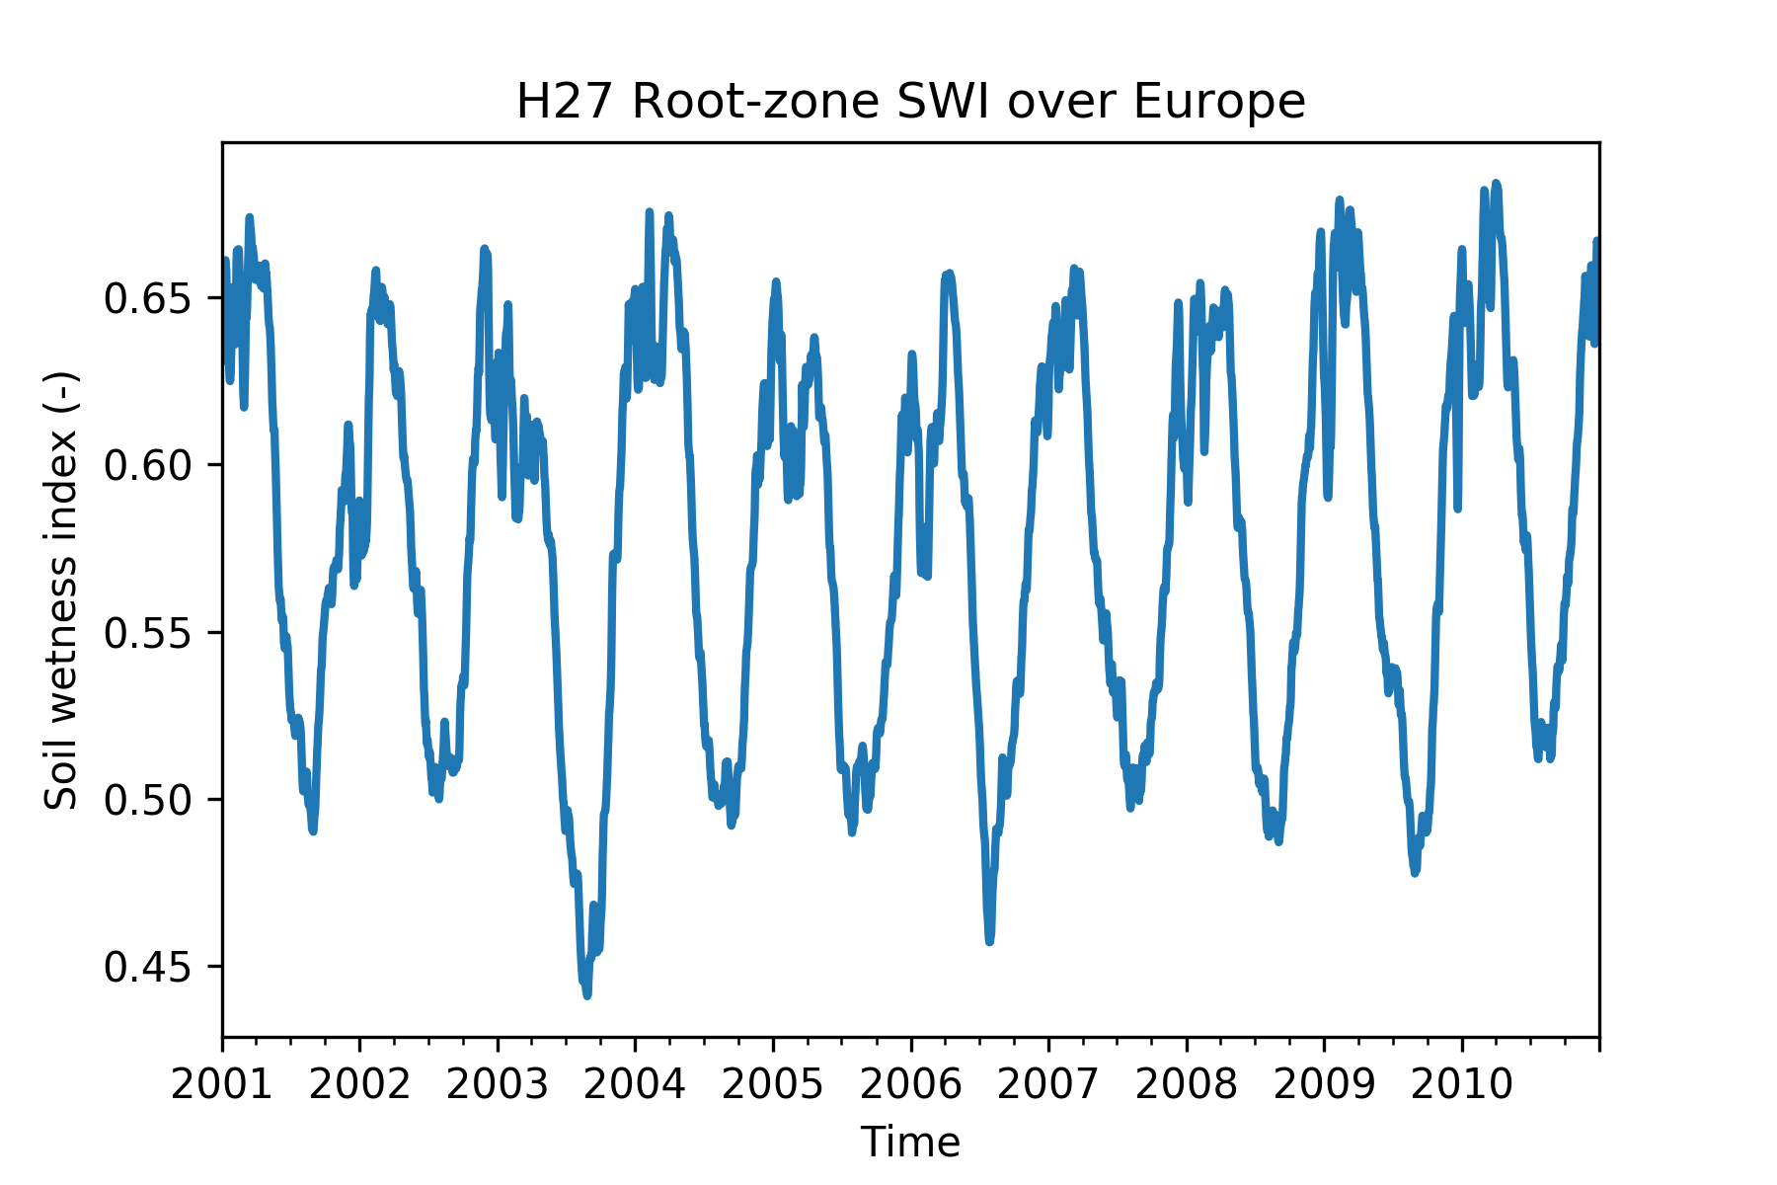
Plot time series over Europe

Slide 19
Plot time series over Europe
Hot and dry summers of 2003 and 2006

Slide 20
Convert grib to netCDF with regional data
The following examples use the CDO tool, which is free to download from:
https://code.mpimet.mpg.de/projects/cdo
Information about latitude and longitude points for reduced Gaussian grid:
https://www.ecmwf.int/en/forecasts/documentation-and-support/gaussian_n400
For our grid (T799), there are 1600 regular latitude points (and 800 longitude points). We can now convert our reduced Gaussian grid to regular lat/lon:
module load cdo
#To convert to regular lat/lon
cdo -R remapcon,r1600x800 -setgridtype,regular h14_2019053000.grib h14_2019053000_r.grib
#Then convert the file from grib to netcdf:
cdo -f nc copy h14_2019053000_r.grib h14_2019053000.nc
#Then extract the Italian domain from the global netcdf file (lon0=5, lon1=19, lat0=36, lat1=48):
cdo -sellonlatbox,5,19,36,48 h14_2019053000.nc h14_2019053000_Italy.nc
#File is vastly reduced (h14_2019053000.nc ~ 25 mb, h14_2019053000_Italy.nc ~ 70 kb)!

Slide 21
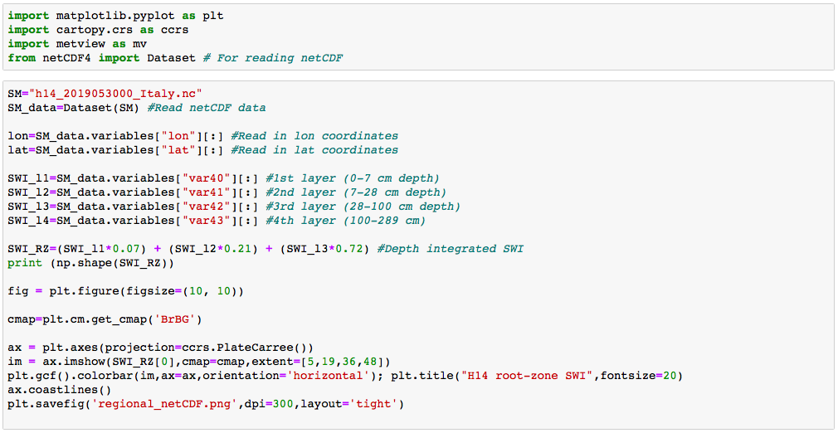
Regional plot of netCDF

Slide 22
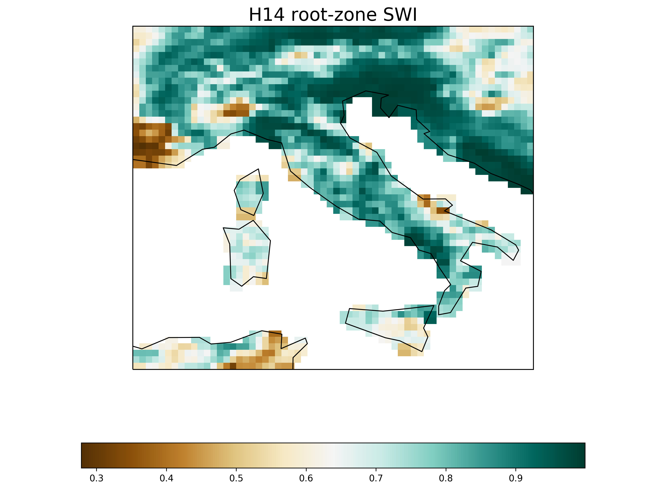
Regional plot of netCDF

Slide 23
Summary
There are 3 different root-zone SWI products:
H14: Global near-real-time 25 km resolution
H27: Global data record (1992-2014)
H140: Global data record (2015-2016)
The metview library directly reads and plots grib data from its original non-Gaussian grid
Metview has other features, including conversion to regular grid, nearest gridpoint extraction and integrating over geographical region
The CDO tool can convert grib files to regular grids in netCDF format and extract local regions
Cartopy is a good alternative to metview for regular grids

Slide 24
References
Albergel, C., 2011 Product Validation Report (PVR-14). URL: http://hsaf.meteoam.it/documents/PVR/SAF_HSAF_PVR-14.pdf. Last accessed April 2018.
E. Artinyan, 2012: Assimilation of small-scale surface soil moisture (H-SAF H08) into a coupled SVAT and hydrological model system. 2012 Eumetsat Meteorological satellite conference, 3-7 September, 2012, Sopot, Poland********* poster presentation
Baguis, P. and Roulin, E., 2017. Soil Moisture Data Assimilation in a Hydrological Model: A Case Study in Belgium Using Large-Scale Satellite Data. Remote Sensing, 9(8), p.820.
Dorigo, W. A., Wagner, W., Hohensinn, R., Hahn, S., Paulik, C., Xaver, A., Gruber, A., Drusch, M.,Mecklenburg, S., van Oevelen, P., Robock, A., and Jackson, T.: The International Soil MoistureNetwork: a data hosting facility for global in situ soil moisture measurements, Hydrol. Earth Syst.Sci., 15, 1675-1698, https://doi.org/10.5194/hess-15-1675-2011,2011.
D. Fairbairn, P. de Ronsay, and P. Browne, “The new stand-alone surface analysis at ECMWF: Implications for land-atmosphere DA coupling,” J. Hydrometeor, 2019. https://doi.org/10.1175/JHM-D-19-0074.1
Koster, R.D., Sud, Y.C., Guo, Z., Dirmeyer, P.A., Bonan, G., Oleson, K.W., Chan, E., Verseghy, D., Cox, P., Davies, H. and Kowalczyk, E., 2006. GLACE: the global land–atmosphere coupling experiment. Part I: overview. Journal of Hydrometeorology, 7(4), pp.590-610.
Massari, C., Brocca, L., Ciabatta, L., Moramarco, T., Gabellani, S., Albergel, C., De Rosnay, P., Puca, S. and Wagner, W., 2015. The use of H-SAF soil moisture products for operational hydrology: flood modelling over Italy. Hydrology, 2(1), pp.2-22.
Struzik, P. and Kępińska-Kasprzak, M., 2016. Use of conventional and satellite data for estimation of evapotranspiration spatial and temporal pattern. Meteorology Hydrology and Water Management. Research and Operational Applications, 4.

