Slide 1
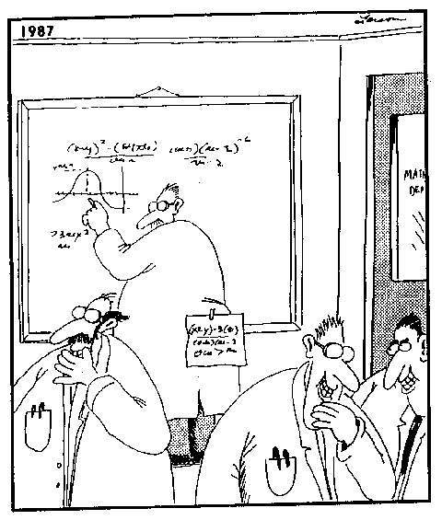
CPSC 313 Introduction to Computability
Problems and Languages (Sipser, Ch. 0)
Renate Scheidler
Winter 2020

Slide 2
More Course Preparation
Do course prep from last lecture
Work through proof examples in last lecture’s slides
Review Sections 0.3-0.4 of Sipser
Work through induction problems (handout)
Now let’s get started …

Slide 3
Problems and Languages
Problem: defined using input and output
Decision Problem: output is either yes or no
Language of a decision problem: set of all inputs where output is yes
The decision problem associated to a language
L = set of objects that satisfy some property P
is defined via:
Input: object x
Output: Yes if x satisfies property P (i.e. belongs to L), no otherwise

Slide 4
Example – Sorting
Sorting Problem
Input: Array of integers
Output: Array with the same integers in non-descending order
Sorting decision problem
Input: Array of integers
Output: Yes if the array is in non-descending order, no otherwise
Sorting Language: set of all integer arrays that are in non-descending order

Slide 5
Example – Code Reachability
Code Reachability Problem
Input: Java computer code
Output: Reachable lines of code
Code Reachability Decision Problem
Input: Java computer code and a line number
Output: Yes if the line is reachable for some input, no otherwise
Reachability Language: set of pairs consisting of a string of Java computer code and the number of a reachable line in that code

Slide 6
Examples – Even String Length and Primality
Decision problem ↔ Language of yes instances
Decision Problem (even string length)
Input: String w
Output: Yes iff w has even length
Language: set of all strings of even length
Decision Problem (primes)
Input: Positive integer N
Output: Yes iff N is prime
Language: set of all primes

Slide 7
Example – Divisibility by 3 Language
Language: set of non-negative integers divisible by 3 L = { 0, 3, 6, 9, …}
Objects: non-negative integers
Property: divisibility by 3
Decision Problem
Input: Non-negative integer N
Output: Yes iff N is divisible by 3

Slide 8
Example – Graph Divisibility Language
Language: set of simple graphs (simple: no loops or multiple edges)
Objects: graphs
Property: simplicity
Decision Problem
Input: Graph G
Output: Yes iff G is simple, i.e. has no loops or multiple edges

Slide 9
Alphabets
An alphabet is a finite non-empty set
An alphabet is generally denoted by the symbol Σ (Greek upper-case “Sigma”)
Examples:
{a}
{0,1}
Set of all symbols used in Java code

Slide 10
Strings
A string is finite sequence of symbols from an alphabet
Length of string w: length of sequence, written as |w|
ε – the empty string (length 0)
Concatenation of w₁ and w₂ : copy of w₁ followed by copy of w₂, written as w₁w₂
|w₁w₂| = |w₁| + |w₂|

Slide 11
Examples of Strings
Σ = {0,1} set of bits
w₁ = 0100, w₂ = 11
w₁w₂ = 010011, |w₁w₂| = 4+2 = 6
Σ = {0, 1, 2, … , 9} set of digits
w = 313
Σ = Set of all symbols used in Java,
w = “public static void fnc() {“ (without the quotes)

Slide 12
Languages
A language over an alphabet Σ is a set of strings consisting of symbols in Σ
May be finite or infinite
Σ* is the set of all strings over Σ (an infinite set)
A language L over Σ is a subset of Σ* (L ⊆ Σ*)
Automata/Machines accept languages

Slide 13
Examples of Languages
Σ = {0, 1} set of bits
Σ* is the set of bit strings
L₁ = { w∈ Σ* | |w| is even } set of bit strings of even length
L₂ = { w∈ Σ* | w contains no 1’s } = {ε, 0, 00, 000, …} = {0}*
Σ = { a, b, c, … , z, A, B, … , Z } English alphabet
Σ* is the set of strings consisting of English letters
L₁ = English language
L₂ = set of last names of students in this class
L₃ = { w∈ Σ* | w contains the letter `a’ }

