Slide 1
Learning-Based Quadruped Locomotion
Project 1, Approach B
Train a robust quadruped locomotion policy that tracks commanded velocity on flat and challenging terrain.
PPO policy training for Unitree Go1 in NVIDIA Isaac Lab
Go1
PPO
2
robot model
learning method
demo conditions
12 actuated leg joints
RSL-RL in Isaac Lab
flat and rough terrain
Demo order: flat policy rollout, then rough-terrain policy rollout.
ECE 489 / ME 446 Final Project
Hayk Soghomonyan and Siqi Pan
ECE 489 / ME 446 Final Project | Learning-Based Quadruped Locomotion
01

Slide 2
PROJECT SCOPE
We implemented the learning-based locomotion track
The final demo focuses on the core quadruped objective from our proposal: stable Go1 locomotion in simulation.
Original proposal objective
Delivered in final demo
Use NVIDIA Isaac Lab for GPU-parallel RL simulation.
800
1500
Train Unitree Go1 with PPO for velocity tracking.
flat iterations
rough iterations
final checkpoint model_799.pt
final checkpoint model_1499.pt
Evaluate behavior on flat and challenging terrain.
Use domain randomization and terrain curriculum for robustness.
Final scope stayed with the core objective: quadruped locomotion under both flat and challenging terrain conditions.
Sources: project proposal and final project requirements
02

Slide 3
RL FORMULATION
Policy maps observations to joint targets
The high-level policy outputs desired joint positions for the Go1 low-level PD controller.
Observations
Policy network
Actions
Simulation
base motion, gravity, joint states, previous action, velocity command, and rough-terrain height scan
PPO actor-critic MLP. The rough policy keeps terrain context; the flat policy removes it.
12 joint-position targets, one for each Go1 leg motor.
Parallel Isaac Lab environments update contacts, rewards, resets, and terrain.
Reward objective
Track commanded velocity while staying upright, avoiding body contact, limiting effort, and encouraging useful foot swing.
ECE 489 / ME 446 Final Project | Learning-Based Quadruped Locomotion
03

Slide 4
IMPLEMENTATION
We built a simulation-to-training pipeline in Isaac Lab
The workflow converts the project objective into repeatable flat and rough terrain PPO experiments.
Robot and terrain
Observation and reward
Parallel PPO training
Evaluation outputs
Unitree Go1 is simulated under two conditions: a flat plane and generated rough terrain.
The policy observes robot motion, joint state, commands, and rough-terrain height scan. Rewards encourage velocity tracking and safe contacts.
Thousands of simulated rollouts run on GPU, and RSL-RL updates the actor-critic policy from reward feedback.
The final artifacts are policy checkpoints, TensorBoard curves, and recorded rollout videos for the demo.
Why this matters: one PPO pipeline supports a consistent flat-vs-rough comparison.
ECE 489 / ME 446 Final Project | Learning-Based Quadruped Locomotion
04

Slide 5
TRAINING SETUP
Flat and rough policies were trained separately
The two-task setup gives a clean comparison between baseline walking and terrain-aware walking.
1024
cuda:0
42
video
parallel envs
GPU device
random seed
rollout record
used for training
RTX 4060 laptop GPU
same seed for final runs
headless video capture
Flat terrain run
Rough terrain run
Isaac-Velocity-Flat-Unitree-Go1-v0
Isaac-Velocity-Rough-Unitree-Go1-v0
final checkpoint: model_799.pt
final checkpoint: model_1499.pt
no height scan or terrain curriculum
height scan and curriculum enabled
ECE 489 / ME 446 Final Project | Learning-Based Quadruped Locomotion
05

Slide 6
ROBUSTNESS DESIGN
Reward shaping and curriculum improve robustness
Default Isaac Lab reward terms were adjusted to emphasize velocity tracking, regular stepping, and safer contacts.
Domain randomization
Terrain curriculum
Reward shaping changes
friction range
begin with easier terrain
stronger velocity tracking
base mass variation
increase terrain difficulty
feet air-time tuned for gait rhythm
motor strength scaling
height scan for local terrain
torque and acceleration penalties tuned
observation corruption
roll out on generated rough terrain
contact penalties adjusted for stability
Example tuning: linear velocity tracking was increased to 1.5 and yaw tracking to 0.75, while effort and contact penalties constrained unstable motion.
ECE 489 / ME 446 Final Project | Learning-Based Quadruped Locomotion
06

Slide 7
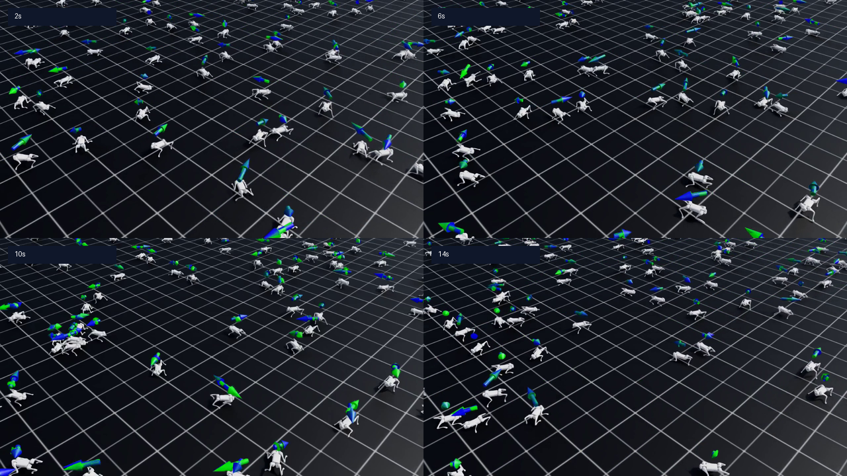
DEMO CONDITION 1
Flat policy produces stable forward locomotion
The flat task tests the learned gait under a clean plane condition.
What to observe
Regular quadruped gait, upright posture, and steady forward progress.
This condition verifies the basic locomotion controller.
Final result video: flat policy after 800 learning iterations.
ECE 489 / ME 446 Final Project | Learning-Based Quadruped Locomotion
07

Slide 8
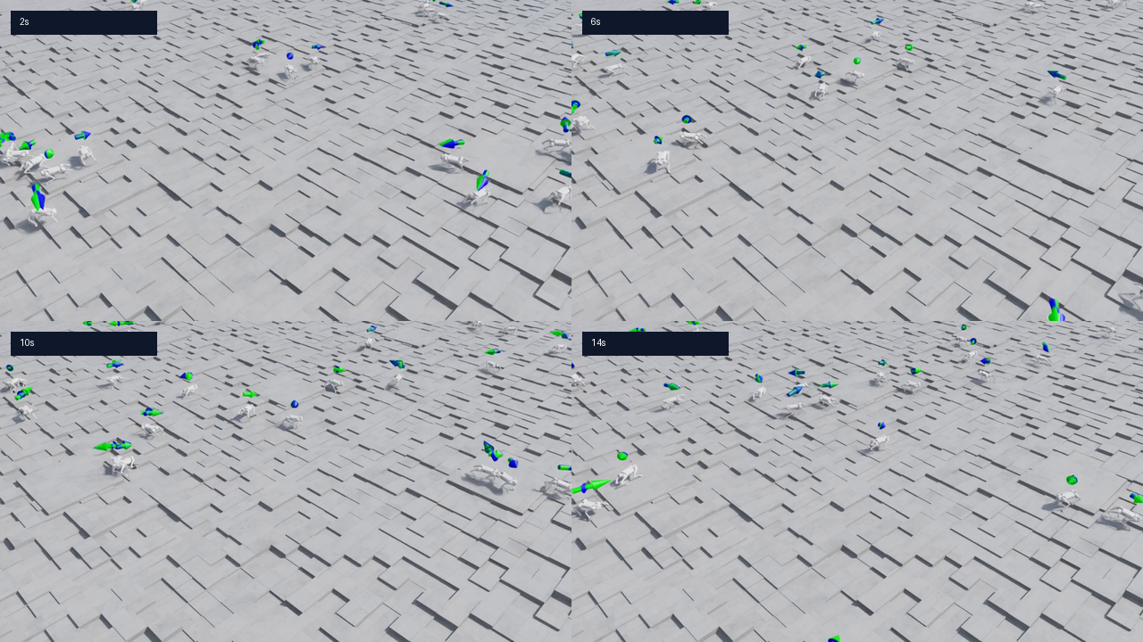
DEMO CONDITION 2
Rough policy traverses generated terrain
The rough task adds elevation changes and terrain height observations.
What to observe
Terrain-aware observations help the policy keep moving over uneven geometry.
Some agents still fail, which shows rough terrain remains the harder condition.
Final result video: rough policy after 1500 learning iterations.
ECE 489 / ME 446 Final Project | Learning-Based Quadruped Locomotion
08

Slide 9
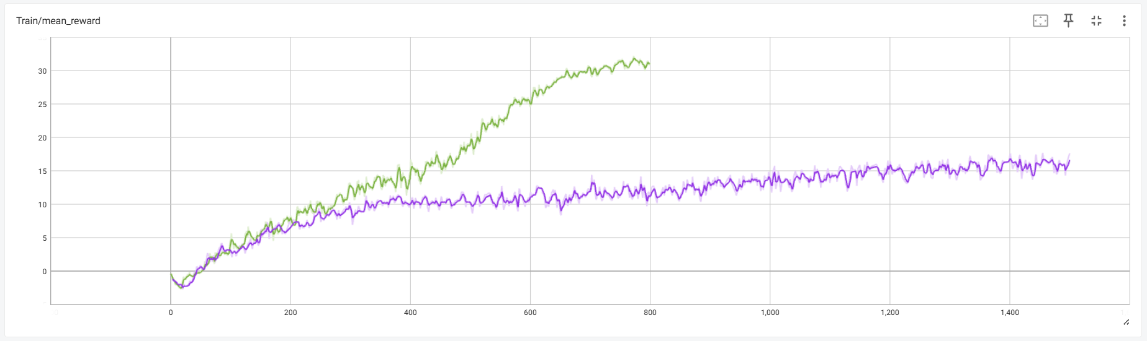
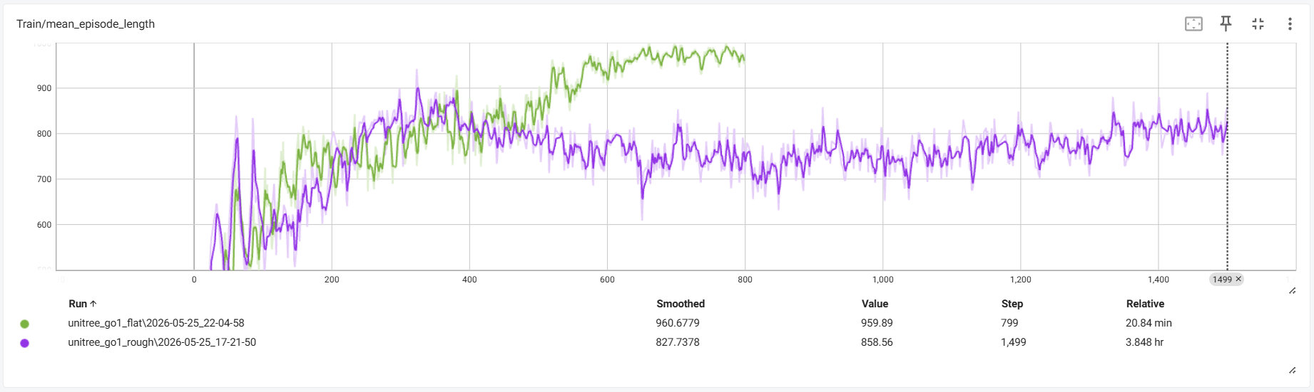
TRAINING EVIDENCE
Two key curves summarize learning progress
Flat converges higher; rough improves under curriculum but remains lower-return.
Mean reward: flat reaches a higher return plateau.
Mean episode length: flat survives longer and more consistently.
Takeaway: the same PPO pipeline learns both policies, but rough terrain remains the harder condition.
Source: TensorBoard logs from final training runs
09

Slide 10
EVALUATION
Flat is stable; rough is functional but harder
Last-100 mean TensorBoard scalars from the final flat and rough runs.
Metric
Flat terrain
Rough terrain
Interpretation
Mean reward
30.716
15.883
flat task reaches higher return
Episode length
971.488
808.395
flat policy survives longer
Velocity XY error
0.223
0.392
tracking is harder on rough terrain
Yaw error
0.398
0.444
rough terrain is slightly worse
Base contact termination
0.037
0.315
rough policy has more body contact
Terrain curriculum level
n/a
4.546
rough run progresses through curriculum
Result summary: the flat policy is stable and clean, while the rough policy shows learned traversal with reduced robustness.
ECE 489 / ME 446 Final Project | Learning-Based Quadruped Locomotion
10

Slide 11
DISCUSSION
Rough-terrain robustness is the main challenge
The final policy satisfies the two-condition demo requirement and shows clear improvement targets.
Strengths
Failure modes
Project contributions
stable flat walking
more body contact on rough terrain
custom Go1 task configuration
PPO training pipeline works
weaker velocity tracking
flat and rough terrain policies
rough terrain traversal is visible
shorter episodes with terrain variation
training curves and checkpoints
reproducible checkpoints and rollout videos
reward tuning affects posture
recorded rollout demo under two conditions
ECE 489 / ME 446 Final Project | Learning-Based Quadruped Locomotion
11

Slide 12
Conclusion and Demo
We trained PPO policies for Unitree Go1 in Isaac Lab and demonstrated walking under both flat and rough terrain conditions.
flat
rough
PPO
Go1
stable baseline condition
challenging condition
learning controller
robot platform
clean forward gait
terrain-aware traversal
joint-position policy
12-DoF quadruped
Recorded demo order
1. Flat final policy video 2. Rough final policy video
ECE 489 / ME 446 Final Project | Learning-Based Quadruped Locomotion
12

Slide 13
TECHNICAL BACKUP
Isaac Lab manager terms used in final runs
This backup slide summarizes the active observations, rewards, terminations, and curriculum terms behind the flat and rough policies.
Flat policy MDP
Rough policy MDP
Shared managers
Observation: 48-D policy input
Observation: 235-D policy input
Command: base velocity
Terrain context: no height scan
Terrain context: 187-D height scan
Events: friction, mass, motor strength
Action: 12-D joint position command
Action: 12-D joint position command
Push: external push every 10-15 s
Curriculum: none
Curriculum: terrain levels enabled
Termination: time out and base contact
Key reward weights
What changed from defaults
velocity tracking: linear 1.5, yaw 0.75
linear velocity tracking increased from 1.0 to 1.5
stability penalties: vertical velocity -2.0, roll/pitch angular velocity -0.05
yaw tracking increased from 0.5 to 0.75
effort penalties: torque -0.0002, acceleration -2.5e-7, action rate -0.01
flat policy uses stronger orientation and feet air-time shaping
gait shaping: feet air-time reward
rough policy relies on height scan and terrain curriculum
Technical backup | Isaac Lab manager summaries from final flat and rough runs
13

Slide 14
Technical Backup: Training and Playback Commands
TRAIN ROUGH TERRAIN
TRAIN FLAT TERRAIN
isaaclab.bat -p scripts\reinforcement_learning\rsl_rl\train.py
--task Isaac-Velocity-Rough-Unitree-Go1-v0 --num_envs 1024
--device cuda:0 --max_iterations 1500 --seed 42 --video
--video_length 200 --video_interval 100 --headless
isaaclab.bat -p scripts\reinforcement_learning\rsl_rl\train.py
--task Isaac-Velocity-Flat-Unitree-Go1-v0 --num_envs 1024
--device cuda:0 --max_iterations 800 --seed 42
--video --headless
PLAY ROUGH TERRAIN
PLAY FLAT TERRAIN
isaaclab.bat -p scripts\reinforcement_learning\rsl_rl\play.py
--task Isaac-Velocity-Rough-Unitree-Go1-v0 --num_envs 512
--device cuda:0 --checkpoint
logs\rsl_rl\unitree_go1_rough\2026-05-25_17-21-50\model_1499.pt
--video --video_length 1000 --enable_cameras --headless
isaaclab.bat -p scripts\reinforcement_learning\rsl_rl\play.py
--task Isaac-Velocity-Flat-Unitree-Go1-v0 --num_envs 512
--device cuda:0 --checkpoint
logs\rsl_rl\unitree_go1_flat\2026-05-25_22-04-58\model_799.pt
--video --video_length 1000 --enable_cameras --headless
TENSORBOARD
tensorboard --logdir=C:\IsaacLab\logs\rsl_rl
Technical backup | Run commands used for final training, playback, and TensorBoard
14

Slide 15
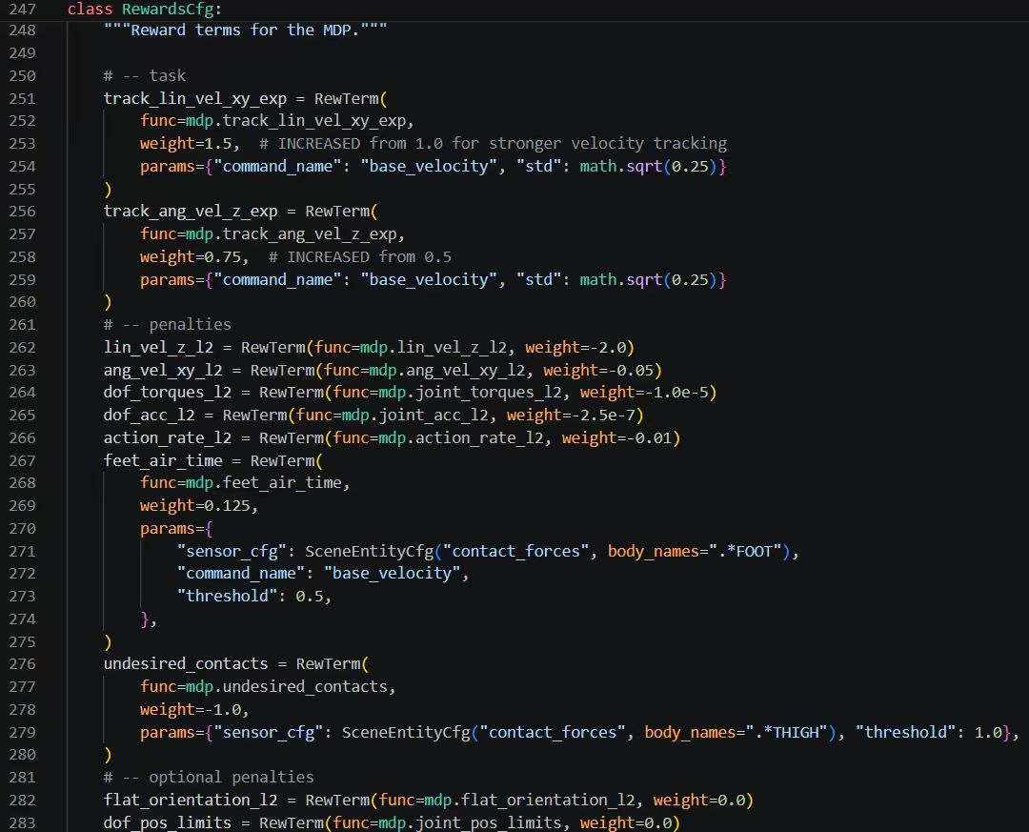
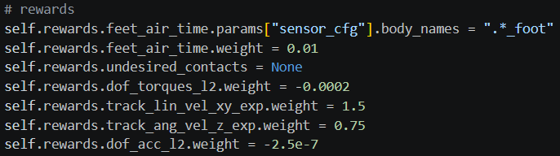

Technical Backup: Reward Shaping Configuration
The default locomotion reward terms were adjusted to prioritize velocity tracking, stable posture, gait rhythm, and lower effort.
Final reward overrides used for the tuned runs (rough terrain).
Reward terms in the locomotion MDP: tracking rewards, stability penalties, effort penalties, and foot air-time. (inside velocity environment configuration file)
Final reward overrides used for the tuned runs (flat terrain).
Summary: stronger tracking rewards encourage commanded motion; penalties discourage unstable vertical motion, excessive torque, and poor contact behavior.
Technical backup | Reward shaping changes from final configuration
15

Slide 16
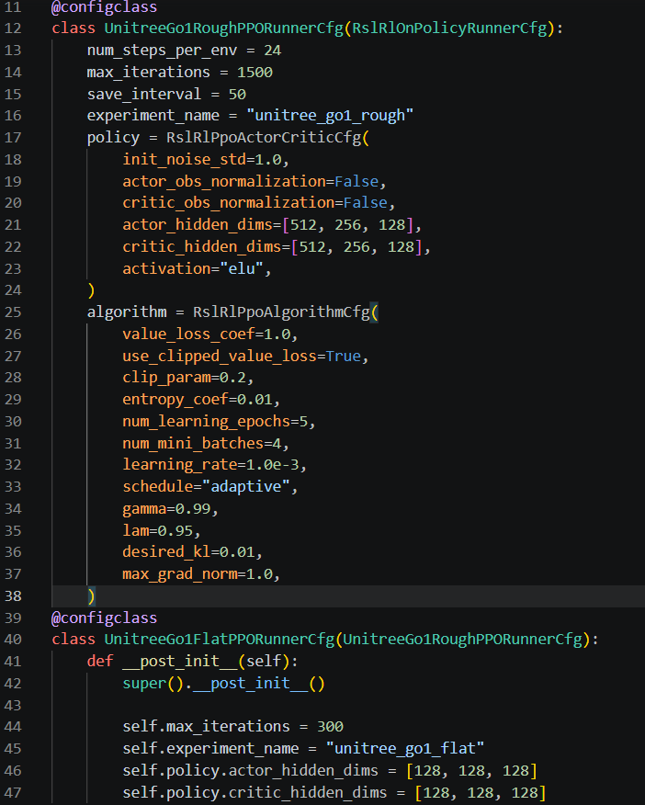
Technical Backup: Reward Shaping Configuration
The default locomotion reward terms were adjusted to prioritize velocity tracking, stable posture, gait rhythm, and lower effort.
Final reward overrides used for the tuned runs (rough terrain).
Final reward overrides used for the tuned runs (flat terrain).
PPO configuration
Technical backup | Reward shaping changes from final configuration
15

Slide 17
Technical Backup: training details (rough)
The default locomotion reward terms were adjusted to prioritize velocity tracking, stable posture, gait rhythm, and lower effort.
[INFO] Termination Manager: <TerminationManager> contains 2 active terms.
+---------------------------------+
| Active Termination Terms |
+-------+--------------+----------+
| Index | Name | Time Out |
+-------+--------------+----------+
| 0 | time_out | True |
| 1 | base_contact | False |
+-------+--------------+----------+
[INFO] Reward Manager: <RewardManager> contains 10 active terms.
+-----------------------------------------+
| Active Reward Terms |
+-------+----------------------+----------+
| Index | Name | Weight |
+-------+----------------------+----------+
| 0 | track_lin_vel_xy_exp | 1.5 |
| 1 | track_ang_vel_z_exp | 0.75 |
| 2 | lin_vel_z_l2 | -2.0 |
| 3 | ang_vel_xy_l2 | -0.05 |
| 4 | dof_torques_l2 | -0.0002 |
| 5 | dof_acc_l2 | -2.5e-07 |
| 6 | action_rate_l2 | -0.01 |
| 7 | feet_air_time | 0.01 |
| 8 | flat_orientation_l2 | 0.0 |
| 9 | dof_pos_limits | 0.0 |
+-------+----------------------+----------+
[INFO] Action Manager: <ActionManager> contains 1 active terms.
+------------------------------------+
| Active Action Terms (shape: 12) |
+--------+-------------+-------------+
| Index | Name | Dimension |
+--------+-------------+-------------+
| 0 | joint_pos | 12 |
+--------+-------------+-------------+
[INFO] Observation Manager: <ObservationManager> contains 1 groups.
+----------------------------------------------------------+
| Active Observation Terms in Group: 'policy' (shape: (235,)) |
+-----------+--------------------------------+-------------+
| Index | Name | Shape |
+-----------+--------------------------------+-------------+
| 0 | base_lin_vel | (3,) |
| 1 | base_ang_vel | (3,) |
| 2 | projected_gravity | (3,) |
| 3 | velocity_commands | (3,) |
| 4 | joint_pos | (12,) |
| 5 | joint_vel | (12,) |
| 6 | actions | (12,) |
| 7 | height_scan | (187,) |
+-----------+--------------------------------+-------------+
Technical backup | Reward shaping changes from final configuration
15

Slide 18
Technical Backup: training details (flat)
The default locomotion reward terms were adjusted to prioritize velocity tracking, stable posture, gait rhythm, and lower effort.
[INFO] Termination Manager: <TerminationManager> contains 2 active terms.
+---------------------------------+
| Active Termination Terms |
+-------+--------------+----------+
| Index | Name | Time Out |
+-------+--------------+----------+
| 0 | time_out | True |
| 1 | base_contact | False |
+-------+--------------+----------+
[INFO] Reward Manager: <RewardManager> contains 10 active terms.
+-----------------------------------------+
| Active Reward Terms |
+-------+----------------------+----------+
| Index | Name | Weight |
+-------+----------------------+----------+
| 0 | track_lin_vel_xy_exp | 1.5 |
| 1 | track_ang_vel_z_exp | 0.75 |
| 2 | lin_vel_z_l2 | -2.0 |
| 3 | ang_vel_xy_l2 | -0.05 |
| 4 | dof_torques_l2 | -0.0002 |
| 5 | dof_acc_l2 | -2.5e-07 |
| 6 | action_rate_l2 | -0.01 |
| 7 | feet_air_time | 0.25 |
| 8 | flat_orientation_l2 | -2.5 |
| 9 | dof_pos_limits | 0.0 |
+-------+----------------------+----------+
[INFO] Action Manager: <ActionManager> contains 1 active terms.
+------------------------------------+
| Active Action Terms (shape: 12) |
+--------+-------------+-------------+
| Index | Name | Dimension |
+--------+-------------+-------------+
| 0 | joint_pos | 12 |
+--------+-------------+-------------+
[INFO] Observation Manager: <ObservationManager> contains 1 groups.
+---------------------------------------------------------+
| Active Observation Terms in Group: 'policy' (shape: (48,)) |
+-----------+---------------------------------+-----------+
| Index | Name | Shape |
+-----------+---------------------------------+-----------+
| 0 | base_lin_vel | (3,) |
| 1 | base_ang_vel | (3,) |
| 2 | projected_gravity | (3,) |
| 3 | velocity_commands | (3,) |
| 4 | joint_pos | (12,) |
| 5 | joint_vel | (12,) |
| 6 | actions | (12,) |
+-----------+---------------------------------+-----------+
Technical backup | Reward shaping changes from final configuration
15

