Slide 1
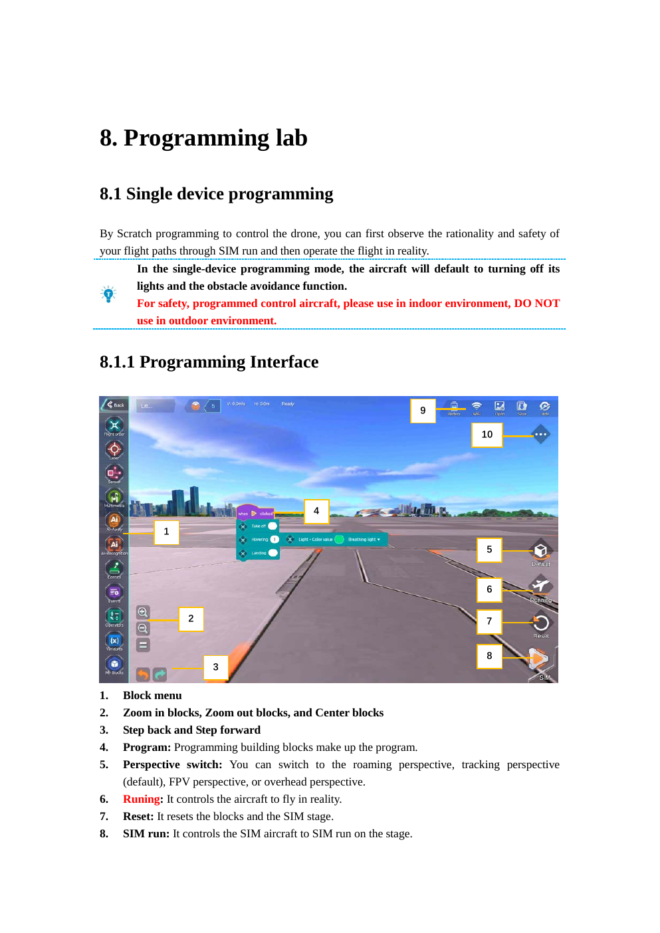
HULA DRONE TRAINING
Phase 2: Block Programming with AI
5-day high-level plan • zero programming background • progressive AI mission path
DAY 1
DAY 3
DAY 5
Blocks
Sensors
AI mission
Phase 2
Source: Hula User Manual, Rev. Jan 30, 2024

Slide 2
FROM PILOT TO AUTONOMOUS MISSION DESIGNER
The learning journey
Day 1
Day 2
Day 3
Day 4
Day 5
First program
Flight logic
Sensors
AI perception
Competition mission
•
Students start from drag-and-drop basics and safe simulation.
•
Each day adds one new capability and ends with a mission.
•
Final challenge combines flight, logic, sensors and AI recognition.
Phase 2
Source: Hula User Manual, Rev. Jan 30, 2024

Slide 3
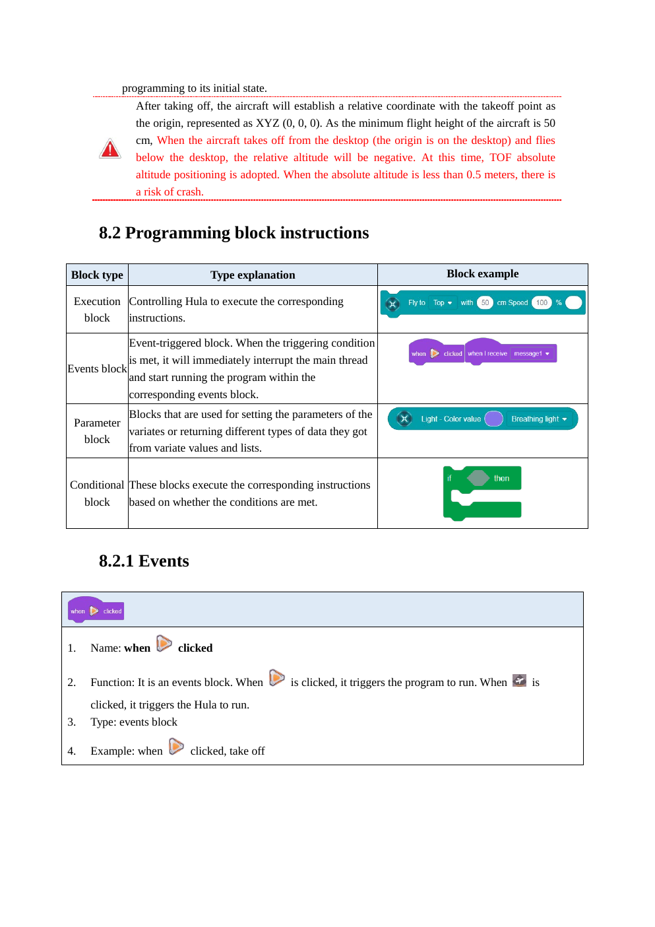
BY THE END OF 5 DAYS
Phase 2 learning outcomes
•
Build block programs using events, movement, waits and landing.
•
Use loops, conditions, variables and operators in mission logic.
•
Explain coordinates and safe programmed movement.
•
Use sensor feedback for simple autonomous behavior.
•
Use AI recognition blocks to respond to labels, QR codes, images, color and posture.
Phase 2
Source: Hula User Manual, Rev. Jan 30, 2024

Slide 4
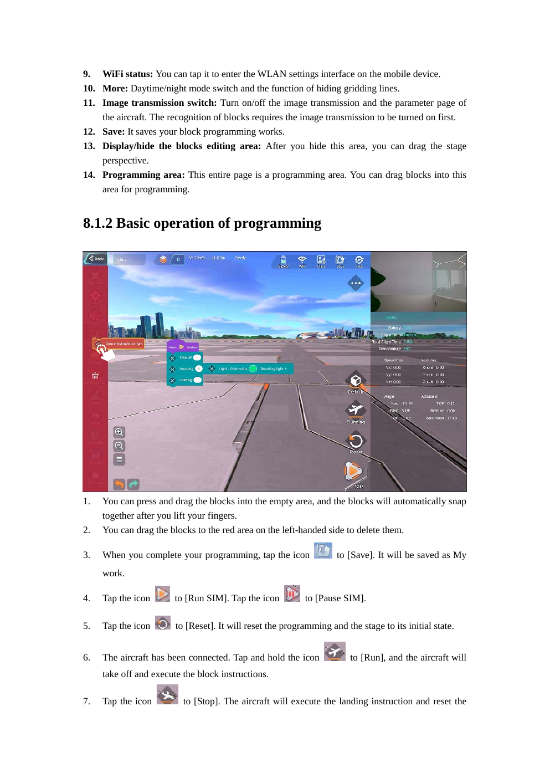
REQUIRED SAFETY ROUTINE
Programming workflow
1
2
3
4
5
Design
Simulate
Inspect
Fly
Improve
•
Hula Programming Lab supports SIM Run before the real aircraft flies.
•
Students must show the simulated path before pressing Run.
•
Teacher/spotter confirms flight area, battery and expected behavior.
Phase 2
Source: Hula User Manual, Rev. Jan 30, 2024

Slide 5
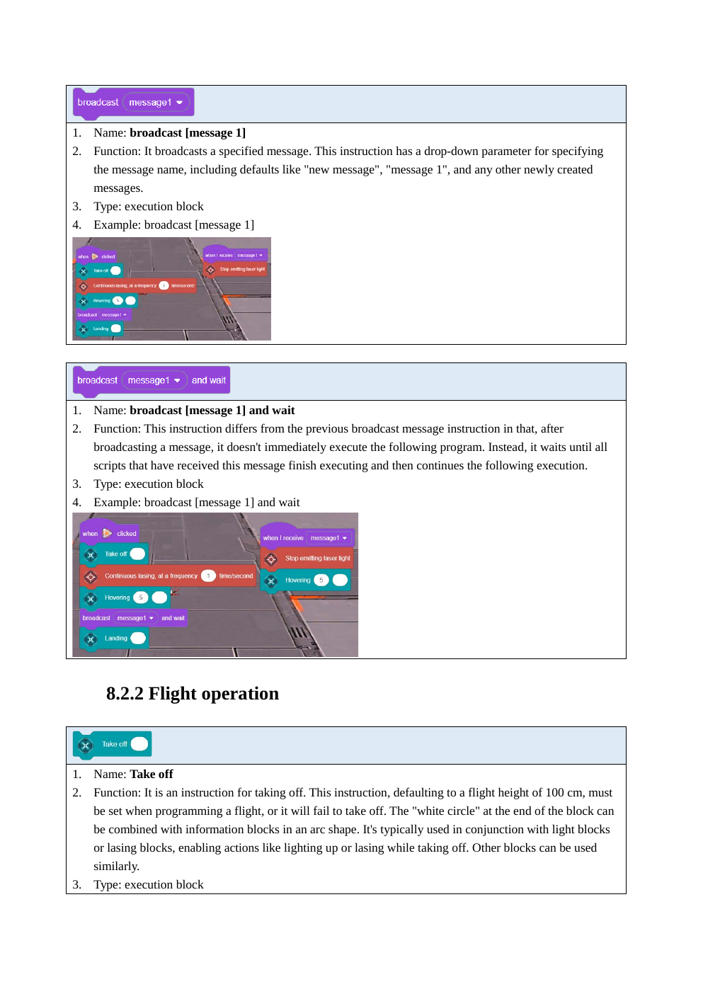
EVENTS, SEQUENCE AND SAFE LANDING
Day 1 — First block program
•
Concept: program = ordered instructions.
•
Blocks: when clicked, take off, hover, fly, turn, land.
•
Rule: every real flight program must include takeoff and landing.
•
Mission: takeoff → hover → move 50 cm → return → land.
Phase 2
Source: Hula User Manual, Rev. Jan 30, 2024

Slide 6
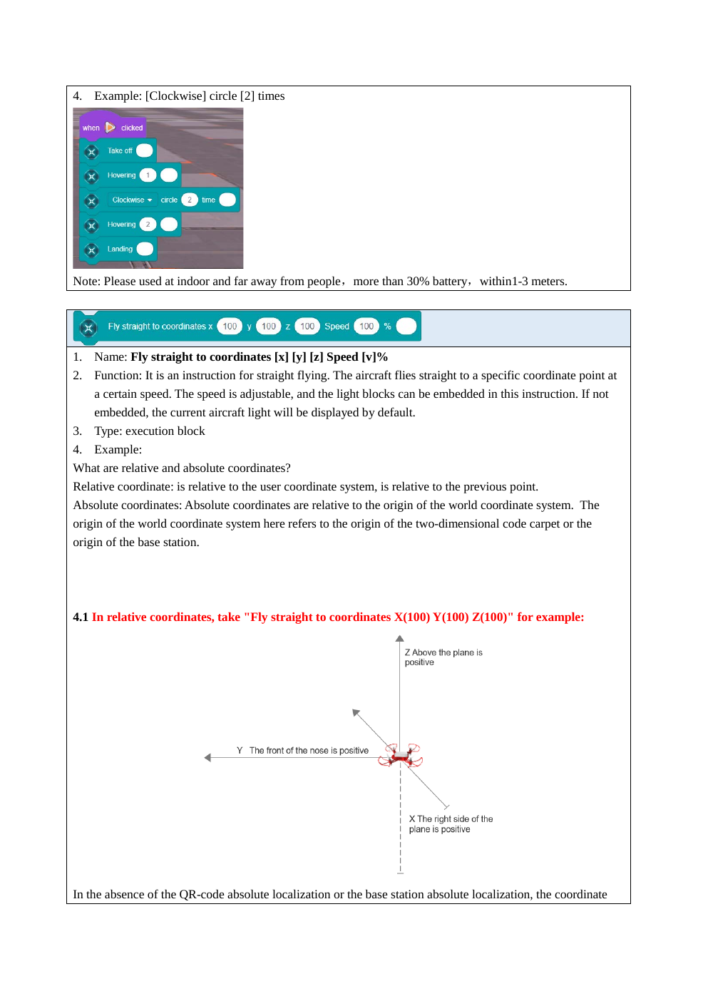
COORDINATES, LOOPS AND VARIABLES
Day 2 — Flight logic
•
Concepts: relative coordinates, speed, distance and repeat loops.
•
Blocks: fly to direction, fly to coordinates, repeat, operators, variables.
•
Mission: program a square, then improve it using a loop.
•
Stretch: use variables to count repeated movements.
Phase 2
Source: Hula User Manual, Rev. Jan 30, 2024

Slide 7
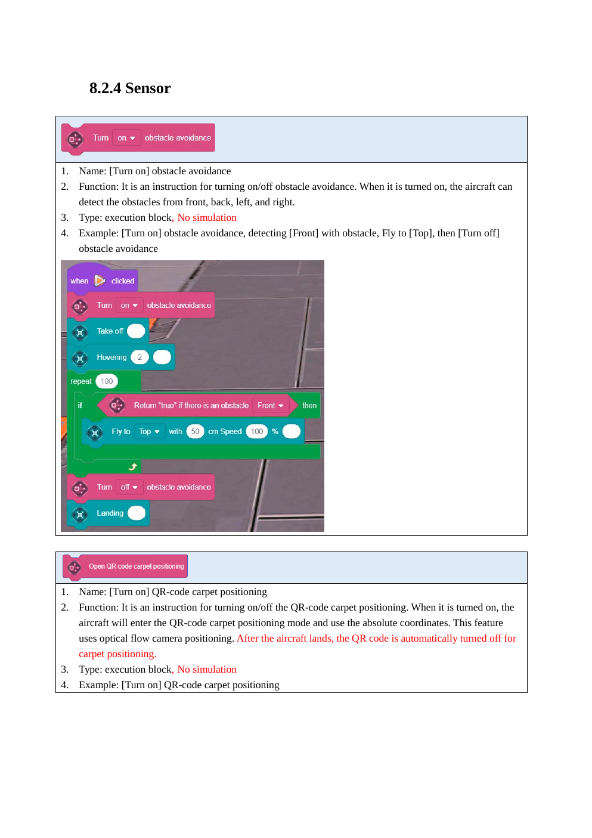
DRONE REACTS TO THE WORLD
Day 3 — Sensors and safe autonomy
•
Concept: sensor input → decision → drone action.
•
Blocks: obstacle avoidance on/off, obstacle detected, battery level, ToF height.
•
Logic: if / else, wait until, repeat until.
•
Mission: patrol forward and react safely when an obstacle appears.
Phase 2
Source: Hula User Manual, Rev. Jan 30, 2024

Slide 8
PERCEPTION → DECISION → ACTION
AI without the math
Camera / sensor input
AI recognition
Program decision
Drone action
•
AI recognition can fail if lighting, distance, background or target visibility is poor.
•
Students learn to test, debug and improve recognition conditions.
•
They also learn that AI output must be handled safely by program logic.
Phase 2
Source: Hula User Manual, Rev. Jan 30, 2024

Slide 9
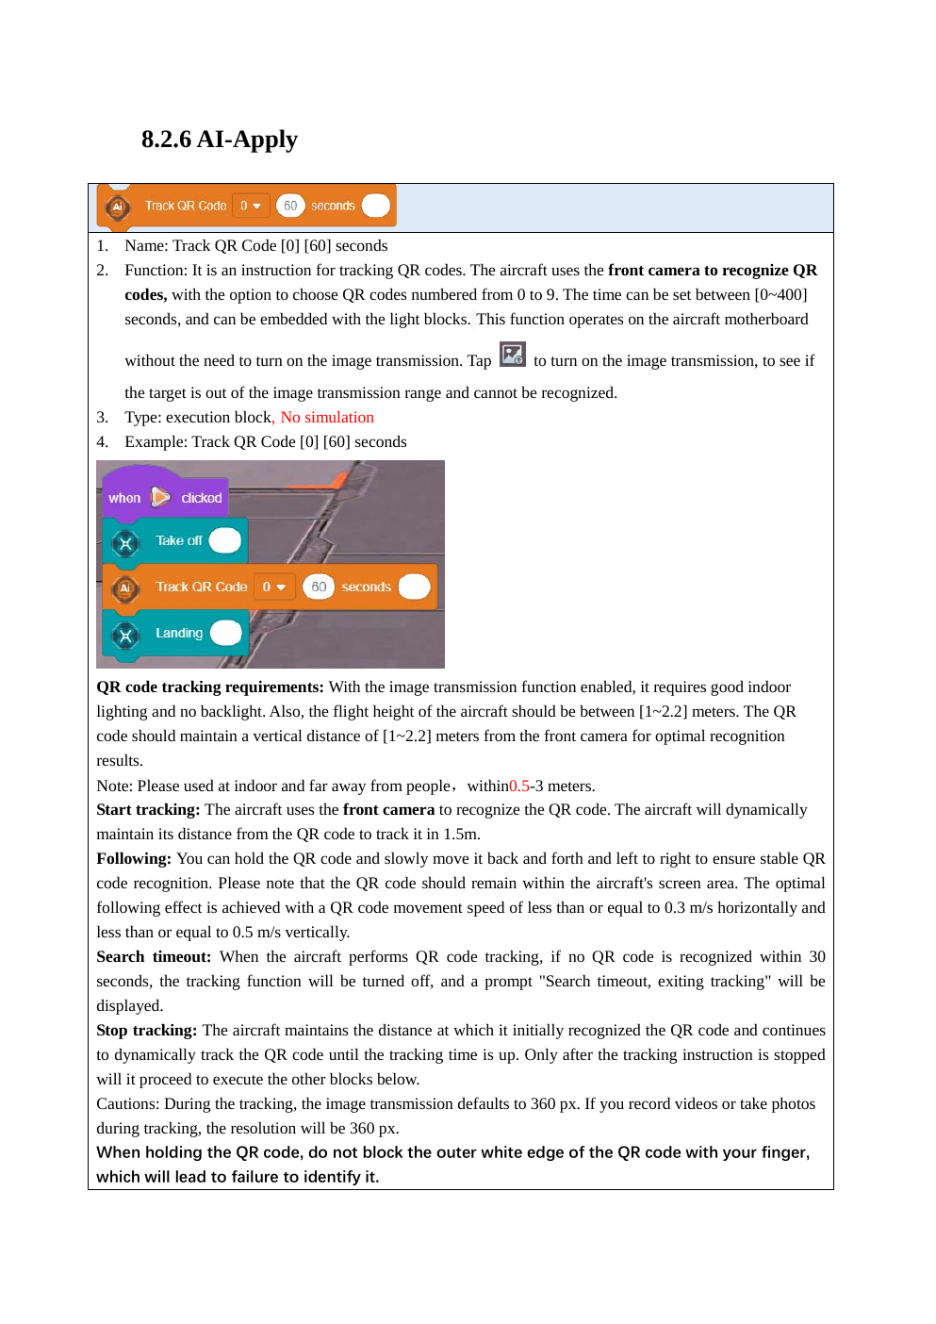
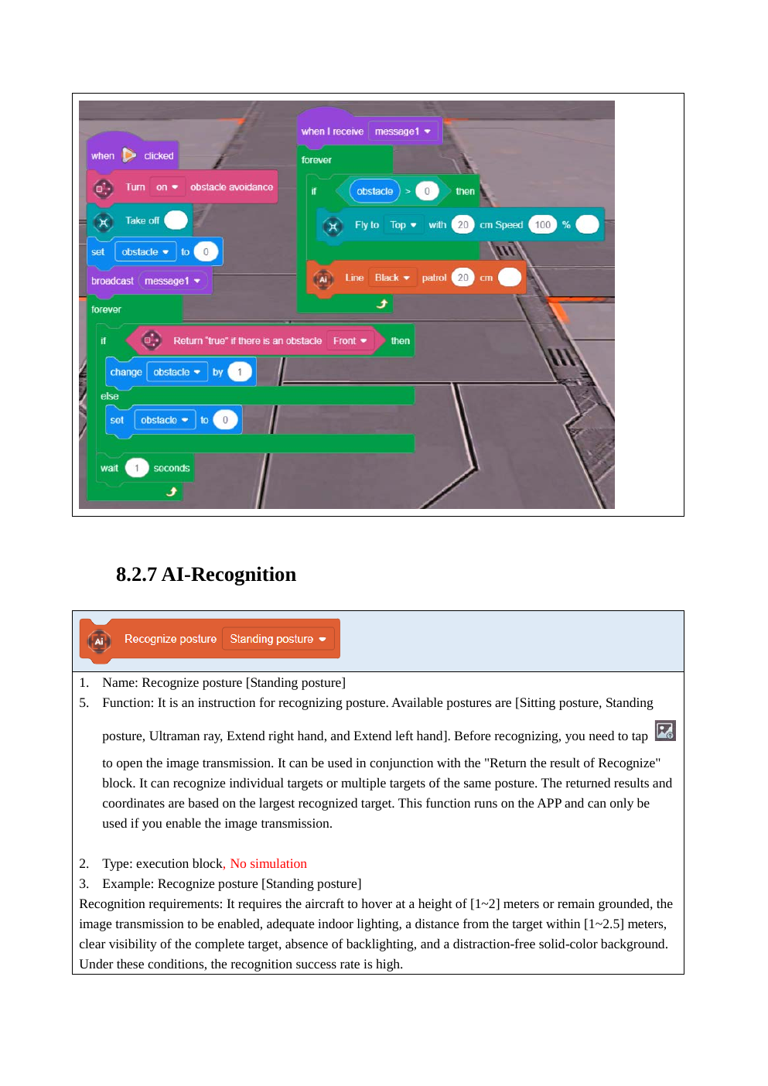
RECOGNITION AND AI-DRIVEN ACTION
Day 4 — Hula AI blocks
•
QR tracking: follow a QR code target for a set time.
•
Line patrol: follow high-contrast floor routes.
•
Recognition: posture, labels, images, QR codes and color.
•
Mission: recognize a target and perform the correct response.
Phase 2
Source: Hula User Manual, Rev. Jan 30, 2024

Slide 10
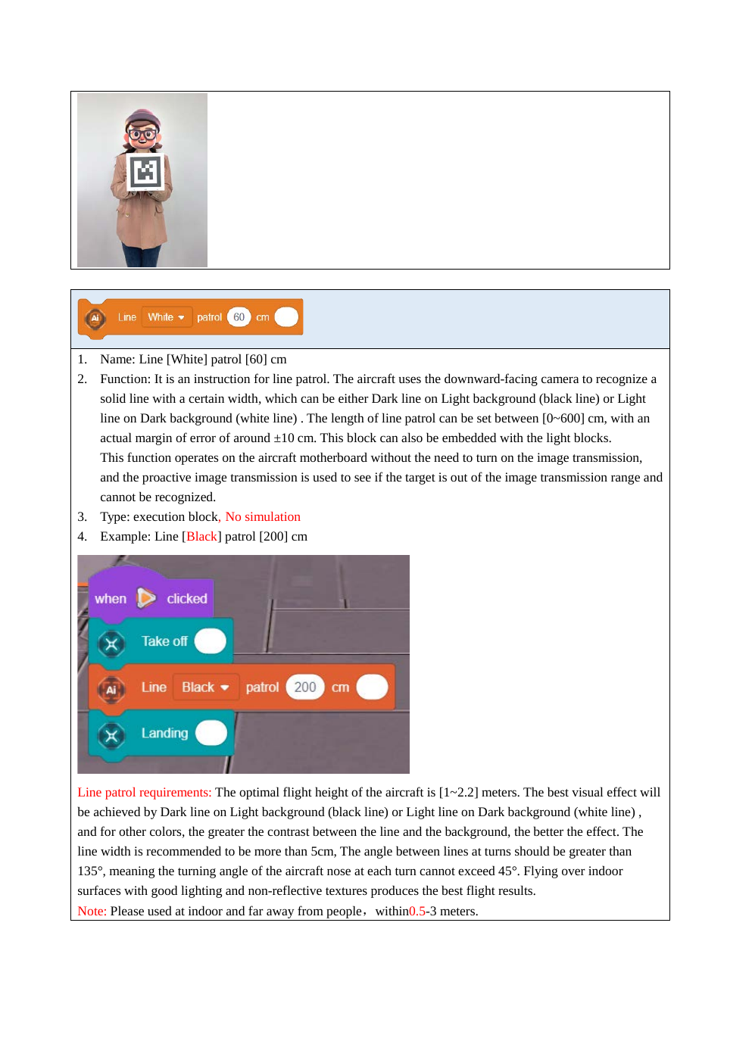
DAILY BUILD TOWARD THE FINAL COMPETITION
Mission progression
M1
M2
M3
M4
M5
First programmed flight
Square route
Obstacle reaction
AI target response
Autonomous challenge
•
Each mission is attempted in simulation first.
•
Teams document the block logic and what changed after testing.
•
Difficulty increases by combining prior concepts, not by adding more lecture.
Phase 2
Source: Hula User Manual, Rev. Jan 30, 2024

Slide 11
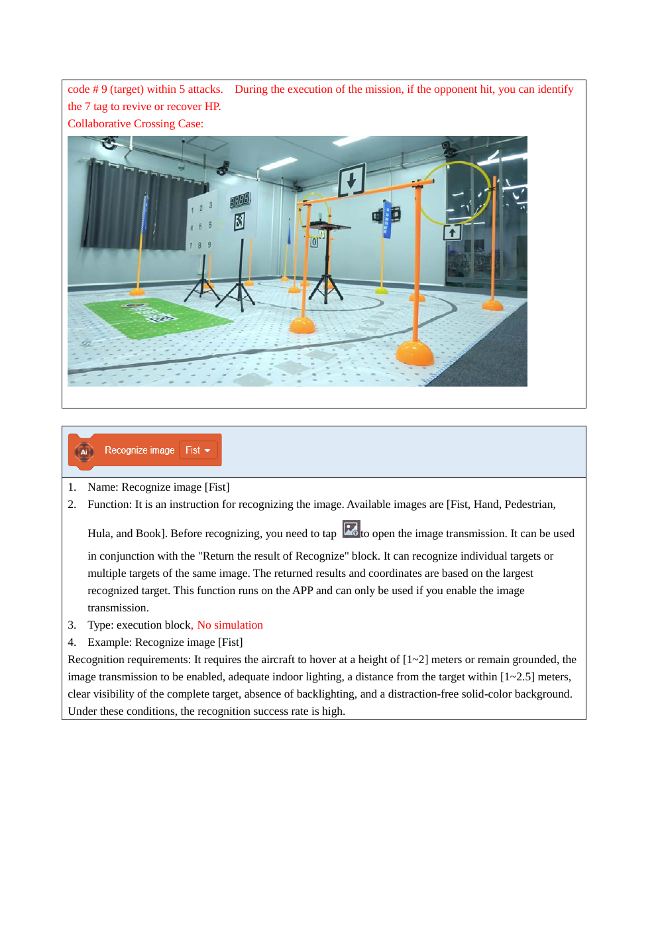
COMPETITION DESIGN
Day 5 — Final AI drone mission
•
Teams design a mission route with at least one AI trigger.
•
Example: follow line → recognize label → rotate → shoot laser → land safely.
•
Teams present: objective, block logic, safety checks and testing results.
•
Competition emphasizes reliability, not only speed.
Phase 2
Source: Hula User Manual, Rev. Jan 30, 2024

Slide 12
FOR THE FOLLOW-ON EVENT
Competition scoring framework
25%
20%
20%
15%
10%
10%
Safety
Program logic
Mission success
AI use
Debugging
Teamwork
•
Suggested format: qualification run + final run.
•
Disqualification: unsafe laser use, ignoring stop command, or flying outside the zone.
•
Deliverables: working program, short explanation, and team reflection.
Phase 2
Source: Hula User Manual, Rev. Jan 30, 2024

Slide 13
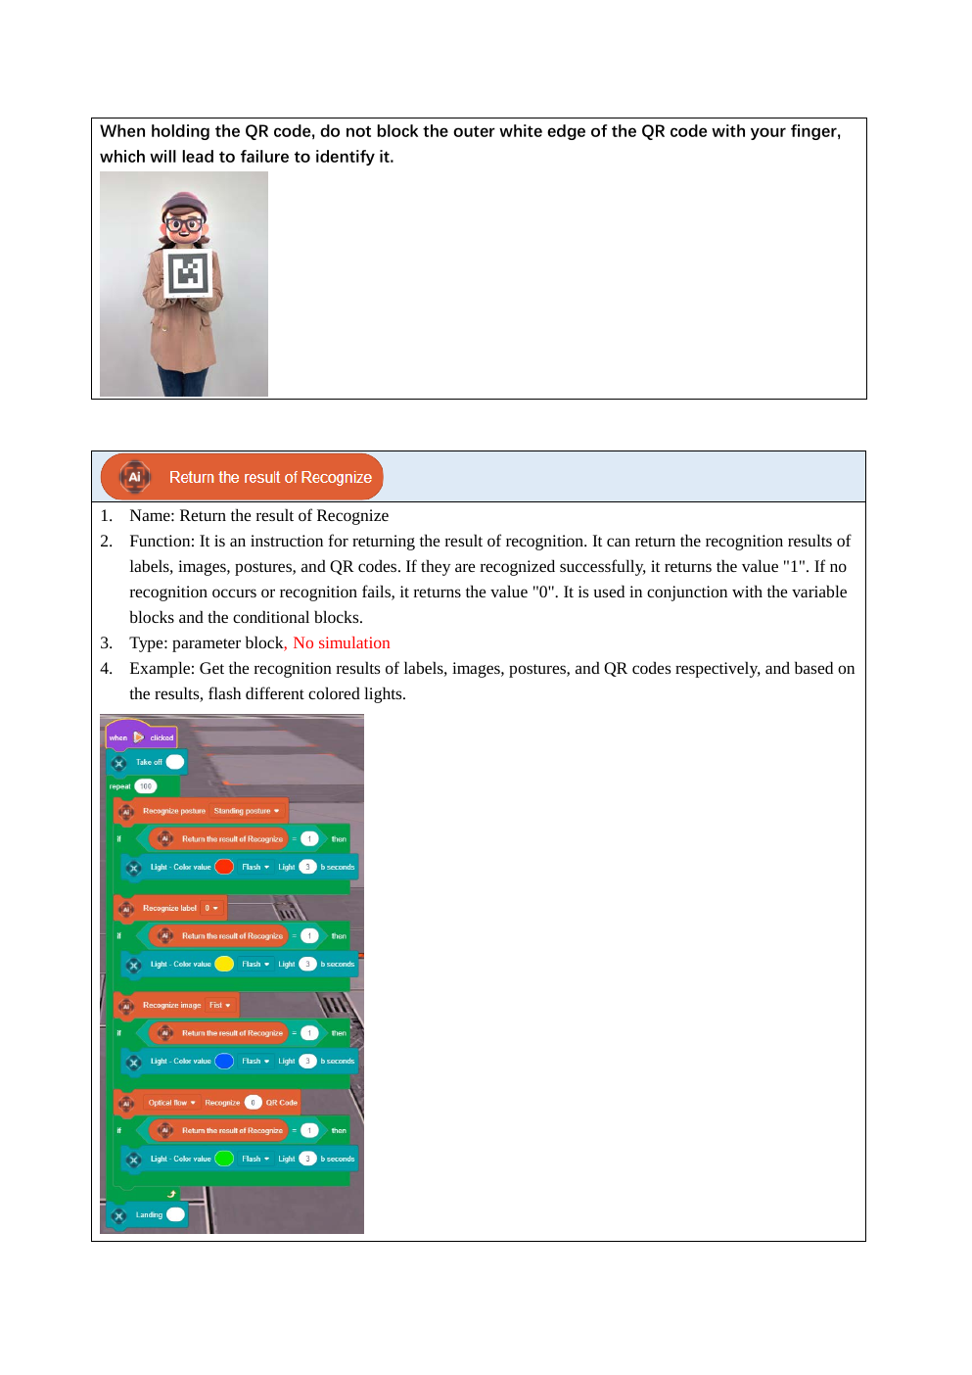
AFTER YOUR APPROVAL
Next development step
•
Convert this high-level plan into full instructor slides.
•
Create student handouts and mission sheets.
•
Prepare safety briefing, checklists and scoring rubrics.
•
Add screenshots of the exact app version and your laser hardware setup.
Phase 2
Source: Hula User Manual, Rev. Jan 30, 2024

