Slide 1
HULA DRONE TRAINING
Phase 3: Python Programming with Hula
my_first_mission.py
from hula_sdk import HulaDrone
with HulaDrone("192.168.1.62") as drone:
print("Battery:", drone.battery())
drone.takeoff()
for side in range(4):
drone.forward(50)
drone.turn_right(90)
drone.land()
5-day high-level plan • grades 6–10 • from drag-and-drop blocks to real Python code
DAY 1
DAY 3
DAY 5
Python basics
First flight
Code mission
Real Python. Real drone. Your code.
Phase 3
Sources: Hula User Manual, Rev. Jan 30, 2024 · hula-sdk README
Notes:
Phase 3 moves students from Phase 2's drag-and-drop blocks to typed Python code, using the hula-sdk library to fly the same Hula drone. Target audience: grades 6-10, no prior text-coding experience assumed. The code on the right is what students will be able to write and explain by Day 3.

Slide 2
FROM BLOCK CODER TO PYTHON PROGRAMMER
The learning journey
Day 1
Day 2
Day 3
Day 4
Day 5
Python basics
Logic & loops
First code flight
Sensors
Code mission
print, variables, math
if / else, loops, functions, bugs
connect, move, turn, shapes
battery, height, obstacles
plan, code, fly, present
ON THE LAPTOP — no drone needed
IN THE AIR — same Python ideas, now flying
Days 1–2 build Python skills on screen, where mistakes are free and instant.
Days 3–5 use those exact skills to fly, sense and react with the real drone.
Every day ends with a short mission and a “show your code” moment.
Phase 3
Sources: Hula User Manual, Rev. Jan 30, 2024 · hula-sdk README
Notes:
Keep the drones in their cases for the first two days. Students who try to fly before they understand loops and indentation spend the session debugging in the air, which is slow and unsafe. The laptop days are also where the fastest students can run ahead with extra challenges.

Slide 3
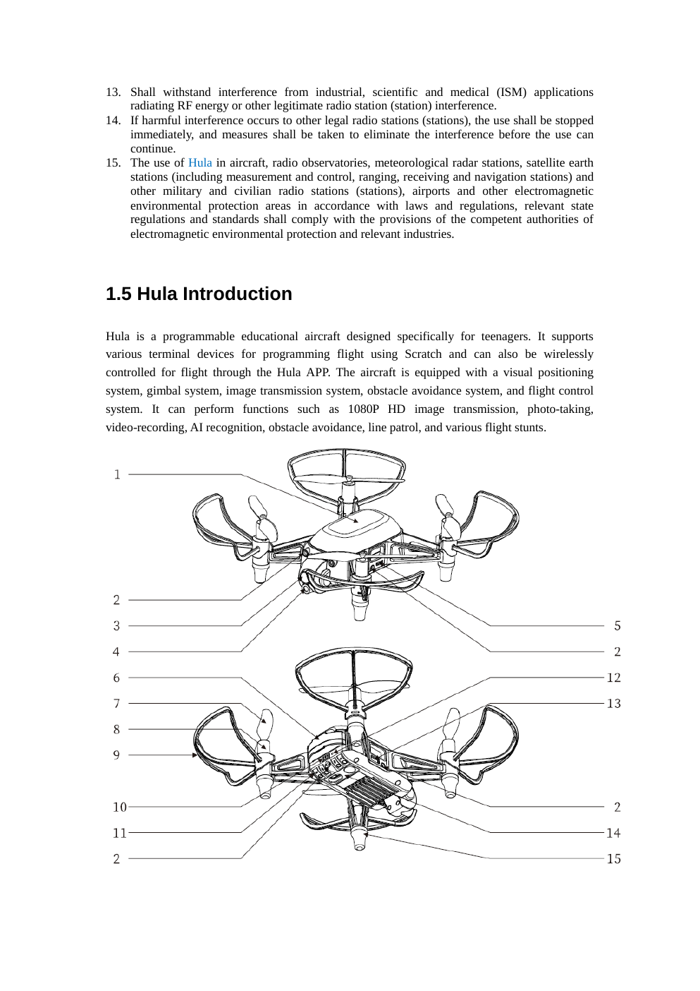
BY THE END OF 5 DAYS
Phase 3 learning outcomes
Write and run Python programs using print, variables and math.
Make decisions with if / elif / else and repeat actions with loops.
Package steps into reusable functions.
Read error messages and fix bugs calmly and methodically.
Fly the Hula with Python: take off, move, turn, hover and land safely.
Use sensor readings (battery, height, obstacles) to make the drone react.
Phase 3
Sources: Hula User Manual, Rev. Jan 30, 2024 · hula-sdk README
Notes:
These outcomes map directly onto the Day 5 scoring rubric: every team's final program must use a variable, a loop, a function and an if statement.

Slide 4
SAME IDEAS, NEW LANGUAGE
Blocks vs. Python
PHASE 2 · BLOCKS
PHASE 3 · PYTHON
when program starts
square.py
take off
drone.takeoff()
for i in range(4):
drone.forward(50)
drone.turn_right(90)
drone.land()
repeat 4 times
fly forward 50 cm
turn right 90°
Each block becomes one line of text — same logic, new form.
Indentation (4 spaces) shows what is inside the loop, like the block’s C-shape.
Python is what real engineers use for robots, games, science and AI.
land
Phase 3
Sources: Hula User Manual, Rev. Jan 30, 2024 · hula-sdk README
Notes:
Put a Phase 2 block program on screen next to this slide if you can. Ask students to match each block to its Python line. The key new idea is that the indentation replaces the C-shaped repeat block: anything indented under 'for' is inside the loop.

Slide 5
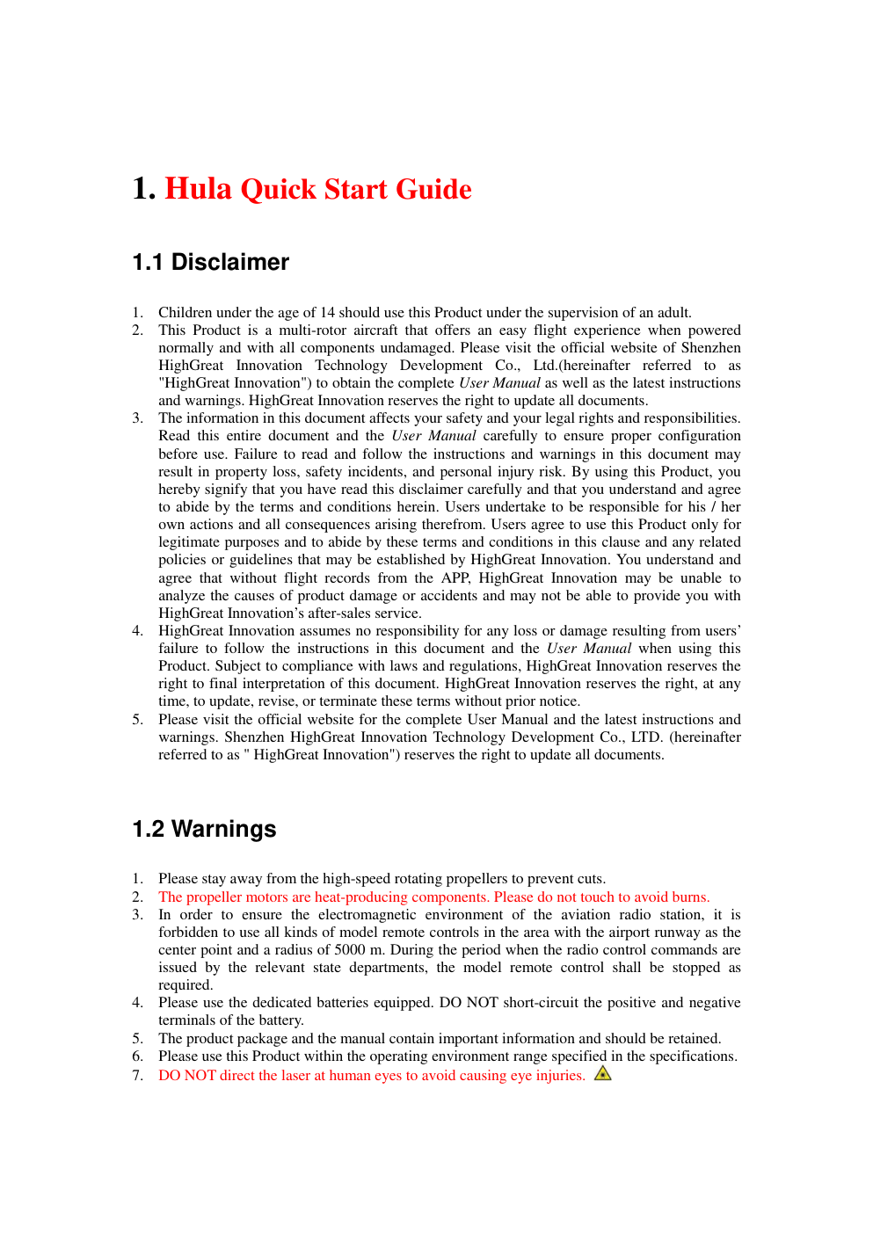
REQUIRED SAFETY ROUTINE
Code safely, fly safely
1
2
3
4
5
Plan
Write
Trace
Fly
Improve
Plan: draw the flight path on paper before typing any code.
Trace: read the code out loud while the spotter follows the path with a finger.
Battery: fly only above 30%. Below 10% the drone’s software force-quits your program.
Every flight program ends with drone.land().
Safety net: inside with HulaDrone(...), a crash or Ctrl+C makes the drone land.
Spotter can call STOP at any time — the pilot presses Ctrl+C immediately.
Phase 3
Sources: Hula User Manual, Rev. Jan 30, 2024 · hula-sdk README
Notes:
The hula-sdk 'with' block lands the drone automatically if the program raises an error or is interrupted with Ctrl+C while airborne. That is why every drone program in this phase uses 'with HulaDrone(...) as drone:'. Low battery is a real hazard: under 10% the vendor library ends the Python process outright instead of raising an error, so the auto-land cannot help. Keep flights above 30%. Same Phase 1 rules still apply: 2 m from people, good lighting, textured floor. The manual page shown is the Hula disclaimer: children under 14 must use the drone under adult supervision, so every flying team needs an adult present.

Slide 6
DAY 1 · YOUR FIRST PROGRAM
print() — make the computer talk
A program is a list of instructions the computer runs from top to bottom.
print() shows a message on the screen.
Text goes inside quotes: "like this". Numbers don’t need quotes.
Lines starting with # are comments: notes for humans that Python skips.
hello.py
# My first Python program
print("Hello, Hula!")
print("Ready for takeoff in...")
print(3)
print(2)
print(1)
print("Liftoff!")
OUTPUT
Hello, Hula!
Ready for takeoff in...
3
2
1
Liftoff!
TRY IT
Print your team name, then a countdown from 5 down to “Liftoff!”
Phase 3
Sources: Hula User Manual, Rev. Jan 30, 2024 · hula-sdk README
Notes:
Have every student type this, not copy-paste it. Typing is where they discover that quotes and brackets must match. Common first bug: using curly 'smart quotes' pasted from a document; Python only accepts straight quotes.

Slide 7
DAY 1 · VARIABLES
Variables — labeled boxes for data
str · text
int · whole number
variables.py
"Falcon"
50
drone_name = "Falcon"
distance = 50 # centimeters
hover_time = 3.5 # seconds
is_flying = False
print("Drone:", drone_name)
print("Distance:", distance, "cm")
always inside quotes
counting, distances
float · decimal
bool · yes / no
3.5
True
seconds, measurements
only True or False
OUTPUT
Drone: Falcon
Distance: 50 cm
= means “put this value in the box” — it is not “equals” like in math.
Good names: distance, hover_time. No spaces, and don’t start with a number.
Phase 3
Sources: Hula User Manual, Rev. Jan 30, 2024 · hula-sdk README
Notes:
Analogy: a variable is a labeled box. The label is the name; what's inside is the value; you can swap the contents any time. Ask: what happens if we write distance = 80 on a new line and print again? (The box now holds 80.) Point out that print() with commas adds spaces automatically.

Slide 8
DAY 1 · MATH IN PYTHON
Operators — Python is a super calculator
add
subtract
multiply
divide
whole divide
remainder
+
-
*
/
//
%
math.py
PREDICT THE OUTPUT
side = 60
perimeter = side * 4
print("Square path:", perimeter, "cm")
sides = 6
turn = 360 // sides
print("Each turn:", turn, "degrees")
1
print(10 + 5 * 2)
2
print(7 // 2, 7 % 2)
3
print("50" + "50")
OUTPUT
Square path: 240 cm
Each turn: 60 degrees
Vote first, then run it. Answers are in the speaker notes.
Phase 3
Sources: Hula User Manual, Rev. Jan 30, 2024 · hula-sdk README
Notes:
Answers: (1) 20 — multiplication happens before addition, like in math class. (2) 3 1 — 7 // 2 is 3 whole times, remainder 1. (3) 5050 — the quotes make them text, and + glues text together instead of adding. This third one sets up the TypeError bug on the debugging slide. Note: we use // for the turn angle because the drone expects whole-number degrees.

Slide 9
DAY 2 · DECISIONS
if / elif / else — the drone’s brain
decide.py
COMPARISON OPERATORS
battery = 45
if battery > 50:
print("Full mission!")
elif battery > 30:
print("Short mission only")
else:
print("Charge me first")
==
!=
>
equal to
not equal
greater than
<
>=
<=
less than
at least
at most
The colon : opens a block; the indented lines (4 spaces) belong to it.
Python checks from the top and runs only the first branch that is true.
Careful: = stores a value, == compares two values.
TRY IT: set battery to 20, then 60. Predict each result before you run it.
Phase 3
Sources: Hula User Manual, Rev. Jan 30, 2024 · hula-sdk README
Notes:
Act it out: one student is the 'battery', holds up a number; the class shouts which branch runs. With battery = 45: 45 > 50 is False, 45 > 30 is True, so it prints 'Short mission only' and skips the else. This exact battery check becomes the first lines of the Day 4 patrol program.

Slide 10
DAY 2 · LOOPS
Loops — repeat without retyping
for — repeat a set number of times
while — repeat while something is true
for_loop.py
while_loop.py
for i in range(4):
print("Side", i + 1)
print("Square done!")
countdown = 3
while countdown > 0:
print(countdown)
countdown = countdown - 1
print("Liftoff!")
OUTPUT
Side 1
Side 2
Side 3
Side 4
Square done!
OUTPUT
3
2
1
Liftoff!
range(4) counts 0, 1, 2, 3 — computers start counting at 0.
A while loop must change something, or it runs forever. (Stuck? Press Ctrl+C.)
Phase 3
Sources: Hula User Manual, Rev. Jan 30, 2024 · hula-sdk README
Notes:
Challenge ladder: (1) print the 7 times table with a for loop; (2) change the countdown to start at 10; (3) what happens if you delete 'countdown = countdown - 1'? Let them see an infinite loop once, on the laptop, and stop it with Ctrl+C. Much better to learn that now than with a drone in the air.

Slide 11
DAY 2 · FUNCTIONS
Functions — teach Python a new word
functions.py
INPUTS side = 50, sides = 4
def greet(pilot):
print("Welcome aboard,", pilot)
def perimeter(side, sides):
return side * sides
greet("Maya")
print(perimeter(50, 4)) # 200
perimeter()
RETURNS 200
OUTPUT
Welcome aboard, Maya
200
def creates a function; the names in ( ) are its inputs.
return hands an answer back to whoever asked.
Write it once, use it forever — soon your drone moves become functions.
Phase 3
Sources: Hula User Manual, Rev. Jan 30, 2024 · hula-sdk README
Notes:
Analogy: a function is a recipe card. def writes the recipe; calling perimeter(50, 4) is cooking it with specific ingredients. greet() does something (prints); perimeter() gives something back (return). Tomorrow, students will write polygon(drone, sides, length) using exactly this idea.

Slide 12
DAY 2 · DEBUGGING
Bugs happen — become a bug hunter
SyntaxError forgot the colon
IndentationError block not indented
✗ if battery > 50
✗ if battery > 50:
print("Go!")
✓ if battery > 50:
✓ if battery > 50:
print("Go!")
NameError typo in a name
TypeError mixing text and numbers
✗ print(distnace)
✗ print("Distance: " + 50)
✓ print(distance)
✓ print("Distance:", 50)
Bug-hunter tip: read the LAST line of the error first — it names the problem and the line number.
Phase 3
Sources: Hula User Manual, Rev. Jan 30, 2024 · hula-sdk README
Notes:
Game: 'Bug Bounty'. Give each team a short broken program (one bug of each type). First team to fix all four and explain each error message wins. Celebrate bugs found; a team bug log starts today and is part of the Day 5 score.

Slide 13
DAY 3 · MEET HulaDrone
Connecting Python to the drone
hello_drone.py
1
import
from hula_sdk import HulaDrone
DRONE_IP = "192.168.1.62" # from your teacher
with HulaDrone(DRONE_IP) as drone:
print("Battery:", drone.battery(), "%")
print("Drone ID:", drone.plane_id())
Borrow the drone toolbox from the hula_sdk library.
2
DRONE_IP
The drone’s address on the classroom Wi-Fi. Solid green light = connected.
3
with … as drone:
OUTPUT
Battery: 87 %
Drone ID: 1
Connect and call it drone. If anything crashes, it lands by itself.
Nothing flies yet — this program only asks questions. A perfect first test.
4
drone.battery()
The dot means “ask this drone”. The ( ) runs the command.
Phase 3
Sources: Hula User Manual, Rev. Jan 30, 2024 · hula-sdk README
Notes:
Each team gets its drone's IP address on a card (see the instructor checklist at the end). The drone must be in networking mode on the classroom Wi-Fi: solid green light. Run this with the drone on the floor. If it fails to connect, check the IP and the light before touching the code. The output numbers shown are examples.

Slide 14
DAY 3 · COMMAND CHEAT SHEET
Drone commands you can use
TAKE OFF & LAND
MOVE (centimeters)
TURN & WAIT
ASK THE DRONE
takeoff()
forward(50) back(50)
turn_left(90)
battery()
Rise to about 1 m and hover
Fly 50 cm ahead or behind
Rotate 90° to the left
Charge left, 0–100
land()
left(30) right(30)
turn_right(90)
tof_height()
Land right where it is
Slide sideways 30 cm
Rotate 90° to the right
Height reading from the floor sensor
with HulaDrone(ip) as drone:
up(20) down(20)
hover(3)
coordinate()
Connect; auto-land on a crash
Climb or drop 20 cm
Stay still for 3 seconds
(x, y, z) in cm from takeoff
obstacles()
Something ahead, behind or beside?
Every command starts with drone. e.g. drone.forward(50). Tricks like circle(), spin() and flip() need teacher approval first.
Phase 3
Sources: Hula User Manual, Rev. Jan 30, 2024 · hula-sdk README
Notes:
Print this slide as a handout for every team. All commands listed here have been verified against real Hula hardware with hula-sdk. Movement distances are in centimeters and turns in degrees. Keep tricks (circle, spin, flip, fly_to) for teams that have shown safe, reliable flights, and only with extra clear space.

Slide 15
DAY 3 · FIRST CODE FLIGHT
Mission 1 — out and back
mission1.py
TOP-DOWN VIEW
from hula_sdk import HulaDrone
with HulaDrone("192.168.1.62") as drone:
drone.takeoff()
drone.hover(2)
drone.forward(50)
drone.hover(2)
drone.back(50)
drone.land()
50 cm ahead
forward(50)
back(50)
Distances are in centimeters; turns are in degrees.
Commands run in order — each one finishes before the next starts.
H
CHALLENGE
Fly an L-shape. Then build an “elevator” with up() and down().
takeoff + land here
Phase 3
Sources: Hula User Manual, Rev. Jan 30, 2024 · hula-sdk README
Notes:
Before this flight: team does Plan and Trace (slide 5). The pilot runs the program, the spotter stands ready to call STOP. hover(2) gives everyone time to see each step. L-shape answer idea: forward(50), turn_right(90), forward(50) — or forward(50), right(50) without turning. Ask which one keeps the camera facing forward.

Slide 16
DAY 3 · LOOPS + FLIGHT
Shapes in the sky
shapes.py
from hula_sdk import HulaDrone
DRONE_IP = "192.168.1.62"
def polygon(drone, sides, length):
turn = 360 // sides
for i in range(sides):
drone.forward(length)
drone.turn_right(turn)
with HulaDrone(DRONE_IP) as drone:
drone.takeoff()
polygon(drone, 4, 50) # a square!
drone.land()
3 sides · 120°
4 sides · 90°
6 sides · 60°
polygon(drone, 3, 60) → triangle
polygon(drone, 4, 50) → square
polygon(drone, 6, 40) → hexagon
Math + loop + function = any shape. Turn angle = 360 ÷ sides.
CHALLENGE
Predict, then fly: polygon(drone, 8, 30). How far does the drone travel in total?
Phase 3
Sources: Hula User Manual, Rev. Jan 30, 2024 · hula-sdk README
Notes:
This is the payoff slide for Days 1-2: variables, math (// for whole degrees), a for loop and a function in one program that flies. Octagon answer: 8 x 30 = 240 cm total. Check the room: a hexagon with 40 cm sides needs roughly a 1 m clear circle plus the 2 m safety distance from people.

Slide 17
DAY 4 · SENSE → DECIDE → ACT
Sensors: the drone answers questions
Sensor reading
Python decides (if / else)
Drone action
battery()
tof_height()
coordinate()
obstacles()
attitude()
0–100 (%)
height from the floor
(x, y, z) cm from takeoff
{'forward': True, …}
(yaw, pitch, roll) in °
Too low? Don’t take off.
Too high? Go down.
How far have I gone?
Wall ahead? Turn.
Which way am I facing?
Sensors turn the real world into numbers that your code can compare.
Test on the ground first: hold a hand in front of the drone and print(drone.obstacles()).
Sensors can be wrong (bad light, shiny floor) — good code plans for that.
Phase 3
Sources: Hula User Manual, Rev. Jan 30, 2024 · hula-sdk README
Notes:
Warm-up: in pairs, write a program that prints every sensor value 5 times, one second apart (import time; time.sleep(1)), while the drone sits on the floor. Move it by hand and watch coordinate() and obstacles() change. This builds trust in the readings before any flight uses them.

Slide 18
DAY 4 · REACTING SAFELY
Mission 4 — obstacle patrol
patrol.py
1
Check first
from hula_sdk import HulaDrone
with HulaDrone("192.168.1.62") as drone:
if drone.battery() < 30:
print("Battery too low - charge first!")
else:
drone.takeoff()
for step in range(5):
blocked = drone.obstacles()
if blocked["forward"]:
print("Wall ahead! Turning.")
drone.turn_right(90)
else:
drone.forward(30)
drone.land()
No takeoff on a low battery.
2
Loop 5 times
Each step: look, then move.
3
Ask
obstacles() gives a dictionary; blocked["forward"] reads one answer.
4
Decide
Wall ahead? Turn. Clear? Move 30 cm.
CHALLENGE
5
Always land
Count how many turns the drone made, and print the total after landing.
land() sits outside the loop, so it runs once at the end.
Phase 3
Sources: Hula User Manual, Rev. Jan 30, 2024 · hula-sdk README
Notes:
Set up a cardboard wall about 1 m ahead of the takeoff point. Before flying, check on the ground that obstacles()['forward'] really turns True with the wall in front (see previous slide); sensor range depends on the surface and lighting. Challenge answer: create turns = 0 before the loop, add turns = turns + 1 inside the if, print(turns) after land().

Slide 19
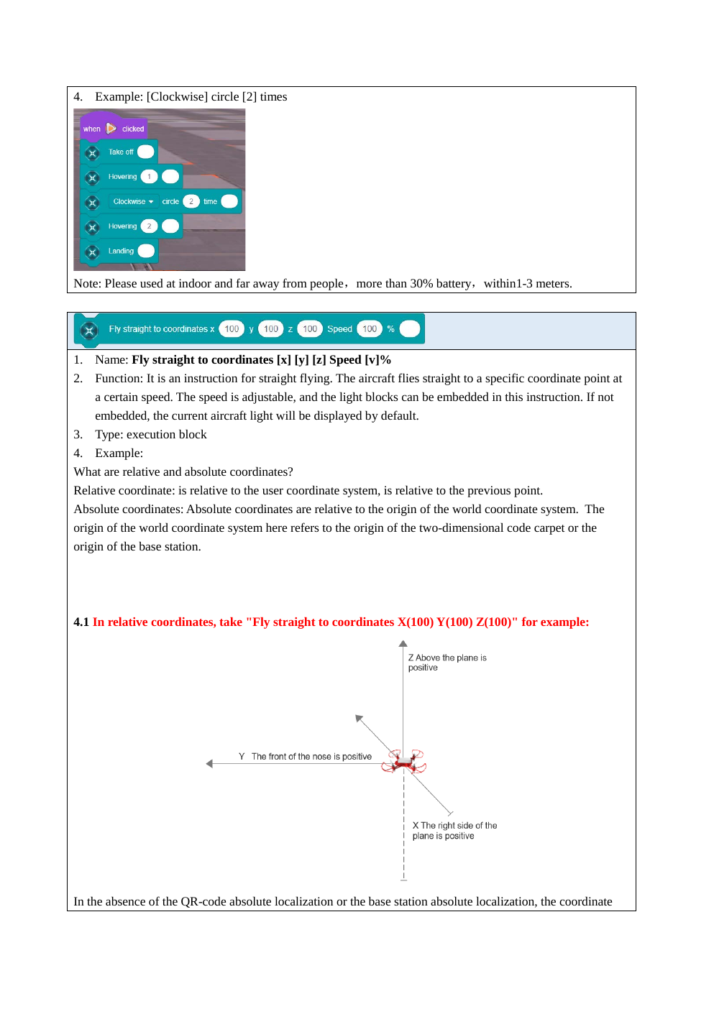
DAILY BUILD TOWARD THE FINAL MISSION
Mission progression
M1
M2
M3
M4
M5
Out and back
Shape function
Waypoint route
Obstacle patrol
Final mission
first commands
loop + function + math
a list of distances
sensors + if / else
everything together
Every mission reuses code from the one before — nothing is thrown away.
Teams keep a bug log: what broke, why, and how they fixed it.
Missions get harder by combining ideas, not by adding more lecture.
M3 idea: route = [50, 30, 50] — loop through the list, turning 90° between legs.
Phase 3
Sources: Hula User Manual, Rev. Jan 30, 2024 · hula-sdk README
Notes:
M3 introduces lists as 'many values in one variable': for distance in route: drone.forward(distance); drone.turn_right(90). Stronger teams can add a second list of turn angles. The manual page on the right shows the drone's coordinate system, useful for teams who want to check position with coordinate().

Slide 20
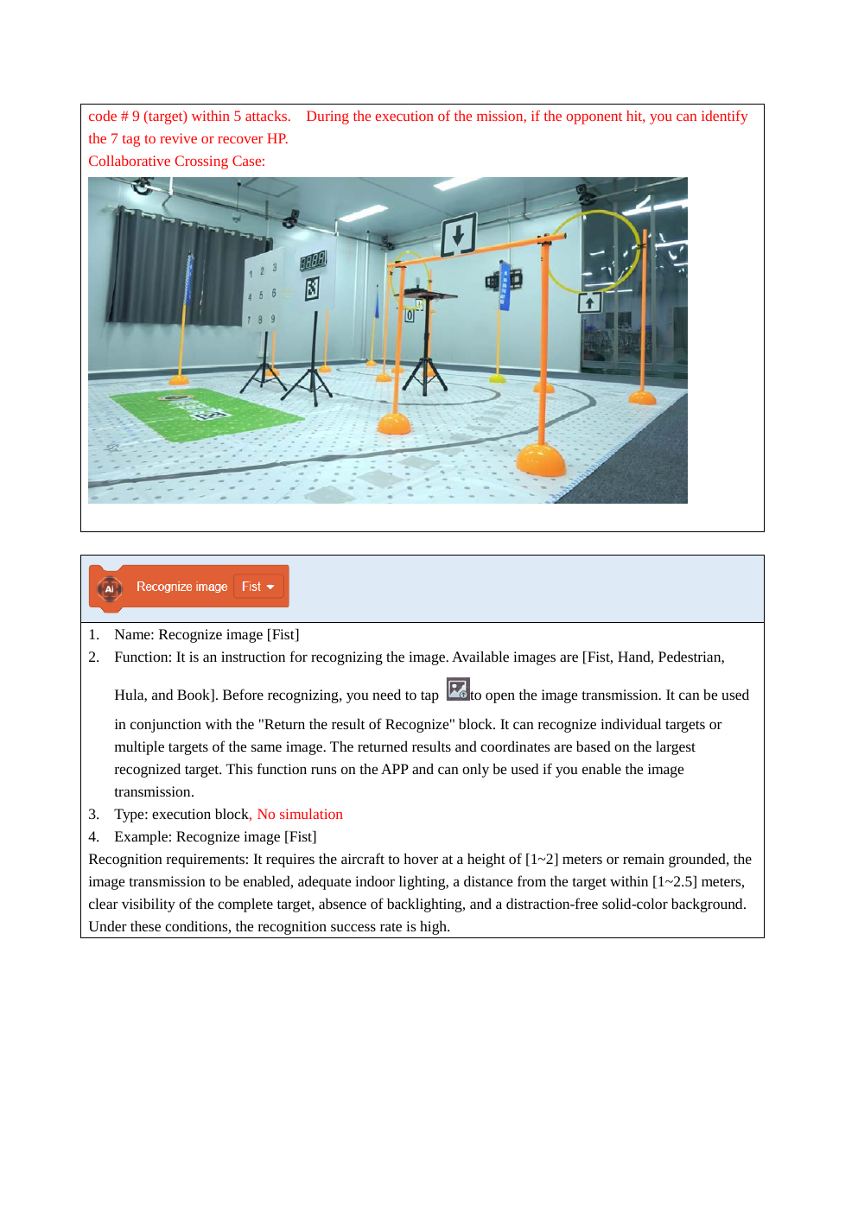
COMPETITION DESIGN
Day 5 — Final Python mission
YOUR PROGRAM MUST USE
✓ a variable
✓ a loop
✓ a function
✓ an if
Teams design their own route and write one Python program to fly it.
Safety: battery check before takeoff, land() at the end, stay in the zone.
Example: check battery → take off → hexagon → obstacle patrol → land.
Teams present their plan, their code and one bug they fixed.
Reliability beats speed: the program must work two runs in a row.
Phase 3
Sources: Hula User Manual, Rev. Jan 30, 2024 · hula-sdk README
Notes:
Give teams the morning to plan and code, with laptop-only trace runs, and the afternoon for flights and presentations. Teams that finish early can add a trick (circle or spin) with teacher approval, or use coordinate() to prove how far the drone flew.

Slide 21
FOR THE FINAL EVENT
Mission scoring framework
25%
20%
20%
15%
10%
10%
Safety
Mission success
Code quality
Python concepts
Bug log
Teamwork
Format: practice run + final run; the best score counts.
Disqualified: a program with no land(), ignoring a STOP call, or flying outside the zone.
Code quality: clear variable names, helpful comments, and a function the team wrote.
Deliverables: the .py file, a 1-minute code walkthrough, and the team’s bug log.
Phase 3
Sources: Hula User Manual, Rev. Jan 30, 2024 · hula-sdk README
Notes:
Python concepts (15%): full marks for using all four required concepts correctly; bonus judgment for lists or sensor-based decisions. Bug log (10%): at least three entries with what broke, why, and the fix. Safety remains the largest single category, as in Phases 1 and 2.

Slide 22
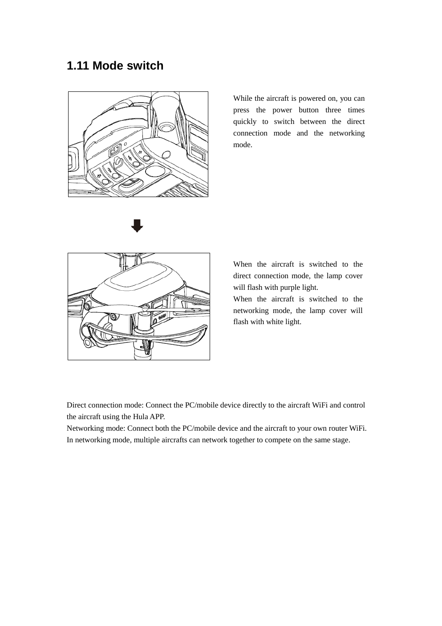
BEFORE CLASS
Instructor setup checklist
Laptops: Windows with Python 3.6 and hula-sdk installed (pip install -e . in the repo).
Days 1–2 need no drone: any Python 3 editor works for the basics.
Each drone activated in the Hula phone app and joined to the classroom Wi-Fi.
Networking mode: triple-press power; solid green light = on the router.
Label each drone with its IP address from the router’s client list.
Run examples/connect_and_read_telemetry.py for every drone — it connects without flying.
Charge all batteries; fly only above 30%.
Phase 3
Sources: Hula User Manual, Rev. Jan 30, 2024 · hula-sdk README
Notes:
Full details are in the hula-sdk README 'Before you start' section. Python 3.6 specifically is required by the vendor's pyhula library. The drone's own direct-connection hotspot (purple light) does not work with hula-sdk; it must be on a router in networking mode. Reserve each drone's IP on the router (static DHCP) so the labels stay correct after a router reboot.

