Slide 1
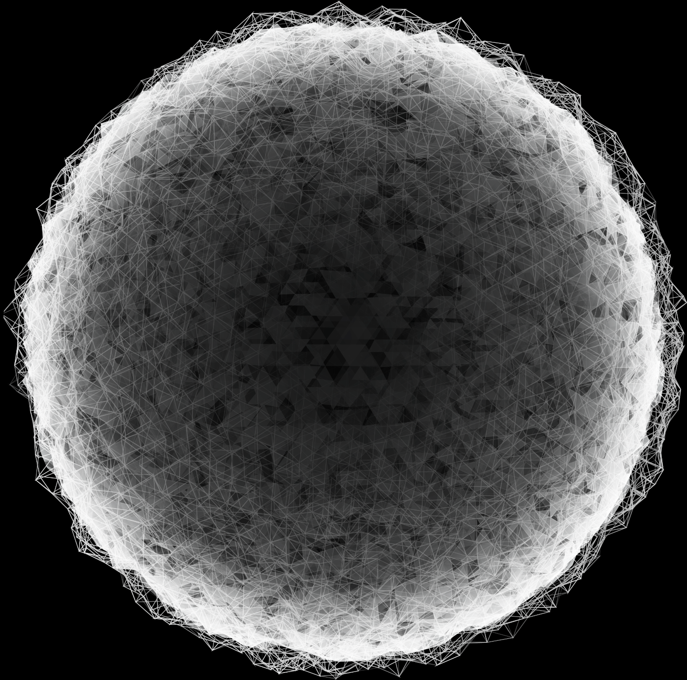

AI Alliance Drone Challenge

Slide 2
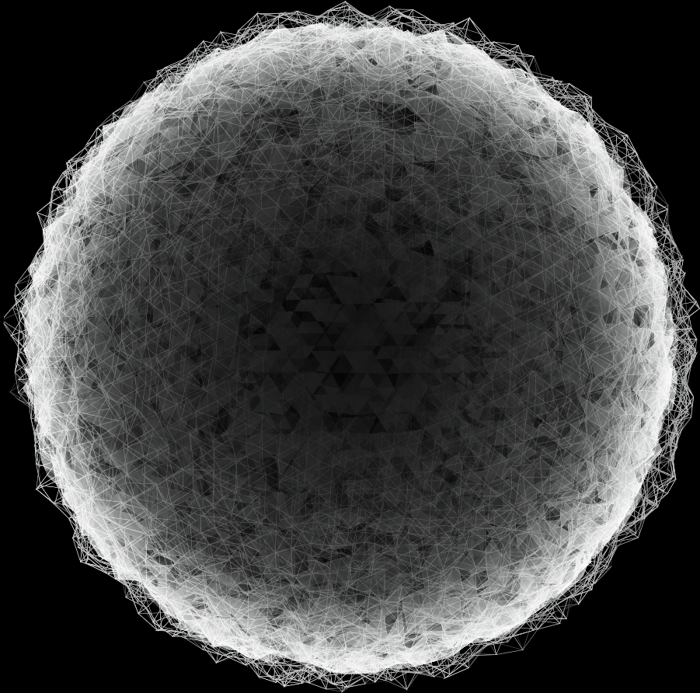
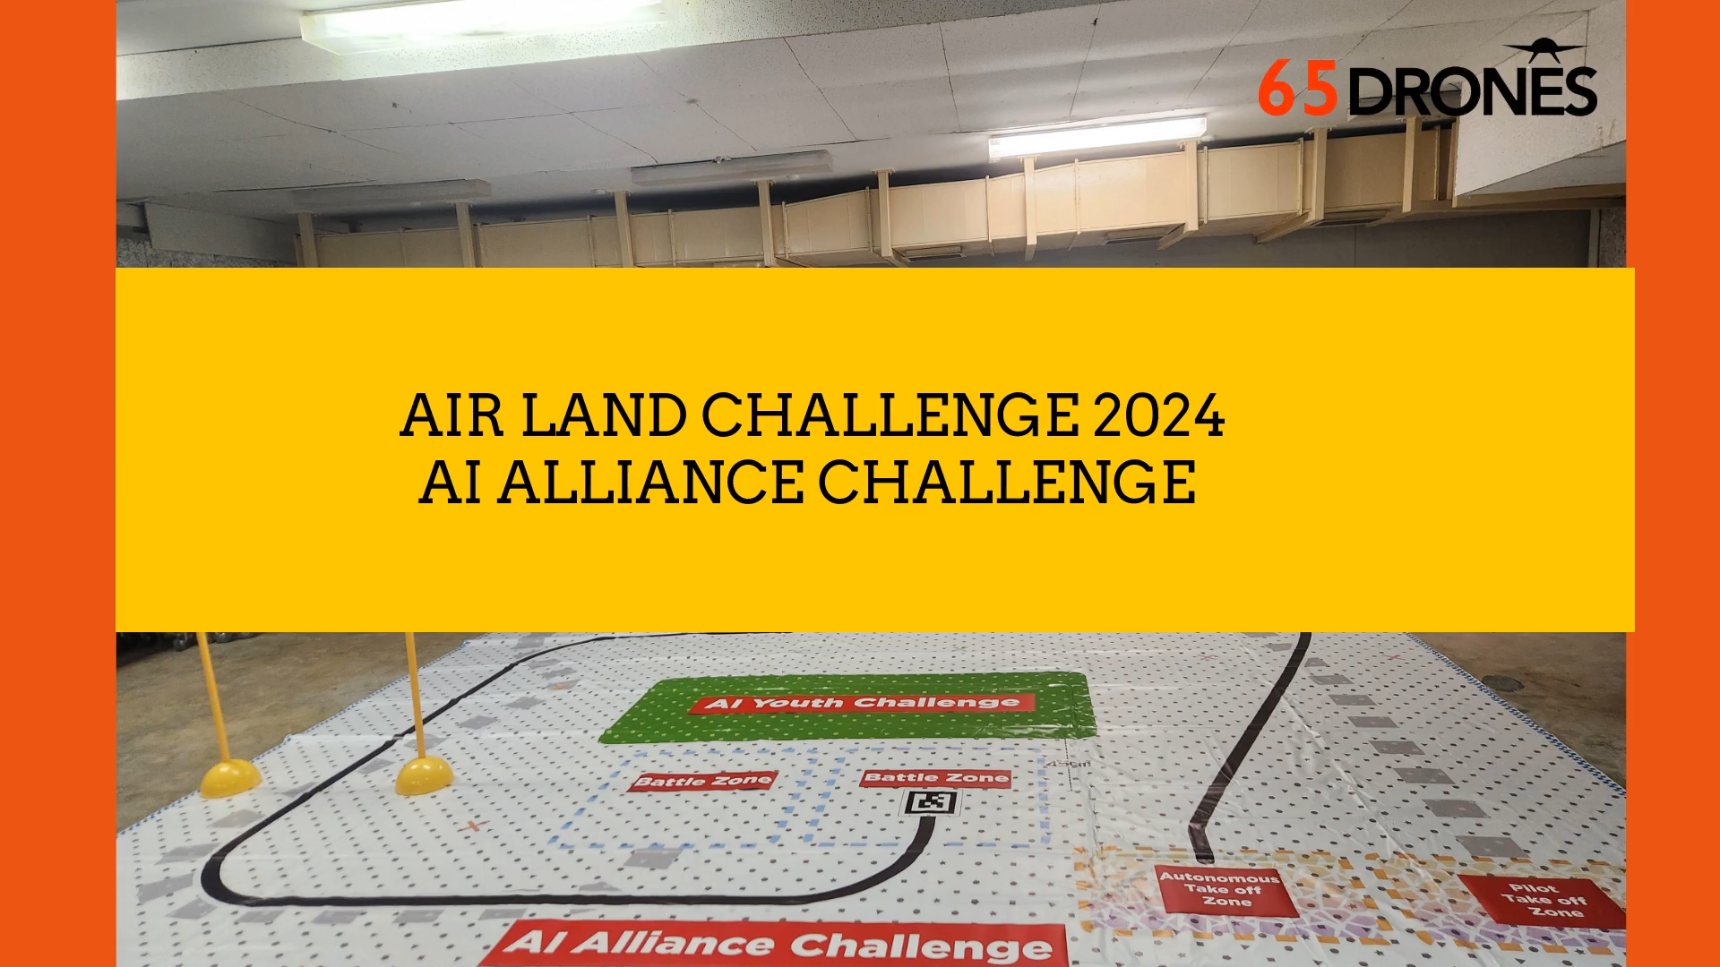
COMPETITION WALKTHROUGH
https://youtu.be/ardb--gxc2Q://youtu.be/ardb--gxc2Q
All right reserved. 65Drones Pte Ltd. No distribution or use without permission from 65Drones Pte Ltd.

Slide 3
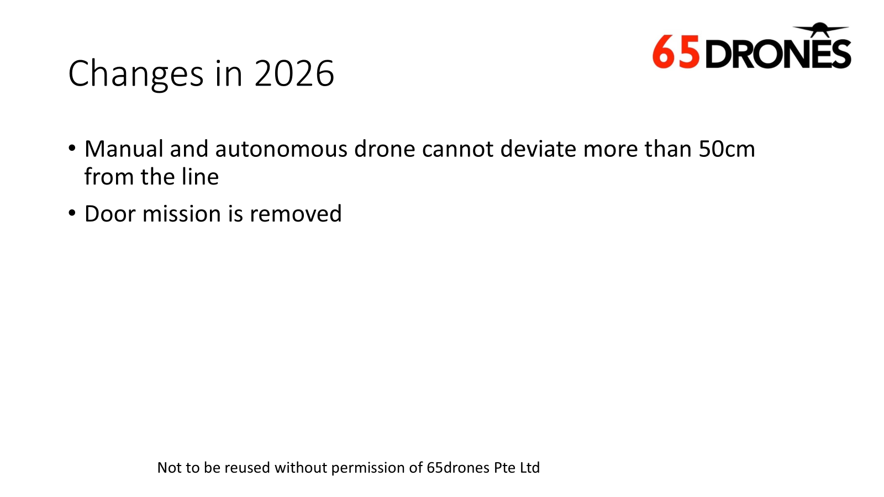
1
COMPETITION FLOW
2
MISSIONS
MENU
3
RESTART
4
INSTRUCTIONS
5
RANK
All right reserved. 65Drones Pte Ltd. No distribution or use without permission from 65Drones Pte Ltd.

Slide 4
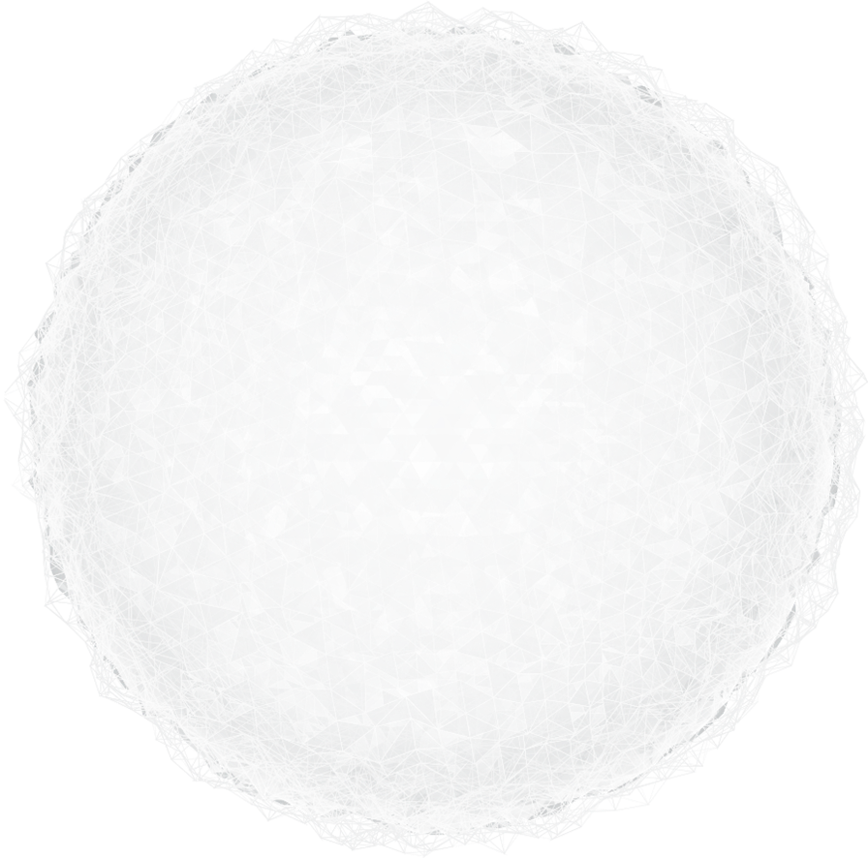
01
COMPETITION FLOW
All right reserved. 65Drones Pte Ltd. No distribution or use without permission from 65Drones Pte Ltd.

Slide 5
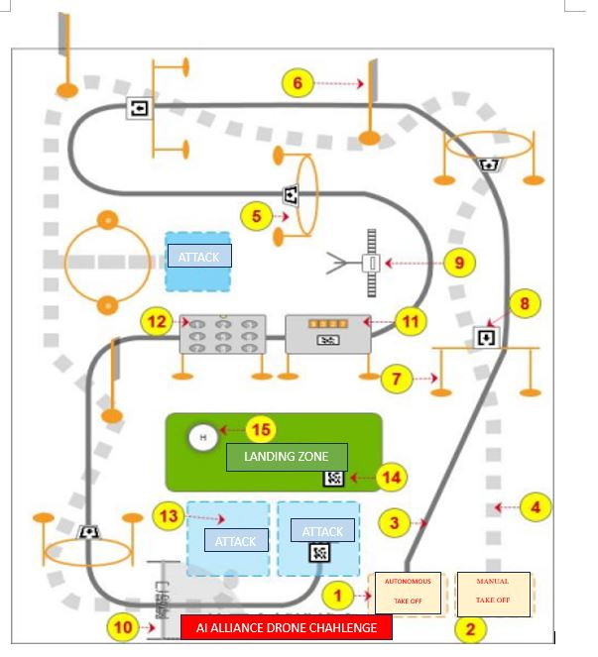
AI ALLIANCE DRONE CHALLENGE
SUMMARY
MANUAL DRONE：Take off at “ Manual take off zone” pad ( at 2) and follow dotted line as flight path and move through different obstacles to reach to the 1st attack zone ( at 9) to fire accurately at moving target board to open the “ door” ( at 10)
1
AUTONOMOUS DRONE：Take off at “ Autonomous take off zone” pad ( at 1)and follow thick line as flight path, identify different directions and move through different obstacles to reach to the attack zone
2
AI ALLIANCE：Manual drone must shoot moving target board accurately ( at 9) to open door ( at 10)in order to enable both manual and autonomous drones to move through.
( At 13) , the autonomous drone must shoot the QR code ( at 11) to activate 4 numbers.
The manual drone must shoot the 4 numbers ( at 12).
3
LANDING：both manual and autonomous drone must land at landing zone ( at 15 and 14 respectively).
4
All right reserved. 65Drones Pte Ltd. No distribution or use without permission from 65Drones Pte Ltd.

Slide 6
02
COMPETITION FLOW- AUTONOMOUS DRONE ( AD)
All right reserved. 65Drones Pte Ltd. No distribution or use without permission from 65Drones Pte Ltd.

Slide 7
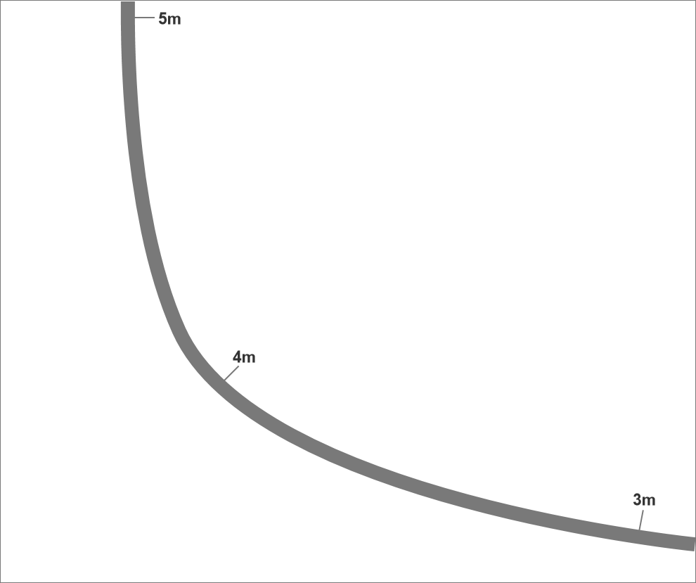
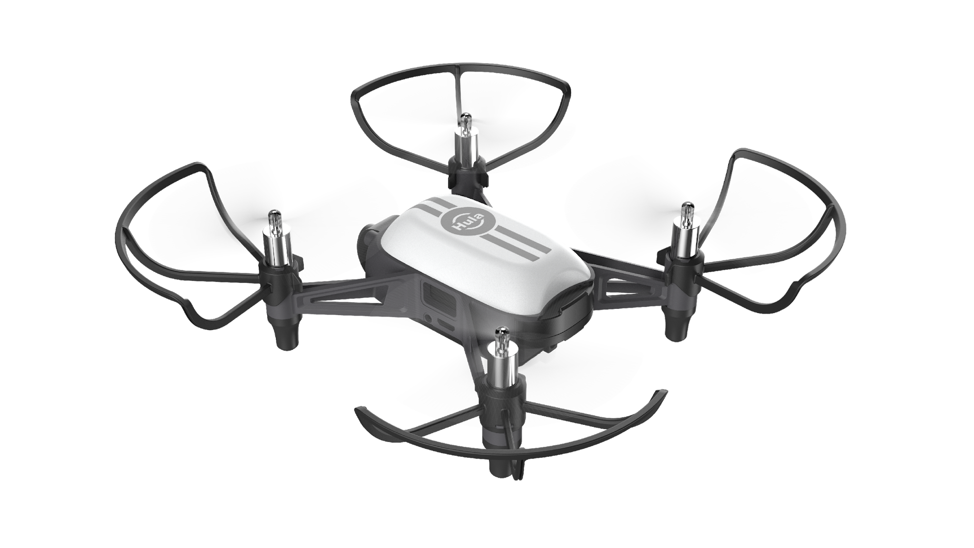
AUTONOMOUS DRONE
TASKS：
Using down-facing camera and AI object recognition, autonomous drone ( AD) must follow thick line as flight path, following the directional signs and moving through the different obstacles.
Penalties：
TYPE | PENALTY
Failure to follow thick line as flight path | -60MARKS
Deviation from flight path for more than 10 seconds | Verbal warning,case by case assessment
Fly out of the playfield | Mark Reset to disqualification
All right reserved. 65Drones Pte Ltd. No distribution or use without permission from 65Drones Pte Ltd.

Slide 8



Obstacle- Round Loop
Code – Round Loop：
AD must pass through the loop in the direction indicated by the directional sign.
LED Light：AD must flash green light when pass through loop. After the pass through, the green light must be coded off.
All right reserved. 65Drones Pte Ltd. No distribution or use without permission from 65Drones Pte Ltd.
TYPE | PENALTY
Crash | -1mark/per time
Failure to move through the loop | -5marks/per time
Failure to flash green light or to off the green light | -1mark/per time

Slide 9

Obstacle-straight barrier
Code – Straight Barrier：
AD must pass through the loop in the direction indicated by the directional sign.
LED Light：AD must flash YELLOW light when pass through loop. After the pass through, the YELLOW light must be coded off.
All right reserved. 65Drones Pte Ltd. No distribution or use without permission from 65Drones Pte Ltd.
TYPE | PENALTY
Crash | -1mark/per time
Failure to move through the barrier | -5marks/per time
Failure to flash yellow light or to off the yellow light | -1mark/per time

Slide 10
02
COMPETITION FLOW- MANUAL DRONE
All right reserved. 65Drones Pte Ltd. No distribution or use without permission from 65Drones Pte Ltd.

Slide 11
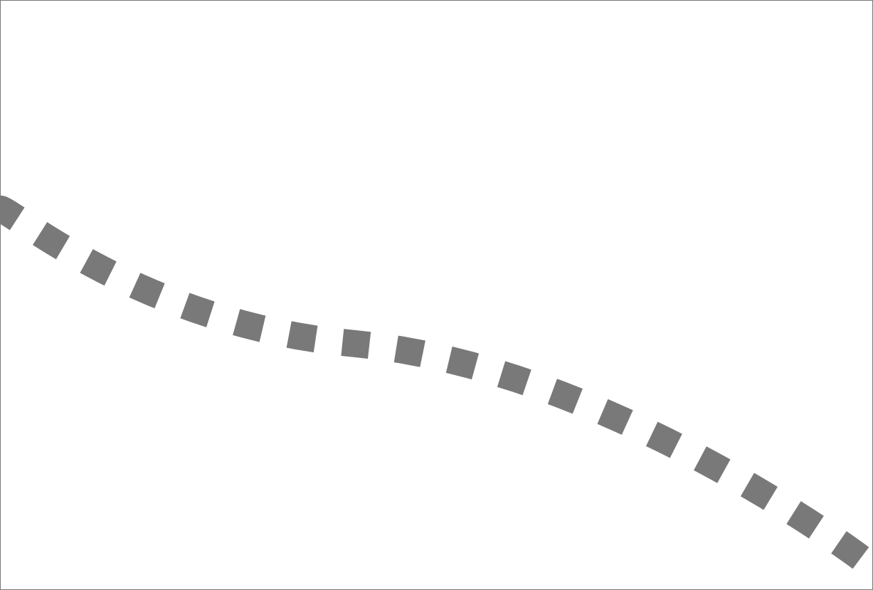




Manual drone- Round Loop
2 Types of round loops.
vertical round loop：fly through the loop
horizontal round loop：fly down and upwards to move through the loop .
TYPE | PENALTY
CRASH | -1mark/per time
Failure to move according to the required direction | -5marks/per time
All right reserved. 65Drones Pte Ltd. No distribution or use without permission from 65Drones Pte Ltd.

Slide 12


Manual Drone- Straight Barrier
Drone must fly from bottom
TYPE | PENALTY
CRASH | -1mark/per time
Failure to move according to the required direction | -5marks/per time
All right reserved. 65Drones Pte Ltd. No distribution or use without permission from 65Drones Pte Ltd.

Slide 13

Manual Drone- Flag barrier
Drone must fly from the flag facing side
TYPE | PENALTY
CRASH | -1mark/per time
Failure to move according to the required direction | -5marks/per time
All right reserved. 65Drones Pte Ltd. No distribution or use without permission from 65Drones Pte Ltd.

Slide 14
02
MISSION-
AI ALLIANCE
All right reserved. 65Drones Pte Ltd. No distribution or use without permission from 65Drones Pte Ltd.

Slide 15
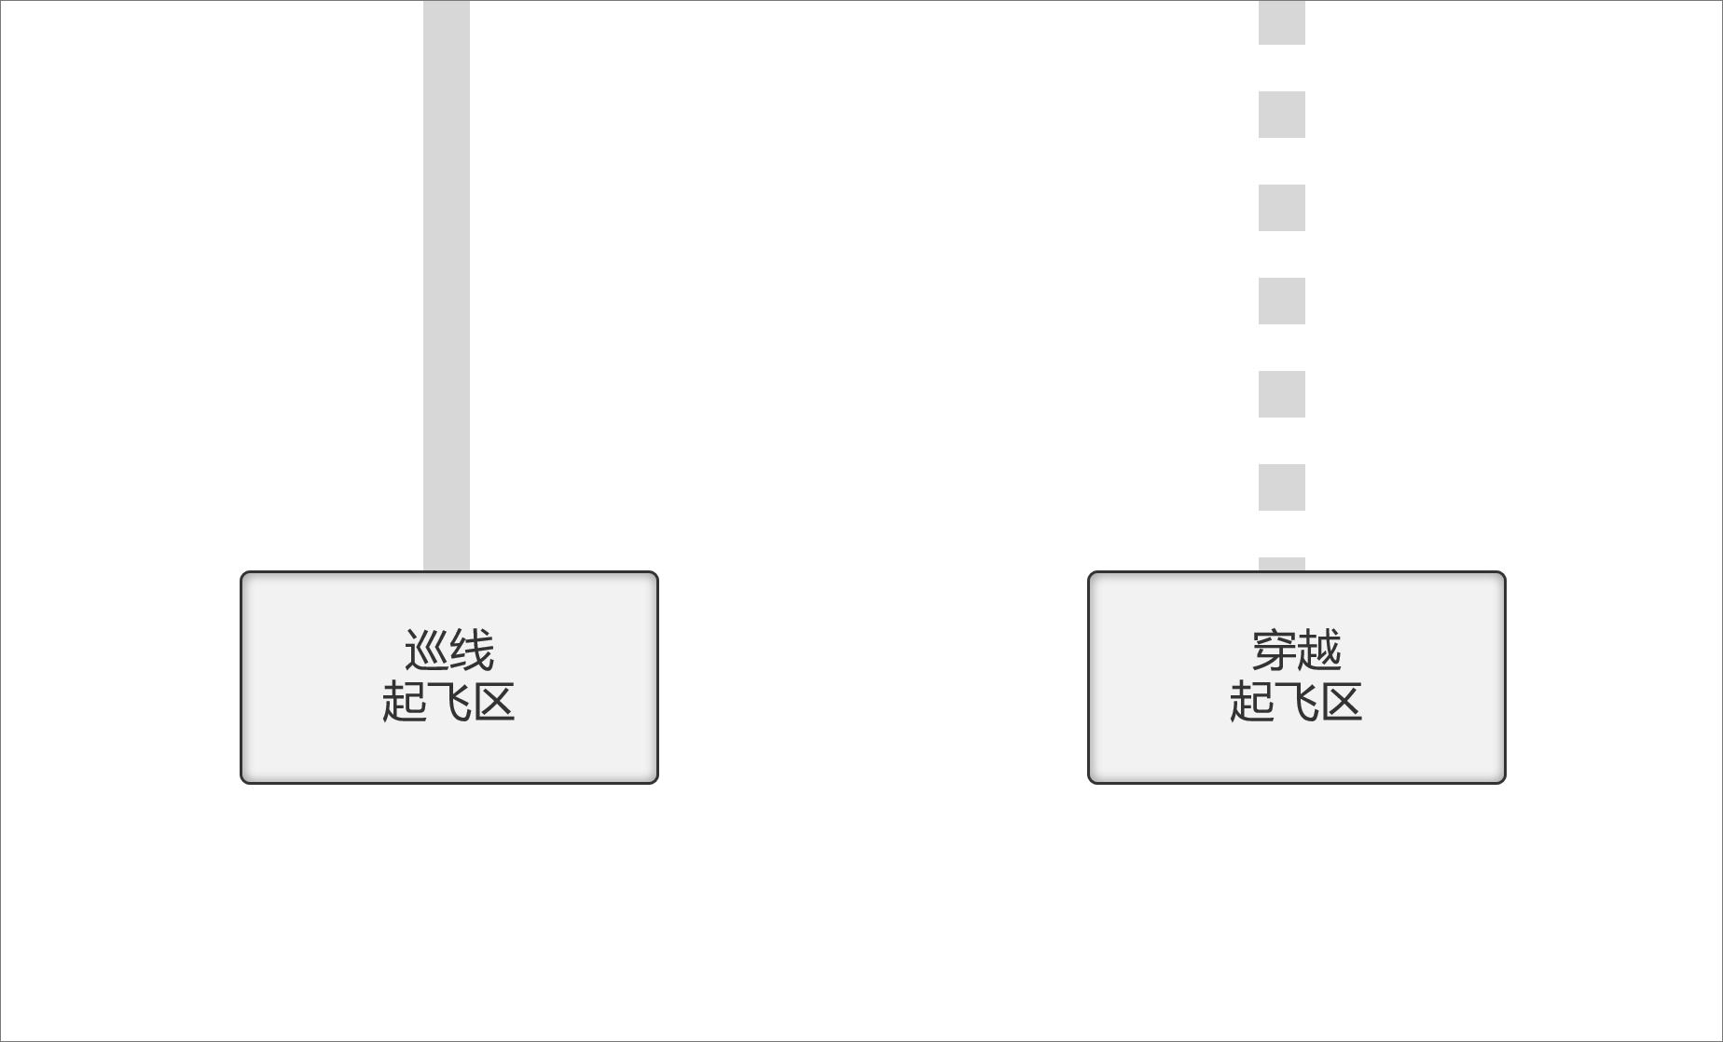
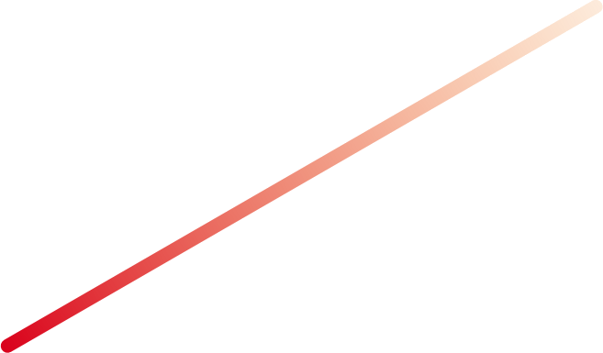
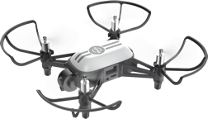
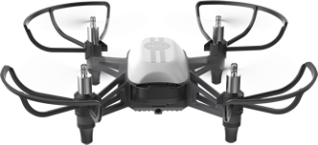
AI Alliance – Take-off mission
Autonomous：Must be fully coded to enable take off by detecting laser from manual drone.
Manual：After take off, shoot laser to AD to cue it to start.
Type | Penalty
Failure to detect laser to take off ( autonomous drone) | -40mark
Wrong placement of drone | Verbal warning
Manual Drone shoot laser before referee announce start | Verbal warning, restart
All right reserved. 65Drones Pte Ltd. No distribution or use without permission from 65Drones Pte Ltd.

Slide 16
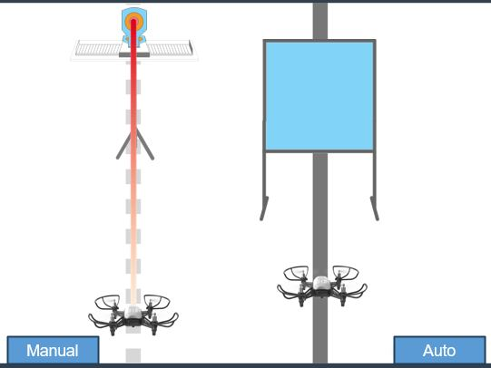

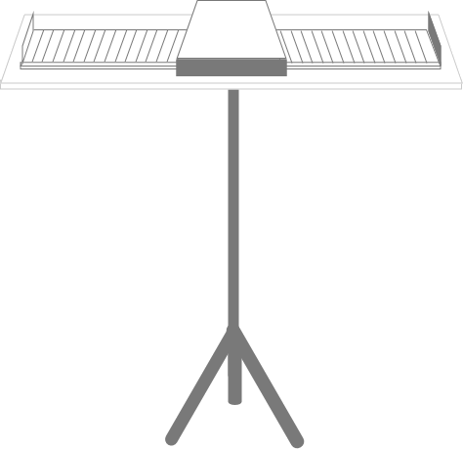


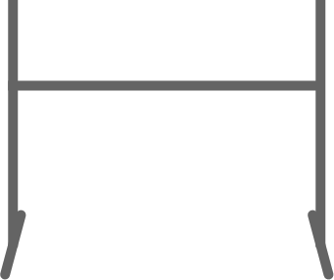
AI Alliance - Door
Autonomous：AD must pass through the door , once the door opens
Manual：MD must shoot the moving target board to open the door
Manual
Auto
Type | Penalty
Failure to open door | -10mark
Autonomous drone did not pass through door | -10mark
Crash | -1mark/per time

Slide 17
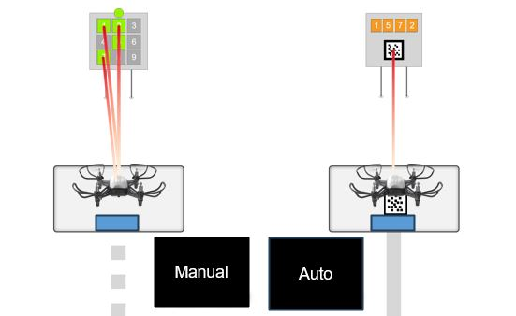





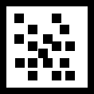
AI Alliance – QR code password
Autonomous：Shoot “ 0” QR code to reveal the 4 numbers password.
Manual：Shoot the 4 numbers after the 4 numbers are revealed.
Type | Penalty
Failure to complete the mission | -10marks
Shooting of laser before 4 digits are shown | -10marks
Wrong password | No penalty. redo

Slide 18
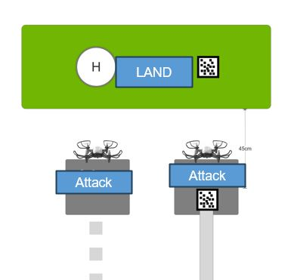
Landing Mission
Drones are required to land at landing zone after all missions are completed
。Autonomous: land after recognizing “ 0” QR code
Manual: Land at H zone
LAND
Attack
Attack
All right reserved. 65Drones Pte Ltd. No distribution or use without permission from 65Drones Pte Ltd.
Type | Penalty
Failure to land at stipulated land spot | -5mark
Failure to land | -10marks
crash | -1mark/per time

Slide 19
03
Restart
All right reserved. 65Drones Pte Ltd. No distribution or use without permission from 65Drones Pte Ltd.

Slide 20
Restart
  Team inform referee to restart by raising their hand and referee agrees
  Team may use their back-up drone.
  When restart, drone may be placed at the last position or at the start point.
  Timing will continue and will not be halted just because there is a restart.
All right reserved. 65Drones Pte Ltd. No distribution or use without permission from 65Drones Pte Ltd.

Slide 21
04
INSTRUCTIONS
All right reserved. 65Drones Pte Ltd. No distribution or use without permission from 65Drones Pte Ltd.

Slide 22
Coding
Each team is given 30 minutes to code.
  Coaches and mentors are not allowed to assist in the coding.
  Teams are not allowed to alter their codes.
  Cheating behaviour will result in disqualification
Type | Penalty
Non –team members assist in coding | Disqualified
Copying or sharing of codes among teams | Disqualified
All right reserved. 65Drones Pte Ltd. No distribution or use without permission from 65Drones Pte Ltd.

Slide 23
PREPARATION STAGE
Before start of competition, each team has 2 minutes of preparation time Drones must be placed at the take off zone after 2 minutes preparation time is up.
Drones’ nose must face the front of the playfield
Type | Penalty
Pilots yet to start competition after 2 minutes mark is up | Verbal Warning
Wrong placement of drone | Verbal Warning
Drones not placed at take off zone | Verbal Warning
All right reserved. 65Drones Pte Ltd. No distribution or use without permission from 65Drones Pte Ltd.

Slide 24
COMPETITION TIMING
Competition is to be completed in 6 minutes.
Pilots must land the drones when 6 minutes is up.
Type | Penalty
Missions not completed within 6 minutes | Deduction of marks according to unfinished missions
All right reserved. 65Drones Pte Ltd. No distribution or use without permission from 65Drones Pte Ltd.

Slide 25
05
Rank
All right reserved. 65Drones Pte Ltd. No distribution or use without permission from 65Drones Pte Ltd.

Slide 26
Rank
•According to final marks. Completion mark is 150 marks. Final mark is after deduction of all related penalties
Time of completion will be used as a consideration , in the event of a tie

Slide 27
END
All right reserved. 65Drones Pte Ltd. No distribution or use without permission from 65Drones Pte Ltd.

