Slide 1
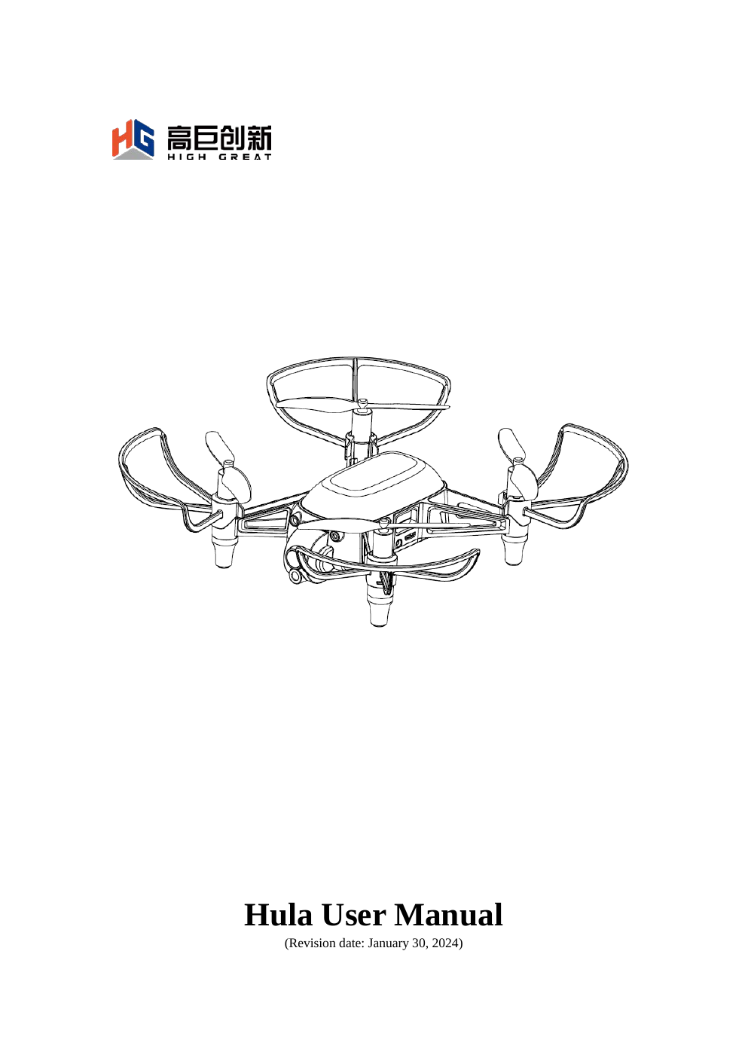


NOVETI DRONE ACADEMY · HULA DRONE TRAINING
Phase 1: Drone Pilot Foundation
1-day high-level plan • 5 training hours • High-school students • 4 drone teams
TEAM
DRONE
GOAL
5 students
1 per team
Safe manual control
Noveti Drone Academy · Phase 1
Source: Hula User Manual, Rev. Jan 30, 2024

Slide 2
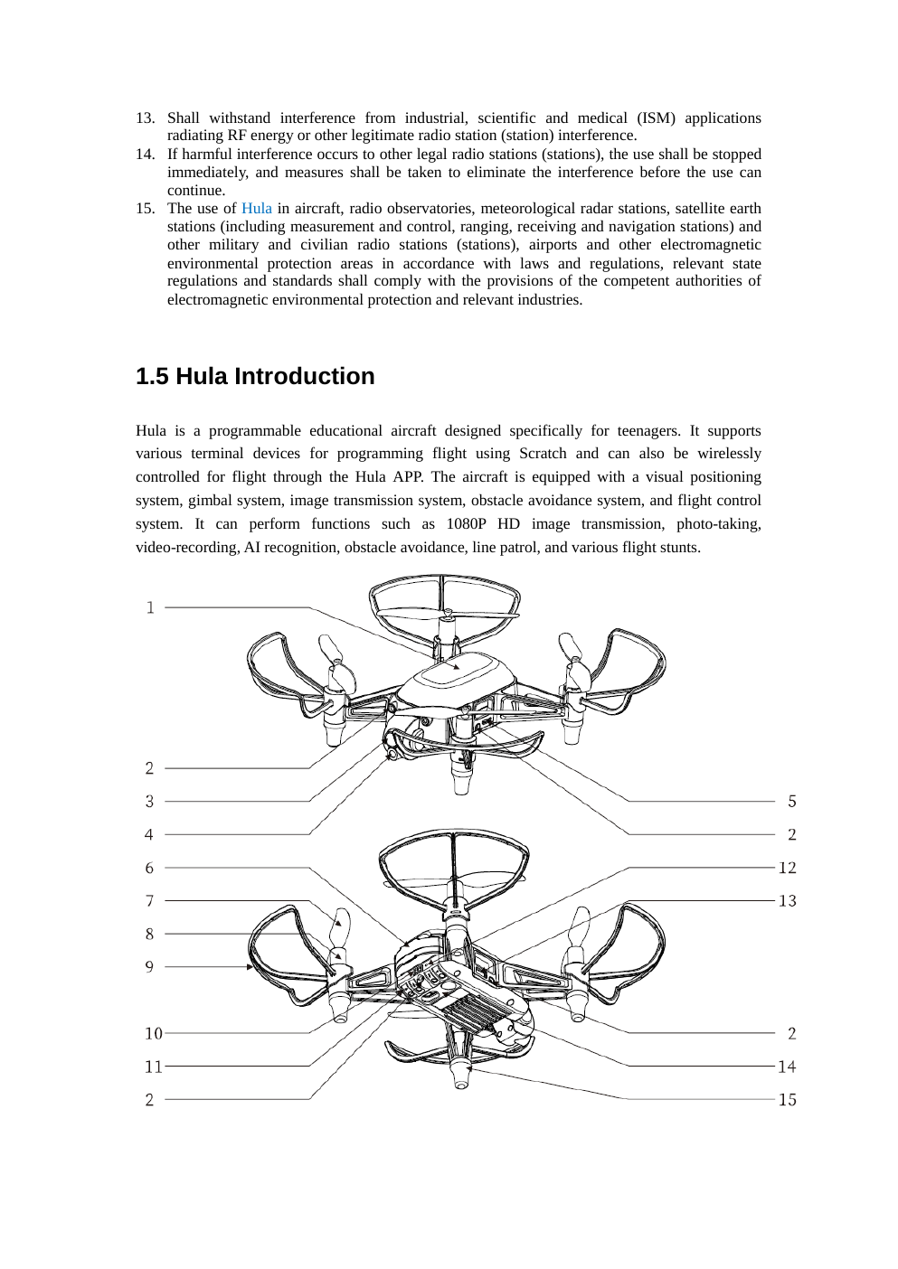
LEARNING OUTCOMES
What students will be able to do
•
Recognize Hula components and explain what each one does.
•
Prepare the drone, battery, propellers and flight area safely.
•
Connect to the drone and read basic status indicators.
•
Perform controlled takeoff, hover, directional movement, rotation and landing.
•
Complete a short manual-flight and laser-target challenge as a team.
Noveti Drone Academy · Phase 1
Source: Hula User Manual, Rev. Jan 30, 2024

Slide 3
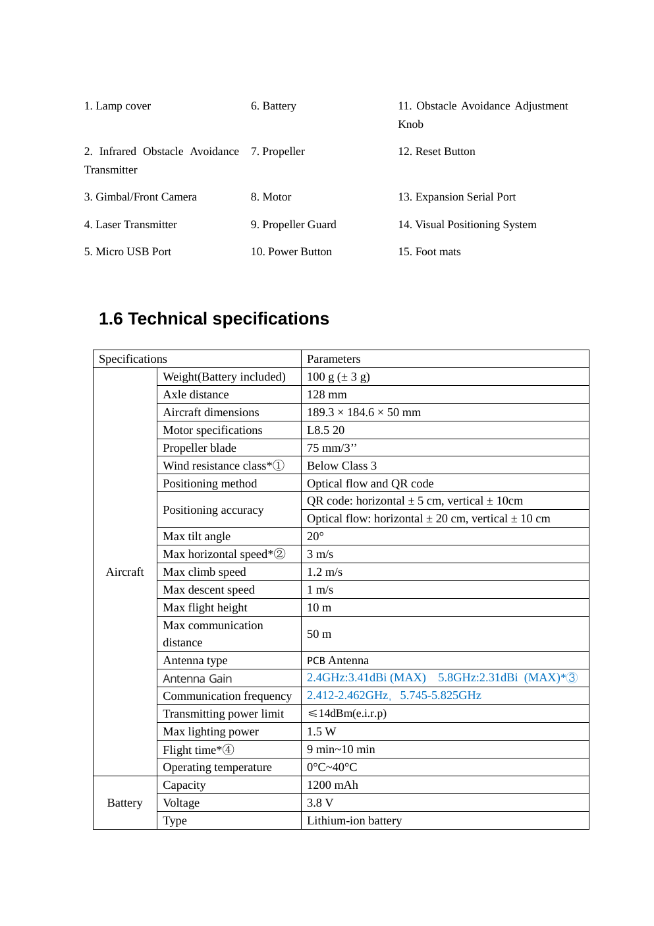
DRONE OVERVIEW
Hula at a glance
100g
9–10
10m
50m
battery included
min flight time
max height
comm. distance
•
Indoor educational programmable drone.
•
Camera, visual positioning, obstacle avoidance and laser module.
•
Manual flight first; programming and AI come in Phase 2.
Noveti Drone Academy · Phase 1
Source: Hula User Manual, Rev. Jan 30, 2024

Slide 4
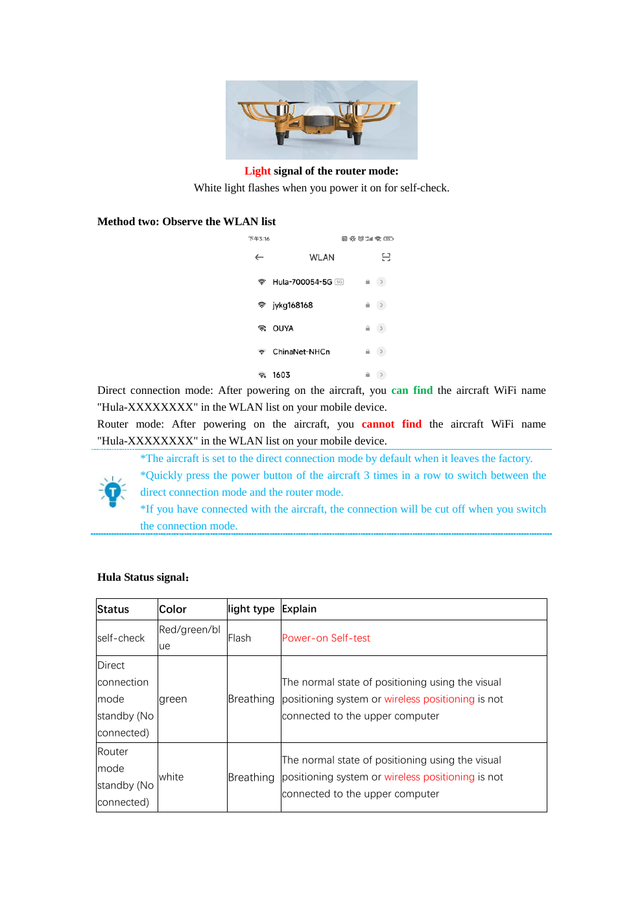
SAFETY FIRST
Safety rules before any flight
01
Indoor, good lighting, textured floor
02
Keep 2 meters away from people during flight
03
Do not fly over water, mirrors or dark/solid floors
04
Stay within safe height; avoid low-altitude fast movement
05
Never point the laser at eyes
Noveti Drone Academy · Phase 1
Source: Hula User Manual, Rev. Jan 30, 2024

Slide 5
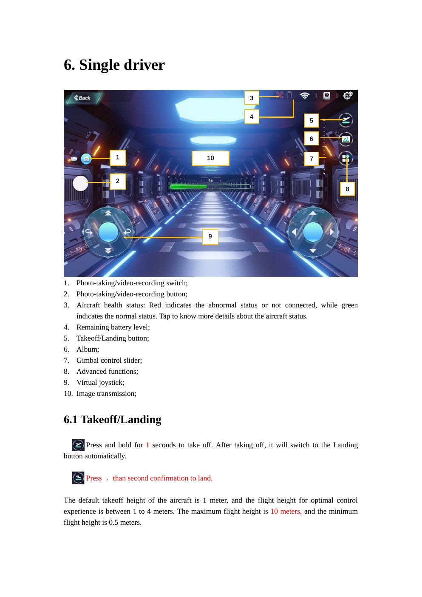
CLASSROOM FORMAT
Team setup and roles
20 students → 4 teams → 5 students per drone
Pilot
Safety
Mission
Recorder
Engineer
flies
spotter
lead
scores
battery / setup
•
Rotate roles after each mission.
•
Only one active pilot at a time.
•
Spotter can stop the mission at any moment.
Noveti Drone Academy · Phase 1
Source: Hula User Manual, Rev. Jan 30, 2024

Slide 6
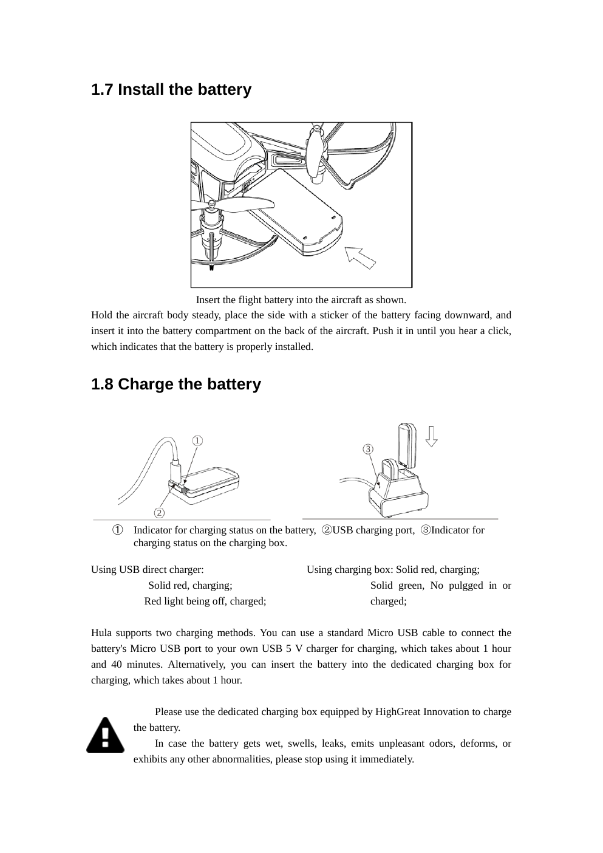
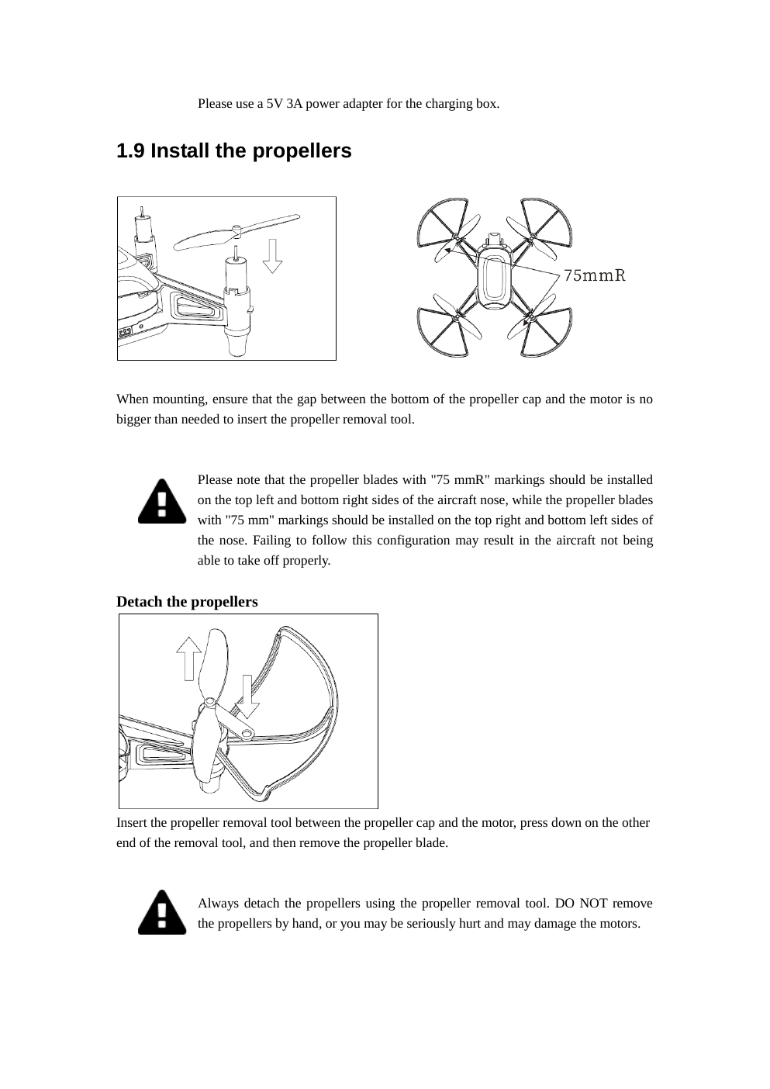
HANDS-ON SETUP
Pre-flight checklist
•
Battery is charged and clicked into place.
•
Propellers are installed in the correct positions.
•
Guards are secure; no damage or loose parts.
•
Optical-flow camera and ToF sensor are clean.
•
Flight space is clear; target area prepared.
Noveti Drone Academy · Phase 1
Source: Hula User Manual, Rev. Jan 30, 2024

Slide 7
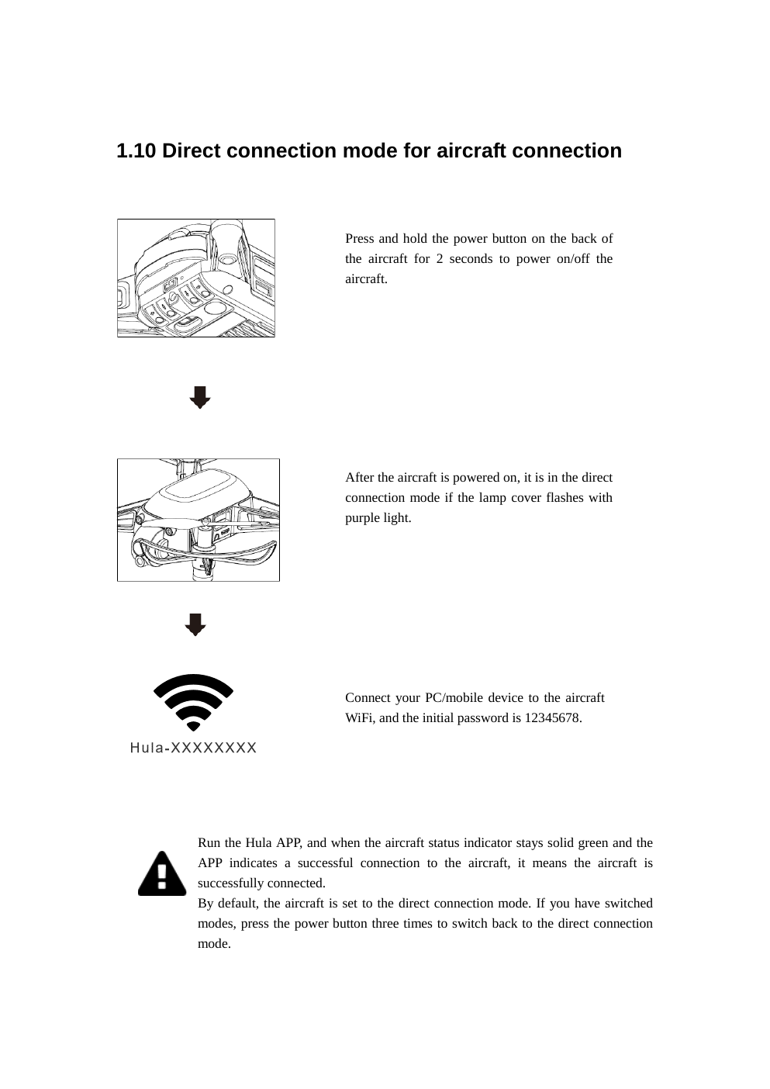
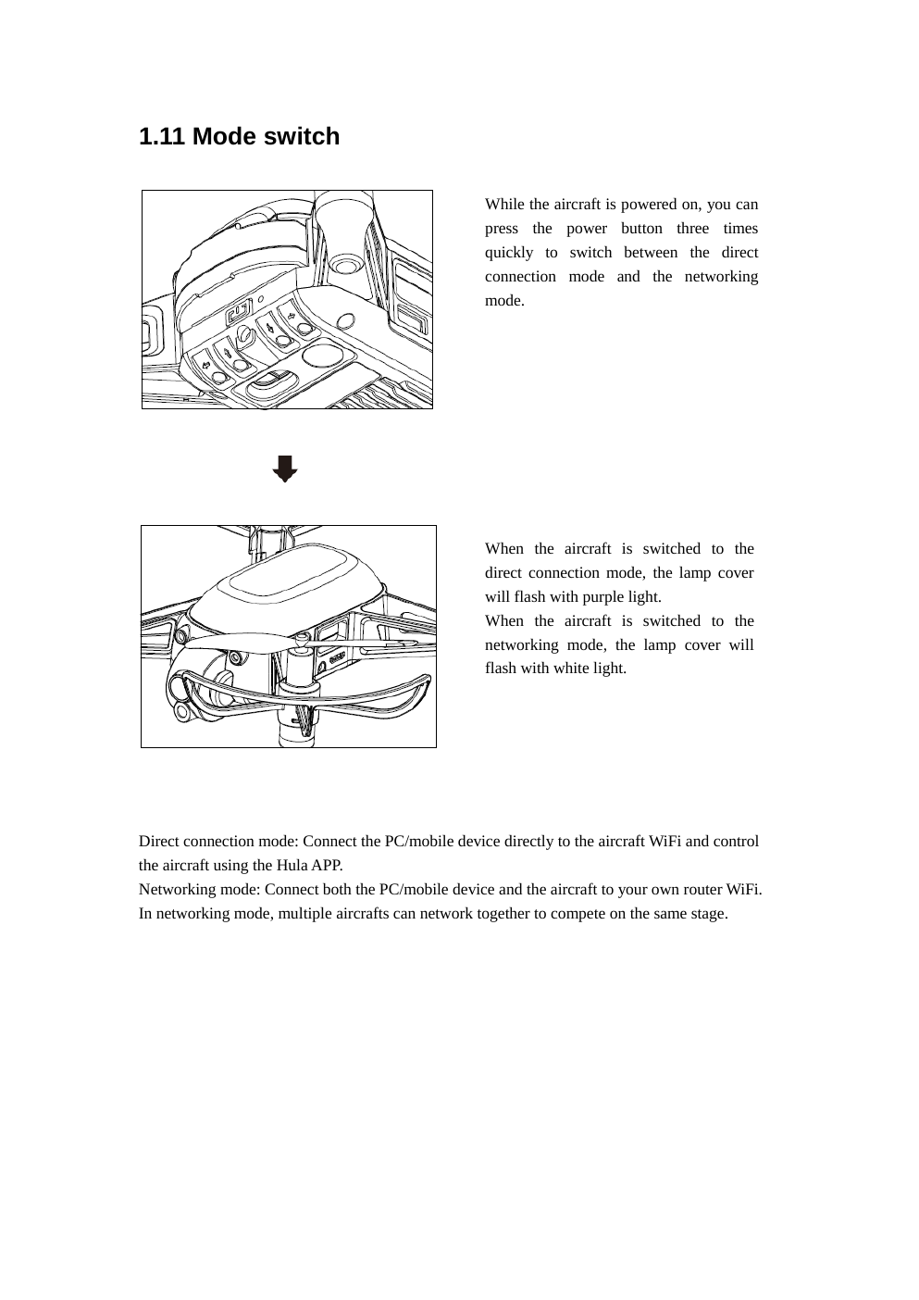
GETTING ONLINE
Connect and confirm drone status
•
Power on: hold the power button for 2 seconds.
•
Direct connection mode is the default; connect to Hula Wi‑Fi.
•
Initial Wi‑Fi password: 12345678.
•
Solid green light means direct connection is successful.
•
If needed, press power button 3 times to switch modes.
Noveti Drone Academy · Phase 1
Source: Hula User Manual, Rev. Jan 30, 2024

Slide 8
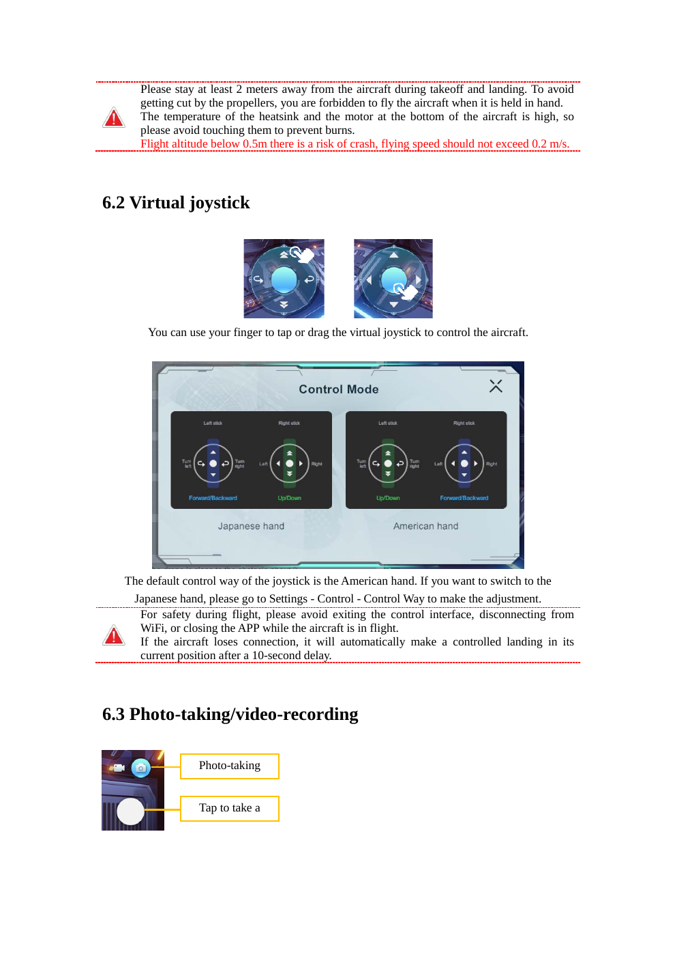
PILOTING BASICS
Manual flight core skills
1
2
3
4
5
Take off
Hover
Move
Rotate
Land
•
Hold takeoff for 1 second; default takeoff height is 1 meter.
•
Use small inputs: forward/backward, left/right, up/down.
•
Rotate clockwise and counterclockwise without drifting.
•
Recover orientation before landing.
Noveti Drone Academy · Phase 1
Source: Hula User Manual, Rev. Jan 30, 2024

Slide 9
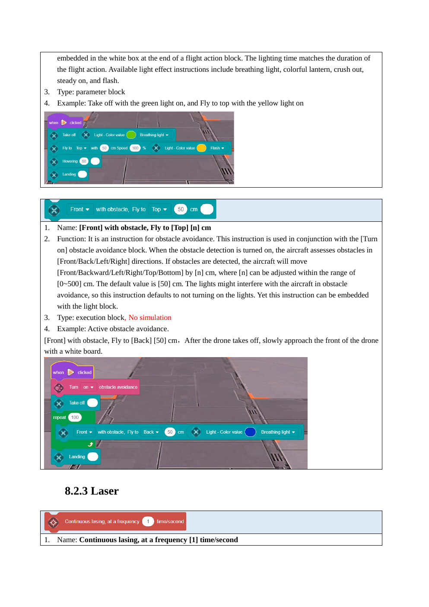
ENGAGEMENT PRACTICE
Manual laser activity
•
Purpose: improve steady hovering, alignment and controlled yaw.
•
Targets are fixed; students must aim without unsafe movement.
•
Laser rule: never aim at faces or eyes.
•
Each team rotates pilot and spotter roles.
Skill
Skill
Skill
Skill
Hover
Aim
Shoot
Recover
Noveti Drone Academy · Phase 1
Source: Hula User Manual, Rev. Jan 30, 2024

Slide 10
5 TRAINING HOURS
One-day schedule
00:00–00:35
00:35–01:20
01:20–02:10
02:10–03:20
03:20–04:20
04:20–05:00
Intro & safety
Setup & connect
Takeoff / hover / land
Movement & rotation
Laser practice
Mini challenge
•
Breaks can be inserted between modules without changing the flow.
•
Every exercise follows: briefing → demo → team practice → quick debrief.
Noveti Drone Academy · Phase 1
Source: Hula User Manual, Rev. Jan 30, 2024

Slide 11
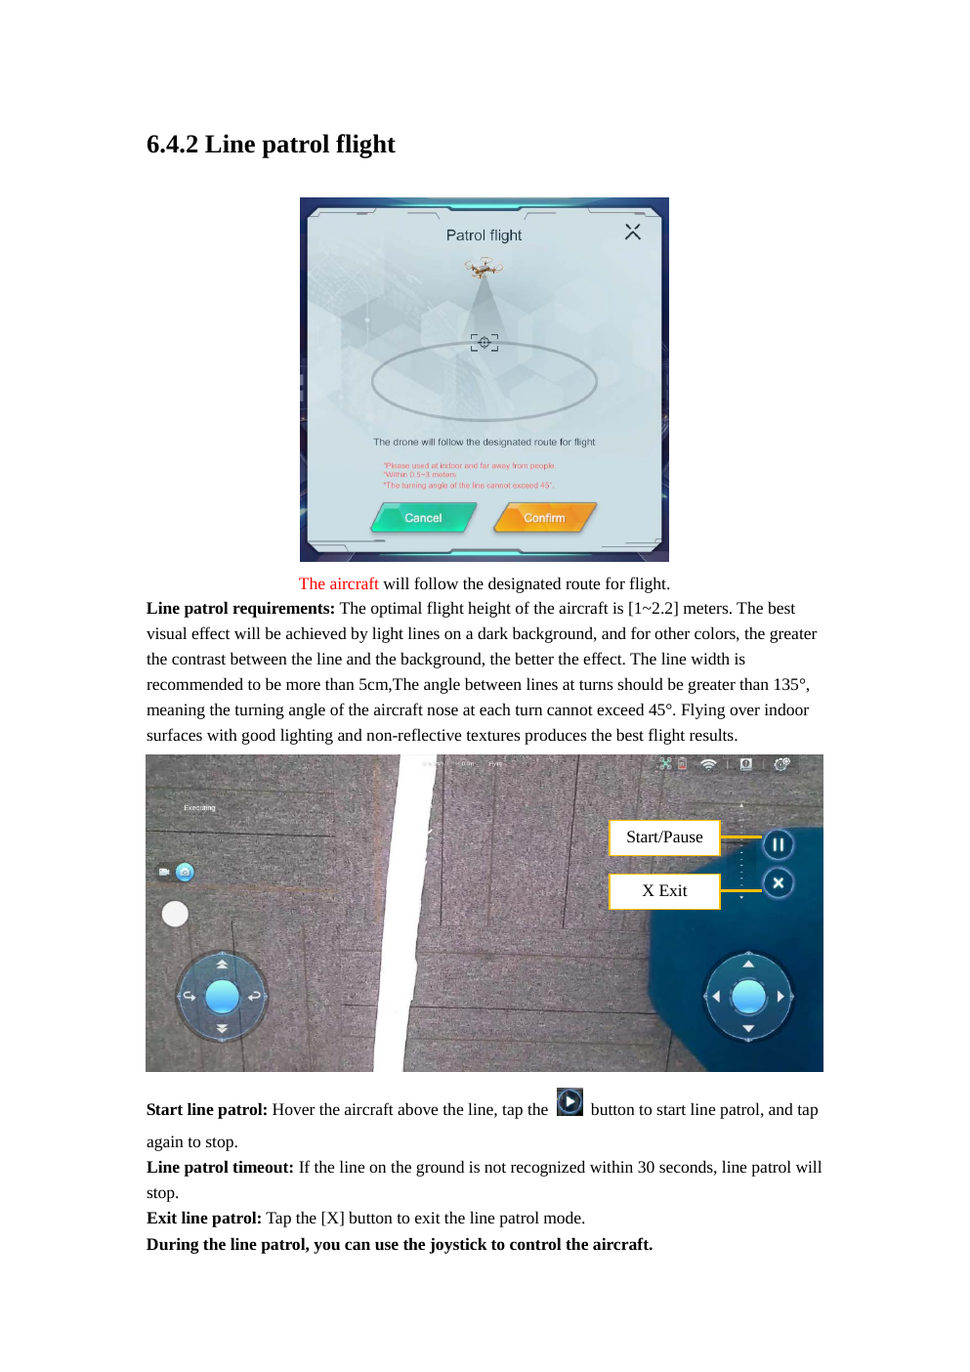
PROGRESSIVE EXERCISES
Practice mission ladder
•
Mission 1: safe takeoff → 5-second hover → land.
•
Mission 2: hover box: front → right → back → left.
•
Mission 3: rotate 90° and return to nose-forward orientation.
•
Mission 4: controlled approach to target zone and retreat.
•
Mission 5: hover and hit a laser target.
Noveti Drone Academy · Phase 1
Source: Hula User Manual, Rev. Jan 30, 2024

Slide 12
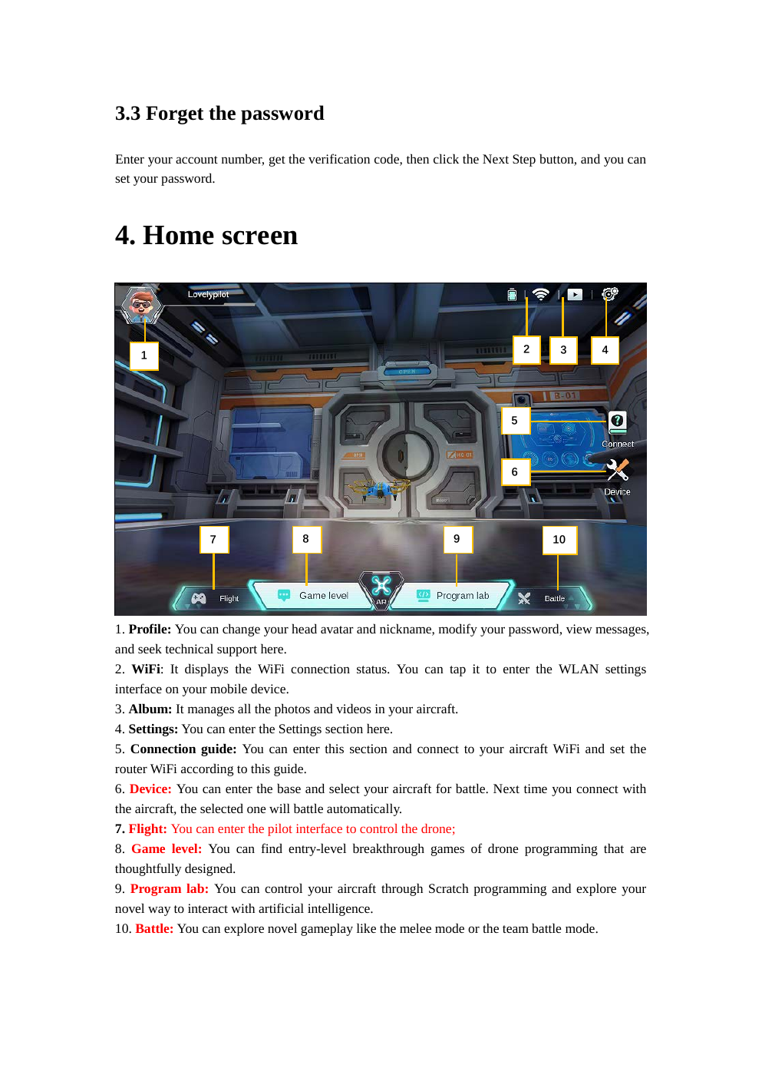
ASSESSMENT
Phase 1 closing challenge
Scoring idea
30%
25%
20%
15%
10%
Safety
Control
Landing
Laser
Teamwork
•
Pass/fail rule: unsafe behavior stops the attempt.
•
Best team is not only fastest; it is the safest and most controlled.
•
This prepares students for Phase 2 autonomous missions.
Noveti Drone Academy · Phase 1
Source: Hula User Manual, Rev. Jan 30, 2024

