Slide 1

ADDEPAR

Slide 2
Background
Privately held investment management cloud-based software
Co-founded by Joe Lonsdale and Jason Mirra in September 2009
Headquarters: Mountain View, California
Ideas behind Addepar:
To replace 20 to 40 years old technology infrastructure used by Wall Street
Efficient and effective ways to store, process, and analyzed big data after the financial crisis
Funding: $240 millions

Slide 3
Business Activities
Bringing data, people, technology together to help clients make better and more informed investment decisions
Navigate the increasingly complex world of investment management with tools such as:
Data aggregation and reconciliation
Customizable reporting
Analytics
API & Integrations
Intended customers are family offices, wealth advisors, and private banks (partnerships)
Main Competitors:
Enfusion
Morningstar
CARTA
Orion
Black Diamond

Slide 4
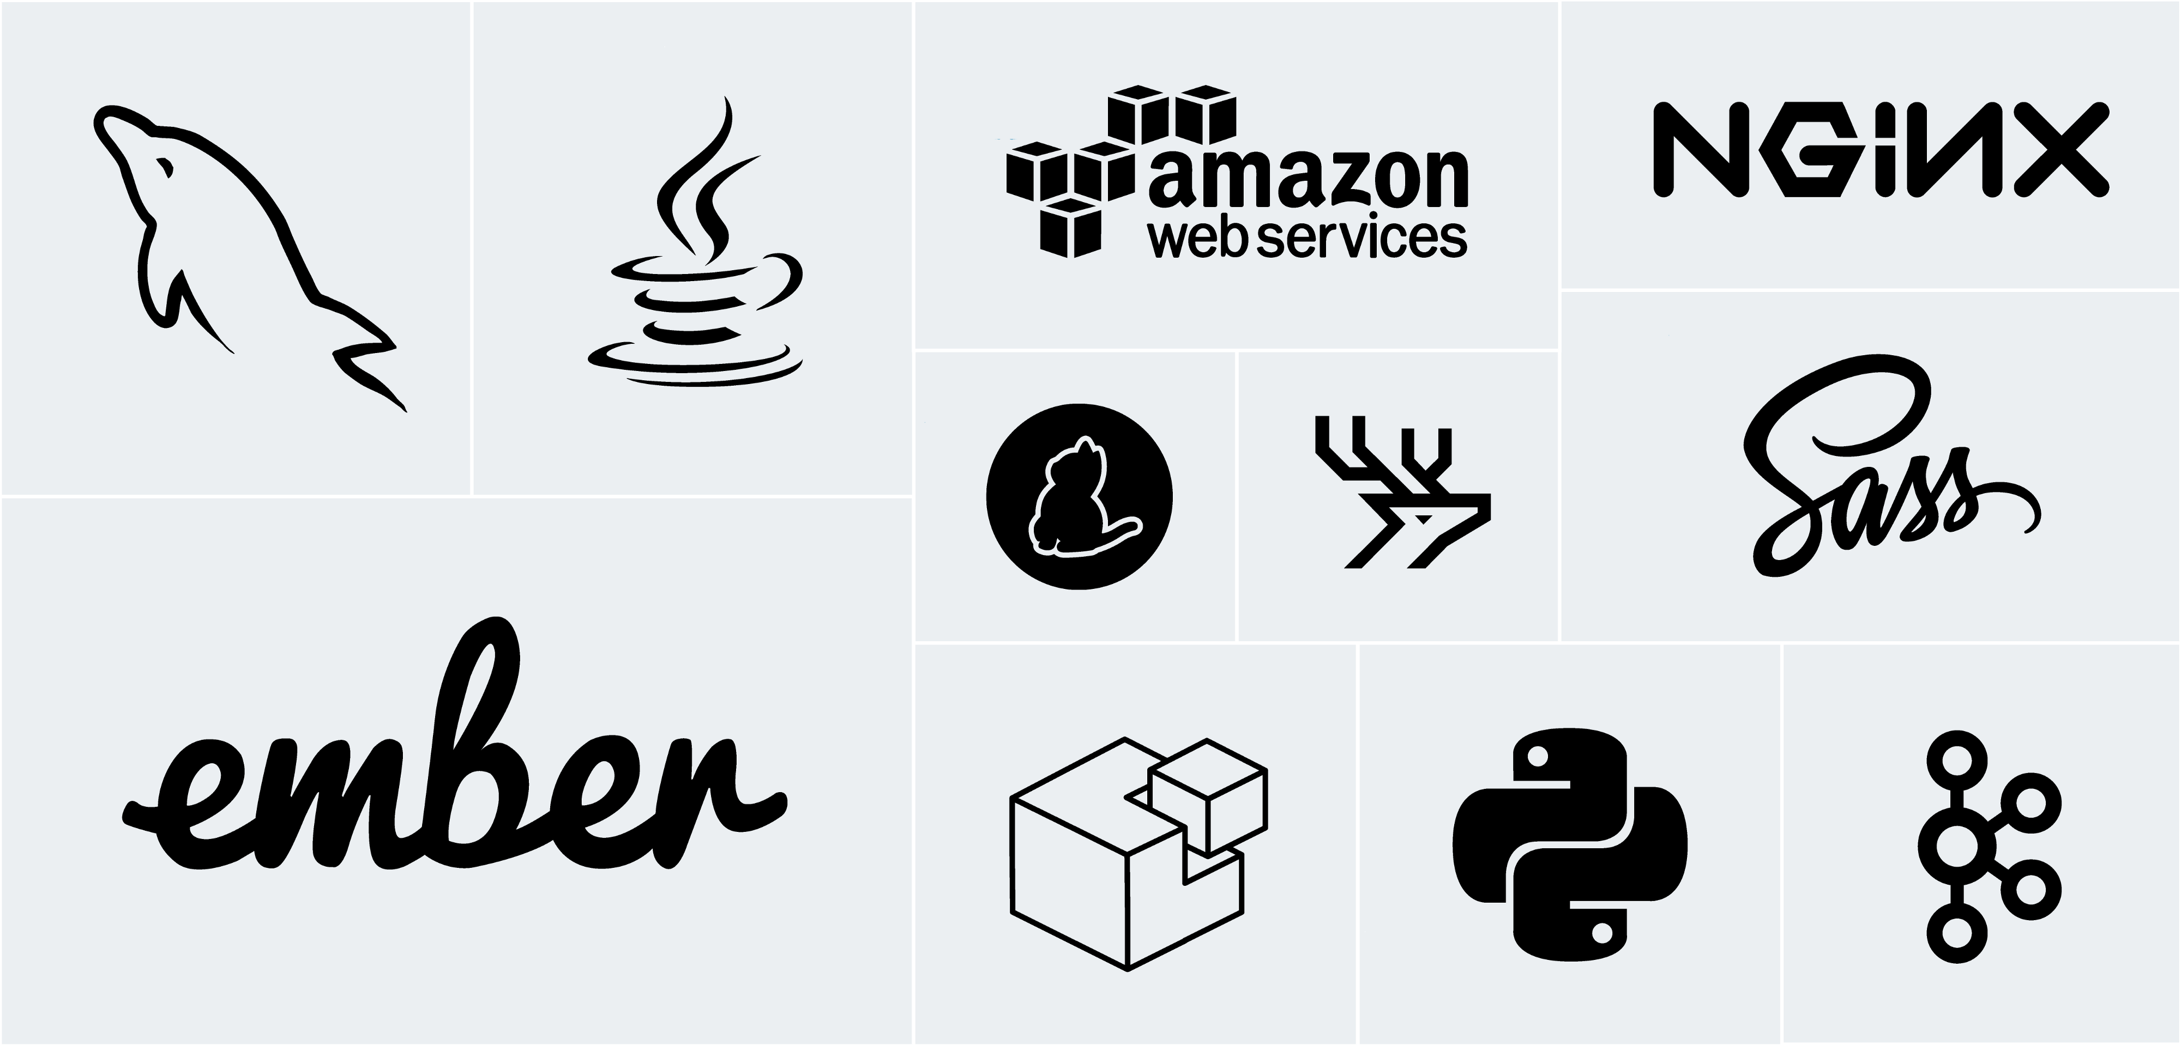

Slide 5
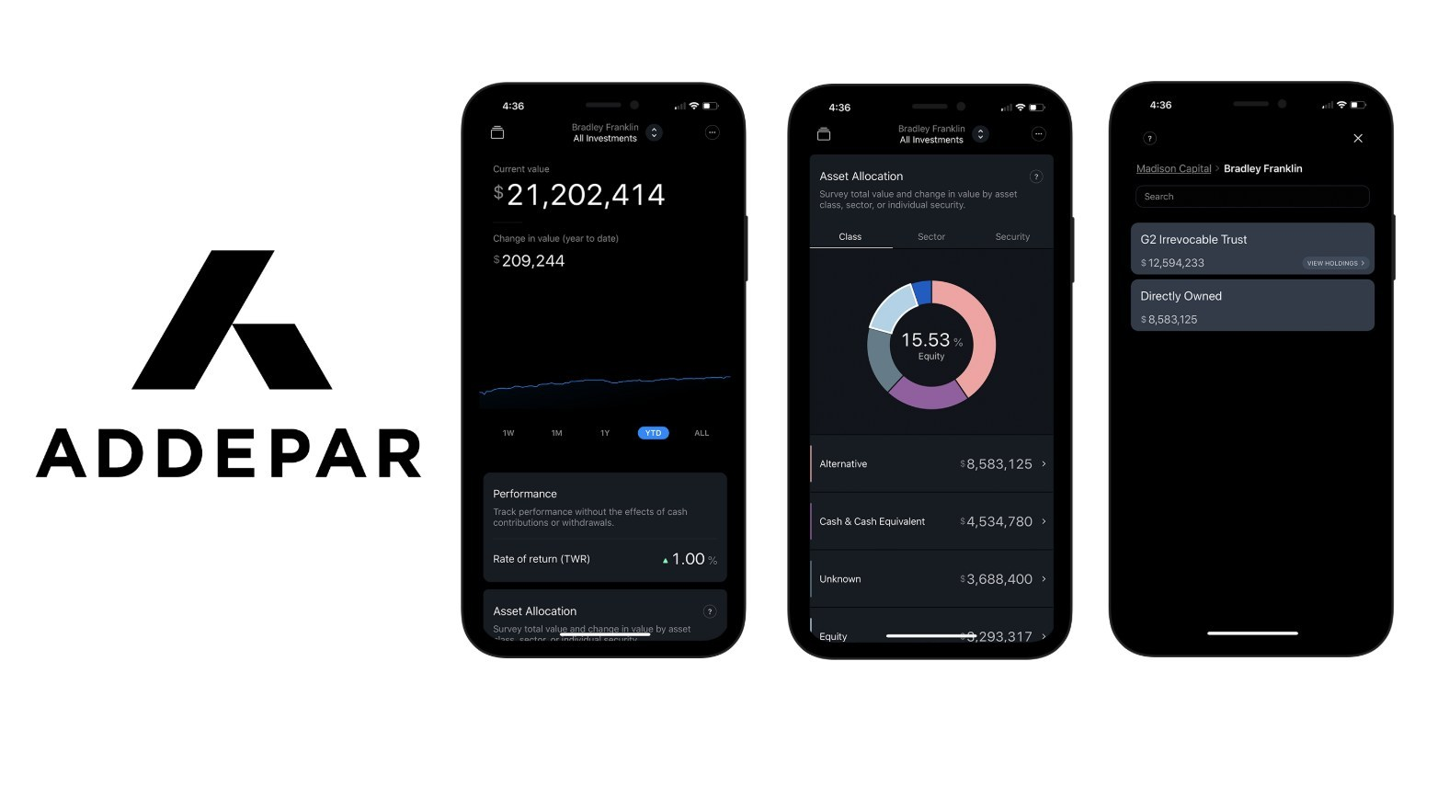
Landscape - FinTech Domain
Wealth Management
Major Trends in the domain:
High demand of digital customer experience
Mobile apps
Digital assistants that involves advanced AI technology for voice recognition
Replacing personnel in bank call centers for virtual assistants

Slide 6
Results
Disrupting the traditional ways to manage portfolios but also creating new resources for revenues
Replacing software like Microsoft Excel and Access and accounting software like QuickBooks
Managing data for over $1.3 trillion of assets on its platform
Awarded by Morgan Stanley for recognition of a FinTech company that has had a significant impact on Morgan Stanley’s mission (2017)

Slide 7

Recommendations
Implementing Blockchain technology to transform the asset management value chain

Slide 8
Thanks

