Slide 1
Portfolio Optimization
TEAM 04: THREE MUSKETEERS

Slide 2
Agenda:
1. Introduction: The Problem
2. Our approach: Techniques and steps
3. Portfolio optimization tool: Pipeline and UI design
4. Demo and results

Slide 3
The Problem:
“Risk comes from not knowing what you're doing’’ - Warren Buffett
Everyone is looking to invest in stock market and win
Stock investment is easy, cheap and dangerous for beginners
Having enough information about the investment can prevent from wrong decisions and help to understand the game of investing.

Slide 4
Techniques/Steps:
Project outline: Markdown file
Pipeline design: Visio
Components finalization:
User-interface design: Balsamiq - cloud based solution
Backend analysis: Monte carlo simulations, efficient frontier and discovery plots
Report: Portfolio Overview and Analysis (HTML, pdf)
Programming: E.g. (Tkinter, jinja2, pandas, numpy, matplotlib, pdfkit)

Slide 5
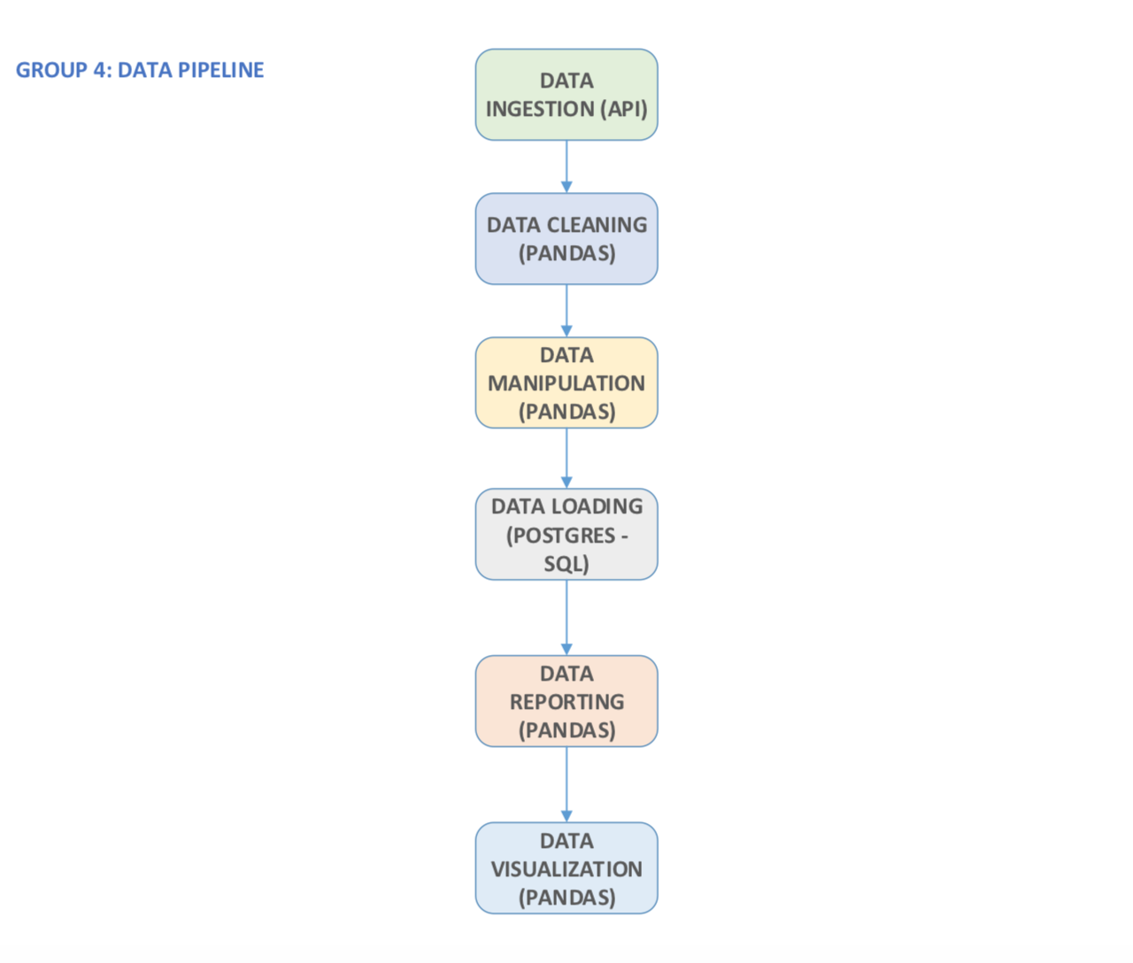
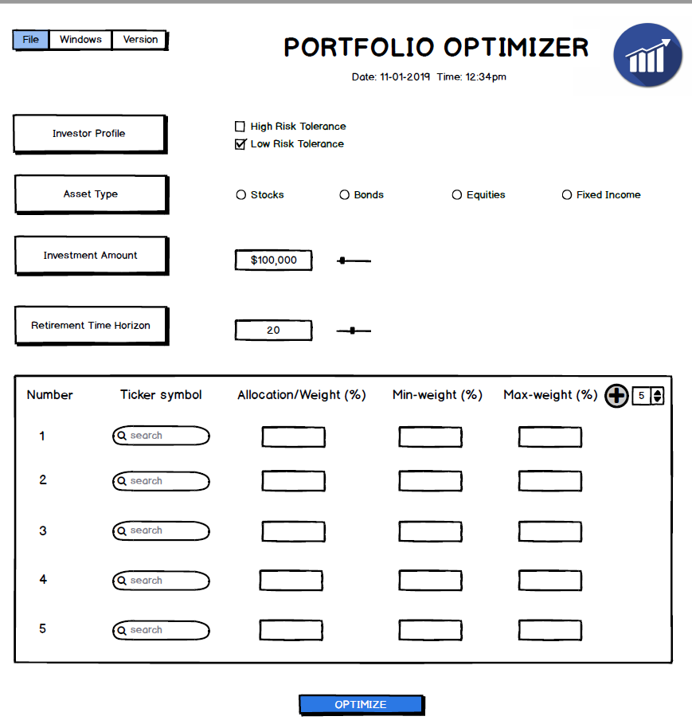
Pipeline and UI design
Initial Pipeline
Initial UI

Slide 6
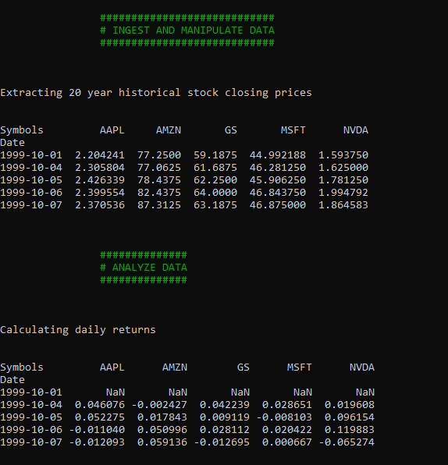
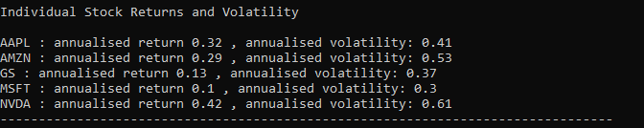
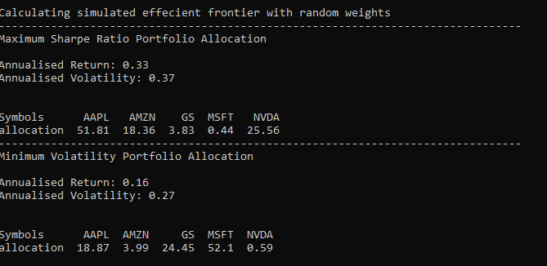
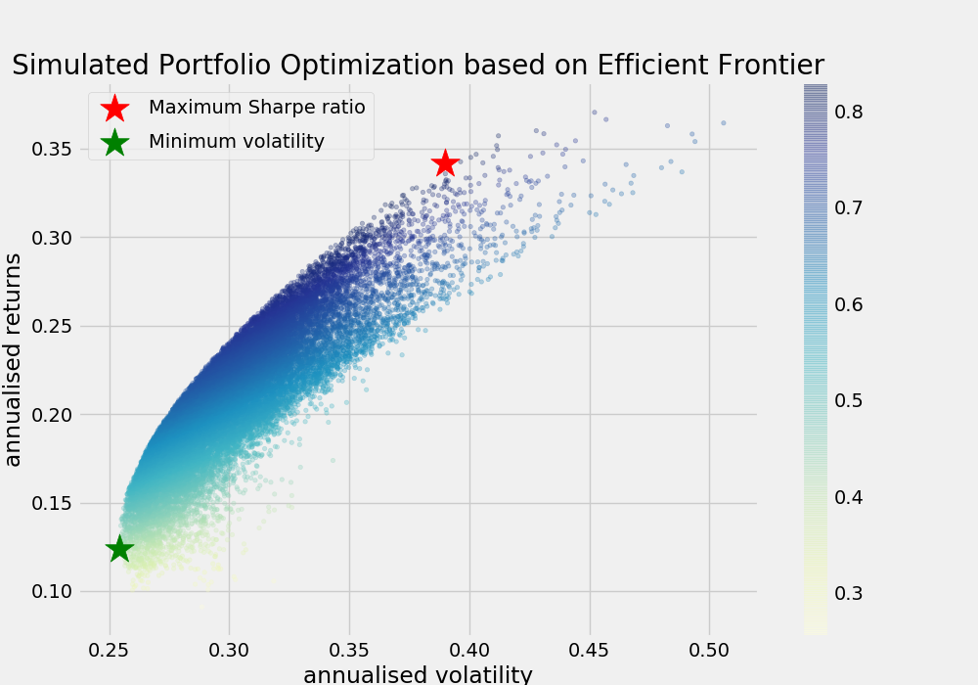
Demo and Results:

