Slide 1

2020 Presidential Candidates
Min Chen

Slide 2
Description:
This purpose of this project is to analyze historical presidential data and current polling averages to predict the likelihood of democratic winning the presidency.

Slide 3
Data Source:
Kaggle datasets
FiveThirtyEight :
Latest Polls dataset
The 2020 Endorsement Primary

Slide 4
Methodology:
Using Pandas to do Exploratory Data Analysis
Data cleaning & data manipulation
Data visualization using matplolib and hvplot
Statistical analysis
Deep learning

Slide 5
Analysis

Slide 6
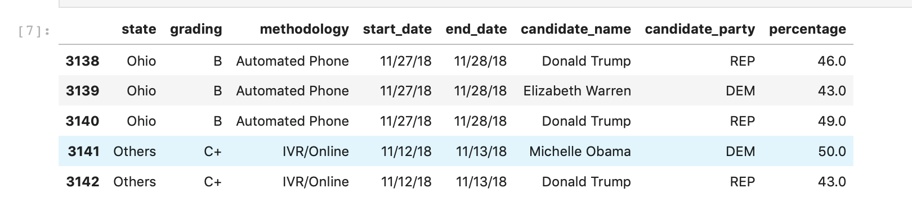
Data-frame after cleaning

Slide 7
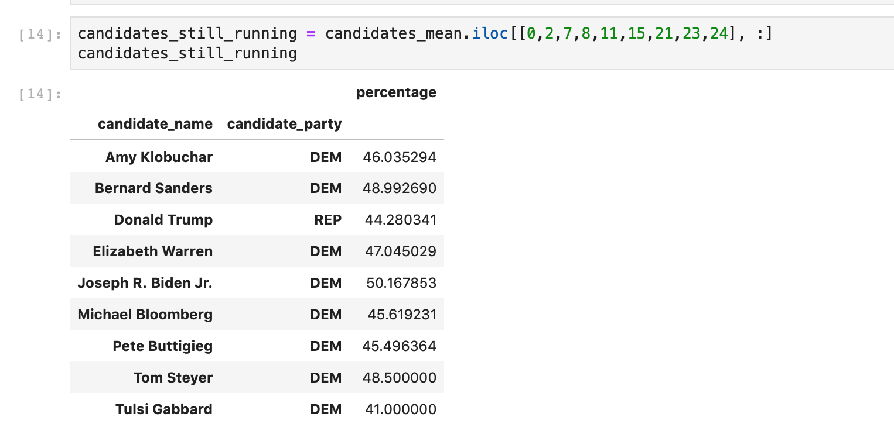
Candidates who still running

Slide 8
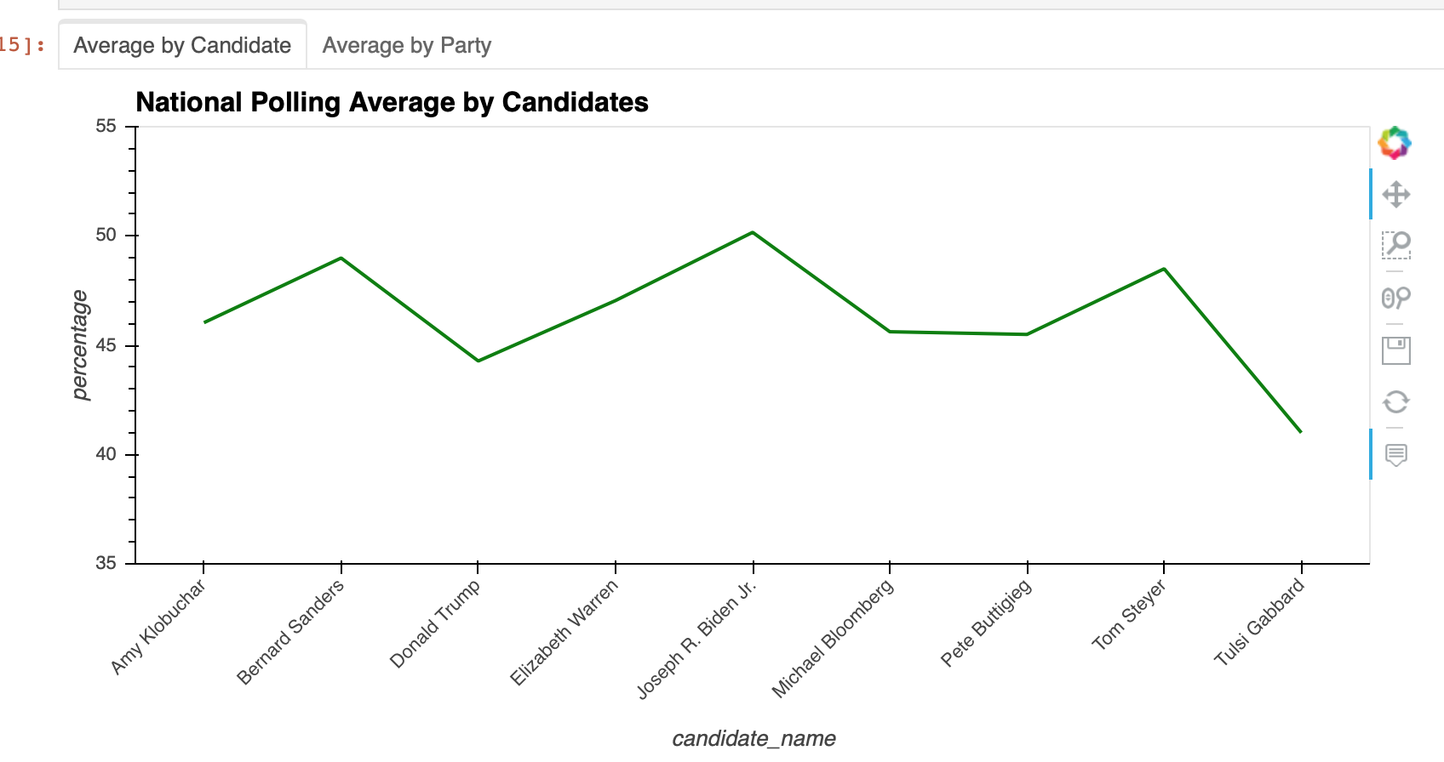
National Polling Average by Candidates

Slide 9
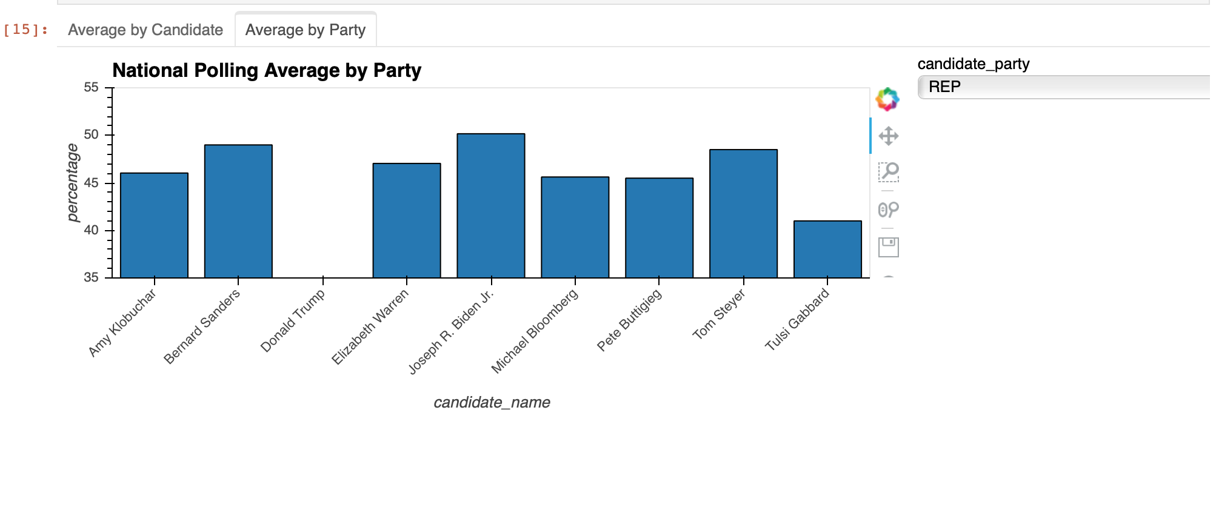
National Polling Average by Party

Slide 10
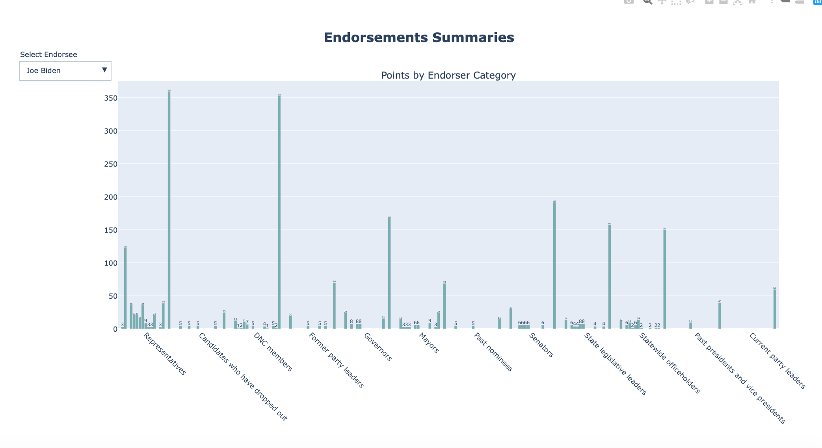
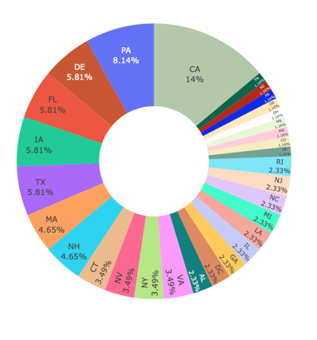
Endorsements by candidates

Slide 11
