Slide 1
SSH/Web/Firewall Anomaly Detection
Windows PowerShell workflow with live Docker ELK monitoring
Three security log domains: Firewall, Web, and SSH
Offline training and evaluation with reusable artifacts
Live log generation, file listening, scoring, and Kibana visualization

Slide 2
Problem Statement
Security operations require correlating heterogeneous logs from different systems.
Public datasets often have limited labels or labels that only partially describe attack behavior.
Static model metrics are not enough; operators need live visibility into raw events and predictions.
The project proposes one reproducible architecture for offline validation and live monitoring.

Slide 3
Research Objectives
Design comparable pipelines for Firewall, Web, and SSH anomaly detection.
Engineer domain-specific features while preserving a shared folder architecture.
Train unsupervised Isolation Forest models using normal baselines or available windows.
Evaluate with ROC, precision-recall, confusion matrix, feature correlation, and latency figures.
Integrate Docker-based Elasticsearch, Logstash, and Kibana for live operational dashboards.

Slide 4
End-To-End Architecture
Data collection
Parsing
Feature engineering
Scaling
Isolation Forest
Evaluation
Live scoring
Docker ELK
The same architecture is reused across all three model folders.

Slide 5
Datasets
Firewall: CSV records with action labels; Action == allow is the normal baseline.
Web: NASA HTTP access log archive; host/hour behavior windows are engineered from Apache-style lines.
SSH: SimpleWeb / University of Twente SSH Dataset 1; auth and Kippo logs are parsed into source-IP windows.
Web and SSH evaluations use pseudo labels because the public logs are not fully attack-labeled.

Slide 6
Feature Engineering
Firewall: bytes per packet, packet rate, byte rate, and port diversity ratio from each CSV row.
Web: request count, unique URLs, bytes, status-code counts, error rate, POST rate, and URL diversity per host/hour.
SSH: failed logins, invalid users, accepted logins, command counts, suspicious commands, failure rates, and burst score per source-IP/10-minute window.
Feature/score correlation figures provide a compact explanation of which engineered features move with anomaly score.

Slide 7
Modeling Method
All models use Isolation Forest, a tree-based unsupervised anomaly detection method.
Numeric features are normalized with StandardScaler before training and scoring.
Firewall trains on Action == allow rows.
SSH trains on low-activity windows.
Web trains on host/hour behavior windows from the NASA HTTP log.
Prediction 1 means normal; prediction -1 means anomalous.

Slide 8
Evaluation Protocol
Firewall: held-out allow rows plus non-allow rows labeled as anomalies.
Web: pseudo anomalies are windows where error_rate > 0.5.
SSH: pseudo anomalies are windows with brute force, enumeration, connection bursts, suspicious commands, or honeypot activity.
Metrics include confusion matrix, ROC-AUC, PR-AUC, score distribution, label balance, feature/score correlation, and inference latency.

Slide 9
Results Summary
Model | Rows | Anomalies | Pred. anomalies | ROC-AUC | PR-AUC
Firewall | 35,420 | 27,892 | 30,566 | 0.9686 | 0.9787
Web | 182,278 | 942 | 9,114 | 0.9855 | 0.1432
SSH | 2,569 | 1,524 | 1,633 | 0.9931 | 0.9946
Firewall and SSH show strong ROC-AUC and PR-AUC under their validation definitions.
Web ROC-AUC is high, but PR-AUC is lower because pseudo anomalies are extremely rare.
Latency benchmarks show the models can score at live-demo speed on a local machine.

Slide 10
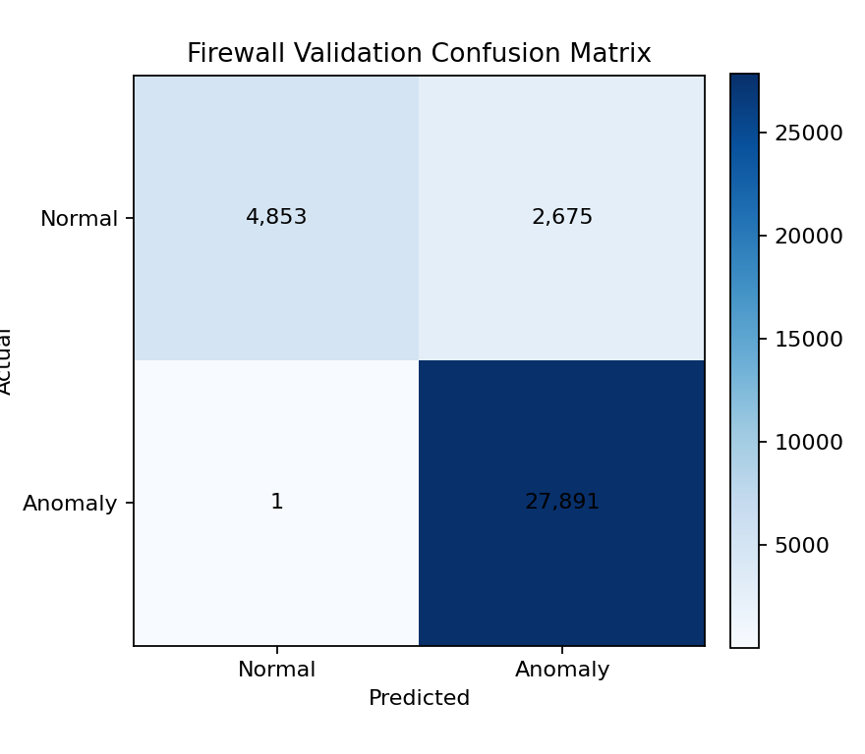
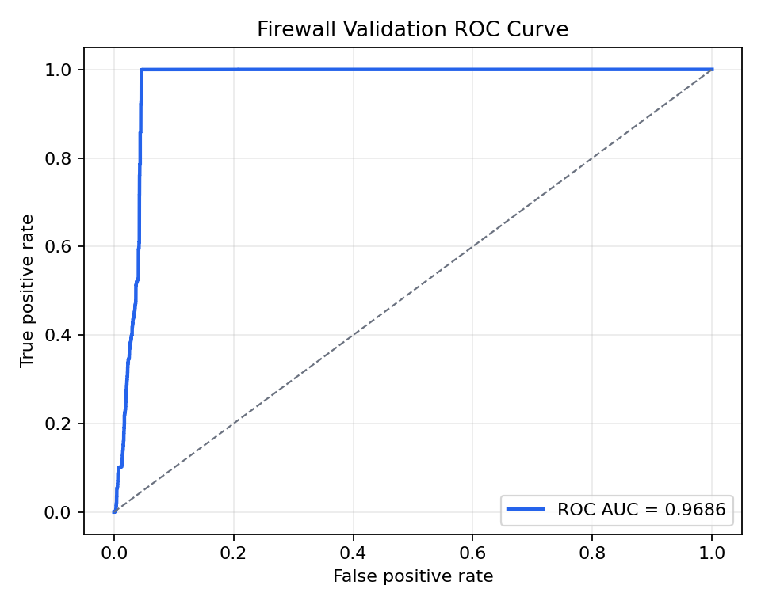
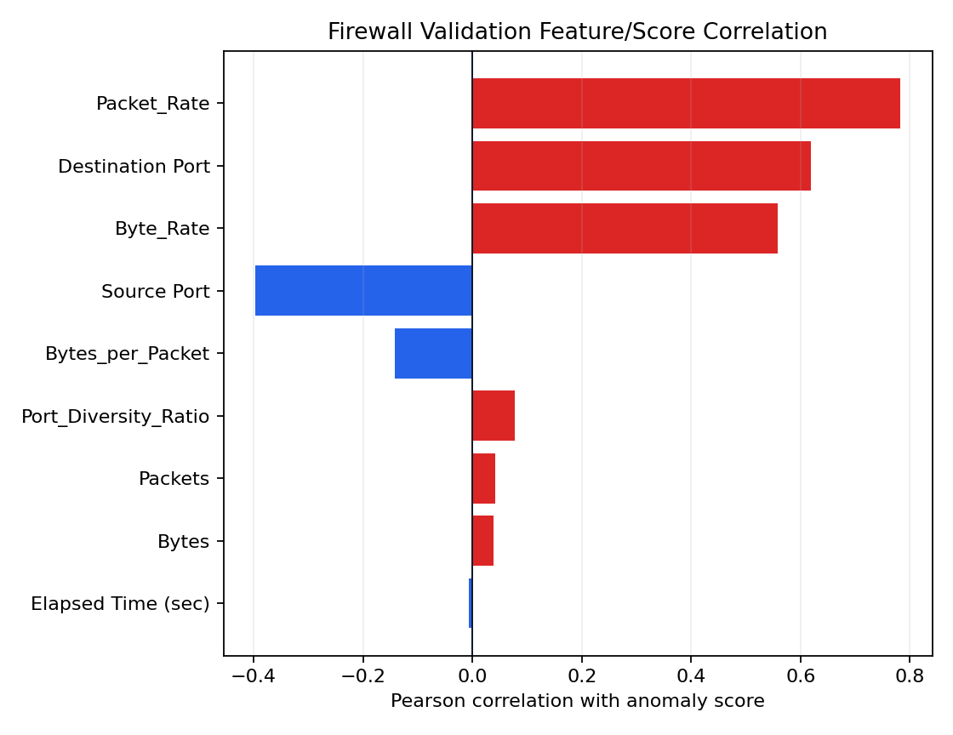
Firewall Results
Rows: 35,420 | ROC-AUC: 0.9686 | PR-AUC: 0.9787
confusion matrix
roc curve
feature score correlation
Ground-truth evaluation uses the Action field.
Strong PR-AUC indicates useful anomaly ranking.
Features capture traffic volume, rate, and port ratios.

Slide 11
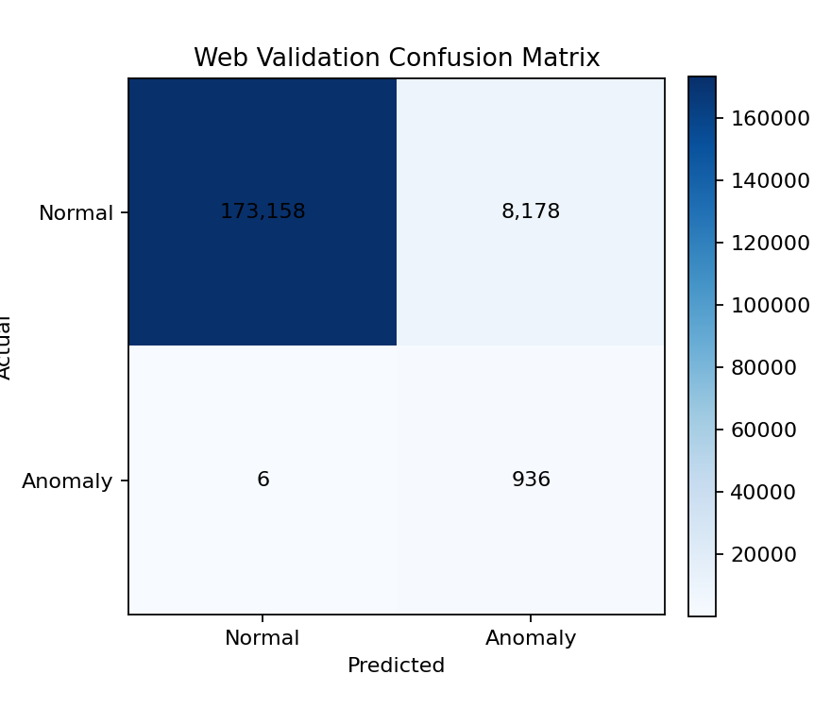
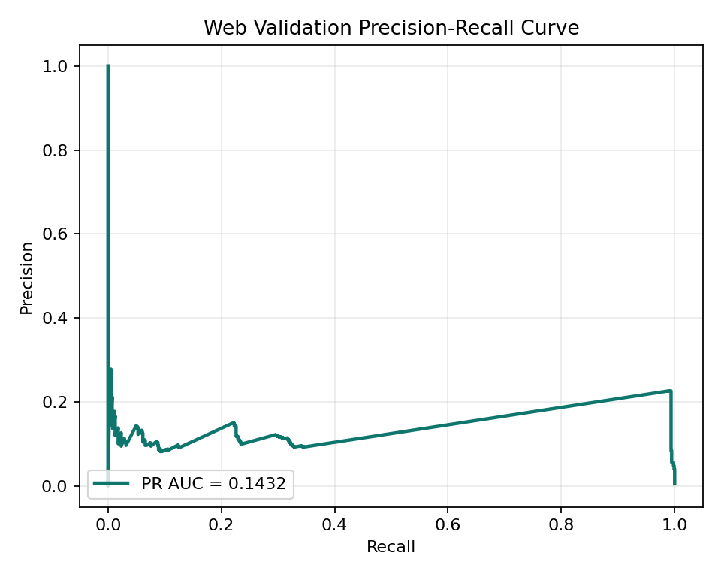
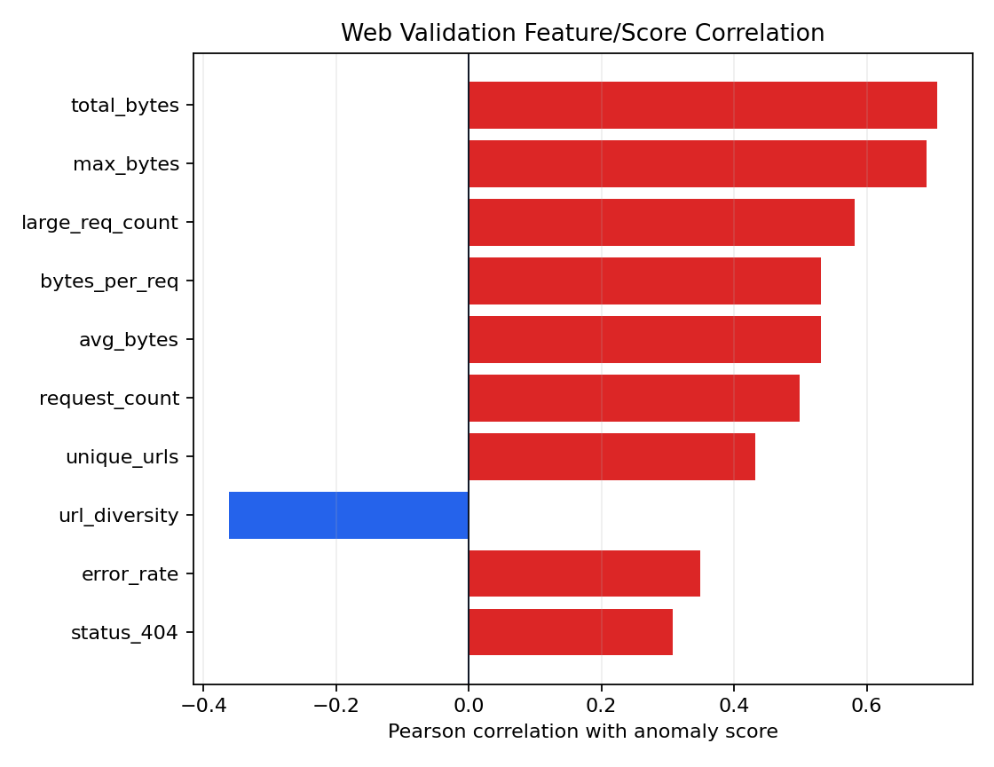
Web Results
Rows: 182,278 | ROC-AUC: 0.9855 | PR-AUC: 0.1432
confusion matrix
precision recall curve
feature score correlation
Evaluation uses error-rate pseudo labels.
PR-AUC is constrained by severe class imbalance.
Hourly host windows make behavior trends visible.

Slide 12
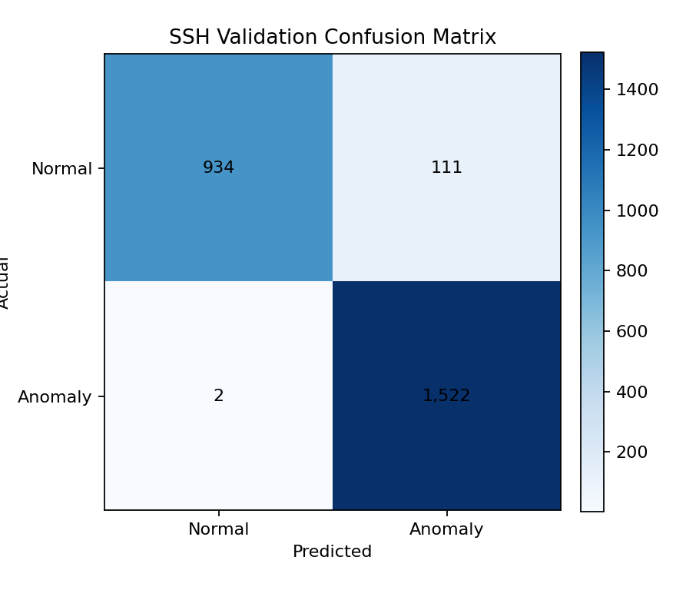
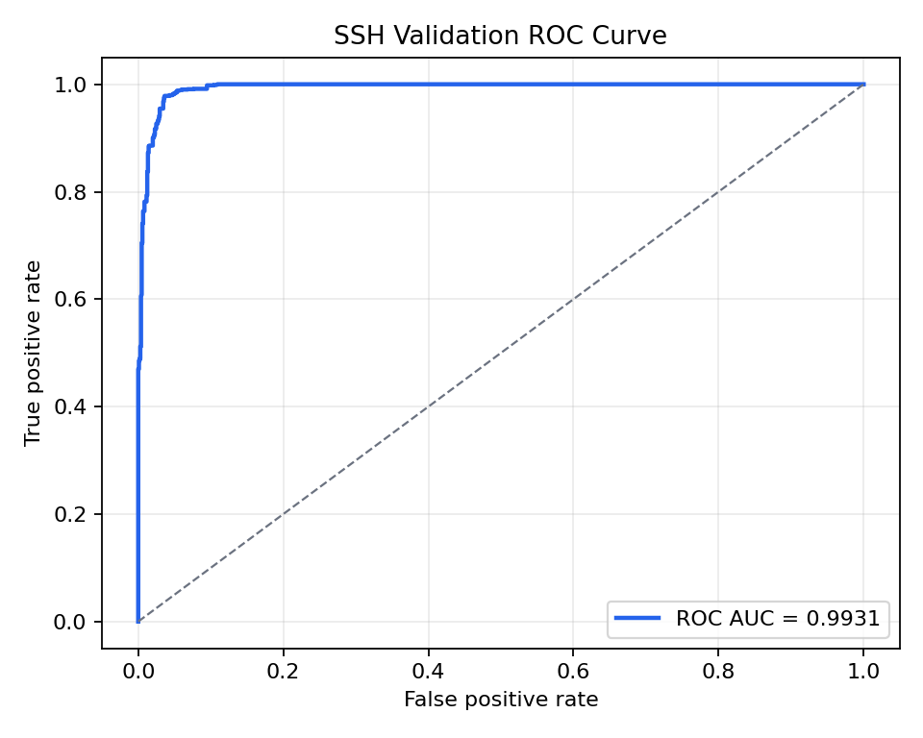
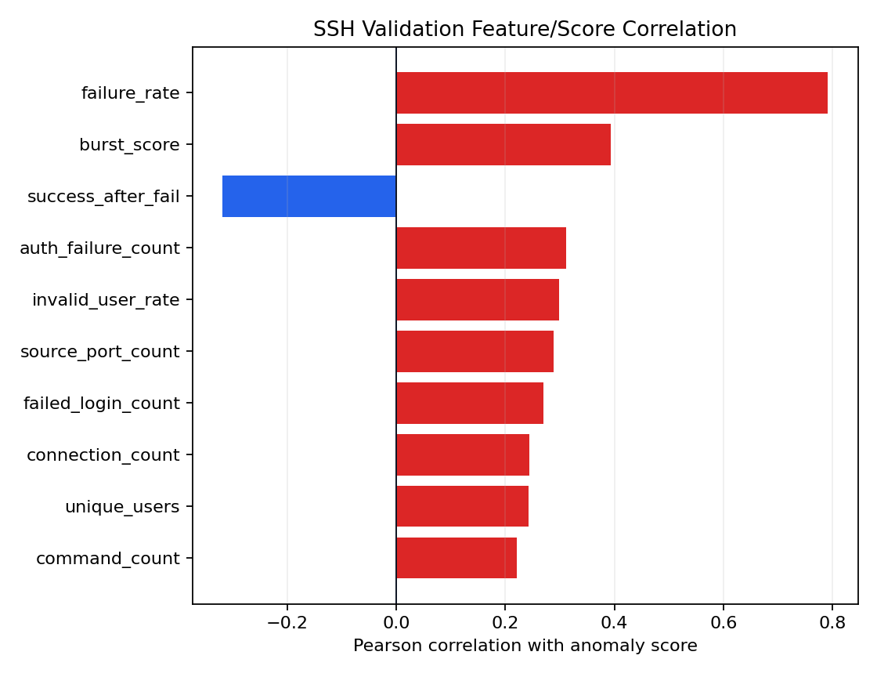
SSH Results
Rows: 2,569 | ROC-AUC: 0.9931 | PR-AUC: 0.9946
confusion matrix
roc curve
feature score correlation
Evaluation uses behavior-rule pseudo labels.
10-minute source-IP windows capture brute-force patterns.
Feature correlations expose suspicious login dynamics.

Slide 13
Live Scoring
The generator writes synthetic Firewall, Web, and SSH logs into local live log files.
The listener tails those files, applies the matching feature pipeline, and writes JSONL prediction files.
Firewall is row-based; Web and SSH are window-based but emit a fresh score after each accepted line updates its window.
Each prediction includes model, scored_at, prediction, is_anomaly, anomaly_score, risk_score, and status fields.

Slide 14
Kibana Dashboard
Docker Compose runs Elasticsearch, Kibana, and Logstash.
Logstash tails raw logs and score JSONL files through bind mounts.
Kibana panels show prediction trends, anomaly mix, average risk, raw log volume, firewall actions, web status outcomes, SSH login status, and top SSH source-IP risk.
Normalized status_label fields make Web and SSH visualizations easier to read.

Slide 15
Limitations
Web and SSH evaluations rely on pseudo labels rather than complete expert labels.
Isolation Forest detects unusual behavior; it does not classify attack families.
The live generator is synthetic and intended for integration testing and demonstration.
Feature/score correlation is interpretability support, not causal explanation.

Slide 16
Reproducibility
Create a Python virtual environment and install requirements.txt.
Run each model's preprocess, train, and evaluate scripts from the repository root.
Run .\evaluation\evaluate_all_models.py to regenerate metrics and figures.
Start ELK with .\elk\start_elk.ps1 and install dashboards with .\elk\setup_kibana.ps1.
Run .\live\listen_and_score.py and .\live\generate_logs.py in separate PowerShell terminals.

Slide 17
Conclusion
The project provides a repeatable multi-source anomaly-detection baseline.
The folder architecture makes model-specific pipelines consistent and maintainable.
Evaluation artifacts support offline analysis and academic reporting.
Docker ELK integration turns local live files into useful operational dashboards.

