Slide 1
Who I am
Lahoucine Digrari, 23 years old, Agadir City
I have Two brothers,
Baccalaureate in mathematics (2020)
Bachelor degree in mathematics and science (2023)
Master degree in Data Science (2025)
Oracle (2025)
Notes:
> So why am I talking about this? Because calisthenics is genuinely a big part of my life.
>
> When I stop training for a while, I feel it. Not just physically — mentally. Something feels off. Like I'm missing a piece of my routine.
>
> It also really helps me with stress. After a long day at work, a good set of pull-ups just clears my head. Better than any app or meditation — sorry, not sorry.
>
> And honestly, it's just about balance. Feeling grounded. Feeling like I'm in control of something, even when everything else is chaotic.
>
> So yeah — that's calisthenics for me. It's simple. You don't need a fancy gym or a personal trainer. Just a bar, some discipline, and maybe a bit of stubbornness. But it has a real impact. Thanks!

Slide 2
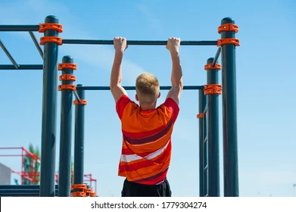
Calisthenics
more than just a hobby
Lahoucine
since 2019
Notes:
Hey everyone! So today I'm going to talk about something that's been part of my life for a while now, calisthenics. I started back in 2019, and honestly, it kind of became a whole lifestyle thing. Let me tell you about it.

Slide 3
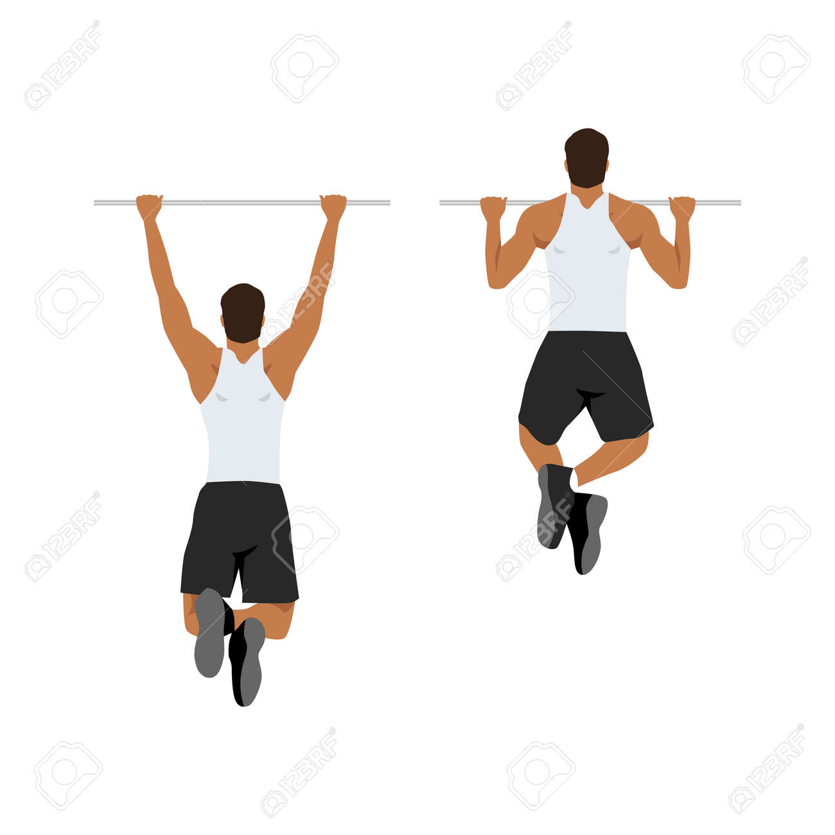
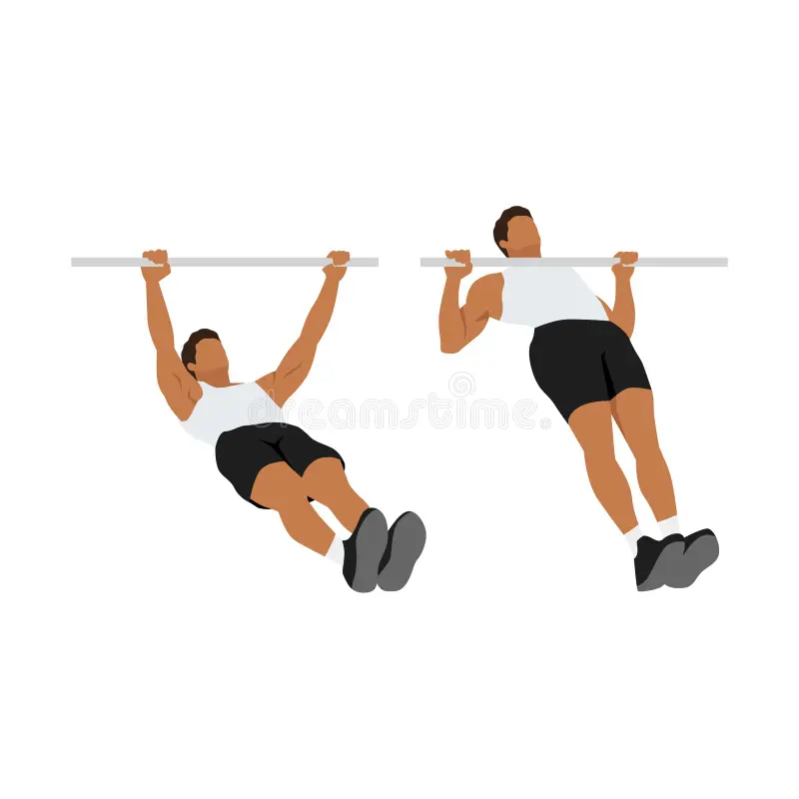
What is Calisthenics?
Training using your own body weight as resistance. Bars, rings, parallettes, but no dumbbells, no machines.
Push-ups, Pull-ups, Dips, Muscle-ups
The core movements, your body is the only weight
Bars, rings, parallettes
You use equipment, but never external weights
Not gym / not weightlifting
No dumbbells, no machines, just bodyweight resistance
Train anywhere
Parks, home, outdoors, wherever there's a bar
Notes:
> So first — what even is calisthenics? Basically, it's training using your own bodyweight. No dumbbells, no weight machines — just you. Push-ups, pull-ups, dips, muscle-ups...
>
> Now, that doesn't mean zero equipment — you definitely use stuff like bars, rings, parallettes. But the weight? That's always YOU. Your body is the resistance.
>
> That's what makes it different from gym or weightlifting. Nobody's asking "how much do you bench?" — it's more like "can you do a muscle-up?" or "how long can you hold a front lever?"
>
> And the nice thing is, you can do it pretty much anywhere there's a bar. Parks, home, a random playground... you figure it out.

Slide 4
My Journey
It wasn't always a straight line, but it kept pulling me back.
2019
Faculty years
The Instagram phase
Discovered calisthenics. Started push-ups in my room, then found a park nearby. Got hooked immediately.
Life got busy. Stopped a few times, laziness, exams, lack of time. But always came back.
Tried posting training videos. It was fun for a bit... then I deleted everything. No regrets though.
Notes:
> So my journey started in 2019. I discovered it kind of randomly — started doing push-ups in my room, then I found a park nearby with bars, and I got hooked.
>
> But I wasn't always consistent... When I started faculty, I stopped a few times. You know how it is — exams, laziness, "I'll start again next week"... classic.
>
> At one point I even tried making content on Instagram. Posted a few training videos, thought I was going to become a fitness influencer or something... Yeah, that lasted about two weeks. Deleted everything. No regrets though — it was funny while it lasted.

Slide 5
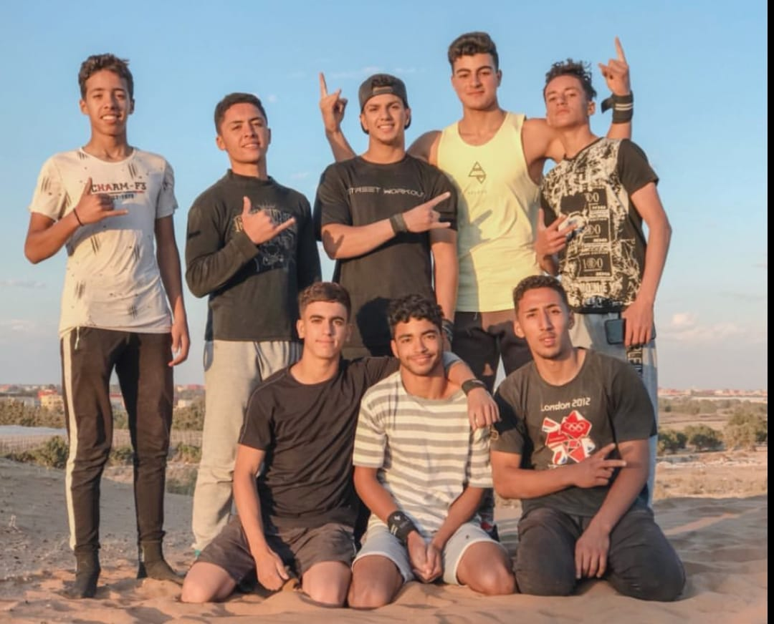
My Journey
October 17, 2019

Slide 6
How I Train
The setting changed, but the habit stayed.
Parks + friends
Casablanca
Home setup
The golden era. Training with friends in the park, laughing, competing, spotting each other. That energy is what made it addictive. The community aspect was the real motivation.
New city, fresh start. Tried to find spots, trained alone. It's not the same without a crew, but I kept going. Sometimes discipline has to replace motivation.
Current chapter. Got a multifunctional bar at home. Pull-ups, dips, rows, all from one corner of my apartment. Not really street workout anymore, but it keeps me moving.
Notes:
> At the beginning, the best part was training with friends in the park. That group energy is something else — you're competing, spotting each other, trying new moves, laughing when you fail... It's like a community.
>
> Then I moved to Casablanca, and I had to start from scratch. No crew, different city. I tried finding spots, trained alone. It's doable, but it's definitely not the same vibe.
>
> And now? Now I have a multifunctional bar at home. Pull-ups in the living room. Dips between two chairs. It's not exactly "street workout" anymore... but hey, it counts.

Slide 7
Why It Matters to Me
It's part of who I am
When I stop training for a while, something feels off. It's become woven into my routine and identity.
Stress goes away
After a tough day at work, a good set of pull-ups clears my head better than anything else.
Mental balance
It's not just about muscles, it's about feeling grounded, focused, and in control of my own body.
"It's simple, but it has a big impact on me."
Notes:
> So why am I talking about this? Because calisthenics is genuinely a big part of my life.
>
> When I stop training for a while, I feel it. Not just physically — mentally. Something feels off. Like I'm missing a piece of my routine.
>
> It also really helps me with stress. After a long day at work, a good set of pull-ups just clears my head. Better than any app or meditation — sorry, not sorry.
>
> And honestly, it's just about balance. Feeling grounded. Feeling like I'm in control of something, even when everything else is chaotic.
>
> So yeah — that's calisthenics for me. It's simple. You don't need a fancy gym or a personal trainer. Just a bar, some discipline, and maybe a bit of stubbornness. But it has a real impact. Thanks!

