Slide 1
Building a Platform to Connect with Potential Agents and Facilitates Application Process and Hiring
PIP2001 Capstone Project
Review-1
Batch Number:
Under the Supervision of,
Prof. Ankita Bhaumik
School of Computer Science and Engineering
Presidency University
Roll Number | Student Name
20211CSD0073 | G HEMANTH KUMAR
20211CSD0128 | Guddattu Ravith Kumar
20211CSD0046 | Abhishek Shivlal Rathod
20221LSD0007 | Salmondavid F Potagoli
Name of the Program:Computer Science Of Engineering (Data Science)
Name of the HoD: Dr. Saira Bhanu
Name of the Program Project Coordinator: Dr. Manjula H M
Name of the School Project Coordinators: Dr. Sampath A K / Dr. Abdul Khadar A / Mr. Md Ziaur Rahman

Slide 2
Introduction
Smart Hiring is an innovative job portal built using the MERN (MongoDB, Express, React, Node.js) stack, designed to streamline the recruitment process for both employers and job seekers. It leverages cutting-edge AI to enhance its Applicant Tracking System (ATS), optimizing resumes for better job matching. The platform uses intelligent algorithms to analyze job descriptions and resumes, ensuring that candidates’ skills and qualifications align with employers' needs. By integrating AI-driven resume optimization, Smart Hiring improves job application success rates, making the hiring process faster, smarter, and more efficient for all parties involved.

Slide 3
Literature Review
The increasing demand for efficient recruitment processes has led to significant advancements in job portals and applicant tracking systems (ATS). Traditional job portals have evolved, incorporating artificial intelligence (AI) and machine learning techniques to improve the hiring process. This review examines the relevant literature that forms the foundation for the development of Smart Hiring, a job portal that combines the MERN stack with AI-driven resume optimization.

Slide 4
Literature Review Cont’d
Evolution of Job Portals and Recruitment Systems
Applicant Tracking Systems (ATS) and Resume Screening
AI in Recruitment and Resume Optimization
MERN Stack and Web Development for Job Portals
Impact of AI-Driven Resume Optimization on Hiring

Slide 5
Existing method Drawback
Keyword-Based Resume Filtering
Lack of Personalization in Job Matching
Inefficient Resume Parsing
Manual Resume Optimization by Job SeekersBias in Hiring Decisions
Bias in Hiring Decisions
Slow and Inefficient Recruitment Process

Slide 6
Proposed Method
AI-Driven Contextual Resume Analysis
Personalized Job Recommendations Using Machine Learning
Advanced Resume Parsing with AI
AI-Powered Resume Optimization Tools for Job Seekers
Bias Mitigation Using AI in ATS
Automated and Streamlined Recruitment Process
Scalable and Responsive MERN Stack Architecture
Real-Time Analytics and Reporting

Slide 7
Objectives
Enhance Job Matching Accuracy
Streamline the Recruitment Process
Provide Personalized Job Recommendations
Optimize Resumes for ATS Systems
Support Scalability and High Performance
Improve User Experience and Engagement
Reduce Recruitment Costs

Slide 8
Methodology/Modules
The development of Smart Hiring follows a structured methodology that integrates cutting-edge technologies like AI, machine learning, and the MERN (MongoDB, Express, React, Node.js) stack. The platform is designed to address key limitations of traditional job portals and enhance the recruitment process for both employers and job seekers.

Slide 9
Methodology/Modules
Requirement Analysis and Problem Definition
System Architecture Design (MERN Stack)
AI and Machine Learning Integration
Development of AI-Powered Resume Optimization Tool
Automation of Recruitment Processes
User Interface and Experience (UI/UX) Development
Testing and Quality Assurance
Deployment and Continuous Improvement

Slide 10
Software Used
The Smart Hiring platform is designed using the MERN stack (MongoDB, Express, React, Node.js) to ensure scalability, high performance, and efficient handling of recruitment-related data. This architecture integrates AI components for resume parsing, job matching, and optimization while leveraging the strengths of each layer in the MERN stack.
Frontend Layer: React
Technology Used: React.js
Backend Layer: Express and Node.js
Technology Used: Express.js and Node.js
Database Layer: MongoDB

Slide 11
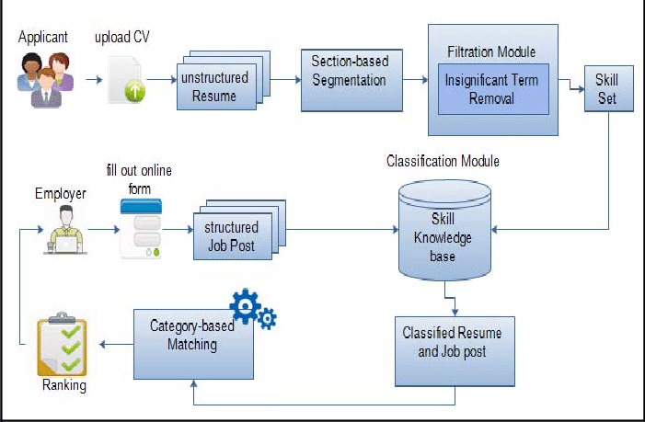
Architecture

Slide 12
Timeline of Project
Task | Week 1 | Week 2 | Week 3 | Week 4 | Week 5 | Week 6 | Week 7
Planning and Strategy Development | ✓ | ✓
Software Architecture and Design |  |  | ✓
Backend Development |  |  | ✓ | ✗
Frontend Development |  |  |  | ✗
Testing and Quality Assurance |  |  |  |  | ✗
User Acceptance Testing |  |  |  |  | ✗
Continuous Improvement |  |  |  |  |  | ✗ | ✗

Slide 13
Expected Outcomes
Enhanced Candidate-Job Matching Accuracy
Improved Resume Success with ATS Systems
Streamlined Recruitment Process for Employers
Reduced Bias in Hiring Decisions
Increased Job Seeker Engagement and Satisfaction
Higher Conversion Rates for Job Applications
Reduced Time-to-Hire for Employers

Slide 14
Conclusion
The Smart Hiring job portal, powered by the MERN stack and AI-driven ATS resume optimization, represents a transformative solution for modern recruitment challenges. By integrating AI into the hiring process, the platform not only enhances the accuracy and relevance of job matching but also optimizes candidates' resumes to improve their chances of passing through ATS systems. This benefits both job seekers, who can tailor their resumes for better visibility, and employers, who can more efficiently screen and rank candidates based on relevance and qualifications.
In conclusion, Smart Hiring creates a win-win scenario in the recruitment space by leveraging cutting-edge technology to streamline the hiring process, reduce biases, and improve the quality of matches, ultimately leading to more successful and efficient recruitment outcomes.

Slide 15
Github Link
https://github.com/H-e-manth/Capstone__CSD-G31.git

Slide 16
References
S. Agarwal, R. Patel, and M. Verma, “Multi-Crop Disease Classification Using CNN and Web-Based Deployment,” IEEE Transactions on Computational Agriculture, vol. 35, no. 4, pp. 1589-1598, Apr. 2023.
D. Zhang, K. Zhao, and Y. Lee, “CNN-Based Plant Disease Detection with Deployment on AWS,” IEEE Access, vol. 9, pp. 10212-10225, Feb. 2022.
H. Singh, P. Gupta, and V. Reddy, “Deploying Scalable Deep Learning Models for Agriculture on Cloud Platforms,” IEEE Transactions on Cloud Computing, vol. 10, no. 5, pp. 1154-1162, Mar. 2021.
“Mordent Online Job Portal Website Page” Available: (Access Date: 05 July 2016)
http://projects-seminars.net/Thread-i-t-job-portal
“Systems development life cycle (SDLC)” Available: (Access Date: 11 August 2016)
https://en.wikipedia.org/wiki/Systems_development_life_cycle
“Waterfall Model description” Available: (Access Date: 20 August 2016) https://www.tutorialspoint.com/sdlc/sdlc_waterfall_model.htm
“Waterfall Model Advan-Disadvan” Available: (Access Date: 12 September 2016) http://istqbexamcertification.com/what-is-waterfall-model-advantages

Slide 17
Thank You

