Slide 1
BERT Architecture & Coding Exercise

Slide 2
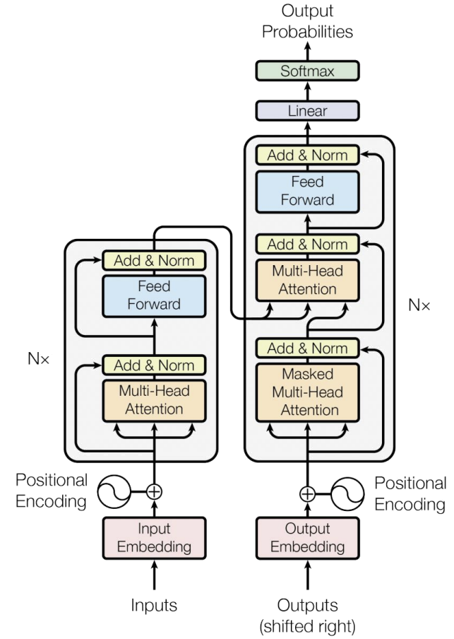
Top View of Architecture
Decoder
Encoder
Attention all you need paper

Slide 3
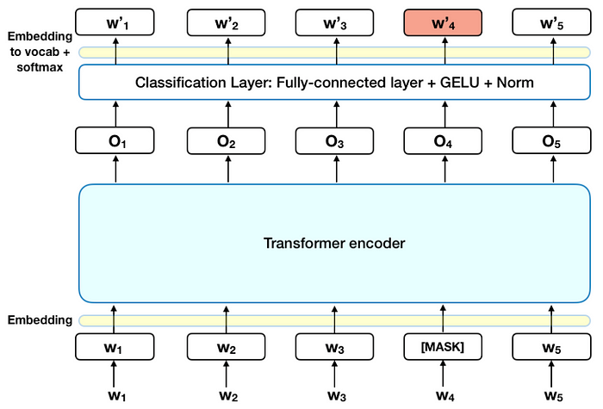
Evolution of Transformers - BERT
31

Slide 4
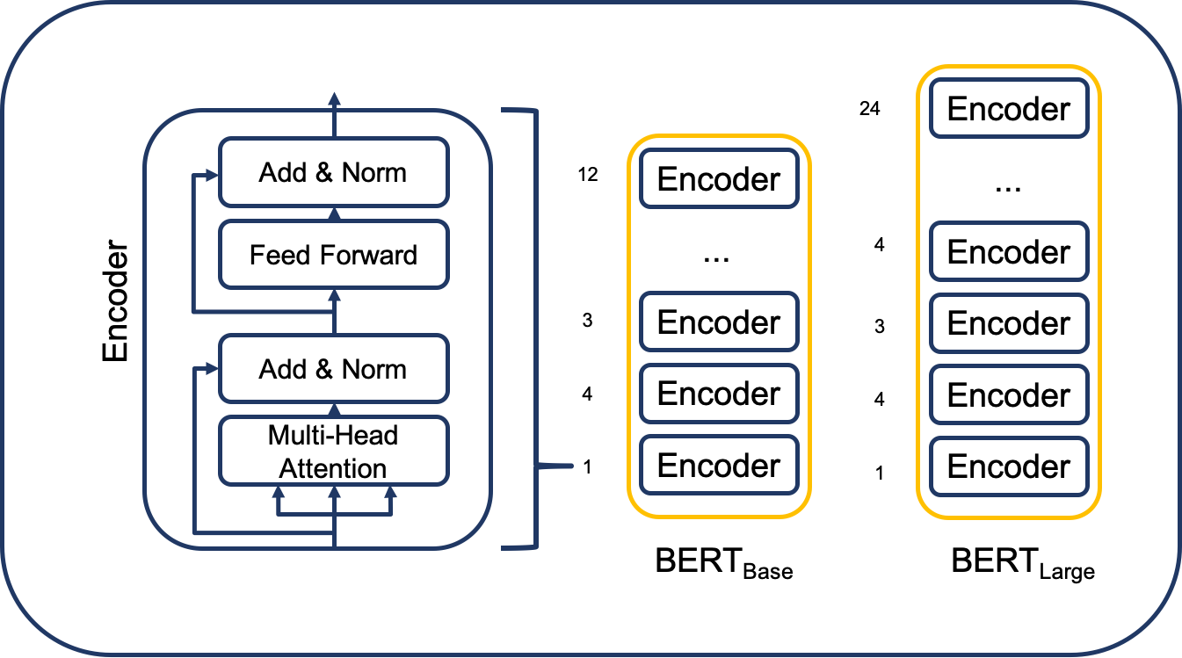
Evolution of Transformers - BERT
The architecture of BERT is a multilayer bidirectional transformer encoder which is quite similar to the transformer model. A transformer architecture is an encoder-decoder network that uses self-attention on the encoder side and attention on the decoder side.
BERT has 12 layers in the Encoder stack. These are more than the Transformer architecture described in the original paper (6 encoder layers).
BERT architectures also have larger feedforward networks (768 and 1024 hidden units respectively), and more attention heads (12 and 16 respectively) than the Transformer architecture suggested in the original paper. It contains 512 hidden units and 8 attention heads.
BERT contains 110M parameters

Slide 5
Evolution of Transformers - BERT
BERT's Architecture:
BERT stands for Bidirectional Encoder Representations from Transformers.
It is built only from the encoder part of the Transformer architecture.
The encoder:
Processes input text tokens.
Computes contextualized representations for each token by attending to all other tokens in the input sequence (bidirectional attention).
2. Purpose of BERT:
BERT is designed primarily for language understanding tasks like:
Sentiment analysis.
Named entity recognition (NER).
Question answering.
Text classification.
These tasks require understanding and encoding information from the input but do not generate new sequences.

