Slide 1
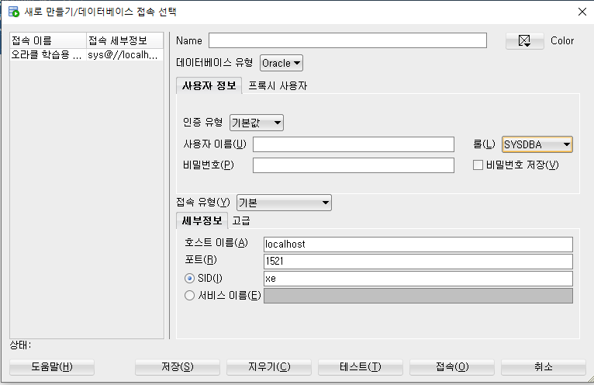
새접속
오라클 학습용 서버
sys/oracle
Sysdba 선택
테스트
저장
접속해서

Slide 2
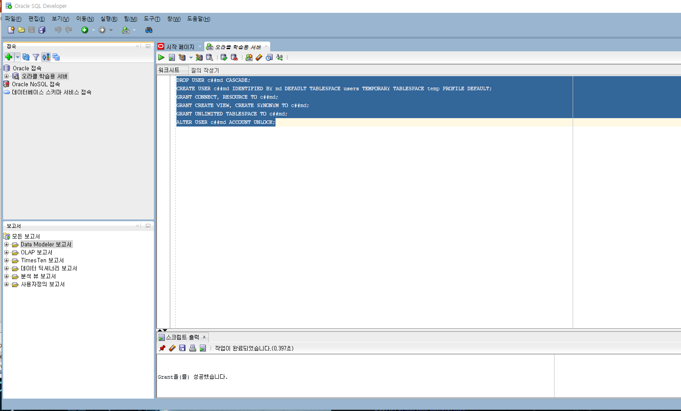
오라클 학습용 서버 에서 유저 등록 작업하기
유저 등록 작업
작성해서 실행

Slide 3
DROP USER c##md CASCADE;
CREATE USER c##md IDENTIFIED BY md DEFAULT TABLESPACE users TEMPORARY TABLESPACE temp PROFILE DEFAULT;
GRANT CONNECT, RESOURCE TO c##md;
GRANT CREATE VIEW, CREATE SYNONYM TO c##md;
GRANT UNLIMITED TABLESPACE TO c##md;
ALTER USER c##md ACCOUNT UNLOCK;

Slide 4
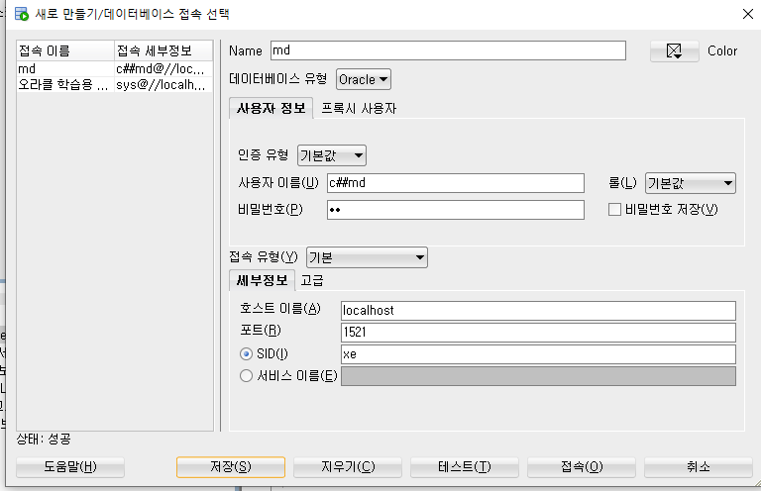
c##md/md
테스트
저장하고
접속해서 사용

Slide 5
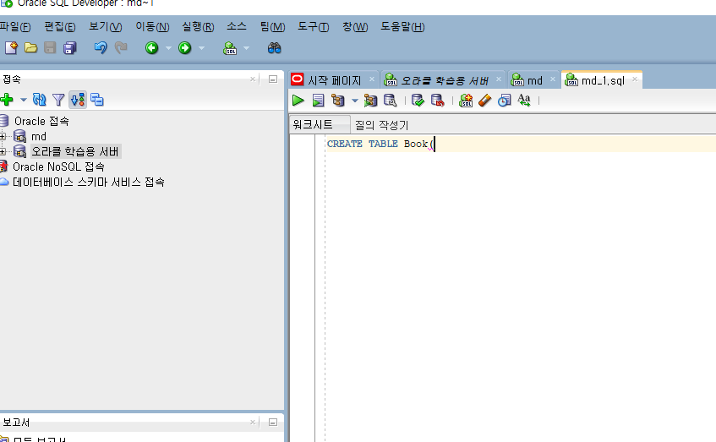
md를 클릭하면 새로운 워크 시트가 생성

Slide 6
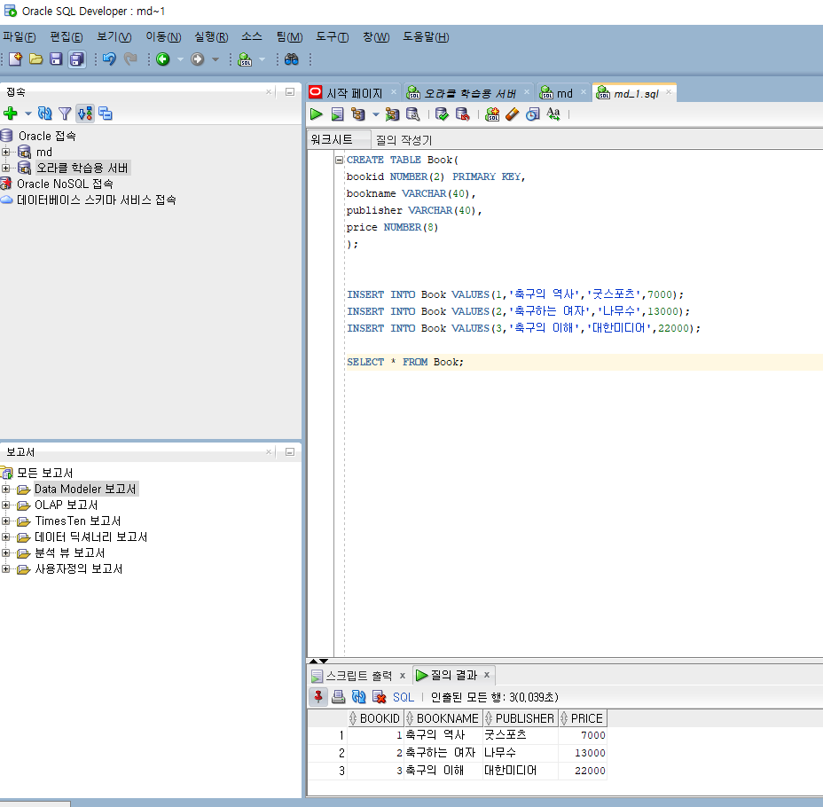
새워크 시트에서 TEST
CREATE TABLE Book(
bookid NUMBER(2) PRIMARY KEY,
bookname VARCHAR(40),
publisher VARCHAR(40),
price NUMBER(8)
);
INSERT INTO Book VALUES(1,'축구의 역사','굿스포츠',7000);
INSERT INTO Book VALUES(2,'축구하는 여자','나무수',13000);
INSERT INTO Book VALUES(3,'축구의 이해','대한미디어',22000);
SELECT * FROM Book;

Slide 7
DROP TABLE Orders cascade constraints purge;
DROP TABLE Book cascade constraints purge;
DROP TABLE Customer cascade constraints purge;
DROP TABLE Imported_Book cascade constraints purge;
CREATE TABLE Book (
bookid NUMBER(2) PRIMARY KEY,
bookname VARCHAR2(40),
publisher VARCHAR2(40),
price NUMBER(8)
);
CREATE TABLE Customer (
custid NUMBER(2) PRIMARY KEY,
name VARCHAR2(40),
address VARCHAR2(50),
phone VARCHAR2(20)
);
CREATE TABLE Orders (
orderid NUMBER(2) PRIMARY KEY,
custid NUMBER(2) REFERENCES Customer(custid),
bookid NUMBER(2) REFERENCES Book(bookid),
saleprice NUMBER(8),
orderdate DATE
);
/* Book, Customer, Orders 데이터 생성 */
INSERT INTO Book VALUES(1, '축구의 역사', '굿스포츠', 7000);
INSERT INTO Book VALUES(2, '축구아는 여자', '나무수', 13000);
INSERT INTO Book VALUES(3, '축구의 이해', '대한미디어', 22000);
INSERT INTO Book VALUES(4, '골프 바이블', '대한미디어', 35000);
INSERT INTO Book VALUES(5, '피겨 교본', '굿스포츠', 8000);
INSERT INTO Book VALUES(6, '역도 단계별기술', '굿스포츠', 6000);
INSERT INTO Book VALUES(7, '야구의 추억', '이상미디어', 20000);
INSERT INTO Book VALUES(8, '야구를 부탁해', '이상미디어', 13000);
INSERT INTO Book VALUES(9, '올림픽 이야기', '삼성당', 7500);
INSERT INTO Book VALUES(10, 'Olympic Champions', 'Pearson', 13000);
INSERT INTO Customer VALUES (1, '박지성', '영국 맨체스타', '000-5000-0001');
INSERT INTO Customer VALUES (2, '김연아', '대한민국 서울', '000-6000-0001');
INSERT INTO Customer VALUES (3, '장미란', '대한민국 강원도', '000-7000-0001');
INSERT INTO Customer VALUES (4, '추신수', '미국 클리블랜드', '000-8000-0001');
INSERT INTO Customer VALUES (5, '박세리', '대한민국 대전', NULL);
INSERT INTO Orders VALUES (1, 1, 1, 6000, TO_DATE('2020-07-01','yyyy-mm-dd'));
INSERT INTO Orders VALUES (2, 1, 3, 21000, TO_DATE('2020-07-03','yyyy-mm-dd'));
INSERT INTO Orders VALUES (3, 2, 5, 8000, TO_DATE('2020-07-03','yyyy-mm-dd'));
INSERT INTO Orders VALUES (4, 3, 6, 6000, TO_DATE('2020-07-04','yyyy-mm-dd'));
INSERT INTO Orders VALUES (5, 4, 7, 20000, TO_DATE('2020-07-05','yyyy-mm-dd'));
INSERT INTO Orders VALUES (6, 1, 2, 12000, TO_DATE('2020-07-07','yyyy-mm-dd'));
INSERT INTO Orders VALUES (7, 4, 8, 13000, TO_DATE('2020-07-07','yyyy-mm-dd'));
INSERT INTO Orders VALUES (8, 3, 10, 12000, TO_DATE('2020-07-08','yyyy-mm-dd'));
INSERT INTO Orders VALUES (9, 2, 10, 7000, TO_DATE('2020-07-09','yyyy-mm-dd'));
INSERT INTO Orders VALUES (10, 3, 8, 13000, TO_DATE('2020-07-10','yyyy-mm-dd'));
CREATE TABLE Imported_Book (
bookid NUMBER,
bookname VARCHAR(40),
publisher VARCHAR(40),
price NUMBER(8)
);
INSERT INTO Imported_Book VALUES(21, 'Zen Golf', 'Pearson', 12000);
INSERT INTO Imported_Book VALUES(22, 'Soccer Skills', 'Human Kinetics', 15000);
COMMIT;

Slide 8
새접속
오라클 학습용 서버에서
DROP USER c##hr CASCADE;
CREATE USER c##hr IDENTIFIED BY hr DEFAULT TABLESPACE users TEMPORARY TABLESPACE temp PROFILE DEFAULT;
GRANT CONNECT, RESOURCE TO c##hr;
GRANT CREATE VIEW, CREATE SYNONYM TO c##hr;
GRANT UNLIMITED TABLESPACE TO c##hr;
ALTER USER c##hr ACCOUNT UNLOCK;

Slide 9
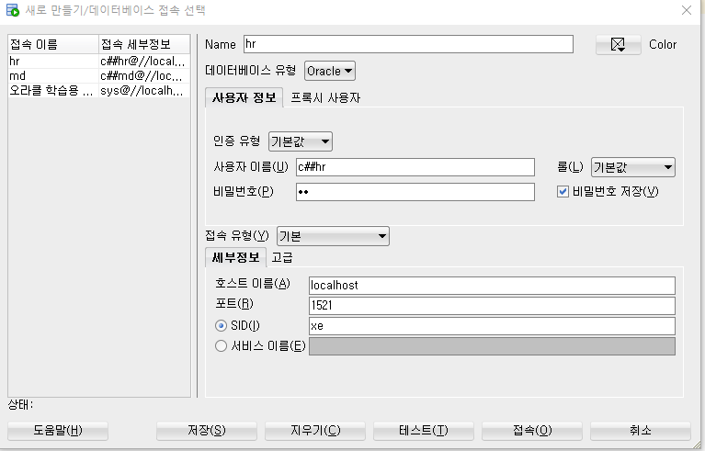
c##hr/hr
테스트
저장하고
접속해서 사용

