Slide 1
数据科学导论
机器学习的实践
韩仁达 蒋新发

Slide 2
作业1 使用 sklearn 处理wine 和wine_quality数据集
(1)使用pandas 库分别读取wine数据集和win_quality数据集。
(2)将wine数据集和wine_quality数据集的数据和标签拆分开。
(3)将wine_quality数据集划分为训练集和测试集。
(4)标准化wine数据集和wine_quality 数据集。
(5)对wine数据集和wine_quality数据集进行PCA 降维。

Slide 3
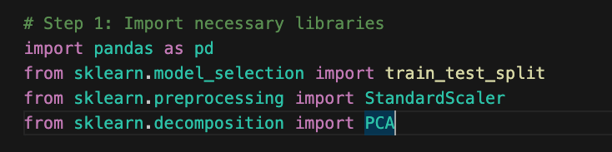
1.引入包
import pandas as pd
from sklearn.model_selection import train_test_split
from sklearn.preprocessing import StandardScaler
from sklearn.decomposition import PCA

Slide 4

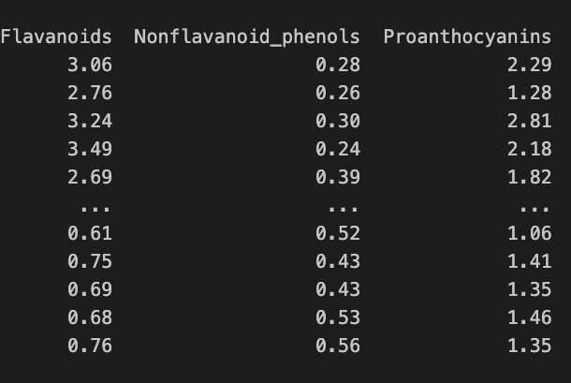
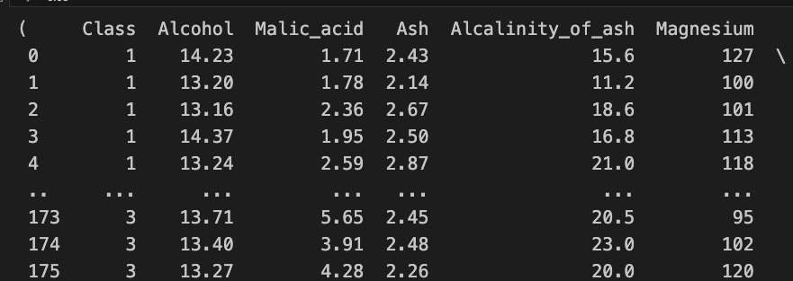
2. 加载数据集
wine_data = pd.read_csv('wine.csv')
wine_quality_data = pd.read_csv('winequality.csv')

Slide 5
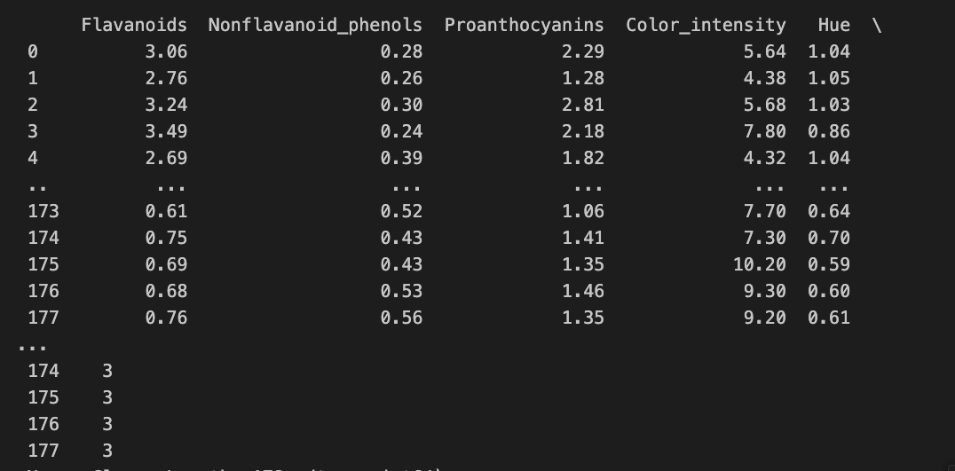
3: Split the datasets into features and labels
# For wine dataset
wine_features = wine_data.drop('Class', axis=1)
wine_labels = wine_data['Class']

Slide 6
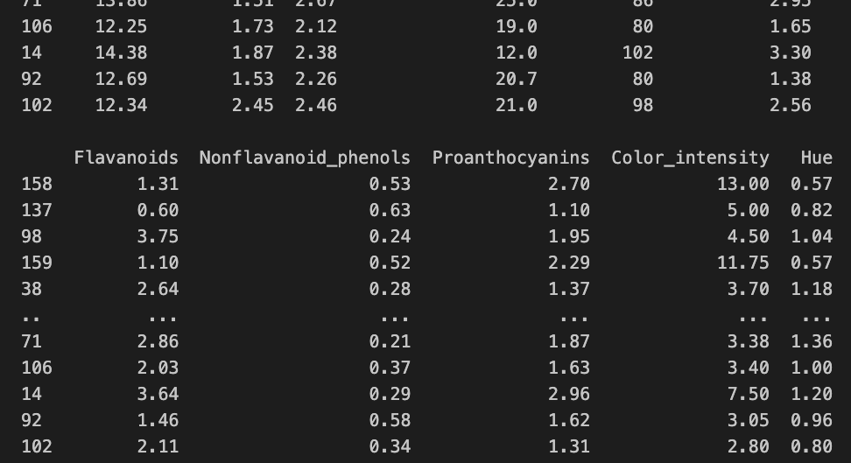
4. 分割训练和数据集
# Step 4: Split the wine dataset into training and testing sets
wine_features_train, wine_features_test, wine_labels_train, wine_labels_test = train_test_split(
wine_features, wine_labels, test_size=0.2, random_state=42)

Slide 7
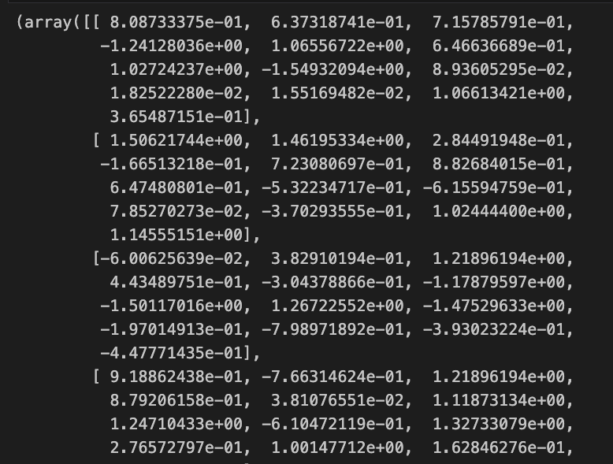
5. 标准化特征和标签
# Step 5: Standardize the wine dataset
scaler = StandardScaler()
wine_features_train_standardized = scaler.fit_transform(wine_features_train)
wine_features_test_standardized = scaler.transform(wine_features_test)
wine_quality_features_train_standardized = scaler.fit_transform(wine_quality_features_train)
wine_quality_features_test_standardized = scaler.transform(wine_quality_features_test)

Slide 8
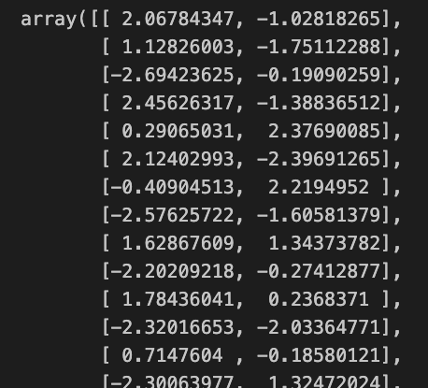
6. PCA分析
# Step 6: Apply PCA for dimensionality reduction
pca_wine = PCA(n_components=2)
wine_features_train_pca = pca_wine.fit_transform(wine_features_train_standardized)
wine_features_test_pca = pca_wine.transform(wine_features_test_standardized

Slide 9
Assignment 2
(1)根据任务1的wine数据集处理的结果，构建聚类数目为3的K-Means 模型。
(2)对比真实标签和聚类标签求取FMI。
(3)在聚类数目为2~10类时，确定最优聚类数目。
(4)求取模型的轮廓系数，绘制轮廓系数折线图，确定最优聚类数目。
(5)求取Calinski-Harabasz指数，确定最优聚类数目。

Slide 10
1: Build K-Means model with 3 clusters
kmeans = KMeans(n_clusters=3, random_state=42)
wine_clusters = kmeans.fit_predict(wine_features_train_standardized)
# Step 2: Compare true labels with cluster labels using Fowlkes-Mallows Index
fmi_score = fowlkes_mallows_score(wine_labels_train, wine_clusters)
print(f"Fowlkes-Mallows Index: {fmi_score}")

Slide 11
Compare true labels with cluster labels using Fowlkes-Mallows Index
# Step 2: Compare true labels with cluster labels using Fowlkes-Mallows Index
fmi_score = fowlkes_mallows_score(wine_labels_train, wine_clusters)
print(f"Fowlkes-Mallows Index: {fmi_score}")
Fowlkes-Mallows Index: 0.9280318290748156

Slide 12
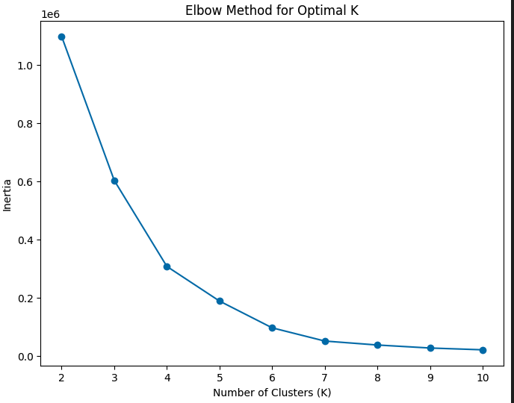
3: Determine the optimal number of clusters (2 to 10)
cluster_range = range(2, 11)
inertia_values = []
for n_clusters in cluster_range:
kmeans = KMeans(n_clusters=n_clusters, random_state=42)
kmeans.fit(wine_features_test)
inertia_values.append(kmeans.inertia_)
plt.figure(figsize=(8, 6))
plt.plot(cluster_range, inertia_values, marker='o')
plt.title('Elbow Method for Optimal K')
plt.xlabel('Number of Clusters (K)')
plt.ylabel('Inertia')
plt.show()

Slide 13
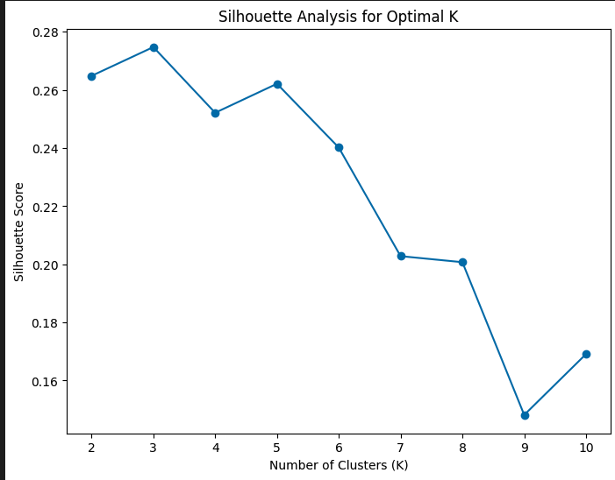
4: Silhouette analysis to determine the optimal number of clusters
silhouette_scores = []
for n_clusters in cluster_range:
kmeans = KMeans(n_clusters=n_clusters, random_state=42)
cluster_labels = kmeans.fit_predict(wine_features_train_standardized)
silhouette_scores.append(silhouette_score(wine_features_train_standardized, cluster_labels))
# Plot the Silhouette scores
plt.figure(figsize=(8, 6))
plt.plot(cluster_range, silhouette_scores, marker='o')
plt.title('Silhouette Analysis for Optimal K')
plt.xlabel('Number of Clusters (K)')
plt.ylabel('Silhouette Score')
plt.show()

Slide 14
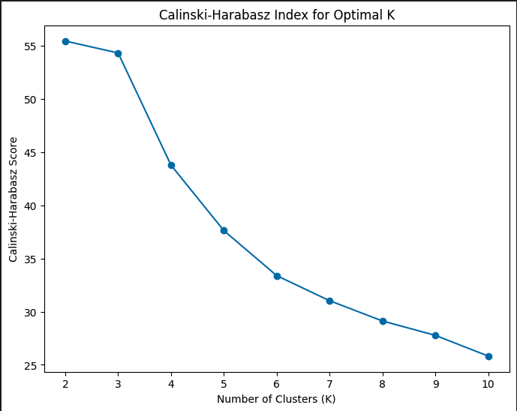
# Step 5: Calinski-Harabasz index to determine the optimal number of clusters
ch_scores = []
for n_clusters in cluster_range:
kmeans = KMeans(n_clusters=n_clusters, random_state=42)
cluster_labels = kmeans.fit_predict(wine_features_train_standardized)
ch_scores.append(calinski_harabasz_score(wine_features_train_standardized, cluster_labels))
# Plot the Calinski-Harabasz scores
plt.figure(figsize=(8, 6))
plt.plot(cluster_range, ch_scores, marker='o')
plt.title('Calinski-Harabasz Index for Optimal K')
plt.xlabel('Number of Clusters (K)')
plt.ylabel('Calinski-Harabasz Score')
plt.show()

Slide 15
任务 3
(1)读取wine数据集，区分标签和数据。
(2)将wine数据集划分为训练集和测试集。
(3)使用离差标准化方法标准化wine数据集。
(4)构建SVM模型，并预测测试集结果。
(5)打印出分类报告，评价分类模型性能。

Slide 16
代码
# 构建SVM模型
svm_model = SVC(kernel='linear', C=1) # 可以选择不同的核函数和超参数
svm_model.fit(wine_features_train_standardized, wine_labels_train)
# 预测测试集结果
svm_predictions = svm_model.predict(wine_features_test_standardized)
# 打印分类报告，评价模型性能
print("Classification Report:")
print(classification_report(wine_labels_test, svm_predictions))
# 打印准确度
accuracy = accuracy_score(wine_labels_test, svm_predictions)
print(f"Accuracy: {accuracy}")

Slide 17
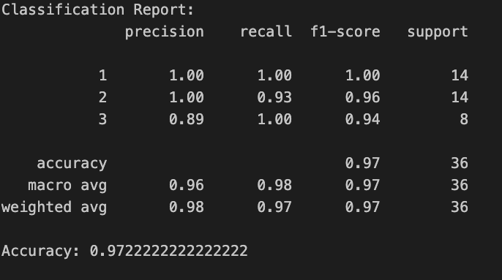

Slide 18
任务4
(1)根据wine_quality数据集处理的结果，构建线性回归模型。
(2)根据wine_quality数据集处理的结果，构建梯度提升回归模型。
(3)结合真实评分和预测评分，计算均方误差、中值绝对误差、可解释方差值。
(4)根据得分，判定模型的性能优劣。

Slide 19
评价模型性能
linear_regression_model = LinearRegression()
linear_regression_model.fit(wine_features_train_standardized, wine_labels_train)
# 构建梯度提升回归模型
gradient_boosting_model = GradientBoostingRegressor(random_state=42)
gradient_boosting_model.fit(wine_quality_features_train, wine_quality_labels_train)
# 预测测试集
linear_regression_predictions = linear_regression_model.predict(wine_features_test_standardized)
gradient_boosting_predictions = gradient_boosting_model.predict(wine_quality_features_test)

Slide 20
评价模型性能
def evaluate_regression_model(true_labels, predicted_labels, model_name):
mse = mean_squared_error(true_labels, predicted_labels)
mae = median_absolute_error(true_labels, predicted_labels)
evs = explained_variance_score(true_labels, predicted_labels)
print(f"\nEvaluation for {model_name} Model:")
print(f"Mean Squared Error (MSE): {mse}")
print(f"Median Absolute Error (MAE): {mae}")
print(f"Explained Variance Score (EVS): {evs}")
# 评价线性回归模型
evaluate_regression_model(wine_labels_test, linear_regression_predictions, "Linear Regression")
# 评价梯度提升回归模型
evaluate_regression_model(wine_quality_labels_test, gradient_boosting_predictions, "Gradient Boosting Regression")

Slide 21
评价模型性能
Evaluation for Linear Regression Model:
Mean Squared Error (MSE): 0.0685334846425599
Median Absolute Error (MAE): 0.15244943797343102
Explained Variance Score (EVS): 0.8826275483099185
Evaluation for Gradient Boosting Regression Model:
Mean Squared Error (MSE): 0.3623352320145906
Median Absolute Error (MAE): 0.43477646630172995
Explained Variance Score (EVS): 0.4468715482546276

