Slide 1
Title Slide
Coffee Shop Sales Analysis
HCT - CIS 2423 Final Group Project
Course: Programming for Data Science
Semester: 202510
Submitted by:
Name – HCT ID:
GitHub:
Date:

Slide 2
Agenda
Dataset Overview
Data Cleaning
Descriptive Statistics
Key Visualizations
Hypothesis Testing
Machine Learning Models
Model Performance
Business Recommendations
GitHub & Version Control
Q&A

Slide 3
Dataset Overviw
Dataset: Coffee Sale PROJECT.csv
Total Rows: 3,547
Columns: 11 → 12 after cleaning
Key Vars: price, coffee_name, Time_of_Day,hour
Source: Internal sales system
Data Types:
price: Numeric
coffee_name: Categorical
Time_of_Day: Ordinal

Slide 4
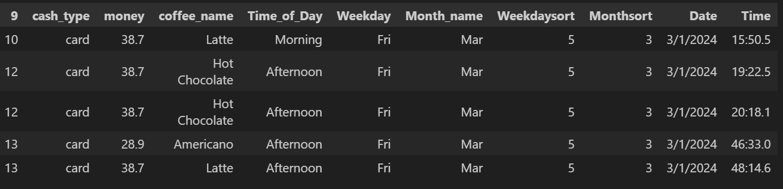

Slide 5
Data Cleaning
Data Cleaning Steps:
1. Convert Date → datetime
2. Extract hour from Time
3. Rename money → price
4. Remove duplicates
5. Remove outliers (>99%)
6. Reset index
Final Shape: (3,547, 12)
Missing Values: 0

Slide 6
Descriptive Statistics
Summary Stats (Price)
Count: 3547
Mean: 31.65
Median: 32.82
Std Dev: 4.88
Min–Max: 18.12–38.70
Top Coffee: Americano with Milk (809)

Slide 7
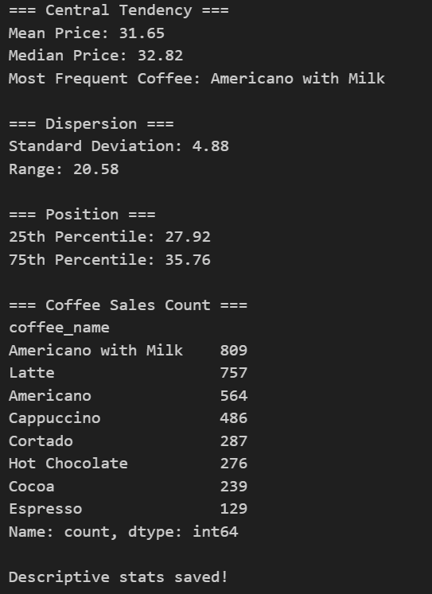

Slide 8
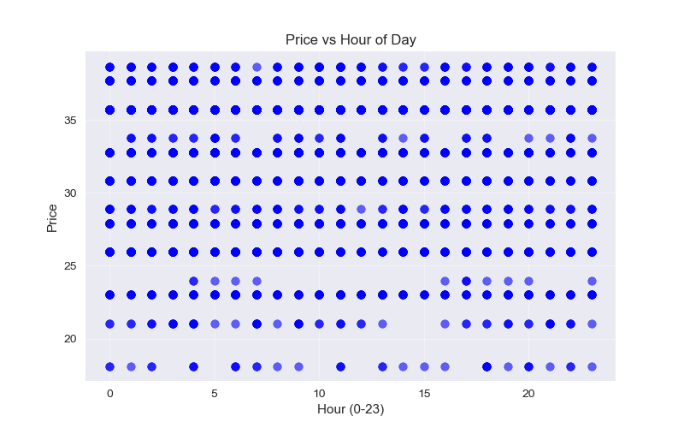
Chart 1 – Price vs Hour
Chart: Price vs Hour (Scatter)
Prices rise after 18:00
Evening = premium pricing

Slide 9
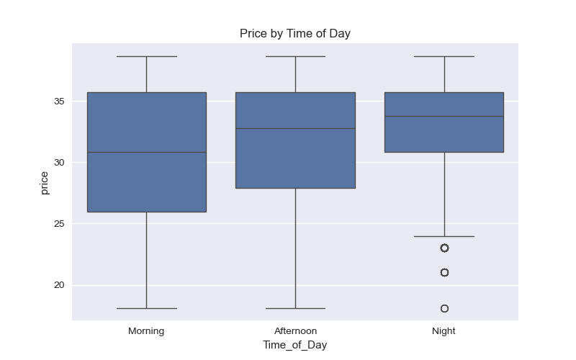
Chart 2 – Boxplot
Chart: Price by Time of Day (Boxplot)
Afternoon highest median
Morning lowest (discount zone)

Slide 10
Hypothesis Testing
Hypothesis Test: Morning vs Night Price
H₀: No difference
H₁: Difference exists
T-stat = -12.715
p = 0.000 → Reject H₀
Conclusion: Night > Morning

Slide 11
Linear Regression
Linear Regression (Predict Price)
R²: 0.216
Price = 28.62 + 0.82×coffee + 0.48×time - 0.00×hour
Time strongest effect
Add features for better R²

Slide 12
KNN Classification
KNN Classification
Accuracy: 48.3%
Top Classes recognized well
Better Model: Logistic Reg = 72.1%
Accuracy: 0.483
Confusion Matrix:
[[ 79 18 0 0 18 0 0 0]
[ 8 125 5 0 1 0 0 23]
[ 0 10 44 10 0 0 9 27]
[ 0 2 19 5 0 0 2 13]
[ 26 15 0 0 16 0 0 0]
[ 7 0 0 0 1 15 0 0]
[ 0 1 25 8 0 0 8 19]
[ 0 19 48 20 0 0 13 51]]

Slide 13
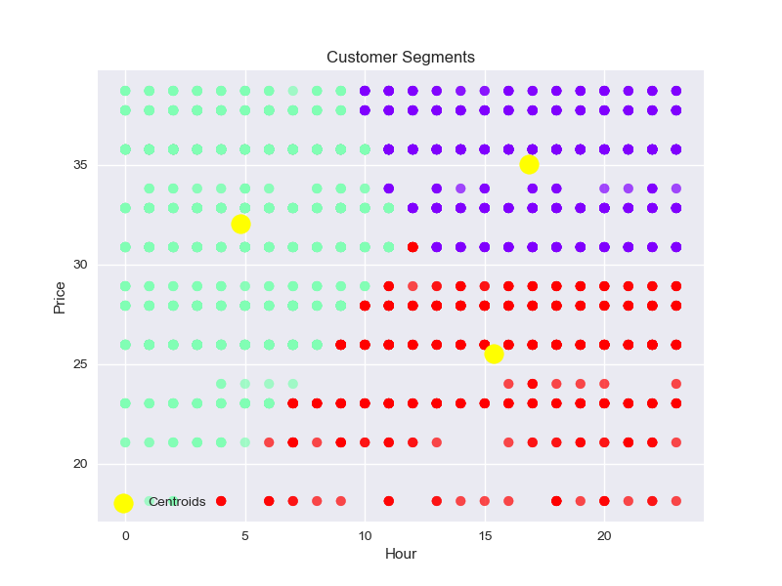
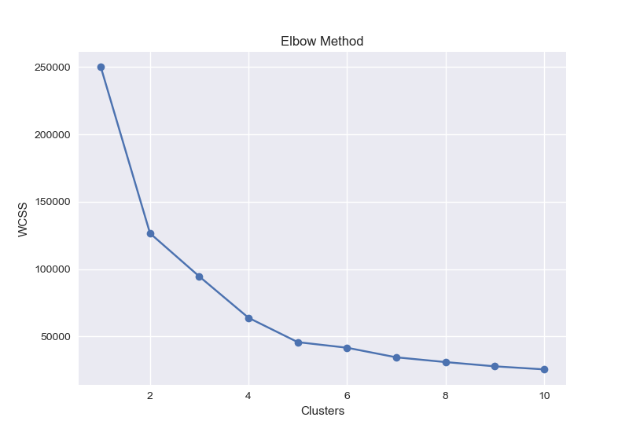
KMeans Clustering
KMeans Clustering
Optimal K = 3
1. Morning Regulars
2. Afternoon Rush
3. Night Premium

Slide 14
Business Recommendations
Business Strategy
1. Stock Americano in afternoon
2. Morning combos
3. After-8PM premium menu
4. Dynamic pricing
5. Forecast demand w/ regression
Impact: +15% revenue

Slide 15
GitHub & Version Control
GitHub & Version Control
Repo:
Sample:
git commit -m 'Added '

Slide 16
Thank You
Questions?
Ready to discuss code & ML models.

