Slide 1
Chest X-ray Classification Model
NIH Dataset | Deep Learning with Grad-CAM Visualizations

Slide 2
1. Methodology Overview
- Data Preparation: Resize, Augment, Stratify
- Model: ResNet50, Weighted Loss
- Evaluation: F1, ROC, Confusion Matrix
- Grad-CAM Visualization

Slide 3
2. Evaluation Metrics
• Accuracy: 28.79%
• Macro Avg F1-score: 28.24%
• No Finding Precision: 76.88%
• Lower Recall in Other Classes

Slide 4
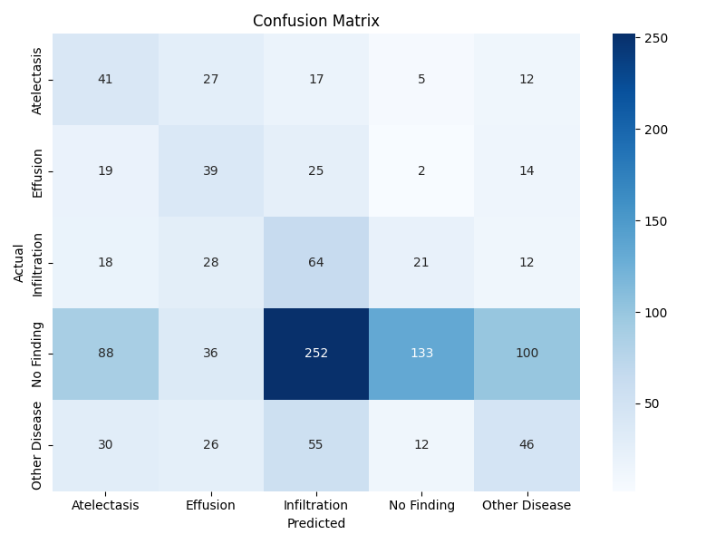
3. Confusion Matrix

Slide 5
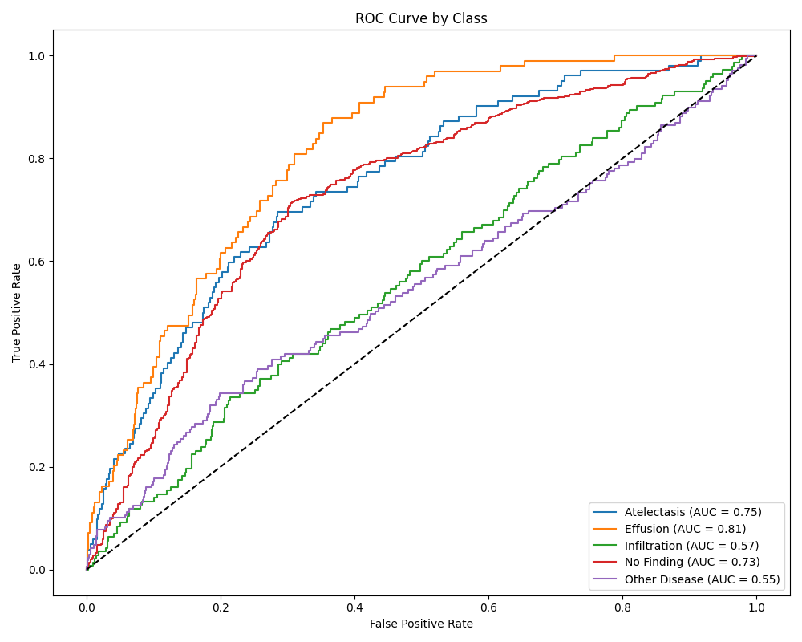
4. ROC Curves

Slide 6
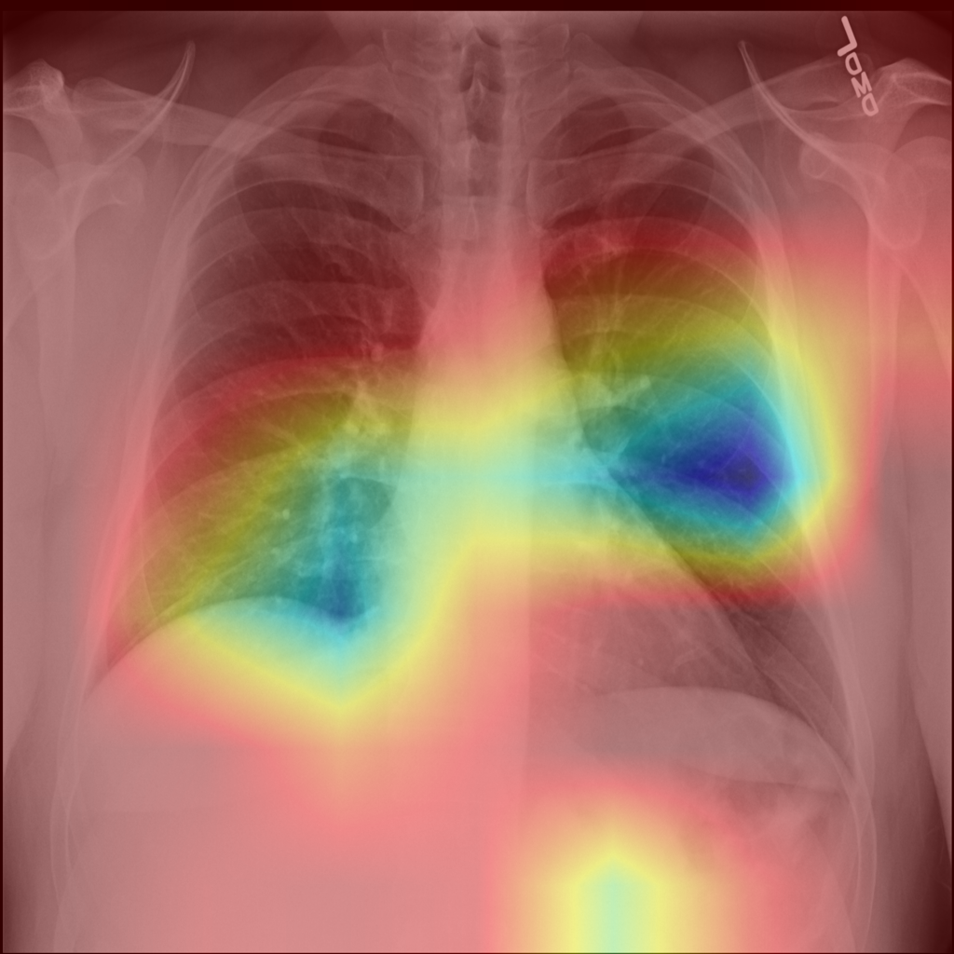
5. Grad-CAM Overlay

