Slide 1
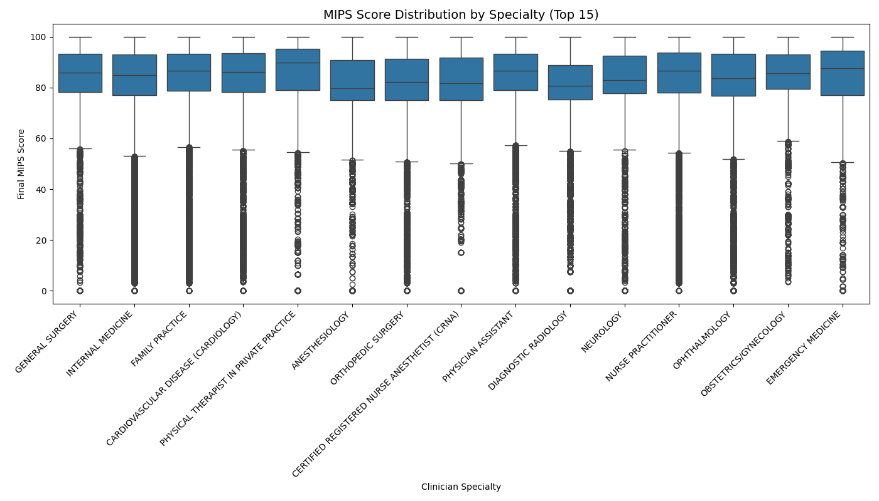
MIPS Score Distribution by Specialty (Top 15)

