Slide 1
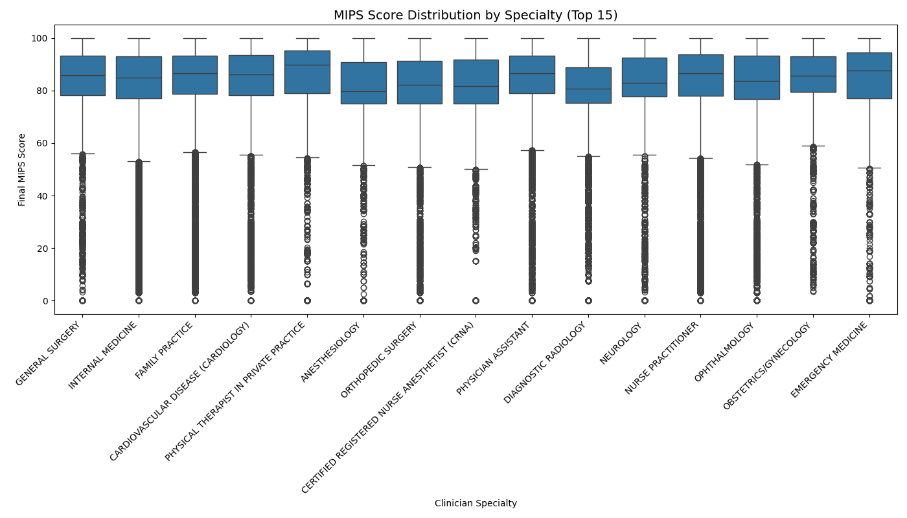
Top 15 Specialties by MIPS Score Distribution 2022 CMS Data

Slide 2
Top 15 Specialties by MIPS Score Distribution 2022 CMS Data
This boxplot shows MIPS score distributions for the 15 most common specialties.
Boxes represent IQRs, lines show medians, and dots indicate outliers.
Specialties like General Surgery and Cardiology trend higher, while Emergency Medicine shows wider variability.

