Slide 1
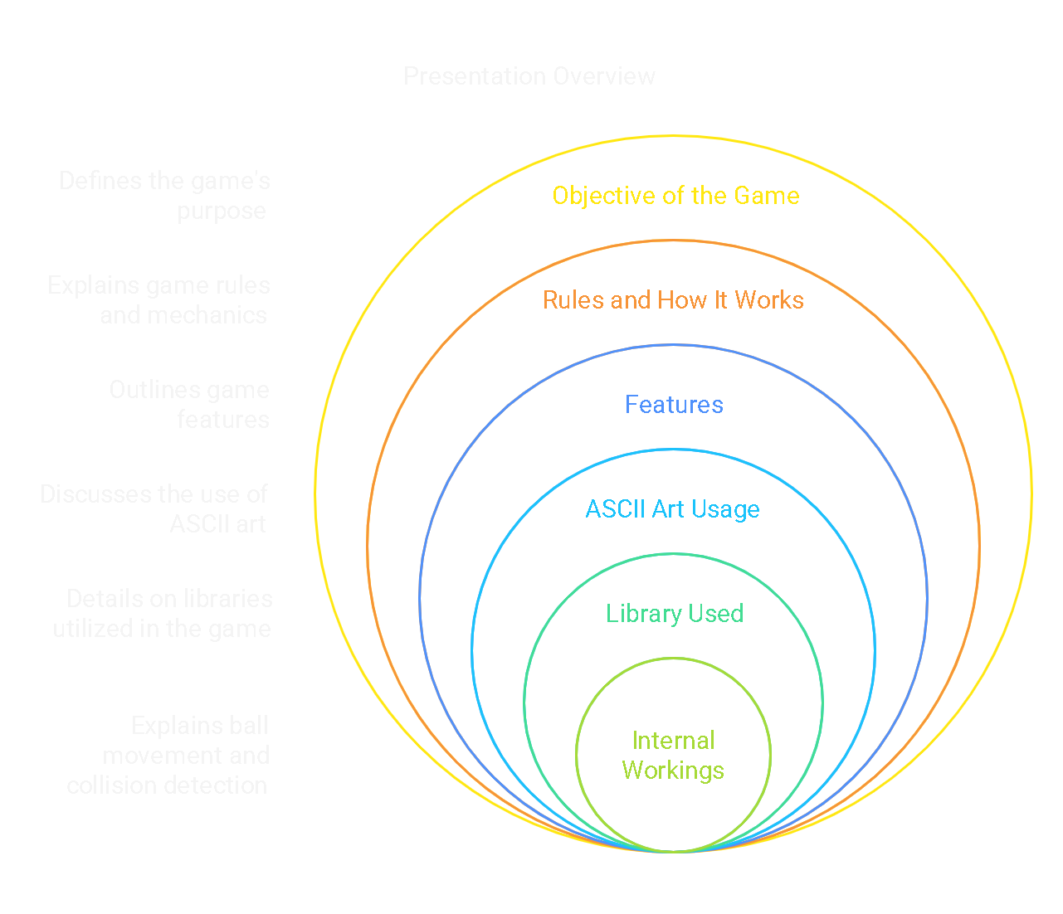
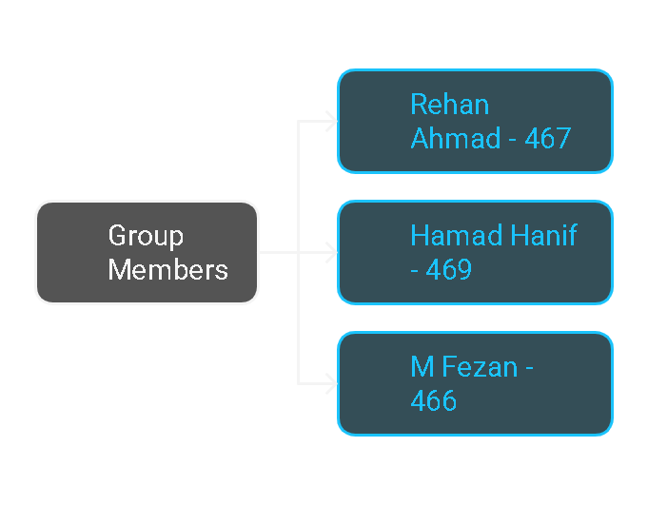
Brick Breaker Game - Game Overview

Slide 2
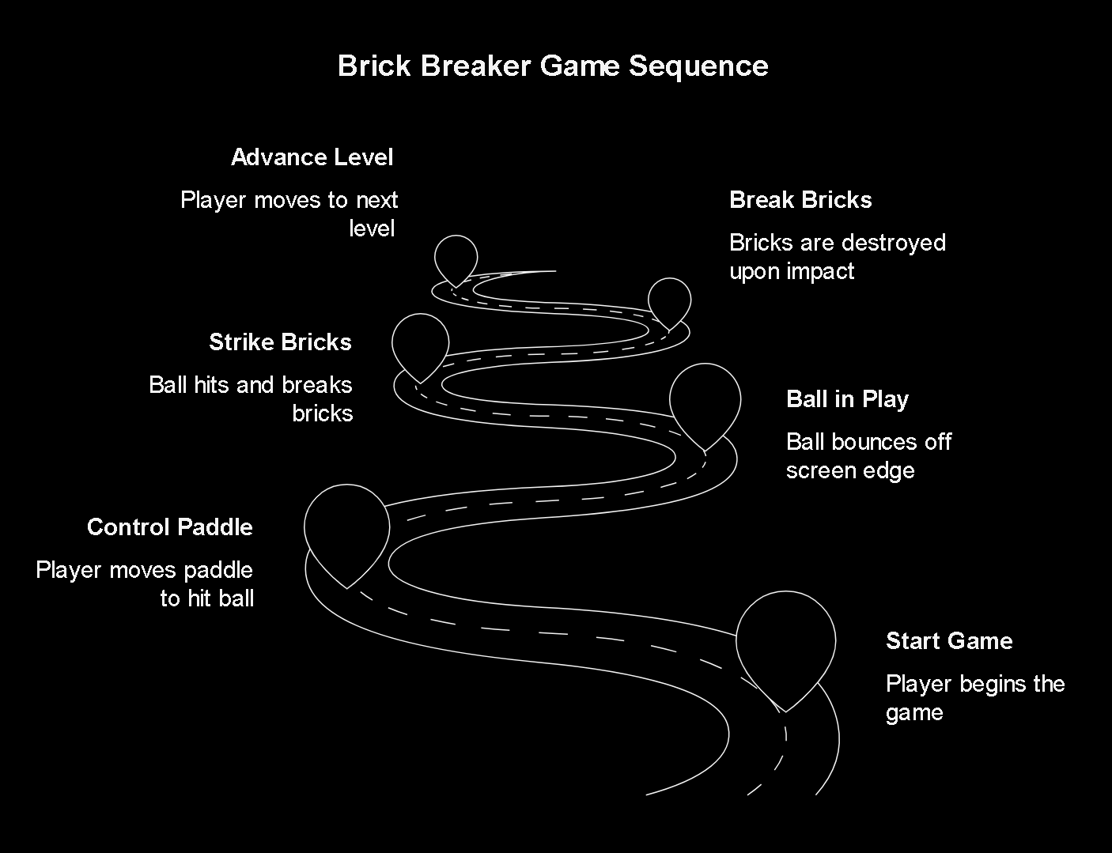
The Objective
Keep the ball in play
The player controls a paddle to keep the ball in play by bouncing it off the bottom edge of the screen.
Break bricks
By striking bricks with the ball, players aim to break them all and advance to the next level.
Completion Goal
Complete all 10 challenging levels to finish the game and become the ultimate Brick Breaker champion!

Slide 3
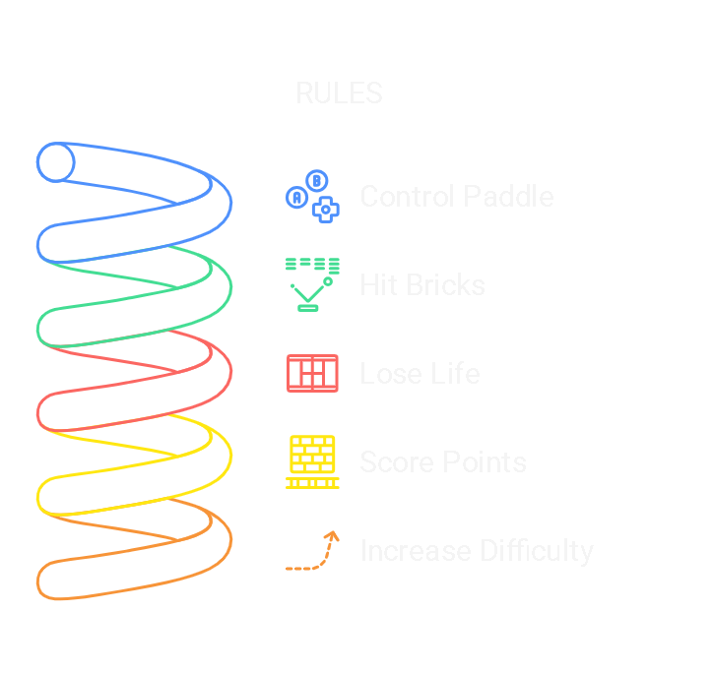
RULES:
Control the paddle using arrow keys or 'A' and 'D' keys to move left and right.
2. Break bricks by hitting them with the ball.
3. Lose a life if the ball falls below the paddle.
4. Score points for each brick broken.
5. Difficulty increases each level (more rows or more bricks).

Slide 4
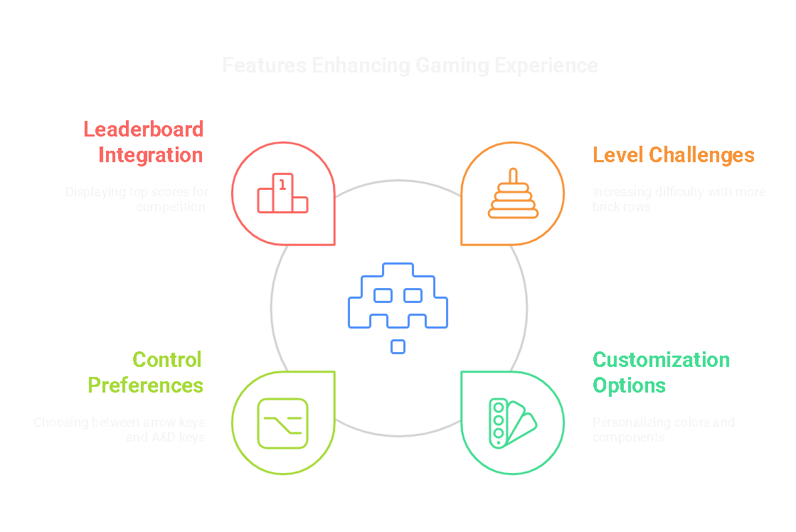
Key Gameplay Features
Multiple Levels with Increasing Difficulty
Each level presents a new challenge with increasing the number of brick rows up to a maximum of 9 and varying brick patterns.
Customization
--Players can change the background color and the colors of game components, like the ball, walls, paddle, and bricks, to personalize their gaming experience.
--Players can also switch to the preferable controls like
the arrow keys or (a) & (d) keys to move the paddle.
Leaderboard
Integrated a leaderboard that displays the top 10 scores ever made creating a sense of competition and achievement.

Slide 5
ASCII ART USAGE
1
Empty Space
4
Ball
The empty space is mapped by 0 which is further mapped as char(32) ascii of empty space.
The Ball is mapped by 5 which is further mapped as char(254) ascii of a ball shape.
2
Paddle
5
Upper and side walls
The paddle is mapped by 1 which is further mapped as char(219) ascii of paddle shaped.
The upper and side walls are mapped by 7 & 9 which is further mapped as char(219) ascii of a wall shaped.
3
Bricks
6
Lower wall / Death wall
The bricks is mapped by 2 which as further mapped as char(240) ascii of brick shape.
The death wall is mapped by 8 which is further mapped as char(233) ascii of a different wall shaped.

Slide 6
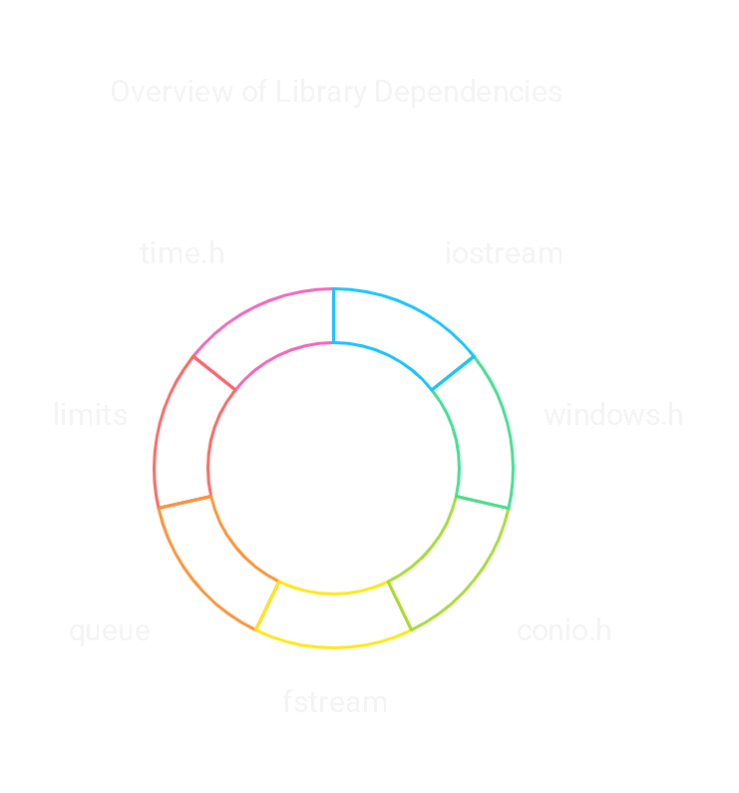
Libraries Used:
QUEUE
WINDOWS.H
CONIO.H
→Usage in
priority queue
for leaderboard
integreation.
→Redefining
properties of
console.
→HideCursor
→Defined x , y
coordinates
→For the input
for the paddle
→Using
_kbhit() and
_getch()
functions.
TIME.H
FSTREAM
→ Randomized brick generation
→Usage in
saving
The scores in a
Txt file for
Leaderboard
Data.
LIMITS
→For user input validation.

Slide 7
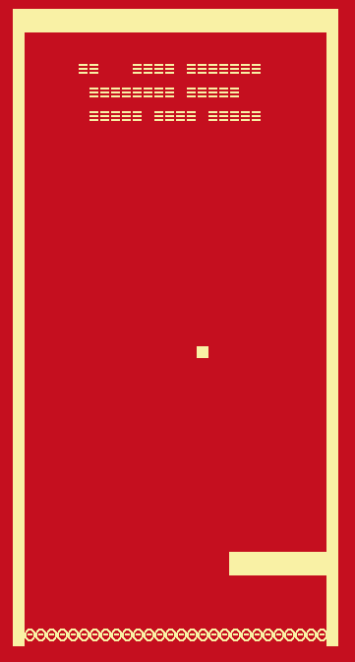
How the paddle moves ?
At first the direction of the paddle is
paddle.x = screenWidth / 2 - 5;
paddle.y = screenHeight - screenHeight / 7 - 1;
resulting in a centered paddle position.
L(left)
R(right)
S(Anything but L or R)
So , if user press left arrow then paddle.dir is set as ’ L‘ and the
Paddle will move in the left direction on the horizontal axis by
x=x-speed and vise versa.
And whenever the ball collides with the death wall the paddle.dir is set to be ‘S’ means to reset its and back to a centered paddle.

Slide 8
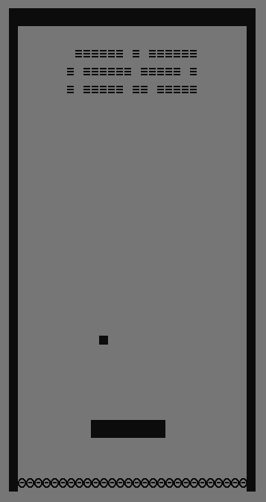
How the ball actually moves ?
This is a 2d-array of [screen width] [screen height]
At first the direction of the ball is rand() % 4 which gives a random number between 0-3.
0(up-left)
1(up-right)
2(down-left)
3(down-right)
So , if doing in that direction doesnot resulting in a collision with the wall or the bricks or the paddle the ball will go in that direction by changing its x & y coordinates according to its speed and then the ball will appear in that indexes of the 2d array[x][y].
And if going to that particular indexes of 2d-array resulting in a collision then the ball will bounce back depending on the direction of the ball at the start point.

Slide 9
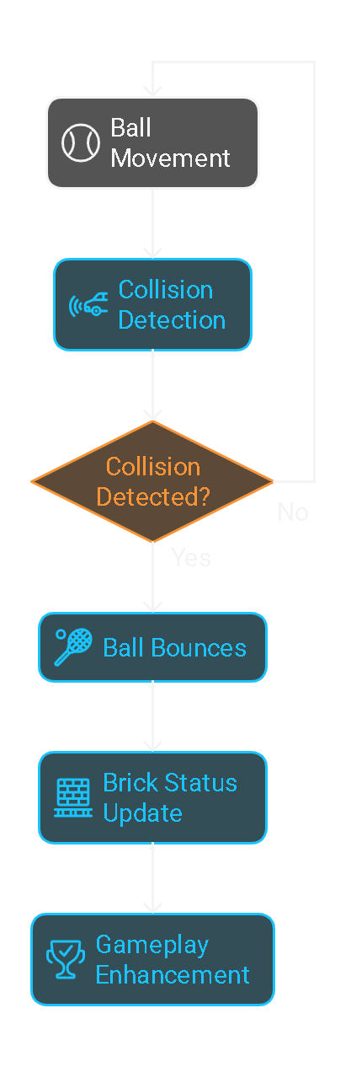
How does collision happens and bricks broken ?
Simply checks if array[x][y] equal to 7&9 or char[219] (ascii code for upper and side walls) then return TRUE means going to these coordinates resulting in a collision.
OR if array[x][y] equal to 2 or char[240] (ascii code for bricks)
If TRUE array[x][y] = ‘ ’; and increment the score.
then return TRUE means going to these coordinates resulting in a collision.
OR if array[x][y] equal to 8 or char[233] (ascii code for lower or death wall) then simply decrement the life and reset the paddle position.
If the collision function returns TRUE means collision happened then just call the bounce function with the same coordinates as before to efficiently manage the physics.

