Slide 1


Maze Generation and Solving using C++
Implementation using DFS and BFS
by 628 Umer awan

Slide 2
Introduction
Purpose
Features
Generate and solve a maze programmatically
Maze generation using DFS
Maze solving using BFS
Visual representation

Slide 3
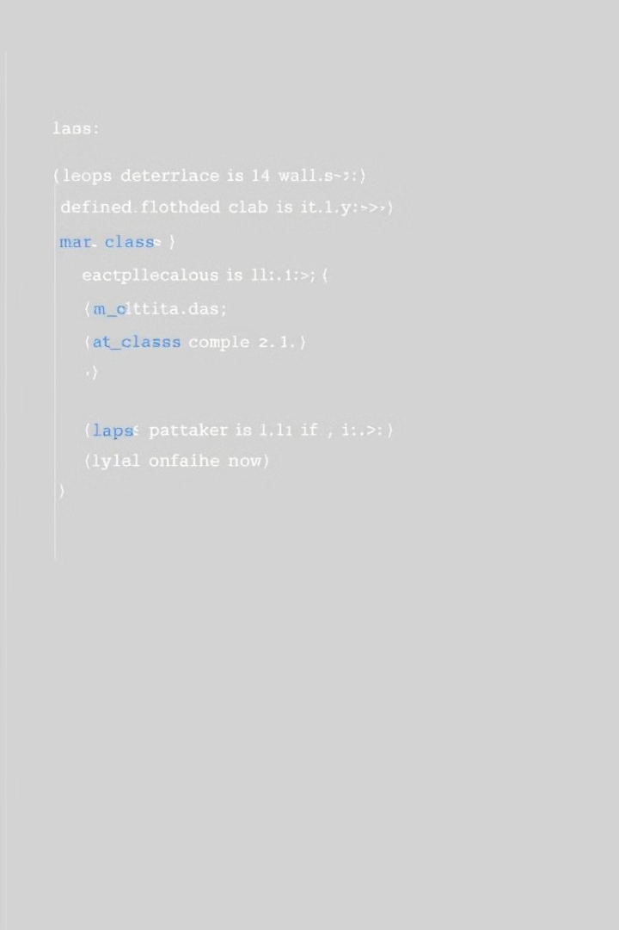
Code Overview
Key Components
Cell Struct, Maze Class

Slide 4
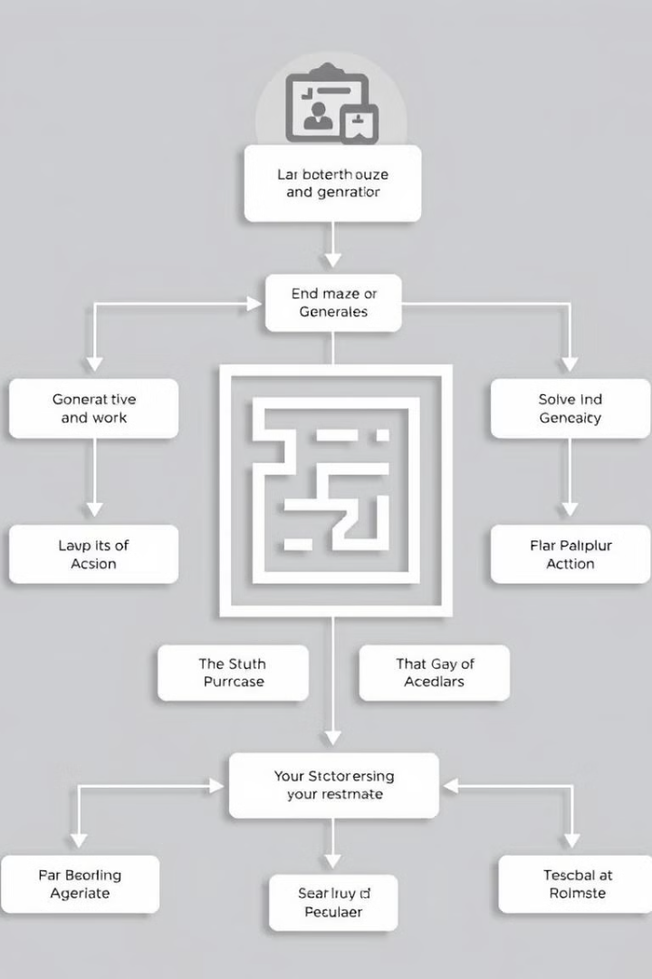
Maze Class Overview
Generation
Start/Exit
Using DFS
Configuration
Visualization
Solving
Display maze structure
Using BFS

Slide 5
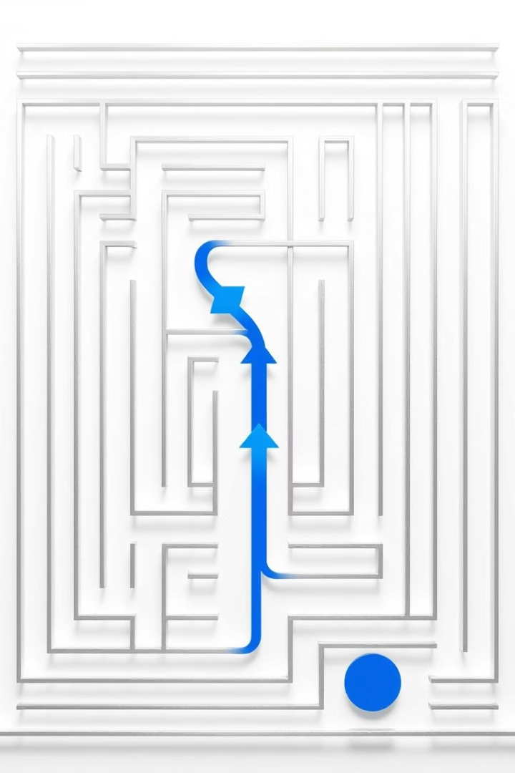
Maze Generation (DFS)
1
Mark current cell as visited
2
Shuffle neighboring cells
3
Recursively visit unvisited neighbors
4
Remove walls between them

Slide 6





Maze Visualization
Display as ASCII art
Walls: +--- or |
Start: S
Exit: E
Path: \*

Slide 7
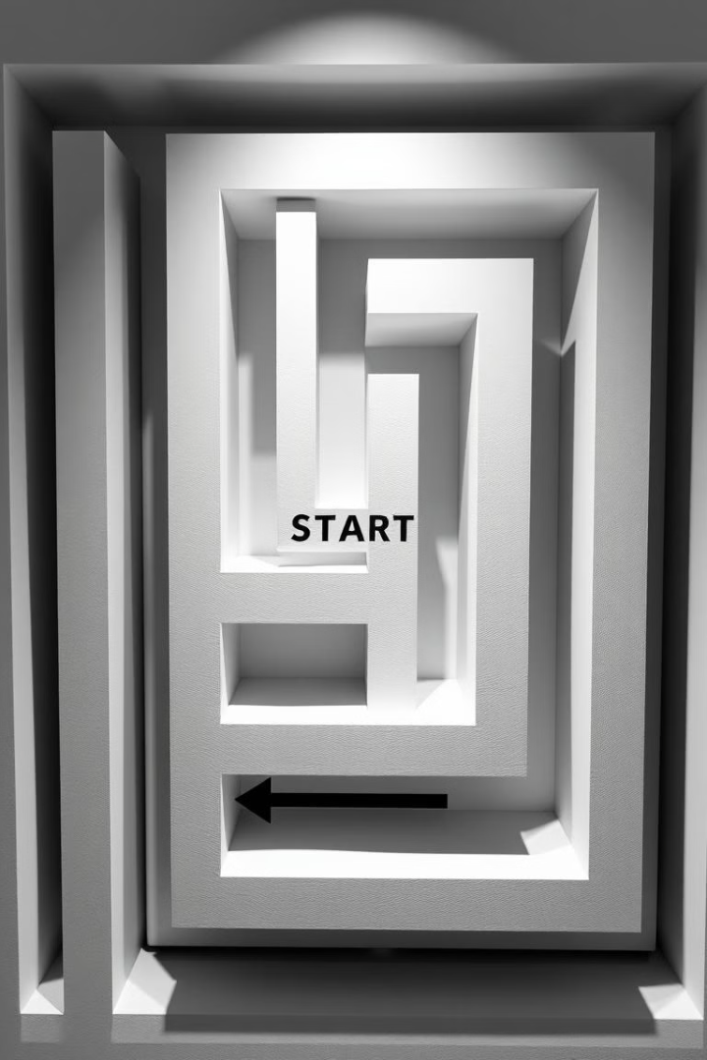


Start and Exit Points
Start
Exit
(0, 0) with left wall removed
(width-1, height-1) with right wall removed

Slide 8
BFS Logic
Queue-Based Traversal
Visited Cell Tracking
Parent Array for Path Reconstruction
Explore the maze level by level, adding cells to a queue.
Avoid revisiting cells to prevent infinite loops.
Store parent cells to retrace the path.

Slide 9
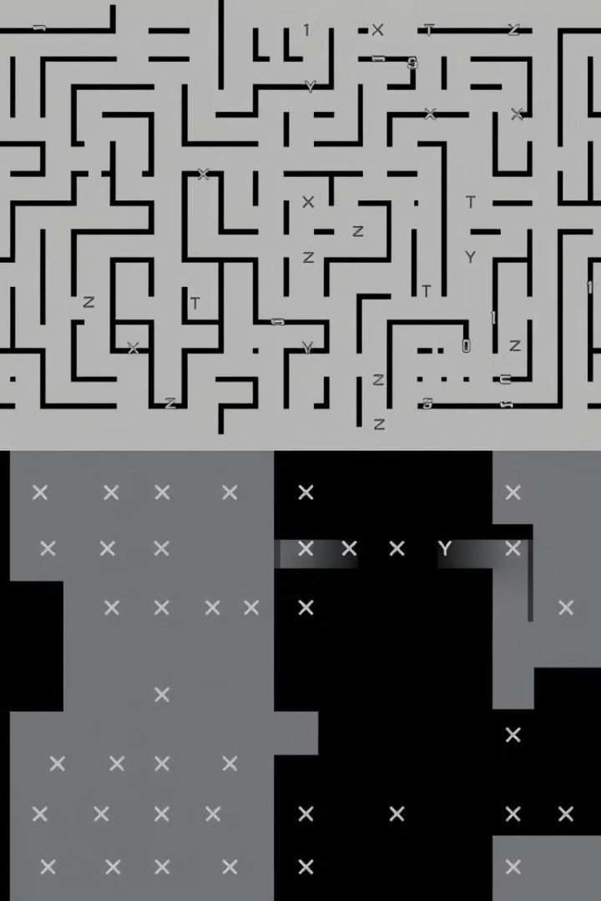
Demo Output
Generated Maze
Solved Maze
ASCII representation of the maze with walls, start, and exit points.
Maze with a \* indicating the solution path.

Slide 10
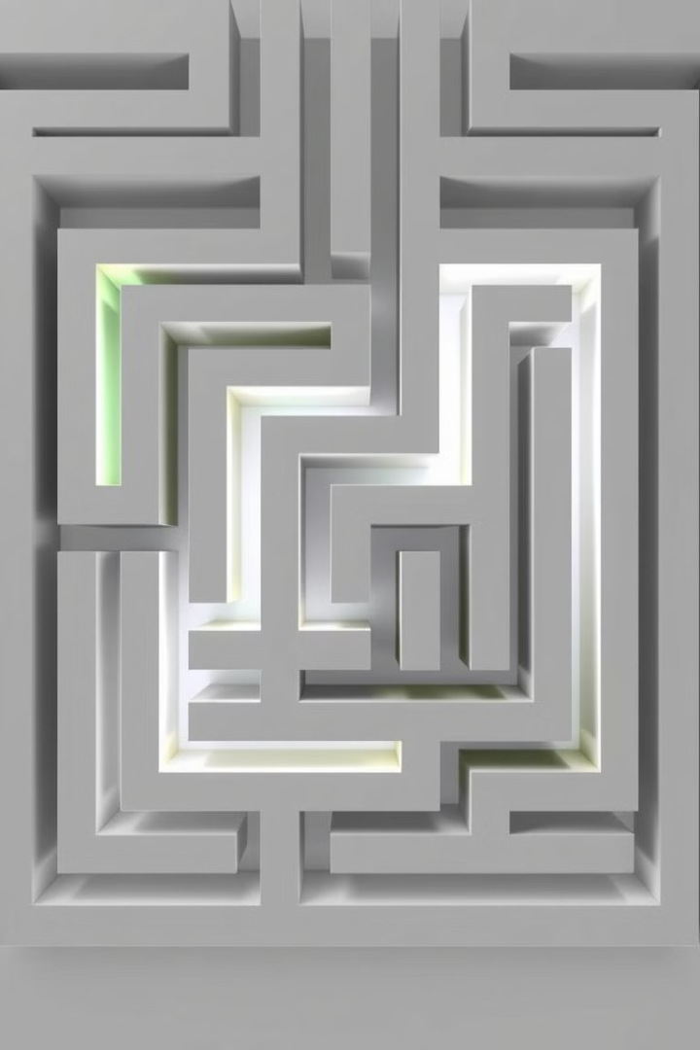
Conclusion
Efficient Solutions
Visual Understanding
DFS and BFS provide effective solutions for maze generation and solving.
Visual representation enhances comprehension of the algorithms.

