Slide 1
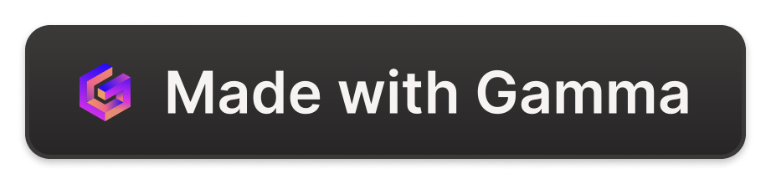
Introduction to Transport Tree
Welcome to the Transport Tree project, a comprehensive initiative aimed at revolutionizing public transportation in Lahore, Pakistan.
Group Members
Umer Shafiq 628
M fezan 466

Slide 2
Lahore's Public Transportation: Metrobus, Speedobus, Orange Train
Metrobus
Speedobus
The Metrobus is a rapid transit bus system serving Lahore, providing a high-capacity, reliable mode of transportation.
The Speedobus is a network of bus routes operating on dedicated lanes to enhance speed and efficiency.
Integrated System
Orange Train
These three systems work together to form a comprehensive and integrated network, providing multiple options for travelers.
The Orange Train is an elevated light rail system that provides fast and comfortable travel across the city.

Slide 3

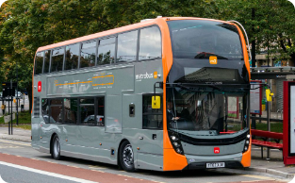
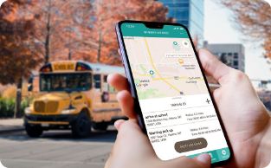

Project Overview: Features and Goals
Comprehensive Station Data
Automated Ticket Generation
User-Friendly Interface
Favorite Stations
The project allows users to create a personalized list of their favorite stations for quick and easy access.
The Transport Tree project will provide a comprehensive list of over 450 stations for the Metrobus, Speedobus, and Orange Train systems.
A user-friendly interface will provide information about routes and station locations.
The system will allow users to generate tickets for all three transport systems, simplifying the ticketing process.

Slide 4
Input Validation with iostream Library Functions
cin.fail()
1
This function checks if the previous input operation failed due to an invalid input type. It's useful for detecting when the user enters non-numeric data when you're expecting a number.
2
cin.peek()
This function looks at the next character in the input stream without extracting it. You can use it to check if the next character is the one you expect, like a newline or a specific delimiter.
cin.clear()
If an input operation fails, this function clears the error flags on the cin object so you can try the input again. It's important to clear the error state before attempting another input.
3
cin.ignore()
This function discards characters from the input stream, which is useful for skipping over invalid input and preparing the stream for the next attempt.
4

Slide 5
File Handling and Data Management
File Handling
Auto-Incrementing Ticket IDs
Station Data Management
Our app utilizes file-based storage to maintain station data, ticket information, and user preferences. We leverage C++ file I/O functions to read, write, and manage these files efficiently.
Each ticket generated by the app has a unique serial number. We use file-based storage to keep track of the last used ticket ID, automatically incrementing the number for each new ticket to ensure consistency.
Station names, IDs, and other details are stored in a data file. We read this file on startup to populate the station information, allowing users to search, view, and select stations seamlessly.
Favorite Stations
Users can mark their favorite stations, and the app stores these preferences in a separate file. This allows users to quickly access their most-used stations.

Slide 6
Station Data: Comprehensive List of 450+ Stations in Lahore
Data Collection
The Transport Tree project involved meticulous data collection to gather information for over 450 stations across the Metrobus, Speedobus, and Orange Train networks in Lahore.

Slide 7



Favorite Stations: Adding, Updating, and Viewing Favorites
Add to Favorites
1
Users can add any station to their personalized favorites list.
Update Favorites
2
Users can remove their favorite lists.
View Favorites
3
Users can quickly access their favorite stations for convenient planning.
The favorite station feature allows users to create a personalized list of their most frequently used stations for quick access. This enhances the user experience by providing a streamlined approach to planning trips and accessing essential information.

Slide 8




Future Enhancements and Possibilities
Real-Time Traffic Data
Personalized Route Suggestions
Accessibility Improvements
Multimodal Integration
Integrate real-time traffic data into the system to provide users with more accurate travel time estimates and help them avoid congestion.
Develop an algorithm that learns user preferences and provides personalized route suggestions for their daily commutes.
Enhance accessibility features by providing detailed information on wheelchair accessibility and other mobility needs.
Integrate information about other modes of transportation, such as taxis and ride-sharing services, to provide a more comprehensive travel planning experience.

