Slide 1
Mini Programming Language
A Roman Urdu Programming Language with Full Compiler Pipeline
Compiler Construction Lab — Semester Project
SUBMITTED TO: Sir Azib Mahmood
SUBJECT: Compiler Construction Lab
SECTION: L(12) | SEMESTER: 6th
GROUP MEMBERS:
M.Fezan — Fall-23-BSCS-466
Shoaib Rafiq — Fall-23-BSCS-479
Umer Malik — Fall-23-BSCS-628
Lahore Garrison University

Slide 2
Agenda
01
Project Overview & Motivation
05
Language Syntax & Features
02
Problem Statement & Approach
06
Web IDE & Screenshots
03
System Architecture
07
Results & Test Cases
04
Compiler Pipeline (7 Stages)
08
Future Work & Conclusion

Slide 3
Project Overview
Mini Programming Language is a custom programming language with Roman Urdu syntax, paired with a complete compiler and interpreter implementation. The project consists of two main components:
Backend
Frontend
Python-based compiler with 7-stage pipeline served through FastAPI REST API
React-based Web IDE featuring Monaco Editor with custom Urdu syntax highlighting
Key Constraint: Zero external compiler tools — no PLY, ANTLR, or parser generators. Every stage is hand-written in pure Python.
14
7
12/12
<5ms
Keywords
Pipeline Stages
Tests Passing
Execution Time

Slide 4
Problem & Motivation
The Problem
Our Approach
Programming languages use English keywords (if, while, print, return) that create a significant barrier for non-English speakers. In Pakistan and South Asia, millions communicate daily in Urdu but have limited English proficiency.
A complete compiler pipeline for a custom language with Roman Urdu syntax — not a thin wrapper, but a full implementation supporting variables, control flow, functions, arrays, and optimization.
Design Principles
Zero External Tools
Urdu-First Errors
Every stage hand-written from scratch — no PLY or ANTLR
Error messages in Urdu with Levenshtein 'did you mean?' suggestions
Educational Focus
Block Scoping
Every pipeline stage visible to the user in the Web IDE
Variables in agar/jabtak blocks are local to that scope

Slide 5
System Architecture
Frontend React + Monaco Port 5173
FastAPI Backend Python + Pydantic Port 8008
6-Tab Output Visualization
POST /run
JSON Response
Tech Stack
Python 3.10+
Backend compiler pipeline
TypeScript 6.0+
Type-safe frontend
FastAPI 0.115+
REST API backend
Vite 8.0.10
Build tool & dev server
React 19.2.5
Frontend UI framework
Pydantic 2.0+
Request/response validation
Monaco Editor 4.7.0
VS Code editor in browser
Uvicorn 0.32+
ASGI server

Slide 6
7-Stage Compiler Pipeline
Stage 1
Stage 2
Stage 3
Stage 4
Stage 5
Stage 6
Stage 7
Lexer
Parser
Semantic
IR Gen
Optimizer
CodeGen
Interpreter
Source → Tokens 14 token types ~270 lines
Tokens → AST 18 node types ~545 lines
Type checking Scope resolution ~385 lines
AST → TAC Temp vars & labels ~220 lines
Const folding Const propagation Dead code elim ~275 lines
AST → Python Transpilation ~180 lines
Tree-walk exec Environment scopes ~375 lines
Source Code
Key Pipeline Features
▸ 6-level operator precedence
▸ Levenshtein suggestions
▸ Block scoping
▸ Constant folding (2 passes)
▸ Constant propagation
▸ Dead code elimination
▸ 10K iteration cap
▸ 100 call depth cap
▸ Urdu error messages

Slide 7
Language Syntax & Keywords
rakho
keep / put
jabtak
while
functionbnao
make function
Variable declaration
While loop
Function definition
dikhao
show
khatam
end
wapisbejo
send back
Print output
Block terminator
Return from function
agar
if
sahi / ghalat
true / false
input
input
Conditional
Boolean literals
Read user input
warna
else
aur / ya
and / or
int / str
type cast
Else branch
Logical operators
Type casting

Slide 8
Code Example — Functions & Arrays
1
functionbnao add(a, b)
2
wapisbejo a + b
3
khatam
5
functionbnao greet(naam)
6
dikhao "Assalam, " + naam
7
khatam
9
greet("Fezan")
10
rakho result = add(10, 20)
11
dikhao result
13
rakho fruits = ["Aam", "Seb", "Kela"]
14
dikhao fruits[0]
15
rakho fruits[1] = "Anaar"
Output: Assalam, Fezan | 30 | Aam

Slide 9
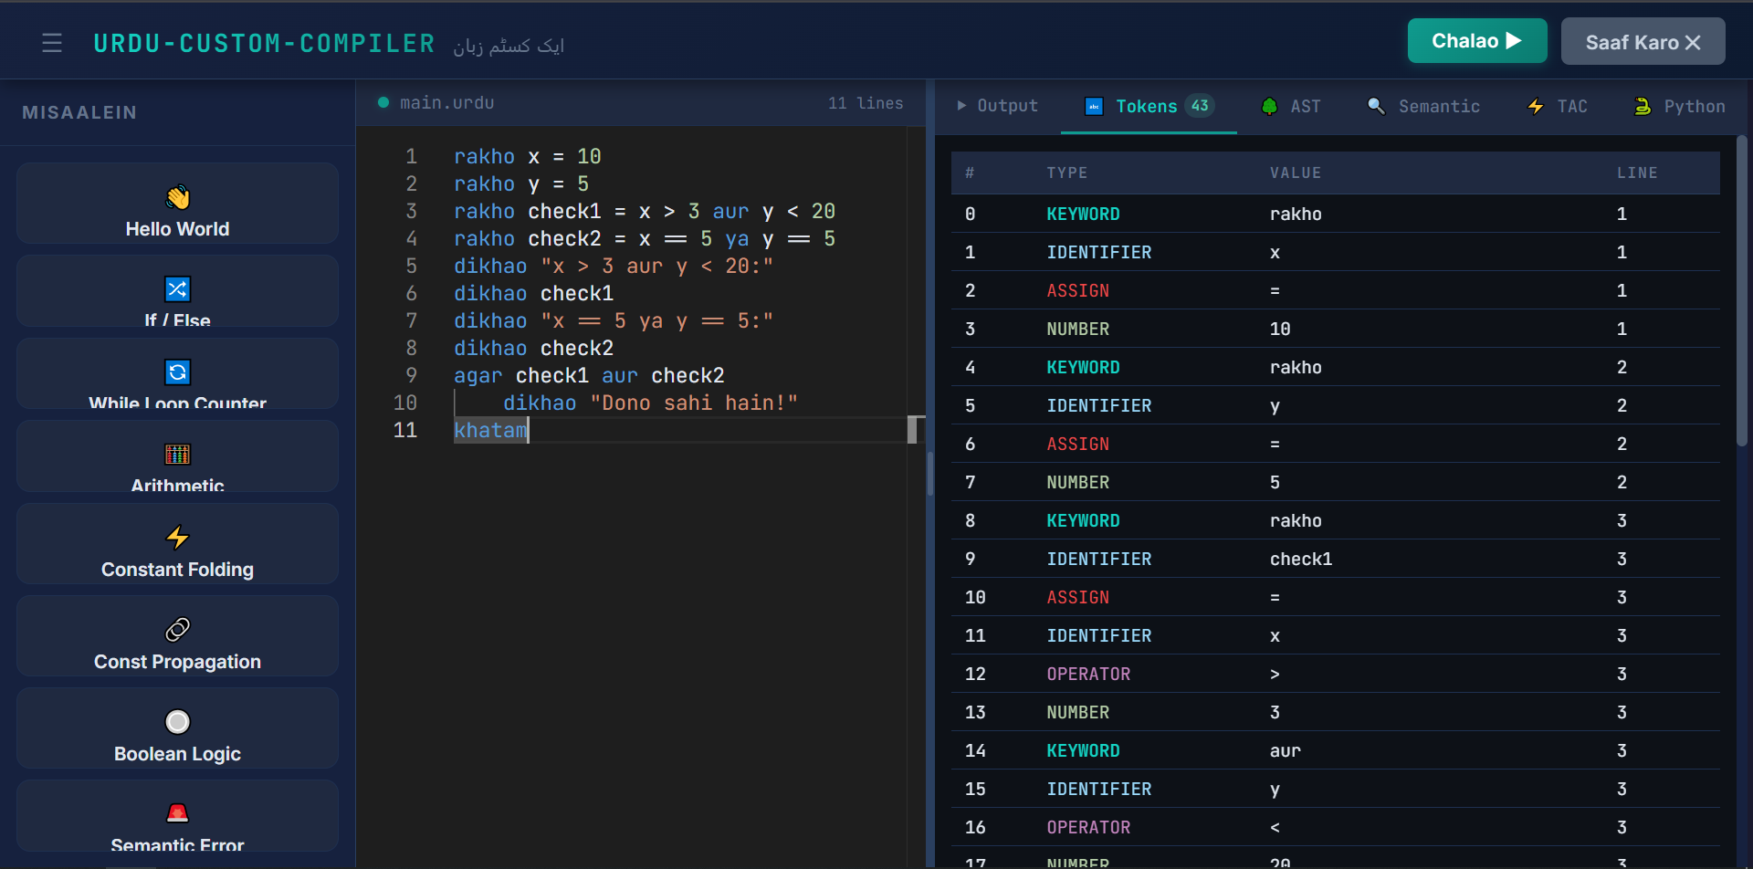
Web IDE — Main Interface

Slide 10
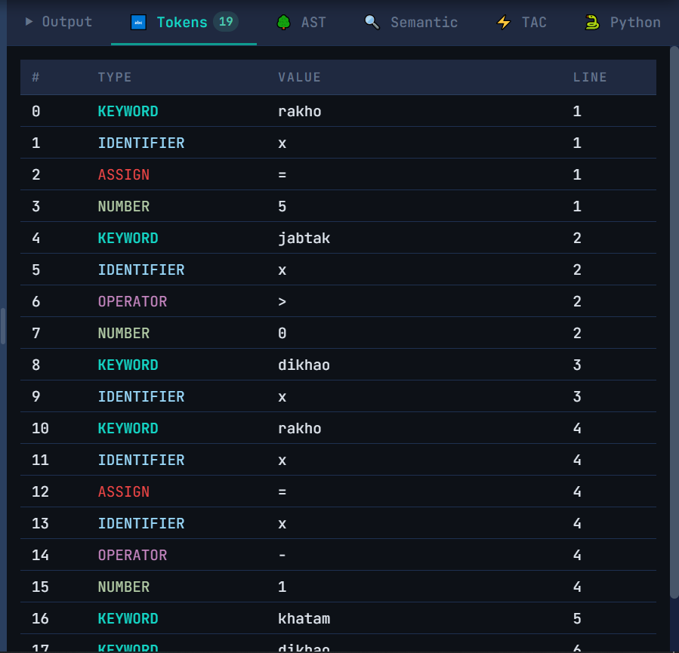
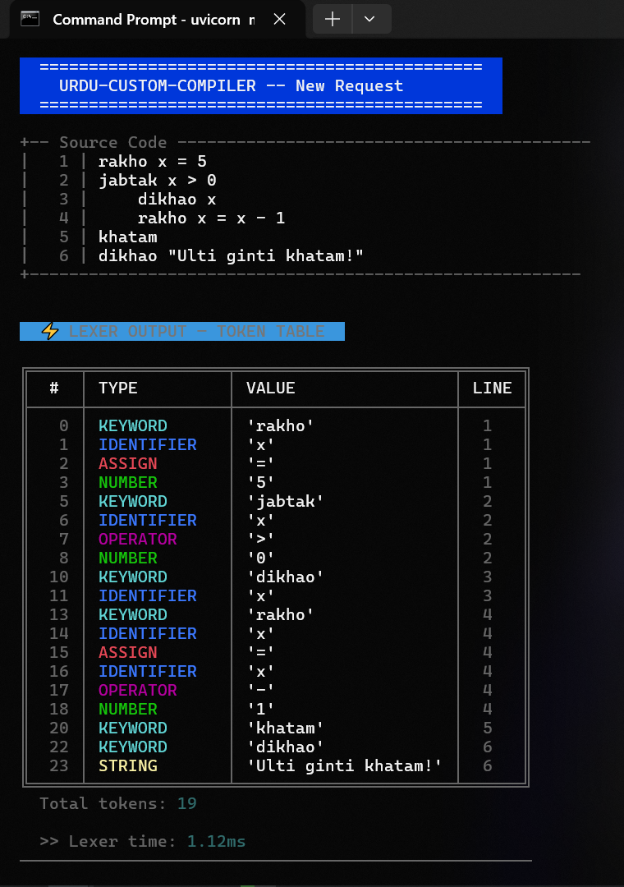
Stage 1: Lexical Analysis — Token Stream

Slide 11
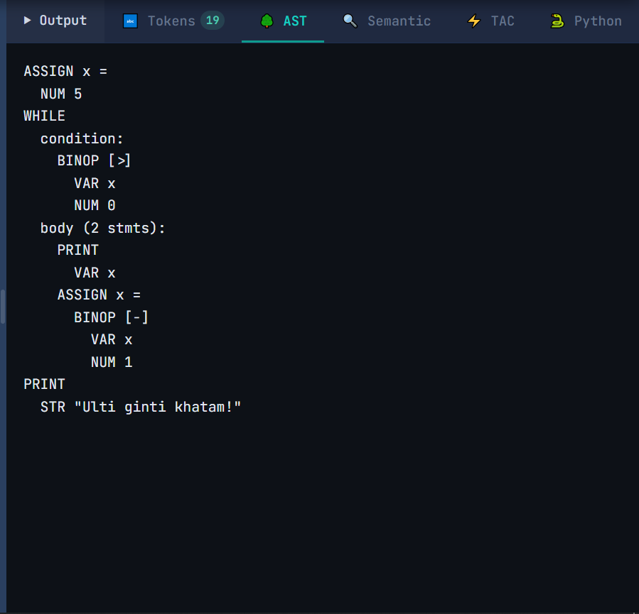
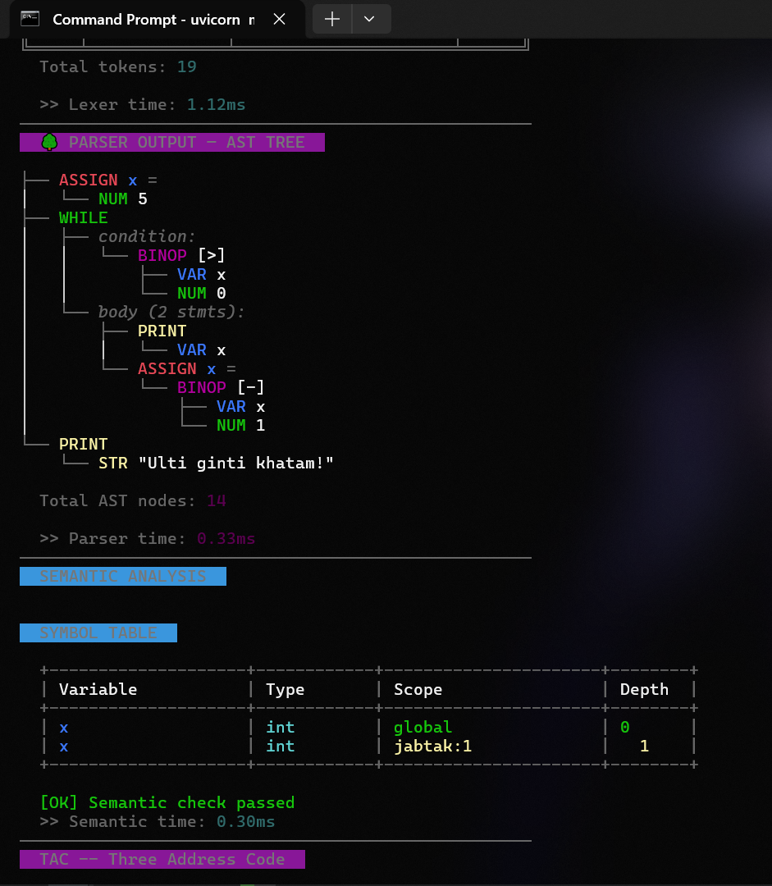
Stage 2: Parsing — AST & Symbol Table

Slide 12
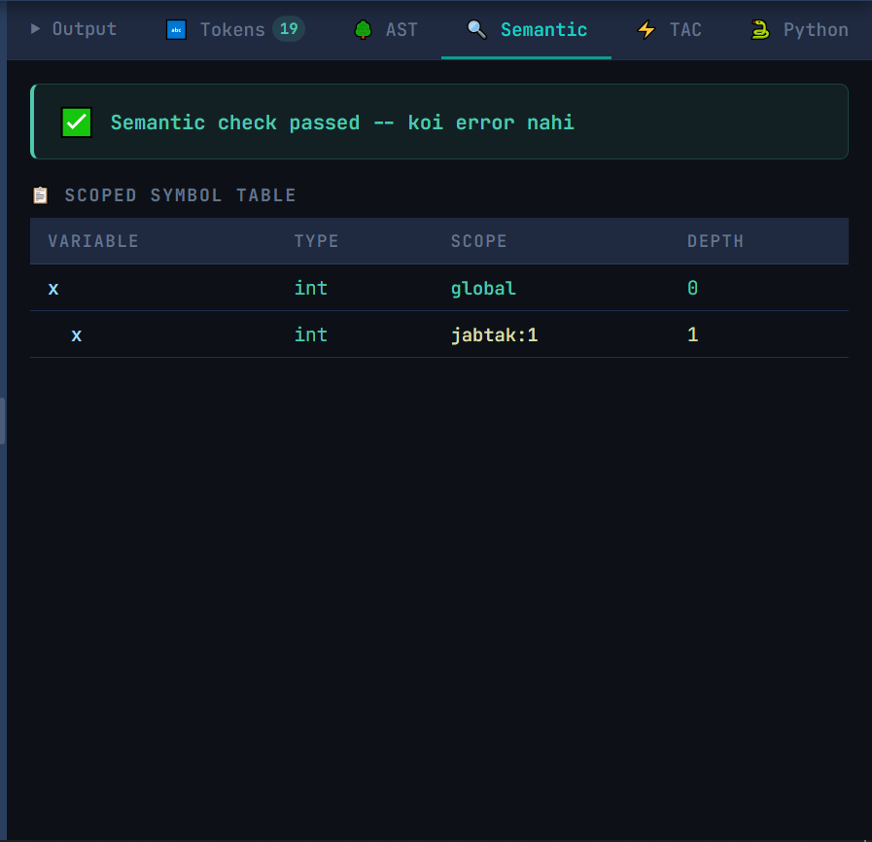
Stage 3: Semantic Analysis
Semantic Analysis Features
✓ Type checking for all expressions
✓ Scope resolution (global & local)
✓ Undefined variable detection
✓ Division-by-zero static detection
✓ Function signature validation
✓ Return type checking
✓ Symbol table generation
✓ Scoped symbol tracking with depth
✓ Urdu-first error messages
✓ Levenshtein 'did you mean?' suggestions

Slide 13
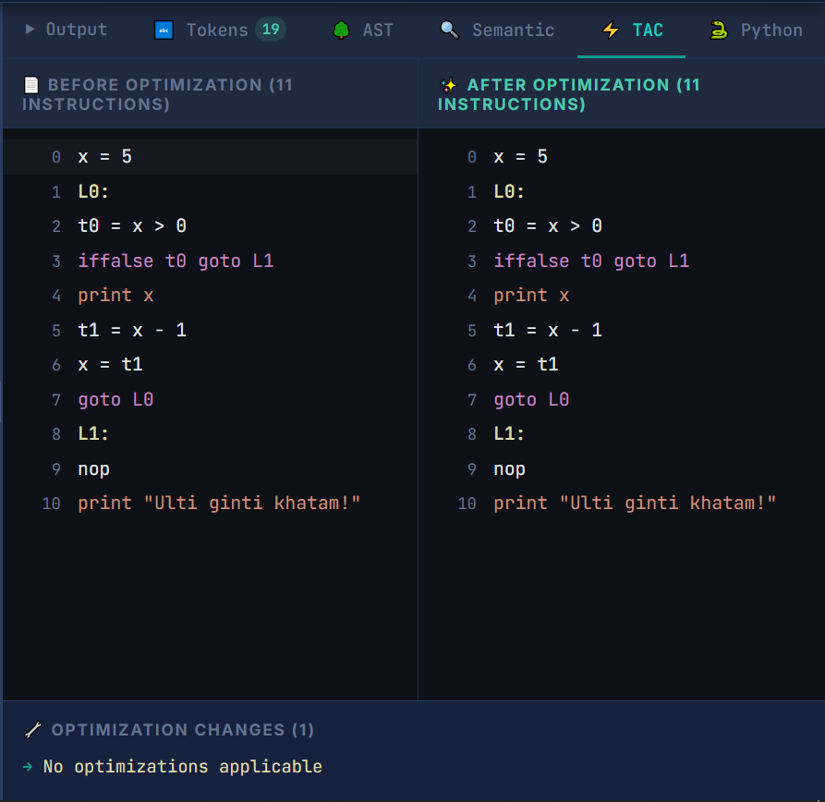
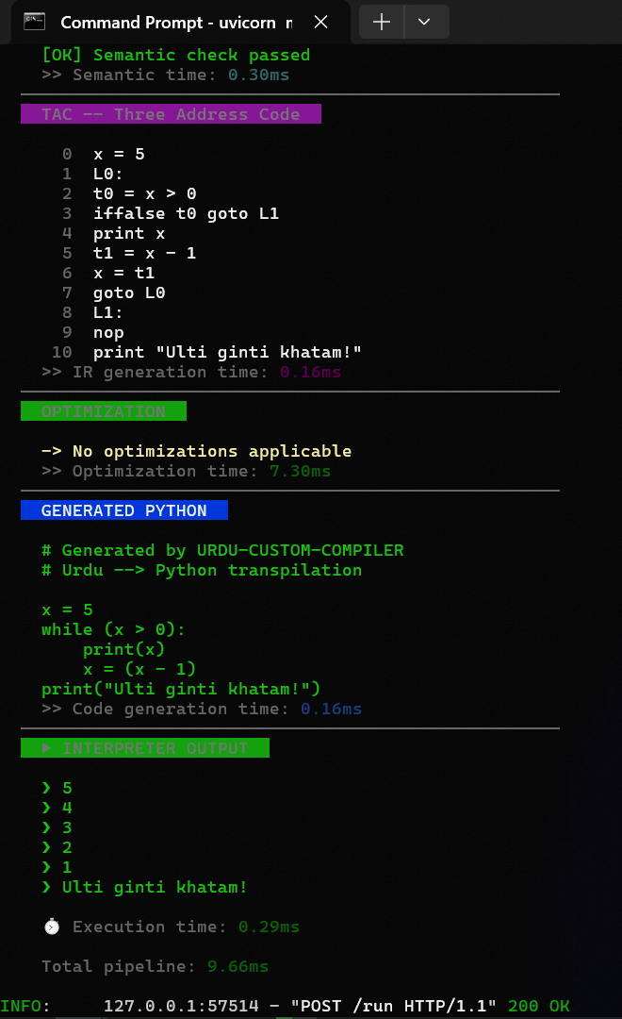
Stages 4 & 5: IR Generation & Optimization

Slide 14
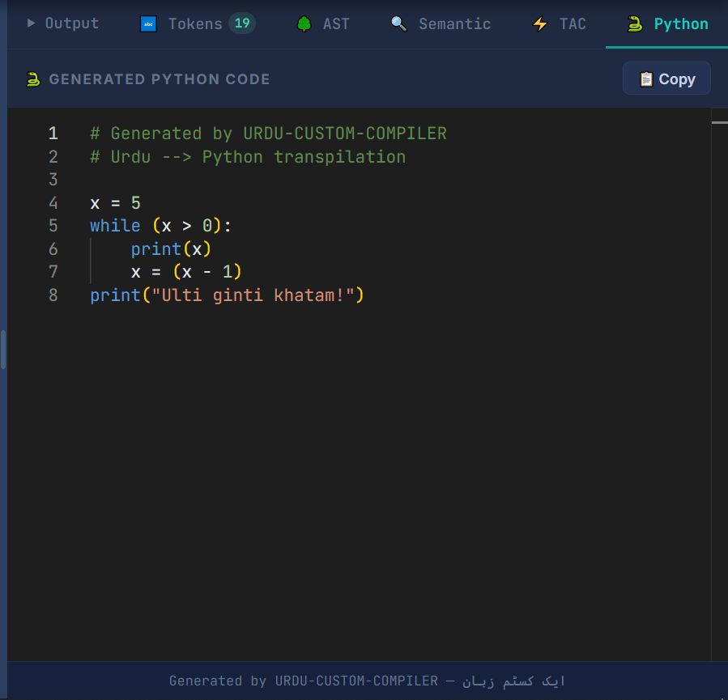
Stage 6: Python Code Generation
Code Generation Features
✓ AST → Python source transpilation
✓ Function definitions with parameters
✓ Control flow (if/else, while)
✓ Array literals and indexing
✓ Print statements
✓ Return statements
✓ Valid Python output (runnable)
✓ ~180 lines of hand-written code

Slide 15
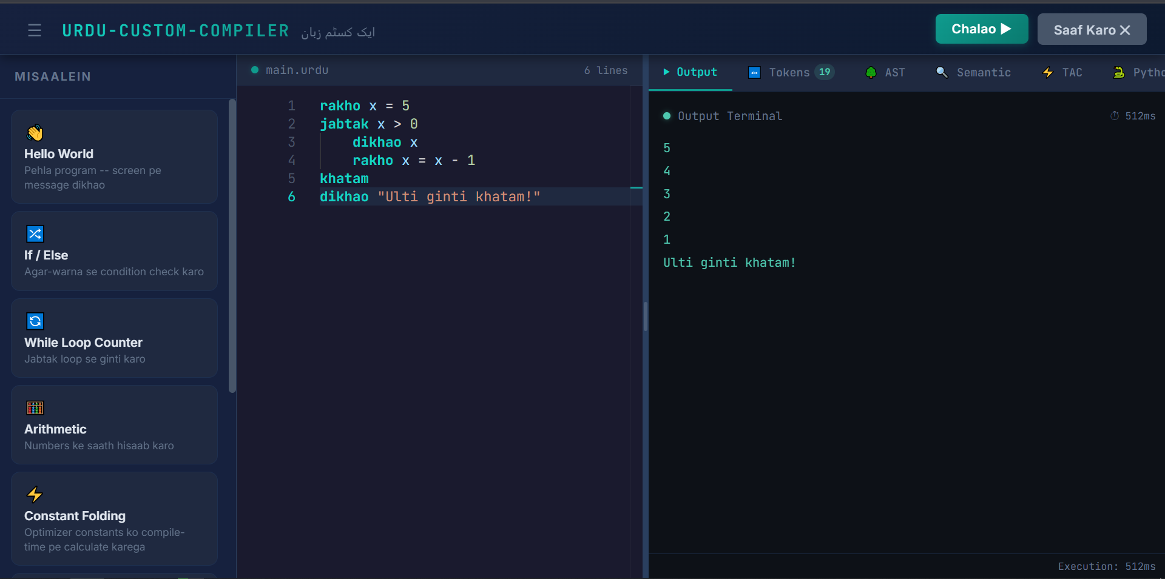
Stage 7: Execution & Final Output

Slide 16
Test Results — 12/12 Passing
01
Block Scoping (agar)
PASSED
07
Function in Expression
PASSED
02
Constant Folding
PASSED
08
Array Creation & Access
PASSED
03
Semantic Error Detection
PASSED
09
Array Index Assignment
PASSED
04
While Loop Scoping
PASSED
10
Void Function (no return)
PASSED
05
Function Definition
PASSED
11
Python Code Generation
PASSED
06
Function with Params & Return
PASSED
12
Full Pipeline (functions + arrays)
PASSED
12/12
100%
<5ms
11
Tests Passed
Pass Rate
Avg Execution
Built-in Examples

Slide 17
Future Enhancements
01
Exception Handling
Add try/catch keywords for runtime error handling
02
File I/O
Support reading and writing files from Urdu code
03
OOP Support
Add classes, objects, and inheritance
04
Standard Library
Expand built-in functions (math, string, list utilities)
05
Bytecode VM
Replace tree-walk interpreter with bytecode virtual machine
06
Debugger
Add breakpoints, step-through execution, variable inspection
07
Multi-file Support
Support imports and modular code organization
08
Language Server
LSP implementation for IDE autocompletion & IntelliSense

Slide 18
Conclusion
This project successfully designed and implemented a complete compiler pipeline for a custom programming language using Roman Urdu syntax — from lexer to interpreter, everything hand-written from scratch.
Zero External Tools
Interactive Web IDE
Every compiler stage hand-written in pure Python — no PLY, ANTLR, or parser generators
React + Monaco Editor with 6-tab pipeline visualization
Full Language Support
Urdu-First Errors
Variables, functions, recursion, arrays, user input, type casting, block scoping
Error messages in Urdu with Levenshtein 'did you mean?' suggestions
Optimization
12/12 Tests Passing
Constant folding, constant propagation, and dead code elimination
Full integration test suite covering all compiler stages

Slide 19
Thank You
Questions & Discussion
M.Fezan | Fall-23-BSCS-466
github.com/H0NEYP0T-466/URDU-CUSTOM-COMPILER
Lahore Garrison University

