Slide 1
Log Analyzer System
Project Synopsis Presentation
Department of Computer Applications

Slide 2
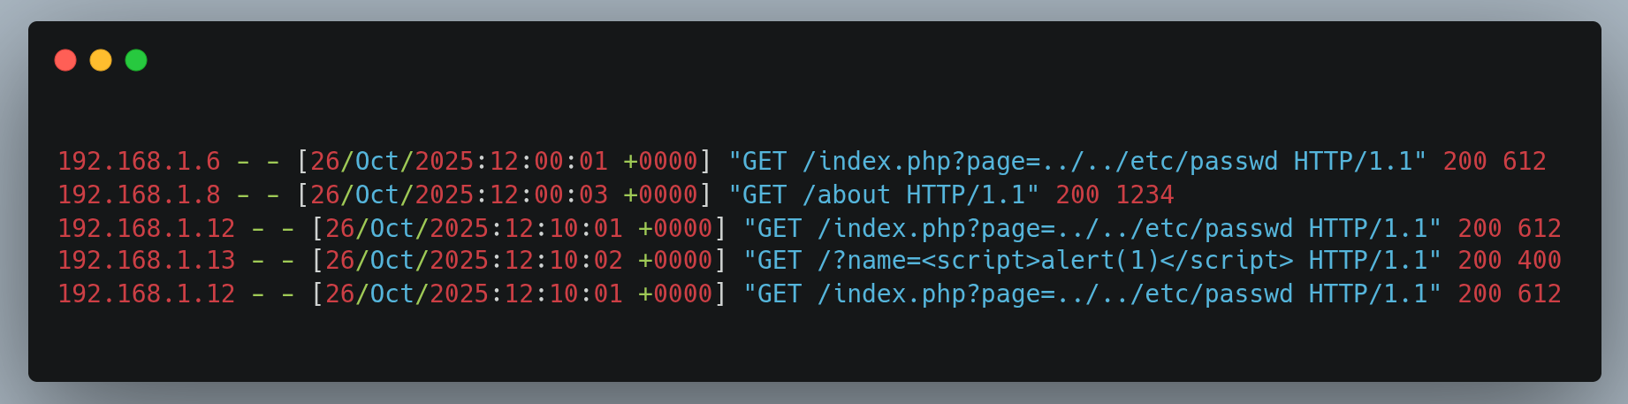
Key Concept in Log Analyzer
Log Files
Every computer system, application, or server keeps a record of activities
Like user logins, errors, or network requests. These records are stored in log files.

Slide 3
Key Concept in Log Analyzer
Regex (Regular Expressions)
Regex is like a smart search pattern — it helps you find specific words or formats in text.
Regex lets us automatically detect attack patterns in log files instead of checking manually.

Slide 4
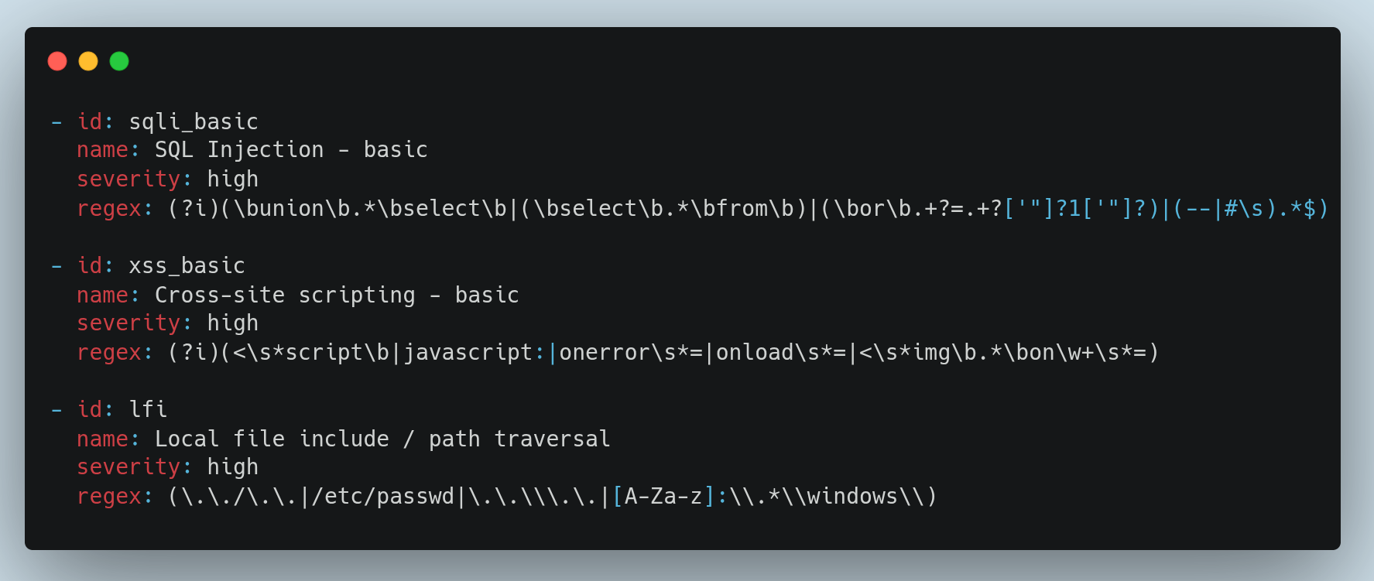
Key Concept in Log Analyzer
YAML (“YAML Ain't Markup Language”)
Human-readable data serialization standard that is often used for configuration files
A simple, human-readable format used for writing detection rules.

Slide 5
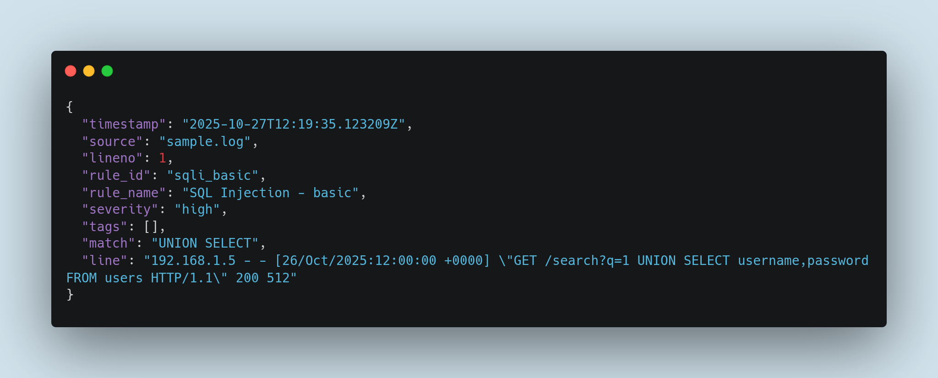
Key Concept in Log Analyzer
JSON (“JavaScript Object Notation”)
A structured format for storing or sending alerts from the analyzer.

Slide 6
Abstract
The proposed system provides a log analyzer for detecting cyber-attacks using regex-based pattern matching.
It scans logs from servers and applications to identify threats such as
SQLi, XSS, LFI, and RCE. and brute-force attacks.
Existing systems are often manual or complex ML-based, making them inefficient or non-transparent.
The proposed system offers a lightweight, flexible, and transparent approach for real-time attack detection.

Slide 7
Problem Statement
Manual log monitoring is time-consuming and error-prone.
Existing automated systems require large datasets or are difficult to customize.
Lack of a lightweight and transparent tool for detecting attack patterns in real-time.

Slide 8
Objectives
Develop a real-time and offline log monitoring system.
Detect common cyber-attacks like SQLi, XSS, LFI, and RCE.
Provide customizable regex-based rules.
Generate JSON-formatted alerts for integration.
Maintain scalability and ease of use.

Slide 9
Scope of the Project
Covers:
Regex-based detection of common attacks.
Real-time and offline log monitoring.
YAML rule configuration and JSON alerts.
Does not cover:
Machine learning-based anomaly detection.
Full-scale SIEM features or network packet inspection.

Slide 10
Methodology
1. Data Collection: Gather sample web and system logs.
2. System Design: Modular structure with input, rule, detection, and output modules.
3. Development: Implement regex-based matching in Python.
4. Testing: Validate against known attack patterns.
5. Deployment: Demonstrate real-time and offline detection.

Slide 11
Tools and Technologies
Language: Python 3.10+
Libraries: PyYAML, re, Rich
Config Format: YAML (rules), JSON (alerts)
Environment: Windows / Linux / macOS
Optional: Kibana / SIEM integration

Slide 12
Expected Outcomes
Functional tool for detecting cyber-attacks from logs.
Lightweight, scalable, and transparent system.
JSON alerts for integration with security tools.
Customizable rule engine for flexible detection.

Slide 13
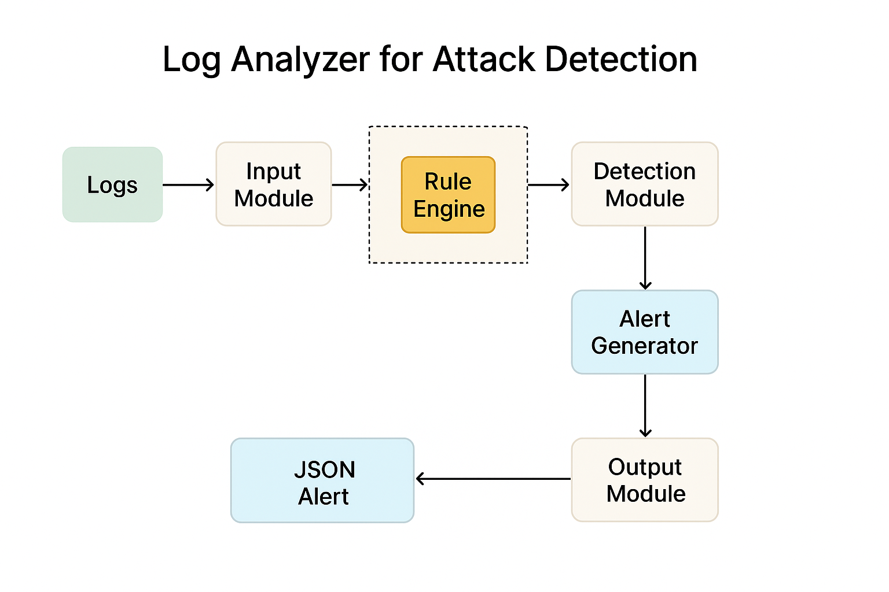
Log Analyzer System

Slide 14
Conclusion
The proposed log analyzer enhances security visibility through regex-based attack detection.
It is lightweight, flexible, and suitable for real-time monitoring.
This project demonstrates a practical approach to improving log analysis and proactive threat detection.

