Slide 1
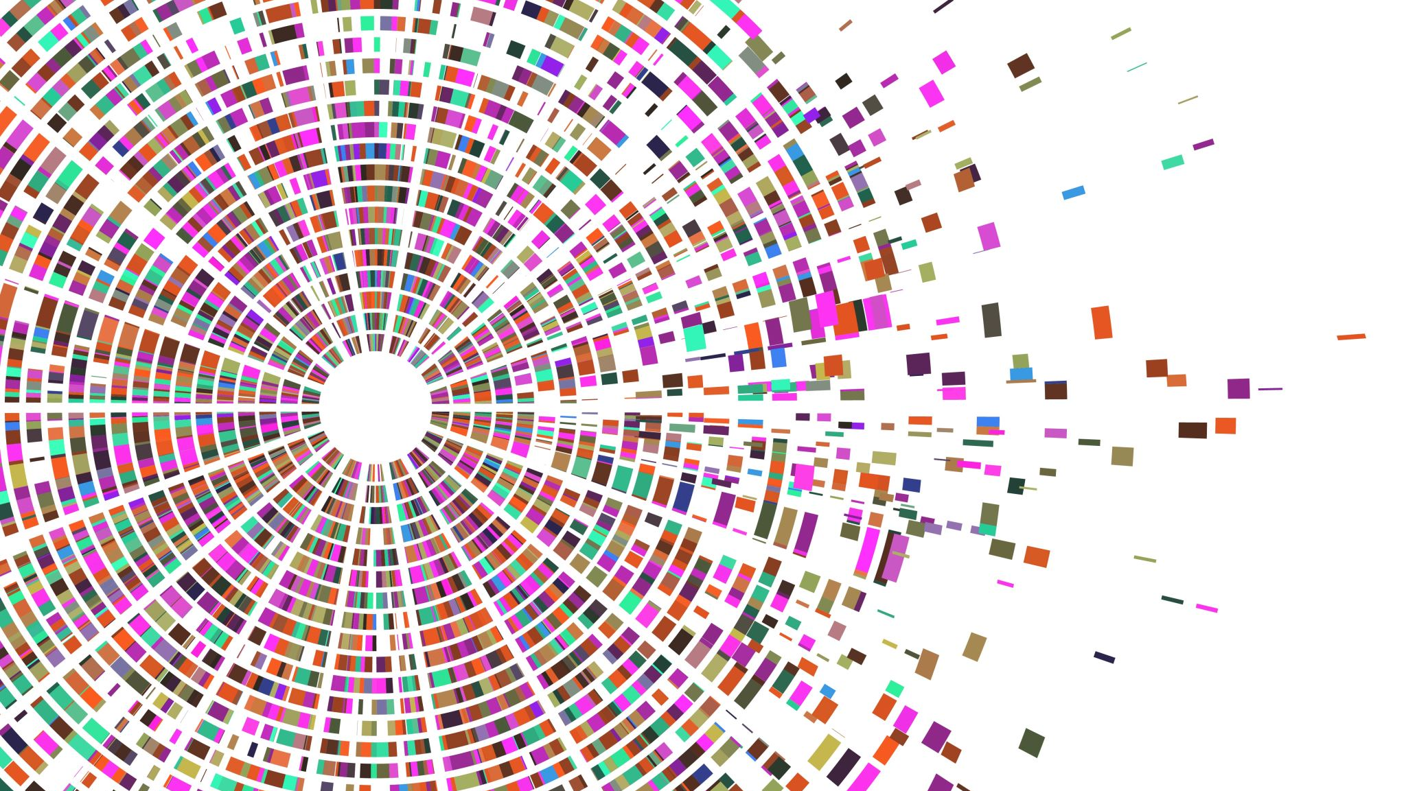

Data Understanding
Using Yelp dataset to create a Recomender System

Slide 2





Dataset Dimension
150 346 businesses
6 990 280
reviews
908 915
tips
1 987 897
users
131 930
check-in’s
Loading time
(with Python 3.10.8, Intel Core i7 , 8th Gen and 16Gb of RAM)
15.2 minutes

Slide 3
Dataset Description
The dataset is mainly composed of these two entities, reviews and users, which is comprehensive, as Yelp main focus is giving users a platform to make reviews.
A review links a user and a business, through their respective ids and it is also linked to a date. Additionally, it is composed of the text, stars rating, as well as 3 different vote types, over the review itself (useful, funny, cool).
A user is mainly composed of its name, review, votes, fans and compliments’ counts, yelp joining date, its friends’ list and the average starts rating given by that same user.

Slide 4
Dataset Description
With considerably fewer entries, the dataset is also composed of the businesses for which the reviews are made, as well as tips, that are like smaller review and check-ins, which represents a physical entrance into the business by a user.

